Slide 1
Welcome Task Force Members & Guests
A few notes prior to the meeting starting:
Task Force Members please have your camera on, audio muted, and relevant documents available at the beginning of the meeting.
Welcome to the public who are watching the meeting via Live Streaming.
If the public has any questions or comments regarding transportation operations, these can be sent via email to Susan Miller at miller_s@cde.state.co.us
If the public has any questions or comments regarding transportation funding, these can be sent via email to Amy Carman at carman_a@cde.state.co.us

Slide 2
SB 23-094 School Transportation Task Force
May 13, 2024
Virtual Meeting

Slide 3
Overview of Today’s Agenda
Agenda Item #1- Data Collection Update
Agenda Item #2- Innovation Grant Program
Agenda Item #3- Transportation Collaboration
Agenda Item #4- Next Steps
Notes:
(Discussion)
(Awareness)
(Review)
(Action)

Slide 4
Guidelines for Interaction, Deliberation and Collaboration
Respect others
Cameras on whenever possible
High engagement from all members
High level of trust with each out
Assume positive intent
Collaborate as a team to benefit our students
Encourage open dialogue
Respectful dialogue
Enable every member to have a voice
Consider other member’s experience and knowledge
Consider other member’s viewpoints
Avoid assumptions
Avoid personal or professional motives
Provide and review topics in advance
Establish clear agendas and desired outcomes for each meeting
Develop clear goals and objectives
Keep the work task and outcome oriented
Keep the interests of the task force and the needs of the students at the forefront of the work.
Keep students at the center of the conversation
Key Norm Areas:
Decision Making Norm
Equality of Process
Conflict Resolution

Slide 5
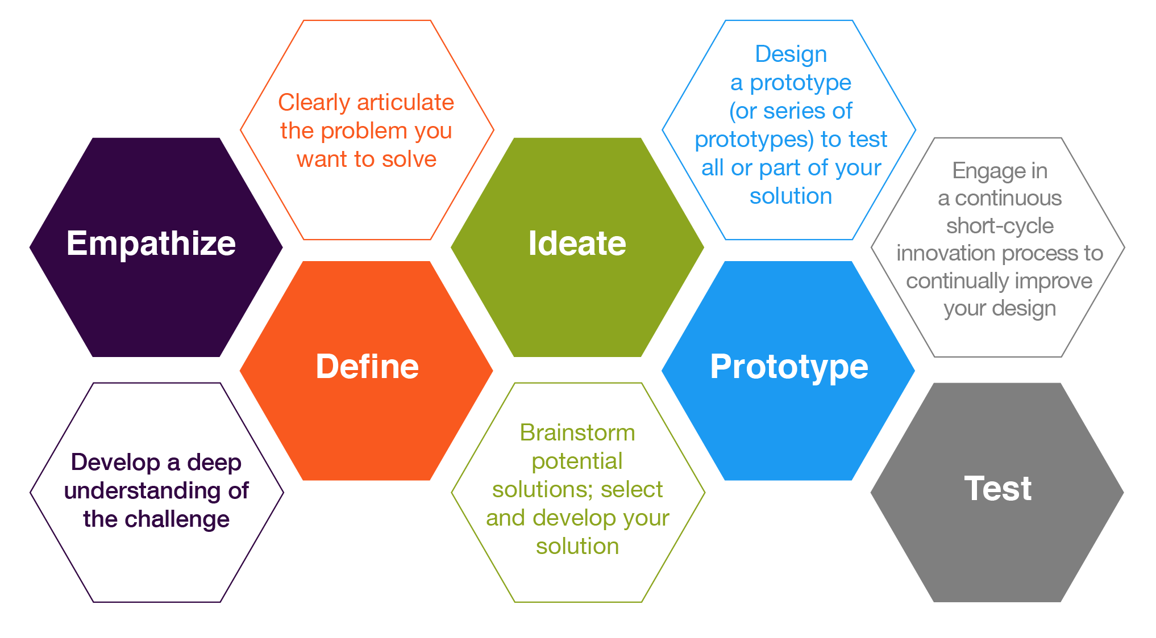
Design Thinking
University of Illinois Urbana-Champaign
Center for Innovation in Teaching and Learning
https://citl.illinois.edu/paradigms/design-thinking

Slide 6
Data Collection Update
Additional District Data
116 districts have provided data through “Utilization Survey”
We are analyzing that data now and will have it before the next meeting
Additional analysis is also being conducted based on original data
Fleet analysis
Driver analysis

Slide 7
Project Plan
Review Topics and Determine Minimum Recommendation Expectations
Decision Making to Establish Final Recommendations
Finalize Recommendations and Report
Innovation Grant Program & Transportation Collaboration Across the State
Decisions on Legislative Rule Changes to Address Eligibility and Utilization
Drivers Salaries, Benefits, and Talent Pipelines
Decisions on Innovation Grant & Collaboration
Finalize Full Set of Recommendations
January
February
March
April
May
June
July
August
September
October
Current Transportation Funding Model and Reimbursement Process
Eligibility, Utilization, and Service Gaps
Decisions on Drivers Salaries, Benefits, and Developing Talent Pipelines
Decision on Changes to Funding Model and Reimbursement Process
Review Final Report

Slide 8
Transportation Task Force
Define
22-107-101 (2) THEREFORE, THE GENERAL ASSEMBLY DECLARES THAT IT IS IN
THE BEST INTERESTS OF THE STATE TO DIRECT THE COMMISSIONER OF
EDUCATION TO CONVENE THE COLORADO SCHOOL TRANSPORTATION
MODERNIZATION TASK FORCE TO STUDY THE ISSUES FACING SCHOOL
TRANSPORTATION SYSTEMS AND USE THE STUDY'S FINDINGS TO DEVELOP
AND RECOMMEND POLICIES, LAWS, AND RULES TO IMPROVE PUBLIC SCHOOL
TRANSPORTATION ACROSS THE STATE IN ORDER TO BETTER MEET STUDENT
NEEDS AND ALLEVIATE BURDENS ON SCHOOL DISTRICTS.

Slide 9
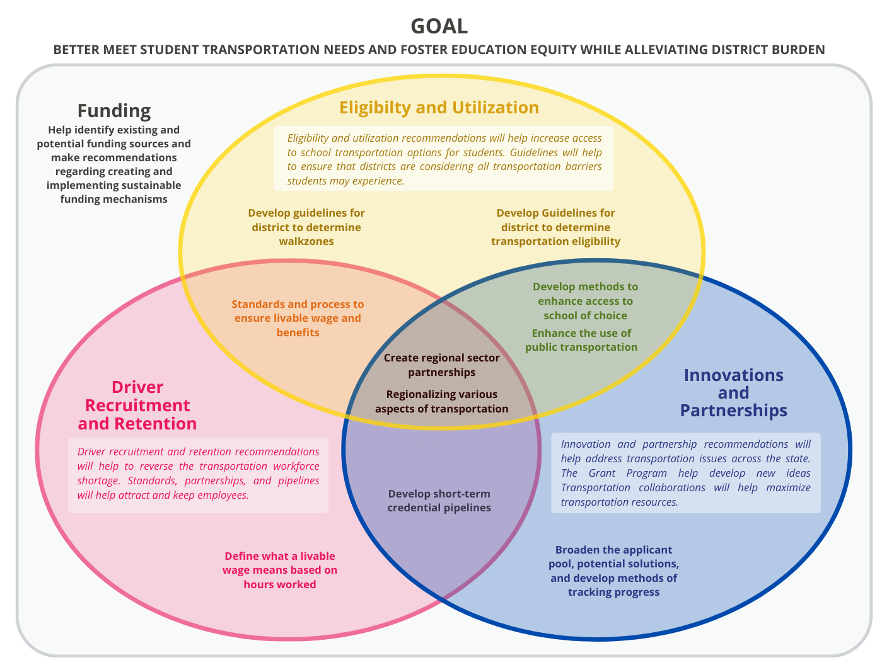
Minimum Requirements Model
Define

Slide 10
Minimum Requirements Model
Define
2
3
1

Slide 11
Transportation Innovation Grant
Define
22-107-104 (2e) RECOMMENDATIONS FOR CREATING AND IMPLEMENTING A
TRANSPORTATION INNOVATION FUND TO SUPPORT LOCAL EFFORTS TO
CREATE NEW AND INNOVATIVE TRANSPORTATION SOLUTIONS THAT MAY
SERVE AS A MODEL TO SCALE AND SUSTAIN IN OTHER SCHOOL DISTRICTS AND CHARTER SCHOOLS;

Slide 12
Consensus Minimum Requirements
Define
During the January Task Force Meeting, the Task Force came to consensus around the following changes to the implemented to the original version of HB 22-1395 (Transportation Innovation Grant Program).
Eligibility
Broadening the eligibility pool of applicants
Selection Process
Refining the priority list for determining grantees
Address replicable, scaleable, and sustainable
Grantee Requirements
Including the expectation of metrics in applications and reports to help track impact
Possible Solutions, Strategies, and Services
Addressing way to help ensure continuous funding
Adding the possibility of addressing chronic absenteeism through the program
Adding the possibility of addressing before/after school programs through the program
Adding the possibility of addressing training of drivers through the program

Slide 13
Innovation Grant Eligibility
Define
Proposed Changes:
Broadening the eligibility pool of applicants
The Transportation Innovation Grant Program would be available to school districts, charter schools, institute charter schools, the state charter school institute, boards of cooperative services, a consortium of school districts, tribal governments, local governments, and community organizations that partner with school districts.
Eligible applicants would serve students of color and students from under-resourced communities who are disproportionately impacted by the transportation shortage and struggle to access school districts of their choice and career pathway programs because of their limited access to transportation.

Slide 14
Eligible Pool of Applicants
Ideate
What additional possible applicants should be considered?
Clarifying
Questions
Should eligible applicants be able to focus on additional populations of students?

Slide 15
Innovation Grant Selection Process
Define
Proposed Changes:
Refining the priority list for determining grantees
Address replicable, scaleable, and sustainable
In making recommendations and awarding grants, the minimum criteria would be considered:
Would the eligible applicant’s need for innovative transportation solutions, strategies, and services have a significant impact on pupils and families;
What would be the likelihood that the eligible applicants plan would result in the implementation of innovative transportation solutions, strategies, and services and improve equitable access to a pupil’s school district of choice and career pathway programs;
The degree to which the proposed innovative solutions, strategies, and services would be different from current public school transportation operations; and
The sustainability of innovative solutions, strategies, services and maintenance of successful practices once the eligible applicant is expanded the awarded grant money.

Slide 16
Selection Process
Ideate
What should be the priorities with regards to choosing grantees?
Should a proposed project be replicable, scalable, and/or sustainable to be eligible?
Clarifying
Questions
If a project must be replicable, scalable, and/or sustainable to be eligible, what are the qualifications?

Slide 17
Innovation Grant Grantee Requirements
Define
Proposed Changes:
Metrics required in applications and reports to help track impact
If selected for a grant, a grantee would be required to submit a report to the Department of Education following the first year of the program and again after completion of the program. The report would include an explanation of the solutions, strategies, and services developed and implemented with the grant money as described in the grantee's grant application.
Following submission of the grantees report, the Department of Education would submit a report, summarizing information submitted by the grantee, to the Education Committees of the Senate and House of Representatives or any successor committees.

Slide 18
Requirements
Ideate
What metrics must be included in the application for a project to be considered?
Clarifying
Questions
What metrics must be included in reports for a project once a grant is awarded?

Slide 19
Innovation Grant Solutions, Strategies, and Services
Define
Possible Changes:
Help ensure continuous funding
Addressing chronic absenteeism through the program
Addressing before/after school programs through the program
Addressing training of drivers through the program
Innovation solutions, strategies, and services could include but would not limited to:
Addressing personnel shortages
Incentive programs to attract and retain bus drivers
Parent carpool or rideshare programs
Analyzing bus route efficiency between and within school districts, district charter schools, and Institute charter schools
Partnering with local transit authorities
Establishing partnerships with community partners
Supporting collaborations between school districts
Addressing transportation needs to travel to employment sites
Implementing intra-district transportation solutions
Creating options to reduce costs, improve efficiency, and increase access
Implementing internet-connected transportation options.

Slide 20
Solutions, Strategies, and Services
Ideate
Should all the above mentioned solutions be added as possibilities?
Clarifying
Questions
Should any of the previously mentioned solutions be removed as possibilities?

Slide 21
Proposed Changes for Recommendation
Prototype
Eligibility
Eligible pool of applicants would also include….
Selection Process
Priority list for determining grantees would also include….
Address replicable, scaleable, and sustainable
Grantee Requirements
Metrics in applications and reports should provide information that……
Possible Solutions, Strategies, and Services
Possible solutions, strategies, and services could also include ways to help ensure continuous funding, addressing chronic absenteeism, addressing before/after school transportation, and addressing training of new and/or existing drivers

Slide 22
Should the Transportation Task Force put forth a recommendation for a Innovation Grant Program with the above mentioned changes?
Decision Needed
Recommendation Stated
Fist to Five Vote
Articulate Concerns*
Discussion of Concerns*
Restate Decision & Record Vote

Slide 23
Break

Slide 24
Transportation Collaboration Across the State
Define
22-107-104 (2f) RECOMMENDATIONS FOR FACILITATING PARTNERSHIPS AMONG SCHOOL DISTRICTS, DISTRICT AND INSTITUTE CHARTER SCHOOLS, PUBLIC TRANSPORTATION PROVIDERS, PRIVATE TRANSPORTATION PROVIDERS, AND LOCAL NONPROFIT ORGANIZATIONS TO MEET TRANSPORTATION NEEDS AND CREATE COST EFFICIENCIES, WHILE MAINTAINING SAFETY STANDARDS;

Slide 25
Consensus Minimum Requirements
Define
During the January Task Force Meeting, the Task Force came to consensus on two broad focus areas for statewide transportation collaboration, the use of public transportation where available and the regionalization of various aspects of transportation.
Use of public transportation where available
Possible areas of regionalization

Slide 26
Consensus Minimum Requirements
Define
During the January Task Force Meeting, the Task Force came to consensus two broad focus areas for statewide transportation collaboration, the use of public transportation where available and the regionalization of various aspects of transportation.
Use of public transportation where available
Ride for free with Student ID
FlexRide- Zero Fare for Youth Pilot
Possible areas of regionalization
Advanced technologies
Administration (sharing transportation directors etc) & Cooperative training
Regionalize special education, pathways, before/after school, & athletics
Sharing insurance, requirements, maintenance, transportation costs & purchasing

Slide 27
Use of Public Transportation
Define
Existing Examples:
Ride for Free with Student ID
FlexRide- Zero Fare for Youth Pilot
Uncover Colorado Transportation
A number of cities throughout the state have public transportation options already in place.
Some provide transit free of charge while others charge
A number of routes include stops at schools in the area.

Slide 28
Use of Public Transportation
Ideate
Should any city or town with a public transit system in place be required to provide transportation free of charge to all students?
Should the Zero Fare for Youth pilot program be extended?
Clarifying
Questions
If public transit is offered to all students with access, who should foot the bill?

Slide 29
Proposed Language for Recommendation
Prototype
Use of Public Transportation
What should be available to students…..
Where should these services be provided…..
Who should cover the cost of this type of transportation……

Slide 30
Should the Transportation Task Force put forth a recommendation regarding the use of public transportation as previously stated?
Decision Needed
Recommendation Stated
Fist to Five Vote
Articulate Concerns*
Discussion of Concerns*
Restate Decision & Record Vote

Slide 31
Consensus Minimum Requirements
Define
During the January Task Force Meeting, the Task Force came to consensus two broad focus areas for statewide transportation collaboration, the use of public transportation where available and the regionalization of various aspects of transportation.
Use of public transportation where available
Ride for free with Student ID
FlexRide- Zero Fare for Youth Pilot
Possible areas of regionalization
Advanced technologies
Administration (sharing transportation directors etc) & Cooperative training
Regionalize special education, pathways, before/after school, & athletics
Sharing insurance, requirements, maintenance, transportation costs & purchasing

Slide 32
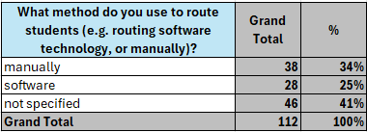
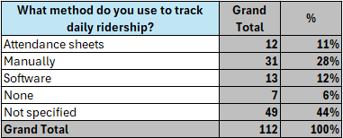
Areas of Regionalization
Define
Examples of Advanced technologies
North Carolina Public Schools: TIMS software for routing
Sussex County- Proprietary software for billing and administrative considerations such as insurance.
Source: CDE 40. 7 districts excluded because there was no data provided. 6 Remote 1 Outlying Town
Source: District Survey
Notes:
ADD DATA- percent that manually route, and manually take daily counts. Information about overall costs of maintaining the fleet

Slide 33
Advanced Technologies
Ideate
What could advanced technologies focus on?
Based on the district data, what areas might be most impacted by advanced technologies?
Clarifying
Questions
Based on the district data, does it appear that advanced technologies might be beneficial?

Slide 34
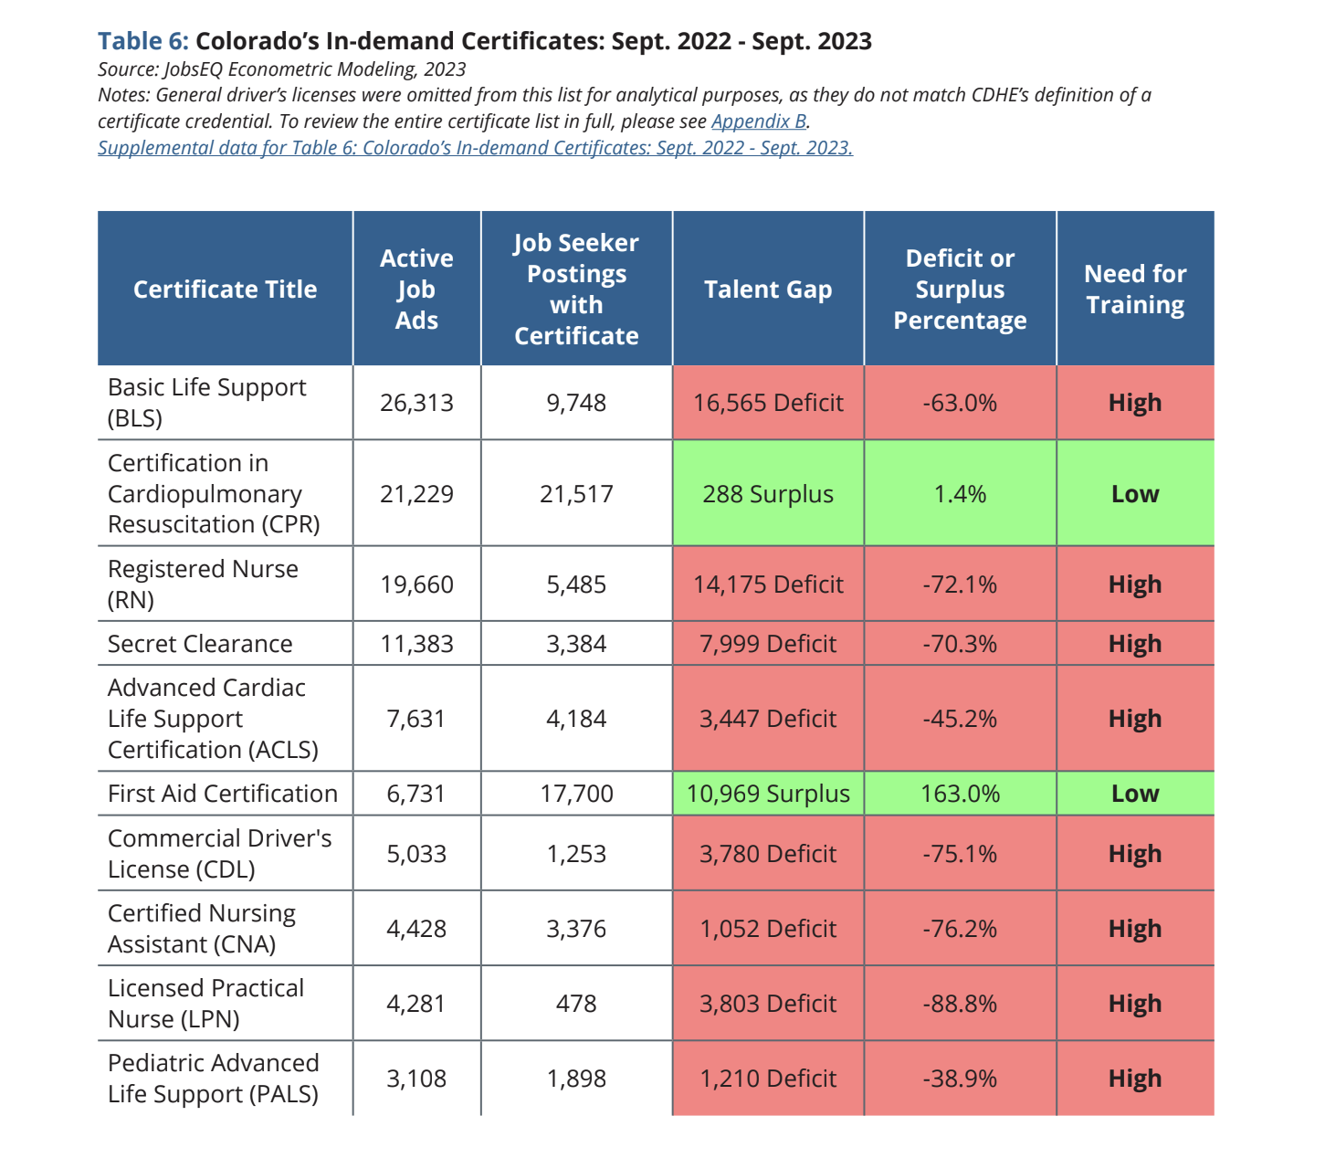
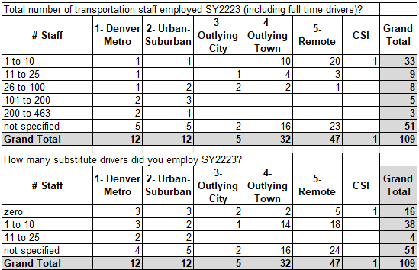
Areas of Regionalization
Define
Examples of Administration & Cooperative Training
Sussex County- Split costs and compile training documentation collectively.
Minneapolis School- operates a bus driving school academy with local technical college
Source: District Survey
Notes:
ADD DATA- need to more CDL training, fleet costs,

Slide 35
Administration & Cooperative Training
Ideate
What could shared administration and/or training focus on?
Based on the district data, what areas might be most impacted by shared administration and/or training?
Clarifying
Questions
Based on the district data, does it appear that shared administration and/or training might be beneficial?

Slide 36
Areas of Regionalization
Define
Examples of regionalized special education, pathways, before/after & athletics
GISD Specialized Transportation Consortium- Provides special needs student transportation.
Example: Academy 20
Urban Setting: Denver Metro
# Pupils Total: 26k
# Pupils Transported: 9,407
FY22-23 Expenditure: $8.2 mill
Reimbursement: $1.7 mill
% Reimbursed: 22%
Total Miles: 1.2 mill
Entitled Miles: 487k
$ Per Pupil: $189
Example: Kit Carson
Urban Setting: Remote
# Pupils Total: < 100
# Pupils Transported: 150
FY22-23 Expenditure: $146k
Reimbursement: $37k
% Reimbursed: 25%
Total Miles: 66k
Entitled Miles: 25k
$ Per Pupil: $247
Genesee Career Institute Transportation Consortium- Provides transportation from 21 school districts to the Genesee Career Institute.
Source: District Survey
New York BOCES- Has shared-service arrangements with neighboring districts.
Source: CDE 40. 7 districts excluded because there was no data provided. 6 Remote 1 Outlying Town
Notes:
ADD DATA- how many miles/money are used for non-reimbursable transportation. SPED requirements .add per pupil, and add an example for adams & remote

Slide 37
SPED, Pathways, Before/After School, Athletics
Ideate
What could regionalized transportation focus on?
Based on the district data, what areas might be most impacted by regionalized transportation?
Clarifying
Questions
Based on the district data, does it appear that regionalized might be beneficial?

Slide 38
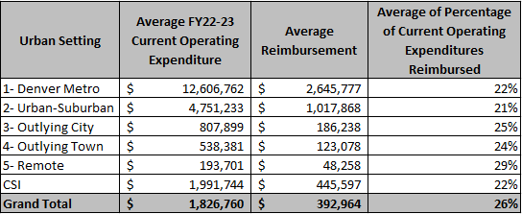
Areas of Regionalization
Define
Examples of sharing insurance, requirements, maintenance, and transportation costs & shared approach to purchasing
Source: CDE40 & District Survey
Belmont County- Shared service model for bus maintenance
Example: Academy 20
Urban Setting: Denver Metro
# Pupils Total: 26k
FY2223 Expenditure: $8.2 milion
Total buses 102
Average vehicle age 11 years
Average replacement 20 years
Average purchase price $160,000
Average mileage traveled 7,195
Average fuel cost $3,961
Average maintenance cost $3,761
Total Cost per year $7,722
(also have 97 other transport vehicles, mostly sped buses)
Example: Kit Carson
Urban Setting: Remote
# Pupils Total: < 100
FY2223 Expenditure: $146k
Total buses 8
Average vehicle age 15 years
Average replacement 25 years
Average purchase price ?
Average mileage traveled 11,000
Average fuel cost 10,880
Average maintenance cost 15,186
Total Cost per year $26,066
Dallas County- Provides busing services and co-op fuel purchasing for member districts
*Traditional school bus examples
Source: CDE 40. 7 districts excluded because there was no data provided. 6 Remote 1 Outlying Town
Notes:
ADD DATA- maintenance costs, bus purchasing costs, age and expense of fleet, fuel costs

Slide 39
Transportation Costs and Purchasing
Ideate
What could shared services and/or purchasing focus on?
Based on the district data, what might be most impacted by shared services and/or purchasing?
Clarifying
Questions
Based on the district data, does it appear that share services and/or purchasing might be beneficial?

Slide 40
Proposed Language for Recommendation
Prototype
Areas of Regionalization
What area(s) should be the focus…..
How should work on the focus areas move forward…..
Who should cover the cost of this type of transportation……

Slide 41
Should the Transportation Task Force put forth a recommendation regarding regionalization of transportation as previously stated?
Decision Needed
Recommendation Stated
Fist to Five Vote
Articulate Concerns*
Discussion of Concerns*
Restate Decision & Record Vote

Slide 42
Next Steps
Next Meeting:
Monday June 11th @ 10AM
Next Topic:
Something
Agenda and Pre-reads will be sent out the week before
If you have suggested readings for the group please send to Kate or Susan

Slide 43
Closing
Thank You!!
See you on June 11th

