Slide 2

School Transportation
Supervisor Training
2019-2020

Slide 3
HOUSEKEEPING
Phones
Restrooms
Food and Beverages
Leaving room clean
Handouts

Slide 4
INTRODUCTIONS
Name
District
Position
Years in industry
What is your greatest concern/challenge?

Slide 5
INTRODUCTIONS
Drove school bus - 16 years
Special Education Assistant - 1 year
9-1-1 Dispatcher
Emergency Medical Technician - 25 years
Transportation Supervisor – over 10 years
Executive Director – Transit System - 7 years
Beginning, Advanced and Supervisor Trainer MDOE – over 10 years
State of Colorado – Since 2014

Slide 6
LEADERSHIP
"Leadership is serving the people that work for you by giving them the tools they need to succeed. Your workers should be looking forward to the customer and not backwards, over their shoulders, at you. It also means genuine praise for what goes well and leading by taking responsibility early and immediately if things go bad.”

Slide 7
ARE YOU AN EFFECTIVE SUPERVISOR?
Do you have credibility?
  Lead by Example
  Consistent
  Professional
  Accountable
  Willing to change
Do you get the most out of your team?
  Communicate – listen as well as talking
  Delegate
  Reward
  Encourage growth
  Confront conflict
  Reasonable expectations
Are you meeting the demands of your position? Your team? Your district?
  Set goals
  Streamline processes
  Don’t procrastinate

Slide 8
A VERY WISE MAN ONCE TOLD ME ( My Father)
“Hold a tight rein loosely”

Slide 9
SO – WHAT DO WE NEED TO KNOW?
Federal Laws
State Laws
Colorado Department of Education Rules/Minimum Standards
Industry Standards – Best Practices
Financial Management – Budgets, Purchasing
District Policies
District Procedures
Human Resource Processes – Interviews, Discipline, Termination
Communication – Computer, Programs

Slide 10
WHAT ARE OUR RESOURCES? WHERE DO WE FIND THEM?
FMVSS /49 CFR, Part 571/NHTSA/USDOT/Minimum Standards
FMCSA/Operation Rules
Commercial Driver License Manual
Model Traffic Code
CDE Resource Guide/Colorado Revised Statutes
Driver Trainer Guide
Operator Guides
Annual Inspection Guide
License Matrix
National Congress of School Transportation National Guideline
CDE Staff
Other Supervisors

Slide 11
CDE WEBSITE
What’s New
All Forms
Terrain Map
All Guides
Past Presentations
Upcoming Training
TAC Minutes/Schedule
Technician Resources
CDL and other Manuals

Slide 12
WHAT IS IT?
Law
Rule
Recommendation
Best Practice/Industry Standard

Slide 13
FEDERAL LAWS

Slide 14
FMVSS - CFR
These Federal safety standards are regulations written in terms of minimum safety performance requirements for motor vehicles or items of motor vehicle equipment. These requirements are specified in such a manner "that the public is protected against unreasonable risk of crashes occurring as a result of the design, construction, or performance of motor vehicles and is also protected against unreasonable risk of death or injury in the event crashes do occur.“

Slide 15
FMCSA
Controlled Substances and Alcohol Use and Testing 382
  All CDL Operators are required to receive training
  Supervisors are required to receive Reasonable Suspicion training
Drug and Alcohol Clearinghouse
  Effective January 2020
Entry Level CDL Training
  Effective February 2020 – More on this later
Driver Medical Requirements
  The Federal Diabetes and Vision Exemption Programs have specific requirements, as well as requests for hearing and seizure exemptions. These requests may include medical exams, employment history, driving experience and motor vehicle records which must be submitted with the application. The Agency will make a final decision within 180 days of receipt of the complete application. This is for INTERSTATE travel. The FMCSA waivers/exemptions do not permit regulatory relief for drivers who plan to limit their operations to intrastate commerce.

Slide 16
DOT PHYSICAL AND WAIVERS
The Colorado INTRASTATE Waiver program may consider a waiver for individuals who have failed to meet the requirements of 49 CFR 391.41 for ONLY ONE following permanent conditions:
391.41(b)(1)-Loss of Limb and (b)(2)-Impairment of Limb (this condition requires a specific waiver application known as a Special Skills Evaluation or SPE);
391.41(b)(3)-Clinical diagnosis of diabetes mellitus currently requiring insulin for control;
391.41(b)(10)-Visual Acuity
https://www.colorado.gov/pacific/csp/medical-waivers
Drivers with physical impairments which affect their ability to safely operate CMVs according to their medical examiners, or with missing limbs (e.g., a hand or finger, an arm, foot or leg), are required to obtain SPE certificates.

Slide 17
IDEA – FAPE – OCR (Special Needs)
Individuals with Disabilities Education Act
http://www2.ed.gov/policy/speced/guid/idea/idea2004.html
Free Appropriate Public Education Under Section 504
http://www2.ed.gov/about/offices/list/ocr/docs/edlite-FAPE504.html
Office of Civil Rights
http://www2.ed.gov/about/offices/list/ocr/504faq.html

Slide 18
FERPA – FOIA - CORA
Family Educational Rights and Privacy Act
The Family Educational Rights and Privacy Act (FERPA) (20 U.S.C. § 1232g; 34 CFR Part 99) is a Federal law that protects the privacy of student education records. The law applies to all schools that receive funds under an applicable program of the U.S. Department of Education.
FERPA gives parents certain rights with respect to their children's education records. These rights transfer to the student when he or she reaches the age of 18 or attends a school beyond the high school level. Students to whom the rights have transferred are "eligible students."
Freedom of Information Act
The Freedom of Information Act (FOIA) gives you the right to request information from federal agencies. From FOIA online you can submit FOIA requests to all participating agencies, track the status of requests, search for requests submitted by others, access previously released records, and generate agency-specific FOIA processing reports.
Colorado Open Records Act
In Colorado, pursuant to the Colorado Open Records Act (CORA) under C.R.S. 24-72-201 et seq., it is declared to be the public policy of the state that all public records shall be open for inspection by any person at reasonable times, except as provided in part 2 or as otherwise specifically provided by law. The CORA is a series of laws designed to guarantee that the public has access to public records of government bodies at all levels in Colorado. The law was enacted in 1969. It applies to “the state, its agencies and institutions, cities, counties, cities and counties, towns, school districts, special districts, and housing authorities.”

Slide 19
NHTSA – USDOT - HEADSTART
National Highway Traffic Safety Administration
Databases for in-depth record of safety Issues for Vehicles, Child Restraints, Tires and Equipment
http://www-odi.nhtsa.dot.gov/owners/SearchSafetyIssues
United States Department of Transportation
www.transportation.gov/areas-of-focus
Head Start - Head Start is a Federal program that promotes the school readiness of children from birth to age five from low-income families by enhancing their cognitive, social, and emotional development. Head Start programs provide a learning environment that supports children's growth in many areas such as language, literacy, and social and emotional development. Head Start emphasizes the role of parents as their child's first and most important teacher. These programs help build relationships with families that support family well-being and many other important areas.

Slide 20
NCLB/ESSA – MCKINNEY VENTO
No Child Left Behind/Every Student Succeeds Act
The previous version of the law, the No Child Left Behind (NCLB) Act, was enacted in 2002. NCLB represented a significant step forward for our nation’s children in many respects, particularly as it shined a light on where students were making progress and where they needed additional support, regardless of race, income, zip code, disability, home language, or background. The law was scheduled for revision in 2007, and, over time, NCLB’s prescriptive requirements became increasingly unworkable for schools and educators. Recognizing this fact, in 2010, the Obama administration joined a call from educators and families to create a better law that focused on the clear goal of fully preparing all students for success in college and careers.
McKinney Vento Education of Homeless Children and Youth Assistance Act
The McKinney-Vento Education of Homeless Children and Youth Assistance Act is a federal law that ensures immediate enrollment and educational stability for homeless children and youth. McKinney-Vento provides federal funding to states for the purpose of supporting district programs that serve homeless students. Sep 6, 2016

Slide 21
COLORADO DEPARTMENT OF EDUCATION RULES

Slide 22
MINIMUM STANDARDS – 301-25
April 30, 2015-Present
September 1, 2007-2015
February 1, 1999-2007
October 1, 1993-1999

Slide 23
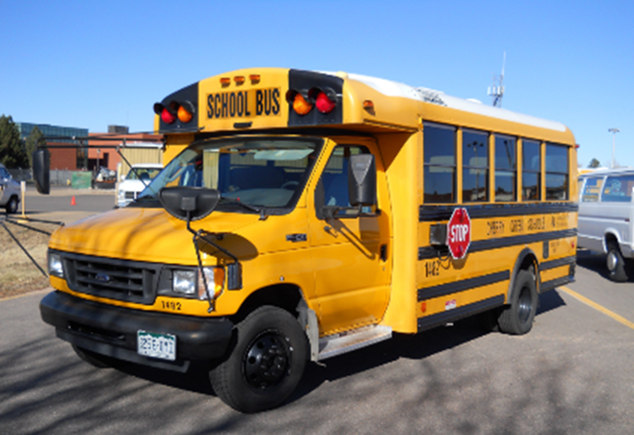
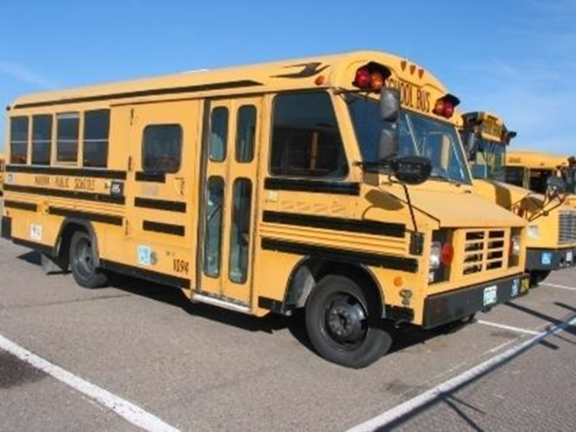
Minimum Standards
Type "A" school bus is a conversion or body constructed utilizing a cutaway front-section vehicle with a left side driver’s door and a gross vehicle weight rating (GVWR) of 21,500 pounds or less.
Type "B" school bus is a body constructed and installed upon a stripped chassis. Part of the engine is beneath and/or behind the windshield and beside the driver's seat. The entrance door is behind the front wheels.

Slide 24
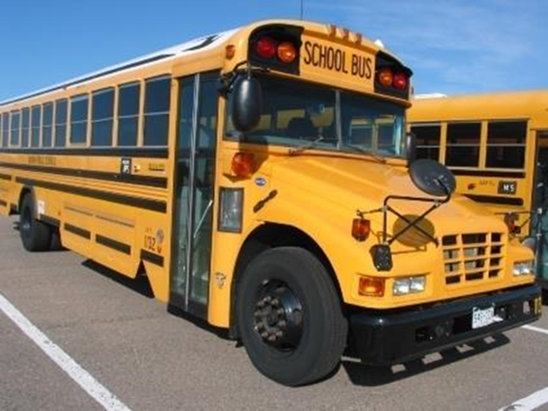
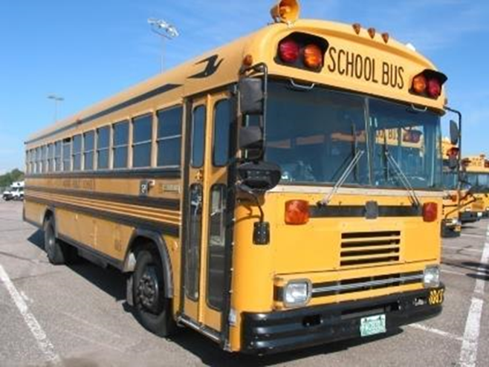
Minimum Standards
Type "C" school bus is constructed utilizing a chassis with a hood and fender assembly. This includes the cutaway truck chassis, including cab, with or without a left side driver door, and with a GVWR greater than 21,500 pounds. The entrance door is behind the front wheels.
Type "D" school bus is constructed utilizing a stripped chassis, the engine may be behind the windshield and beside the driver's seat; it may be at the rear of the bus, behind the rear wheels. The entrance door is ahead of the front wheels.

Slide 25
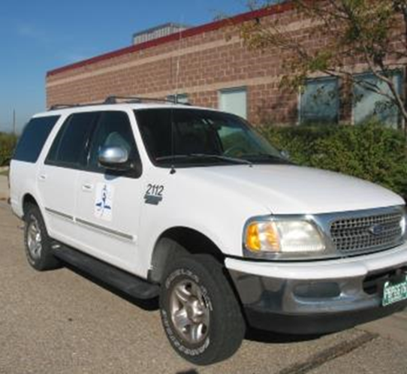
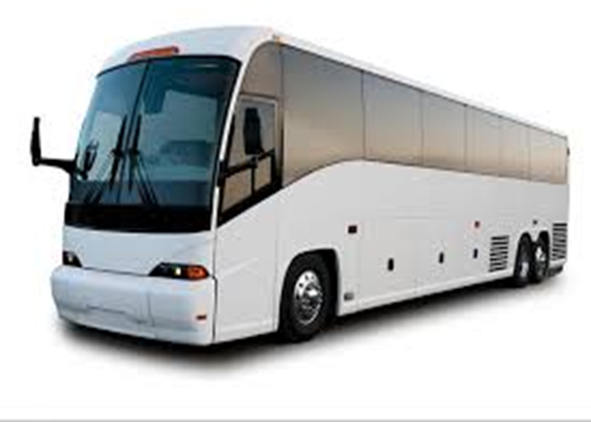
Minimum Standards
Small Vehicle shall be a motor vehicle, which does not meet the requirements of a Type A, B, C or D school bus, designed for general purpose use. A small vehicle shall meet or exceed section 20.05 of these rules. These vehicles may be used to carry students to and from school, from school to school, or to school related events.
Under federal law (49 USC 30112(a)), a new over-the-road motor coach (motor coach) bus may not be sold for the purpose of transporting school-age students to and from school or to school related events unless it meets all FMVSS requirements for school buses.

Slide 26
Motor Coach Use Requires a Local Board of Education Resolution
4.01(a) Under federal law (49 USC 30112(a)), a new over-the-road motor coach (motor coach) bus may not be sold for the purpose of transporting school-age students to and from school or to school related events unless it meets all FMVSS requirements for school buses. Upon passage of a local board of education resolution, a school district may purchase a used over-the-road motor coach (motor coach) bus and/or attain a short term rental of a motor coach bus from a contract carrier for the transportation of students to school related events. Such resolution shall specify that consideration was given to the standards of safety to promote the welfare of students, including recommendations of national transportation organizations. In no event shall a motor coach bus be used for the transportation of students to and from school or school to school. A board resolution is not necessary for transporting students on common carriers.

Slide 27
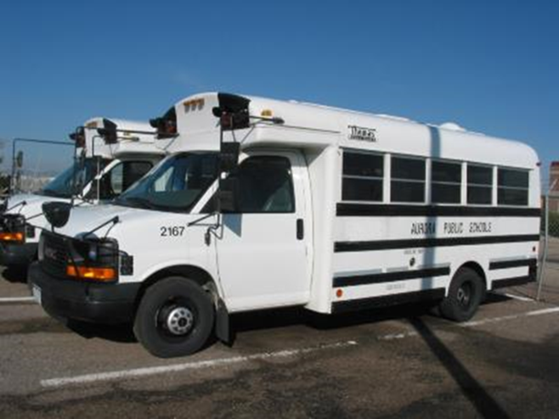
Minimum Standards
Multifunction bus shall be a motor vehicle, built to federal multifunctional school activity bus standards, designed for transporting students.
These buses must also meet Colorado school bus construction standards with 6 exceptions:
6 exceptions: [5.04(a)]
16.00 Color; chassis
54.00 Color. Body
63.01 Lettering; SCHOOL BUS
63.06 Lettering; STOP ON FLASHING RED
67.07 8-way lamps
77.00 Stop signal arm
May be any capacity

Slide 28
15-Passenger Vans
15-passenger van defined --In this subsection, the term ``15-passenger van'' means a vehicle that seats 10 to 14 passengers, not including the driver.
A school or school system may not purchase or lease a new 15-passenger van if it will be used significantly by, or on behalf of, the school or school system to transport preprimary, primary, or secondary school students to or from school or an event related to school, unless the 15-passenger van complies with the motor vehicle standards prescribed for school buses and multifunction school activity buses under this title.
http://www.cde.state.co.us/transportation/trans15passengervan.htm

Slide 29
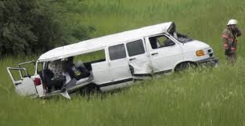
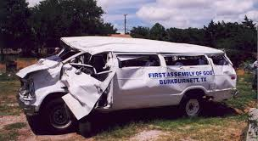
15-Passenger Vans
15-Passenger Van Accident Statistics. The National Highway Traffic Safety Administration estimates that 31 percent of fatal rollover accidents involving 15-passenger vans happen during the summer months. From 1997 through 2006, accidents involving these vehicles led to the deaths of more than 1,000 occupants

Slide 30
REIMBURSEMENTS
1 CCR 301-14 Rules for the Administration of the Public School Transportation Fund
Route operating expenses
Route mileage
Must be submitted through district
For more information contact –
Adam Williams, Financial Data Coordinator:
williams_a@cde.state.co.us
CSI Charter Schools submit through the Charter School Institute

Slide 31
OPERATIONS/MAINTENANCE/ANNUAL INSPECTIONS 301-26
4204-R-2.00 Applicability of Rules
2.01 These rules and regulations apply to the operation, maintenance and inspection of all public
school transportation conducted by:
2.01(a) A school district or charter school for routes (home to school, school to school, and
school to home);
2.01(b) A school district or charter school for activity trips (school related events);
2.01 (c) A company or individual hired by a district or charter school (service provider) for routes (home to
school, school to school, and school to home).

Slide 32
OPERATIONS/MAINTENANCE/ANNUAL INSPECTIONS 301-26
2.02 These rules are not intended to include:
2.02(a) Private motor vehicles used exclusively to carry members of the owner's household; or
2.02(b) Transportation arrangements not authorized by the district including but not limited to
sharing of actual gasoline expense or participation in a car pool; or
2.02(c) The operations of vehicles in bona fide emergency situations consistent with policies of the local board of education; or
2.02(d) Transportation conducted by a company or individual for activity trips (school related events), including service providers, parent volunteers, and coaches or teachers using a private motor
vehicle; or

Slide 33
OPERATIONS/MAINTENANCE/ANNUAL INSPECTIONS 301-26
2.02(e) Route transportation provided by a company or individual as part of their operation as a common carrier under the jurisdiction of the US Department of Transportation or Public Utilities Commission, including RTD, taxi cab services, Uber services, and Lyft services.
2.03 These rules shall not preclude a school district or service provider from establishing a more rigid standard or policy when deemed necessary by the local board of education or service provider.

Slide 34
OPERATIONS/MAINTENANCE/ANNUAL INSPECTIONS 301-26
4204-R-3.00 Non-Compliance
4204-R-4.00 School District and Service Provider Employment Responsibilities
4204-R-5.00 School Transportation Vehicle Operator Requirements
4204-R-6.00 School Transportation Annual Inspector Requirements
4204-R-7.00 Annual Inspector Hands-On Tester
4204-R-8.00 Pre-trip/Post-trip Vehicle Inspections
4204-R-9.00 Inspection Site Certification
4204-R-10.00 Annual Inspection
4204-R-11.00 Maintenance and Repair
4204-R-12.00 Operation of a School Transportation Vehicle
4204-R-13.00 Authorized Passengers
4204-R-14.00 Safety Restraints
4204-R-15.00 Transportation of Miscellaneous Items
4204-R-16.00 Maximum Driving Time for School Transportation Vehicle Operators
4204-R-17.00 Route Planning – Student Loading and Discharge
4204-R-18.00 Emergency Evacuation Drills

Slide 35
Qualification Files

Slide 39
Reviews
DISTRICT Full Name | CDL/SMV | Copy of License | MVR | DOT Physical/ STU-17 | Annual Written Test | Annual Driving Perform/ Pre-Trip | 1st Aid /CPR Training | Pre- Service Training | Guide Cert. | D & A Training | Job Descr. | Confident.

Slide 40
COMMON QUESTIONS
What do we do if we do not have any documentation of an operators pre-service training?
How do you want our files organized?
Can Drug and Alcohol documentation be in the DQ file?
Can I put all of my Small Vehicle Operator’s in a notebook?
If I have a vehicle with a vehicle capacity of 20 and I remove seats, can I make it a 14 passenger vehicle?
How often are CDE forms updated?
How often are CDE tests changed?
What is the difference between CSI and Charter Schools?
Can I go into another school district and pick up students?

Slide 41
22-32-113
22-32-113. Transportation of pupils - when
(1) The board of education of a school district may furnish transportation:
(a) To and from public schools of the district for any reasonable classification of resident pupils enrolled in the schools of the district;
(b) To and from public schools located in an adjacent state for any reasonable classification of resident pupils who have not completed the twelfth grade, but only if the district of attendance is one to which the district of residence of such pupils is authorized to pay tuition for the attendance of such pupils;
(c) To and from public schools for any reasonable classification of pupils enrolled in the schools of the district who are residents of any other school district, IF THE DISTRICT OF RESIDENCE IS ADJACENT TO THE DISTRICT OF ATTENDANCE, AND IF THE BOARD OR OTHER GOVERNING BODY OF THE DISTRICT OF RESIDENCE CONSENTS TO SUCH TRANSPORTATION;
(d) To and from any school-sponsored activity, or for any emergency, for any reasonable classification of resident pupils enrolled in the schools of the district,
whether said activity or emergency be within or without the territorial limits of the district, and whether or not occurring during school hours.

Slide 42
CONTINUED
Section 22-32-113(2)
A board may determine the points at which pupils shall be received and delivered and the routes of transportation pursuant to subsection (1) of this section.
Section 22-32-113(3)
If it is impractical, as determined by the board, to furnish transportation to and from school for any resident pupil enrolled or eligible to be enrolled in the schools of the district pursuant to subsection (1) (a), (1) (b), or (1) (c) of this section, the board may pay the cost, or any portion thereof, of room and board for the pupil to reside at a point near a school of the district of residence or a school of a district to which the district of residence is authorized to pay tuition.
Section 22-32-113(4)
(4) A board may reimburse a parent or guardian for the expenses incurred by such parent or guardian in furnishing transportation to and from a public school or designated school vehicle stop for his or her child or children and for other pupils enrolled in the schools of the district, BUT THE BOARD SHALL NOT REIMBURSE ANY PERSON FOR TRANSPORTATION FURNISHED TO A PUPIL RESIDENT IN ANOTHER SCHOOL DISTRICT WITHOUT THE CONSENT OF THE BOARD OR OTHER GOVERNING BODY OF THE DISTRICT OF RESIDENCE. The amount and payment of transportation expenses are determined by the board paying the expenses.

Slide 43
OTHER RESOURCES

Slide 44
OTHER RESOURCES
License and Training Matrix Guide
Resource Guide for 1 CCR 301-26 Colorado Rules for the Operation, Maintenance and Inspection of School Transportation Vehicles
School Transportation Technicians Annual Inspection Guide
Colorado Commercial Driver License Manual
First Aid and CPR Clarification from Public Health and Environment
DOT Office of Drug and Alcohol Policy and Compliance
School Bus Facts.com
Colorado State Pupil Transportation Association (CSPTA)
Colorado Safe Routes to School
National Association of Pupil Transportation (NAPT)
National Association of State Directors of Pupil Transportation Services (NASDPTS)
National Congress Student Transportation (NCST)

Slide 45
OTHER RESOURCES
CDE Website
Reimbursement Claim Form (CDE-40) and Audit Resource Guide
School Finance calendar
School Finance home page

Slide 46
OPERATIONS

Slide 47


Slide 48


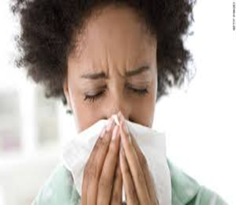

CHALLENGES???
Driver/Staff Shortage
Budgets
Parent Complaints
Administration/other district staff
Employee issues – illness/discipline/family matters
Vehicle - out of service/repairs
Interpersonal relationships with staff
New students/route changes

Slide 49
SOLUTIONS??
Driver/Staff Shortage
  Stay home Moms
  Retiree’s
  Younger Trainees
Budgets
  Ask for help
  Asset Management
Parent Complaints
  Address immediately? Or let them cool off?
  Meetings with drivers/paraprofessionals
Administration/other district staff
  Understanding personality traits/differences
  Show appreciation
  Increase Respect Levels
Employee issues – illness/discipline/family matters
  Bonus
  Discipline Policy? Are you following it?
  FMLA/absenteeism

Slide 50
Other Challenges?
Sexual Harassment
Helping Drivers Problem Solve
Knowing when to send it “up the ladder”
The buck stops with you
Don’t have favorites
Deal with issues immediately – don’t let them fester.
Follow the rules! If you bend them once………
Have high expectations.

Slide 51
BUS STOPS

Slide 52
DO YOU . . . . . . . . . . . . ?
Do you require documentation of new students?
Does district allow __ Days before permission to ride?
Do you physically go out and view each bus stop?
Do you measure distances if there is questionable distance requirements?
Do you document it?
Do you give parents a “window” for pick up/drop off?
Do you have a transportation handbook?
Do you have a meet and greet/Kindergarten Roundup?

Slide 53
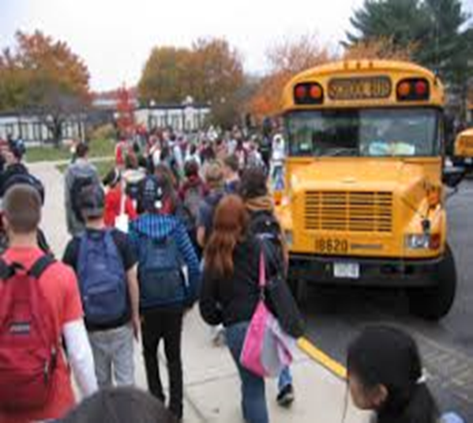
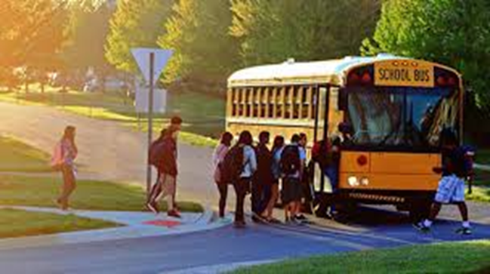
ANY PROBLEMS?

Slide 54
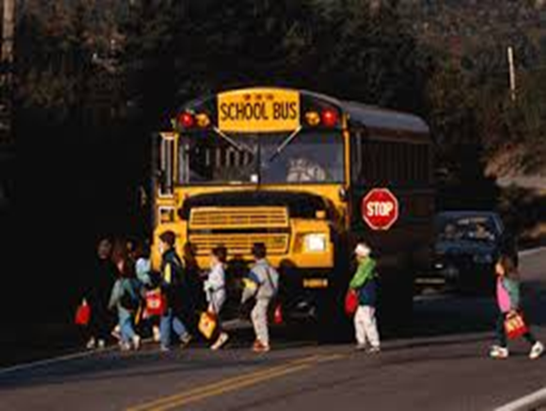
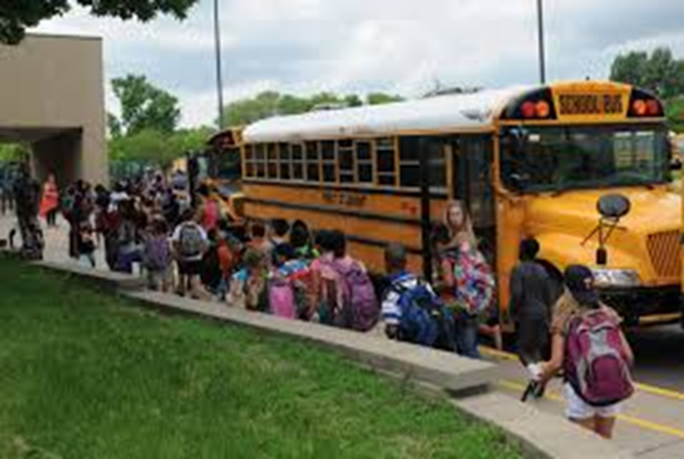

Slide 55
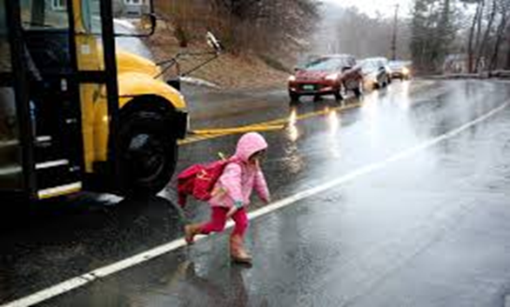
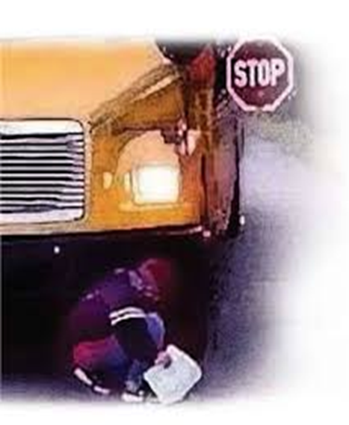

Slide 58
FACTORS WE MUST CONSIDER
Age of Students
Visibility
Lateral Clearance
Student Access
Control of Other Motorists
Roadway Conditions/Lanes
Student Waiting Area
Eliminating Railroad Crossings
Distance Between Stops
Wildlife Threat
Intersections
Light Usage

Slide 59

Bus Stops
300 feet

Slide 60
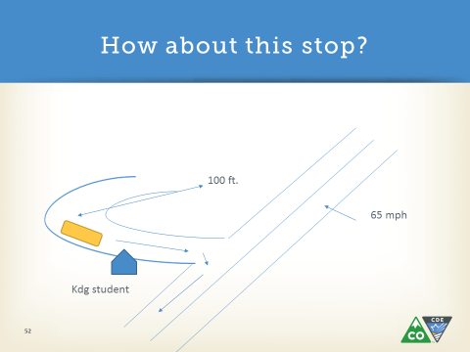
Bus Stops

Slide 61
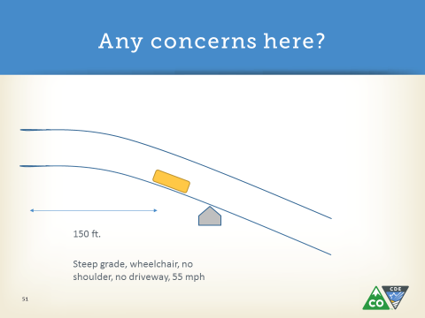
Bus Stops

Slide 62
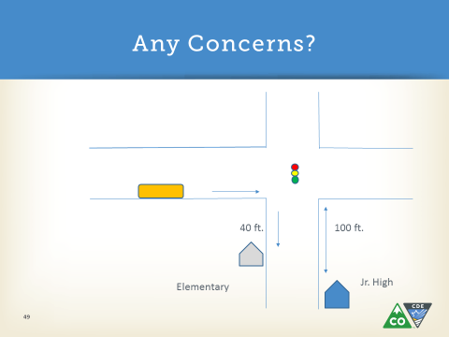
Bus Stops

Slide 63
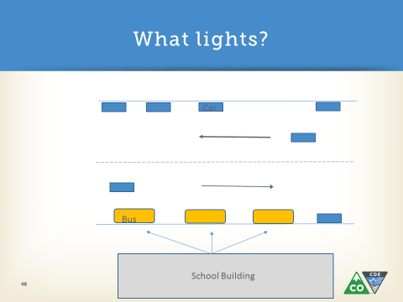
Bus Stops

Slide 64


Let’s talk about this bus stop..

Slide 65





As a rescue bus- what location should you stop at? What lights do you use?
2
3
1
disabled
4

Slide 66
The bus driver is in the process of unloading a student that must cross the roadway. The bus stops, engages the red lights, permits the student to unload then looks up and sees that there appears to be a police officer in pursuit headed directly toward them. What should the driver do?
What if it was an ambulance coming toward them lights and sirens?

Slide 67
A school bus driver has just recognized that they are having a medical emergency. Recognizing that, they pull over to the side of the road and stop, put the bus in park, but before they could notify anyone they have a stroke and are unable to speak. What are some of the things this driver hopefully taught the students to do?

Slide 68
Questions??

