Slide 1
Coffee Chat
Student and Family Reengagement Strategies
January 15, 2021

Slide 2
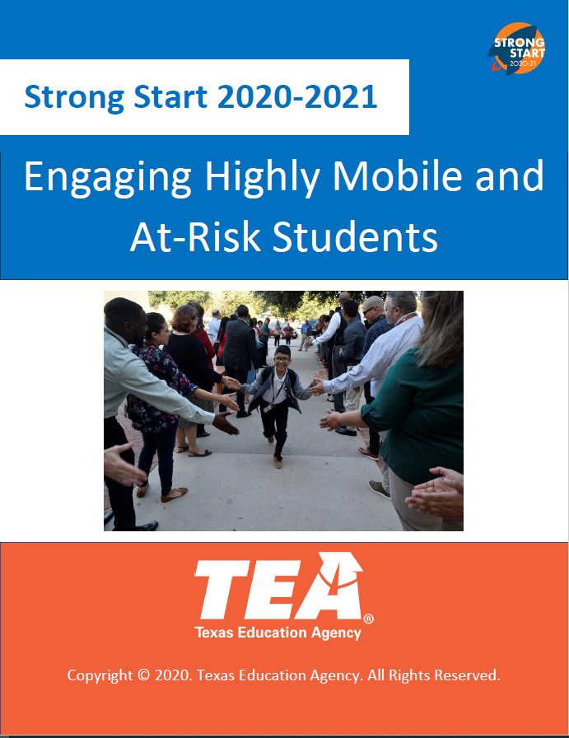
Strong Start 2020-2021 from TEA

Slide 3
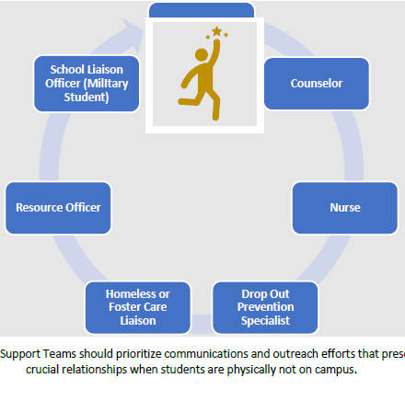
Student Support Teams
What is a Student Support Team?
District and campus leadership are encouraged to create and utilize Student Support Teams comprised of trained staff and community partners that can voluntarily be arranged to conduct home visits or other outreach interventions for the most at-risk and vulnerable student populations. Support Teams will reflect the unique staffing of each campus and may include social workers, behavior specialists or other designated campus or district staff.

Slide 4
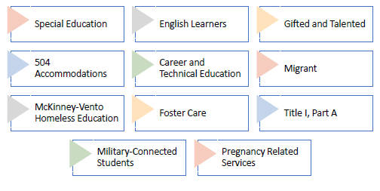
Provide a multi-tiered level of support by collaborating with other student programs such as:

Slide 5
Categorization
Engaged
Student was responding to requests from administrators and teachers and completing assignments. For secondary students, enrolled in multiple classes, completing assignments in any core content areas would count as engaged.
Unengaged/Disengaged
Student was responding to requests from administrators and teachers; however, the student was not completing assignments. For secondary students, enrolled in multiple classes, not completing assignments in any core content areas would count as unengaged. Students should be classified as unengaged regardless for the underlying reason for not being engaged (whether by choice or uncontrollable circumstance).
Not Contactable/Uncontactable
An uncontactable student is defined as a student that did not participate in the continuing instruction formats provided by the district and for whom multiple efforts to contact them or their relatives listed as the student’s contacts failed during the COVID-19 pandemic as campuses transitioned from in-person to virtual learning platforms.

Slide 6
Key Considerations- Non-Contactable Students
District and campus staff should consider the following:
Create a list of uncontactable students to be located and reengaged.
Review student attendance and level of engagement to identify any gaps that occurred before or during COVID-19.
Determine what factors may have contributed to a student’s uncontactable status or change in engagement (e.g. loss of housing, moved out of the area, etc.).
Meet regularly to discuss the progress of reestablishing communication or locating uncontactable students.
Provide any updated student or family contact information to your registrar as soon as possible.
Determine what academic interventions or supports are needed to ensure on-time promotion and graduation for the 2020-2021 school year.

Slide 7
Key Considerations- Not Engaged Students
District and campus staff should consider the following:
Create a list of students who were coded not engaged at the end of the 2019-2020 school year.
Determine when the student was last engaged to identify interventions and supports.
Determine what factors may have contributed to the student’s level of engagement (e.g. loss of housing, moved out of the area, etc.).
Meet regularly to discuss the progress of reestablishing communication or locating uncontactable students.
Develop a plan to reestablish engagement to support academic continuity.
Review student attendance and level of engagement to identify any gaps that occurred before or during COVID-19.
Determine what academic intervention or supports are needed to ensure on-time promotion and graduation for the 2020-2021 school year.

Slide 8
Key Considerations- Engaged Students
District and campus staff must consider the following:
Identify if these students were able to complete their coursework and were promoted or graduated.
Assess what interventions or additional academic progress monitoring were utilized to ensure on-time promotion and graduation for the 2019-2020 school year.
Review grades and credits to ensure all engaged students are on track for on-time promotion and graduation for the 2020-2021 school year.

Slide 9
Academic Reports
District and campus staff should collaborate with their data coordinator or school registrar to run the following academic reports:
Attendance (prior to and during COVID-19)
Grades
Credits Earned vs Credits Attempted
Assessment scores (prior to COVID-19)
At-Risk Indicators

Slide 10
Review of Academic Data
District and campus staff should review academic data to:
Identify trends in level of engagement or prevalence of uncontactable student by grade level, student groups, and special student population.
Identify trends in promotion rates by grade level, subject areas, student groups, or special student populations.
Identify which student groups or special student populations need the most academic support.
Data trends may indicate variance in academic knowledge and deficits by grade level, student group, or special student population. District and campus staff will need to determine what targeted interventions, academic supports, and progress monitoring strategies will be needed to support academic achievement for all student groups for the 2020-2021 school year and beyond.

Slide 11
Innovative Outreach Efforts
Door Hangers or Flyers
  Campus staff can create door hangers with the following information:
    Warm and welcoming message (e.g. “You are missed…”)
    Campus contact information to include both phone number and email address
    Important upcoming dates
    All material available in English and Spanish
Apartment Manager Outreach
  Identify apartment complexes that feed into campus attendance zones and contact the managers in-person or phone call.
  Provide the following information to the apartment managers:
    Name of campus staff member
    Name of school/district
    Contact information (phone and email) where campus staff can be reached
    Drop off door hangers, business cards, McKinney-Vento posters

Slide 12
Innovative Outreach Efforts continued…
Supporting Students Living in Hotels or Motels
  District and campus staff should collaborate with their McKinney-Vento Homeless Liaisons to establish strong communication channels with hotel and motel staff to disseminate district, campus, and homeless education program information, resources, and supplies.
  Homeless liaisons should provide McKinney-Vento Posters via email to local hotel and motel staff.
  Homeless Liaisons should work with motel and hotel staff to ensure posters are placed strategically (e.g. laundromat area, community information boards, etc.) so that students and parents can easily access the information.
Leveraging Social Media Platforms
  Districts and campuses can utilize their social media platforms such as Facebook and Twitter to craft a message for students encouraging communication.
  Districts and campuses can craft messages encouraging students to reach out to friends who they know might have become disengaged during the school year.
  Districts and campuses may also consider sending text messages, automated voice messages, and letters sent to the home.
Establishing Protocols for Concerns
  District and campus staff must be knowledgeable of policies and protocols in place to respond to certain crisis such as: mandatory reporting of child abuse, neglect, including human trafficking, food insecurities, mental health, and for students experiencing homelessness.

Slide 13
Ongoing Engagement Strategies
Assess Needs (changes to remote needs, basic needs, academic challenges)
  Shared Google Doc
Mentors within each building/district
Text “buddies”
Summer Programming
Staff to be “advocate“ or “advisory” personnel
Online/Virtual events (Parent University, clubs, engagement classes, book club)

