Slide 1
SY20-21 MKV Back to School
August 27, 2020

Slide 2
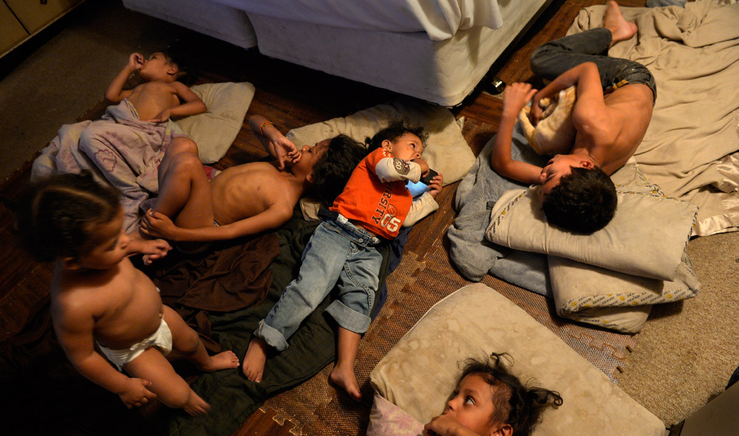
The “Why” https://extras.denverpost.com/homelessstudents/

Slide 3
Overview
Back to School Tips and Reminders
New Data Elements for Homeless Students
Improving Engagement and Attendance
From the Field- Cherry Creek School District
Considerations for Homeless Students- School Re-entry
Additional Support and Trainings
Natural Disasters

Slide 4
Preparing for the Year Ahead
Revisit your roles and responsibilities
Introduce yourself or reconnect with school staff
Counselors/Social Workers
Registrars
Enrollment Staff
Set-meetings with district level partners
Title I
Transportation
Data– End of Year Data
Hang posters (https://nchehelpline.org/)
Connect with community partners
Stock up on supplies

Slide 5
Where to begin…
What is the McKinney-Vento Homeless Assistance Act?
Subtitle VII-B of The McKinney-Vento Homeless Assistance Act authorizes the federal Education for Homeless Children and Youth (EHCY) Program and is the primary piece of federal legislation related to the education of children and youth experiencing homelessness. It was reauthorized in December 2015 by Title IX, Part A, of the Every Student Succeeds Act (ESSA).

Slide 6
Local Liaison Responsibilities
The McKinney-Vento Act requires every local educational agency to “designate an appropriate staff person” to serve as a McKinney-Vento Homeless Education Liaison.
specialize in legally qualifying students for McKinney-Vento and are responsible for identifying eligible students
expedite enrollment into public school for McKinney-Vento students
provide access to free school meals
make referrals to other school and community resources
inform families and students about transportation services, determining school of origin and mediating disputes.
Liaisons can also serve as one of the primary contacts between McKinney-Vento eligible families and school staff, district personnel, shelter workers, and other service providers.

Slide 7
“Homeless” Definition
What is the definition of “homeless” under the McKinney-Vento Act?
Section 725(2) of the McKinney-Vento Act defines “homeless children and youths” as individuals who lack a fixed, regular, and adequate nighttime residence. The term includes—
Children and youths who are:
sharing the housing of other persons due to loss of housing, economic hardship, or a similar reason (sometimes referred to as “doubled-up”);
living in motels, hotels, trailer parks, or camping grounds due to lack of alternative adequate accommodations;
living in emergency or transitional shelters; or abandoned in hospitals;
Children and youths who have a primary nighttime residence that is a public or private place not designed for, or ordinarily used as, a regular sleeping accommodation for human beings;
Children and youths who are living in cars, parks, public spaces, abandoned buildings, substandard housing, bus or train stations, or similar settings; and
Migratory children who qualify as homeless because they are living in circumstances described above.

Slide 8
What are the educational rights of McKinney-Vento eligible students?
McKinney-Vento eligible students have the right to:
receive a free, appropriate public education;
enroll in school immediately, even if lacking normally required for enrollment, or having missed application or enrollment deadlines during any period of homelessness;
enroll in school and attend classes while the school gathers needed documents;
continue attending the school of origin, or enroll in the local attendance area school if attending the school of origin is not in the best interest of the student or is contrary to the request of the parent, guardian, or unaccompanied youth;
receive transportation to and from the school of origin, if requested by the parent or guardian, or by the local liaison on behalf of an unaccompanied youth; and
receive educational services comparable to those provided to other students, according to each student’s need.

Slide 9
New Data Elements for Homeless Students
Question #1
01- No, not in housing crisis
03- Yes, in a housing crisis and with a parent/guardian
04- Yes, in a housing crisis and not with a parent/guardian
Question #2 - Primary Nighttime Residence (four options that determine eligibility)
01- Shelter/Transitional Living
02- Doubled-up
03- Unsheltered
04- Hotel/Motel
Question #3 – Cause of Housing Crisis
01- Eviction/Foreclosure/Cannot afford housing
02- Household/Domestic Factors
03- Loss or decrease in income/Loss of job
04- Natural Disaster
05- Pandemic
99- None of the above
Question #4 – Additional Cause of Housing Crisis
00- Not applicable/No additional cause
01- Eviction/Foreclosure/Cannot afford housing
02- Household/Domestic Factors
03- Loss or decrease in income/Loss of job
04- Natural Disaster
05- Pandemic
99- None of the above

Slide 10
Improving Engagement and Attendance

Slide 11
Engagement Strategies
Embed questions and information about homelessness in all school or district outreach efforts, including: enrollment materials, food pick-up or delivery; mailing of learning packets; emails or other communications to all parents/students; school/district automated calling systems; and the school/district website, Facebook page, and other social media.
Post flyers, brochures, and posters in the community where students and parents might see them, even if those locations are different due to COVID-19. For example, while campgrounds, motels, libraries and laundromats may continue to be important places to post information, grocery stores and pharmacies might be even more essential locations for such information at this time

Slide 12
Engagement Strategies
Ask community partners to use an online referral form, that can be completed and submitted via a Google Doc or email, to connect families and youth to McKinney-Vento liaisons and early childhood programs for education-related needs
If your school is doing meals, post flyers in an area where families picking up meals can see them and include a flyer or brochure in to-go meals.
Create user-friendly websites and Facebook pages with clear information about community resources, food distribution, and distance learning, including how to obtain devices and internet connectivity.

Slide 13
Engagement Strategies
Many families may not self-identify as homeless or understand that living doubled-up may qualify them for services. Be creative with the questions that can help identify students and families experiencing homelessness in the COVID-19 context. Questions may include:
Have you had an eviction deferred, and if so, when will the eviction moratorium end?
Have you had rent, or utility payments deferred, and if so, when will those payments resume?
Do you have a steady income? Has your work schedule been reduced?
Do you have a working stove and refrigerator?
Have you had utilities shut-off?
How long have you been where you are staying currently, and how long do you think you will be able to stay there?
Have you recently had to move in with family or friends because of financial circumstances?

Slide 14
From the Field… What is the field hearing as far as returning to school and the engagement of students? Are you hearing that some students are not enrolling or engaging? What does this look like?

Slide 15
Re-Entry Models

Slide 16
In Person Classes
Is there sufficient PPE?
Who provides PPE? How will it be provided to those who need it?
What will happen for families who refuse to use PPE? Parents uncomfortable returning to school?
How will hygiene supplies for students be provided?
How will quarantine/isolation be addressed?
How will students be prioritized for transportation?
What considerations will be made for out-of-school time? (extracurriculars, before and after school care)
Other considerations? Local strategies? Type in the chat!
Notes:
Patricia Popp:
I don’t know what you’re seeing, but few of my LEAs are planning for full in-person classes as school begins this year. However, for those districts that are in-person and knowing that, eventually, we will have face-to-face instruction, here are the main considerations our team identified. I don’t think we have easy answers for any of them, but we tried to come up with some thoughts to get the conversations started today and hope you’ll share additional ideas in the chat box.
While there are overarching concerns for all of these that would apply to any student, we’ll try to focus on the EXTRA considerations for our students experiencing homelessness and conversation we probably need to be having with our liaisons
PPE – I think the MV language regarding the removal of barriers gives us the mandate to address this as SC and local liaisons.
Local funds (is the school district providing for everyone??), Title I, MV, community donations, ESSER funds are options. I had a liaison send me a photo of a room filled with hand-made face coverings in a variety of colors for students coming back to school. – Have available at the door, extras in nurses’ offices or in each classroom, mailing (if time) to families in advance. The same could apply to hygiene products. I know many of my liaisons are including PPE and hygiene items in their back-to-school supplies they’re preparing. I’ve heard thermometers are becoming a hot topic as families are being asked to screen for symptom at home prior to coming to school each day. (CDC change from supporting temp checks at school)
Local policies are likely to shape what happens if a student/family refuses to use PPE – from the soft “encourage” to consequences if not used of not being able to enter a classroom (I recognize this is a higher ed example, but this is policy at W&M – faculty can refuse entry to a student.) I believe the best compromise I’ve seen for families who either do not wish to comply or feel unsafe about sending their children back to school is providing a fully virtual option for any family that wishes. Some LEAs can do this in-house; in Virginia, we have a statewide system called Virtual Virginia that also can be accessed for our students enrolled in public schools.
The next several bullets all have the potential to affect best interest determinations for school of origin.
In addition to processes that will be used to quarantine/isolate if there is exposure to the virus, BID conversations will likely need to include a discussion about how a students can be picked up in the middle of the day if the student is sick. (I’m hearing many contractors will not transport a sick child.) Having reliable emergency contacts if the parent cannot be reached will be even more critical. I know some of my liaisons use a history of not being to contact anyone when there’s been an emergency in the past, but this is likely to have a heightened concern now. The need for isolation should be part of an initial needs assessment – what will some of our families do if they need to quarantine – definitely an area that will need some creative problem solving.
I can’t imagine how transportation directors are handling this right now. Social distancing on buses is going to limit a system that in many places is already over-taxed. Liaisons tell me many of the contract services they’ve used for school of origin transportation in the past will NOT transport students this coming year. Again, strong justification from a BID may help when advocating that a student to remain in the same school, even if it’s not easy to transport. I fear some liaisons may fall back on saying, we don’t have a way to transport. We need to make sure they realize the decision should be within the context of the best interest determination – discussing the ability to transport SAFELY is reasonable as part of that process.
Extracurricular activities and before/after school care will need to have added lens of the pandemic in SOO determinations and probably need to be part of any needs assessment, even for attending the SOR to problem-solve added barriers that might arise.

Slide 17
Virtual Classes
What online platform is being used? Is it consistent across grade spans?
Will there be support to assist parents?
What does internet access look like?
How do students get homework help?
Is there a checklist for online education? What is needed?
How will basic needs be met? (Food, etc.)
Consider the use of home visits? What might guidance for MV families look like?
Other considerations? Local strategies? Type in the chat!
Notes:
Karen Rice:
In Wisconsin we really have really mixed plans for returning to school, including many who will be virtual only.
Barriers must be removed for virtual or distance learning. Consider what barriers may exist and how to support LEAs in removing those, including providing strategies that will be addressed with this slide.
Acknowledging challenges/difficulties of distance learning that LEAs will face, such as :
Lack of internet
Lack of devices
Lack of electricity
Lack of safe, stable environment conducive to learning
Lack of transportation to reach internet spots or pick up devices
Strategies we’ve shared and heard from others, based on the considerations on this slide. These are strategies that can be shared with LEAs to help think through removing barriers for students experiencing homelessness:
Funding:
Use district funds, Title I, Part A, or ESSER funds to pay for devices (chromebooks, hotspots, etc.)
Increase the amount of the Title I homeless reservation or use ESSER funds to support students or the work of the homeless liaison
Get creative about providing internet access (examples: mobile internet access, expanding district wifi, etc.)
Provide students with unlimited high-speed data, including through hotspots and cellphone data and minutes, to ensure students can complete all assignments and stay connected with liaisons, teachers, mentors, and peers.
Plan to meet learning challenges beyond basic connectivity and devices, such as providing portable chargers for students without access to electricity; offering in-person or virtual supplemental academic support; and maintaining mentorship relationships with youth experiencing homelessness without a parent or guardian, in particular.
Consistency in platforms used so parents aren’t having to learn different platforms for students in different grades
Reach out to shelters to help arrange spaces and technology for students to learn
Share learning models that respond to housing realities - shorter chunks of assignments and credits
Think about awarding partial credits for work completed virtually, esp for those who struggle with internet access, safe and sufficient places for work. Consider how district policies and procedures may need to be changed or implemented to ensure partial credits are awarded
Think about projects - ways that partial credit can be earned (not all work should be projects, however, to prevent burnout)
Schedule regular check ins, think of ways to maintain communication (prepaid cell phones, etc)
Think of who else in the district has relationships with the students to check in and maintain contact (doesn’t just have to be the liaison)
At a state level, think about how you can be involved in conversations about reopening and providing guidance and strategies to LEAs. We know many states are putting out guidance and resources for districts. It’s important to keep homelessness in that conversation. The strategies shared above may be some of the ones that you will be able to include from your state.

Slide 18
Hybrid Models
How will you ensure that students continue to access the curriculum on days when they aren’t physically present?
What support will be provided to UHY?
How will meals be provided to students on their “off” days?
If students are in an early shift for school will they still have access to the extra-curricular activities and after-school programming?
If students are arriving and leaving at different times, will all students have access to the same classes?
It will be important to maintain consistency of the model throughout the school year for the benefit of students, parents, and staff.
Other considerations? Local strategies? Type in the chat!
Notes:
Kristen Dial:
There are many hybrid models being discussed around the country.
Some LEAs will split in-person and virtual learning by grade span.
Some will split the student body into AM and PM shifts or every other day or week in person classes.
Still others will split in person and virtual classes based on content area, with science labs in person and English classes via computer.

Slide 19
Overarching Considerations
How will McKinney-Vento students be prioritized for restricted resources, such as limited seats on buses?
How will local policies be reviewed to ensure that they do not create new barriers for McKinney-Vento students?
What outreach will be in place to re-engage students and families who have fallen away from the school?
How will you reach families eligible for McKinney-Vento services for the first time?

Slide 20
Overarching Considerations (cont.)
How will different models impact credit accrual?
What conflicts might arise for students in School of Origin situations when LEAs are using different models?
How might varying models impact childcare in and out of shelters?
How will schools address trauma, social-emotional learning and equity?
It will be important to maintain consistency of the model throughout the school year for the benefit of students, parents, and staff.
Other considerations? Local strategies? Type in the chat!

Slide 21
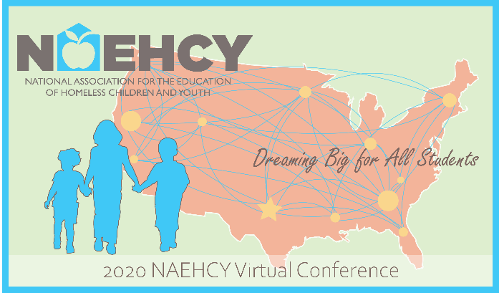
Where to go for help
CDE McKinney-Vento Webpage
Natural Disasters
National Center for Homeless Education (NCHE)
Liaison Toolkit
Quick Guide to Important Sections of McKinney-Vento Act
Understanding My LEA's Homeless Education Program
National Association for the Education of Homeless Children and Youth (NAEHCY)

