Slide 1
Overview of the Instructional Unit Samples
Colorado’s District Sample Curriculum Project
Stephanie Hartman
Social Studies Content Specialist, CDE
http://www.cde.state.co.us/standardsandinstruction

Slide 2
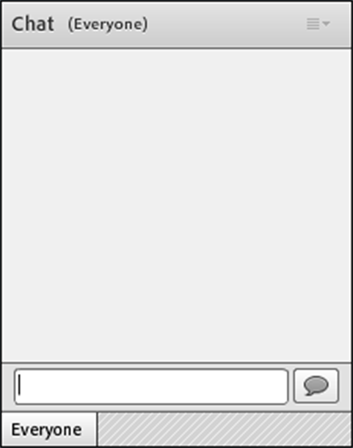
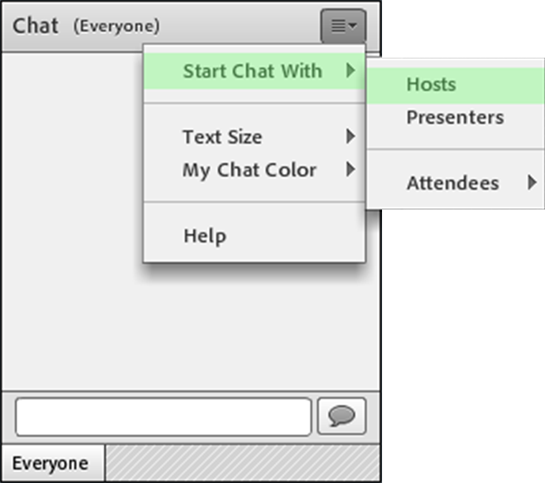
Navigating Adobe Connect
For a private Chat, choose person you want to contact in attendee list
Use Chat to share, respond to questions and ask questions

Slide 3
Webinar Goals
During this webinar, we will be using one instructional unit to explore:
  The processes utilized to create them
  The components of the units
  The possible next steps in utilizing these resources
As an introduction to the units, this webinar will not address:
  State summative assessments
  Educator evaluation
Please feel free to ask questions- I will address them at the end

Slide 4
Colorado District Sample Curriculum Project
Big Picture
From its beginning, the District Sample Curriculum Project has had a singular focus: to build the capacity of teachers to use their content expertise and passion for student learning to create samples that support teaching to student mastery of the Colorado Academic Standards.

Slide 5
Teacher-Authored Samples
Curriculum Overviews
  700+ unit overviews- all content areas (k-12)
  All samples coded to the Colorado Academic Standards-Ensuring attention to all Evidence Outcomes (indicators of mastery)
  Teacher/educator authorship and district affiliation noted at the bottom of every unit overview
  Samples available in PDF and Word formats on the Standards and Instructional Support website-by individual content area and grade level
  Videos detailing specific aspects of the unit overviews available as a resource
  Each sample provides an option for standards-based planning that emphasizes what students should understand, know, and be able to do at the end of a given unit of instruction

Slide 6
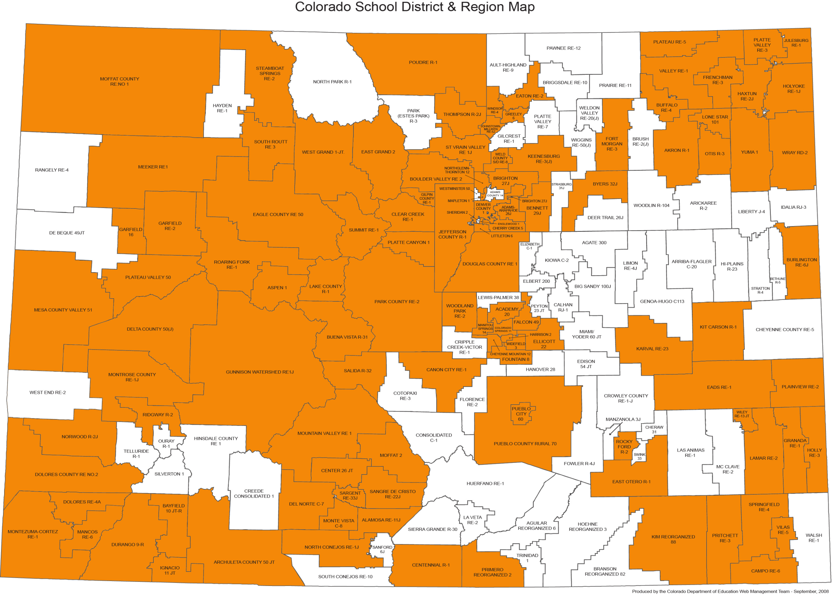
Colorado School District Map

Slide 7
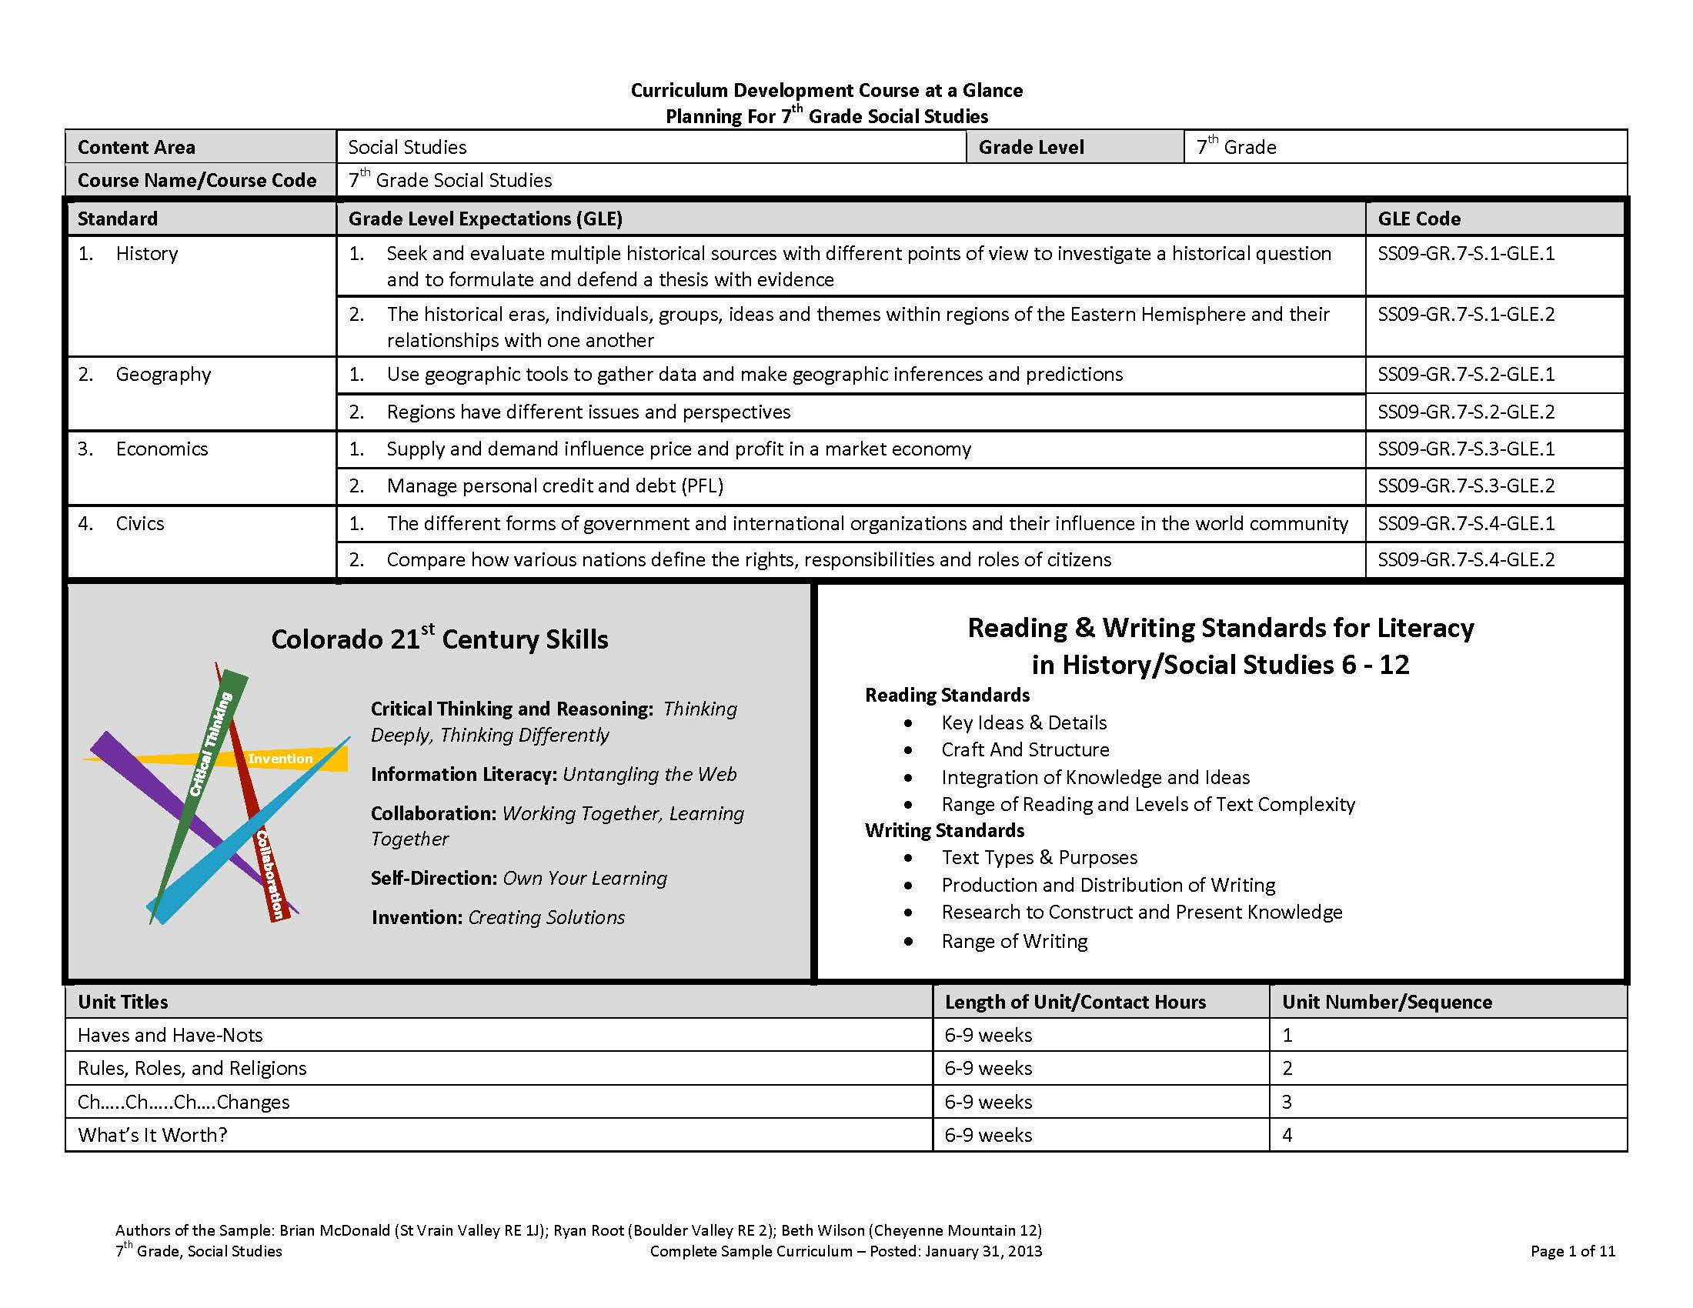

Slide 8
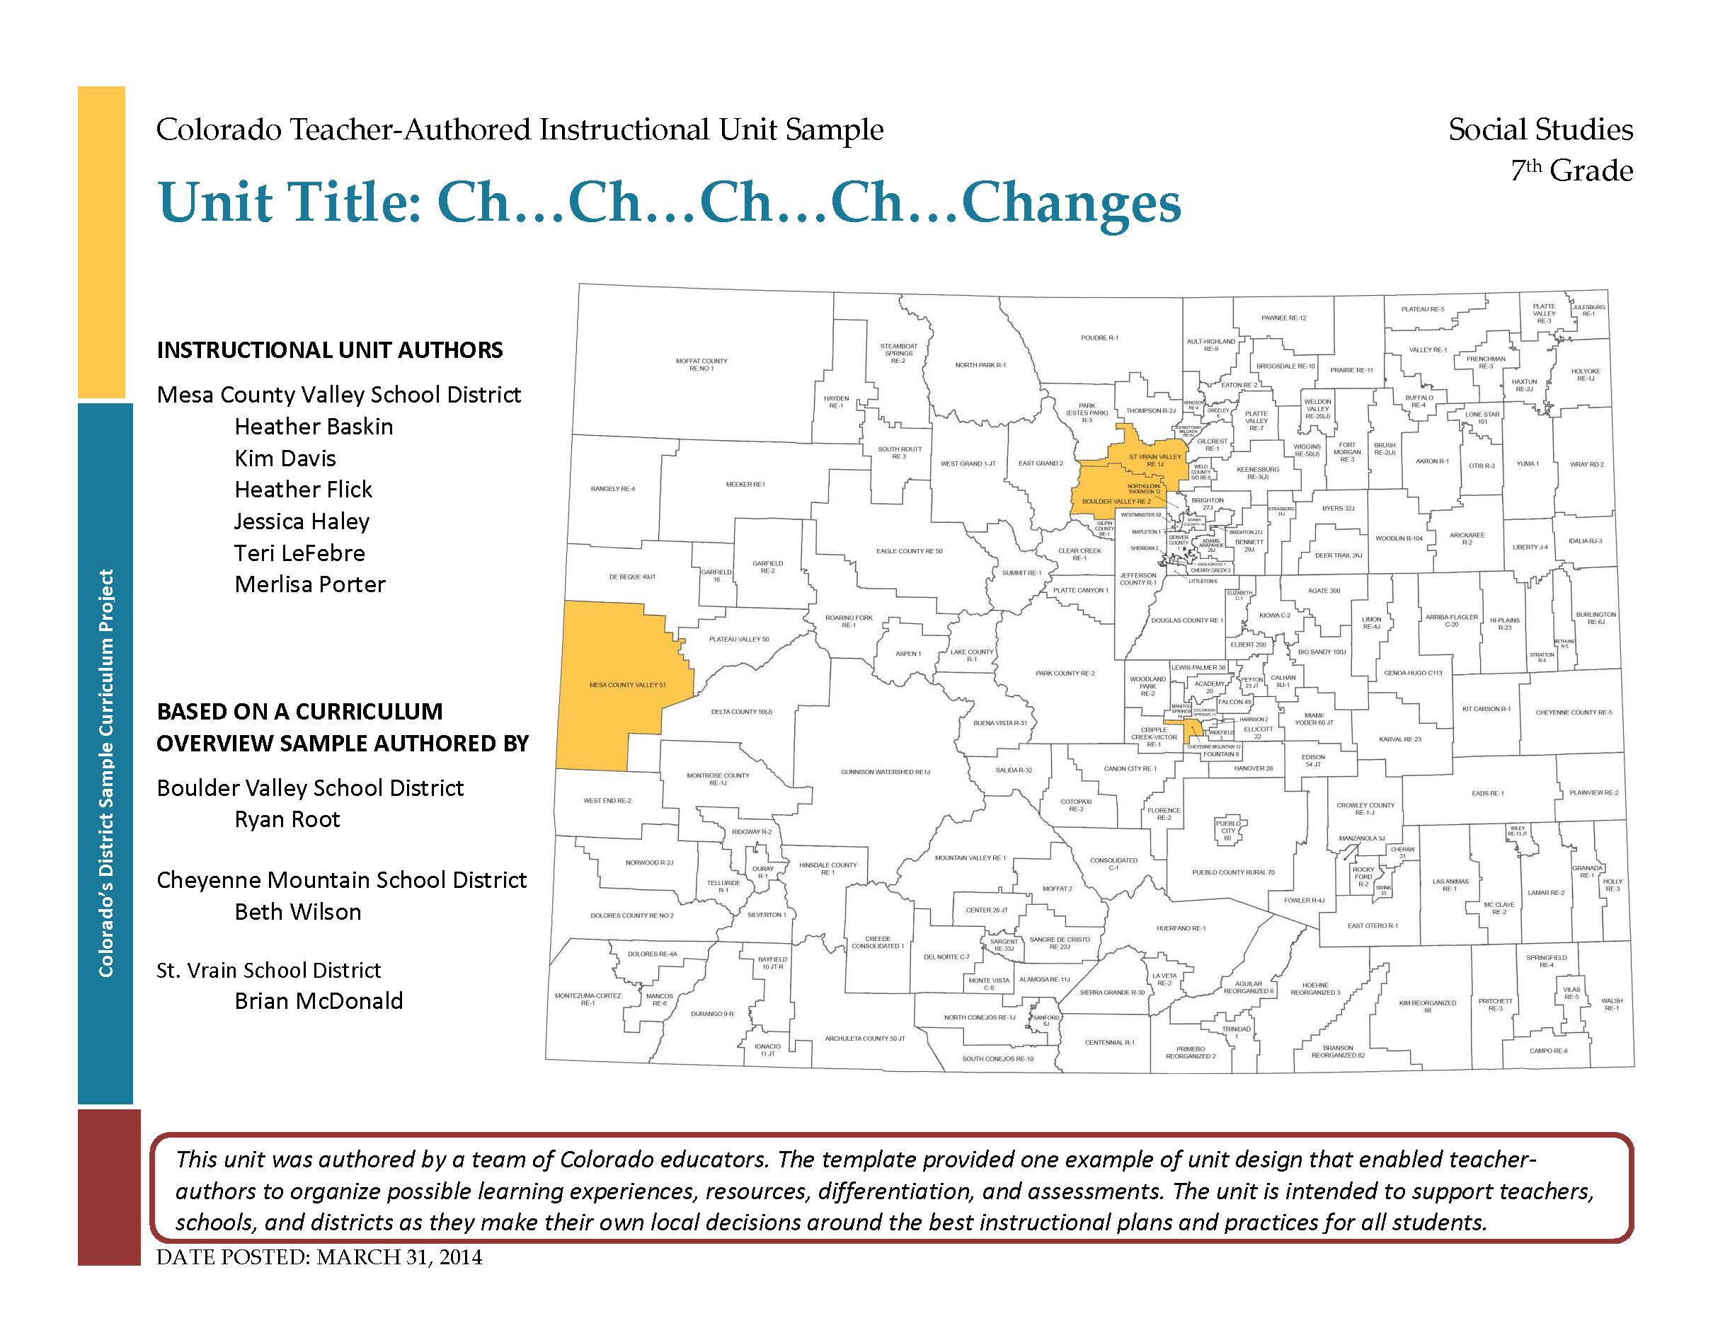

Slide 9
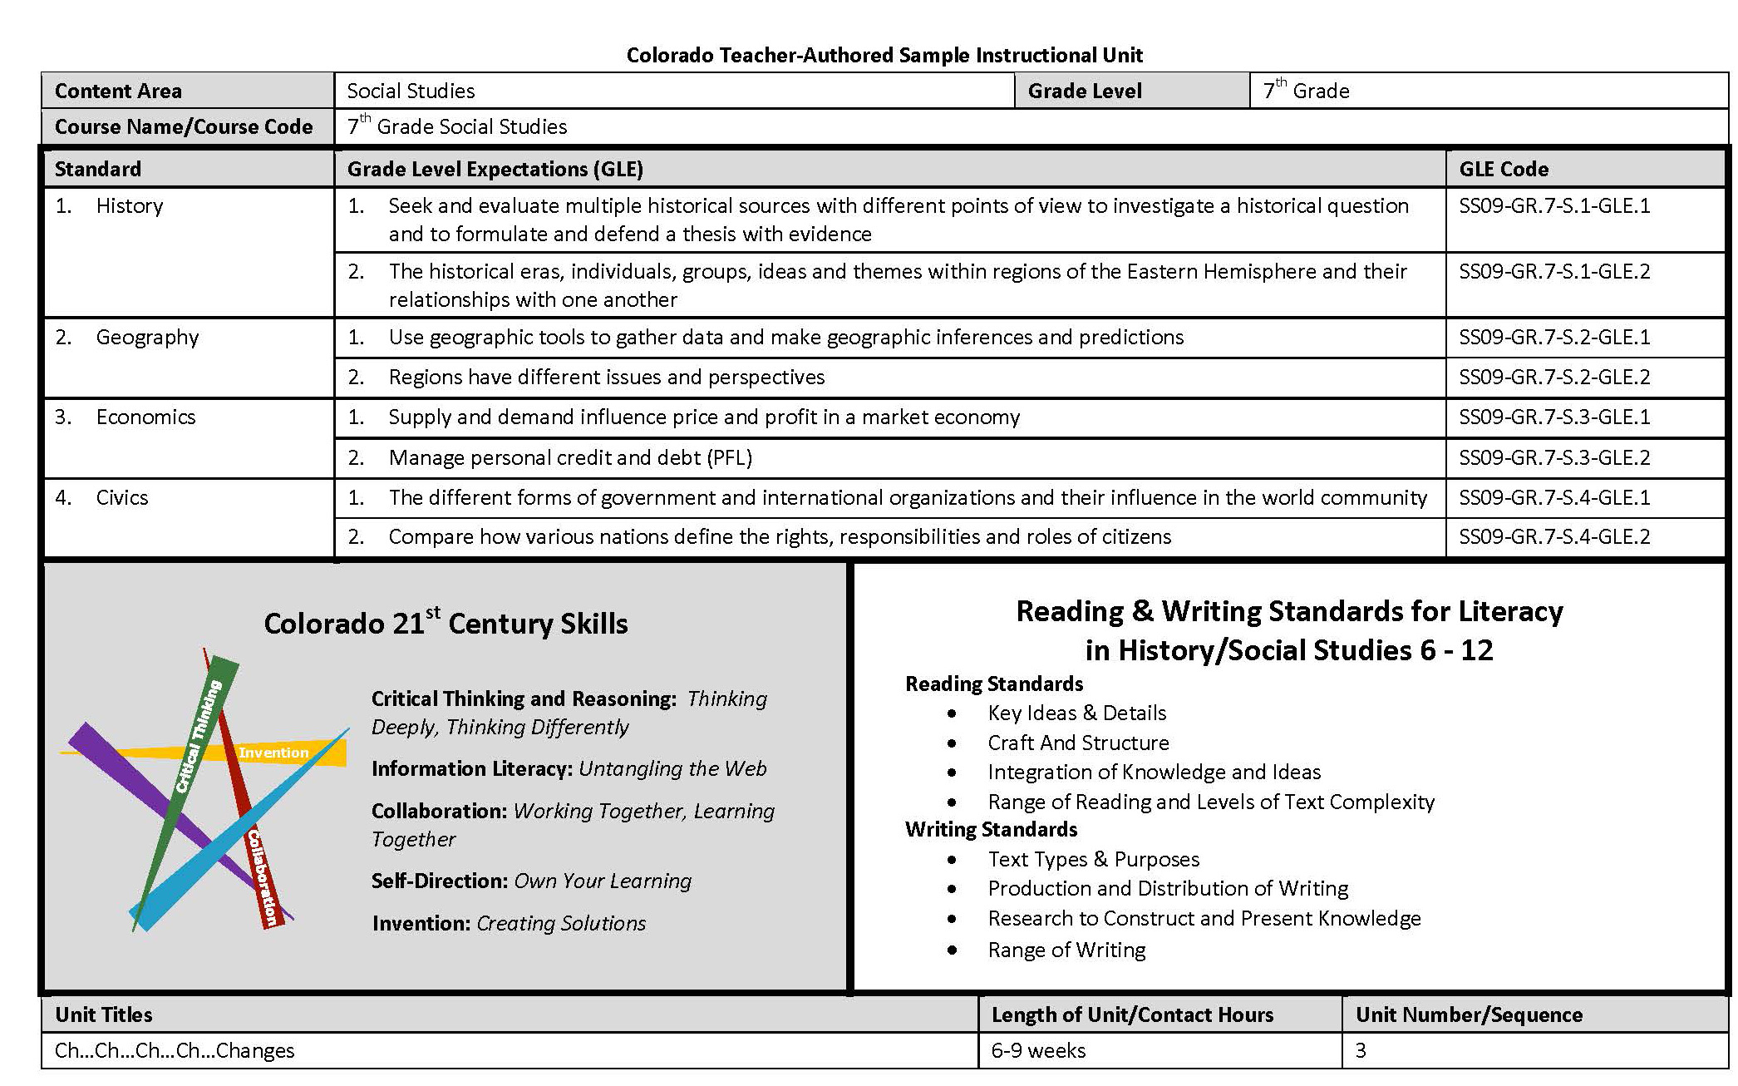
Notes:
Begin with course at a glance- in this case 4th grade social studies
Pre-populated with the standards and GLEs
Here’s a closer look at the economic standard for elementary SS and its 2 GLEs
Codes-Explain and highlight that these will recur throughout the document-visual illustration that ALL GLES and EOs are attended to within the units for a grade/content area
21st century skills cut across the standards Colorado's description of 21st century skills is a synthesis of the essential abilities students must apply in our fast changing world-emphasized and embedded across the standards

Slide 10
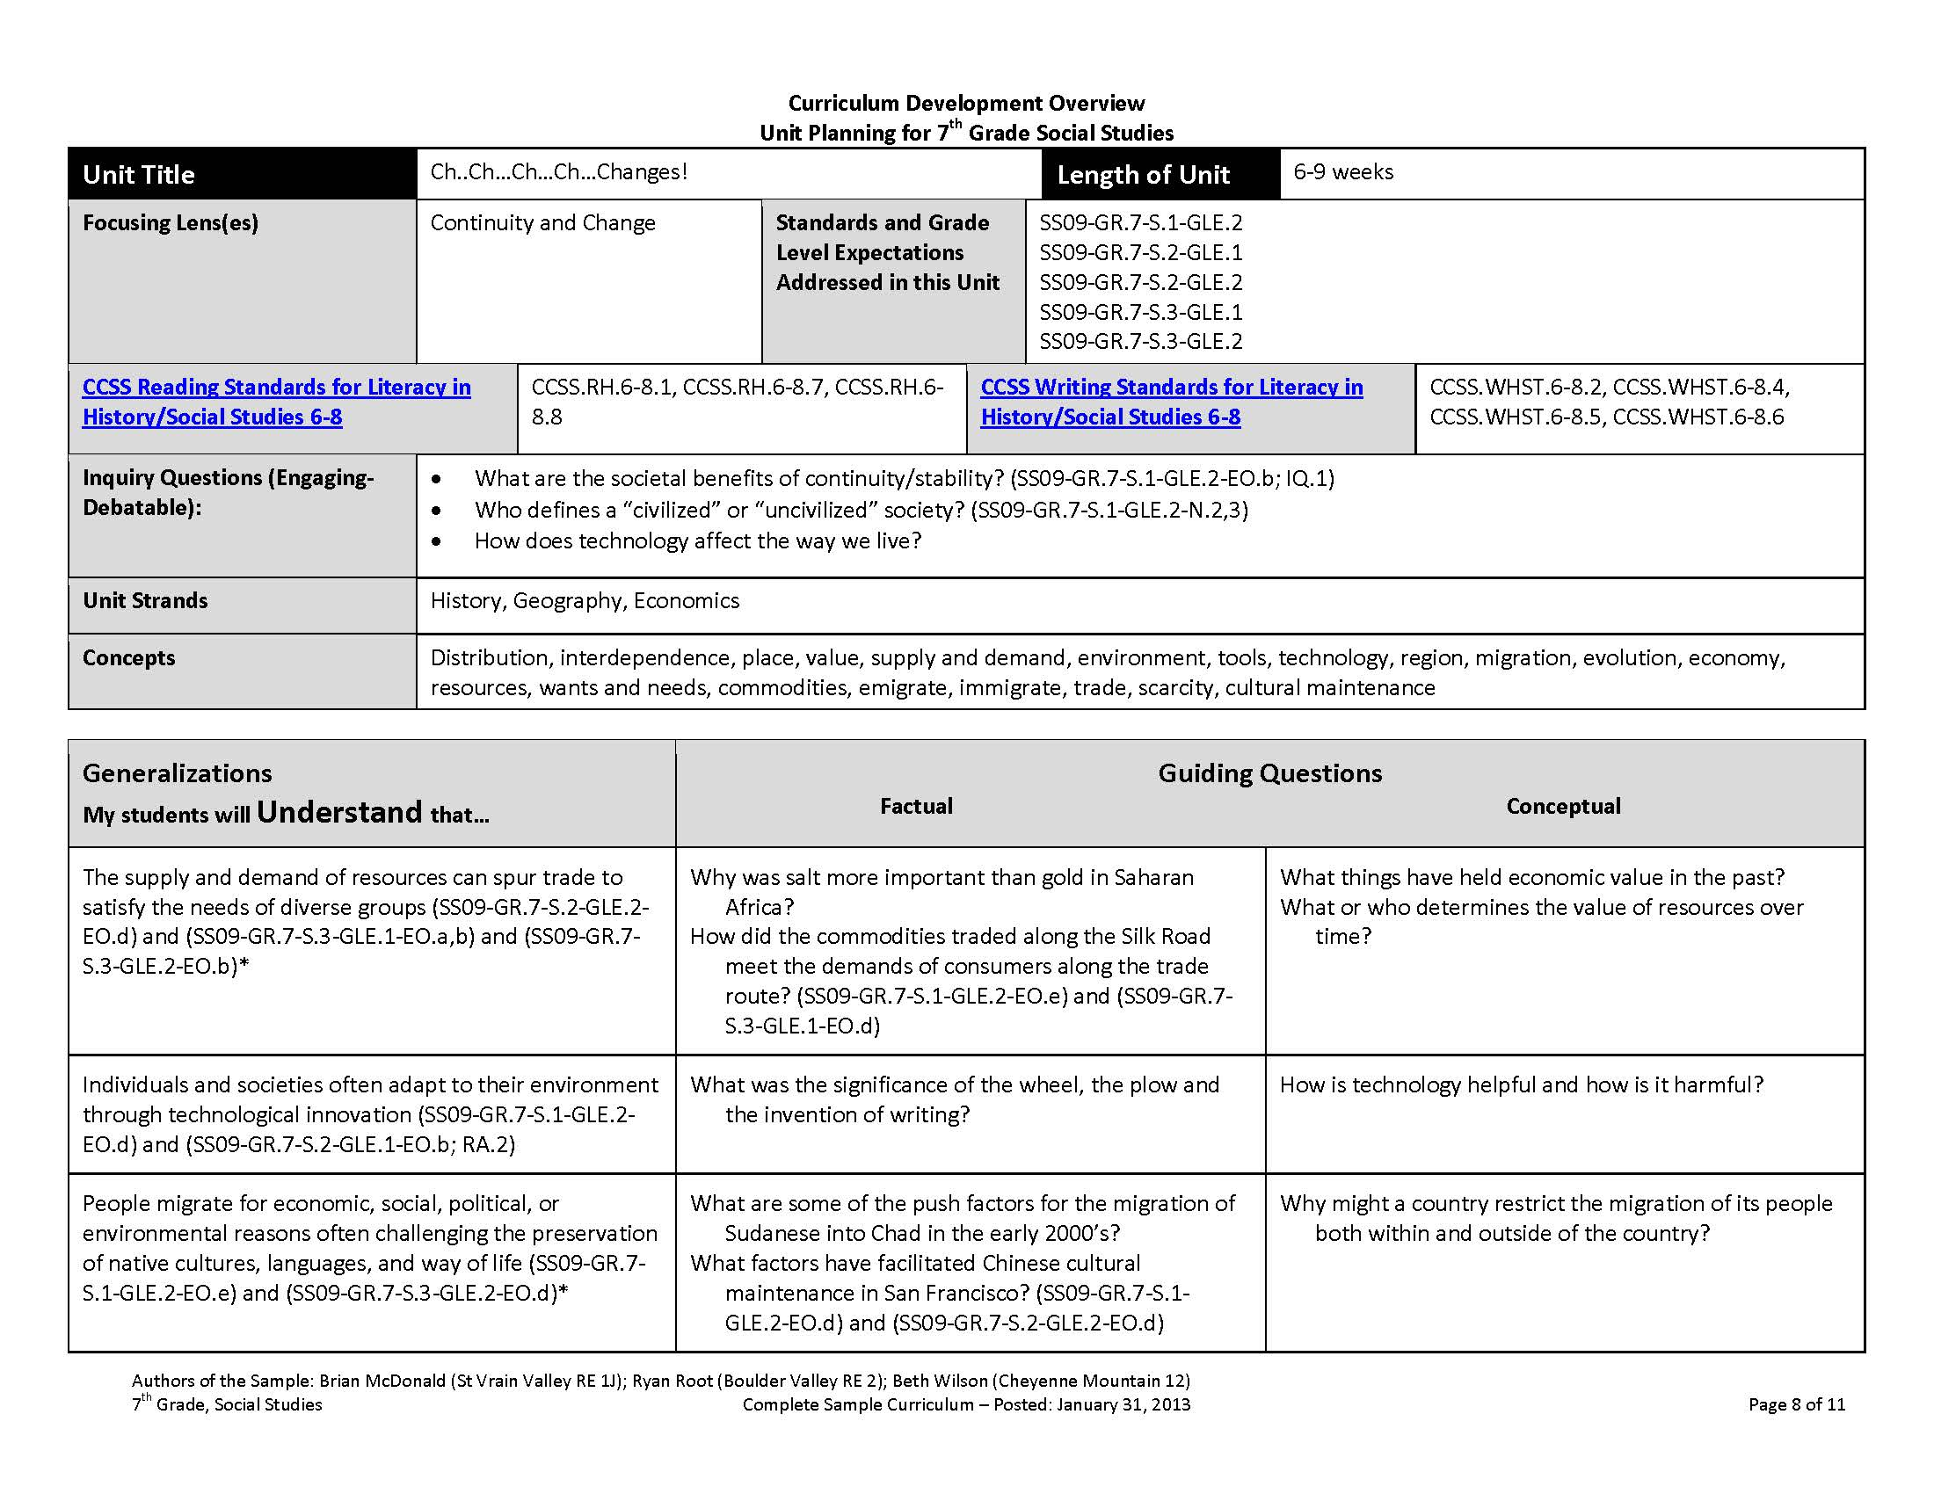
Notes:
Title
Length of unit
Standards and Grade Level Expectations
(Coding again….across the unit overview- coding illustrates the truly standards based nature of the units and will, eventually, add searchable and customizable options in the future postings of the samples)
Generalizations and associated guiding questions- The generalizations represent what students will understand as a result of the unit. In other words, the generalizations are the hoped-for outcomes that provide the basis for designing backwards the rest of the unit.
Right next to the generalizations are the guiding questions, both factual and conceptual, that represent inquiries directly linked to the generalizations/understandings.
Factual (Specific convergent content questions that have specific and/or right or wrong answers): What were the major cycles of Boom and Bust in Colorado over the past 150 years?
Conceptual (Broader divergent questions designed to provoke thoughtful, multiple, even subjective answers): How are personal or social values represented by the economic choices we make in our daily lives?
Both kinds of questions are essential for building those understandings, those generalizations.

Slide 11
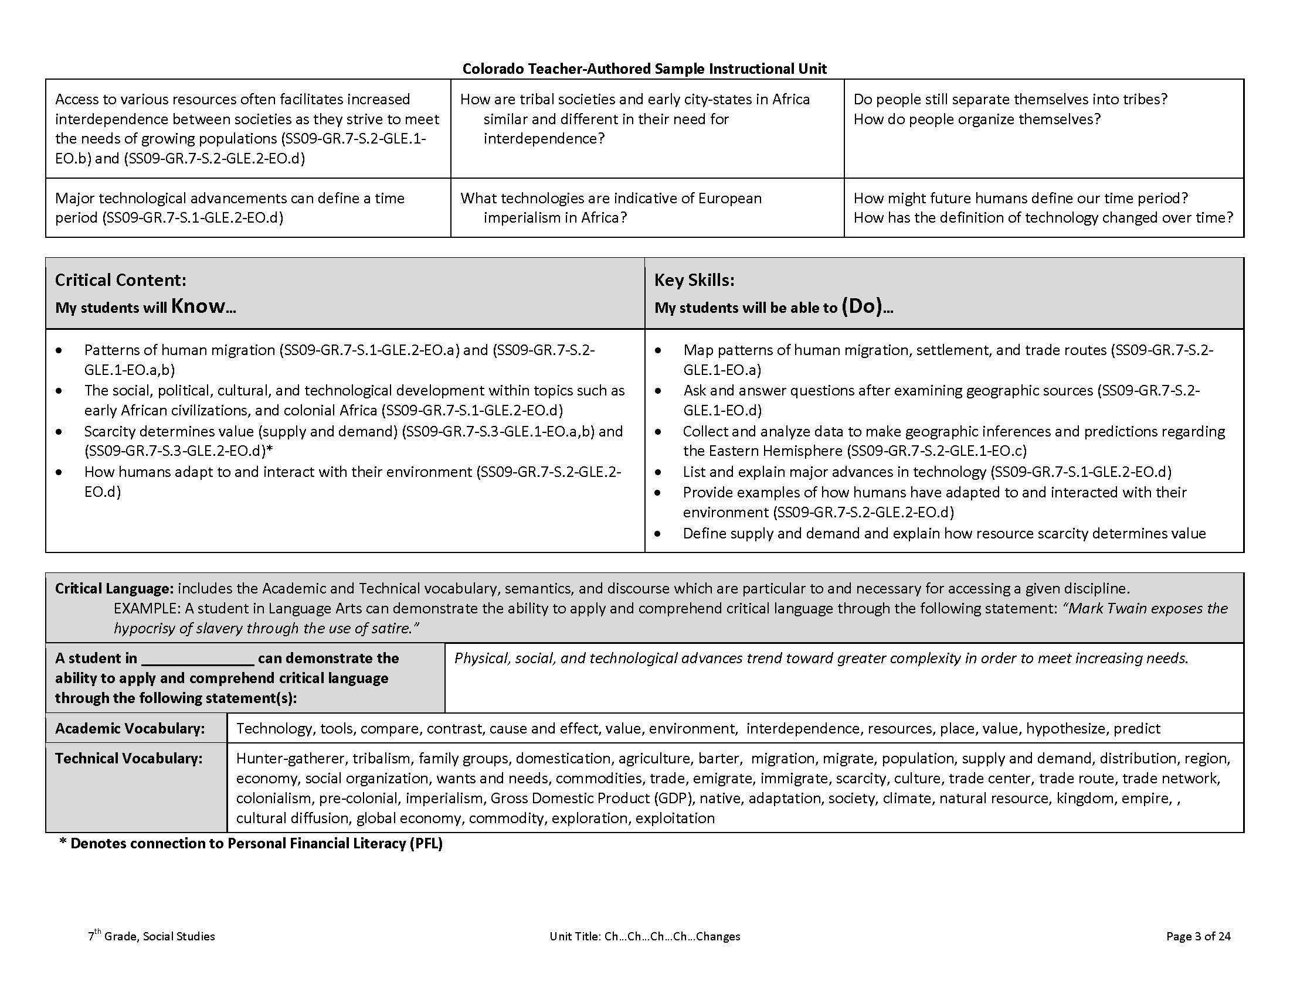
Notes:
Critical Content and Skills-Moving on, the next two major components highlight what students should know and be able to do
Knowledge or topics-The specific factual information and topics related to the unit focus and necessary for achieving the unit’s big understandings
Skills- Those abilities that will develop across the course of the unit and that transfer to work in other content areas
Example-Content The realities and impact of the Colorado Fur Trade and the Colorado Mining Industry (specific and locked to Colorado history)
Example-Skills Analyze cause and effect relationships between societal values/needs and individual lives, the physical environment, and the economy. (Analysis of Cause and Effect-transferable to all disciplines)

Slide 12
Project Overview
Lesson Plans will be the work of individual schools and teachers.
Lesson Plan
Standards
Lesson Plan
Instructional Unit Development
Lesson Plan
Unit Overview
Year At A Glance
(page 1)

Slide 13
The Samples Left Work to be Done….
As suggested sequencing resources, the Curriculum Overviews do NOT contain:
learning experiences
resources
assessment ideas
differentiation options

Slide 14
Teacher-Authored Samples
Instructional Units
During a three-day workshop a team of educators created an instructional unit designed to provide teachers with support for using their professional judgment to teach to student mastery of the standards-based generalizations, content, and skills of one selected overview.
Teams were typically comprised of:
  2 general education teachers (content specialists)
  1 ELL teacher
  1 Gifted and Talented teacher
  1 Special education teacher
  1 Title One teacher
  100+ units developed and published on March 31, 2014 (one for each grade k-12 mathematics, reading, writing, and communicating, science, social studies, comprehensive health, visual arts, drama/theatre, dance, and music).

Slide 15
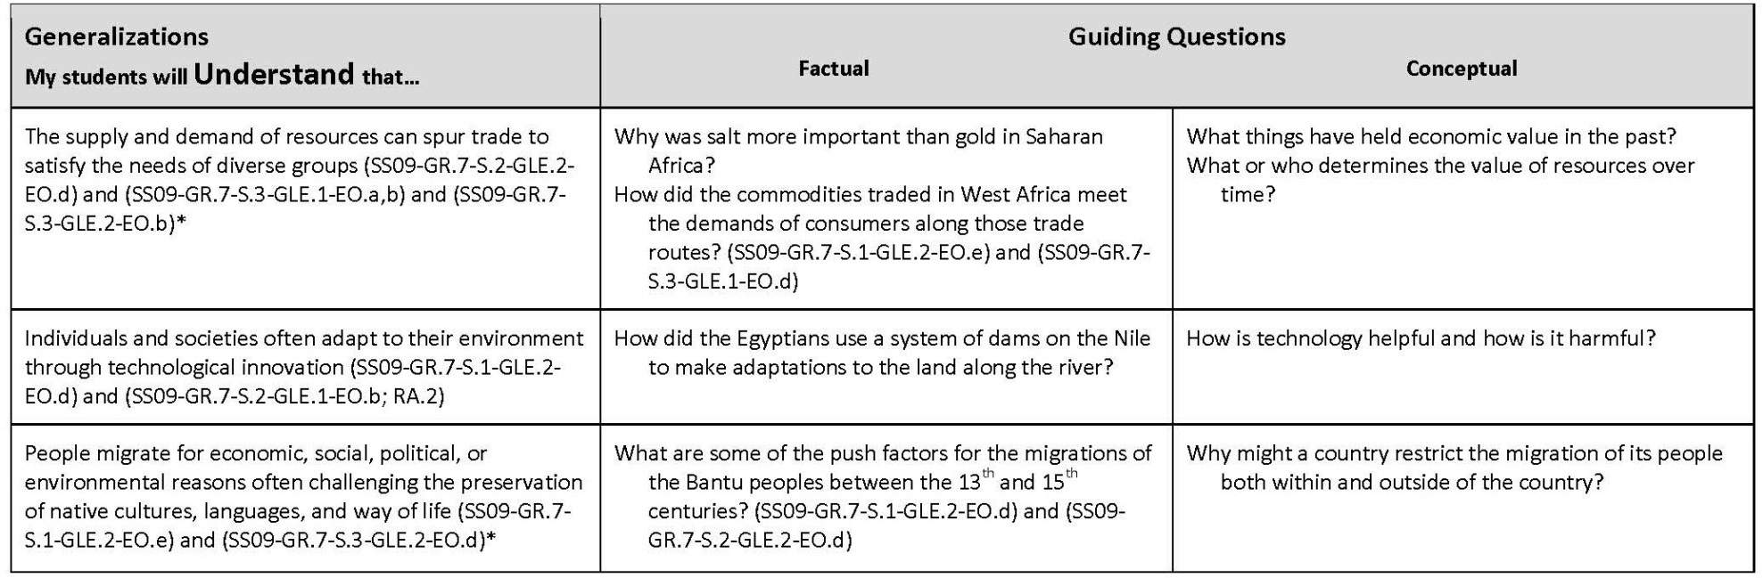
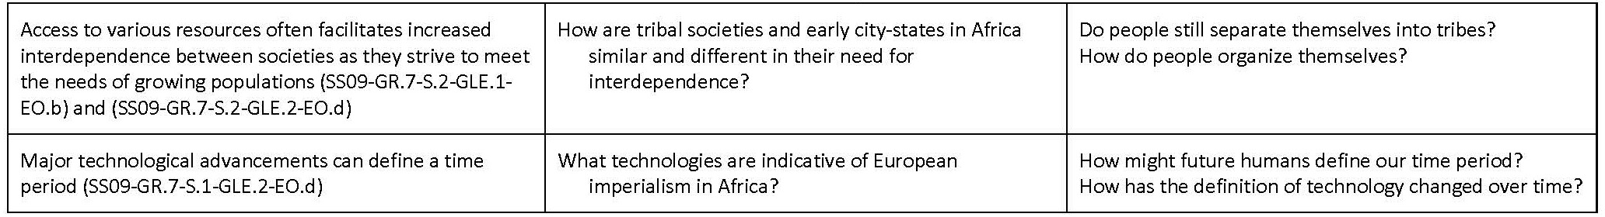
Generalizations: The Starting Point

Slide 16
The KEY Generalization- The all encompassing heart of the unit!
Key Generalization | People migrate for economic, social, political, or environmental reasons often challenging the preservation of native cultures, languages, and way of life
Supporting Generalizations | The supply and demand of resources can spur trade to satisfy the needs of diverse groups
 | Individuals and societies often adapt to their environment through technological innovation
 | Major technological advancements can define a time period
 | Access to various resources often facilitates increased interdependence between societies as they strive to meet the needs of growing populations

Slide 17
The Capstone Performance Assessment-R.A.F.T.
Key generalization-the basis for the creation of the PA (RAFT):
  Role: Who are you? A pilgrim? A soldier? The President?
  Audience: To whom are you writing/speaking/presenting? A political rally? A potential employer?
  Format: In what format are you writing/speaking/presenting? A letter? An advertisement? A speech?
  Topic: What are you writing/speaking/presenting about ?
    R: Citizen
    A: Congress
    F: Letter
    T: Taxation

Slide 18
Performance Assessment
R.A.F.T. | You and your fellow museum exhibit design team have been hired to create a special museum exhibit for the new Royal Museum of Africa in Denver. The focus of the special exhibit is on the migration of peoples in Africa. The grand opening of this special exhibit will be during the annual Night at the Museum event. The museum curator has requested the inclusion of the economic, social, political and/or environmental factors that influence the movement of people in and out of Africa, as well as the impact these movements have on native cultures.

Slide 19
Product/Evidence
Performance Assessment: The capstone/summative assessment for this unit.
Claims: (Key generalization(s) to be mastered and demonstrated through the capstone assessment.) | People migrate for economic, social, political, or environmental reasons often challenging the preservation of native cultures, languages, and way of life.
Stimulus Material: (Engaging scenario that includes role, audience, goal/outcome and explicitly connects the key generalization) | You and your fellow museum exhibit design team have been hired to create a special museum exhibit for the new Royal Museum of Africa in Denver. The focus of the special exhibit is on the migration of peoples in Africa. The grand opening of this special exhibit will be during the annual Night at the Museum event. The museum curator has requested the inclusion of the economic, social, political and/or environmental factors that influence the movement of people in and out of Africa, as well as the impact these movements have on native cultures.
Product/Evidence: (Expected product from students) | Students will create a virtual museum in groups of 3 - 4. Each group will create a regional exhibit for the museum. The focus of each exhibit will be on an era and/or region (e.g., Ancient Egypt (Middle-New Kingdoms), Kingdom of Ghana (1500 BC - 300 AD), The Rise of Islam (979 AD - 1214 AD), Colonial South Africa (19th Century), the Guinea Coast (17th & 18th Centuries), the Swahili Trading States (1215 AD – 1453 AD). Within each regional exhibit, there will be 4 rooms, each one focusing on a reason for migration (economic, social, political, and environmental) and an additional 5th room focusing on the impact of migration on native cultures. Each student will locate artifacts for display; write an explanation of the significance of the artifact for the time period and region; and justifications for why the artifact should be included in the exhibit.
Differentiation: (Multiple modes for student expression) | Students may develop their own virtual museum template or use one provided by the teacher. Students may choose to create a museum exhibit on poster board. http://christykeeler.com/EducationalVirtualMuseums.html (How to create Virtual Museums Using PowerPoint) http://www.timemaps.com/history/africa-1453ad (World History Maps: Africa History Timeline through Maps)
Product/Evidence: (Expected product from students) | Students will create a virtual museum in groups of 3 - 4. Each group will create a regional exhibit for the museum. The focus of each exhibit will be on an era and/or region (e.g., Ancient Egypt (Middle-New Kingdoms), Kingdom of Ghana (1500 BC - 300 AD), The Rise of Islam (979 AD - 1214 AD), Colonial South Africa (19th Century), the Guinea Coast (17th & 18th Centuries), the Swahili Trading States (1215 AD – 1453 AD). Within each regional exhibit, there will be 4 rooms, each one focusing on a reason for migration (economic, social, political, and environmental) and an additional 5th room focusing on the impact of migration on native cultures. Each student will locate artifacts for display; write an explanation of the significance of the artifact for the time period and region; and justifications for why the artifact should be included in the exhibit. This assessment will necessitate the creation of a rubric with a set of criteria to determine the degree to which a student's performance meets the expectations of the summative/capstone assessment. Here is an overview of the steps in developing a performance assessment rubric.

Slide 20
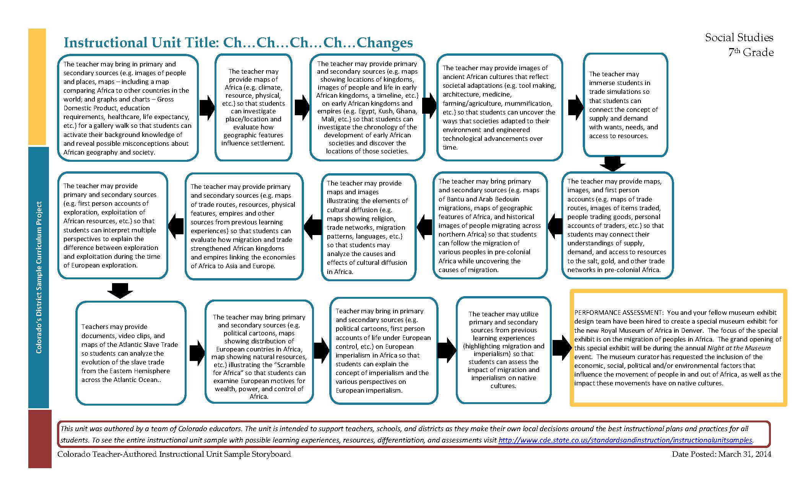
Unit Trajectory- Learning Experiences

Slide 21
Instructional Unit Learning Experiences
Task Description
Learning Experience # 1
The teacher may bring in primary and secondary sources (e.g. images of people and places, maps – including a map comparing Africa to other countries in the world; and graphs and charts – Gross Domestic Product, education requirements, healthcare, life expectancy, etc.) for a gallery walk so that students can activate their background knowledge of and reveal possible misconceptions about African geography and society.
Generalization Connection(s): | People migrate for economic, social, political, or environmental reasons often challenging the preservation of native cultures, languages, and way of life
Teacher Resources: | http://tinyurl.com/mlwldjk (Images of Africa from National Geographic Education) http://opendataforafrica.org/ngstkbe/africa-gdp-per-capita (Africa: GDP per capita) http://opendataforafrica.org/spcesjf/africa-duration-of-education (Africa: Duration of Education) http://www.wdl.org/en/search/?regions=africa (Regions of Africa from the World Digital Library) http://etc.usf.edu/maps/galleries/africa/complete/index.php (86 historical maps of Africa) http://flowingdata.com/2010/10/18/true-size-of-africa/ (Map comparison of Africa to world) http://kellogg.nd.edu/outreach/africares.shtml (General Information on Africa) http://www.worldtrek.org/odyssey/teachers/index.html (General Information on Africa) http://kellogg.nd.edu/outreach/ocobock.pdf (Maps and real images of the land and people from ancient times to today)
Student Resources: | http://www.worksheetworks.com/miscellanea/graphic-organizers/tchart.html (T-chart worksheet generator)
Assessment: | Students will write a brief reflection comparing their misconnections about Africa to their new knowledge about African geography and societies.
Differentiation: (Multiple means for students to access content and multiple modes for student to express understanding.) | Access (Resources and/or Process) | Expression (Products and/or Performance)
 | N/A | Students may verbalize what they’ve learned about Africa following the gallery walk
Extensions for depth and complexity: | Access (Resources and/or Process) | Expression (Products and/or Performance)
 | Students may explore factors that can contribute to societal misconceptions http://goafrica.about.com/od/peopleandculture/tp/Top-10-Myths-About-Africa.htm (Top 10 Myths about Africa) http://listverse.com/2011/12/15/top-10-misconceptions-about-africa/ (Misconceptions about Africa) http://aafroscandic.wordpress.com/2013/03/23/top-10-myths-about-africa-did-you-really-just-say-that-listen-to-yourself/ (Western myths and misconceptions about Africa) | Students may create a chart of misconceptions and document the origins of those misconceptions
Critical Content: | Physical geography of Africa (e.g., climate zones, land forms, water features, etc.) Examples of cultural aspects of various peoples in Africa such as clothing, religion, housing, language, jobs, foods, etc. Data on African countries including various data tables and statistical graphs such as GDP, education requirements, healthcare, life expectancy, etc.
Key Skills: | Analyze current maps of Africa, and charts and graphs of African information Question common beliefs about African society and geography Reassess generalizations using supporting evidence
Critical Language: | Primary source, culture, geography, environment, GDP, society, life expectancy, preservation of native language, climate, land form, religion
The teacher may bring in primary and secondary sources (e.g. images of people and places, maps – including a map comparing Africa to other countries in the world; and graphs and charts – Gross Domestic Product, education requirements, healthcare, life expectancy, etc.) for a gallery walk so that students can activate their background knowledge of and reveal possible misconceptions about African geography and society.

Slide 22
Instructional Unit Learning Experiences
Learning Experience # 1
The teacher may bring in primary and secondary sources (e.g. images of people and places, maps – including a map comparing Africa to other countries in the world; and graphs and charts – Gross Domestic Product, education requirements, healthcare, life expectancy, etc.) for a gallery walk so that students can activate their background knowledge of and reveal possible misconceptions about African geography and society.
Generalization Connection(s): | People migrate for economic, social, political, or environmental reasons often challenging the preservation of native cultures, languages, and way of life
Teacher Resources: | http://tinyurl.com/mlwldjk (Images of Africa from National Geographic Education) http://opendataforafrica.org/ngstkbe/africa-gdp-per-capita (Africa: GDP per capita) http://opendataforafrica.org/spcesjf/africa-duration-of-education (Africa: Duration of Education) http://www.wdl.org/en/search/?regions=africa (Regions of Africa from the World Digital Library) http://etc.usf.edu/maps/galleries/africa/complete/index.php (86 historical maps of Africa) http://flowingdata.com/2010/10/18/true-size-of-africa/ (Map comparison of Africa to world) http://kellogg.nd.edu/outreach/africares.shtml (General Information on Africa) http://www.worldtrek.org/odyssey/teachers/index.html (General Information on Africa) http://kellogg.nd.edu/outreach/ocobock.pdf (Maps and real images of the land and people from ancient times to today)
Student Resources: | http://www.worksheetworks.com/miscellanea/graphic-organizers/tchart.html (T-chart worksheet generator)
Assessment: | Students will write a brief reflection comparing their misconnections about Africa to their new knowledge about African geography and societies.
Differentiation: (Multiple means for students to access content and multiple modes for student to express understanding.) | Access (Resources and/or Process) | Expression (Products and/or Performance)
 | N/A | Students may verbalize what they’ve learned about Africa following the gallery walk
Extensions for depth and complexity: | Access (Resources and/or Process) | Expression (Products and/or Performance)
 | Students may explore factors that can contribute to societal misconceptions http://goafrica.about.com/od/peopleandculture/tp/Top-10-Myths-About-Africa.htm (Top 10 Myths about Africa) http://listverse.com/2011/12/15/top-10-misconceptions-about-africa/ (Misconceptions about Africa) http://aafroscandic.wordpress.com/2013/03/23/top-10-myths-about-africa-did-you-really-just-say-that-listen-to-yourself/ (Western myths and misconceptions about Africa) | Students may create a chart of misconceptions and document the origins of those misconceptions
Critical Content: | Physical geography of Africa (e.g., climate zones, land forms, water features, etc.) Examples of cultural aspects of various peoples in Africa such as clothing, religion, housing, language, jobs, foods, etc. Data on African countries including various data tables and statistical graphs such as GDP, education requirements, healthcare, life expectancy, etc.
Key Skills: | Analyze current maps of Africa, and charts and graphs of African information Question common beliefs about African society and geography Reassess generalizations using supporting evidence
Critical Language: | Primary source, culture, geography, environment, GDP, society, life expectancy, preservation of native language, climate, land form, religion
Generalization Connection(s): | People migrate for economic, social, political, or environmental reasons often challenging the preservation of native cultures, languages, and way of life

Slide 23
Instructional Unit Learning Experiences
Learning Experience # 1
The teacher may bring in primary and secondary sources (e.g. images of people and places, maps – including a map comparing Africa to other countries in the world; and graphs and charts – Gross Domestic Product, education requirements, healthcare, life expectancy, etc.) for a gallery walk so that students can activate their background knowledge of and reveal possible misconceptions about African geography and society.
Generalization Connection(s): | People migrate for economic, social, political, or environmental reasons often challenging the preservation of native cultures, languages, and way of life
Teacher Resources: | http://tinyurl.com/mlwldjk (Images of Africa from National Geographic Education) http://opendataforafrica.org/ngstkbe/africa-gdp-per-capita (Africa: GDP per capita) http://opendataforafrica.org/spcesjf/africa-duration-of-education (Africa: Duration of Education) http://www.wdl.org/en/search/?regions=africa (Regions of Africa from the World Digital Library) http://etc.usf.edu/maps/galleries/africa/complete/index.php (86 historical maps of Africa) http://flowingdata.com/2010/10/18/true-size-of-africa/ (Map comparison of Africa to world) http://kellogg.nd.edu/outreach/africares.shtml (General Information on Africa) http://www.worldtrek.org/odyssey/teachers/index.html (General Information on Africa) http://kellogg.nd.edu/outreach/ocobock.pdf (Maps and real images of the land and people from ancient times to today)
Student Resources: | http://www.worksheetworks.com/miscellanea/graphic-organizers/tchart.html (T-chart worksheet generator)
Assessment: | Students will write a brief reflection comparing their misconnections about Africa to their new knowledge about African geography and societies.
Differentiation: (Multiple means for students to access content and multiple modes for student to express understanding.) | Access (Resources and/or Process) | Expression (Products and/or Performance)
 | N/A | Students may verbalize what they’ve learned about Africa following the gallery walk
Extensions for depth and complexity: | Access (Resources and/or Process) | Expression (Products and/or Performance)
 | Students may explore factors that can contribute to societal misconceptions http://goafrica.about.com/od/peopleandculture/tp/Top-10-Myths-About-Africa.htm (Top 10 Myths about Africa) http://listverse.com/2011/12/15/top-10-misconceptions-about-africa/ (Misconceptions about Africa) http://aafroscandic.wordpress.com/2013/03/23/top-10-myths-about-africa-did-you-really-just-say-that-listen-to-yourself/ (Western myths and misconceptions about Africa) | Students may create a chart of misconceptions and document the origins of those misconceptions
Critical Content: | Physical geography of Africa (e.g., climate zones, land forms, water features, etc.) Examples of cultural aspects of various peoples in Africa such as clothing, religion, housing, language, jobs, foods, etc. Data on African countries including various data tables and statistical graphs such as GDP, education requirements, healthcare, life expectancy, etc.
Key Skills: | Analyze current maps of Africa, and charts and graphs of African information Question common beliefs about African society and geography Reassess generalizations using supporting evidence
Critical Language: | Primary source, culture, geography, environment, GDP, society, life expectancy, preservation of native language, climate, land form, religion
Teacher Resources: | http://tinyurl.com/mlwldjk (Images of Africa from National Geographic Education) http://opendataforafrica.org/ngstkbe/africa-gdp-per-capita (Africa: GDP per capita) http://opendataforafrica.org/spcesjf/africa-duration-of-education (Africa: Duration of Education) http://www.wdl.org/en/search/?regions=africa (Regions of Africa from the World Digital Library) http://etc.usf.edu/maps/galleries/africa/complete/index.php (86 historical maps of Africa) http://flowingdata.com/2010/10/18/true-size-of-africa/ (Map comparison of Africa to world) http://kellogg.nd.edu/outreach/africares.shtml (General Information on Africa) http://www.worldtrek.org/odyssey/teachers/index.html (General Information on Africa) http://kellogg.nd.edu/outreach/ocobock.pdf (Maps and real images of the land and people from ancient times to today)
Student Resources: | http://www.worksheetworks.com/miscellanea/graphic-organizers/tchart.html (T-chart worksheet generator)

Slide 24
Instructional Unit Learning Experiences
Learning Experience # 1
The teacher may bring in primary and secondary sources (e.g. images of people and places, maps – including a map comparing Africa to other countries in the world; and graphs and charts – Gross Domestic Product, education requirements, healthcare, life expectancy, etc.) for a gallery walk so that students can activate their background knowledge of and reveal possible misconceptions about African geography and society.
Generalization Connection(s): | People migrate for economic, social, political, or environmental reasons often challenging the preservation of native cultures, languages, and way of life
Teacher Resources: | http://tinyurl.com/mlwldjk (Images of Africa from National Geographic Education) http://opendataforafrica.org/ngstkbe/africa-gdp-per-capita (Africa: GDP per capita) http://opendataforafrica.org/spcesjf/africa-duration-of-education (Africa: Duration of Education) http://www.wdl.org/en/search/?regions=africa (Regions of Africa from the World Digital Library) http://etc.usf.edu/maps/galleries/africa/complete/index.php (86 historical maps of Africa) http://flowingdata.com/2010/10/18/true-size-of-africa/ (Map comparison of Africa to world) http://kellogg.nd.edu/outreach/africares.shtml (General Information on Africa) http://www.worldtrek.org/odyssey/teachers/index.html (General Information on Africa) http://kellogg.nd.edu/outreach/ocobock.pdf (Maps and real images of the land and people from ancient times to today)
Student Resources: | http://www.worksheetworks.com/miscellanea/graphic-organizers/tchart.html (T-chart worksheet generator)
Assessment: | Students will write a brief reflection comparing their misconnections about Africa to their new knowledge about African geography and societies.
Differentiation: (Multiple means for students to access content and multiple modes for student to express understanding.) | Access (Resources and/or Process) | Expression (Products and/or Performance)
 | N/A | Students may verbalize what they’ve learned about Africa following the gallery walk
Extensions for depth and complexity: | Access (Resources and/or Process) | Expression (Products and/or Performance)
 | Students may explore factors that can contribute to societal misconceptions http://goafrica.about.com/od/peopleandculture/tp/Top-10-Myths-About-Africa.htm (Top 10 Myths about Africa) http://listverse.com/2011/12/15/top-10-misconceptions-about-africa/ (Misconceptions about Africa) http://aafroscandic.wordpress.com/2013/03/23/top-10-myths-about-africa-did-you-really-just-say-that-listen-to-yourself/ (Western myths and misconceptions about Africa) | Students may create a chart of misconceptions and document the origins of those misconceptions
Critical Content: | Physical geography of Africa (e.g., climate zones, land forms, water features, etc.) Examples of cultural aspects of various peoples in Africa such as clothing, religion, housing, language, jobs, foods, etc. Data on African countries including various data tables and statistical graphs such as GDP, education requirements, healthcare, life expectancy, etc.
Key Skills: | Analyze current maps of Africa, and charts and graphs of African information Question common beliefs about African society and geography Reassess generalizations using supporting evidence
Critical Language: | Primary source, culture, geography, environment, GDP, society, life expectancy, preservation of native language, climate, land form, religion
Assessment: | Students will write a brief reflection comparing their misconceptions about Africa to their new knowledge about African geography and societies.

Slide 25
Instructional Unit Learning Experiences
Learning Experience # 1
The teacher may bring in primary and secondary sources (e.g. images of people and places, maps – including a map comparing Africa to other countries in the world; and graphs and charts – Gross Domestic Product, education requirements, healthcare, life expectancy, etc.) for a gallery walk so that students can activate their background knowledge of and reveal possible misconceptions about African geography and society.
Generalization Connection(s): | People migrate for economic, social, political, or environmental reasons often challenging the preservation of native cultures, languages, and way of life
Teacher Resources: | http://tinyurl.com/mlwldjk (Images of Africa from National Geographic Education) http://opendataforafrica.org/ngstkbe/africa-gdp-per-capita (Africa: GDP per capita) http://opendataforafrica.org/spcesjf/africa-duration-of-education (Africa: Duration of Education) http://www.wdl.org/en/search/?regions=africa (Regions of Africa from the World Digital Library) http://etc.usf.edu/maps/galleries/africa/complete/index.php (86 historical maps of Africa) http://flowingdata.com/2010/10/18/true-size-of-africa/ (Map comparison of Africa to world) http://kellogg.nd.edu/outreach/africares.shtml (General Information on Africa) http://www.worldtrek.org/odyssey/teachers/index.html (General Information on Africa) http://kellogg.nd.edu/outreach/ocobock.pdf (Maps and real images of the land and people from ancient times to today)
Student Resources: | http://www.worksheetworks.com/miscellanea/graphic-organizers/tchart.html (T-chart worksheet generator)
Assessment: | Students will write a brief reflection comparing their misconnections about Africa to their new knowledge about African geography and societies.
Differentiation: (Multiple means for students to access content and multiple modes for student to express understanding.) | Access (Resources and/or Process) | Expression (Products and/or Performance)
 | N/A | Students may verbalize what they’ve learned about Africa following the gallery walk
Extensions for depth and complexity: | Access (Resources and/or Process) | Expression (Products and/or Performance)
 | Students may explore factors that can contribute to societal misconceptions http://goafrica.about.com/od/peopleandculture/tp/Top-10-Myths-About-Africa.htm (Top 10 Myths about Africa) http://listverse.com/2011/12/15/top-10-misconceptions-about-africa/ (Misconceptions about Africa) http://aafroscandic.wordpress.com/2013/03/23/top-10-myths-about-africa-did-you-really-just-say-that-listen-to-yourself/ (Western myths and misconceptions about Africa) | Students may create a chart of misconceptions and document the origins of those misconceptions
Critical Content: | Physical geography of Africa (e.g., climate zones, land forms, water features, etc.) Examples of cultural aspects of various peoples in Africa such as clothing, religion, housing, language, jobs, foods, etc. Data on African countries including various data tables and statistical graphs such as GDP, education requirements, healthcare, life expectancy, etc.
Key Skills: | Analyze current maps of Africa, and charts and graphs of African information Question common beliefs about African society and geography Reassess generalizations using supporting evidence
Critical Language: | Primary source, culture, geography, environment, GDP, society, life expectancy, preservation of native language, climate, land form, religion
Differentiation: (Multiple means for students to access content and multiple modes for student to express understanding.) | Access (Resources and/or Process) | Expression (Products and/or Performance)
 | N/A | Students may verbalize what they’ve learned about Africa following the gallery walk
Extensions for depth and complexity: | Access (Resources and/or Process) | Expression (Products and/or Performance)
 | Students may explore factors that can contribute to societal misconceptions http://goafrica.about.com/od/peopleandculture/tp/Top-10-Myths-About-Africa.htm (Top 10 Myths about Africa) http://listverse.com/2011/12/15/top-10-misconceptions-about-africa/ (Misconceptions about Africa) http://aafroscandic.wordpress.com/2013/03/23/top-10-myths-about-africa-did-you-really-just-say-that-listen-to-yourself/ (Western myths and misconceptions about Africa) | Students may create a chart of misconceptions and document the origins of those misconceptions

Slide 26
Instructional Unit Learning Experiences
Learning Experience # 1
The teacher may bring in primary and secondary sources (e.g. images of people and places, maps – including a map comparing Africa to other countries in the world; and graphs and charts – Gross Domestic Product, education requirements, healthcare, life expectancy, etc.) for a gallery walk so that students can activate their background knowledge of and reveal possible misconceptions about African geography and society.
Generalization Connection(s): | People migrate for economic, social, political, or environmental reasons often challenging the preservation of native cultures, languages, and way of life
Teacher Resources: | http://tinyurl.com/mlwldjk (Images of Africa from National Geographic Education) http://opendataforafrica.org/ngstkbe/africa-gdp-per-capita (Africa: GDP per capita) http://opendataforafrica.org/spcesjf/africa-duration-of-education (Africa: Duration of Education) http://www.wdl.org/en/search/?regions=africa (Regions of Africa from the World Digital Library) http://etc.usf.edu/maps/galleries/africa/complete/index.php (86 historical maps of Africa) http://flowingdata.com/2010/10/18/true-size-of-africa/ (Map comparison of Africa to world) http://kellogg.nd.edu/outreach/africares.shtml (General Information on Africa) http://www.worldtrek.org/odyssey/teachers/index.html (General Information on Africa) http://kellogg.nd.edu/outreach/ocobock.pdf (Maps and real images of the land and people from ancient times to today)
Student Resources: | http://www.worksheetworks.com/miscellanea/graphic-organizers/tchart.html (T-chart worksheet generator)
Assessment: | Students will write a brief reflection comparing their misconnections about Africa to their new knowledge about African geography and societies.
Differentiation: (Multiple means for students to access content and multiple modes for student to express understanding.) | Access (Resources and/or Process) | Expression (Products and/or Performance)
 | N/A | Students may verbalize what they’ve learned about Africa following the gallery walk
Extensions for depth and complexity: | Access (Resources and/or Process) | Expression (Products and/or Performance)
 | Students may explore factors that can contribute to societal misconceptions http://goafrica.about.com/od/peopleandculture/tp/Top-10-Myths-About-Africa.htm (Top 10 Myths about Africa) http://listverse.com/2011/12/15/top-10-misconceptions-about-africa/ (Misconceptions about Africa) http://aafroscandic.wordpress.com/2013/03/23/top-10-myths-about-africa-did-you-really-just-say-that-listen-to-yourself/ (Western myths and misconceptions about Africa) | Students may create a chart of misconceptions and document the origins of those misconceptions
Critical Content: | Physical geography of Africa (e.g., climate zones, land forms, water features, etc.) Examples of cultural aspects of various peoples in Africa such as clothing, religion, housing, language, jobs, foods, etc. Data on African countries including various data tables and statistical graphs such as GDP, education requirements, healthcare, life expectancy, etc.
Key Skills: | Analyze current maps of Africa, and charts and graphs of African information Question common beliefs about African society and geography Reassess generalizations using supporting evidence
Critical Language: | Primary source, culture, geography, environment, GDP, society, life expectancy, preservation of native language, climate, land form, religion
Critical Content: | Physical geography of Africa (e.g., climate zones, land forms, water features, etc.) Examples of cultural aspects of various peoples in Africa such as clothing, religion, housing, language, jobs, foods, etc. Data on African countries including various data tables and statistical graphs such as GDP, education requirements, healthcare, life expectancy, etc.

Slide 27
Instructional Unit Learning Experiences
Learning Experience # 1
The teacher may bring in primary and secondary sources (e.g. images of people and places, maps – including a map comparing Africa to other countries in the world; and graphs and charts – Gross Domestic Product, education requirements, healthcare, life expectancy, etc.) for a gallery walk so that students can activate their background knowledge of and reveal possible misconceptions about African geography and society.
Generalization Connection(s): | People migrate for economic, social, political, or environmental reasons often challenging the preservation of native cultures, languages, and way of life
Teacher Resources: | http://tinyurl.com/mlwldjk (Images of Africa from National Geographic Education) http://opendataforafrica.org/ngstkbe/africa-gdp-per-capita (Africa: GDP per capita) http://opendataforafrica.org/spcesjf/africa-duration-of-education (Africa: Duration of Education) http://www.wdl.org/en/search/?regions=africa (Regions of Africa from the World Digital Library) http://etc.usf.edu/maps/galleries/africa/complete/index.php (86 historical maps of Africa) http://flowingdata.com/2010/10/18/true-size-of-africa/ (Map comparison of Africa to world) http://kellogg.nd.edu/outreach/africares.shtml (General Information on Africa) http://www.worldtrek.org/odyssey/teachers/index.html (General Information on Africa) http://kellogg.nd.edu/outreach/ocobock.pdf (Maps and real images of the land and people from ancient times to today)
Student Resources: | http://www.worksheetworks.com/miscellanea/graphic-organizers/tchart.html (T-chart worksheet generator)
Assessment: | Students will write a brief reflection comparing their misconnections about Africa to their new knowledge about African geography and societies.
Differentiation: (Multiple means for students to access content and multiple modes for student to express understanding.) | Access (Resources and/or Process) | Expression (Products and/or Performance)
 | N/A | Students may verbalize what they’ve learned about Africa following the gallery walk
Extensions for depth and complexity: | Access (Resources and/or Process) | Expression (Products and/or Performance)
 | Students may explore factors that can contribute to societal misconceptions http://goafrica.about.com/od/peopleandculture/tp/Top-10-Myths-About-Africa.htm (Top 10 Myths about Africa) http://listverse.com/2011/12/15/top-10-misconceptions-about-africa/ (Misconceptions about Africa) http://aafroscandic.wordpress.com/2013/03/23/top-10-myths-about-africa-did-you-really-just-say-that-listen-to-yourself/ (Western myths and misconceptions about Africa) | Students may create a chart of misconceptions and document the origins of those misconceptions
Critical Content: | Physical geography of Africa (e.g., climate zones, land forms, water features, etc.) Examples of cultural aspects of various peoples in Africa such as clothing, religion, housing, language, jobs, foods, etc. Data on African countries including various data tables and statistical graphs such as GDP, education requirements, healthcare, life expectancy, etc.
Key Skills: | Analyze current maps of Africa, and charts and graphs of African information Question common beliefs about African society and geography Reassess generalizations using supporting evidence
Critical Language: | Primary source, culture, geography, environment, GDP, society, life expectancy, preservation of native language, climate, land form, religion
Key Skills: | Analyze current maps of Africa, and charts and graphs of African information Question common beliefs about African society and geography Reassess generalizations using supporting evidence

Slide 28
Instructional Unit Learning Experiences
Learning Experience # 1
The teacher may bring in primary and secondary sources (e.g. images of people and places, maps – including a map comparing Africa to other countries in the world; and graphs and charts – Gross Domestic Product, education requirements, healthcare, life expectancy, etc.) for a gallery walk so that students can activate their background knowledge of and reveal possible misconceptions about African geography and society.
Generalization Connection(s): | People migrate for economic, social, political, or environmental reasons often challenging the preservation of native cultures, languages, and way of life
Teacher Resources: | http://tinyurl.com/mlwldjk (Images of Africa from National Geographic Education) http://opendataforafrica.org/ngstkbe/africa-gdp-per-capita (Africa: GDP per capita) http://opendataforafrica.org/spcesjf/africa-duration-of-education (Africa: Duration of Education) http://www.wdl.org/en/search/?regions=africa (Regions of Africa from the World Digital Library) http://etc.usf.edu/maps/galleries/africa/complete/index.php (86 historical maps of Africa) http://flowingdata.com/2010/10/18/true-size-of-africa/ (Map comparison of Africa to world) http://kellogg.nd.edu/outreach/africares.shtml (General Information on Africa) http://www.worldtrek.org/odyssey/teachers/index.html (General Information on Africa) http://kellogg.nd.edu/outreach/ocobock.pdf (Maps and real images of the land and people from ancient times to today)
Student Resources: | http://www.worksheetworks.com/miscellanea/graphic-organizers/tchart.html (T-chart worksheet generator)
Assessment: | Students will write a brief reflection comparing their misconnections about Africa to their new knowledge about African geography and societies.
Differentiation: (Multiple means for students to access content and multiple modes for student to express understanding.) | Access (Resources and/or Process) | Expression (Products and/or Performance)
 | N/A | Students may verbalize what they’ve learned about Africa following the gallery walk
Extensions for depth and complexity: | Access (Resources and/or Process) | Expression (Products and/or Performance)
 | Students may explore factors that can contribute to societal misconceptions http://goafrica.about.com/od/peopleandculture/tp/Top-10-Myths-About-Africa.htm (Top 10 Myths about Africa) http://listverse.com/2011/12/15/top-10-misconceptions-about-africa/ (Misconceptions about Africa) http://aafroscandic.wordpress.com/2013/03/23/top-10-myths-about-africa-did-you-really-just-say-that-listen-to-yourself/ (Western myths and misconceptions about Africa) | Students may create a chart of misconceptions and document the origins of those misconceptions
Critical Content: | Physical geography of Africa (e.g., climate zones, land forms, water features, etc.) Examples of cultural aspects of various peoples in Africa such as clothing, religion, housing, language, jobs, foods, etc. Data on African countries including various data tables and statistical graphs such as GDP, education requirements, healthcare, life expectancy, etc.
Key Skills: | Analyze current maps of Africa, and charts and graphs of African information Question common beliefs about African society and geography Reassess generalizations using supporting evidence
Critical Language: | Primary source, culture, geography, environment, GDP, society, life expectancy, preservation of native language, climate, land form, religion
Critical Language: | Primary source, culture, geography, environment, GDP, society, life expectancy, preservation of native language, climate, land form, religion

Slide 29
Ongoing Learning Experiences
5. | Description: | Think/work like a historian by sorting, organizing and classifying primary and secondary resources chronologically | Teacher Resources: | http://www.loc.gov/teachers/usingprimarysources/resources/Analyzing_Books_and_Other_Printed_Texts.pdf (Analyzing Books and Other Printed Texts Worksheet from the Library of Congress) http://www.educationoasis.com/curriculum/GO/sequence.htm (Chain of Events Graphic Organizer) http://www.umbc.edu/che/tahlessons/pdf/historylabs/In_What_Ways_We_faculty:RS20.pdf (Chronological Graphic Organizer)
 |  |  | Student Resources: | http://www.loc.gov/teachers/usingprimarysources/resources/Analyzing_Books_and_Other_Printed_Texts.pdf (Analyzing Books and Other Printed Texts Worksheet from the Library of Congress) http://www.educationoasis.com/curriculum/GO/sequence.htm (Chain of Events Graphic Organizer) http://www.umbc.edu/che/tahlessons/pdf/historylabs/In_What_Ways_We_faculty:RS20.pdf (Chronological Graphic Organizer)
 | Skills: | Gather and organize historical content into a chronological order | Assessment: | Students will create multiple timelines.
6. | Description: | Think/work like a geographer through interpretation of maps and use of geographic tools to find patterns in human and physical systems | Teacher Resources: | http://flowingdata.com/2010/10/18/true-size-of-africa/ (Map of Africa showing how big the continent is compared to other countries) http://education.nationalgeographic.com/education/mapping/outline-map/?map=Africa&ar_a=1 (National Geographic Education: Map of Africa) http://www.humbleisd.net/page/26821 (Multiple links to various types of maps)
 |  |  | Student Resources: | http://flowingdata.com/2010/10/18/true-size-of-africa/ (Map of Africa showing how big the continent is compared to other countries)
 | Skills: | Analyze maps to locate, identify, and predict and infer about resources, settlement patterns, trade routes and migration | Assessment: | Students will discuss (writing or oral) information gleaned from map and other resources. Students will create a multipurpose map.
Think/work like a historian by sorting, organizing and classifying primary and secondary resources chronologically

Slide 30
Connections to Literacy
Texts for independent reading
Reading & Writing for Literacy in History and Social Sciences
Texts for independent reading or for class read aloud to support the content
Informational/Non-Fiction | Fiction
Beah, I. A Long Way Gone. Lexile: 920 Friedman, M. Africa. Lexile: 780 Lekuton, J.L. Facing the Lion: Growing Up Maasai on the African Savanna. Lexile: 720 Macaulay, D. Pyramid. Lexile: 1110 Morley, J. You Wouldn’t Want to be a Pyramid Builder. Lexile: 940 Yomtov, N. Ancient Egypt. Lexile: 1110 | Ferish, T. The Good Braider. Lexile: 630 McDermott, G. Anansi the Spider: A Tale from the Ashanti. Lexile: 290 Park, L.S. A Long Walk to Water. Lexile: 720 Steptoe, J. Mufaro's Beautiful Daughters. Lexile: 720 Whelan, G. Listening for Lions. Lexile: 900
CCSS Reading Standards for Literacy in History/Social Studies 6-8 | CCSS.RH.6-8.1 CCSS.RH.6-8.7 CCSS.RH.6-8.8 | CCSS Writing Standards for Literacy in History/Social Studies 6-8 | CCSS.WHST.6-8.2 CCSS.WHST.6-8.4 CCSS.WHST.6-8.6

Slide 31
Instructional Unit Description & Considerations
Unit Description: | The focus of this unit is the continent of Africa. Students will investigate and analyze the economic (such as access to and availability of resources), social (the proliferation of cultures, interdependence), political (unrest) and/or environmental reasons why people migrate. The time frame encompassed in this unit is Ancient Kingdoms (e.g., Egypt, Kush, etc.) to European imperialism and the impact that the movement of peoples on native peoples/cultures. Teachers may choose to make connections to present day Africa in order to illuminate the continued conflicts that have their roots in European imperialism and/or the forced movement of people.
Considerations: | The writers of the unit Ch…Ch…Ch...Changes made the decision to study the eastern hemisphere through a regional lens. Because concepts thread across regions and time, it made sense to re-order the units in the 7th grade sample curriculum. Thus, the unit entitled, Rules, Roles, and Religion, could be the first unit focusing on the ancient Middle East, China and India (the time frame for this unit extends from the earliest civilizations through the spread of Buddhism). Have and Have Nots would be the second unit bridging ancient civilizations to more organized civilizations. Have and Have Nots could begin with Ancient Greece and Rome and continue through Medieval Europe. The third unit, Ch…Ch… Ch… Changes, is based on the movement of people, ideas, and cultures, and the changes that occurred as a result of this movement. This unit’s regional focus is on Africa from Ancient Egypt to Post-colonial Africa. Finally, What’s It Worth can focus on the global interconnectedness within the Eastern Hemisphere through the lens of innovation and choice.

Slide 32
Things to Remember
The sample instructional units leave work to be done…
  Creation of additional instructional units
  Teacher developed lesson plans
  Allow for addition of factual and conceptual questions and resources
The samples are:
  An example of one way to translate the standards into curriculum
  Meant to be a resource for teachers to support current curriculum and content
The samples are NOT:
  MANDATED
  Lesson plans
  Fully built out for all grades and every unit
  Intended to supplant district work, but rather, support it

Slide 33


Slide 34

Discussion Time
Questions?

Slide 35
Contact Information
Stephanie Hartman, PhD
Social Studies Content Specialist
Colorado Department of Education
hartman_s@cde.state.co.us
(720) 498-2084
Instructional Units Webpage: http://www.cde.state.co.us/standardsandinstruction/instructionalunits-socialstudies
Social Studies Webpage:
http://www.cde.state.co.us/cosocialstudies

