Slide 1
Overview of the Instructional Unit Samples
Colorado’s District Sample Curriculum Project
Brian Sevier- Standards Project Director, CDE
http://www.cde.state.co.us/standardsandinstruction

Slide 2
Webinar Goals
During this webinar, we will be using one instructional unit to explore:
  The components of the units
  The processes utilized to create them
  The possible next steps in utilizing these resources
As an introduction to the units, this webinar will not address:
  State summative assessments
  Educator evaluation
Send questions-I will pause and/or address them at the end

Slide 3
Colorado District Sample Curriculum Project
Big Picture
From its beginning, the District Sample Curriculum Project has had a singular focus: to build the capacity of teachers to use their content expertise and passion for student learning to create samples that support teaching to student mastery of the Colorado Academic Standards.

Slide 4
Teacher-Authored Samples
Curriculum Overviews
  700+ unit overviews- all content areas (k-12)
  All samples coded to the Colorado Academic Standards-Ensuring attention to all Evidence Outcomes (indicators of mastery)
  Teacher/educator authorship and district affiliation noted at the bottom of every unit overview
  Samples available in PDF and Word formats on the Standards and Instructional Support website-by individual content area and grade level
  Videos detailing specific aspects of the unit overviews available as a resource
  Each sample provides an option for standards-based planning that emphasizes what students should understand, know, and be able to do at the end of a given unit of instruction

Slide 5
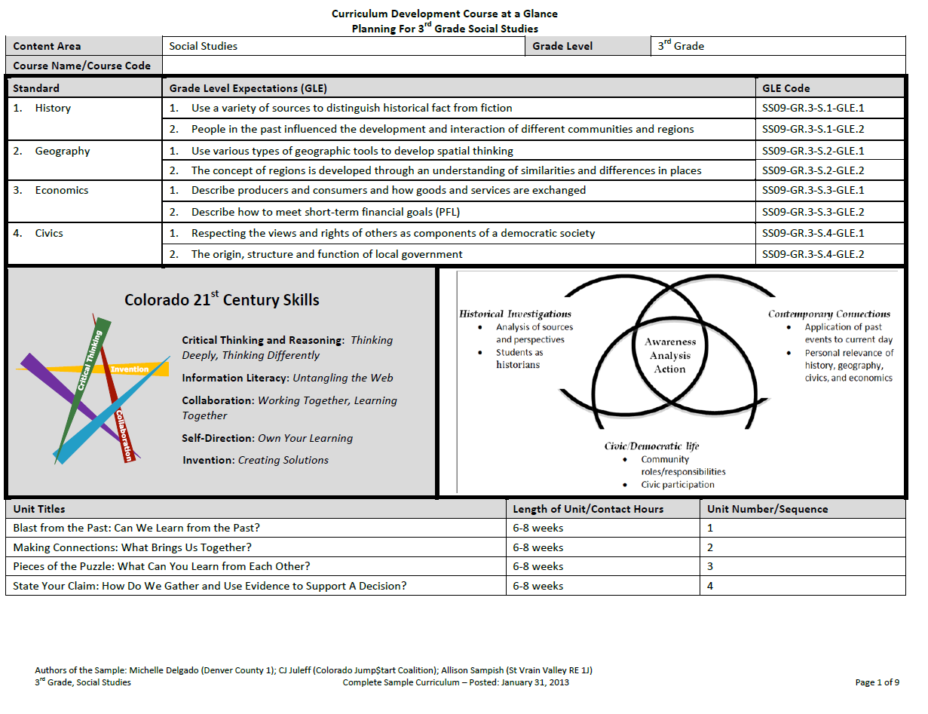

Slide 6
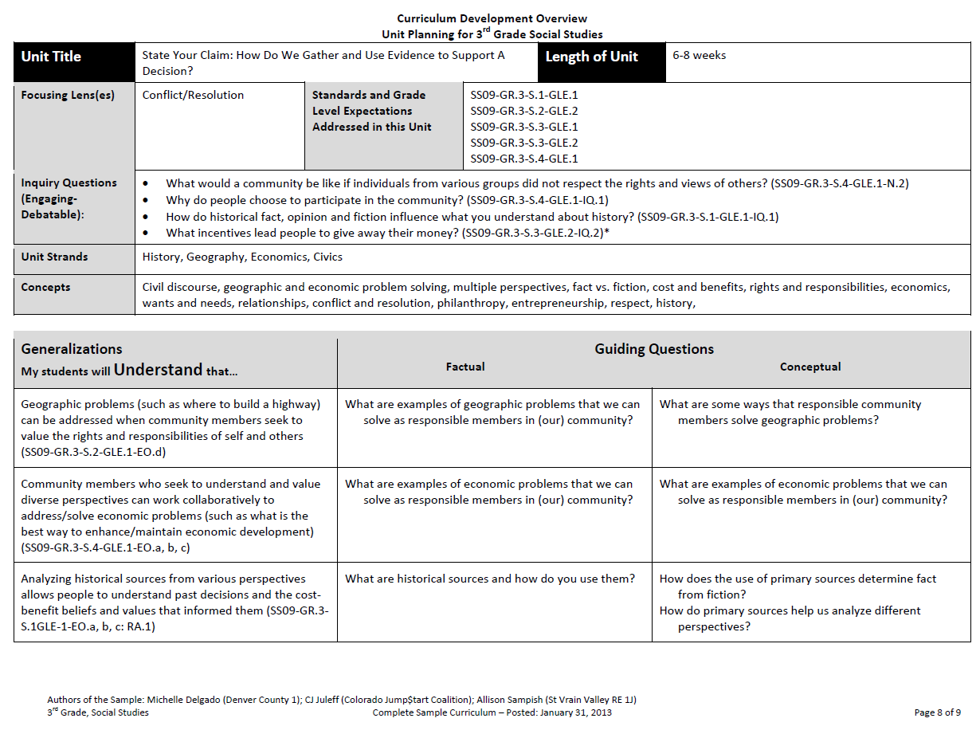

Slide 7
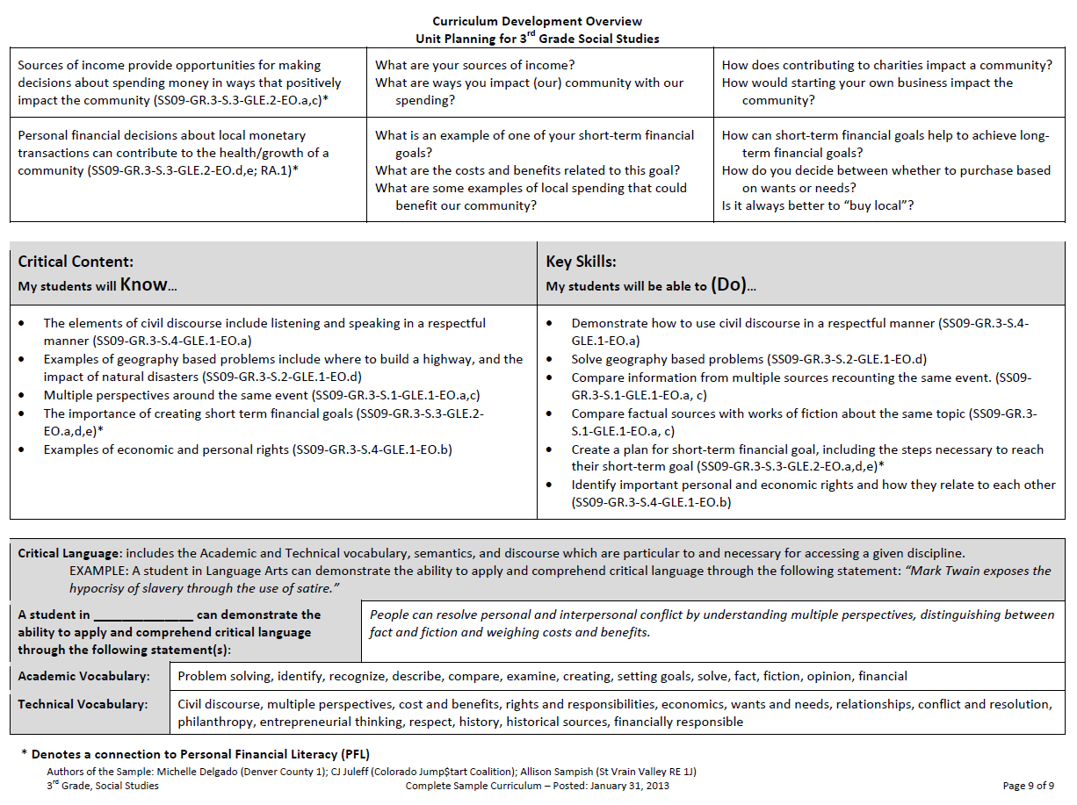

Slide 8
The samples leave work to be done….
As suggested sequencing resources, the Curriculum Overviews do NOT contain:
learning experiences
resources
assessment ideas
differentiation options

Slide 9
Teacher-Authored Samples
Instructional Units
During a three-day workshop a team of educators created an instructional unit designed to provide teachers with support for using their professional judgment to teach to student mastery of the standards-based generalizations, content, and skills of one selected overview.
Teams were typically comprised of:
  2 general education teachers (content specialists)
  1 ELL teacher
  1 Gifted and Talented teacher
  1 Special education teacher
  1 Title One teacher
  100+ units developed and published on March 31, 2014 (one for each grade k-12 mathematics, reading, writing, and communicating, science, social studies, comprehensive health, visual arts, drama/theatre, dance, and music).

Slide 10
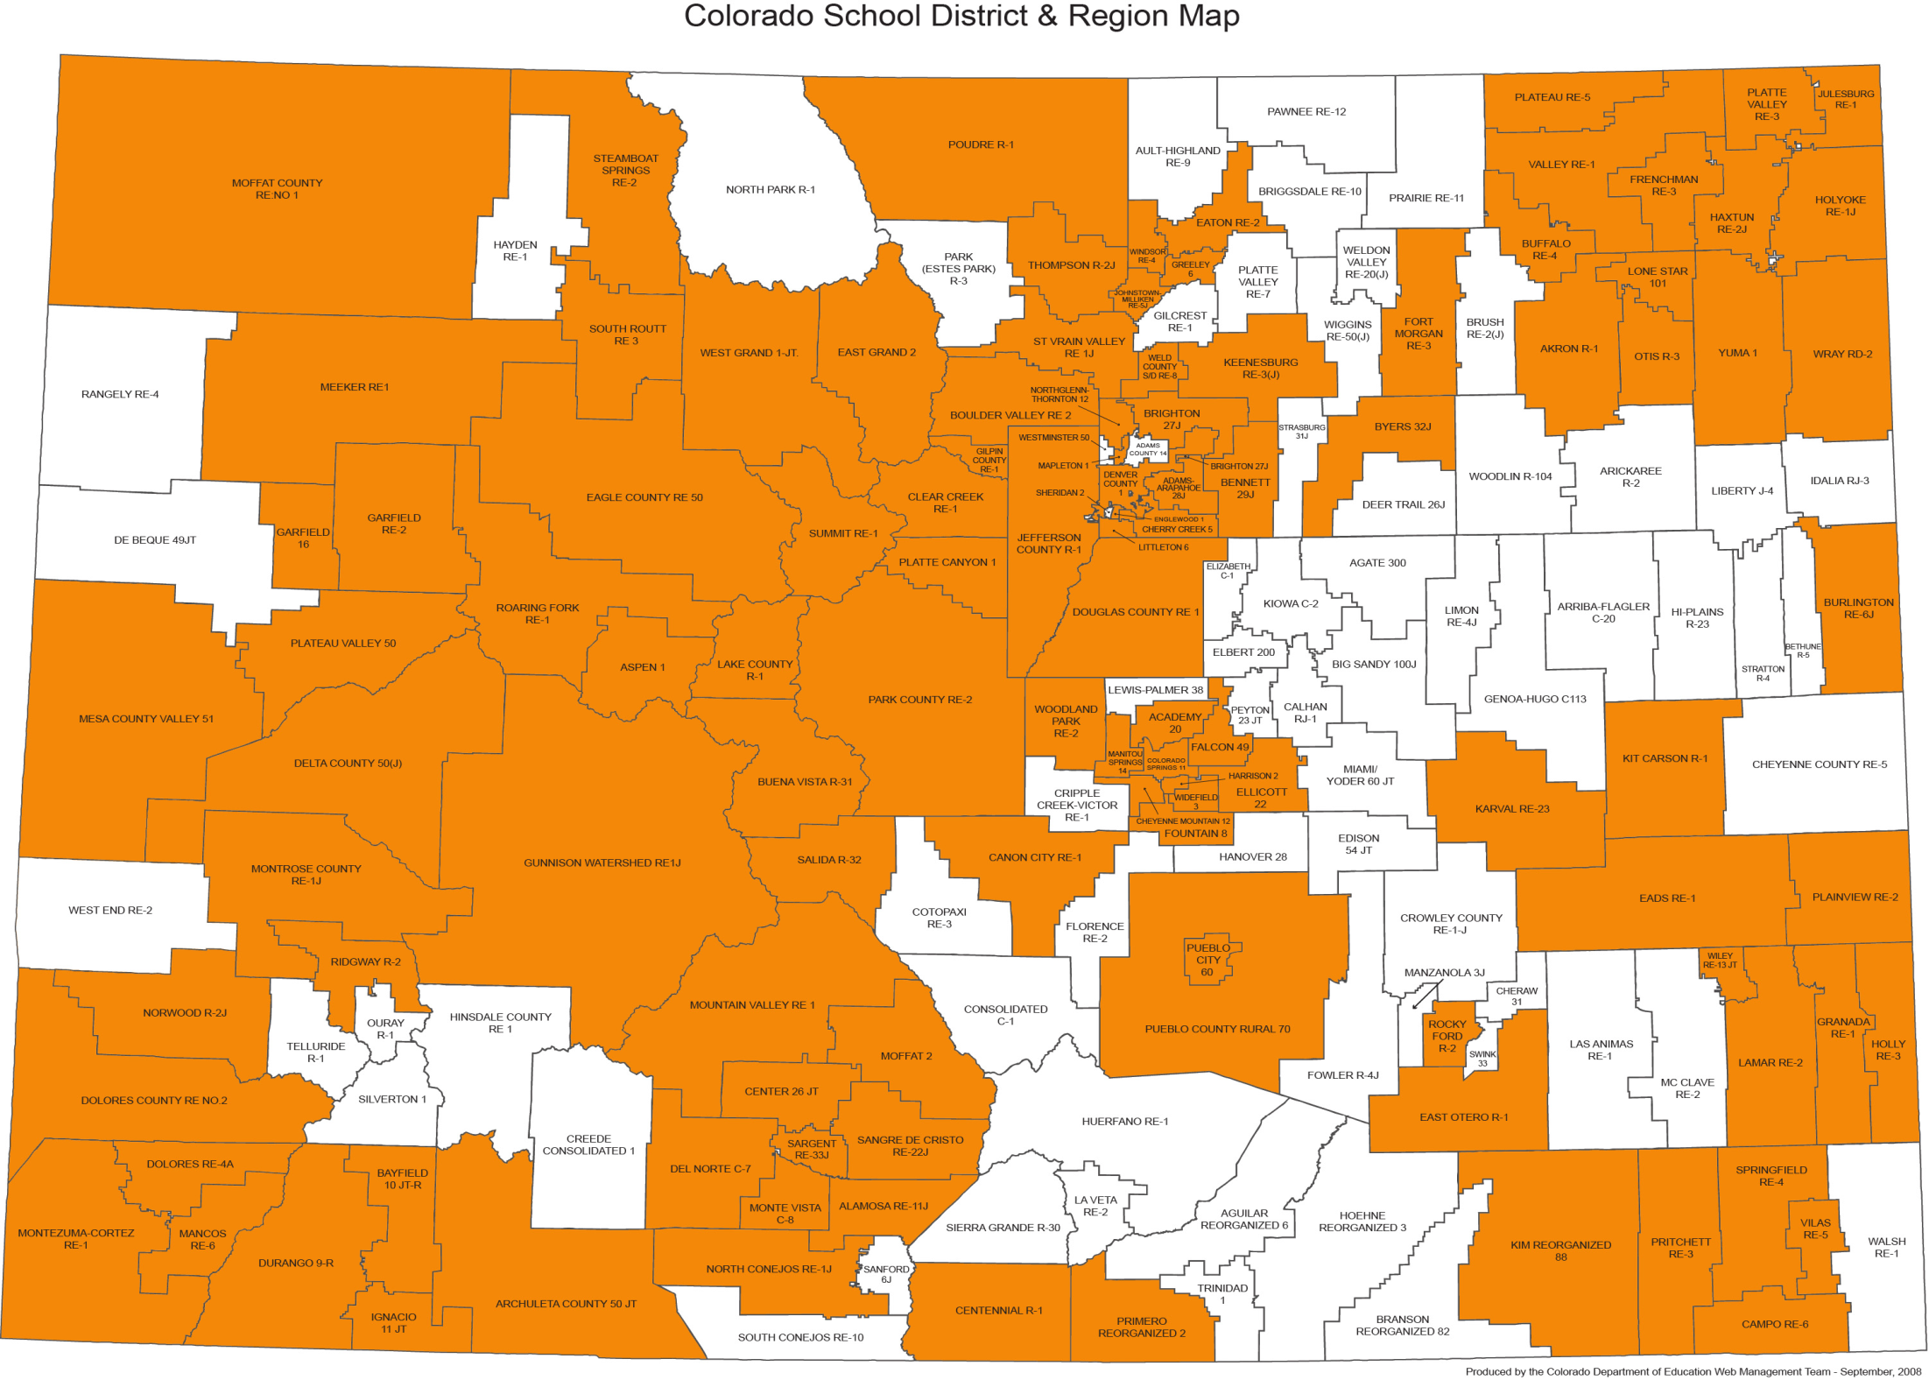

Slide 12
Generalizations: The Starting Point
Generalizations My students will Understand that… | Guiding Factual Conceptual
Geographic problems (such as where to build a highway) can be addressed when community members seek to value the rights and responsibilities of self and others (SS09-GR.3-S.2-GLE.1-EO.d) | What are examples of geographic problems that we can solve as responsible members in (our) community? | What are some ways that responsible community members solve geographic problems?
Community members who seek to understand and value diverse perspectives can work collaboratively to address/solve economic problems (such as what is the best way to enhance/maintain economic development) (SS09-GR.3-S.4-GLE.1-EO.a, b, c) | What are examples of economic problems that we can solve as responsible members in (our) community? | What are examples of economic problems that we can solve as responsible members in (our) community?
Analyzing historical sources from various perspectives allows people to understand past decisions and the cost- benefit beliefs and values that informed them (SS09-GR.3- S.1GLE-1-EO.a, b, c: RA.1) | What are historical sources and how do you use them? | How does the use of primary sources determine fact from fiction? How do primary sources help us analyze different perspectives?
Sources of income provide opportunities for making decisions about spending money in ways that positively impact the community (SS09-GR.3-S.3-GLE.2-EO.a,c)* | What are your sources of income? What are ways you impact (our) community with our spending? | How does contributing to charities impact a community? How would starting your own business impact the community?
Personal financial decisions about local monetary transactions can contribute to the health/growth of a community (SS09-GR.3-S.3-GLE.2-EO.d,e; RA.1)* | What is an example of one of your short-term financial goals? | How can short-term financial goals help to achieve long- term financial goals?

Slide 13
The KEY Generalization- The all encompassing heart of the unit!
Key Generalization | Community members who seek to understand and value diverse perspectives can work collaboratively to address/solve economic problems (such as what is the best way to enhance/maintain economic development)
Supporting Generalizations | Geographic problems (such as where to build a highway) can be addressed when community members seek to value the rights and responsibilities of self and others
 | Analyzing historical sources from various perspectives allows people to understand past decisions and the cost- benefit beliefs and values that informed them
 | Sources of income provide opportunities for making decisions about spending money in ways that positively impact the community
 | Personal financial decisions about local monetary transactions can contribute to the health/growth of a community

Slide 14
The Capstone Performance Assessment-R.A.F.T.
Key generalization-the basis for the creation of the PA (RAFT):
  Role: Who are you? A pilgrim? A soldier? The President?
  Audience: To whom are you writing/speaking/presenting? A political rally? A potential employer?
  Format: In what format are you writing/speaking/presenting? A letter? An advertisement? A speech?
  Topic: What are you writing/speaking/presenting about ?
    R: Citizen
    A: Congress
    F: Letter
    T: Taxation

Slide 15
State Your Claim: How Do We Gather and Use Evidence to Support A Decision?
R.A.F.T. | You are a member of the (Boulder) community or someone very interested in the economic success of the (Boulder) community. You might, for example, be a (CU) student, a parent, a homeowner, a business person, etc. Recently, a famous company has proposed construction of a large box store (e.g., a Wal-Mart Supercenter or Super Target) in downtown (Boulder). As a community member/interested party, you have a very strong opinion about the construction and location of this proposed store. You will present your opinion at the next upcoming (Boulder) city council meeting. And while you do believe strongly that your position is correct, you know that that there are diverse opinions in your community; city council (and other community members) might not agree with you. Whatever the outcome, you will work with your fellow community members to find ways to collaboratively make the best of the city council’s decision for the (Boulder) community.

Slide 16
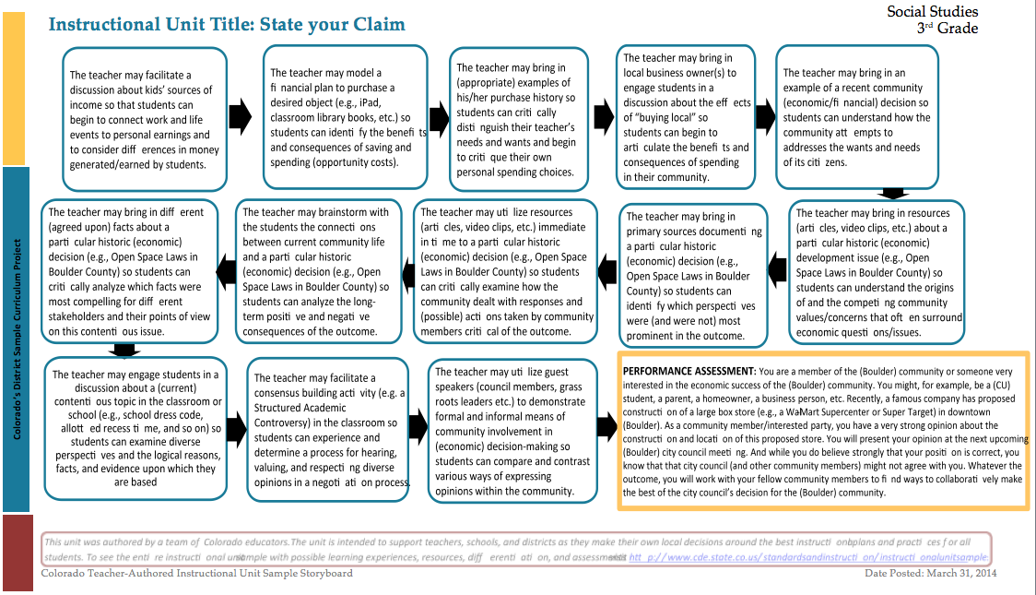
Unit Trajectory- Learning Experiences

Slide 17
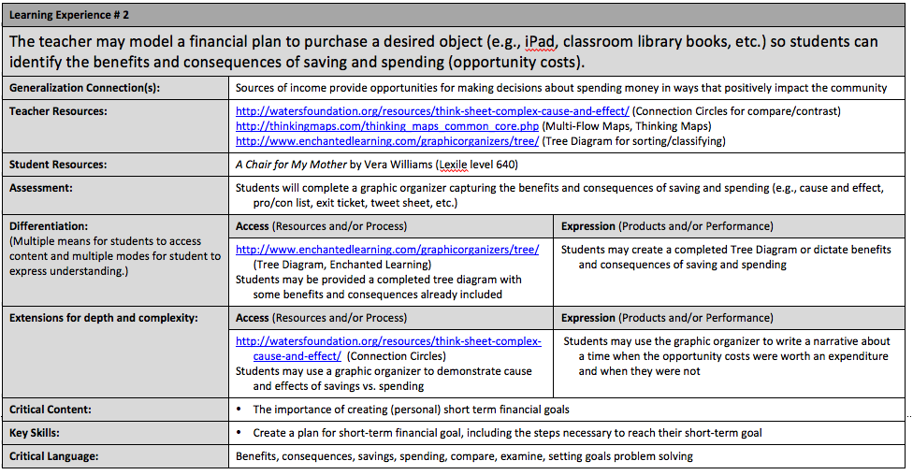
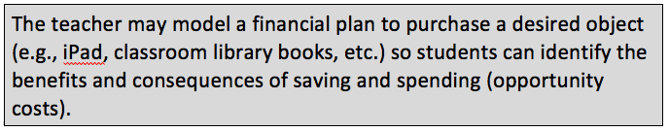
Instructional Unit Learning Experiences

Slide 18
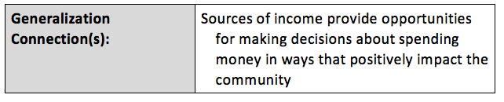
Instructional Unit Learning Experiences

Slide 19
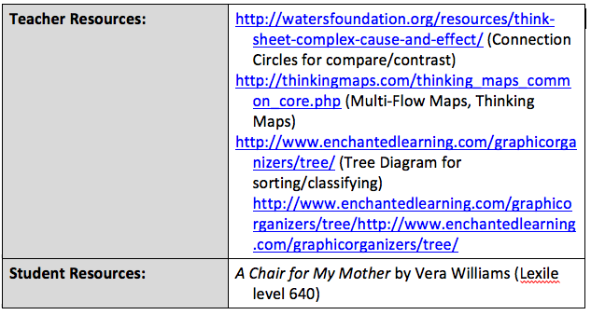
Instructional Unit Learning Experiences

Slide 20
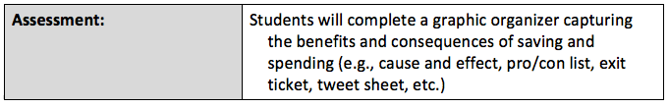
Instructional Unit Learning Experiences

Slide 21
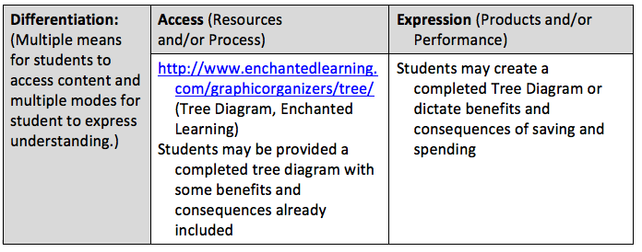
Instructional Unit Learning Experiences

Slide 22
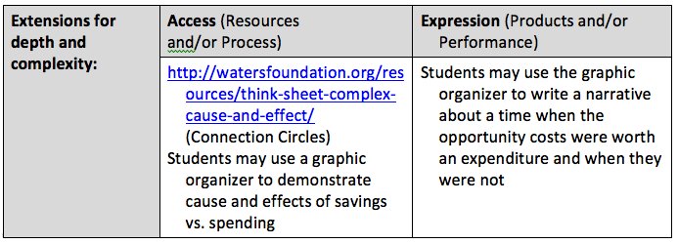
Instructional Unit Learning Experiences

Slide 23
Instructional Unit Learning Experiences

Slide 24
Instructional Unit Learning Experiences

Slide 25
Instructional Unit Learning Experiences

Slide 26
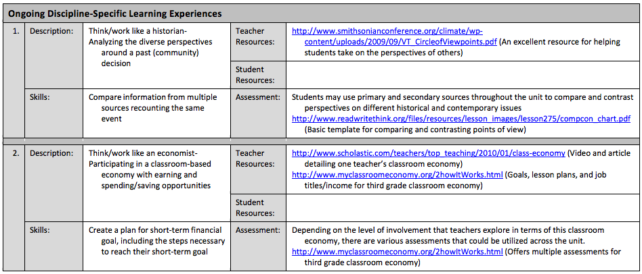
Ongoing Learning Experiences
Think/work like a historian – Analyzing the diverse perspective around a past (community) decision

Slide 27
Unit Trajectory- Learning Experiences

Slide 28
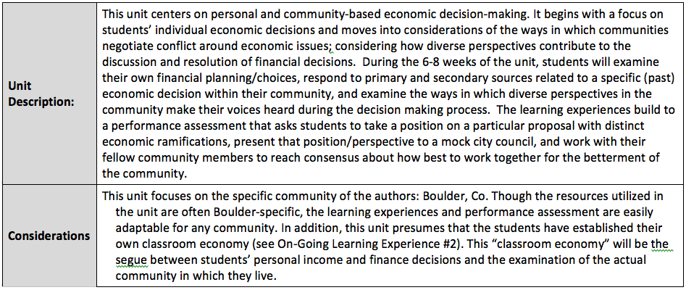
Instructional Unit Description & Considerations

Slide 29
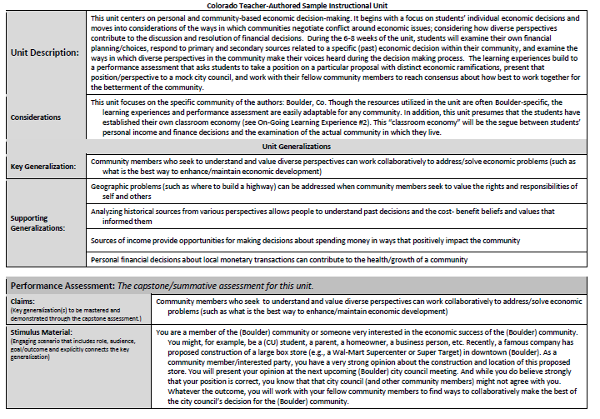
State Your Claim: How do we gather and use evidence to support a decision

Slide 30
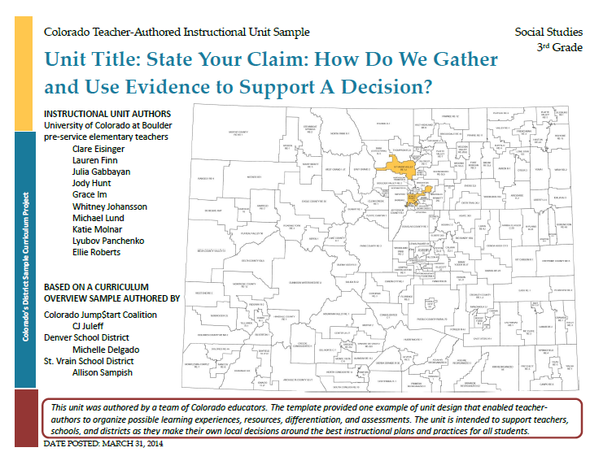

Slide 31

Discussion Time
Questions?

Slide 32
Upcoming Webinars
Reading, Writing, and Communicating Instructional Units April 18 @ 12:30 http://connect.enetcolorado.org/siu_rwc/
Visual and Performing Arts Instructional Units April 21 @ 12:30 http://connect.enetcolorado.org/siu_arts/
Science Instructional Units April 22 @ 12:30 http://connect.enetcolorado.org/siu_science/
Comprehensive Health Instructional Units April 23 @ 12:30 http://connect.enetcolorado.org/siu_health/
Mathematics Instructional Units April 24 @ 12:30 http://connect.enetcolorado.org/siu_mathematics/
Social Studies Instructional Units April 25 @ 12:30 http://connect.enetcolorado.org/siu_socialstudies/

