Slide 1
KSR Collection: Instructions for Data Exported from Multiple Sources
October 16, 2024
Tara Rhodes
KSRData@cde.state.co.us

Slide 2
Agenda
Overview of the KSR Assessment
  Changes for 24-25 Collection Year
  Data from a single source versus multiple sources
Vendor Information
  Vendor Platforms/Assessment Tools
Steps to Complete the Collection
  Detailed Walkthrough of Completing the File Export
  Troubleshooting
Resources and Reminders
Time for Questions

Slide 3
Overview of Kindergarten School Readiness Assessment

Slide 4
Overview of Kindergarten School Readiness
Who: All kindergarten students who receive 0.5 FTE funding or greater.
What: Assess the varying skill levels and knowledge with which students enter kindergarten (C.R.S. 22-7-1002 (2)) and inform individual learning plans (C.R.S. 22-7-1014).
  Physical well-being and motor development
  Social and emotional development
  Language and comprehension development
  Cognition
  Literacy
  Math
Where: All schools that serve kindergarten students who receive 0.5 FTE or greater. This includes charter schools.
When: Students are assessed in the first 60 days of the school year. The first 60 days should align with each school’s calendar.
How: The State Board of Education has approved a menu of tools for the KSR Assessments. Here’s the link to the list of approved assessments.

Slide 5
Overview of Kindergarten School Readiness
(Continued)
The KSR assessment is required.
Districts can choose any combination of the approved assessment tools to assess the six domains.
Districts can also decide how to enter and store their data in their systems.
If a district has a question regarding their assessment tool, the district should contact that vendor for technical assistance.
  CDE’s Assessment Choices and School Readiness Plans website provides a link to each vendor.
Depending on the district, these steps might be completed by a staff member other than the data respondent. Districts are welcome to develop a system that works well for them.

Slide 6
Changes for 24-25 Collection Year
24-25 Changes to the Collection:
With the State Board of Education voting to add single-domain assessment tools to the school readiness assessment tool menu, this necessitated adding an additional column to the file layout to capture that information.
Business rules have been updated to reflect this change. However, vendors have not implemented this change and so this will need to be done manually after extracting your data from the vendor system or by adding this piece of information if you are already manually aggregating your data.
This is not collecting any new information; historically, this information was collected through a front-end screen in Data Pipeline. That screen has been dismantled and now it’s part of the file layout.

Slide 7
Data Sources
Data from a single source is possible if all student level assessment and demographic data is stored in one location.
  Each of the six domains
  Demographic data
    Gender
    Free and reduced-price lunch
    Race and Ethnicity
Data from multiple sources will be required if the student level data is stored in more than one location.
  Most commonly due to using more than one assessment tool.
  Example: Literacy was assessed using FastBridge earlyReading. The other five domains were assessed using Teaching Strategies GOLD.

Slide 8
Vendor Information

Slide 9
KSR Vendor Platforms and Assessment Tools
Assessment tools the State Board of Education approved for all six domains:
  COR for Kindergarten
  Desired Results Developmental Profile for Kindergarten (DRDP-K)
  Teaching Strategies GOLD
  North Carolina Kindergarten Entry Assessment
Assessment tools the State board of Education approved for less than six domains:
  Acadience Math K-6
  Brigance Early Childhood Screens III
  DIAL-4 Developmental Indicators for the Assessment of Learning
  FastBridge earlyMath
  FastBridge earlyReading
  FastBridge SAEBRS
  Istation's Indicators of Progress (ISIP)

Slide 10
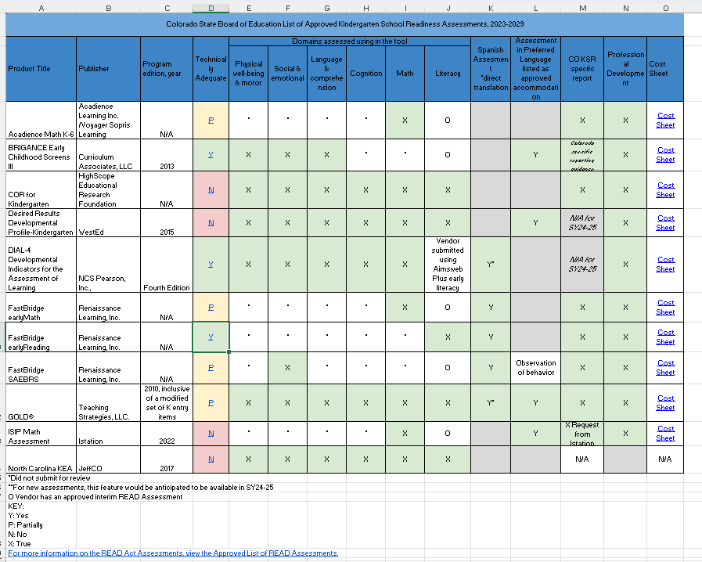
Assessment Menu Matrix
Notes:
Please see Column M for which vendors have reports available for whatever domains.

Slide 11
Vendor Contacts
Assessment Tools Approved for Single Domains:
Brigance Resources:
BRIGANCE website
BRIGANCE Professional Learning and Training Videos
BRIGANCE Chronological Age Calculator
BRIGANCE Screens III Scoring Tool
BRIGANCE Screens III Social Emotional Scoring Tool
BRIGANCE Inventory of Early Development III Scoring Tool
Contact BRIGANCE Support: brigance@brigance.com
PDF available upon request (email: ksrdata@cde.state.co.us)
iStation
Contact iStation Support: support@istation.com
Renaissance (FastBridge and SAEBRS)
Student Data Download Article
Accessing Data from Previous Years Article
Submit a help ticket
Call (800) 338-4204
Assessment Tools Approved for All Domains:
HighScope COR:
For general customer services questions, please contact customerservice@highscope.org
For questions around platform support, please contact platformsupport@highscope.org
For questions around pulling the Colorado specific report, please contact Jeff Beal, jbeal@highscope.org
Teaching Strategies GOLD®:
Review articles in the Support Portal.
Users can also issue cases through the Support Portal.

Slide 12
Steps to Complete the Collection

Slide 13
Steps to Complete the KSR Collection
General Steps to Complete the Collection:
Step 1: Students are assessed and data recorded within the first 60 calendar days of the school year, per HB15-1323.
Step 2: Data are aggregated or extracted from certain vendor systems to meet the file layout. (Note: Make sure the new Assessment Used column is added to your file template.)
Step 3: Data is uploaded in the correct file layout to Data Pipeline.
Step 4: Any errors are resolved within Data Pipeline.
Step 5: Once error-free, data are locked within Data Pipeline.
Step 6: Superintendent sign-off form is downloaded, signed, and emailed back to KSRData@cde.state.co.us.

Slide 14
Step 2: Extract Data from Vendor Systems
Vendor Contacts
Assessment Tools Approved for Single Domains
Brigance Resources:
BRIGANCE website
BRIGANCE Professional Learning and Training Videos
BRIGANCE Chronological Age Calculator
BRIGANCE Screens III Scoring Tool
BRIGANCE Screens III Social Emotional Scoring Tool
BRIGANCE Inventory of Early Development III Scoring Tool
Contact BRIGANCE Support: brigance@brigance.com
PDF available upon request (email: ksrdata@cde.state.co.us)
iStation
Contact iStation Support: support@istation.com
Renaissance (FastBridge and SAEBRS)
Student Data Download Article
Accessing Data from Previous Years Article
Submit a help ticket
Call (800) 338-4204
Assessment Tools Approved for All Domains:
HighScope COR:
For general customer services questions, please contact customerservice@highscope.org
For questions around platform support, please contact platformsupport@highscope.org
For questions around pulling the Colorado specific report, please contact Jeff Beal, jbeal@highscope.org
Teaching Strategies GOLD®:
Review articles in the Support Portal.
Users can also issue cases through the Support Portal.

Slide 15
Step 2: Troubleshooting the Export
If data the data is not exporting from the vendor platform, please check the following:
  Have teachers finalized their data?
  Has it been 24 hours since the data were finalized?
  Is the data in the correct checkpoint?
    Examples: Fall, Winter, Spring. The data should be entered in the Fall checkpoint.
    The data cannot be automatically transferred into a different checkpoint by the vendor. The data will need to be manually re-entered by the district.
  Was the data entered in the correct license?
      Sometimes it is difficult to distinguish the preschool and kindergarten licenses from a vendor offering both. Make sure you are logged into the correct license (kindergarten).
      The data cannot be automatically transferred into a different checkpoint by the vendor. The data will need to be manually re-entered by the district.
If none of these work, please contact your vendor directly.

Slide 16
Calculating the NONE Category:
Getting the Data
Complete the exports from all assessment tools.
Use those exports to get the names (or SASIDs) of the students in the “None” category from each export
  Students who did not meet or exceed expectations in any of the domains assessed by that assessment tool.
  Remember this calculation is completed separately for each school.
  How this information is presented can vary between assessment tools.
    Contact the assessment tool vendor for support if needed.
  Consider the possibility of duplicate names within a school.
    Larger districts/schools might consider pulling in another common piece of PII, such as birth date.
Copy and paste the “None” names (or SASIDs) from each export into Excel
  SASIDs will be easiest, due to consistency
    Ensure cells are in the same format (Text vs. Number format, etc.)
  Ensure the names (and birthdates, if used) are in the same format.
    Are the first and last name in the same cell or in two separate cells?
    Are the names in the same order, with the same punctuation? (Last, First / First Last)
    Are the middle names entered consistently in each export?
    Date format is consistent (MM/DD/YYYY, Sept 2, 2018, MM/DD/YY HH:MM)

Slide 17
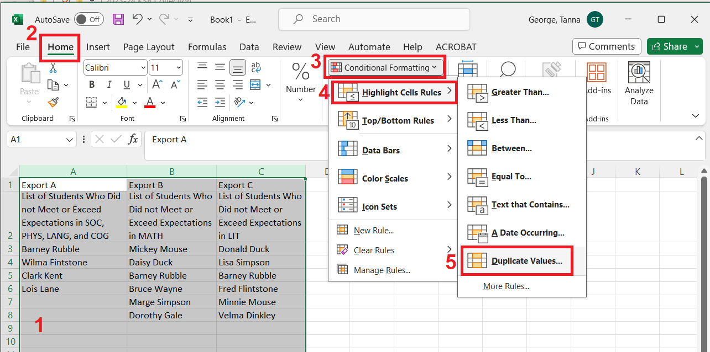
Calculating the NONE Category:
Identifying the Students in NONE
Highlight the columns with the student data
Click “Home”
Click on “Conditional Formatting”
Click on “Highlight Cell Rules”
Click on “Duplicate Values

Slide 18
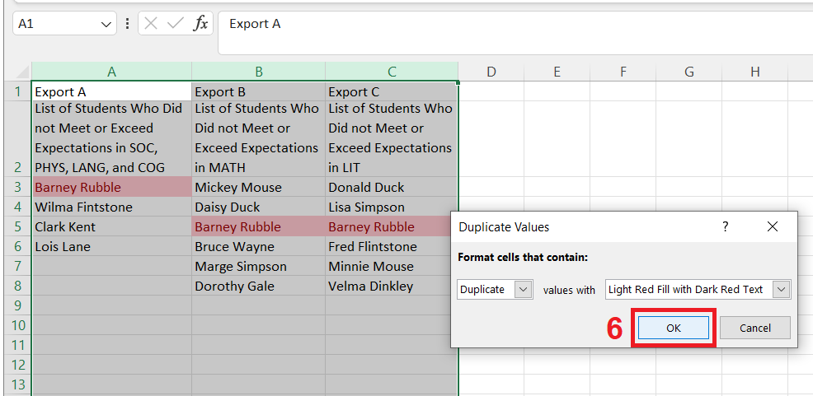
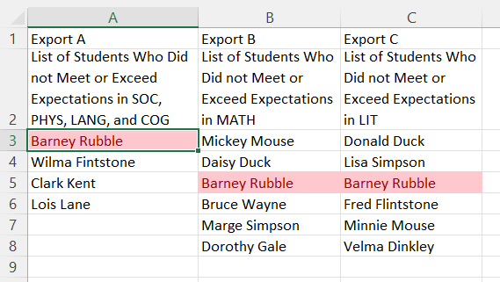
Calculating the NONE Category:
Identifying the Students in NONE (Continued)
6) In the new window, click “OK”.
The children's names that appear in all three export lists now have a red text and a pink cell color.
Possible sources of errors
  Different formatting
  Name order
  Name spelling
  Punctuation
  Duplicate Names
  Extra “spaces”

Slide 19
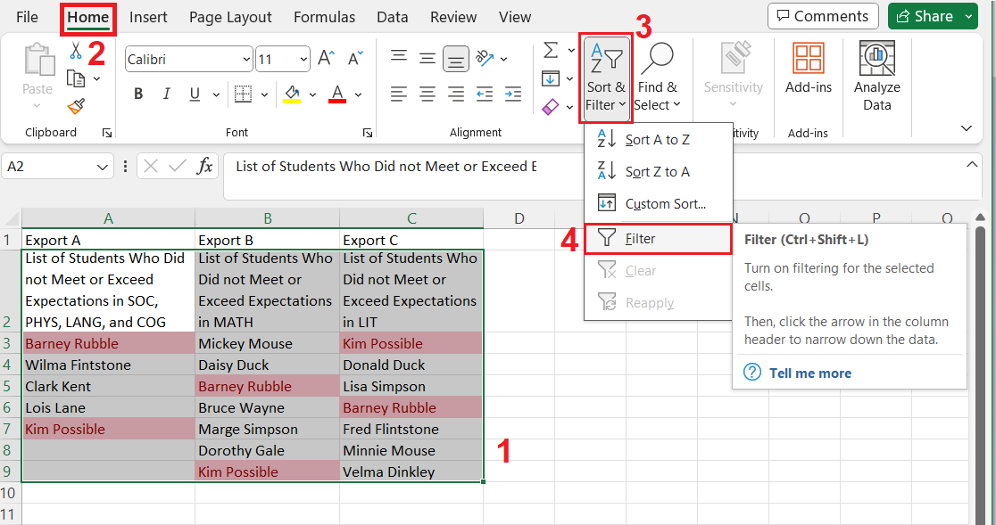
Calculating the NONE Category:
Filtering the Student List
If the list of names is long, then filtering can be helpful to consolidate the student names.
Highlight student names and the column header.
Click “Home”.
Click “Sort and Filter”.
Click “Filter” from the new menu.

Slide 20
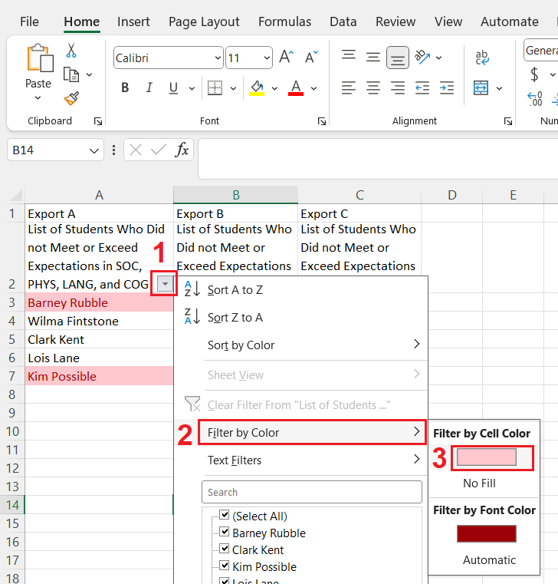
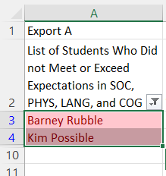
Calculating the NONE Category:
Filtering the Student List (Continued)
Click on the new menu button in the header cell. It’s the grey square.
Click on “Filter by Color”.
Click on the color box. It is pink in this example.

Slide 21
Calculating the None Category:
Reminders
The “NONE” category needs to be calculated for each school.
Once the students in the “NONE” category are identified, you will need their demographic information to complete the rest of the File Template: Gender, FRL status, Race/Ethnicity
I can provide support and answer questions.
  Don’t send student PII over email, especially student names or SASIDs.
  CDE uses Syncplicity for sending files with PII. I can provide instructions for using Syncplicity.

Slide 22
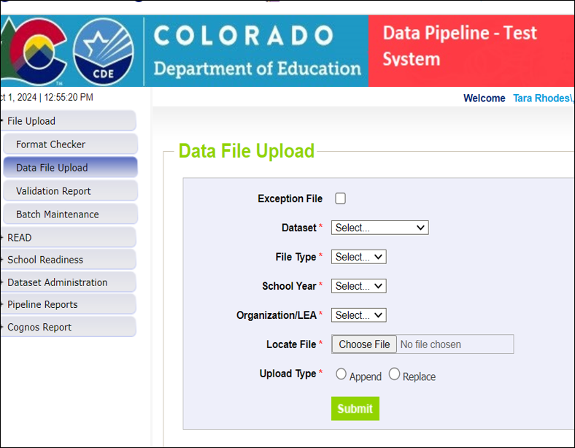
Step 3: Upload file into Data Pipeline
To Complete an Upload:
Log into Data Pipeline.
Click on “File Upload” in the gray boxes along the left-hand side.
Click on “Data File Upload”.
Select “Dataset: School Readiness”
Select “File Type: School Readiness Collection”
The menus for School Year and Organization/LEA should prepopulate to your LEA.
Select the “Choose File” button to open the dialog box to navigate to your prepared data file.
For most districts, select “Replace” for “Upload Type”.
Click on “Submit”.

Slide 23
Step 3: Information about Upload Process
The final data file that will be uploaded into Data Pipeline will need to be in the .xlsx format. Therefore, exporting the data into a spreadsheet (such as one that can be opened in Excel) will be beneficial.
  Note: There is an uncommon file format called “.xlsx (Open)” in most views, it will look like a normal “.xlsx” format, but Data Pipeline will not accept it. Use the save as function to check if the file is saved as just “.xlsx” or “.xlsx (Open)”.
Data Pipeline does not accept file names with special symbols or characters or spaces.
  It will trigger an upload error in Data Pipeline.
  Examples: !@#$%&*?

Slide 24
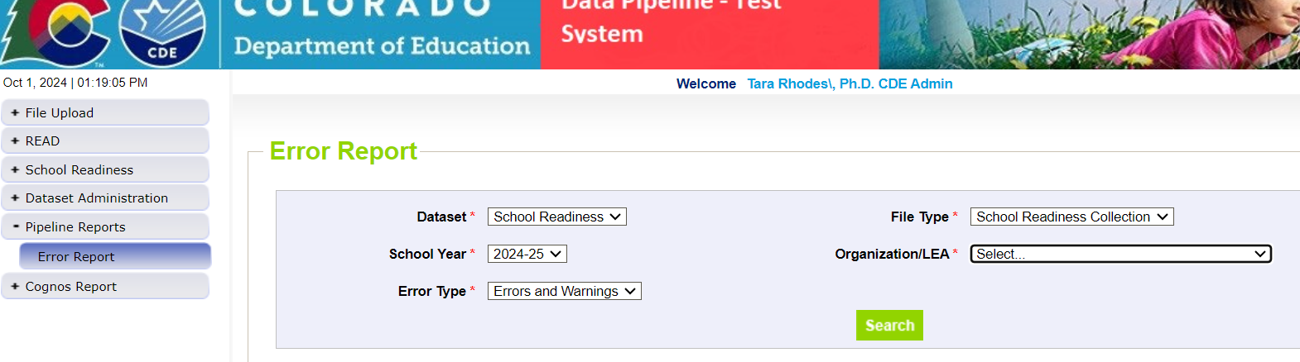
Step 4: Error Resolution Process – Main Screen
After you’ve completed an upload, two things will happen:
  1. You will receive either a green message or a red message in Data Pipeline under the “Data File Upload” header.
  2. You (and me) will receive a CDE PROD email. This email will state how many errors you have.
You can also check errors by going to Pipeline Reports > Error Reports in Data Pipeline and making the following selections:

Slide 25
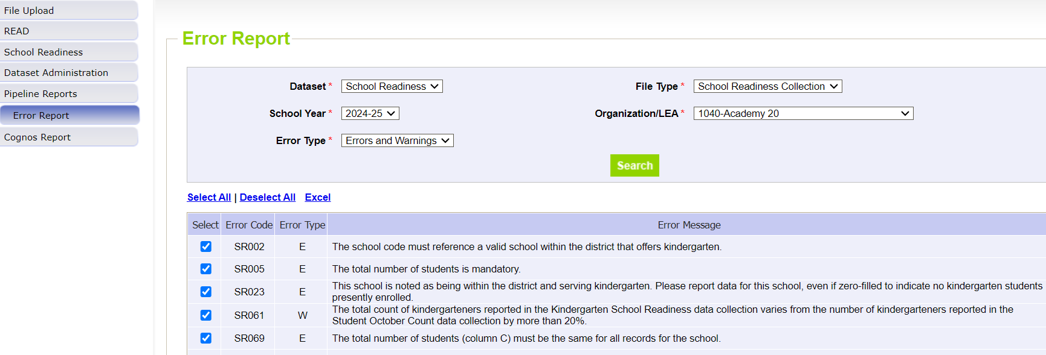
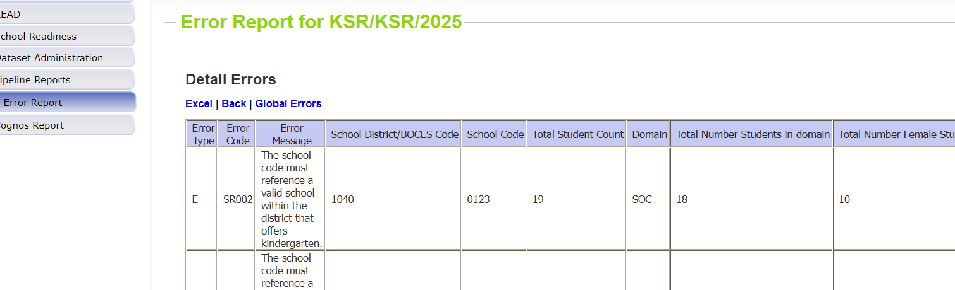
Step 4: Error Resolution Process – Error Report
Once you hit “Search”, you will see a screen similar to this:
This screen will reference each of errors and warning that you have in your current file. You can also click on “View Details” at the bottom of the screen to look at the specific records causing these errors.
Notes:
At this point, you will want to work in your data file to correct these errors.

Slide 26
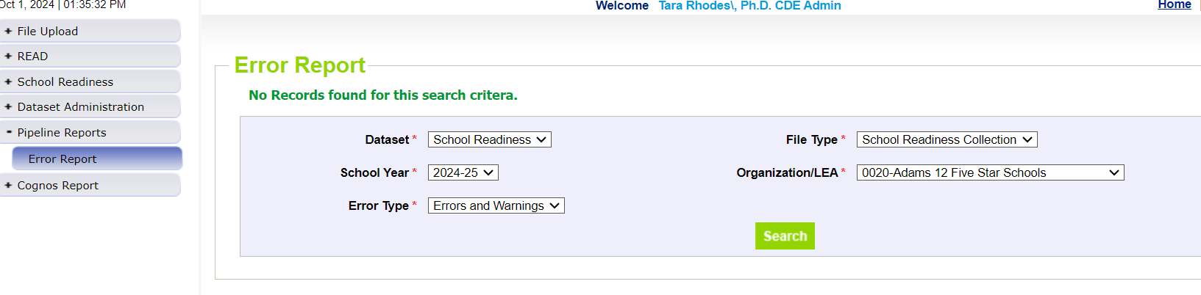
Step 4: Error Resolution Process – No Further Errors
At this point, you will want to work in your data file to correct these errors. Once you believe you have corrected all of your errors, you’ll continue this process of uploading and checking errors until you have no further errors to address. The error screen at that point will look like this:

Slide 27
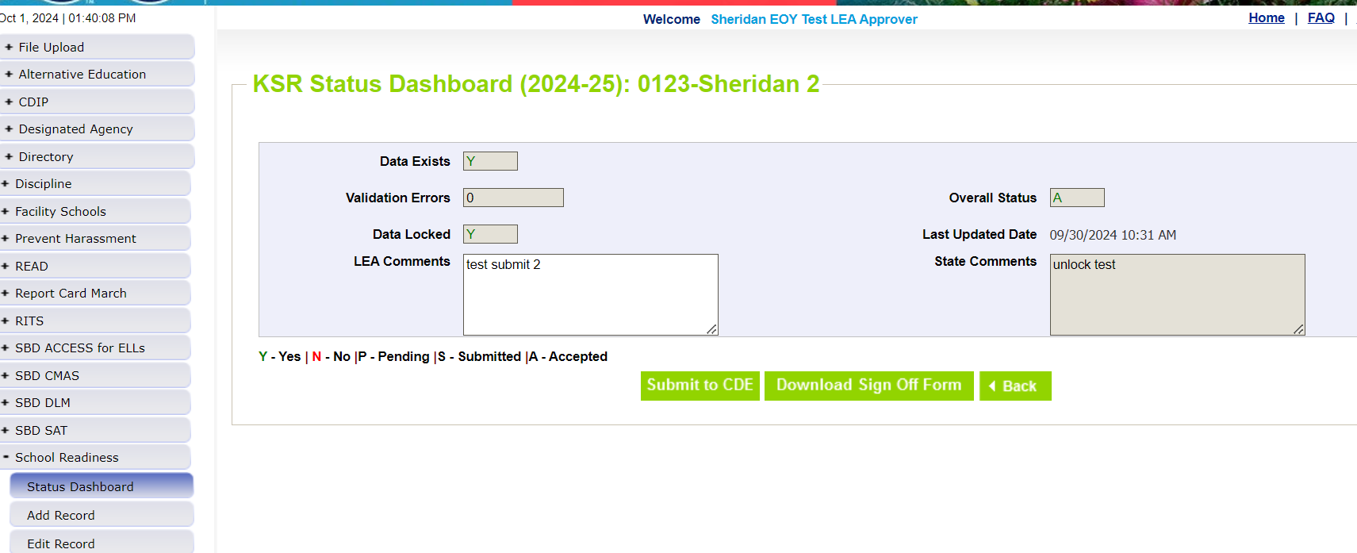
Step 5: Submission Process
How to Officially Submit/Lock Your Data:
Once you have reached zero errors, you still need to lock your submission. This ensures that no further changes can be made to your submission and officially sends your data over to CDE.
This is done in Data Pipeline > School Readiness > Status Dashboard through hitting the “Submit to CDE” button. Please note you will only see this button if you have the LEA APPROVER role.
Notes:
Because the collection is not considered complete until this step is taken, I will bug you to officially submit or lock your data until this is done.

Slide 28
Step 6: Download Sign-Off Form
How to Download the Sign-Off Form:
This is done in Data Pipeline > School Readiness > Status Dashboard through hitting the “Download Sign-Off Form” button. Please note you will only see this button if you have the LEA APPROVER role and only after you have clicked on the “Submit to CDE” button.
This form can be emailed to KSRData@cde.state.co.us.
Notes:
Because the collection is not considered complete until this step is taken, I will bug you to officially submit or lock your data until this is done.

Slide 29
Resources

Slide 30
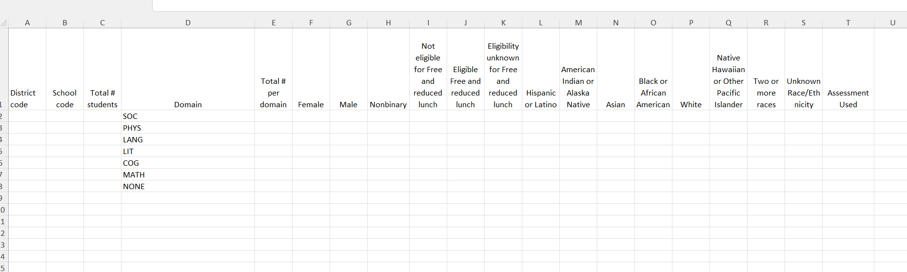
Resources: KSR File Template
The File Template can be found on the Kindergarten School Readiness Data Collection website.
Data Elements:
  District Code
  School Code
  Total # students
  Domain
  Total # per domain
  Gender
  Free and Reduced-Price Lunch
  Race and Ethnicity
  Assessment used

Slide 31
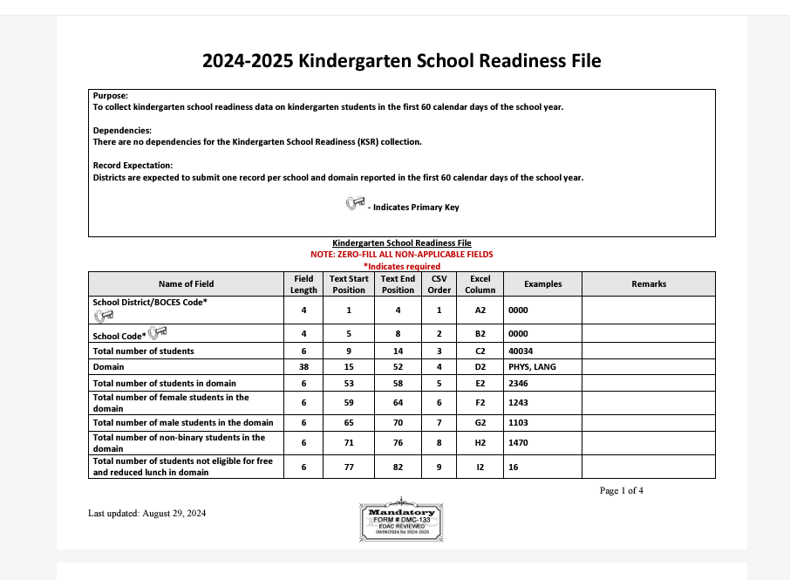
Resources: File Layout
The KSR file layout can be accessed off the KSR Data Collection website.
It contains:
  The data elements and in the order in which Pipeline is expecting them;
  The correct formatting for all fields;
  Coding for various fields (such as gender, etc);
  Definitions of fields.

Slide 32
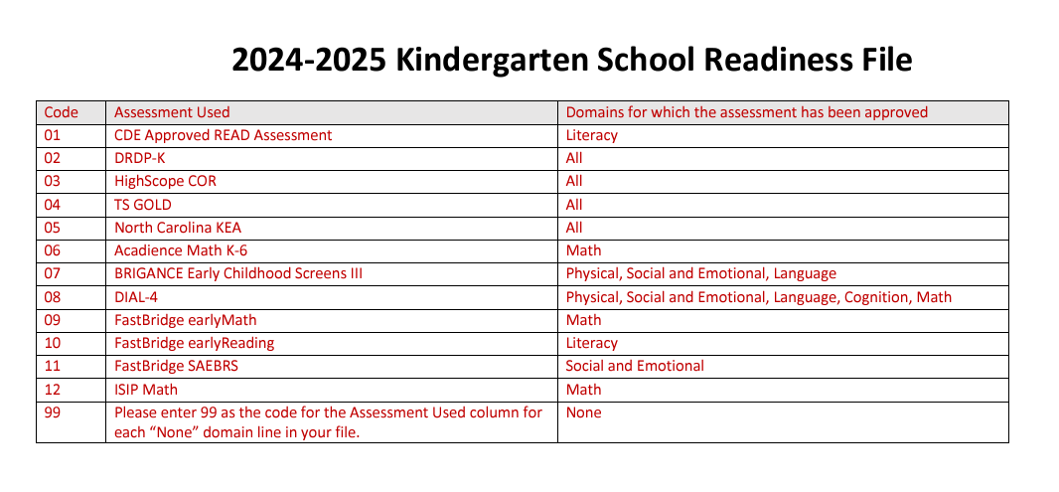
Resources: Assessment Used Codes
Below is a screenshot of the codes for the different assessment tools. These are entered into your data file to denote which assessment was used. (Note: The NONE domain must have a code of 99.)
Tutorial for how to add the additional column in Excel

Slide 33
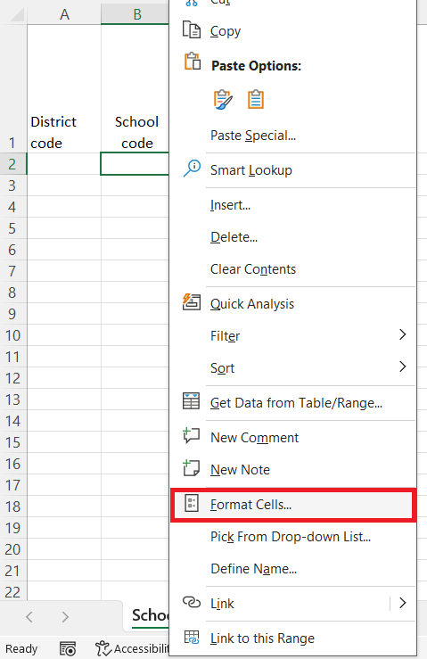
File Template: Columns A and B
District Code and School Code (Columns A and B): A unique 4-digit code is assigned to each district, and to each school.
  Don’t know your codes? Find them on the Data Pipeline Frequently Requested Codes website.
The District and School Code columns must be formatted as “Text” in the final file.
This preserves the leading zeros in the codes.
  Example: 0235
Option 1: To format as “Text” in Excel.
  Open the file in Excel.
  Find the cell(s) you want to reformat.
  Right click with your mouse on the cell.
  In the new window that pops up, select “Text” form the list of formats, and click “OK”.
  All other numerical cells in the file will be formatted as numbers.
Option 2:
  Put a single apostrophe (‘) in front of the code.
    Ex: ‘0123

Slide 34
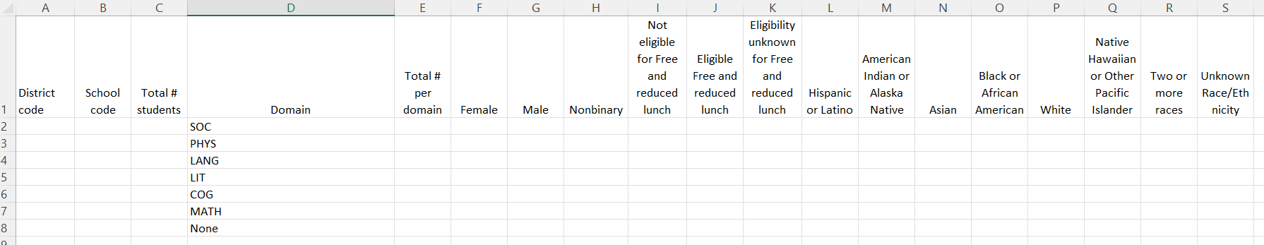
File Template: Columns C, D, and E
100
90
Total # Students (Column C): Total number of students included in the KSR Assessment (all kindergarteners receiving 0.5 FTE or greater)
Domain (Column D): The abbreviated six domains included in the KSR Assessment.
  Social and emotional development
  Physical well-being and motor development
  Language and comprehension development
  Cognition
  Literacy
  Math
Total # Per Domain (Column E): Total number of assessed students who are meeting or exceeding expectations in that domain.
  Example: Out of the 100 students assessed, how many met or exceeded expectations in Math?

Slide 35
File Template: Columns F, G, H (Gender)
90
Female (Column F): Out of the total number of students who met or exceeded expectations in Math, how many are female?
Male (Column G): Same process
Nonbinary (Column H): Same process
Using our Math domain example: If 90 students met or exceeded expectations in Math, then the sum of Female, Male, and Nonbinary should equal 90 (that’s the number in Column E, Total # per Domain)
If no students are identified in a demographic category, enter a zero.
  Leaving it blank will trigger an error in Data Pipeline.

Slide 36
File Template: Columns I, J, K (Free and Reduced Lunch)
90
Not Eligible for Free and Reduced Lunch (Column I): Out of the total number of students who met or exceeded expectations in Math, how many are Not Eligible for Free and Reduced Lunch?
Eligible for Free and Reduced Lunch (Column J): Same process
Eligibility Unknown for Free and Reduced Lunch (Column K): Same process
Using our Math domain example: If 90 students met or exceeded expectations in Math, then the sum of Not Eligible, Eligible, and Eligibility Unknown should equal 90 (the number in Column E, Total # per Domain)
All FRL data is collected for every child in the district, and it should be available on record. That data is part of the Student October Count.

Slide 37
File Template: Columns L through S (Race/ Ethnicity)
90
Hispanic or Latino (Column L): Out of the total number of students who met or exceeded expectations in Math, how many are Hispanic or Latino?
All the other Race / Ethnicity Categories (Columns M-S): Same process.
Using our Math domain example: If 90 students met or exceeded expectations in Math, then the sum of all the Race /Ethnicity categories should equal 90 (the number in Column E, Total # per Domain)
All race/ethnicity data is collected for every child in the district and should be available on record. That data is part of the Student October Count.
If no students are identified in a demographic category, enter a zero.
  Leaving it blank will trigger an error in Data Pipeline.

Slide 38
Reminders

Slide 39
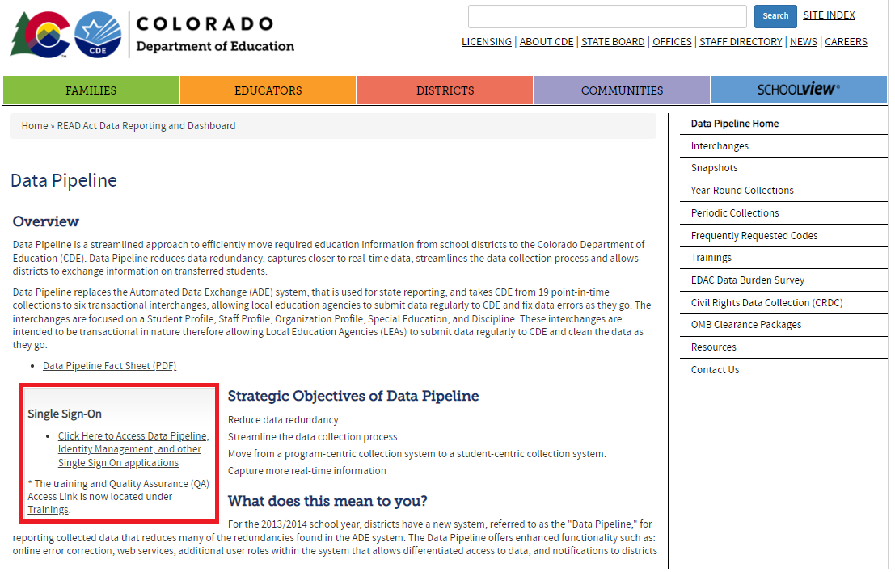
Reminder 1: Verify you have Data Pipeline Access
Each individual Data Pipeline user must be granted a Data Pipeline login, and access to the KSR Collection within Pipeline.
To login to Data Pipeline.
  Link to Data Pipeline website.
  Click on the “Single Sign-On” link.
  Enter your login credentials.
CDE cannot manage district staff assignments in Data Pipeline.
Each district’s Local Access Manager (LAM) manages their staff’s Pipeline access, and assignment of roles. The LAM is frequently the Superintendent for many smaller districts.

Slide 40
Reminder 1: Verify you have Data Pipeline Access (Continued)
If you do not know the LAM is for your district, this is the link to the LAM inquiry form.
Your LAM can do the following:
    Grant Data Pipeline logins
    Assign a Data Respondent(s) to the KSR Collection within Data Pipeline
    Change staff’s role assignments for each collection.
  Roles:
    Viewer: They can only see the uploaded data for the KSR Collection.
    User: They can view the collection data, upload data, and finalize the data. They cannot submit to CDE within Pipeline.
    Approver: They are the only role that can submit the data to CDE within Data Pipeline. Submitting the data to CDE is a required step of the collection. If you do not have the Approver role, you will need to identify the district staff member with that role.

Slide 41
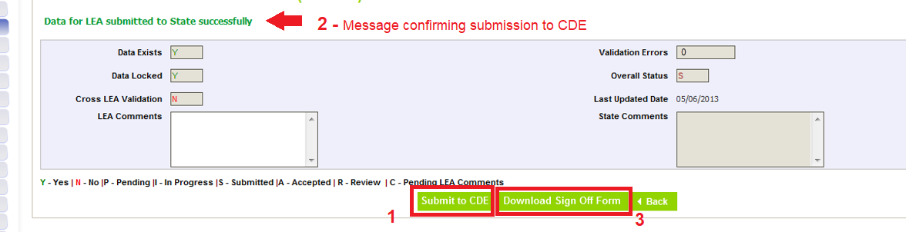
Reminder 2: Submit Data to Data Pipeline
Data must first be uploaded and error free.
Select “School Readiness”, then select “Status Dashboard” on the left-hand menu.
Click on the “Submit to CDE” button (1)
  If you cannot see this button, it means you do not have the correct Data Pipeline role to submit the data. The “Viewer” and “User” roles cannot submit the data. Only the “Approver” role can submit. Contact your LAM to either gain the Approver role for yourself or identify the staff member with the Approver role.
A message in green text will appear near the top of the screen. It confirms the data was submitted successfully. (2)
Then click on the “Download Sign Off Form (3)

Slide 42
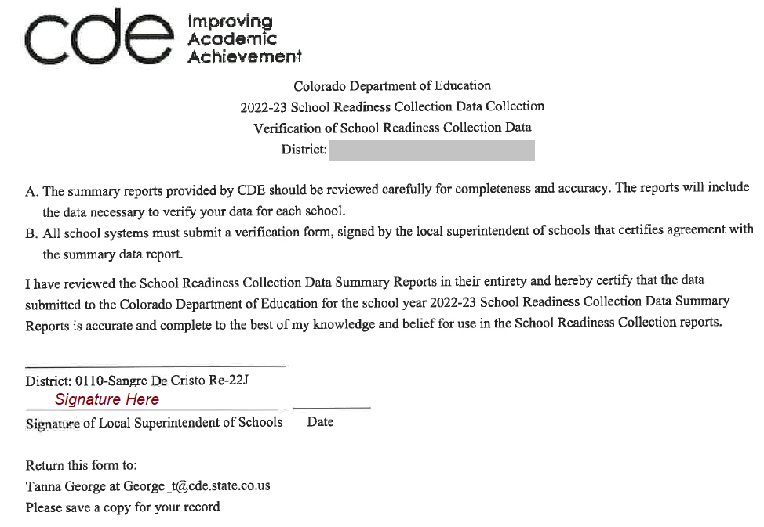
Reminder 3: Complete the KSR Signature Form
This is accessible in Data Pipeline through the Status Dashboard.
The file downloads as a pdf.
The file must be signed by the district’s superintendent
CDE accepts both physical and electronic signatures on this form.
The signed form can be emailed to me (KSRData@cde.state.co.us)
This is the final step in the collection.

Slide 43
Questions

Slide 44
Thank you!
Please reach out to Tara Rhodes, Interim Kindergarten School Readiness Collection Lead, if you have any questions or concerns.
Email: KSRData@cde.state.co.us
If you have questions regarding the assessment process for Kindergarten School Readiness, please contact Megan Rogers.
Email: Rogers_M@cde.state.co.us

