Slide 1
Kindergarten School Readiness Back to School
Elementary Literacy and School Readiness Office
Notes:
Welcome. I am Megan Prior Rogers, Kindergarten School Readiness Consultant at the Department of Education.
Introduce in small groups in just a minute, go ahead and type your name and district/town in the chat
Launch Poll

Slide 2
Agenda
Notes:
Agenda: https://docs.google.com/document/d/1MJ4By9HqiHotbdUj0hQ8YlO3FiX3DV_JZnevYSKyWC8/edit?usp=sharing

Slide 3
Small Groups
Introductions by all group members and temperature.
Share bright spots: What has been a success this year?
One success in general
One focused on kindergarten and/or school readiness
Notes:
In small groups, please discussion the following:
Introductions by all group members and temperature.
Share bright spots: What has been a success this year?
One success in general
One focused on kindergarten and/or school readiness

Slide 4
Ready Child
School readiness describes both the preparedness of a child to engage in and benefit from learning experiences, and the ability of a school to meet the needs of all students enrolled in publicly funded kindergarten. School readiness is enhanced when schools, families, and community service providers work collaboratively to ensure that every child is ready for higher levels of learning in academic content.
~State Board of Education, 2023
Ready System
Notes:
Drop any bright spots you would like to share in the chat. We’d love to hear. While you type, I’ll walk through some grounding content.
The school readiness description was updated this past school year. The primary shift was to eliminate preschool from the board’s description and to emphasize kindergarten and the role we have as SEA and LEAs to ensure schools are ready to meet the needs of incoming kindergartners in addition to the preparedness of the child to engage in and benefit from kindergarten classrooms and curricula. The school-ready and child-ready focus remains. Additionally, the latter half of the description focuses on partnerships. This was a large emphasis on feedback received during the review of the description. That is partnerships with families and communities allow us to systematically work together toward ensuring the readiness of each child, year after year.

Slide 5
Overview of School Readiness
Data-informed decisions at the classroom, school, district, and state level
Class: data-informed instruction and intervention
School and district: informed decisions on instruction, resources, and community partnerships.
State: informed policy decisions, state agency partnerships
Notes:
You are likely familiar with this image. We have used this to summarize and operationalize the description of school readiness in recent years.
For today, we will emphasize:
Data-informed decisions: analyzing available data at the classroom level, the school, and community levels to make informed decisions and then using a problem-solving process to select evidence-based strategies and innovations to continually improve.
CAP4K report: https://www.cde.state.co.us/sites/default/files/docs/cdedepcom/2023%20CAP4K%20Legislative%20Report%202.13.23.pdf
Pause for questions on the overview/bright spots

Slide 6
Key Responsibilities
Schools and districts serving publicly funded students in kindergarten
Use state board-approved assessment tools.
Assess six domains of learning and development in school readiness.
Administer the KSR assessment from 1st day of school through the first 60 calendar days.
Create individual learning plans (school readiness or K plans) for each student.
Report data during the KSR data collection window.
Notes:
Key responsibilities for schools and districts have remained the same.
We will revisit SBE-approved assessments in the next section
Statute requires assessment 6 domains of learning and development, type one in the chat, the SBE defined general knowledge as literacy and math.
physical well-being and motor development, social and emotional development, language and comprehension development, cognition, literacy, and mathematics
Regardless of the tool/tools used each student must be assessed in all 6 domains with all data reported in the KSR collection
First 60 calendar days: The assessment is to capture baseline or BOY data
All students in kindergarten are required to be assessed including students in charter schools, students who attend online, and students who are homeschooled and receive .5 FTE or more of public funding
Individual Learning plans for all students in K
If it is determined a student also needs a READ plan, then the READ plan is to become a component of this Individual Learning plan in K.
Report data—The data collection window this year is October 4th _ December 5th
Pause: Before we move on, are there any requirements you need more information on, links or resources?

Slide 7
Flexibilities and Local Decisions
READ ACT Interim Assessments may be used to inform the literacy domain.
Consideration of what is assessed
Consideration of manual aggregation or merging data for the data collection.
Assess additional relevant domains
English language development
Health
Assessment during mid- and end-of-year assessment windows to inform instruction and measure continual progress.
How often
Which domains are assessed
Notes:
READ ACT Interim Assessments may be used to inform the literacy domain.
Consider what is assessed
Consider need for manual aggregation or merging data for the data collection.
Assess additional relevant domains
English language development
Health
Assessment during mid- and end-of-year assessment windows to inform instruction and measure continual progress.
How often
Which domains are assessed
TIMELINE: contains these 5 responsibilities and an editable timeline.
https://www.cde.state.co.us/schoolreadiness/ksrtimeline
Other option: Fact sheet which is currently being updated

Slide 8
Statute Says
Notes:
www.kahoot.it w/ game pin
Kahoot app
Scan QR code
*Multi-select means 2 right answers

Slide 9
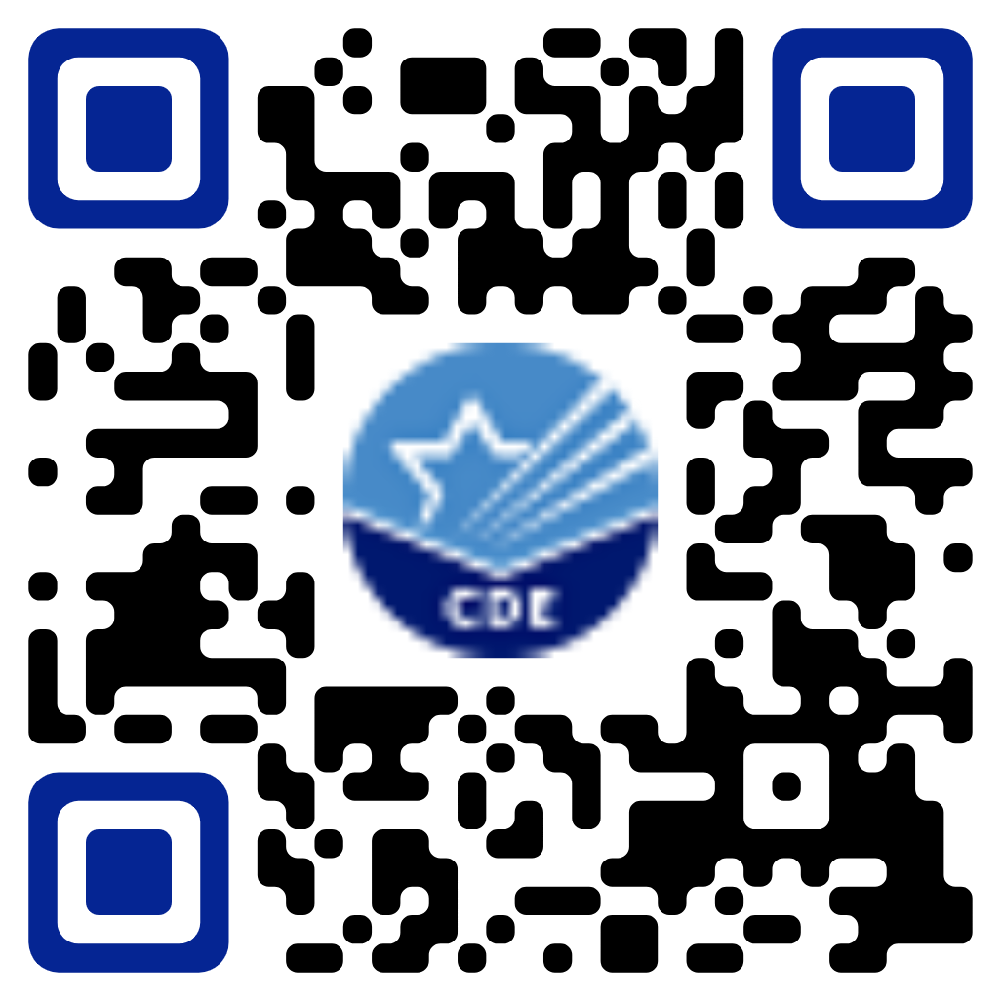
Expanded List of Approved Assessments
Notes:
https://www.cde.state.co.us/schooleradiness/assessment#srassessmentmenu
One adjustment this year, the SBE approved additional assessment tools that can be used to help fulfill the assessment requirements in kindergarten for KSR
All domains are still required to be assessed, greater flexibility in how you choose to assess
May require merging data sets
The chart you see on this screen is available to download here: https://www.cde.state.co.us/schooleradiness/assessment#srassessmentmenu
High-level overview of information collected during the review process.
Presented to aid in your selection of assessment
Walk through each column and links OPEN FROM WEBSITE
https://www.cde.state.co.us/schooleradiness/assessment#srassessmentmenu
Public folders: https://drive.google.com/drive/folders/1qV5bBTl75RDsglgCKCK8S__NLuhLY-Ky?usp=drive_link
Included in the review was an in-depth look at the assessment of literacy and the assessment of CLD students, including language accommodations and assessment language.

Slide 10
Small Group Discussion
What questions do you have for your colleagues?
On what topics do you need more information?
Notes:
Prompts for small group discussion:
What questions do you have for your colleagues?
What topics do you wish to know more about or need more information? What learning do you hope to engage in?
Complete the interest survey form during this time and after as well: https://app.smartsheet.com/b/form/fc514bd10bac411aaa63f69e783c4d19

Slide 11
District Authorizers
Charter Waivers
Waiver of using an approved assessment tool
Replacement plan describes how charter will assess publicly funded kindergartners
Assessing each required domain
Research-based, valid, and reliable tools
Provide data to inform individual learning plans
Report data reflecting students meeting or exceeding BOY benchmark in SBE approved file layout during the KSR Collection
If specific assessment tool(s) are not listed on the replacement plan for each of the 6 required domains, the charter’s waiver may not be placed on the consent agenda for the State Board of Education (August 17th, 2023).
Notes:
A note on charter school waivers for District Authorizers and those who support this process by reviewing waiver replacement plans.
If this is not you, please feel free to use the next few moments to complete the Interest Survey while you listen in.
The waiver is only for the use of SBE-approved assessment tools.
Replacement plans for how a charter will assess publicly funded K’s are required.
The replacement plan must:
-provide a plan for assessing each of the required domains; definitions of the domains
-the tools used are still to be research-based, valid, and reliable (technical study)
-provide data to inform individual learning plans in K and hence inform instruction
-provide data reflecting students meeting or exceeding K BOY benchmark in SBE approved file layout during collection
Concerns:
**Self-made checklists and other tools that do not meet statutory requirements
**use of proprietary vendor information, without using vendor or vendor assessment tool
**incomplete plans—assessing only some required domains
**using K grade level standards as a checklist for assessing students (By EOY)

Slide 12
Office Hours Time: 12:30-1:00 Fall Dates: September 14th, September 28th, and October 12th Link located on the School Readiness Training and Meeting Webpage
Notes:
Office hours are an informal time for questions and discussion throughout the fall.
Generally, we will gauge discussion around the time period we are in, but there may be a few reminders
The link to join can be found online: https://www.cde.state.co.us/schoolreadiness/trainings
Calendy link for 1 on 1 discussions: https://calendly.com/rogers_m/30-minute-meeting
Interest Survey: https://app.smartsheet.com/b/form/fc514bd10bac411aaa63f69e783c4d19
Thank you.

