Slide 1
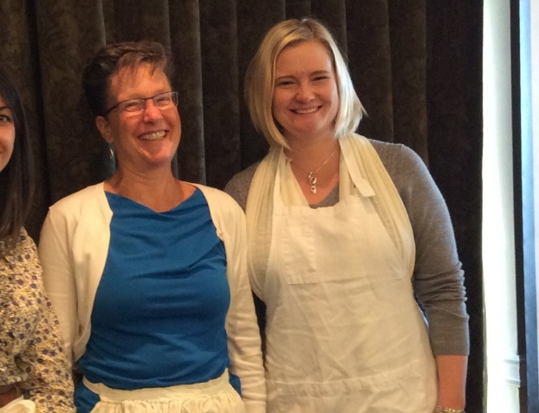
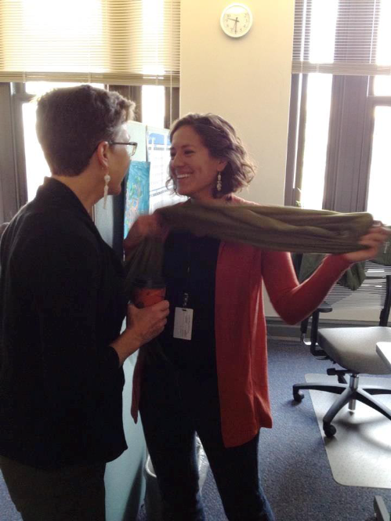
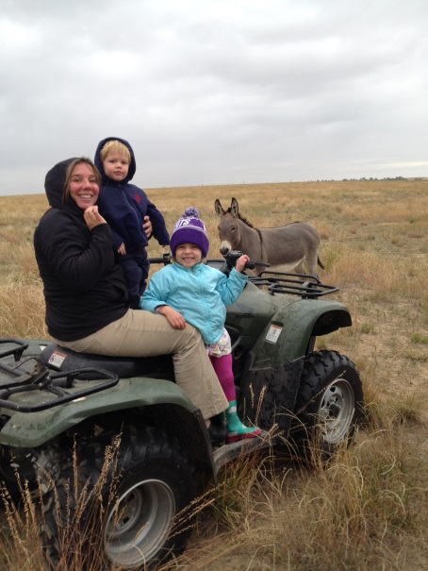
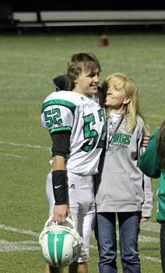
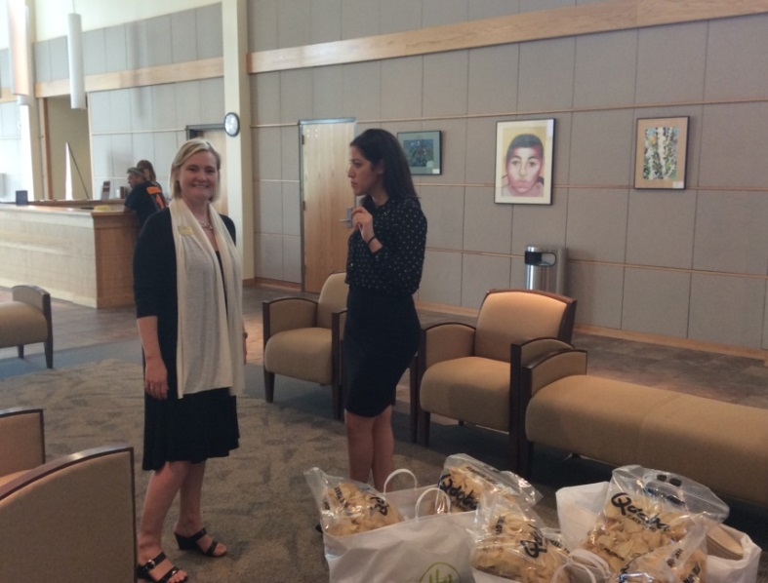
Colorado School Counselor Corps Grant Program
WHO ARE WE?

Slide 2
We Live in the Office of Postsecondary
OPR
CE
ASCENT
Counselor Corps
GED
ICAP
21st Cent Skills
CTE
AP
FAFSA Project

Slide 3
Colorado by the Numbers
75.4% graduation rate
2.9% dropout rate (12,256 students)
$3.2 Billion lost lifetime earnings**
31.8% remediation rate
36.1% of high school seniors took an AP exam and 22.3% received a 3 or higher
65% college enrollment rate of high school graduates
19% of Colorado 11th and 12th grade students in a public high school are participating in a dual enrollment program.
37% CTE participation
* Data from 2011-12 academic year
**Alliance for Education Excellence
Notes:
So what does this mean for Colorado. Revisiting our shared values that students are not defined by a single test and that students have the option to go into the military, career, college or other pathway and have the skills to earn a living wage. We have decreased the dropout rate to just under three percent and increased the graduation rate to 75% over the past few years. However, we still have a distance to go.
Time is the variable and as time is flexible students have the option to help ensure they have the necessary skills and abilities to succeed beyond high school. We can do more. More than 30% of Colorado students that enter a Colorado postsecondary institution are not prepared for college-level work. Additionally, we know that programs such as concurrent enrollment are making a difference.
<John/Mary: discuss experiences with benefits of concurrent enrollment revolutionizing learning in Aurora and hope for all students>

Slide 4
Counselor Corps Goals
Decrease student/counselor ratio
Increase graduation rate
Decrease dropout rate
Decrease remediation rate
Increase postsecondary matriculation rate
Student connections w/ supportive adult
Licensed school counselors
Implement ASCA Model Source: 22-91, C.R.S.

Slide 5
2014-2015 SCCGP Reporting
CDE Data
- Graduation/Matriculation Rate
- Grades
- Dropout Rate
- ACT & TCAP
- Credential Attainment
- Postsecondary Enrollment
- Career
- Remedial Needs
- Concurrent Enrollment & CTE Participation
- FAFSA Completion
- 9th Grade matriculation
District & School Data
- Disaggregated Grad/Matriculation /Dropout
- Admissions Applications
- Scholarship $$
- Attendance
- Counselor/Student Ratio
- College Visits
- Postsecondary Goal
- Parent Engagement
- EXPLORE/Plan
- ASCA Standards Adoption
- ICAP Development/Implementation

Slide 6
SCCGP
Over the six-year history of the
Counselor Corps Grant
153 Secondary Schools
64 Districts
Represents all regions of the state
200+ Licensed Professional School Counselors
have served
Colorado schools, districts, BOCES and students.

Slide 7
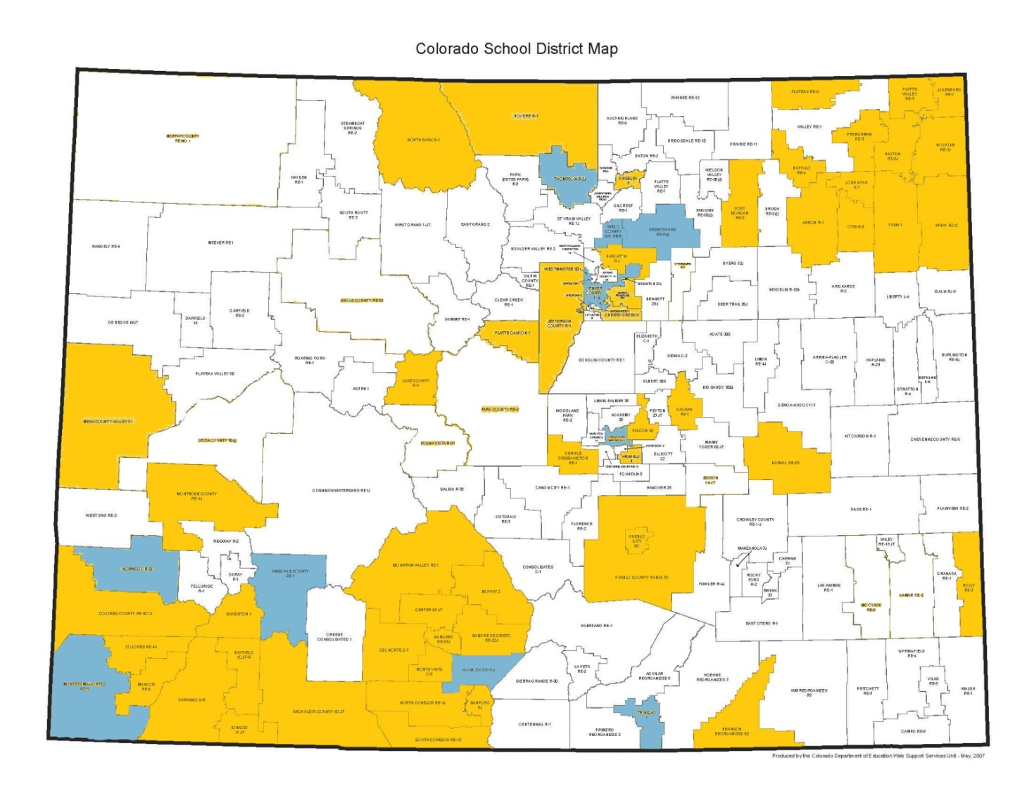
2014-15 Counselor Corps Districts

Slide 8
Cohort Two Outcomes, Year Two
23 grantees funding a total of 76 secondary schools
18 grantees were districts and 5 were charter schools
56,794 students, 59 % free or reduced lunch, in 2012-13
Graduation rates increased by 5 percentage points
Dropout rates decreased by 3.7 percentage points
13 percent increase in student enrolling in postsecondary within one year.
Nearly 70 school counselors were hired lowering student-to-counselor ratios from 363:1 in 2010-11 to 237:1 in 2012-13.

Slide 9
Timeline for Grantees
Monthly Webinars (Sept – April, no March webinar)
November Training
November 5th, 2014
University of Northern Colorado – Greeley
February Training (only attend one)
Grand Junction
Denver
May 1st end of year report
Fiscal Deadlines
Quarterly Reports

Slide 10
Development Year
Environmental Scan & Needs Assessment
Monthly Training
Internal Expertise
Consultants
Laurie Carlson
Pam Decker
John Happs
Rhonda Williams
Identifying Gaps
Aligning Interventions (align w/ UIP)

Slide 11
Grant Administration
The Players instrumental to the SCCG Success at the District and school level:

Slide 12
Roles
Principal/Leadership
Counselors
Program Manager
Fiscal Manager

Slide 13
Reporting Timeline
Annual Report – Due May 1st
Annual Financial Report – Due September 30th
Interim Financial Reports
Screen Shot of from financial system
First working day of the month
October
January
April

Slide 14
Budget Expenditures
Professional Development
Academic Counseling for Career & College
Tools & Resources
Curriculum
Materials
Counselor Salary & Benefits
Transition Programs
College & Career Exploration
Consultants & Professional Services
Trainers
Change Experts

Slide 15
Budget Adjustments
Approvals:
Out-of-state Travel
Personnel
Technology
>10% of Budget
Counselors
Laptop or IPAD
Basic Materials

Slide 16
Review and Questions
Budget Information
CDE Annual Report for Counselor Corps
8 Questions
Found on our website
Includes Budget information

Slide 17
Contact Information
Eve Pugh
pugh_e@cde.state.co.us
303-866-4123
Misti Ruthven
ruthven_m@cde.state.co.us
303-866-6206
www.cde.state.co.us/postsecondary

Slide 18
TEST
https://www.polleverywhere.com/multiple_choice_polls/cjP011XG8716ekY
https://www.polleverywhere.com/multiple_choice_polls/YSiqjaPONKy6u6Z
https://www.polleverywhere.com/multiple_choice_polls/jGBwzSpK15ys9LP

