Slide 1
School Counseling Leadership
Samantha Haviland, Ph. D.
Director of Counseling, Denver Public Schools
President, Colorado School Counselor Association 2013-14

Slide 2
And PROUD to be a CSU Ram

Slide 3
Activity
Write a few sentences on why you are a counselor. What impact are you most proud of?
.

Slide 4
It is the set of the sails, not the direction of the wind that determines which way we will go.
--Jim Rohn

Slide 5
Why is Counseling a leadership role?

Slide 6
School counselors are responsible for each and every student in the building and, unlike others on campus, they are in a position to focus on the educational journey of each student.
The Education Trust| Poised to Lead: How School Counselors Can Drive College and Career Readiness | DECEMBER2011

Slide 7
How do you lead?

Slide 8
Structural leadership:
Leadership in the building of viable organizations
1. Build the foundation of an effective school counseling program.
2. Attain technical mastery of counseling and education.
3. Design strategies for growth of the school counseling program.
4. Implement an effective school counseling program.

Slide 9
Human resource leadership:
Leadership via empowerment and inspiration of followers
1. Believe in people.
2. Communicate that belief.
3. Be visible and accessible.
4. Empower others.

Slide 10
Political leadership:
Leadership in the use of interpersonal and organizational power
1. Understand the distribution of power within the building and district.
2. Build linkages with important stakeholders (e.g., parents, administrators, teachers, board members).
3. Use persuasion and negotiation.

Slide 11
Symbolic leadership:
Leadership via the interpretation and re-interpretation of the meaning of change.
1. Use symbols and metaphors to gain attention of followers.
2. Frame experience in meaningful ways for followers.
3. Discover and communicate a vision.
4. Maintain a relationship with the community you represent (e.g., students, parents, school colleagues).
5. Model health on all levels to inspire others.
6. Lead by example.

Slide 12
Then why aren’t Counselors seen more as leaders?

Slide 13
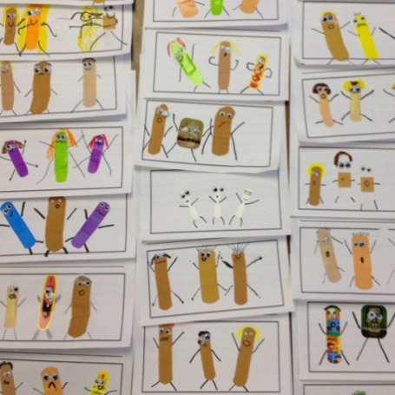
Reporting data
Methods
Audiences
Newsletters
Paper OR email!
Presentations
Bulletin Boards
Accountability Reports
Administrators
Teachers
Parents
Students
District level staff

Slide 14
Accountability Reports

Slide 15
Representing
“I read a thing that actually said that speaking in front of a crowd is considered the number one fear of the average person. I found that amazing- number two was death! That means to the average person if you have to be at a funeral, you would rather be in the casket than doing the eulogy.”
– Jerry Springfeld

Slide 16
Talking the language to increase awareness

Slide 17
Talking the language to increase awareness

Slide 18
Ted Talk
The Lone Nut

Slide 19
I can't change the direction of the wind, but I can adjust my sails to always reach my destination. Jimmy Dean

