Slide 1
Role of the Professional School Counselor
Presentation Link
https://tinyurl.com/CORPSROC
Terry Waldermen, Director of Student Services Sonya L. Sallak, Counselor Coordinator

Slide 2
Welcome!
Presentation Link
https://tinyurl.com/CORPSROC
Sonya L. Sallak
Counselor Coordinator
sallak@jeffco.k12.co.us
303-982-6909

Slide 3
Front Side:
Name, district and email.
Back Side:
What keeps you coming back?

Slide 4
Front Side:
Name, district and email.
Back Side:
What keeps you coming back?

Slide 5
“I have found that, among its other benefits, GIVING liberated the soul of the giver.”
Maya Angelou

Slide 6
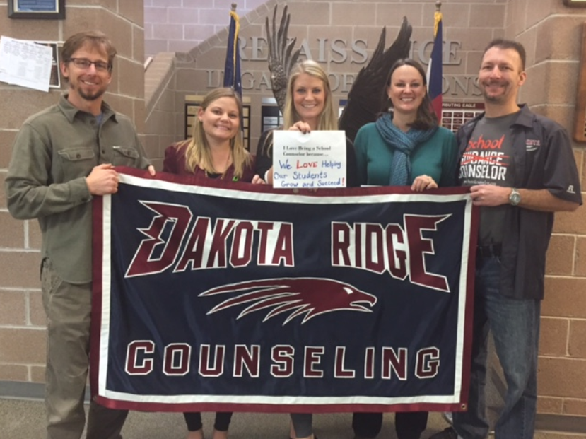
Session Outcomes
Increased understanding of how counselors support the academic, career, & social/emotional needs of our students.
Increased understanding of how you can leverage their unique expertise to maximize student success.

Slide 7
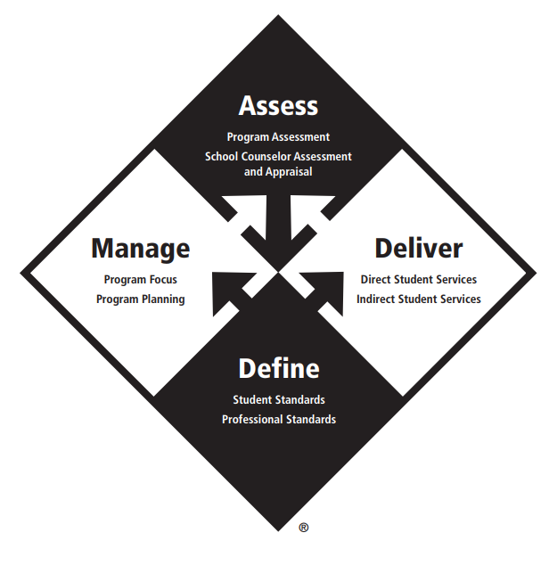

Slide 8
3 ASCA Domains of Counseling
Academic
Social/Emotional
Career

Slide 9
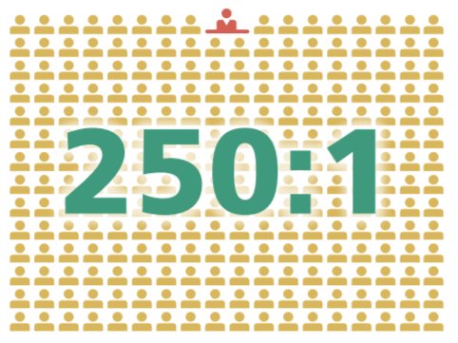
Role of the Professional School Counselor
Role of the School Counselor
https://www.schoolcounselor.org/asca/media/asca/Careers-Roles/RoleStatement.pdf
Essential Role of the High School Counselors
https://www.schoolcounselor.org/asca/media/asca/Careers-Roles/WhyHighSchool.pdf
Essential Role of the Middle School Counselors
https://www.schoolcounselor.org/asca/media/asca/Careers-Roles/WhyMiddle.pdf
Essential Role of the Elementary School Counselors
https://www.schoolcounselor.org/asca/media/asca/Careers-Roles/WhyElem.pdf

Slide 10
ASCA is a
Data-Based Decision Making Model
with alignment to the Counselor Corps, CDE Counselor Evaluation and your UIP.

Slide 11
ASCA National Model - Define
Student Standards
ASCA Mindsets & Behaviors for Student Success: K–12 College- and Career-Readiness for Every Student
Professional Standards
ASCA Ethical Standards for School Counselors
ASCA School Counselor Professional Standards & Competencies
Notes:
Three sets of school counseling standards define the school counseling profession. These standards help new and experienced school counselors develop, implement and assess their school counseling program to improve student outcomes.

Slide 12
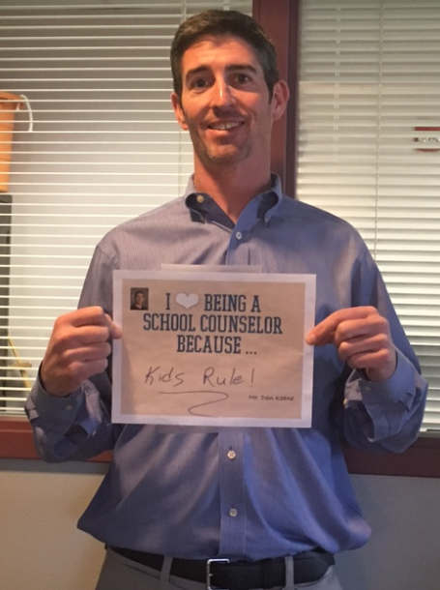
ASCA National Model - Manage
Program Focus
Beliefs
Vision Statement
Mission Statement
Program Planning
School Data Summary
Annual Student Outcome Goals
Action Plans
Classroom and Group
Closing the Gap
Lesson Plans
Annual Administrative Conference
Use of Time
Calendars
Annual or Weekly
Advisory Council
Download the ASCA National Model templates
Notes:
MANAGE To be delivered effectively, the school counseling program must be efficiently and effectively managed. The ASCA National Model provides school counselors with the following program focus and planning tools to guide the design and implementation of a school counseling program that gets results.

Slide 13
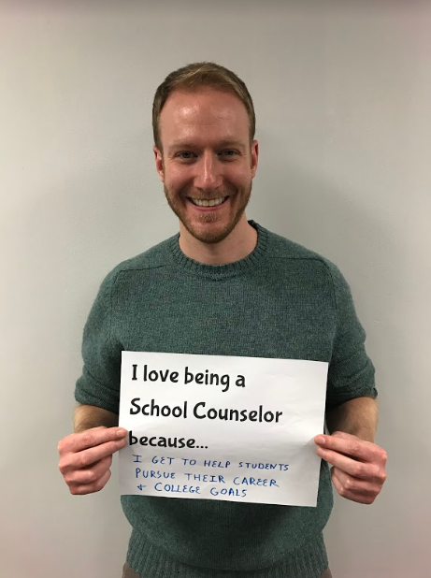
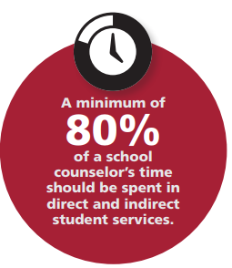
ASCA National Model - Delivery System
Direct Student Services
Instruction
Appraisal and Advisement
Counseling
Indirect Student Services
Consultation
Collaboration
Referrals
Notes:
DELIVER School counselors deliver developmentally appropriate activities and services directly to students or indirectly for students as a result of the school counselor’s interaction with others. These activities and services help students develop the ASCA Mindsets & Behaviors for Student Success and improve their achievement, attendance and discipline.

Slide 14
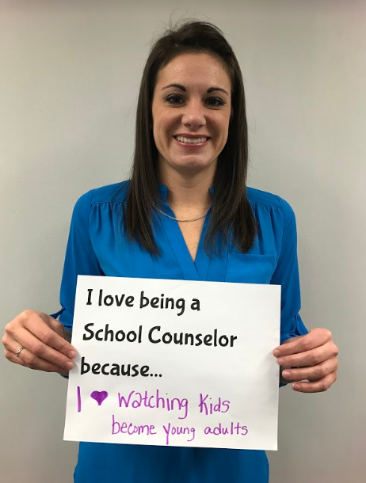
ASCA National Model - Assess
Program Assessment
School Counseling Program Assessment
Annual Results Reports School Counselor
Assessment and Appraisal
ASCA School Counselor Professional Standards & Competencies Assessment
School Counselor Performance Appraisal Template
Notes:
To achieve the best results for students, school counselors regularly assess their program to: ■ determine its effectiveness ■ inform improvements to their school counseling program design and delivery ■ show how students are different as a result of the school counseling program School counselors also self–assess their own mindsets and behaviors to inform their professional development and annually participate in a school counselor performance appraisal with a qualified administrator. The ASCA National Model provides the following tools to guide assessment and appraisal.

Slide 16
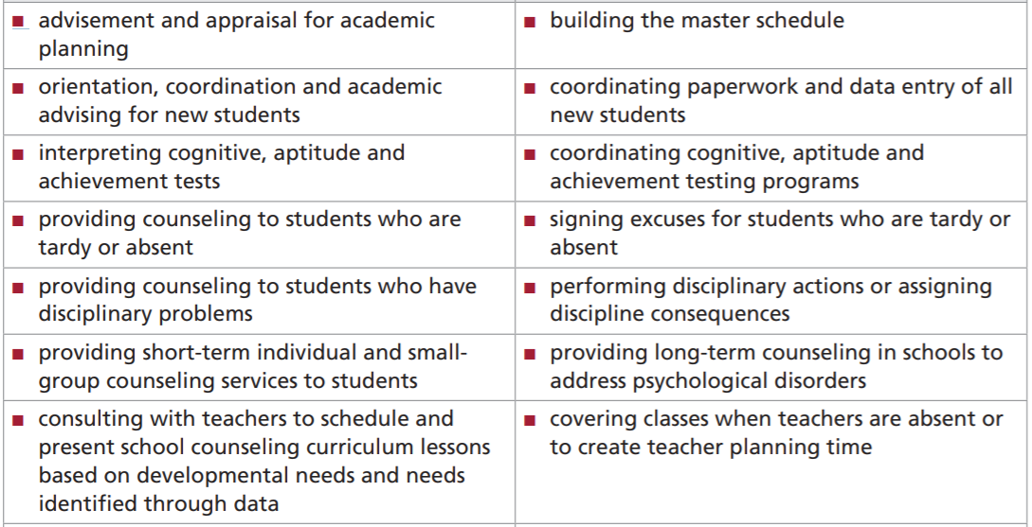
Appropriate and Inappropriate Activities for School Counselors: ASCA Model
Appropriate
Inappropriate
https://www.schoolcounselor.org/asca/media/asca/home/appropriate-activities-of-school-counselors.pdf

Slide 17
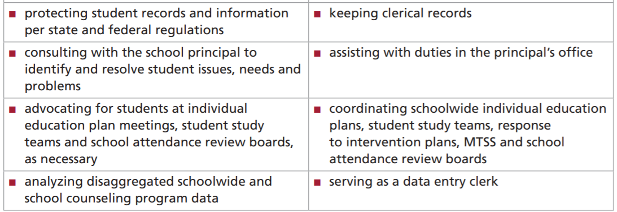
Appropriate and Inappropriate Activities for School Counselors: ASCA Model
Appropriate
Inappropriate
https://www.schoolcounselor.org/asca/media/asca/home/appropriate-activities-of-school-counselors.pdf

Slide 18
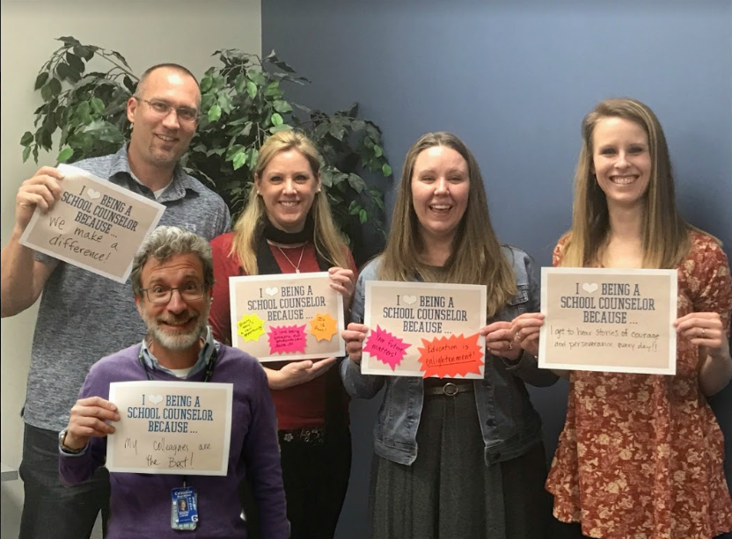
Why is Professional School Counseling important?
High school students who have more access to school counselors (i.e., lower student-school counselor ratios) and related college and career counseling services are more likely to graduate and less likely to have behavioral problems.
School counselors can impact the achievement gap by examining school-wide data and using the data to deliver an effective group intervention.
.
Empirical Research Studies Supporting the Value of School Counseling: ASCA Model https://www.schoolcounselor.org/asca/media/asca/Careers-Roles/Effectiveness.pdf

Slide 19
Why is Professional School Counseling important?
School counselors can use a research-supported group counseling model to improve the academic and social functioning of middle school students.
Through intentional efforts, school counselors can positively influence the social norms that fuel destructive rumor spreading by junior high students.
Empirical Research Studies Supporting the Value of School Counseling: ASCA Model https://www.schoolcounselor.org/asca/media/asca/Careers-Roles/Effectiveness.pdf

Slide 20
Role of the Professional School Counselor in Jeffco

Slide 21
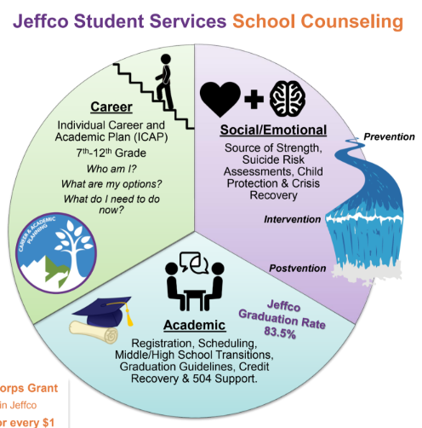

Slide 22
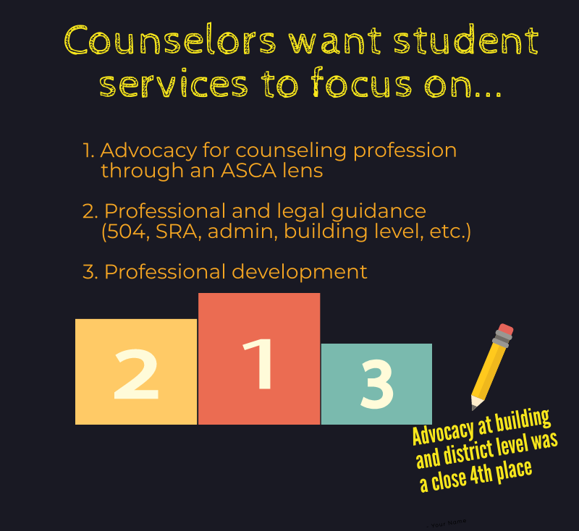
Jefferson County Counselor Association

Slide 23
Advocacy
Counselor Coordinator
Role of the Counselor with Admin
Roadshow
Monday Memo
Counselor Leadership
Counselor Evaluation

Slide 24
Principal-Counselor Relationship
Finding a Way Practical Examples of How an Effective Principal-Counselor Relationship Can Lead to Success for All Students
https://www.schoolcounselor.org/asca/media/asca/home/FindWay.pdf
A Closer Look at the Principal-Counselor Relationship: A Survey of Principals and Counselors
https://secure-media.collegeboard.org/digitalServices/pdf/nosca/a-closer-look_2.pdf
Sample Annual Agreement
https://www.schoolcounselor.org/asca/media/asca/ASCA%20National%20Model%20Templates/AnnualAgreementTemplate.pdf

Slide 25
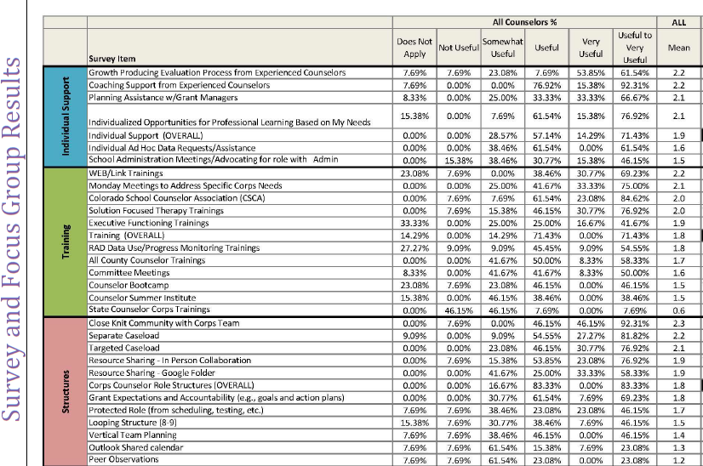
Research Report: How Schools can Support Counselors Working with At-Risk Youth
Protected Role
Specific Caseload
Meaningful evaluation process
Relevant professional development
Time to collaborate with team
Supported by trained school counselor
https://drive.google.com/file/d/1nB2mG1Ur4vLe3KYxQ8MDQ3MgTTAEMN7F/view?usp=sharingk/view?usp=sharing

Slide 26
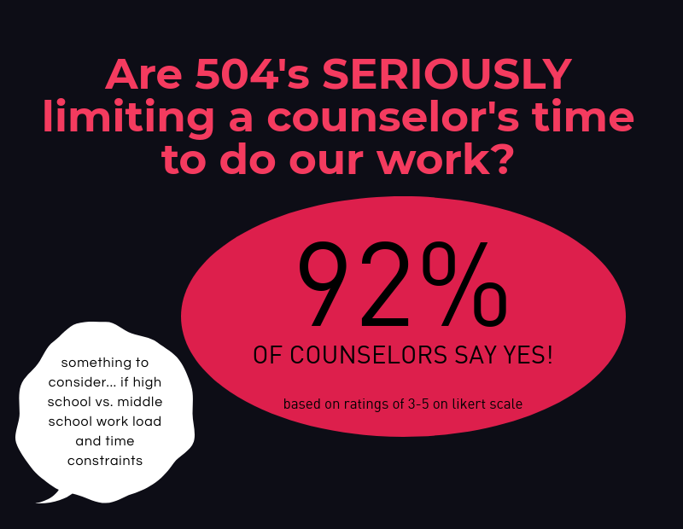
Professional and Legal Guidance

Slide 27
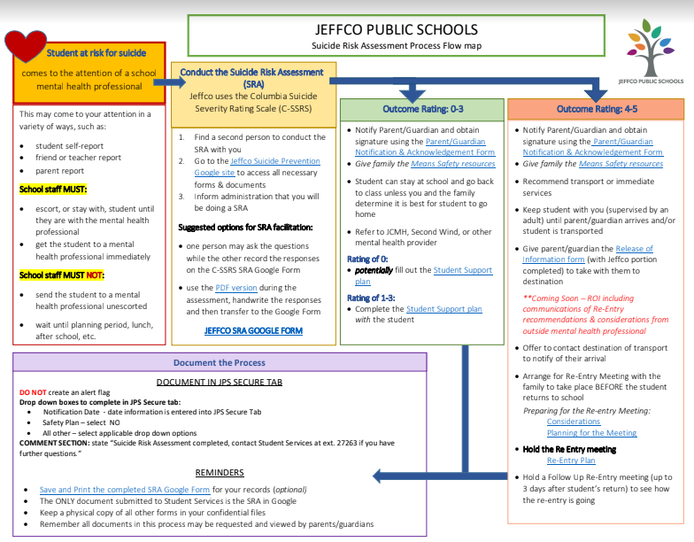

Slide 28
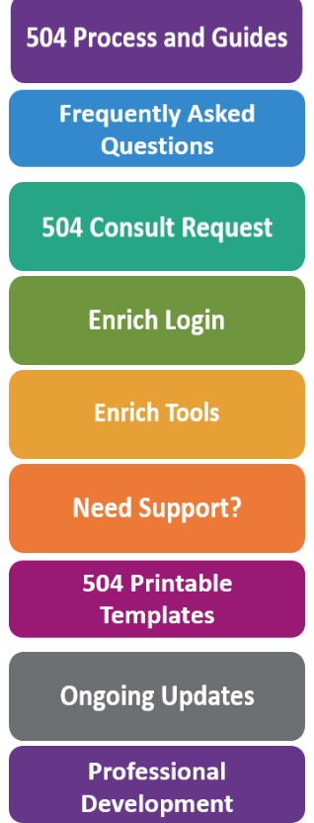
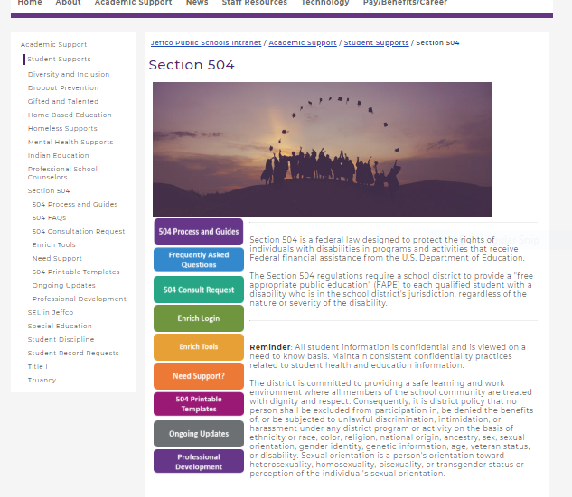

Slide 29
Professional Development
2019-20 Student Services Kick-Off
Counselor Professional Learning Committee
HS and MS Committee Meetings
All County Counselor Training
School Counselor Summer Institute
Guest Speakers
Additional ongoing PD relevant to their role
Feedback and data to drive decisions

Slide 30
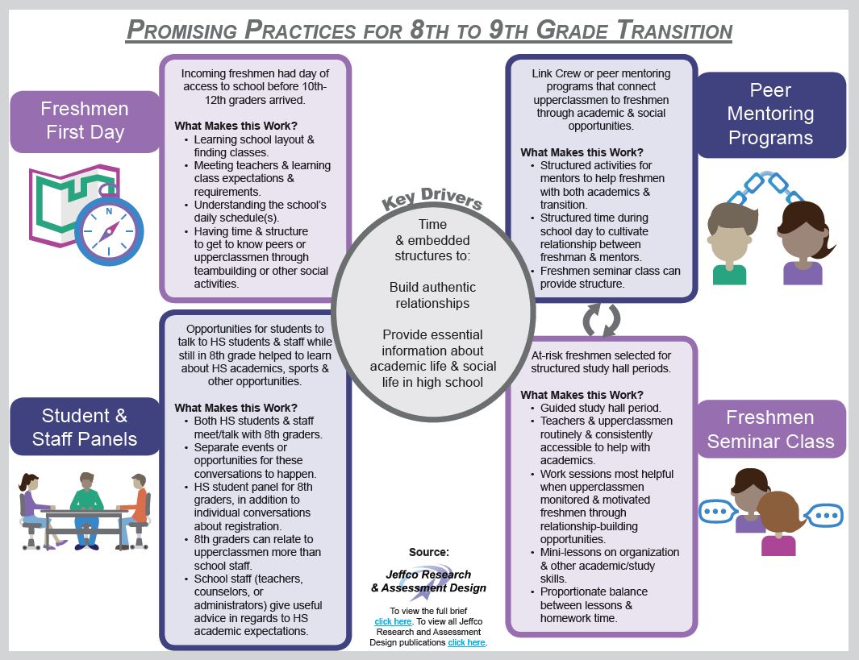
Jeffco Counselor Corps Research Brief: 8th to 9th Grade Transition Perceptions and Supports
https://drive.google.com/file/d/0B_A00_7stTN9WVpHaXhMY25VUk

Slide 31
https://www.schoolcounselor.org/school-counselors-members/about-asca-(1)/national-school-counseling-week

Slide 32
Terry Walderman
Director of Student Services
Terry.Walderman@jeffco.k12.co.us
303-982-6397
Sonya L. Sallak
Counselor Coordinator
sallak@jeffco.k12.co.us
303-982-6909

