Slide 1
Before We Begin
Recording in Process
Closed-captioning: click the Live Transcript option on your bottom Zoom toolbar, under more.

Slide 2
School Counselor Corps Grant (SCCG) Program Pursuant to C.R.S. 22-91-101 through 22-91-105
Application Information Webinar
February 2024

Slide 3
SCCG and the Office of
Postsecondary & Workforce Readiness
Jennica Mabe
School Counseling Specialist
Mabe_j@cde.state.co.us
Brooke Morgan
School Counseling Specialist
Morgan_b@cde.state.co.us

Slide 4
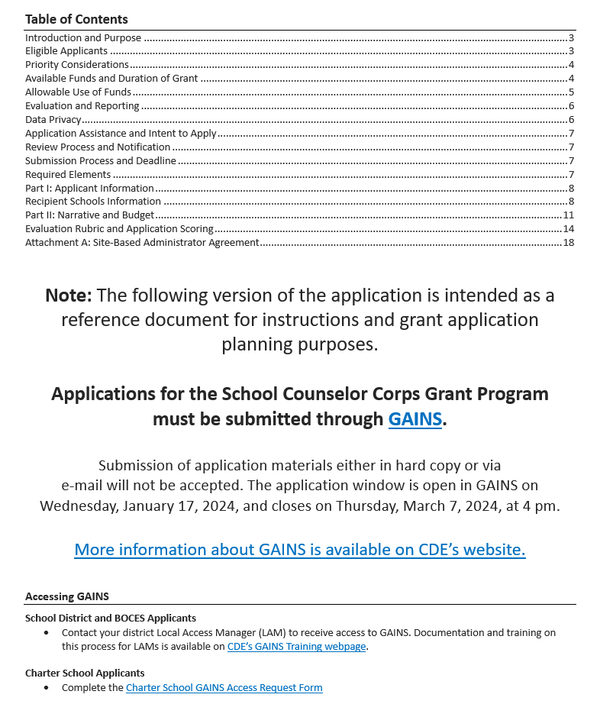
Request for Application (RFA) 2024
View the Word document version for reference only (DOC)

Slide 5
Program
Key Elements

Slide 6
Introduction and Purpose
This Request for Applications (RFA) is designed to distribute funds to eligible education providers pursuant to the requirements of the School Counselor Corps Grant Program (SCCGP), C.R.S. 22-91-101 through 22-91-105.
The purpose of SCCGP is to increase the availability and implementation of effective school-based counseling to:
Increase the state graduation rate
Increase the percentage of students who appropriately prepare for, apply to, and continue into postsecondary education
Support work-based learning awareness, education, and opportunities

Slide 7
Types of Applications
School Site Application
Intent is to fund individual school counselors at school sites.
District-wide Application
Intent is to fund a school counselor at the district level or coordinate alignment and school counseling system support.
No more than 25% of the applications submitted for specific districtwide positions will be approved in this competition.

Slide 8
Eligible Applicants-
General Information
Education providers are eligible to apply for this opportunity to increase the number of school counselors for secondary and elementary students and the level of school counseling services provided.
Elementary applicants must apply with the secondary school(s) (middle and/or high schools) for which they are a feeder school.
The secondary school(s) must either be included as part of this grant application or be a current SCCGP grantee.
Elementary applications must address how early exposure to comprehensive school counseling programs prepares young students for postsecondary and workforce readiness.

Slide 9
Eligible Applicants-
General Information Continued
Local Education Providers (LEPs) are eligible to apply for this opportunity. An eligible LEP is:
A School District;
A Board of Cooperative Educational Services (BOCES);
A Charter School authorized by a School District; or
A Charter School authorized by the Charter School Institute.
Note: Applications will not be accepted from individual non-charter schools and must be authorized and submitted through the LEP. Only one application will be considered per LEP.
Each grant application must address needs specific to the individual district and schools. The submission of applications that are identical or similar to previously submitted RFAs, except for names, data and descriptions of the eligible schools or district, will not be accepted.

Slide 10
Eligible Applicants-
Charter Schools
Pursuant to C.R.S. 22-30.5-104 (11), a charter school may choose to apply apart from their authorizer for a competitive grant program created by a federal or state statute or program. The charter school is considered the LEP only for the purposes of applying and determining eligibility. A charter school’s authorizer will be the fiscal agent, if funded.
A charter school that applies for a grant shall provide to its authorizing district:
A copy of the grant application at the time the application is submitted to CDE; and
If the charter school receives the grant moneys, a summary of the grant requirements, a summary of how the charter school is using the grant moneys, and periodic reports on the charter school’s progress in meeting the goals of the grant as stated in its application.
If a charter school intends to apply for a grant that the school’s authorizing school district is also intending to apply for, the charter school shall seek to collaborate with the school district in the application and to submit the application jointly. If the charter school and the school district are unable to agree to collaborate in applying for the grant, the charter school may apply for the grant independently or in collaboration with other charter schools.

Slide 11
Eligible Applicants-
Previously Funded
Those who have been previously funded with SCCGP funds may apply, however:
Applicants that have previously received funds from SCCGP may apply for this current funding opportunity for sites that were not awarded in the last five years.
Previously awarded school sites must wait one year from completion of the SCCGP to re-apply in another application round of SCCGP.
No more than 25% of previously participating school sites will be awarded in this competition.
Previously funded must describe current grant activities and services and demonstrate how, if awarded, capacity to provide activities and services will be expanded, augmented, or sustained. Sustainability, past expenditure of funds and quality of program implementation will also be considered.

Slide 12
Priority Considerations
Available grant funding will be distributed to Education Providers with school(s) demonstrating high need based on Priority Criteria:
Dropout rate or identified with significant reading deficiency at that exceed the statewide average.
Schools with a high percentage of students who are eligible for Free and Reduced Lunch exceeding the statewide K-12 rate.
Postsecondary remediation (Developmental Education) rates at secondary schools that exceed the statewide average.
Postsecondary matriculation (Postsecondary Enrollment) rates that are below the statewide average.
LEPs (Districts/BOCES/Charter Schools) that have never received the grant.
Education providers in geographic locations of underserved areas of the state.
Education providers with current student-to-counselor ratio at the school higher than 250 students per school counselor.

Slide 13
Available Funds and Duration of Grant
This application is being released but is contingent upon enacting pending appropriations to the School Counselor Corps Grant Program for the 2024-2025 school year.
Anticipated level of funding available for 2024-2025: approximately $600,000 for grant awards
Year One (development): awards will range between $30,000 and $50,000
Focus on an intentional data review, creation of SMART goals, program development, and direct services.
Year Two- Four: awards up to $90,000 per funded school site
Focus on implementation and increase of school counseling services.
There is a limit of six funded sites per application based on state allocations. The final funding amount will be based on identified need as determined by the development year report.

Slide 14
Available Funds and Duration of Grant Continued
Grants will be awarded for a four-year term beginning in the 2024-2025 school year.
Each year of grant funding is contingent upon annual appropriations by the State Legislature.
Funded applicants will be eligible for continued funding in the second, third, and fourth years of the grant cycle after successfully demonstrating the following:
Submission of all required evaluation materials;
Adequate progress toward successfully meeting annual objectives;
Thorough needs assessment/environmental scan of district, along with postsecondary and workforce readiness;
Completed program development report after the first year to demonstrate fidelity to proceed with years two, three, and four; and
Completed budgets and finalized funding amounts for years two, three, and four following the first year.

Slide 15
Allowable Uses of Funds
Funds may be used to supplement and not supplant any monies currently being used to provide school counseling positions and/or activities.
Allowable activities include:
Licensed school counselor salaries and benefits for site-base, districtwide, or BOCES-wide positions;
Grant related travel to in-person required trainings and professional development;
Career awareness and postsecondary preparatory services;
Professional development;
School counseling program development and implementation; and
Consulting services.
Funds may not be used for the following (including, but not limited to):
Capital equipment;
Building improvements, construction, or maintenance;
Indirect costs, or incentives for students and or staff; or
FTE related to non-school counseling positions (i.e., school psychologists, social workers, clinical counselors).

Slide 16
Allowable Uses of Funds-
Professional Development & Trainings
Applicants must budget for a team to attend three, one-day grant trainings during each year of the grant cycle.
Year one must budget for a team member to attend monthly webinars.
Required trainings will provide professional development consistent with grant expectations for postsecondary preparation counseling.
Key staff most closely related to the success of the grant (e.g., school counselors, teachers, administrators) must attend.
It is an expectation in each year of funding, that at least one school leadership member (principal or assistant principal and school counseling team, if applicable) must attend the trainings in addition to counselors funded with Counselor Corps grant dollars.

Slide 17
Evaluation and Reporting
Grant Year One (Development Year)
Each Education Provider that receives funds through SCCG is required to report, at a minimum, the following information to the Department in year one (to include but not limited to):
The number of school counselors hired using grant moneys;
Any professional development programs provided using grant moneys;
Any other services provided using grant moneys;
Original application goals;
School Counseling Program Vision and Mission Statements
Intentional data review process and findings;
Determined areas of focus;
Needs assessment process and findings;
Site-based SMART goals;
Interventions planned;
Changes in goals during the development year process;
Feedback on the development year process; and
District and school level contact information.

Slide 18
Evaluation and Reporting
Years Two, Three, Four Implementation Years)
Each Education Provider that receives funds through SCCG is required to report, at a minimum, the following information to the Department each year (to include but not limited to):
The number of school counselors hired using grant moneys;
Any professional development programs provided using grant moneys;
Any other services provided using grant moneys;
A comparison of the dropout rates, and the college matriculation and remediation rates, if applicable, at the recipient schools for the years prior to receipt of the grant and the years for which the education provider receives the grant;
Information indicating an increase in the level of postsecondary preparation services provided to students at recipient schools, such as the use of individual career and academic plans or enrollment in pre-collegiate preparation programs or post secondary or vocational preparation programs;
Any additional information that the state board, by rule, may require;
School counselor to student ratio;
Evaluation of impact of Grant Program;
Adoption of American School Counseling Association (ASCA) model and standards;
A comparison of the attendance and reading proficiencies prior to the receipt of the grant and the years for which the education provider receives a grant at the recipient elementary schools;
Successful matriculation through elementary and between middle and high school (if applicable); and
An annual performance report by May 30 of each year of the grant.

Slide 19
Data Privacy
CDE takes seriously its obligation to protect the privacy of student and educator Personally Identifiable Information (PII) collected, used, shared, and stored. PII will not be collected through the School Counselor Corps Grant Program. All program evaluation data will be collected in the aggregate and will be used, shared, and stored in compliance with CDE’s privacy and security policies and procedures.
Note: Documents submitted as part of the application must not contain any personally identifiable student or educator information including names, identification numbers, or anything that could identify an individual. All data should be referenced/included in the aggregate and the aggregate counts should be redacted to remove small numbers under n=16 for students or n=5 for educators.
Information reported to CDE in relation to grant activities is not confidential and is subject to public request. Awarded grantees should ensure reported information does not contain Personally Identifiable Information (PII) or confidential information.

Slide 20
Application Elements and Timeline

Slide 21
Timeline
If interested in applying for this funding opportunity, submit the Intent to Apply by Thursday, February 29, 2024.
Although strongly encouraged, completion of the Intent to Apply is not a required component of the application process.
Completing the Intent to Apply assists CDE in knowing who needs access to the application in GAINS and providing access guidance, securing a sufficient number of peer reviewers, and provides an avenue to communicate important updates with potential applicants.
Activity | Date
Intent to Apply Due | Thursday, February 29, 2024
Application Due | Thursday, March 7, 2024, by 4 pm
Application Review | March 8, 2023 – April 12, 2023
Initial Notifications | No later than Friday, June 14, 2024
State Board Meeting | May 8, 2024 – May 9, 2024

Slide 22
Submission Process and Deadline
Applications must be completed and submitted through GAINS by Thursday, March 7, 2024, by 4 pm.
Application materials and resources for review only are available on CDE’s School Counselor Corps Grant Program webpage.
Incomplete or late applications will not be considered. If you have questions about your submitted application email CompetitiveGrants@cde.state.co.us.
GAINS Training: https://www.cde.state.co.us/gains/gainstrainings

Slide 23
Review Process and Notifications
Applications will be reviewed by the School Counselor Corps Grant Program Advisory Board members and peer reviewers.
This process may be discontinued at any point as funding is contingent upon pending appropriations to the School Counselor Corps Grant Program for 2024-2025 school year.
If the state budget is passed and appropriations are available, applicants will be notified of final award status no later than Friday, June 14, 2024.
This is a competitive process – applicants must score at least 42 points out of the 61 possible narrative points to be approved for funding.
Award funding is contingent upon pending appropriations to the School Counselor Corps Grant Program, and CDE will award applications until the level of available funding has been met.
Applications that score below 42 points may be asked to submit revisions that would bring the application up to a fundable level.
There is no guarantee that applying will result in funding or funding at the requested level.
All award decisions are final. Applicants that do not meet the qualifications may reapply for future grant opportunities.

Slide 24
Required Elements
The format outlined in the RFA document, must be followed to assure consistent application of the evaluation criteria. See Evaluation Rubric for specific selection criteria (RFA doc. pages 14-17).
Part I: Application Information, School Information, and Program Assurance
Part II: Narrative and Budget
Uploads: Site-Based Administrator Agreement
Note: Apart from the items noted above, attachments or addendums cannot be utilized to address the required elements or be factored into the scoring and are therefore discouraged.

Slide 25
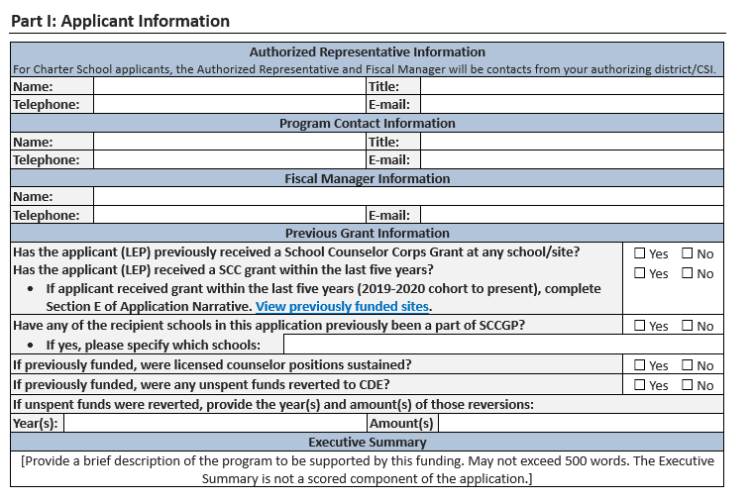
Required Elements-
Part I: Applicant Information

Slide 26
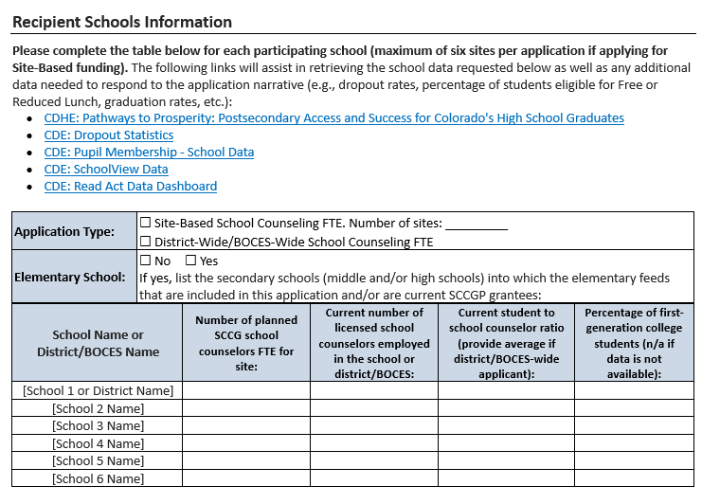
Required Elements-
Part I: School Information

Slide 27
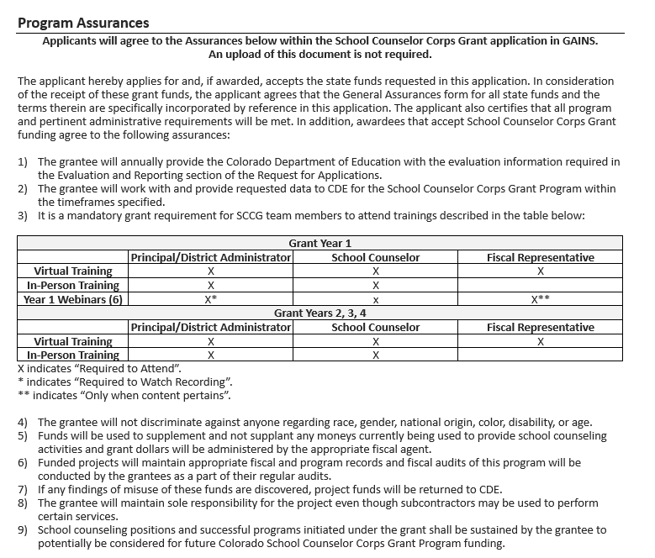
Required Elements-
Part I: Program Assurances
Applicants will agree to the Assurances below within the School Counselor Corps Grant application in GAINS.

Slide 28
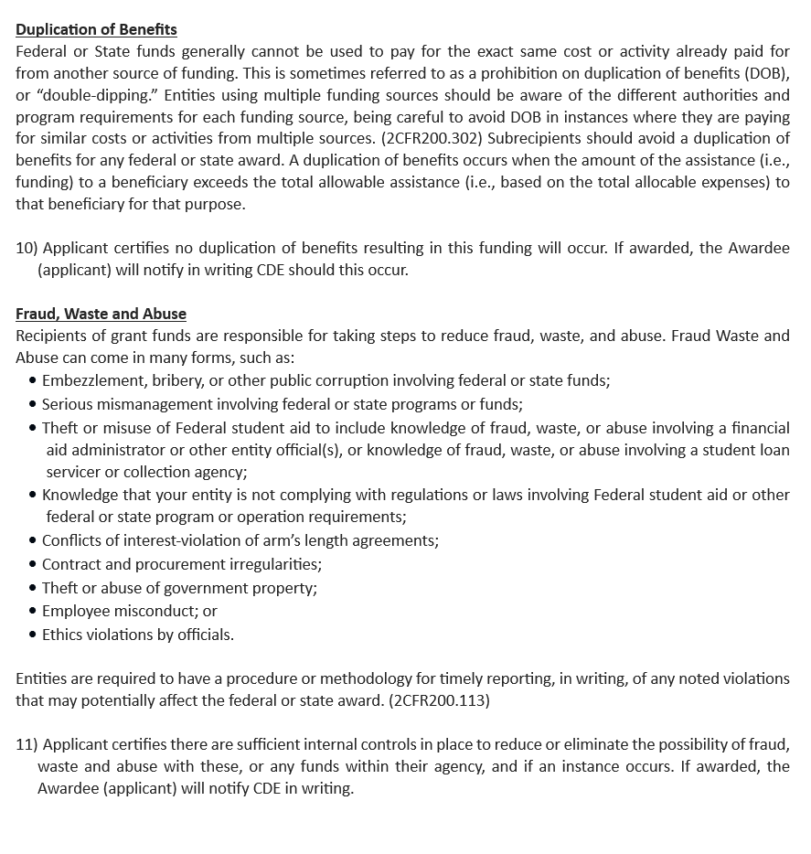
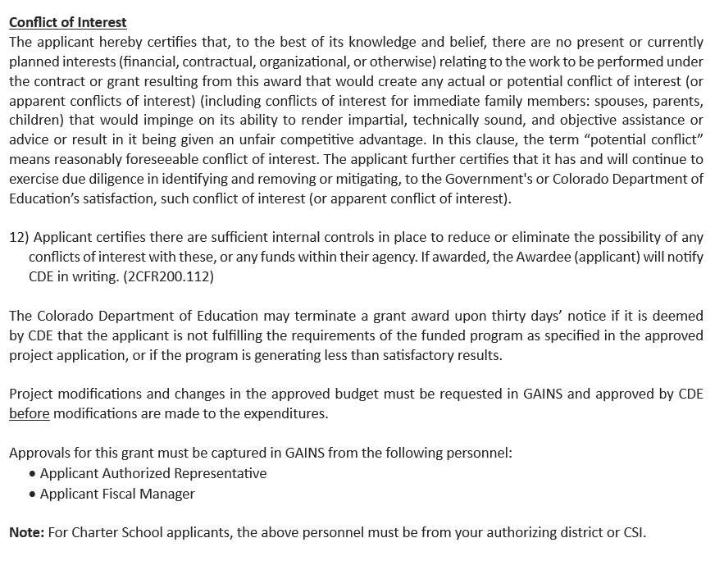
Required Elements-
Part I: Program Assurances Continued
Applicants will agree to the Assurances below within the School Counselor Corps Grant application in GAINS.

Slide 29
Required Elements-
Part II: Narrative
Responses should be completed in the online application form. Although the system will save your work in progress, applicants may find it useful to compose answers in a separate document and copy them into the form.
For those applicants that have previously received funding from the School Counselor Corps Grant Program the expectation is that the narrative responses will include references to that award, where applicable. For example, discuss how the funds contributed to the program and what still needs to be accomplished. Applicants should demonstrate ongoing and improved capacity in the program and a well-developed plan for sustainability.
See narrative questions in RFA document on the SCCG website or in GAINS.

Slide 30
Required Elements-
Part II: Narrative and Budget
Complete your proposed program budget in GAINS.
Budget guidance and examples can be found on the SCCG application webpage.
This RFA requires grantees to write a proposed budget for year one:
Year one: budget request of $30,000 and maximum $50,000
Year two: budget request of maximum $90,000 per funded school
Budgets for years two, three and four will be written during the course of the grant program.

Slide 31
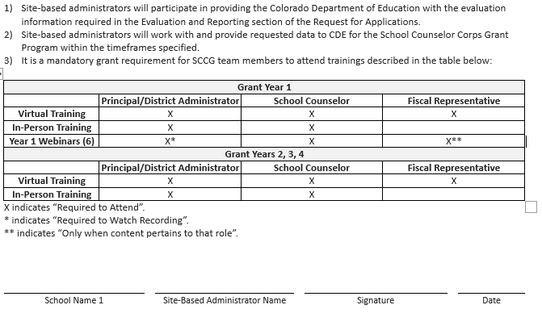
Required Elements-
Uploads
Participating site-based administrators must sign and upload to GAINS to indicate their understanding and agreement to the requirements of the School Counselor Corps Program.

Slide 32
Evaluation Rubric and Scoring
The following criteria will be used by reviewers to evaluate the application.
For the application to be recommended for funding, it must receive at least 42 points out of the 61 possible narrative points and all required elements must be addressed.
An application that scores below 42 points may be asked to submit revisions that would bring the application up to a fundable level. An application that receives a score of zero on any required elements will not be funded without revisions.

Slide 33
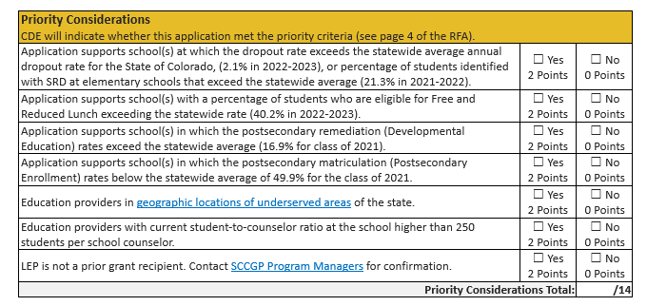
Evaluation Rubric and Scoring
Priority Considerations

Slide 34
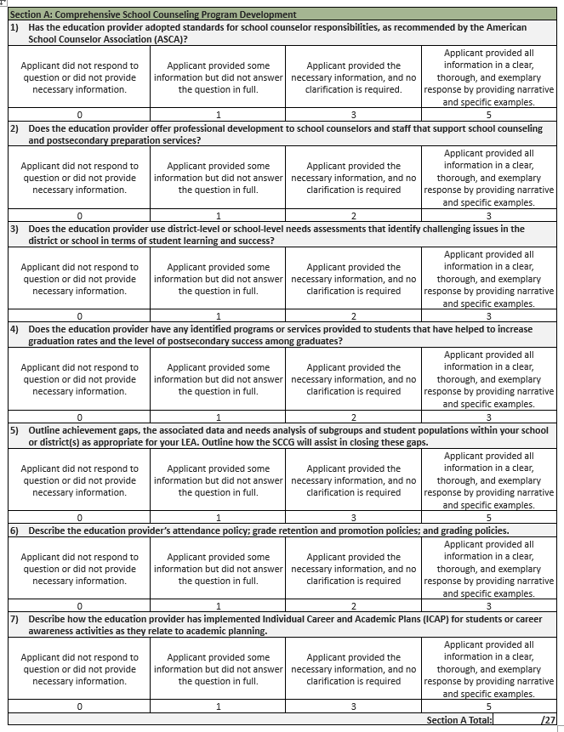
Evaluation Rubric and Scoring
Section A: Comprehensive School Counseling

Slide 35
Budget Workbook – In GAINS
Complete your proposed program budget in GAINS.
Budget guidance and examples can be found on the SCCG application webpage- Budget Reminders (DOC).
This RFA requires grantees to write a proposed budget for year one only.
Year one: budget request of $30,000 and maximum $50,000
Year two: budget request of maximum $90,000 per funded school site (how many sites do you plan to fund?)
Budgets for years two, three and four will be written during the course of the grant program.

Slide 36
Budget Workbook – Budget Details Personnel Costs & Budget Codes
Salaries (0100): staff regular salaries & stipends
Employee Benefits (0200): staff regular benefits
Purchased Professional & Technical Services (0300): consultants for direct service
Other Purchased Services (0500): professional development contracts

Slide 37
Budget Workbook – Budget Details Supplies & Operating Costs Budget Codes
Travel, Registration and Entrance (0580): approved conferences/training, per diem
Supplies (0600): subscriptions, membership fees, counseling supplies, books, food, furniture
Non-Capitalized Equipment (0735): technology

Slide 38
Tips
and
Resources

Slide 39
General Application Guidance
Read the RFA thoroughly.
Confirm eligibility and that grant requirements can be met (i.e. trainings with admin & counselors).
Know dates, set a timeline, create a work plan
Get approval from school administration before you start the application process.
Know how much you can apply for
Make sure to do the Intent to Apply
Create a team to help (make sure you have the right people in the room)
Know your numbers and how to create/run a budget
Write a good narrative
Look at the scoring rubric, it's your best friend!

Slide 40
Contact Us
Program Questions:
Brooke Morgan, School Counseling Specialist
(303) 923-0966 | Morgan_B@cde.state.co.us
Jennicca Mabe, School Counseling Specialist
(303) 923-0974 | Mabe_J@cde.state.co.us
Budget/Fiscal Questions:
Tricia Miller, Grants Fiscal Management
(303) 877-2154 | Miller_T@cde.state.co.us
Application Process Questions:
Mandy Christensen, Grants Program Administration (303) 957-6217 | Christensen_A@cde.state.co.us

