Slide 1
Data,
Where To Find It & What to Do With it...
Notes:
VALERIE

Slide 2
Presenters
Valerie Scates
Facilitator, Counseling Services
Colorado Springs School District 11
valerie.scates@d11.org
Dave West
Coordinator, Counseling Services
Aurora Public Schools
dlwest@aurorak12.org
Notes:
VALERIE
Intros and have people share out their hopes

Slide 3
A typical reaction to a four letter word...DATA!
Notes:
VALERIE
Which one of these images most closely approximates your reaction to the 4 letter word, DATA?
What is your biggest hope for today’s presentation?

Slide 4
What data really is to a
school counselor...
WHAT IS YOUR “WHY?”
Art & Science of SC
3 more students coming to school regularly
Passing rates of students are comparable across races and genders
6 less students being suspended
2 more students saying no to risky sex
1 more student reaching out for help instead of attempting suicide
31 more parents coming to open house
12 more students enrolling in college
Adapted from Hatching Results presentation for Aurora Public Schools (2019)
Notes:
VALERIE

Slide 5
Analyze
your data to identify needs and gaps
Determine implications - how can
we be more effective?
Determine
the root cause of students’ struggles
Analyze pre/post test data and review progress toward goals
Write SMART
goals
“SOOs”
Student-Centered, Data-Informed
Decision-Making Cycle
Deliver the interventions and pre/post tests
Select interventions that match the root causes
Build out the interventions and write lesson plans
Select M&Bs and write measurable objectives
Develop a pre/post test to measure student learning
Adapted from: ASCA Implementation Guide, 1st Ed., p. 24
Adapted from Hatching Results presentation for Aurora Public Schools (2019)
Notes:
DAVE

Slide 6
Hatching Results Conceptual Diagram
How Do School Counselors Impact School Data?
Process Data
(Participation)
Perception Data
(Mindsets & Behaviors)
Outcome Data
“Participation Data”
“M&Bs Data”
Achievement-Related Data
Achievement Data
Who?
What?
When?
Where?
How Long?
Attendance
Discipline Referrals
Parent Involvement
Homework Completion
Course Enrollment Patterns
Postsecondary Test Taking
College Applications
FAFSA Completion
Report Card Grades
GPA
Promotion Rates
Graduation Rates
AP Test Scores
ACT/SAT/etc. Test Scores
College Enrollment Rates
Financial Aid Earned
Attitudes
Skills
Knowledge
Behavior Change
Tier 1: Core Curriculum Class Lessons
Tier 2: Intentional Interventions
Hatch, T (2006)
Adapted from Hatching Results presentation for Aurora Public Schools (2019)
Use of Data pg. 82
Notes:
DAVE
Process/Participation: What you did & for whom…
Perception/Mindsets/Behaviors: Did you ask attitudes, knowledge & skills
Outcomes: So what…?
Turn and Talk:
How many of you are familiar with this conceptual diagram?
How many of you use this?
What types of data do you see?
What do you think the red boxes are for? (RAMP)
How are you interpreting the arrows at the bottom

Slide 7
Linkages Between Standards & Competency Data, Achievement-Related Data, & Achievement Data
Examples of Standards & Competency Data |  | Student Achievement-Related Data |  | Student Achievement Data
Knowledge of college requirements Accurately complete a four-year plan Demonstrate ability to set and achieve a goal Use time management skills Demonstrate conflict resolution skills | Leads to... | Course enrollment patterns Discipline referrals Suspension rates Rates of alcohol, tobacco, & other drug use Attendance patterns Parent involvement levels Rates of participation in extracurricular activities | Leads to... | Standardized test data Math passing rates Passage rates for high school exit examinations G.P.A. SAT/ACT scores Changes in scores n benchmark assessments (math, reading) Dropout rate Completion of college prep requirements College freshman remediation rates
The Use of Data, Hatch, T. (2014)
Notes:
DAVE
Standards & Competencies= Attitudes, Knowledge, Skills

Slide 8
What to Measure (ASK)
What do you want me to believe that I did not believe before?
What do you want me to know that I didn’t know before?
What do you want me to demonstrate that I did not demonstrate before?
Adapted from Hatching Results presentation for Aurora Public Schools (2019)
Attitude (A)
Likert Scale Q’s
Knowledge (K)
Multiple Choice Q’s
Skill (S)
Word Problems
Demonstration of skill
Notes:
DAVE
Ask for examples they have seen/heard in each area

Slide 9
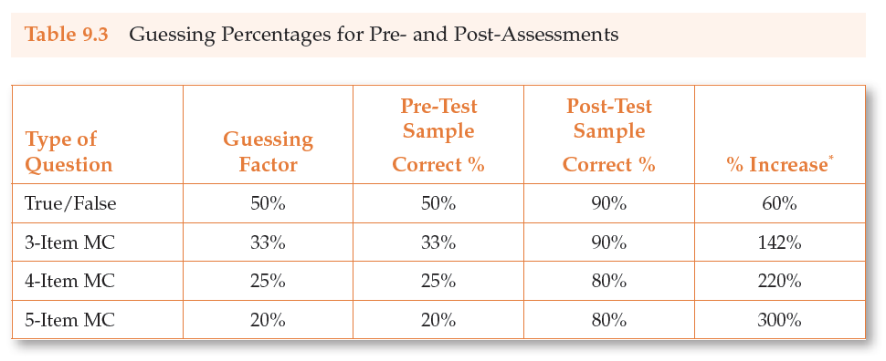
Knowledge (K): True/False vs Multiple Choice?
It’s an issue of data validity...
“All of the above”/“None of the above” - Use judiciously, according to developmental level
Adapted from Hatching Results presentation for Aurora Public Schools (2019)
Notes:
DAVE
Things that make you go...Hmmm?

Slide 10
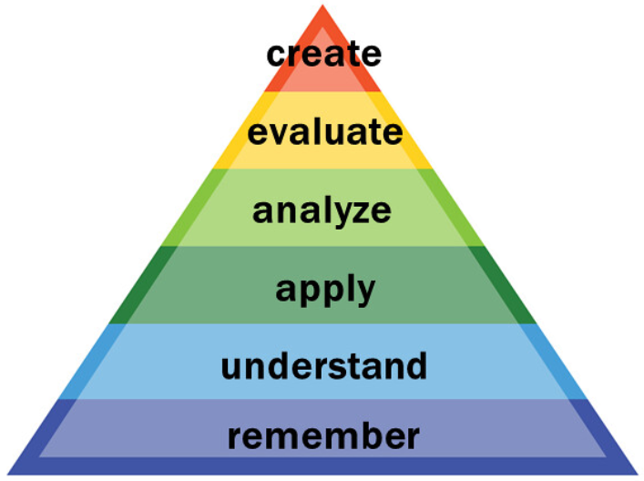
What is the question measuring?
1. Which of the following is a way to resist violence?
a. Conflict management
b. Moving to a safe area
c. Both A & B
d. None of the above
Adapted from Hatching Results presentation for Aurora Public Schools (2019)
Attitude
Knowledge
Skill
Hatch, T. (2014)
Notes:
VALERIE
Turn and talk

Slide 11
What is the question measuring?
Some students come up to you at lunch and start calling your mom names and want you to fight. Which of the following is a good way to resist violence?
Tell them you will see them after school
Get friends to back you up
Push one of them and run
Tell them you do not want to get suspended because of them
Adapted from Hatching Results presentation for Aurora Public Schools (2019)
Attitude
Knowledge
Skill
Hatch, T. (2014)
Notes:
VALERIE
Turn and talk

Slide 12
Hints for Pre/Post Tests
Pre-Vetted and Approved Samples:
Use of Data Online Appendix, Ch. 7
Hatching Results for Elementary School Counseling textbook, Ch. 8
Hatching Results for Secondary School Counseling textbook, Ch. 9
Avoid essay, true/false, and fill-in-the-blanks
Decide whether to include a neutral choice
Eliminate double negatives
Ask only one question at a time
Watch your language
Try it out first
Little ones
100 responses is enough if needed
NOTE: Be careful on the internet!
Hatch, T. (2014)
Adapted from Hatching Results presentation for Aurora Public Schools (2019)
Notes:
VALERIE

Slide 13
Where to Find your data...
Schoolview
Infinite Campus
Canned Reports
Ad Hoc Reporting
Tableau
Needs Assessments
Notes:
VALERIE

Slide 14
Schoolview
Schoolview from CDE
School and District Dashboards for Graduation Rates, Dropout Rates, and Matriculation Rates
District at a Glance from CDHE
Postsecondary Enrollment and Outcomes, FAFSA Completion, Pell Recipients, Concurrent Enrollment, First Year Persistence, Credential Attainment
Compare with National, State, and Local trends

Slide 15
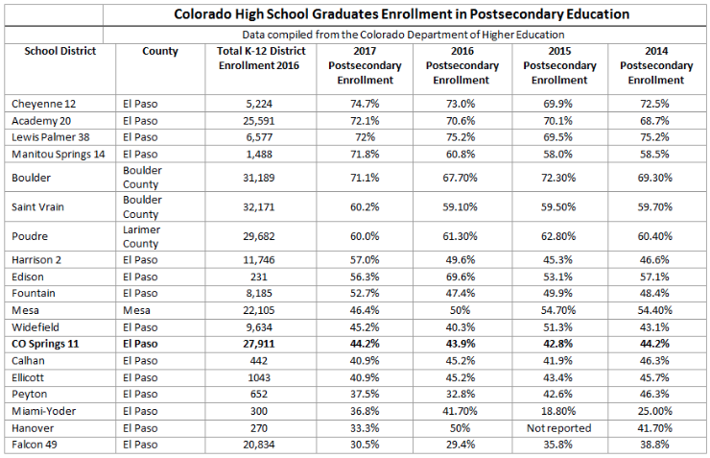

Slide 16
Infinite Campus
Notes:
DAVE

Slide 17
Ad Hoc Reporting
Ad Hoc Reporting tools provide users with the ability to filter, display and report specific database information based on defined criteria. Ad hoc filters can also be used in conjunction with many reports throughout Campus to further filter results to a specific set of data or students.
Users can typically access to the following types of reporting features within Infinite Campus:
Canned reports:
These are prepared reports that are easily accessible under the Index Menu. Some reports require various options to be selected, prior to the report being generated. All reports can be generated as a PDF, some also have a CSV option.
Data Viewer:
The Data Viewer is a user-friendly report building tool which allows users to drag and drop fields into a real-time view of the report as it is being built.
Filter Designer:
The Filter Designer provides a tool for the end user to select certain fields located throughout the product and place them in one central report. It allows users to build reports two different ways:
The Query Wizard allows users to create a filter by selecting specific data fields from within the product.
The Selection Editor allows users to manually select a group of students for whom a report can be run.
Notes:
DAVE

Slide 18
Canned Reports
Notes:
DAVE

Slide 19
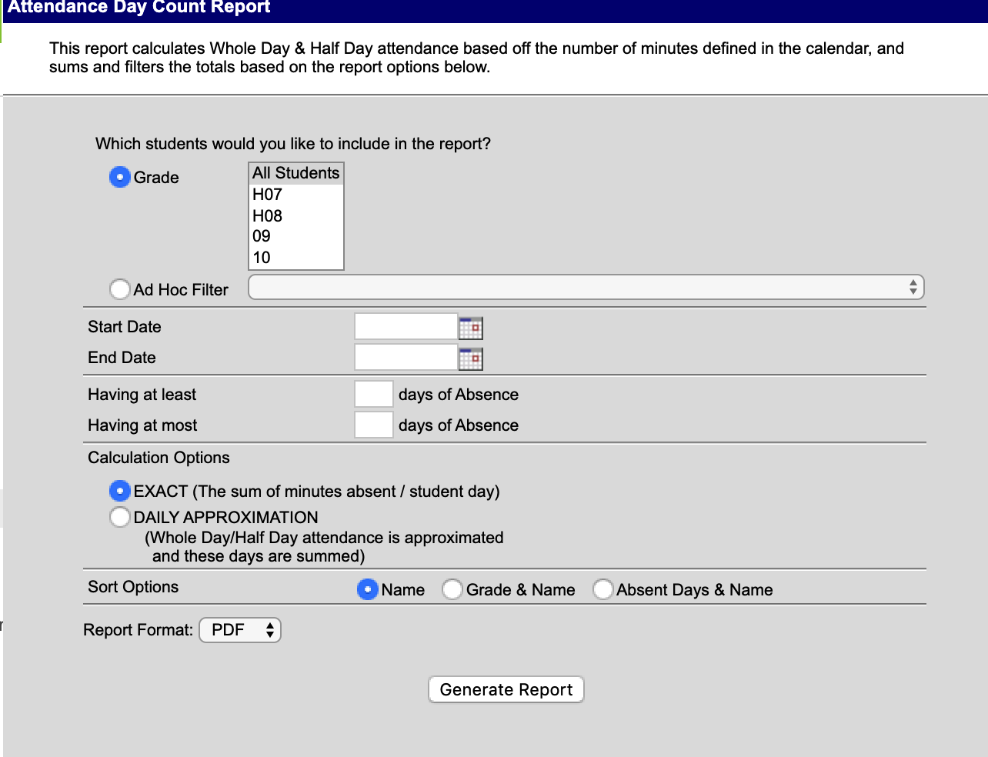
Student Attendance
Attendance>
Reports>
Day Count OR Period Count
Notes:
DAVE
What type of data is this?

Slide 20
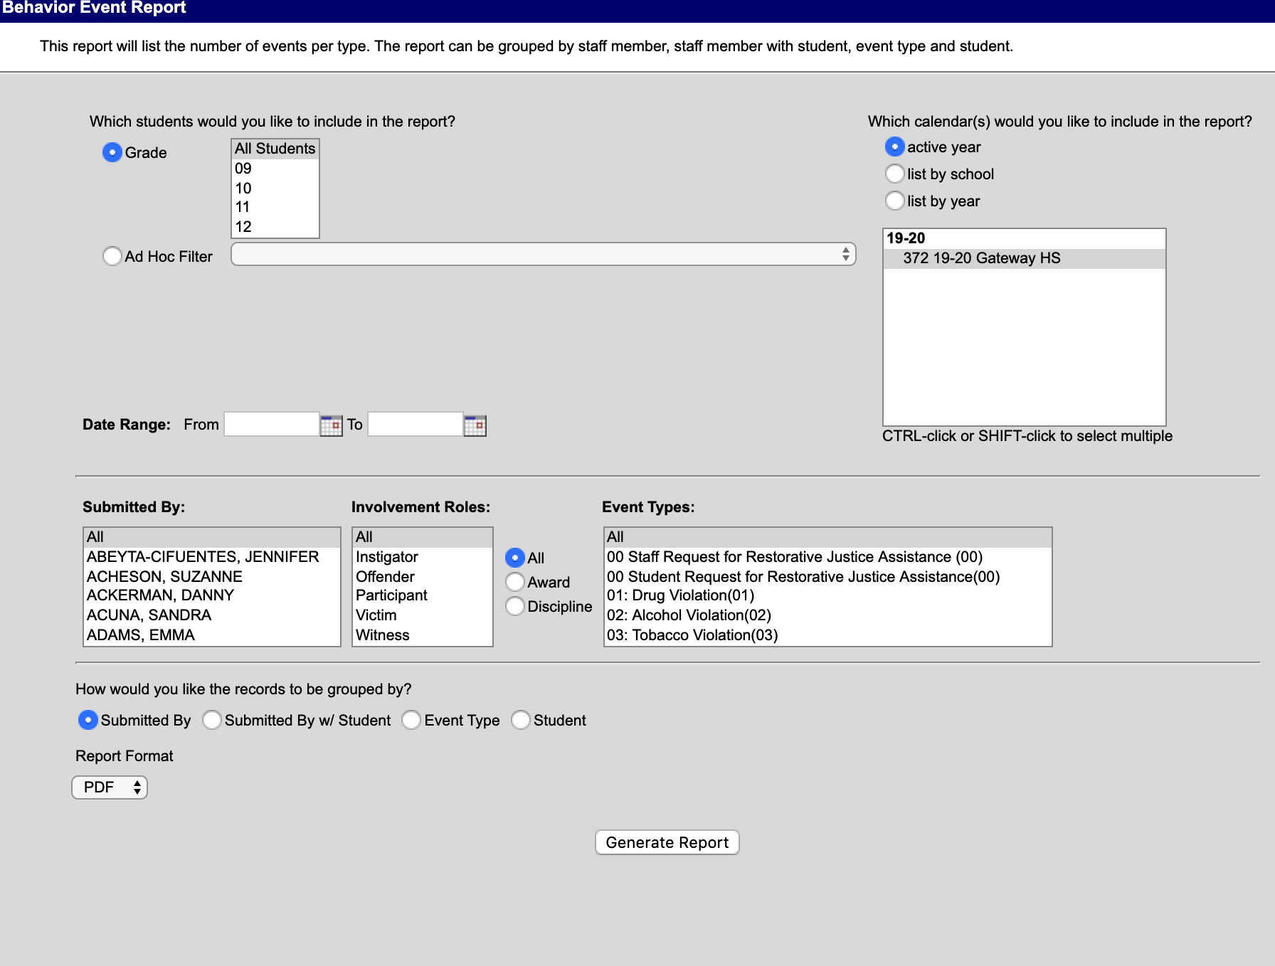
Student Behaviors
Behavior>
Reports>
Events
Notes:
DAVE

Slide 21
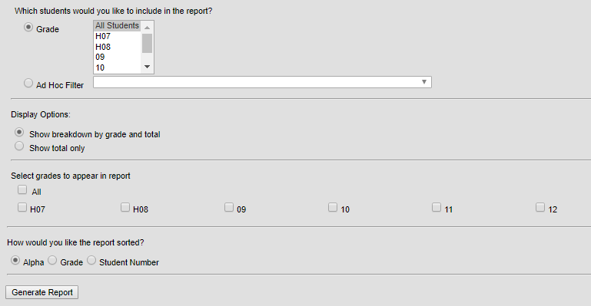
Student Credits
Grading & Standards>
Reports>
Students Credits
Notes:
DAVE

Slide 22
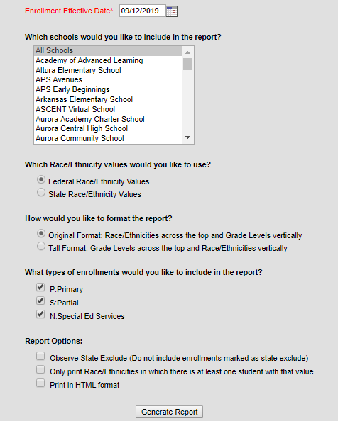
Enrollment Summary
Student Information>Reports>Enrollment Summary
Notes:
DAVE

Slide 23
Data Viewer vs. Filter Designer
Both of these reporting tools are very similar.
The biggest difference with Data Viewer is the instant gratification to view results:
10 results (at first)
If any filters you may have added are working
Are these the results you are looking for?
When building a report with Filter Designer
You have to “save & test” your report, before you see any results,
If nothing shows, you need to go back and adjust your filters and/or fields, then
Save & test again, and again…..
Both tools allow you to run reports as a PDF and/or CSV.
Both also allow you to run a report for multiple schools.
Data Viewer will allow you to run a report against a secondary ad hoc as well.
Notes:
DAVE

Slide 24
Needs Assessment
This is a tool to determine your building’s/district’s needs
Think of this as “what” (what are the building/district needs) that precedes the gap analysis, which is the “how” (how to close the gap between where the school/district is currently and where the desired state).
Three typical parts
Initiation: Identifying the “frame factors,” otherwise known as “limiting factors,” for the needs assessment project, the school/district being analyzed, and the project stakeholders--This is the ENVIRONMENTAL SCAN we discussed in the September webinar.
Data Collection & Analysis- A SWOT (Strengths, Weaknesses, Opportunities, Threats) analysis can assist in understanding areas of success as well as concerns to mitigate
Final Product- This is where the work of the SMART goal comes into play
Notes:
VALERIE

Slide 25
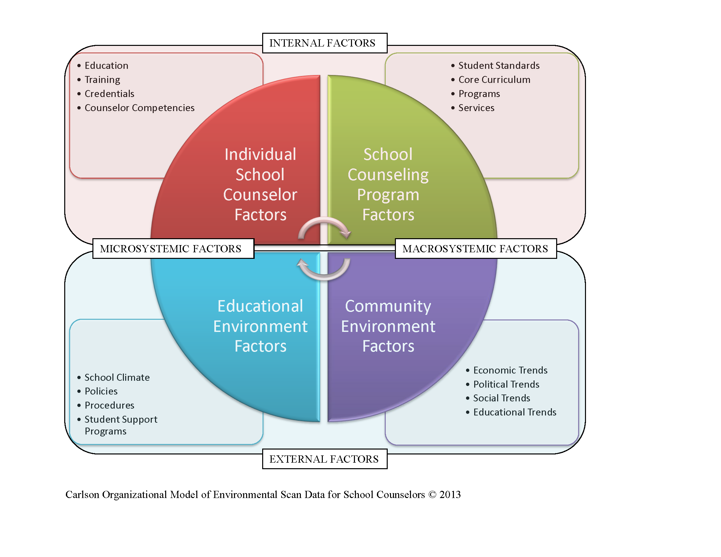
Environmental Scan
Notes:
VALERIE

Slide 26
Smart Goal examples
APS
Boston P-8
Mosley P-8
Clyde Miller
Notes:
DAVE

Slide 27
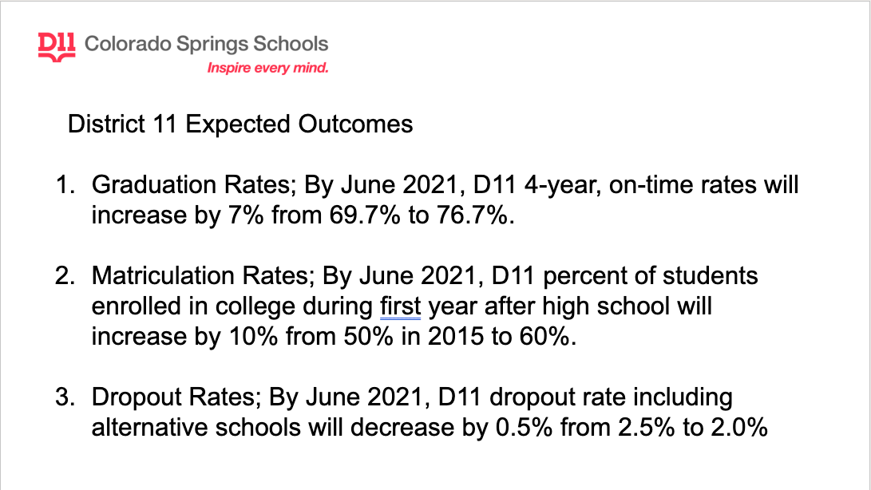
Notes:
VALERIE

Slide 28
Notes:
VALERIE

Slide 29
How are you feeling about today’s work?
Notes:
DAVE
QUESTIONS?

