Slide 1
Before We Begin
Recording in Process
Closed-captioning: click the Live Transcript option on your bottom Zoom toolbar, under more.
Notes:
Brooke

Slide 2
School Counselor Corps Grant Program (SCCGP) Pursuant to C.R.S. 22-91-101 through 22-91-105
Application Information Webinar
January 15, 2025
Notes:
Brooke

Slide 3
SCCG and the Office of
Postsecondary & Workforce Readiness
Jennicca Mabe
School Counseling Specialist
Mabe_j@cde.state.co.us
Brooke Morgan
School Counseling Specialist
Morgan_b@cde.state.co.us
Notes:
Brooke

Slide 4

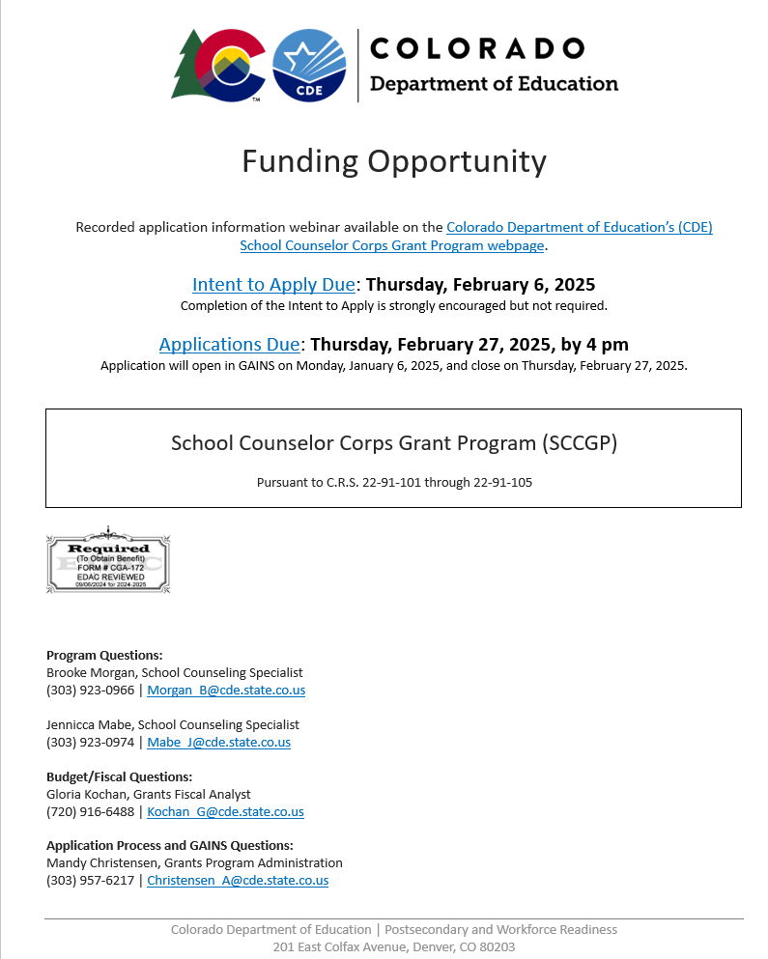
Request for Application (RFA) 2025
View the Word document version for reference only (DOC)
Notes:
Brooke

Slide 5
Program
Key Elements
Notes:
Jennicca

Slide 6
Introduction and Purpose
This Request for Applications (RFA) is designed to distribute funds to eligible education providers pursuant to the requirements of the School Counselor Corps Grant Program (SCCGP), C.R.S. 22-91-101 through 22-91-105.
The purpose of SCCGP is to increase the availability and implementation of effective school-based counseling to:
Increase the state graduation rate
Increase the percentage of students who appropriately prepare for, apply to, and continue into postsecondary education
Support work-based learning awareness, education, and opportunities
Notes:
Jennicca

Slide 7
Types of Applications
School Site Application
Intent is to fund individual school counselors at school sites.
District-wide Application
Intent is to fund a school counselor at the district level or coordinate alignment and school counseling system support.
No more than 25% of the applications submitted for specific districtwide positions will be approved in this competition.
Notes:
Jennicca

Slide 8
Eligible Applicants
General Information
Education providers are eligible to apply for this opportunity to
Increase the number of school counselors for secondary and elementary students
Increase the level of school counseling services provided
Elementary applicants must apply with the secondary school(s) (middle and/or high schools) for which they are a feeder school.
The secondary school(s) must either be included as part of this grant application or be a current SCCGP grantee.
Elementary applications must address how early exposure to comprehensive school counseling programs prepares young students for postsecondary and workforce readiness.
Notes:
Jennicca

Slide 9
Eligible Applicants
General Information Continued
Local Education Providers (LEPs) are eligible to apply for this opportunity. An eligible LEP is:
A School District;
A Board of Cooperative Educational Services (BOCES);
A Charter School authorized by a School District; or
A Charter School authorized by the Charter School Institute.
Note: Applications will not be accepted from individual non-charter schools and must be authorized and submitted through the LEP. Only one application will be considered per LEP.
Each grant application must address needs specific to the individual district and schools. The submission of applications that are identical or similar to previously submitted RFAs, except for names, data and descriptions of the eligible schools or district, will not be accepted.
Notes:
Jennicca

Slide 10
Eligible Applicants
Charter Schools
Pursuant to C.R.S. 22-30.5-104 a charter school may choose to apply apart from their authorizer for a competitive grant program created by a federal or state statute or program.
The charter school is considered the LEP only for the purposes of applying and determining eligibility. A charter school’s authorizer will be the fiscal agent, if funded.
Notes:
Jennicca

Slide 11
Eligible Applicants
Charter Schools Part II
A charter school that applies for a grant shall provide to its authorizing district:
A copy of the grant application at the time the application is submitted to CDE; and
If the charter school receives the grant moneys, a summary of the grant requirements, a summary of how the charter school is using the grant moneys, and periodic reports on the charter school’s progress in meeting the goals of the grant as stated in its application.
If a charter school intends to apply for a grant that the school’s authorizing school district is also intending to apply for, the charter school shall seek to collaborate with the school district in the application and to submit the application jointly. If the charter school and the school district are unable to agree to collaborate in applying for the grant, the charter school may apply for the grant independently or in collaboration with other charter schools.
Notes:
Jennicca

Slide 12
Eligible Applicants
Previously Funded
Those who have been previously funded with SCCGP funds may apply, however:
Applicants that have previously received funds from SCCGP may apply for this current funding opportunity for sites that were not awarded in the last five years (2019-2024).
Previously awarded school sites must wait one year from completion of the SCCGP to re-apply in another application round of SCCGP.
Previous grant recipients must demonstrate how previously funded school counseling positions and successful programs have been sustained. Past expenditure of funds and quality of program implementation will also be considered, including the return of any unused funds to CDE.
No more than 25% of applications that include previously funded sites will be awarded in this competition.
Notes:
Jennicca

Slide 13
Priority Considerations
*Each funded site on the application must meet priority considerations to receive the points.
Available grant funding will be distributed to Education Providers with school(s) demonstrating high need based on Priority Criteria:
LEPs that have not employed a licensed school counselor in the last 3 years.
LEPs with current student-to-counselor ratio higher than 250 students per school counselor.
Schools at which the dropout rate exceeds the statewide average. 2022-23 annual dropout rate for the State of Colorado is 2.1% OR percentage of K-3 students identified with significant reading deficiency at elementary schools that exceed the statewide average of 21.3% in 2021-2022; and
Notes:
Brooke
Available grant funding will be distributed to Education Providers with school(s) demonstrating high need based on Priority Criteria. Priority will be given to applicants that demonstrate:
· Schools at which the dropout rate exceeds the statewide average. 2022-23 annual dropout rate for the State of Colorado is 2.1% OR percentage of K-3 students identified with significant reading deficiency at elementary schools that exceed the statewide average of 21.3% in 2021-2022; and
· Schools with a high percentage of students who are eligible for Free and Reduced Lunch exceeding the statewide K-12 rate of 40.2% from 2022-2023.
· Postsecondary remediation (Developmental Education) rates at secondary schools that exceed the statewide average of 16.9% for the class of 2021;
· Postsecondary matriculation (Postsecondary Enrollment) rates that are below the statewide average of 49.9% for the class of 2021.
· LEPs (Districts/BOCES/Charter Schools) that have never received the grant. View previously funded sites.
· Education providers in geographic locations of underserved areas of the state.
· Education providers with current student-to-counselor ratio at the school higher than 250 students per school counselor.

Slide 14
Priority Considerations Continued
Schools with a high percentage of students who are eligible for Free and Reduced Lunch exceeding the statewide K-12 rate of 40.2% from 2022-2023.
Postsecondary remediation (Developmental Education) rates at secondary schools that exceed the statewide average of 16.9% for the class of 2021;
Postsecondary matriculation (Postsecondary Enrollment) rates that are below the statewide average of 49.9% for the class of 2021.
LEPs (Districts/BOCES/Charter Schools) that have never received the grant.
LEPs in geographic locations of underserved areas of the state.
Notes:
Brooke
Available grant funding will be distributed to Education Providers with school(s) demonstrating high need based on Priority Criteria. Priority will be given to applicants that demonstrate:
· Schools at which the dropout rate exceeds the statewide average. 2022-23 annual dropout rate for the State of Colorado is 2.1% OR percentage of K-3 students identified with significant reading deficiency at elementary schools that exceed the statewide average of 21.3% in 2021-2022; and
· Schools with a high percentage of students who are eligible for Free and Reduced Lunch exceeding the statewide K-12 rate of 40.2% from 2022-2023.
· Postsecondary remediation (Developmental Education) rates at secondary schools that exceed the statewide average of 16.9% for the class of 2021;
· Postsecondary matriculation (Postsecondary Enrollment) rates that are below the statewide average of 49.9% for the class of 2021.
· LEPs (Districts/BOCES/Charter Schools) that have never received the grant. View previously funded sites.
· Education providers in geographic locations of underserved areas of the state.
· Education providers with current student-to-counselor ratio at the school higher than 250 students per school counselor.

Slide 15
Available Funds and Duration of Grant
This application is being released but is contingent upon enacting pending appropriations to the School Counselor Corps Grant Program for the 2025-2026 school year.
The anticipated level of funding available for the 2024-2025 school year is approximately $600,000.
Funding Process:
Year One (development): awards will range between $30,000 and $50,000 to focus on an intentional data review, creation of SMART goals, program development, and direct services.
Years Two through Four: awards up to $90,000 per funded school site to focus on implementation and increase of school counseling services.
There is a limit of six funded sites per application based on state allocations. The final funding amount will be based on identified need as determined by the development year report.
Notes:
Brooke

Slide 16
Available Funds and Duration of Grant
Continued
Grants will be awarded for a four-year term beginning in the 2025-2026 school year.
Each year of grant funding is contingent upon annual appropriations by the State Legislature.
Funded applicants will be eligible for continued funding in the second, third, and fourth years of the grant cycle after successfully demonstrating:
Submission of all required evaluation materials;
Adequate progress toward successfully meeting annual objectives;
Thorough needs assessment, along with postsecondary and workforce readiness;
Completed program development report after the first year to demonstrate fidelity to proceed with years two, three, and four; and
Completed budgets and finalized funding amounts for years two, three, and four following the first year.
Notes:
Brooke

Slide 17
Allowable Uses of Funds
Funds may be used to supplement and not supplant or replace any monies currently being used to provide school counseling positions or activities.
Allowable activities include:
Licensed school counselor salaries and benefits for site-base, districtwide, or BOCES-wide positions.
Grant Year One: School counselor salaries and benefits are an optional use of funds to support grant work in year one only.
Grant Years Two-Four: 1.0 School counselor FTE salaries and benefits are required per funded site.
Grant related travel to in-person required training and professional development.
Career awareness and postsecondary preparatory services.
Professional development.
Events, supplies, and technology related to comprehensive school counseling program development and implementation; and school counseling program development and implementation.
Consulting services.
Notes:
Brooke

Slide 18
Unallowable Uses of Grant Funds
Funds may be used to supplement and not supplant or replace any monies currently being used to provide school counseling positions or activities.
Funds may not be used for the following (including, but not limited to):
Capital equipment.
Building improvements, construction, or maintenance.
Indirect costs, or incentives for students and or staff.
FTE related to non-school counseling positions (i.e., school psychologists, social workers, clinical counselors).
Notes:
Brooke

Slide 19
Allowable Uses of Funds-
Professional Development & Trainings
Applicants must budget for a team to attend three, one-day grant trainings during each year of the grant cycle.
Year one must budget for a team member to attend monthly webinars.
Required trainings will provide professional development consistent with grant expectations for postsecondary preparation counseling.
In each year of funding, counselors funded with Counselor Corps grant dollars and at least one school leadership member (principal or assistant principal) must attend the trainings.
Notes:
Brooke

Slide 20
Evaluation and Reporting
Grant Year One (Development Year)
Each Education Provider that receives funds through SCCG is required to report, at a minimum, the following information to the Department in year one (to include but not limited to):
The number of school counselors hired using grant moneys;
Any professional development programs provided using grant moneys;
Any other services provided using grant moneys;
Original application goals;
School Counseling Program Vision and Mission Statements
Intentional data review process and findings;
Determined areas of focus;
Needs assessment process and findings;
Site-based SMART goals;
Interventions planned;
Changes in goals during the development year process;
Feedback on the development year process; and
District and school level contact information.
Notes:
Jennicca

Slide 21
Evaluation and Reporting
Years Two, Three, Four (Implementation Years)
Each Education Provider that receives funds through SCCG is required to report, at a minimum, the following information to the Department each year (to include but not limited to):
The number of school counselors hired using grant moneys;
Any professional development programs provided using grant moneys;
Any other services provided using grant moneys;
A comparison of the dropout rates, and the college matriculation and remediation rates, if applicable, at the recipient schools for the years prior to receipt of the grant and the years for which the education provider receives the grant;
Information indicating an increase in the level of postsecondary preparation services provided to students at recipient schools, such as the use of individual career and academic plans or enrollment in pre-collegiate preparation programs or post secondary or vocational preparation programs;
Any additional information that the state board, by rule, may require;
School counselor to student ratio;
Evaluation of impact of Grant Program;
Adoption of American School Counseling Association (ASCA) model and standards;
A comparison of the attendance and reading proficiencies prior to the receipt of the grant and the years for which the education provider receives a grant at the recipient elementary schools;
Successful matriculation through elementary and between middle and high school (if applicable); and
An annual performance report by May 30 of each year of the grant.
Notes:
Jennicca

Slide 22
Data Privacy
CDE takes seriously its obligation to protect the privacy of student and educator Personally Identifiable Information (PII) collected, used, shared, and stored. PII will not be collected through the SCCG. All program evaluation data will be collected in the aggregate and will be used, shared, and stored in compliance with CDE’s privacy and security policies and procedures.
Note: Documents submitted as part of the application must not contain any personally identifiable student or educator information including names, identification numbers, or anything that could identify an individual. All data should be referenced/included in the aggregate and the aggregate counts should be redacted to remove small numbers under n=16 for students or n=5 for educators.
Information reported to CDE in relation to grant activities is not confidential and is subject to public request. Awarded grantees should ensure reported information does not contain Personally Identifiable Information (PII) or confidential information.
Notes:
Jennicca

Slide 23
Application Elements and Timeline
Notes:
Jennicca

Slide 24
Timeline
If interested in applying for this funding opportunity, submit the Intent to Apply by Thursday, February 6, 2025.
Although strongly encouraged, completion of the Intent to Apply is not a required component of the application process.
Completing the Intent to Apply assists CDE in knowing who needs access to the application in GAINS and providing access guidance, securing a sufficient number of peer reviewers, and provides an avenue to communicate important updates with potential applicants.
Activity | Date
Intent to Apply Due | Thursday, February 6, 2025
Application Due | Thursday, February 27, 2025, by 4:00 pm
Application Review | March 10, 2025 – May 1, 2025
Initial Notifications | No later than Monday, June 30, 2025
State Board Meeting | June 11-12, 2025
Notes:
Jennicca

Slide 25
Submission Process and Deadline
Applications must be completed and submitted through GAINS by Thursday, February 27, 2025, by 4:00 pm.
Application materials and resources for review only are available on CDE’s School Counselor Corps Grant Program webpage.
Incomplete or late applications will not be considered. If you have questions about your submitted application email CompetitiveGrants@cde.state.co.us.
GAINS Training: https://www.cde.state.co.us/gains/gainstrainings
Notes:
Jennicca

Slide 26
Review Process and Notifications
Applications will be reviewed by the SCCGP Advisory Board members and peer reviewers.
This process may be discontinued at any point as funding is contingent upon pending appropriations to the SCCGP for 2025-2026 school year.
If the state budget is passed and appropriations are available, applicants will be notified of final award status no later than Monday, June 30, 2025.
Notes:
Brooke

Slide 27
Review Process and Notifications Continued
This is a competitive process – For the application to be recommended for funding, it must address all required elements and receive at least 51 points out of the 72 possible narrative points.
Award funding is contingent upon pending appropriations to the School Counselor Corps Grant Program, and CDE will award applications until the level of available funding has been met.
There is no guarantee that applying will result in funding or funding at the requested level.
All award decisions are final. Applicants that do not meet the qualifications may reapply for future grant opportunities.
Notes:
Brooke

Slide 28
Required Elements
The format outlined in the RFA document, must be followed to assure consistent application of the evaluation criteria. See Evaluation Rubric for specific selection criteria (RFA doc. pages 14-17).
Part I: Application Information, School Information, and Program Assurance
Part II: Narrative and Budget
Uploads: Site-Based Administrator Agreement
Note: Apart from the items noted above, attachments or addendums cannot be utilized to address the required elements or be factored into the scoring and are therefore discouraged.
Notes:
Brooke

Slide 29
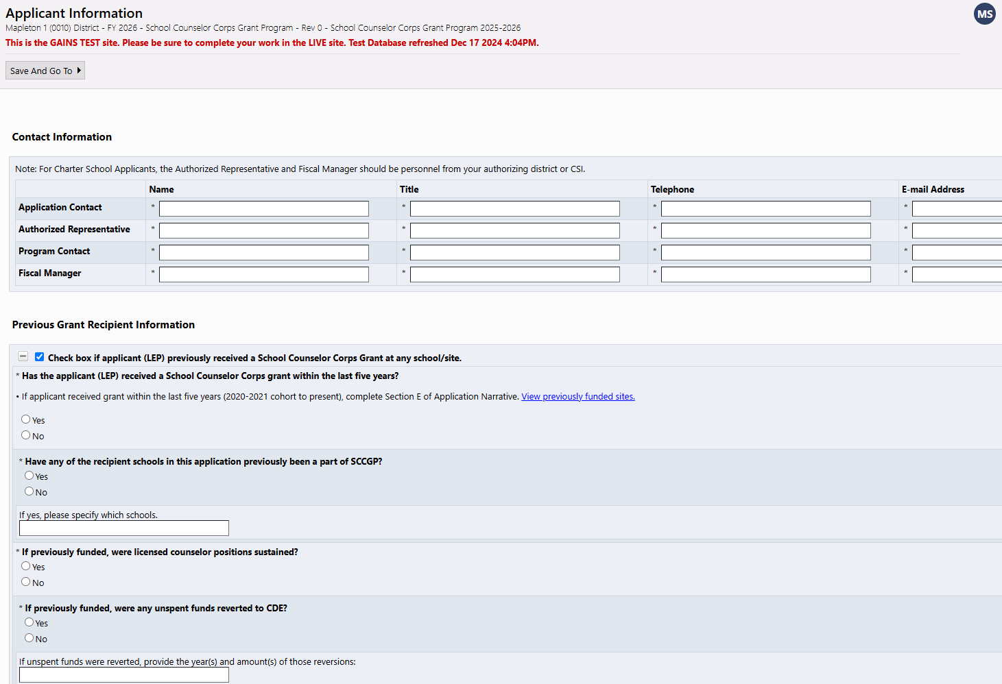
Required Elements
Part I: Applicant Information
Notes:
Brooke

Slide 30
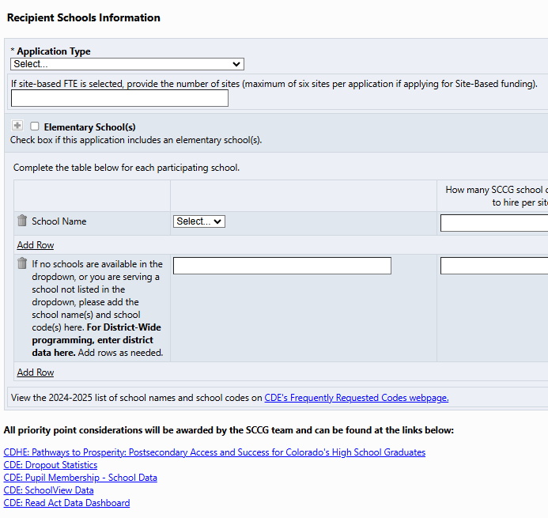
Required Elements
Part I: School Information and Priority Considerations
Notes:
Brooke

Slide 31
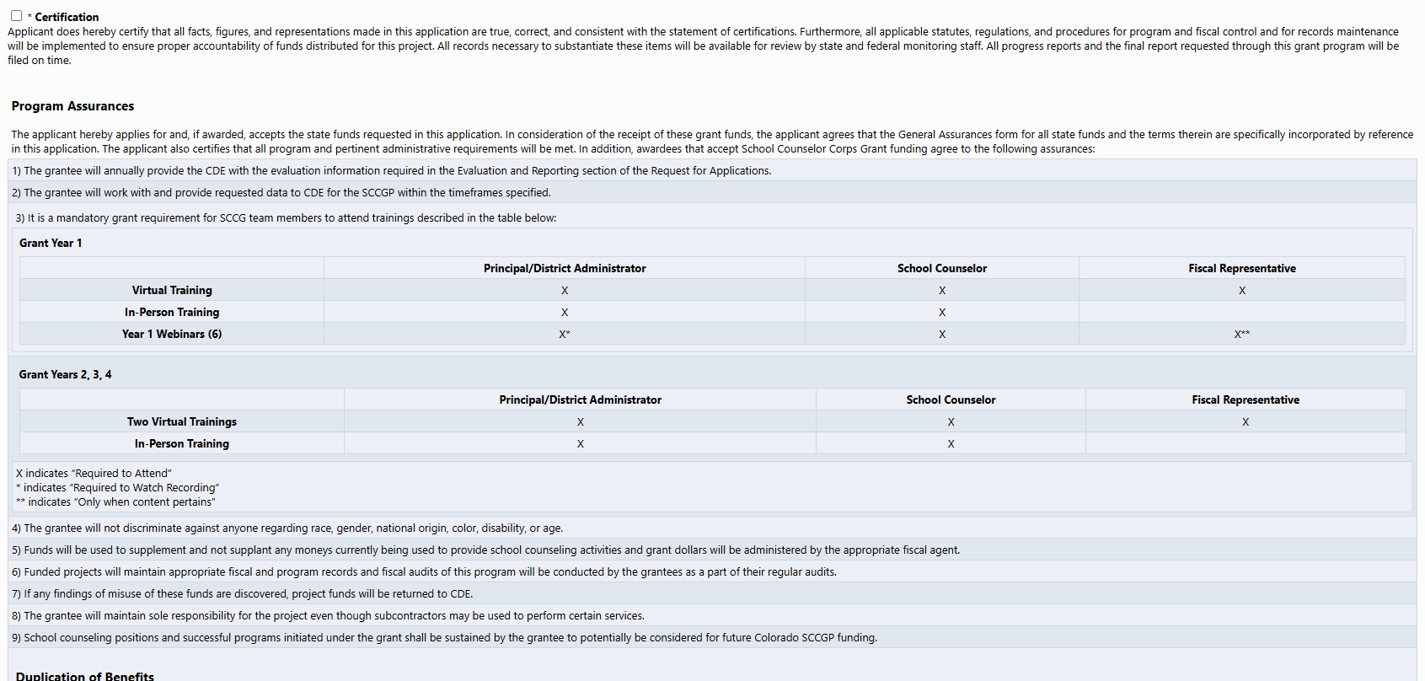
Required Elements
Part I: Program Assurances Continued
Applicants will agree to the Assurances below within the School Counselor Corps Grant application in GAINS.
Notes:
Brooke

Slide 32
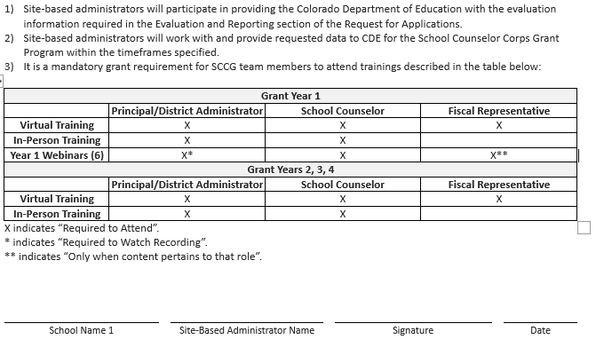
Required Elements
Uploads
Participating site-based administrators must sign and upload to GAINS to indicate their understanding and agreement to the requirements of the School Counselor Corps Program.
Notes:
Jennicca
1) Site-based administrators will participate in providing the Colorado Department of Education with the evaluation information required in the Evaluation and Reporting section of the Request for Applications.
2) Site-based administrators will work with and provide requested data to CDE for the School Counselor Corps Grant Program within the timeframes specified.
3) It is a mandatory grant requirement for SCCG team members to attend trainings described in the table below:

Slide 33
Required Elements
Part II: Narrative
Responses should be completed in the online application form. Although the system will save your work in progress, applicants may find it useful to compose answers in a separate document and copy them into the form.
For those applicants that have previously received funding from the School Counselor Corps Grant Program the expectation is that the narrative responses will include references to that award, where applicable. For example, discuss how the funds contributed to the program and what still needs to be accomplished. Applicants should demonstrate ongoing and improved capacity in the program and a well-developed plan for sustainability.
See narrative questions in RFA document on the SCCG website or in GAINS.
Notes:
Jennicca

Slide 34
Required Elements
Part II: Narrative and Budget
Complete your proposed program budget for year one in GAINS.
Budget guidance and examples can be found on the SCCG funding webpage- Budget Reminders (DOC).
This RFA requires grantees to write a proposed budget in GAINS for year one:
Budget request of $30,000 and maximum $50,000
Budgets for years two, three and four will be written during the course of the grant program.
Year two: budget request of maximum $90,000 per funded school (narrative should illustrate the number of sites you plan to fund).
Notes:
Jennicca

Slide 35
Budget Workbook – Budget Details Personnel Costs & Budget Codes
Salaries (0100): staff regular salaries & stipends
Employee Benefits (0200): staff regular benefits
Purchased Professional and Technical Services (0300): consultants for direct service
Other Purchased Services (0400): professional development contracts
Travel, Registration and Entrance (0580): approved conferences/training, per diem
Supplies (0600): subscriptions, membership fees, counseling supplies, books, food, furniture
Non-Capitalized Equipment (0735): technology
Notes:
Jennicca

Slide 36
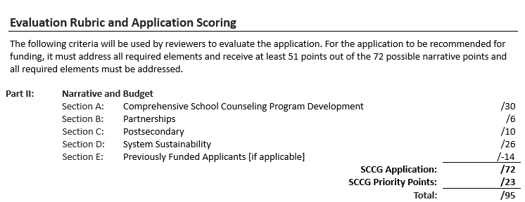
Evaluation Rubric and Scoring
The following criteria will be used by reviewers to evaluate the application.
For the application to be recommended for funding, it must receive at least 51 points out of the 72 possible narrative points and all required elements must be addressed.
Notes:
Jennicca

Slide 37
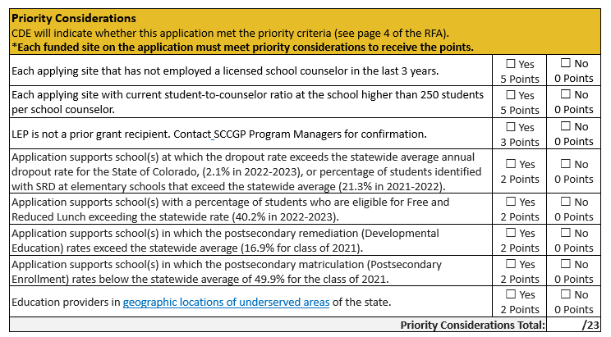
Evaluation Rubric and Scoring
Priority Considerations
Notes:
Jennicca

Slide 38
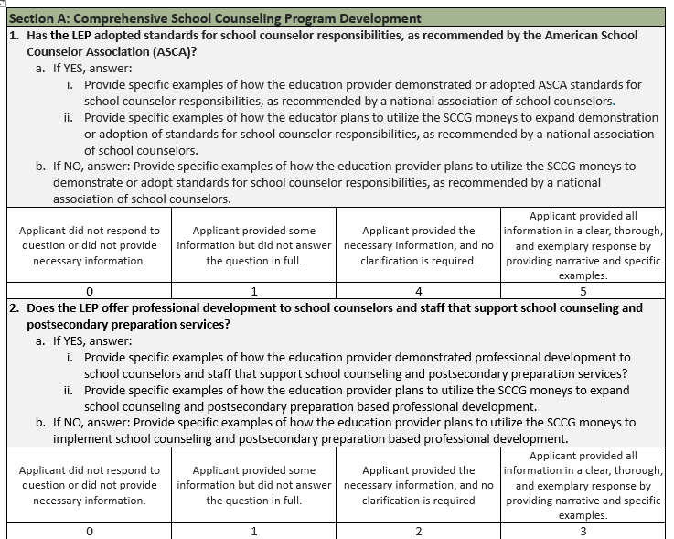
Evaluation Rubric and Scoring
Section A: Comprehensive School Counseling
Notes:
Jennicca

Slide 39
Tips and
Frequently Asked Questions
Notes:
Brooke

Slide 40
General Application Tips
Start early! Log into GAINS and confirm access.
Read the RFA word document thoroughly.
Confirm eligibility and that grant requirements can be met.
Confirm that building administrators and grant team can attend required trainings, participate in webinars, etc.
Create a team to help complete the application- are the stakeholders involved? Get approval from school administration before you start.
Schedule dates, set a timeline, and create a work plan.
Write a good narrative- show your need and fully answer the questions.
Look at the scoring rubric, it's your best friend!
Know how much you can apply for, how to create a budget, and how to manage the budget.
Make sure to do the Intent to Apply
Notes:
Brooke

Slide 41
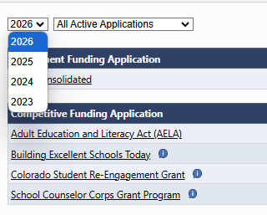
Frequently Asked Questions
What year do I select for the grant application in GAINS?
Make sure to use the dropdown to select year 2026.
“All my boxes are grayed out” in GAINS. What do I do?
99% of the time you need to select “draft started” in the application.
I don’t have access in GAINS to work on the application?
See details on GAINS Access online oremail Mandy Christensen for help.
Notes:
Brooke

Slide 42
Frequently Asked Questions Continued
I am applying with one school that was previously funded and one school that has never been funded. Will that impact us being funded?
Potentially- no more than 25% of applications that include previously funded sites will be awarded in this competition. That 25% will be determined based on the ranked scores of the applications in which they are included, beginning with the highest scoring applications.
Can I get priority points if 3 out of 4 sites meet them?
No, each funded site on the application must meet priority considerations to receive the points.
Notes:
Brooke

Slide 43
Contact Us
Program Questions:
Brooke Morgan, School Counseling Specialist
(303) 923-0966 | Morgan_B@cde.state.co.us
Jennicca Mabe, School Counseling Specialist
(303) 923-0974 | Mabe_J@cde.state.co.us
Budget/Fiscal Questions:
Gloria Kochan Grants Fiscal Management
(720) 916-6488 | Kochan_g@cde.state.co.us
Application Process Questions:
Mandy Christensen, Grants Program Administration (303) 957-6217 | Christensen_A@cde.state.co.us
Notes:
Brooke

