Slide 1
CDE Rationale for having an ICAP
The intent of the ICAP policy is to ultimately decrease dropout rates and increase graduation rates by assisting students in developing and maintaining a personalized postsecondary plan that ensures readiness for postsecondary and workforce success. An ICAP should be designed to assist a student and his or her parent or legal guardian in exploring the postsecondary career and educational opportunities available to the student, aligning course work and curriculum, applying to postsecondary education institutions, securing financial aid and ultimately entering the workforce. - See more at: http://www.cde.state.co.us/secondaryinitiatives/icap#sthash.ii6JLWFB.dpuf
Source – CDE Website

Slide 2
What is a Quality ILP?
A document consisting of a student’s (a) course taking and post-secondary plans aligned to career goals and (b) documentation of the range of college and career readiness skills he/she has developed.
A process that relies on a student’s understanding of the relevance of school courses as well as out-of‐school learning opportunities and provides the student access to career development opportunities that incorporate self-exploration, career exploration, and career planning and management activities.
Source: National Collaborative on Workforce and Disability

Slide 3
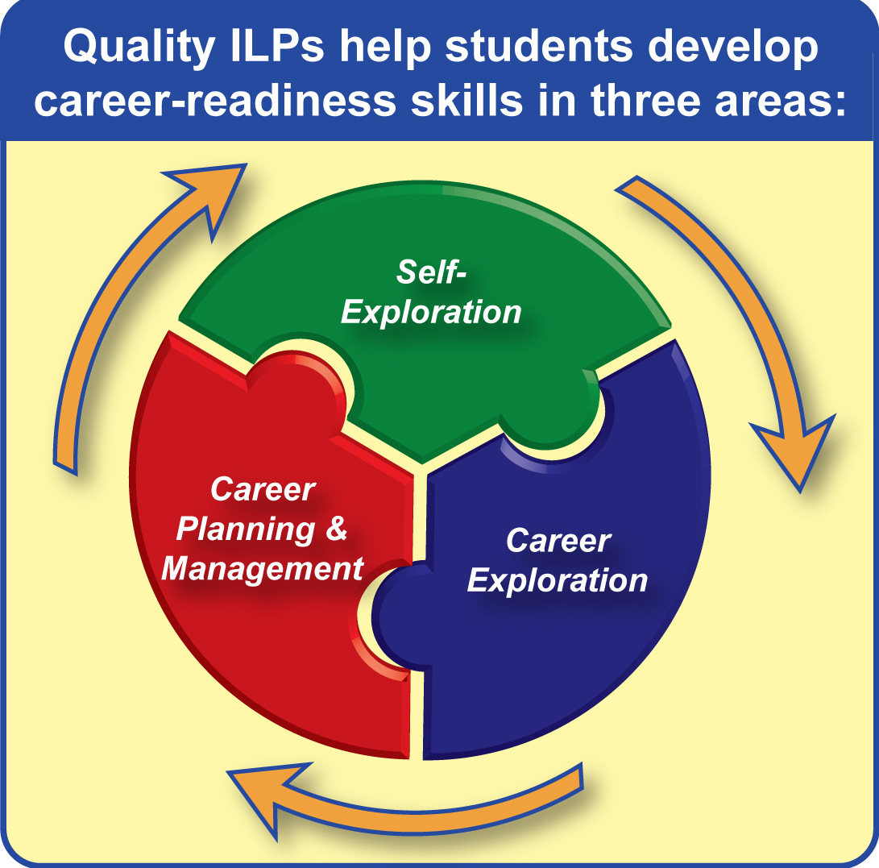
Source: National Collaborative on Workforce and Disability

Slide 4
We’re not alone…
 | ILP Model | Guidance Framework or Other College and Career Readiness Initiative
States with Mandates | Alaska, Arizona, Arkansas, Colorado, Connecticut, Delaware, District of Colombia, Florida, Hawaii, Idaho, Indiana, Iowa, Kentucky, Louisiana, Michigan, Missouri, Nevada, New Jersey, New Mexico, Oregon, Rhode Island, South Carolina, South Dakota, Utah, Virginia, Washington, West Virginia | Georgia, Mississippi, Tennessee
States without Mandates | Kansas, Nebraska, New Hampshire, New York, Ohio, Texas*, Vermont, Wisconsin | Alabama, California, Illinois, Maine, Maryland, Massachusetts, Minnesota, Montana, North Carolina, North Dakota, Oklahoma, Pennsylvania, Wyoming

Slide 5

Arizona
ECAP PowerPoint presentation
2008 - An ECAP reflects a student’s current plan of coursework, career aspirations, and extended learning opportunities in order to develop the student’s individual academic and career goals. Graduation requirement for the class of 2013.

Slide 6

Florida
Started in 2005 –7th or 8th grade career preparation course is mandated. In high school, students create a career plan and school counselors sign off on the plan.

Slide 7

Georgia
2009 – Website launched to help students discover a career pathway – “Seal of Completion” became a possible after completing a career graduation pathway

Slide 8







Washington
Notes:
Navigation 101 is a student planning and guidance curriculum that has key elements. Some schools have one or two of these elements in place, but we’ve found that it’s the interconnectedness of all five elements that really makes the difference. Navigation 101 is committed to personalizing each student’s education through a curriculum-delivered advisory model: Navigation 101 works by engaging students and making sure students build bonds with advisors and other students. We accomplish this through curriculum-driven advisories that students attend at least twice a month. These advisory sessions create opportunity for students to gain critical career development and self-management skills necessary for career and college readiness. It is imperative that students have a way to organize what they are learning about themselves and about planning for their educational and career futures in these advisories. Student Planning Portfolios provide that mechanism for organizing their learning. Throughout their time in Navigation 101, students are expected to keep portfolios with 4-year plan, goal setting worksheets, and samples of their work. Students use their portfolios to reflect on their academic progress and make informed educational program choices, known as their High School & Beyond Plan. It is not enough that students develop and record information about themselves. Demonstrating their understandings through Student-led Conferences, conducted each year, provide students with an opportunity to demonstrate their progress in academics, career planning, and individual growth to their parents and advisor. It also serves as a means by which the student’s family is more actively engaged in the educational and career planning of their student. We also believe that it is essential that the school respond to the informed and best efforts of it’s students around educational planning. Respecting student choices is empowering—We call that Student-informed scheduling: through Navigation 101, students are encouraged to select the most challenging courses that are consistent with their educational and career goals. This is only possible though, if schools implement student-informed scheduling so that students can actually access and be supported in the courses they need for continuing their career goals. The Navigation program is built on an understanding of student needs, and a responsiveness by the school in meeting those needs, based on data. Using data to inform decisions around school program is critical to building student success. Sustaining Navigation 101 over time is dependent on effective program management and integration within a comprehensive guidance and counseling program.
Navigation 101 is a student planning and guidance curriculum that has key elements. Some schools have one or two of these elements in place, but we’ve found that it’s the interconnectedness of all five elements that really makes the difference. Navigation 101 is committed to personalizing each student’s education through a curriculum-delivered advisory model: Navigation 101 works by engaging students and making sure students build bonds with advisors and other students. We accomplish this through curriculum-driven advisories that students attend at least twice a month. These advisory sessions create opportunity for students to gain critical career development and self-management skills necessary for career and college readiness. It is imperative that students have a way to organize what they are learning about themselves and about planning for their educational and career futures in these advisories. Student Planning Portfolios provide that mechanism for organizing their learning. Throughout their time in Navigation 101, students are expected to keep portfolios with 4-year plan, goal setting worksheets, and samples of their work. Students use their portfolios to reflect on their academic progress and make informed educational program choices, known as their High School & Beyond Plan. It is not enough that students develop and record information about themselves. Demonstrating their understandings through Student-led Conferences, conducted each year, provide students with an opportunity to demonstrate their progress in academics, career planning, and individual growth to their parents and advisor. It also serves as a means by which the student’s family is more actively engaged in the educational and career planning of their student. We also believe that it is essential that the school respond to the informed and best efforts of it’s students around educational planning. Respecting student choices is empowering—We call that Student-informed scheduling: through Navigation 101, students are encouraged to select the most challenging courses that are consistent with their educational and career goals. This is only possible though, if schools implement student-informed scheduling so that students can actually access and be supported in the courses they need for continuing their career goals. The Navigation program is built on an understanding of student needs, and a responsiveness by the school in meeting those needs, based on data. Using data to inform decisions around school program is critical to building student success. Sustaining Navigation 101 over time is dependent on effective program management and integration within a comprehensive guidance and counseling program.
Navigation 101 is a student planning and guidance curriculum that has key elements. Some schools have one or two of these elements in place, but we’ve found that it’s the interconnectedness of all five elements that really makes the difference. Navigation 101 is committed to personalizing each student’s education through a curriculum-delivered advisory model: Navigation 101 works by engaging students and making sure students build bonds with advisors and other students. We accomplish this through curriculum-driven advisories that students attend at least twice a month. These advisory sessions create opportunity for students to gain critical career development and self-management skills necessary for career and college readiness. It is imperative that students have a way to organize what they are learning about themselves and about planning for their educational and career futures in these advisories. Student Planning Portfolios provide that mechanism for organizing their learning. Throughout their time in Navigation 101, students are expected to keep portfolios with 4-year plan, goal setting worksheets, and samples of their work. Students use their portfolios to reflect on their academic progress and make informed educational program choices, known as their High School & Beyond Plan. It is not enough that students develop and record information about themselves. Demonstrating their understandings through Student-led Conferences, conducted each year, provide students with an opportunity to demonstrate their progress in academics, career planning, and individual growth to their parents and advisor. It also serves as a means by which the student’s family is more actively engaged in the educational and career planning of their student. We also believe that it is essential that the school respond to the informed and best efforts of it’s students around educational planning. Respecting student choices is empowering—We call that Student-informed scheduling: through Navigation 101, students are encouraged to select the most challenging courses that are consistent with their educational and career goals. This is only possible though, if schools implement student-informed scheduling so that students can actually access and be supported in the courses they need for continuing their career goals. The Navigation program is built on an understanding of student needs, and a responsiveness by the school in meeting those needs, based on data. Using data to inform decisions around school program is critical to building student success. Sustaining Navigation 101 over time is dependent on effective program management and integration within a comprehensive guidance and counseling program.

Slide 9
Key Elements
PERSONALIZING
Advisories
PLANNING
Portfolios
DEMONSTRATING
Student-led
Conferences
EMPOWERING
Student-Informed
Scheduling
EVALUATING
Data–Informed
WHAT IT IS:
Small groups of students with an advisor-educator
Keep same group until graduation
BEST PRACTICE:
Advisories meet 2x per month or more
Advisors use guidance curriculum
WHAT IT IS:
Paper or electronic
Organized by 3 ASCA areas: Academic, Career, Personal/Social
BEST PRACTICE:
Each student keeps a portfolio and uses it for student-led conferences
WHAT IT IS:
Annual conference led by student
Focuses on 3 ASCA areas: Academic, Career, Personal/Social
BEST PRACTICE:
Each student holds a conference each year and uses the conference to register for next year’s courses
WHAT IT IS:
Students are encouraged to take courses with a plan
Course schedule is based on students’ requests
BEST PRACTICE:
Each student obtains the courses selected
More students take gatekeeper courses
WHAT IT IS:
Information about student outcomes
Collected by each
school
BEST PRACTICE:
Each school submits data each year
Program is improved based on what we learn
Program Management
Central to the career and college readiness mission of the school as a component of the school improvement plan with leadership team that includes administrator, counselor and teachers
Comprehensive Guidance and Counseling
Provides sound context for the full development and integration of a comprehensive
guidance and counseling program as a career guidance model
Notes:
As Navigation 101 was developed, it was built around key elements. Each of these elements is important but it’s their interconnectedness that makes a career guidance program so powerful.
Personalizing – Curriculum-delivered advisories. Advisories are the heart of career guidance. Advisories help students engage in school by ensuring that at least one adult at school knows and cares about each student. The advisory is a group of 15 to 20 students and an educator, who serves as a guide for twice-a-month or more frequent meetings. To help the advisor, OSPI has provided a full grade 6-12 curriculum with 20 lesson plans for each grade level, plus videos on each of the key elements, and a suite of professional development materials. Best practice in this area means regular advisory sessions that are built into the school’s weekly schedule.
Planning – Portfolios. Students organize – and reflect on – their work through planning portfolios. Navigation portfolios can be either paper or electronic, depending on your school’s preference. Portfolios should be organized into three sections, based on the three American School Counselor Association (ASCA) domains: Academic Development, Career Development, and Personal/Social Development. OSPI’s Navigation 101 web site contains a Portfolio how-to, and the lesson plans introduce and help students organize their portfolios. Best practice in this area means that each student has a portfolio and uses it to organize his or her student-led conference.
Demonstrating – Student-led Conferences. Student-led conferences are the centerpiece of the school year. Students lead these conferences, in front of their parents and advisor. Conferences are organized around the three ASCA domains: Academic (What have I accomplished this year?) Career (What do I want to do in the future?) and Personal (Who am I?). The Navigation lesson plans include all the information students and advisors need to organize conferences. Best practice in this area means at least one student-led conference a year that is tied to the school’s course registration process.
Empowering – Student-driven Scheduling. Research studies have shown that the rigor of a student’s courses during high school is the single greatest determinant of college success. To help students succeed, encouragement for students to enroll in challenging, “gatekeeper” courses in math and science help increase rigor. Best practice in this area means that a higher number of students take gatekeeper courses and get the help they need to succeed.
Evaluating – Data Collection and Analysis. We will only know if a career guidance program is succeeding if we measure students’ outcomes. Schools can use data indicators measure student and parent satisfaction with and attendance at student-led conferences; student state assessment scores; graduation rates; success in gatekeeper courses; and need for remedial, pre-college work after graduation.

Slide 10
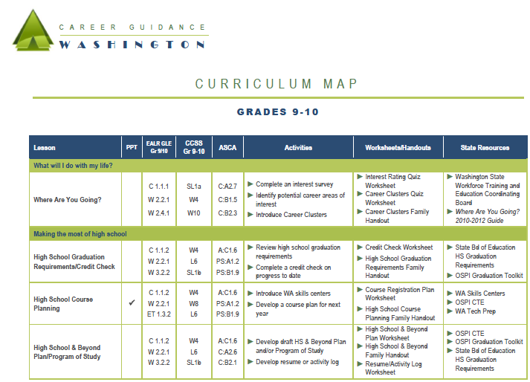
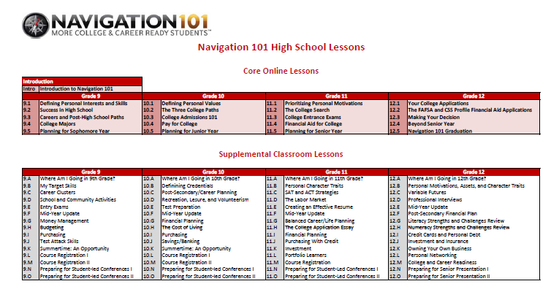
Holistic Curriculum Plan
Notes:
It is recommended that schools use a holistic approach to the guidance curriculum. School leaders can spiral lessons year to year and customize scope and sequence to fit the needs of their school.

Slide 11
NAVIGATION 101 History in WA
2000 – School inspired by Dr. Gysbers & Franklin Pierce
2001– Five school districts – Lighthouse districts
2006 –Development funding from legislature
2008 – Partnership with College Spark WA for CRI grant
2009 – Partnership for online curriculum
2010 – Navigation 101 linked to CGCP statewide
2011 – Navigation 101 available to all MS and HS at no cost
2012 -2013 – Over half of middle and high schools for Nav 101.com; OSPI curriculum development
2013-15 No state grants funded; Career Guidance WA moved forward with new lessons for Navigation 101

Slide 12
Minnesota
1. Career development process: Working on a logic model and benchmarks according to age/ grade
2. Best practices: Working on an inventory of what works in career development and how to connect to those things. Resources for youth, families, educators, community practitioners, etc.
3. Business and Community engagement: How to push forward more of this with schools
4. Technology that Supports ILPs: ILP is a very new topic here in MN, and we are still trying to figure out how the digital infrastructure is supported. (this is a hot topic here!)
5. Professional Development: Career development training, etc. for the practitioners and educators that serve youth
6. Parent/ Family Involvement: Information for families on how to support youth in their career development

Slide 13
Common Characteristics
Student’s strengths and needs
Academic, career and personalized goals are identified
Career Exploration and assessment
Personality and learning style assessments
Academic Plan (4-12 year plans)
Action Plan with deadlines
Community service learning
Resume
Annual Reflection
Updated annually
ILP Shared with student, parent, counselor, and teacher
Aligned to graduation or career goals/clusters

Slide 14

In Colorado

Slide 15
The ICAP journey…
Awareness & Dissemination
2010 - 2011
Developing readiness, creating awareness, conducting training and planning
Implementation
2011-2012
Making meaning of the ICAP, engaging in activities and process
Implementation Continued – embedded into new legislation
2012-2013
ICAP Reboot: rethinking the entire process, partnerships, cross-collaboration, systems
Refinement
2013 – 2014
ICAPs integral part of school/district culture, revising milestones and indicators
Source:CCCS/CDE 2013

Slide 16
Policy Framework for PWR
Bill Name | PWR | ICAP | Concurrent Enrollment | ASCENT | Secondary Initiatives
PWR (Postsecondary and Workforce Readiness) & Endorsed Diplomas | SB08-212 | SB08-212 |  |  | SB08-212
Grad Guidelines | HB07-1118 | HB07-1118 |  |  | HB07-1118
School Counselor Corps |  | HB08-1370 |  |  | HB08-1370
ICAP | SB09-256 | SB09-256 |  |  | SB09-256
Concurrent Enrollment | HB09-1319 SB09-285 | HB09-1319 SB09-285 | HB09-1319 SB09-285 | HB09-1319 SB09-285 | HB09-1319 SB09-285
Early HS Grads | HB12-1043 | HB12-1043 | HB12-1043 | HB12-1043 | HB12-1043
Dropout Recovery | HB12-1146 | HB12-1146 | HB12-1146 |  | HB12-1146
Basic Skills Tests | HB12-1345 | HB12-1345 |  |  | HB12-1345
Source-CDE 2013

Slide 17
In Colorado
CDE ICAP Webpage
CDE Rules
CCCS Webpage of 8 bizillion resources

Slide 18
Four Components of Colorado’s ICAP
Source: CCCS/CDE 2012

Slide 19
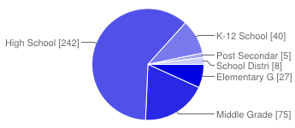
In which setting do you work?
Elementary Grades School (ECE or preK/K5th grade) | 27 | 7%
Middle Grades School (6th8th grade) | 75 | 19%
High School Grades (9th12th grade) | 242 | 61%
K12 School | 40 | 10%
Post Secondary Setting | 5 | 1%
School District/BOCES Central Office | 8 | 2%

Slide 20
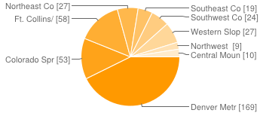
Which part of the state are you located?
Denver Metro | 169 | 43%
Colorado Springs/Pueblo/Trinidad Metro | 53 | 13%
Ft. Collins/Loveland/Longmont Metro | 58 | 15%
Northeast Colorado | 27 | 7%
Southeast Colorado | 19 | 5%
Southwest Colorado | 24 | 6%
Western Slope | 27 | 7%
Northwest | 9 | 2%
Central Mountains | 10 | 3%

Slide 21
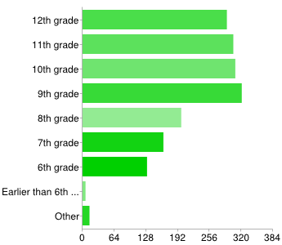
In what grade is your school district implementing ICAP?
17%
18%
18%
18%
11%
9%
7%
0%
1%

Slide 22
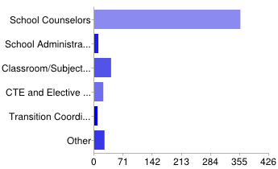
Who is mainly responsible for implementing ICAPs in your setting?
83%
2%
9%
5%
2%
5%

Slide 23
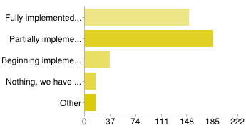
In your district, what is your level of ICAP implementation?
37%
46%
9%
4%
4%

Slide 24
How are ICAPs being implemented?
ICAPs are embedded into current classroom and counseling curricula and are referred to on a regular basis. | 31 | 7%
ICAPs are being completed through classroom or counseling curricula throughout the school year. | 154 | 35%
Students complete their ICAPs in one or two settings, at a computer or with a few handouts. | 138 | 32%
Elements of ICAP are being completed, but we could be doing more. | 74 | 17%
Students are not completing ICAPs | 23 | 5%

Slide 25
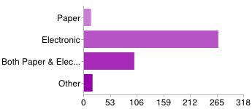
In what format is your district implementing ICAP?
20%
67%
25%
4%

Slide 26
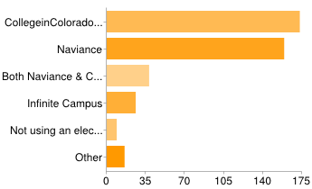
If your school is using an electronic tool to assist with ICAP, which one?
41%
38%
9%
6%
2%
7%

Slide 27
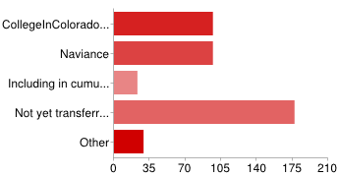
How are you transferring ICAP information when a student moves out of your school?
23%
23%
5%
42%
7%

Slide 28
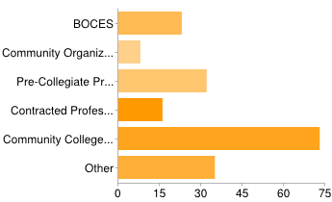
If applicable, what community partners is your school/district utilizing to assist with ICAP implementation? – 47% of those surveyed, responded to this question.
12%
4%
17%
9%
39%
19%

Slide 29
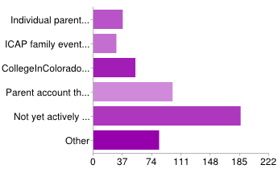
How are you involving parents/guardians in students’ ICAP development?
Individual parent meetings; if so, how often? Please leave details in the box marked 'other', below. | 8%
ICAP family events; if so, how often? Please leave details in the box marked 'other', below. | 6%
CollegeInColorado.org electronic parent outreach | 11%
Parent account through Naviance | 20%
Not yet actively involving parents/guardians | 38%

Slide 30
What are your thoughts about ICAPs?
ICAPs are a valuable tool | 247 | 62%
ICAPs are helping to lower the dropout rate. | 45 | 11%
ICAPs are helping more students to reach their postsecondary aspirations. | 141 | 35%
ICAPs are helping students to follow their optimal career pathway goal | 151 | 38%
ICAPs are not developmentally appropriate. | 38 | >1%
The ICAP Legislation will eventually go away. | 26 | >1%
Our ICAP process has helped us to be more data driven | 109 | 27%
ICAPs are an element of the ASCA model. | 207 | 52%
ICAPs have helped us to improve our counseling program | 130 | 33%
ICAPs have negatively impacted the role of the school counselor. | 56 | 14%

Slide 31
Check all statements that apply to your counseling program.
My program has received RAMP recognition | 22 | >1%
My program is based on the ASCA National Model | 203 | 35%
My program is developmentally appropriate and comprehensive in nature. | 235 | 51%
We do not have an actual program in place, but we believe we are providing the services that our students need. | 78 | 20%
We are considering creating an actual program that will meet the needs of our students. | 20 | >1%
I do not have a counseling program in place, I have too many other responsibilities | 11 | >1%
Other | 19 | >1%

Slide 32
Takeaways
Counselors are responsible for the implementation
Especially at the high school level, counselors feel ICAPs are a valuable tool.
The process is better if it has a champion, particularly if it is the principal.
The process is even better if it is spread across disciplines.
The more meaningful and less “tasks to be completed” the more it is embraced by the student.
Schools want more direction

Slide 33
Promising Practices
Dedicate time to conduct ICAP work regularly- perhaps 2-3 times per week.
Provide students the opportunity to connect with a mentor or advisor throughout their high school years to support their ICAP.
Align the ICAP to state established career clusters to provide focus.
Develop opportunities for student-led parent teacher conferences.

Slide 34
Promising Practices cont.
Involve all school staff, businesses, post-secondary institutions, community organizations, and parents in the delivery of the plan.
Think about the roles and functions of various stakeholders and how to engage them effectively.
Establish a key leadership group in each school and district to develop the plans and monitor progress.

Slide 35
Aiming for Meaning

Slide 36
