Slide 1
Principal / Counselor Relationship
Sandy Steiner, Director, postsecondary & Workforce Readiness
Melisa Sandoval, support director, SEL & Student agency
Westminster public schools

Slide 2
WPS Demographics
Enrollment: 9,282
SPECIAL EDUCATION STUDENTS
12 %
CULTURALLY AND LINGUISTALLY DIVERSE
38 %
FREE / REDUCED LUNCH - ELEMENTARY
62 %
FREE / REDUCED LUNCH - MIDDLE
69 %
Notes:
Melisa

Slide 3
Please bring to class each day
Counselor Leadership & Empowerment
Roles
Motivation
Teaming
Today’s Topics
Establishing Goals of Principal/Counselor Relationship
Defining joint work at the onset
Gather baseline information (example tool)
Considerations for SEL
Embedding SEL into Academics
10 Characteristics
Next Steps
Notes:
Sandy

Slide 4
Please bring to class each day
Counselor Leadership & Empowerment
Roles
Motivation
Teaming
Today’s Topics
Establishing Goals of Principal/Counselor Relationship
Defining joint work at the onset
Gather baseline information (example tool)
Considerations for SEL
Embedding SEL into Academics
10 Characteristics
Next Steps

Slide 5
Counselor Leadership & Empowerment
Understand & Establish Roles & Responsibilities
School Counselors Work with All Students (Direct/Indirect)
Academic Achievement Strategies
Career Development
Social/Emotional Development
Importance of Tiered Systems
Connections to District Systems
Motivation & Empowerment
Balance – Leader and Teammate
Voice
Understand strengths & preferences of your counselor
CACREP
Link: Role of the School Counselor
Belonging, Trust, Teaming
Notes:
Melisa

Slide 6
Counselor Leadership & Empowerment
Questions to Consider
Who is on your Counselor’s team? Do they feel connected to school community?
What is the role of the Counselor in working with Admin? Teachers?
What PD is needed to support Counselor growth? Teacher growth?
What specific boundaries need to be in place? Examples:
When to involve (or not involve) counselor in behavioral conversations
Confidentiality
Actions from principals that are helpful / not helpful
Notes:
Melisa

Slide 7
Please bring to class each day
Counselor Leadership & Empowerment
Roles
Motivation
Teaming
Today’s Topics
Establishing Goals of Principal/Counselor Relationship
Defining joint work at the onset
Gather baseline information (example tool)
Considerations for SEL
Embedding SEL into Academics
10 Characteristics
Next Steps

Slide 8
Establishing Goals of Counselor / Principal Relationship
Define work in the beginning
Gather baseline information
Identify Needs
Alignment with Vision & UIP
Assume a Presentation to the School Board
Engage External Reviewers
Always track your work
example tool
Notes:
Sandy

Slide 9
Please bring to class each day
Counselor Leadership & Empowerment
Roles
Motivation
Teaming
Today’s Topics
Establishing Goals of Principal/Counselor Relationship
Defining joint work at the onset
Gather baseline information (example tool)
Considerations for SEL
Embedding SEL into Academics
10 Characteristics
Next Steps

Slide 10
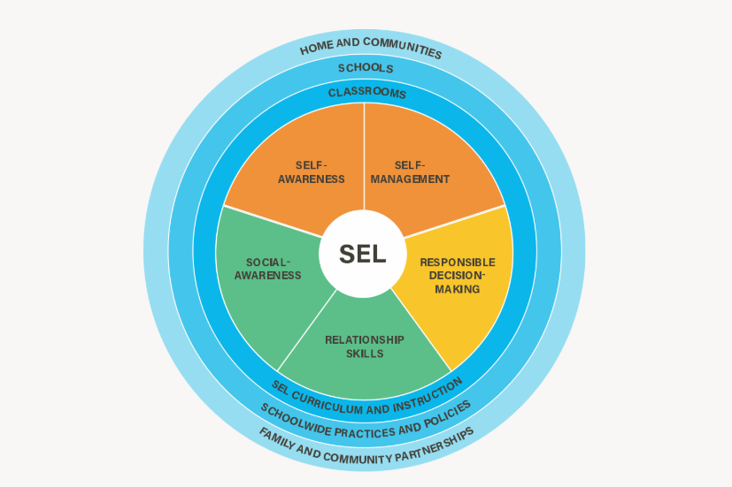
Embedding SEL into Academics
What is SEL? Link
What supports to Counselors need to support teachers with implementation and application?
What systems are in place to support SEL?
Collaborative for Academic, Social, and Emotional Learning. (2013). Implementing systemic district and school social and emotional learning. Chicago, IL
Notes:
-

Slide 11
Please bring to class each day
Counselor Leadership & Empowerment
Roles
Motivation
Teaming
Today’s Topics
Establishing Goals of Principal/Counselor Relationship
Defining joint work at the onset
Gather baseline information (example tool)
Considerations for SEL
Embedding SEL into Academics
10 Characteristics
Next Steps

Slide 12
Resource: 10 Characteristics of Effective Relationships

Slide 13
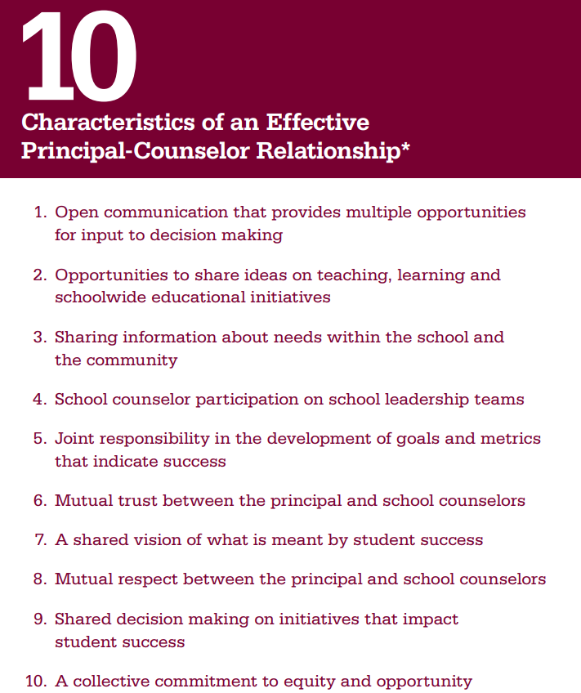
Resource: 10 Characteristics of Effective Relationships

Slide 14
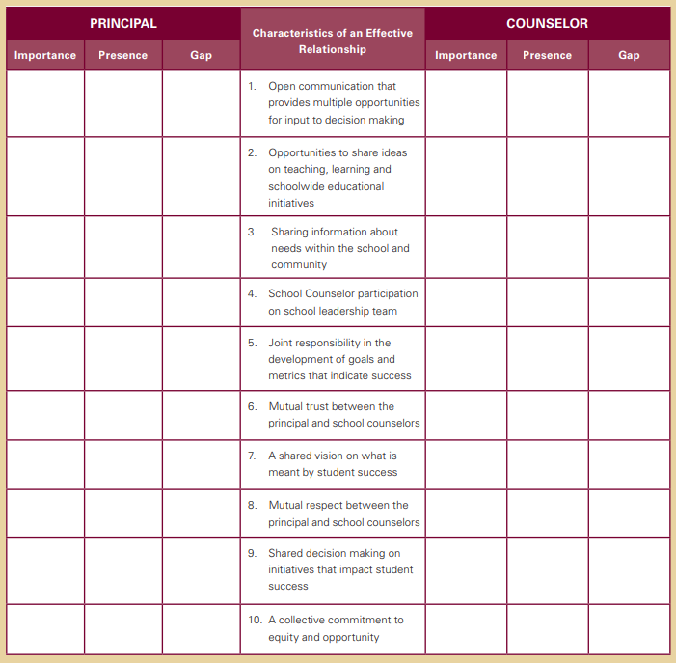
Resource Taking One Step Forward: A Self Assessment Tool

Slide 15
Setting Counselors Up for Success
Voice
Teaming
Belonging
Building from strengths & unique background
Empowerment
Trust
Notes:
Sandy

Slide 16
Building Community and Sense of Belonging
Closing Activity
Think of a time when you truly felt connected to something, like you belonged? How did you feel? How did you act? (WRITE YOUR ANSWERS DOWN)
Think of a time when you felt disconnected or left out? How did you feel? How did you act? (WRITE YOUR ANSWERS ON YELLOW STICKY NOTES)

Slide 17
A sense of belonging is connected to...
Confidence
Attitude
Friendships
Performance
Communication Skills
Motivation
Behavior
Engagement

Slide 18
Contact Us!
Sandy Steiner,
Director, Postsecondary & Workforce Readiness
ssteiner@westminsterpublicschools.org
Melisa Sandoval, LPC, NBCT
Support Director, SEL & Student Agency
msandoval@westminsterpublicschools.org
6933 Raleigh St., Westminster, CO 80030
303-428-3511
Notes:
Sandy

