Slide 1
Child Nutrition Program Implementation
School Year 2021-22
Colorado Child Nutrition Programs Statewide Sharing Call
May 27, 2021
Notes:
Hi Everyone my name is Kerri Link and I am a supervisor with the School Nutrition Unit. Welcome to our monthly statewide sharing call for Child Nutrition Program operators. These calls are scheduled for the last Thursday of each month and are a great opportunity to hear about what is happening around Colorado.
Just a reminder that you can register for these calls through the Dish each month or via the CDE- School Nutrition website. Today’s call will focus on reviewing the Child Nutrition Program options for SY 2021-22 and how to implement the USDA waivers.

Slide 2
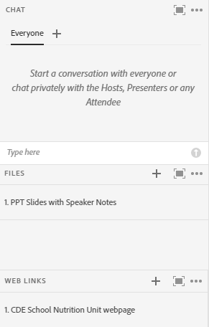
Call Details
Computer audio- already muted
Conference line- please mute
For technical support- contact
Alicia Grove at grove_a@cde.state.co.us or
20-795-2038
Notes:
First, I will cover some quick housekeeping items before we jump into the content.
If you are experiencing any technical difficulties, please reach out to Alicia Grove. Her information is available on this slide and in the chat.
All attendees who join via computer audio will enter muted to reduce background noise. If you have joined via the conference line, please mute your line to reduce background noise.
Just below the presentation are the files and weblinks pod. The files pod is where you will find the PowerPoint file for today with speaker notes. We will refer to these resources during the presentation.
Lastly, if you have any questions, please put them in the chat pod—we will monitor the chat and compile a list of questions to address at the end of the webinar.

Slide 3
CDE Vision
All students graduate ready for college and careers and are prepared to be productive citizens of Colorado.
CDE School Nutrition Unit Mission
The School Nutrition Unit is committed to ensuring all school-aged children have equal access to healthy meals by supporting, training, and connecting Colorado’s child nutrition community.
3
Notes:
You are likely familiar with the CDE vision and School Nutrition Unit’s Mission statements. If not, please take a moment to read though them.

Slide 4
Non-Discrimination Statement
In accordance with Federal civil rights law and U.S. Department of Agriculture (USDA) civil rights regulations and policies, the USDA, its Agencies, offices, and employees, and institutions participating in or administering USDA programs are prohibited from discriminating based on race, color, national origin, sex, disability, age, or reprisal or retaliation for prior civil rights activity in any program or activity conducted or funded by USDA. Persons with disabilities who require alternative means of communication for program information (e.g. Braille, large print, audiotape, American Sign Language, etc.), should contact the Agency (State or local) where they applied for benefits. Individuals who are deaf, hard of hearing or have speech disabilities may contact USDA through the Federal Relay Service at (800) 877-8339. Additionally, program information may be made available in languages other than English.
To file a program complaint of discrimination, complete the USDA Program Discrimination Complaint Form, (AD-3027) found online at: https://www.usda.gov/oascr/how-to-file-a-program-discrimination-complaint, and at any USDA office, or write a letter addressed to USDA and provide in the letter all of the information requested in the form.
To request a copy of the complaint form, call (866) 632-9992. Submit your completed form or letter to USDA by: (1) mail: U.S. Department of Agriculture Office of the Assistant Secretary for Civil Rights; 1400 Independence Avenue, SW Washington, D.C. 20250-9410;
(2) fax: (202) 690-7442; or (3) email: program.intake@usda.gov.
This institution is an equal opportunity provider.
Notes:
This slide features the non-discrimination statement again something you are likely all familiar with.

Slide 5
Conditions for Success
Arrive on time
Be present and engaged
Put your cell phone out of arms reach
Close out email or other tabs
Avoid multi-tasking or doing other work
Participate in discussion
Mute your microphone when you’re not talking
Bring a positive attitude and be ready to share
Actively listen
Be respectful, inclusive, and open minded
Notes:
This call is meant to be an open space to ask questions, brainstorm, and share your ideas with your peers.
Please share. In addition, some other conditions for success to make our time together today as meaningful as possible include: (go through slide)
Please take just a second to enter into the chat your name, as well as your district or school.
We will not be doing a big introduction round robin, so before you speak, please introduce yourself with your name and district before speaking.

Slide 6
Learning Objectives
By the end of this training, sponsors will be able to:
Demonstrate understanding of USDA waivers and Child Nutrition Program options for school year 2021-22.
Utilize resources and appropriate CDE School Nutrition staff
Professional Standards
1 hour of training
Key Area/s and Learning Codes:
1100
3100
3200
4000
Notes:
By the end of this training you will be able to:
You will receive 1 hour of training today in Menu Planning, Free and Reduced-Price Meal Benefits, Program Management, and Communications and Marketing. The training certificate is accessible after you complete the evaluation survey that will be sent to you via email within the next couple of days.

Slide 7
Icebreaker
In three words or less, what are you hoping to take away from todays training?
https://www.menti.com/vh3geqye6j
5494 0518
In three words or less, what are you MOST looking forward to for next school year (personally or professionally)?
Notes:
First question – menti meter
Second question – chat blast

Slide 8
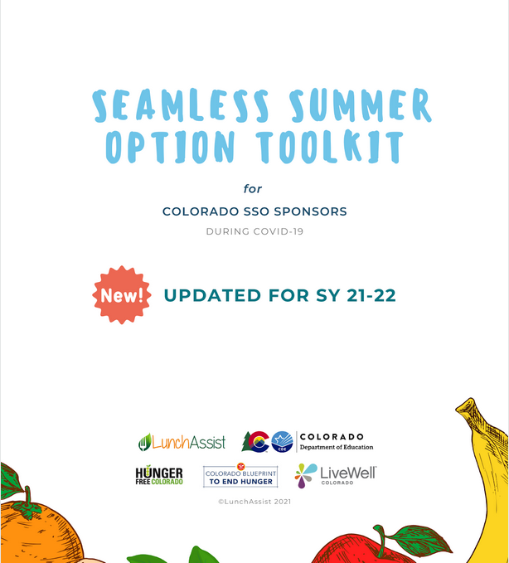
Training Guides
Toolkit
Pg. 1
FAQ
Pg. 1
Notes:
Today’s training will follow directly along with content in the SSO toolkit and our FAQ document.
The SSO toolkit is still being finalized and will be published to our website soon; but is very similar to the SFSP toolkit from this past year. Keep an eye out in the DISH and on our website for this.
The FAQ is linked in the presentation and is on our website. The information has been included in the content and we will also cover specific questions submitted– the page numbers may change in the future as we add/update the document weekly. When updates are made, they are highlighted in yellow to make it easier for you to read and locate new information. You can also “control f” in both of these documents to search specific words you are looking for in the resource.

Slide 9
Nationwide Waiver Overview Effective July 1, 2021 through June 30, 2022, unless otherwise noted https://app.smartsheet.com/b/publish?EQBCT=2fbcc0b15a604b2fb461289e54d80f71
Notes:
The United States Department of Agriculture (USDA) released a series of nationwide waivers that allow flexibility to school meal programs for the 2021-22 school year. The CDE School Nutrition Unit has opted into all waivers for the state of Colorado. The only waiver that a sponsor has to apply for is related to meal patterns, which we will go in to later.
The waivers apply to the National School Lunch Program (NSLP), School Breakfast Program (SBP), Seamless Summer Option (SSO), and the Child and Adult Care Food Program (CACFP). Waiver authority does not apply to the Special Milk Program.
The link in this slide takes you to a summary of all of the waivers – past, present, CO specific and pending – with links to the FNS full memo of each. This is a great reference if you need a deeper dive into any of the content; however, the tool kit and FAQ are meant to be a summary for you.

Slide 10
Operations for SY 2021-22
Toolkit
Pg. 7
FAQ
Pg. 2-3
Notes:
Sponsors have the option to serve meals to students under the National School Lunch/School Breakfast programs or Seamless Summer Option for school year 21-22.
The Seamless Summer Option (SSO) is a component of the National School Lunch Program (NSLP) and combines features of the NSLP, School Breakfast Program and the Summer Food Service Program. Under the SSO, sponsors will follow the NSLP and SBP meal pattern requirements and are able to provide free meals to all students and claim the meals at the free rate.
For school year 2021-22, all meals served under the SSO will be reimbursed at the SFSP rate.
We will go through the considerations/differences of these programs in the next slide to inform your decision…

Slide 11
Seamless Summer Option (SSO) OR National School Lunch Program (NSLP)
 | SSO | NSLP/SBP
Allowable Meals | Up to 2 meals each day: Breakfast, Lunch, Snack (AM or PM), and/or Supper | Breakfast, Lunch, Afterschool snacks
Reimbursement Rates | SFSP reimbursement rate | NSLP/SBP reimbursement rates
Meal Claiming | All meals are free | Claim meals by student income eligibility (free/reduced/paid)
Meal Pattern | NSLP/SBP meal pattern | NSLP/SBP meal patterns
Applications | Child Nutrition Portal | Child Nutrition Portal
FFVP | May apply and serve if awarded | May apply and serve if awarded
ASP | May apply and serve – waiver for area eligibility applicable | May apply and serve – waiver for area eligibility applicable
Notes:
This is high level, some of the main differences in program operations. We will go into more detail for each section throughout the presentation.
Allowable meals: Sponsors may serve up to two meals a day. Allowable meal types under the SSO include: breakfast, AM snack, lunch, PM snack, and supper (this does not include snacks served under ASP). We will go in to more detail in the next slide.
Reimbursement rate:
Meal claiming: All children 18 years of age or younger are eligible to receive free meals during the 2021-22 school year, The Nationwide Waiver to Allow the SSO through School Year 2021-22 ensures that all schools may provide meals to all children at no cost.
Meal pattern: same for both
Applications: SSO application will be within the SNP packet and will likely open in July.
Application timelines and further guidance coming soon as we are continuing to work with our software vendor to make the process as streamlined as possible for you.
All other applicable waivers apply to both programs (despite area eligibility for SSO) – we will go into more details on each these later as well.
The benefits of operating the SSO include being able to provide all meals to children for free, and receiving a higher reimbursement rate for meals served.

Slide 12
Allowable Meals - SSO
Sponsors may serve up to two meals a day at sites.
Allowable meal types : breakfast, AM snack, lunch, PM snack, and supper (this does not include snacks served under ASP). For example, a sponsor may serve breakfast and lunch under SSO and a snack under ASP.
Sponsors may choose which combination of meals they would like to serve; however, serving lunch and supper to the same children on the same day is not allowed
Toolkit
Pg. 7
FAQ
Pg. 7-9
Notes:
Up to two meals, per child, per day, in any combination except lunch and supper, may be reimbursed through the SSO.
We are still awaiting guidance from USDA on if meals for weekend/non-school days will be allowable for SY 2021-22.

Slide 13
Meal Counting and Claiming
Under SSO, all reimbursable meals served are free. Sponsors do not need to track meals based on the student’s eligibility status.
Must establish a point of service and record meals as they are served.
May use a paper form or electronic point of service system to record meals by meal type each serving day
Under NSLP and SBP, meals must be claimed by the student’s eligibility status (free, reduced, or paid), unless the school participates in a provisional program, such as the Community Eligibility Provision (CEP).
Toolkit
Pg. 8
FAQ
Pg. 6-7
Notes:
Regardless of the meal operation type (SSO or NSLP), and use of waivers such as the meal time, non-congregate feeding and parent meal pick up, sponsors must ensure that meals are accurately counted and claimed, and the integrity of the program is upheld.
As mentioned when we reviewed the comparison chart, under the Seamless Summer Option (SSO), all reimbursable meals served are free. Sponsors do not need to track meals based on the student’s eligibility status. Sponsors can count meals on the day they are distributed for each meal type served. Sponsors are not required to have separate meal count forms for the days meals are intended to be eaten. For example, if 3 days’ worth of meals are served, a sponsor will have one breakfast meal count form and one lunch meal count form that shows 3 days’ worth of meals distributed at that site.
Under the National School Lunch (NSLP) and School Breakfast Programs (SBP), meals must be claimed by the student’s eligibility status (free, reduced, or paid), unless the school participates in a provisional program, such as the Community Eligibility Provision (CEP). Sponsors may also use money from the general fund to cover the cost for paid student meals if they wish to provide free meals for all students. Meals served at no cost will need to be tracked and claimed according to eligibility status

Slide 14
Free & Reduced-Price Meal Applications
Sponsors operating the Seamless Summer Option may continue to collect and process free and reduced-price meal applications to establish eligibility for other benefits, specifically Pandemic-EBT (P-EBT).
Sponsors must provide new students, such as kindergarteners, and newly eligible children an opportunity to establish their eligibility, specifically for P-EBT.
Outreach materials coming soon!
Toolkit
Pg. 7
FAQ
Pg. 12
Notes:
Sponsors operating the Seamless Summer Option may continue to collect and process free and reduced-price meal applications to maintain POS systems and also to establish eligibility for other benefits, specifically Pandemic-EBT (P-EBT). Sponsors must provide new students, such as kindergarteners, and newly eligible children an opportunity to establish their eligibility, specifically for P-EBT.
- Additionally, sponsors must continue to complete direct cert uploads.

Slide 15
Poll Question
Which meal program do you plan to serve under?
SSO
NSLP/SBP
Still deciding
For those of you still deciding, is there any additional information you need from us to inform your decision?
Notes:
Poll question (just 1st question)
2nd question – chat blast
I am now going to turn it over to Erin Opgenorth, to go in over the meal pattern requirements and considerations for next school year.

Slide 16
Meal Pattern
All meals served must follow the NSLP/SBP meal pattern requirements. Sponsors that are unable to meet the meal pattern may request a waiver.
Toolkit
Pg. 11-14
FAQ
Pg. 4-5
Notes:
Erin
Poll Question: How are you feeling about returning to the NLSP/SBP meal patterns?
Great – I love the vegetable subgroups!
The first few weeks may be challenging, but then we’ll get the hang of it.
Help! SSO? More like SOS!

Slide 17
Meal Pattern Overview
All meals offered must meet the NSLP/SBP meal pattern component and quantity requirements and dietary specifications
Meal patterns emphasize fruits and vegetables, whole grains, and age-appropriate nutrition
USDA recognized the potential challenges of returning to NSLP/SBP meal patterns and is allowing flexibilities
Notes:
Erin
All meals offered next school year must meet the NSLP and SBP meal pattern requirements. As we know, these meal patterns emphasize fruits and vegetables, whole grains, and age-appropriate nutrition through the quantity requirements and dietary specifications. Receiving high-quality, nutritious meals will help our students succeed in the classroom.
With that being said, USDA also recognized that there will be challenges in returning to these more complex meal patterns and is allowing flexibilities through the meal pattern waivers.
We will cover a brief overview of these meal patterns, Offer vs Serve, and the meal pattern waivers.

Slide 18
School Breakfast Program Meal Pattern
 | Grades K-5 | Grades 6-8 | Grades 9-12
Fruit (or vegetables)* | 1 cup daily and 5 cups weekly
Grain | 1 oz eq daily 7 oz eq weekly | 1 oz eq daily 8 oz eq weekly | 1 oz eq daily 9 oz eq weekly
Milk | 1 cup daily and 5 cups weekly
*Vegetables from any subgroup can be substitutes for fruit for the 2021-22 school year
Notes:
Erin
Here is a look at the basics of the SBP meal pattern. The main differences from SFSP meal pattern are that you will need to offer 1 cup of fruit (or vegetables) as opposed to ½ cup in the SFSP and you will need to keep the weekly requirements in mind for the grains. All grains must be whole grain-rich next school year, unless you are approved for a meal pattern waiver. As a reminder, you can credit a meat/meat alternate as a grain once the daily 1 oz eq grain requirement has been met.
There are also K-8 and K-12 breakfast meal pattern options to help streamline menu planning and service. Visit the link in the title of the slide for the complete meal pattern, including dietary specifications. Please note that we are waiting on guidance from USDA on whether pre-K students that are not comingled with older students can be included in the age/grade group waiver.

Slide 19
Breakfast Offer versus Serve
What sponsors must offer | At least four food items from three food components (grain, fruit or vegetable, fluid milk)
Daily minimums to offer | K-12 1 oz eq grain* 1 cup fruit or vegetable 1 cup milk Food items are: 1 oz eq grain (or m/ma counting as a grain) ½ cup fruit or vegetable 1 cup milk
What students must select | At least three food items, one of which is ½ cup fruit, vegetable, or a combination.
*May need to offer additional grains to satisfy weekly requirements
Notes:
Erin
As we begin to see more students return to in-person learning, more sponsors may be interested or able to implement Offer versus Serve. As a reminder, under OVS at breakfast, sponsors must offer at least four food items from the three required components and must plan the offered menu to meet all daily and weekly requirements (K-12 shown here). Food items at breakfast are considered 1 oz eq grain (or m/ma counting as a grain), ½ cup fruit (or vegetable), and 1 cup fluid milk. Students must select at least three food items, with one being at least ½ cup fruit, vegetable, or combination. This is different than OVS in the SFSP, which has no ½ cup fruit/vegetable requirement.

Slide 20
National School Lunch Program Meal Pattern
 | Grades K-5 | Grades 6-8 | Grades 9-12
Fruit | ½ cup daily 2 ½ cups weekly |  | 1 cup daily 5 cups weekly
Vegetables | ¾ cup daily 3 ¾ cup weekly |  | 1 cup daily 5 cups weekly
Dark Green | ½ cup weekly |  | ½ cup weekly
Red/Orange | ¾ cup weekly |  | 1 ¼ cup weekly
Beans/Peas (Legumes) | ½ cup weekly |  | ½ cup weekly
Starchy | ½ cup weekly |  | ½ cup weekly
Other | ½ cup weekly |  | ¾ cup weekly
Additional to reach total | 1 cup weekly |  | 1 ½ cup weekly
Grain | 1 oz eq daily 8 oz eq weekly |  | 2 oz eq daily 10 oz eq weekly
Meat/Meat Alternate | 1 oz eq daily 8 oz eq weekly | 1 oz eq daily 9 oz eq weekly | 2 oz eq daily 10 oz eq weekly
Milk | 1 cup daily and 5 cups weekly
Notes:
Erin
Here are the basics of the National School Lunch Program meal pattern. As compared to the SFSP meal pattern, fruits and vegetables are now two separate components and you must offer both daily. In addition, you must offer vegetables from all subgroups in the respective quantities over the course of the week. All components have both daily and weekly quantity requirements.
Again, you can visit the link in the title of the slide for the complete meal pattern, including dietary specifications.

Slide 21
Lunch Offer versus Serve
What sponsors must offer | All five food components (grain, meat/meat alternate, fruit, vegetable, fluid milk)
Daily minimums to offer | K-8 1 oz eq grain* 1 oz eq meat/meat alternate ½ cup fruit ¾ cup vegetable 1 cup milk 9-12 2 oz eq grain 2 oz eq meat/meat alternate 1 cup fruit 1 cup vegetable 1 cup milk
What students must select | At least three different food components, one of which is ½ cup fruit, vegetable, or a combination.
*May need to offer additional grains to satisfy weekly requirements
Notes:
Erin
Let’s refresh ourselves on the lunch OVS requirements. Your planned menu must offer all five food components to meet daily and weekly amounts (K-8 and 9-12 shown here). Students must select at least three different food components, with one being at least ½ cup fruit, vegetable, or combination.
OVS not required for senior high schools next school year under a waiver from USDA. There is no need for sponsors to apply for this – we have opted in for the state.

Slide 22
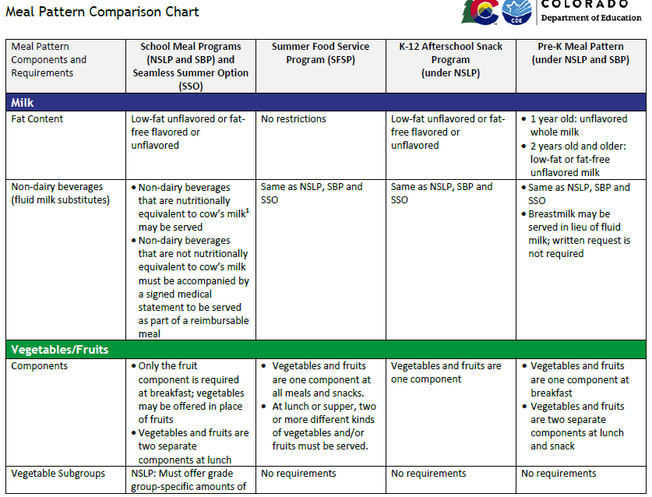
Meal Pattern Comparison Chart
Notes:
Erin
New resource to help you and your staff remember the details of the various meal patterns.

Slide 23
Meal Pattern Waivers
USDA is allowing meal pattern waiver requests for the following:
Sodium requirements
Whole grain-rich requirements
Vegetable subgroup requirements
Milk variety requirements
Low-fat flavored milk
Age/grade group (K-12)
Sponsors may apply for these flexibilities using the Meal Pattern Waiver Request form
For questions, contact Erin Opgenorth at Opgenorth_e@cde.state.co.us or 720-822-1883.
Notes:
Erin
As I mentioned, USDA is allowing sponsors to request specific meal pattern flexibilities for next school year to help ensure a safe meal service, listed here.
All sponsors who apply for the sodium waiver will be approved to remain at sodium Target 1 levels for the 2021-22 school year. The other waiver requests will be approved based on specific situations and justification. As I mentioned, we are waiting on guidance from USDA on whether pre-K students that are not comingled with older students can be included in the age/grade group waiver.
I will review all waiver requests and may contact you for additional information if needed.

Slide 24
Meal Pattern Waiver Implementation
Request age/grade group waiver for grab and go meals.
Request age/grade group waiver for grab and go meals. Meals will be planned to meet the K-8 meal pattern requirements, as the majority of students picking up meals will be from that grade group.
Request age/grade group waiver for vegetable subgroups.
Requesting flexibility in meeting the beans/peas (legumes) and starchy vegetable subgroup weekly requirements. Sponsor is serving cold meals in the classroom and is finding it challenging to plan menus that incorporate vegetables from these two subgroups to meet requirements. Sponsor is currently planning to serve hummus, bean and corn salad, and frozen peas and will continue to incorporate vegetables as new ideas are found and accepted by students.
Notes:
Erin
When completing the meal pattern waiver requests it is important to provide as much information and detail as needed to support your request. USDA has emphasized that waivers are in place to support sponsors in providing safe meals while we may still be experiencing the need for alternate meal service styles, increased social distancing, or other safety measures due to the pandemic.
There are two examples on this slide. The left side has waiver requests without much detail. The right side has enough detail to explain exactly why the waiver is needed.
When completing your waiver request, consider including if the waiver will only be for grab and go meals, which specific grade group requirements you will plan for, which specific grain items will be enriched and not whole grain-rich, or which vegetable subgroups requirements you may not consistently meet and why.
USDA did not provide minimum requirements to meet, such the percent of whole grain-rich foods you must serve over the week, so requests will be approved based on justification.
One additional reminder: if you feel that your sites may safely implement salad bars or self-serve stations next year, check in with your local health department. They are the ones who can help you decide if that is appropriate.
I will be providing additional meal pattern and menu planning training this summer at CSNA and through our unit, so please let me know what to include to best prepare you for next school year.

Slide 25
https://jamboard.google.com/d/1Xh6ii5QUTiaKRN4m1VCtg51usghx-hZHPEqmvnEHr_M/edit?usp=sharing
Notes:
Erin & Kerri
https://jamboard.google.com/d/1Xh6ii5QUTiaKRN4m1VCtg51usghx-hZHPEqmvnEHr_M/edit?usp=sharing
Q&A here – about half way. Questions specific to meal operation type or meal patterns.

Slide 26
Meal Times
Allows sponsors to set meal service times that work best for their school and community needs.
Toolkit
Pg. 4
FAQ
Pg. 2,
8-9
Notes:
Kerri
We are now going to go through the additional waivers for SY 2021-22.
Apply to NSLP and SSO.
The meal service time restrictions waiver allows sponsors to set meal service times that work best for their school and community needs. There are no restrictions on time between meals or length of service; however, you should keep these in mind to best meet the needs of your students.
In conjunction with the non-congregate feeding waiver (which we will go in to next), this also allows sponsors to distribute up to 5 days’ worth of meals at one time.

Slide 27
Non-Congregate Feeding
Meals and snacks may be taken and consumed off-site.
FAQ
Pg. 2,8
Toolkit
Pg. 4
Notes:
To ensure appropriate safety measures and support social distancing, meals and snacks may be taken and consumed off-site. This allows schools the opportunity to provide meal pick-up options for students learning virtually and facilitates grab-and-go meals for students in school.

Slide 28
Parent Meal Pick Up
The “USDA Best Practices for Parent Pick-Up of Meals and Snacks” provides helpful information for understanding Parent Meal Pick Up.
Toolkit
Pg. 4, 7-8
FAQ
Pg. 2,5
Notes:
Per the Nationwide USDA Waiver, children are not required to be present while their parents/guardians pick up the meals; however, program accountability must be maintained in order to prevent duplicate meals or meals being served to adults without eligible children. The “USDA Best Practices for Parent Pick-Up of Meals and Snacks” provides helpful information for understanding Parent Meal Pick Up.
The non-congregate, meal service times, and parent pick-up waivers allow schools to utilize meal distribution methods that work best for their students such as, home delivery, grab and go, curbside pick-up, multiple meal distribution, bulk meals, and parent-pick up.
Again, Sponsors are encouraged to have a procedure in place ensuring the students are in attendance of the school by either requesting a student ID or student name.

Slide 29
Monitoring & Audits
Sponsors may complete monitoring requirements through an off-site desk audit. Sponsors must review each meal site at least once during each site’s operation and can use this SSO review form
Toolkit
Pg. 4,9
FAQ
Pg. 10-11
Notes:
Sponsors may complete monitoring requirements through an off-site desk audit. Sponsors must review each meal site at least once during each site’s operation and can use this SSO review form.
This is the same for NSLP reviews.

Slide 30
SY 2021-22 Administrative Reviews
CDE School Nutrition will maintain it's planned review schedule.
Review and technical assistance schedule can be found here: https://www.cde.state.co.us/nutrition/adminreviewandtechnicalassistancecycle
Additional information on how to prepare, time frame, reviewer and if the review will be on or off-site is forthcoming.

Slide 31
Area Eligibility
Allows sponsors to operate the SSO at any school site, regardless of its location.
Toolkit
Pg. 5
FAQ
Pg. 2-3
Notes:
N/A for NSLP.
Allows sponsors to operate the SSO at any school site, regardless of its location. This ensures all children in all areas across the state can receive free meals during the school year.

Slide 32
Reimbursement Rates
Toolkit
Pg. 5
SSO = SFSP reimbursement rates: http://www.cde.state.co.us/node/55492
Updates from USDA coming soon!
NSLP/SBP = NSLP reimbursement rates: https://www.cde.state.co.us/nutrition/reimbursementrates
FAQ
Pg. 2-3,7
Notes:
Updated reimbursement rates coming soon; however, SFSP reimbursement rates are higher than NSLP.
Waiting on USDA guidance on how to code SSO meals.

Slide 33
Afterschool Snack Program (ASP)
Based on the Area Eligibility for Afterschool Programs nationwide waiver, all schools, regardless of their location, can provide and claim all afterschool snacks at the free rate.
ASP can operate at sites providing breakfast and lunch under SSO
Toolkit
Pg. 5
FAQ
Pg. 3,8

Slide 34
Fresh Fruit and Vegetable Program (FFVP)
The FFVP can operate at sites providing meals under the SSO during school year 2021-22.
CDE School Nutrition will be going for additional waivers to allow for parent pick up and alternate site pick up – stay tuned!
Apply for FFVP in the Colorado Nutrition Portal by Saturday, July 31.
FAQ
Pg. 3
Notes:
School Year 2021-22 Fresh Fruit and Vegetable application is open
- Operate the same as last school year hopefully with these waivers
sponsors must complete the FFVP application packet in the Colorado Nutrition Portal by Saturday, July 31; you can reference the application instructions for more information
At this time, sponsors should not make any updates to the National School Lunch Program or Seamless Summer Option applications. Ensure you are in the correct school year by selecting ‘Year’ in the top right hand corner of the portal upon logging in.
For questions, contact Erica Boyd at boyd_e@cde.state.co.us or 720-693-3232.
Qualified schools may be awarded FFVP funds based on the following criteria:
Be an elementary school
Begin FFVP operations at the start of the school year
Have at least 50% of its students eligible for free or reduced price school meals based on the 2020-2021 PK-12 free and reduced-price data. Preference will be given to schools with the highest eligibility percentage

Slide 35
Other Program Considerations
Food Safety
Civil Rights and Special Dietary Needs
Professional Standards
Smart Snacks and Competitive Foods
Financial Management
Toolkit
FAQ
Notes:
There wasn’t enough time to get through everything today, but you must also keep these other program requirements in mind in your planning and program implementation. Additional training and information can be found in our FAQ document, on the training page on our website and will be covered in the “Back to School” session at CSNA.

Slide 36
Resources
Colorado Department of Education Back to School Guidance: http://www.cde.state.co.us/node/52637
USDA Waivers and Guidance (Colorado): https://app.smartsheet.com/b/publish?EQBCT=2fbcc0b15a604b2fb461289e54d80f71
School year 2021-22 FAQs: http://www.cde.state.co.us/nutrition/backtoschoolfaqs
Notes:
Here are some resources that we used throughout the presentation for your reference.
Other trainings coming up include:
- Back to School Session at CSNA on June 15 – it will be a more in depth version of todays training

Slide 37
Notes:
In light of all the changes and unique operations over the last year, our unit as continued to work on ways to improve and support you, our customers, to best serve Colorado children.
After a lot of work, use of data, and resources such as contractors and you all, we are excited to implement some of these improvements.

Slide 38
CDE Updates
Strategic Plan
Positions and unit teams with more defined and dedicated areas of work.
Revisioning small teams that provide support for specific program areas.
Caseload Model
Model to provide more individualized customer service.
Program related questions and support with applications, reviews, and training and technical assistance needs.
Notes:
- over the past year we have taken steps to focus on our unit strategic plan. To meet our goals and improve our strategy, changes to our structure will take place over the next year to accommodate our growing team.
Examples of some of the changes include:
Positions and unit teams with more defined and dedicated areas of work such as policy, grants, training, and communications.
Revisioning small teams that provide support for specific program areas such as school meal eligibility, meal quality, procurement, and financial management.
Additionally, starting this summer, School Nutrition will move to a point person model to provide more individualized customer service. Sponsors can contact the person assigned to their application in the Colorado Nutrition Portal for program related questions and support with applications, reviews, and training and technical assistance needs. Sponsors operating SFSP can continue to contact the person assigned to their SFSP application. Once sponsors transition to planning for next school year, you can contact the person assigned to your SNP (SSO) application. This person will be your point of contact moving forward for program related questions and support with applications, reviews, and training and technical assistance needs.

Slide 39
Questions? Submit via form at any time: https://app.smartsheet.com/b/form/0614096b88c046cbbb6ddda19d96ceb8

Slide 40
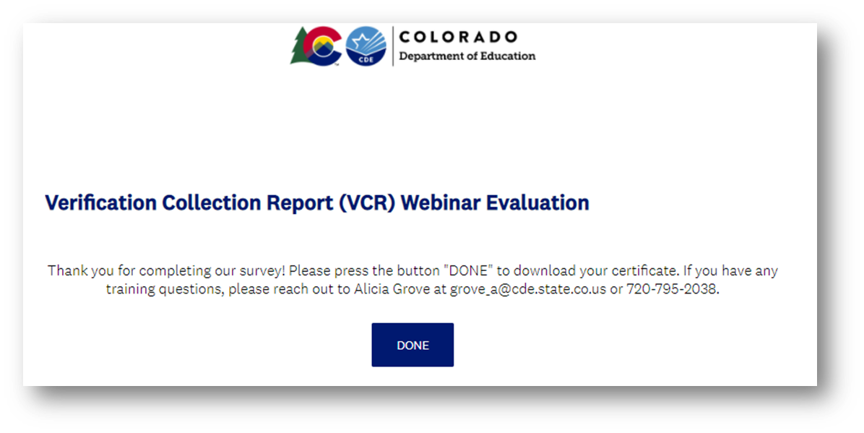
Training Evaluation and Certificate
Click this link to complete a quick training evaluation
https://www.surveymonkey.com/r/MGFHPPQ
When you submit the evaluation click “DONE” on the survey thank you page to download your certificate
Notes:
This link will be emailed out to all training attendees. This information is included for those watching this training at a later date as a recording.
Thank you so much for your feedback- we are always looking for ways to improve our trainings to better support you.

Slide 41
Next on the Menu Call:
June 24, 2021, 2-3pm
Notes:
Thank you all so much for joining todays on the Menu Call. Please join us on, February 25th from 2-3 pm where we will discuss community engagement and outreach in the SFSP.

