Slide 1
Cohort 1 - Year 2 Kickoff
Office of Learning Supports
September 2017

Slide 2
Outcomes (on agenda)
Cultivate common language from CDE regarding MTSS implementation.
Contribute to collegial conversations & build individual & collective capacity.
Identify opportunities and action planning for 2017-2018.
http://www.cde.state.co.us/mtss/ co-spdg-cohort1y2-fall2017kickoff

Slide 3
Expectations
Notes:
Click each to animate: These are some expectations for our day (some examples for others, perhaps)…we can agree each category could be adapted somewhat, but hopefully, these feel reasonable for major actions of the day.
When in your MLTs, you have defined norms/agreements that have been guiding you (outside of these). But basically (overall), we are seeking: Communication, Collaboration, and Respect.

Slide 4
CDE OLS Staff
Director Scott Ross
Specialists
Lynne DeSousa
Jason Harlacher
Andrew Schaper
Sam Swauger
Adam Collins
Carole Pandorf
Sean Taylor
Kim Watchorn
Diane Barranco, Program Assistant
Implementation Consultants
Katy Goebel
Rebecca Knighton
Sheree Wheeler
Megan Rogers
Sara Widiger
Jill Youngren
Milcah Hawk
Matt Klausmeier
Kelly Ratliff
Robyn Shank
Emily Kielmeyer
Erin Ax

Slide 5
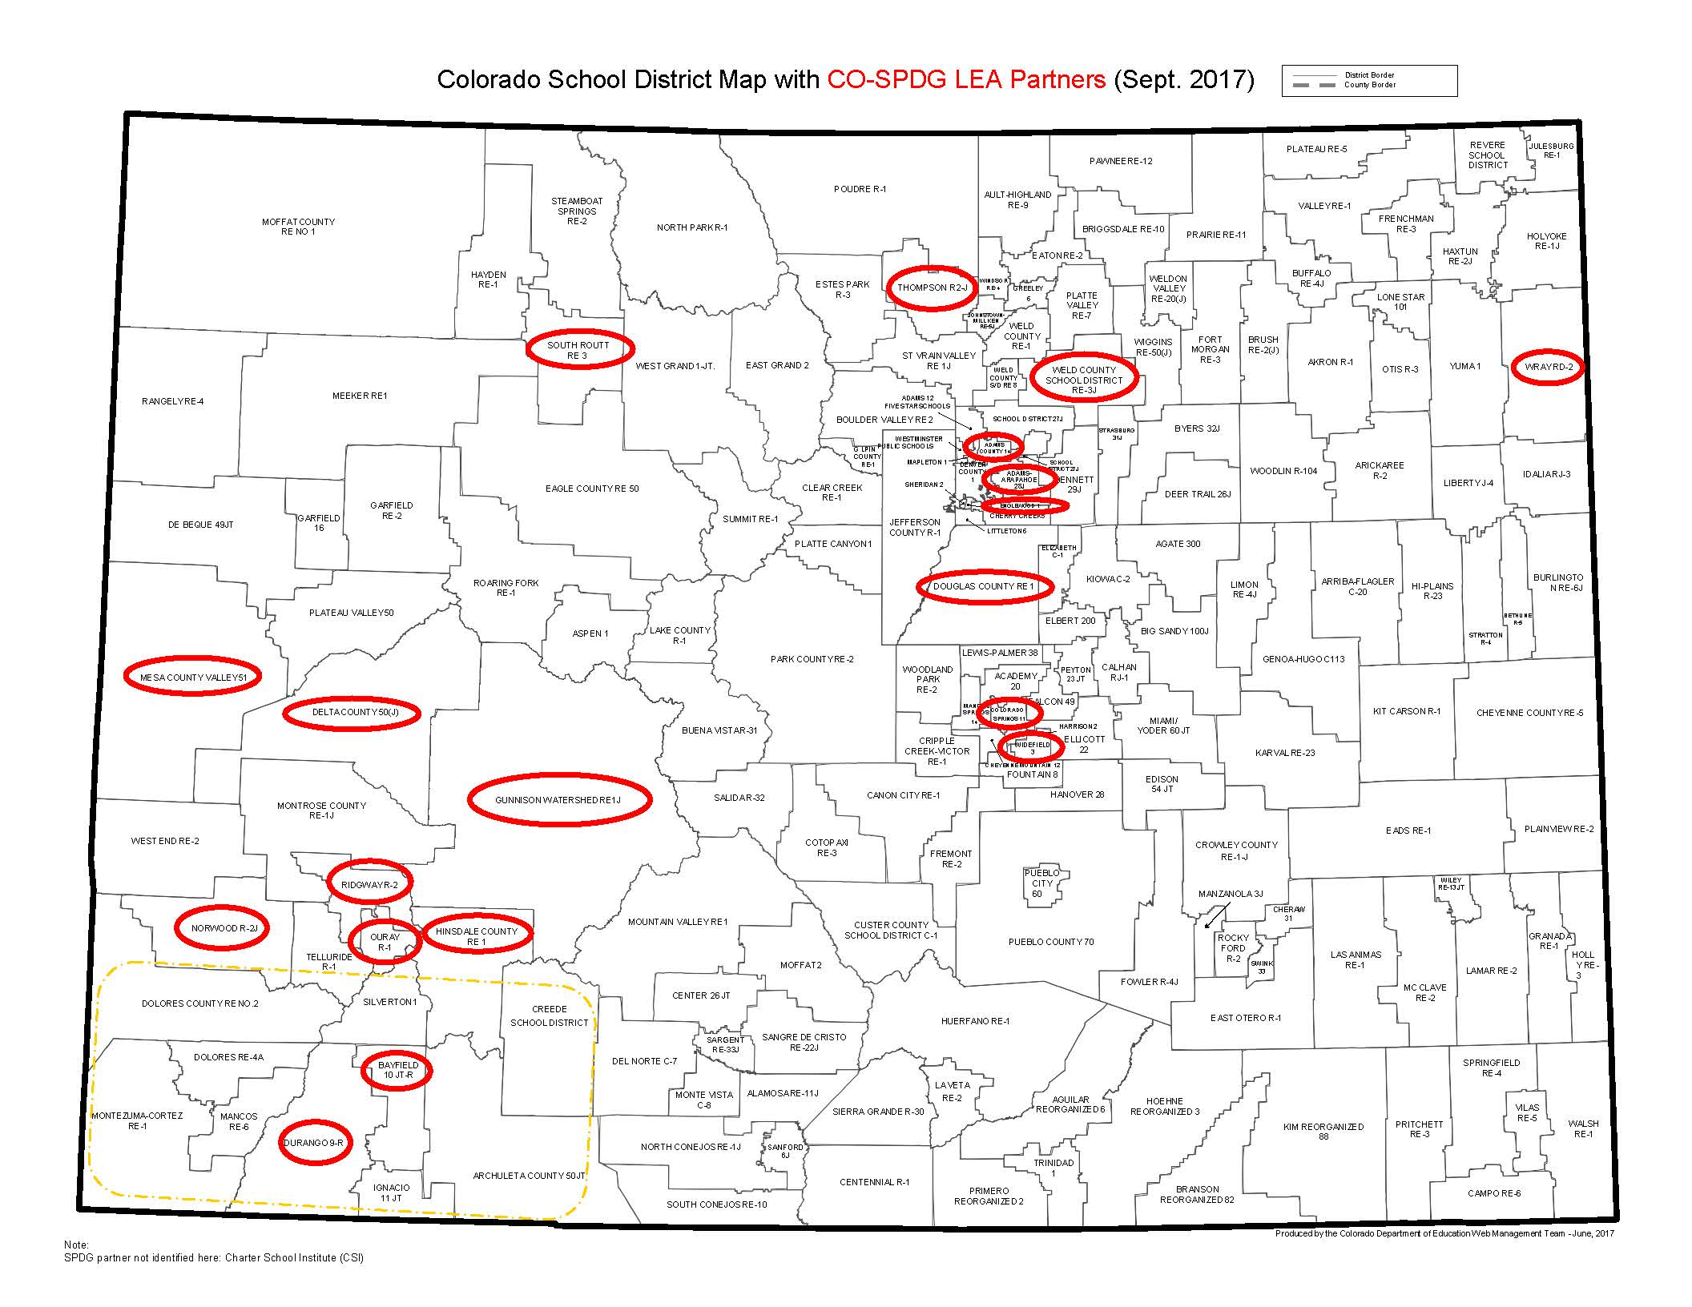
http://www.cde.state.co.us/mtss/co-mtss-spdg-grantees

Slide 6
Self-Identify by Team
Adams 14 School District | Adams Arapahoe 27J School District (APS) | Bayfield 10 JT-R School District
Charter School Institute (CSI) | Colorado Springs District 11 | Delta County School District
Douglas County School District | Durango School District 9-R | Englewood Schools
Gunnison Watershed School District | Hinsdale County School District RE-1 | Mesa 51 School District
Norwood R2-J School District | Ouray School District R-1 | Ridgway R-1 School District
San Juan BOCES | South Routt RE-3 School District | Thompson R2-J School District
Weld RE-3J School District | Widefield School District 3 | Wray RD-2 School District
http://www.cde.state.co.us/mtss/co-mtss-spdg-grantees
Notes:
Highlighted districts are here today! When your team is called out, please self-identify (shout out…or stand up…or wave).

Slide 7
Roles in the Room (paraphrased titles)
CLD/ELD Specialist/Dir.
Data/Assessment Specialist
Director of Support Programs
Director of Culture/Climate
Director of Curr./Instruction
Director of Elem./Sec. Ed.
ECE Coord./Director
Family/Comm. Coordinator
Gifted Education Specialist
Grade-Level/Content Teacher (generalist)
Grant Coord./Specialist
Interventionist
MTSS Coach/Coordinator or PBIS Coordinator
Parent/Family Member
PD Specialist/Coord./Dir.
Principal/Asst. Principal/ Dean
Social Worker or Counselor
Special Education Coord./Dir./Ex. Director
Special Education Teacher
Superintendent/Asst. Super./Chief Officer
Title I Programs Coord./Dir.
Notes:
Slide projected…find yourself represented. When we call out the roles, please stand or raise your hand as self-identification.

Slide 8
Video (welcome)
25 Reasons to be Thankful
https://www.youtube.com/watch?v=yA5Qpt1JRE4
And we are thankful for all of you…
What are you thankful for today?

Slide 9
Celebrations
Consider the successes within your district…
What are you proud of? What has worked or is working? What would you like to share?
Dialogue as a team, and identify at least 1-3 shareable “Celebrations” related to you & MTSS.
Create a poster by capturing ideas on chart paper (text, images, timelines, flow charts, metaphors, etc.)
CDE staff will take pictures of teams in practice and of products (for public posting)
Digital “gallery walk” will be on a Twitter stream
Twitter Hashtag(s): #COSPDGwins (feel free to tweet yourself, as well!)…and #MTSS

Slide 10
Video (transition)
Be Like Mike
https://www.youtube.com/watch?v=5D11e424M_Q
Monday morning…here we go…

Slide 11
Pre-Learning
Narrated recording: Focus on capacity development (including Implementation Science)
Tool: Colorado Evidence-Based Personnel Development Rubric
Self-Analysis of LEA status on MLT Self-Assessment…THANKS to all completed!

Slide 12
Concepts from Pre-Learning
Taking Stock
Leadership Team Identity
Implementation Practices
Implementation Drivers
Implementation Stages
Readiness
Selection
Managing Complex Change
Enabling Change (Formula for Success)
Adult Learning (including coaching)
Notes:
What are some noticings? Thoughts? Takeaways? Things to investigate further? Questions?

Slide 13
Adult Learning Principles
Introduction
Illustration
Mastery
Practicing
Reflection
Evaluation
Adapted from:
Trivette, 2012 (http://www.signetwork.org/file_attachments/123/download)
Notes:
These authors were able to study and come out with these areas that we cite as “Adult Learning Principles” that would be applied with any adult learning opportunity.

Slide 14
Bridging Pre-Learning and Today’s Work
Pre-Learning & Introductions: Introduction
Celebrations: Reflection
Activities & slides: Introduction & Illustration
Self-Assessment: Reflection, Evaluation, Mastery
Integrated Learning/Networking: Practicing & Reflection
Debriefs: Reflection
Breakouts: Introduction & Illustration
MLT > BLT: Mastery
Action Planning: Reflection, Action Planning
Closure: Reflection, Evaluation
http://files.eric.ed.gov/fulltext/ED565253.pdf

Slide 15
Colorado Evidence-Based Personnel Development

Slide 17
Competency Development
Disposition & Mindset…Readiness
Who needs to know what by when?
How are you applying “Tiered Logic” (MTSS logic) to adults? (Individuals & schools)
Review the PD Rubric with teammates
Consider your current state for both sections: Infrastructure & Delivery
Consider the questions to the left. Who needs MTSS training/TA? What should they know? When?

Slide 18
What & Why…
“Just Do It…” (FrameWorks Institute, 2015)

Slide 19
Predictions & Implications
“Just Do It…” (FrameWorks Institute, 2015)

Slide 20
CO-MTSS State Personnel Development Grant (SPDG)
Goal 1
Increase state leadership capacity for CO-MTSS by improving the professional learning, technical assistance, data-based problem solving, initiative alignment, capacity building, funding, visibility, political support, and policy of CDE.
Goal 2
Increase regional and district capacity for CO-MTSS through effective leadership, planning, and the provision of professional development and technical assistance.
Goal 3
Increase preschool-12, school-level capacity for CO-MTSS through team-driven shared leadership, data-based problem solving, family school, and community partnering, and a layered continuum of evidence-based practices.
Goal 4
Support teacher effectiveness through district and regional systems of professional development and technical assistance.
Goal 5
Increase family, school, and community partnering around CO-MTSS through specific
activities and engagement.

Slide 21
CO-MTSS Project Activities & Timeline
Goal 2: Regional and District Capacity, Implementation Science
MLT Self Assessment, Initiative Inventory, PD Planning, Communication Planning, Action Planning, P-3 within CO-MTSS, FSCP, content based PD and TA
Goal 3: School Capacity and High Quality Personnel Development
BLT Self Assessment, Short Cycle Action Planning, content based PD & TA
Year 1
Year 2
Year 3
Year 4

Slide 22
MLT Implementation
Action Planning
Initiative
Inventory
MLT Self
Assessment
Communication Planning
Selection
Family, School,
and Community Partnering
P-3 within CO-MTSS
Personnel Development
Planning

Slide 23
Active Implementation Stages
Identify
Plan
Get Started
Get Better
Exploration
Installation
Initial Implementation
Full Implementation
Assess need;
Examine fit and feasibility
Assure resources;
Develop supports
Initiate practice; use data to improve supports
Practice is consistent; positive outcomes

Slide 24
Using MLT Dashboards
Andrew Schaper

Slide 25
Section Overview & Objection
Learning Objective: Learn how to access and navigate dashboard, as well as where to enter data
Overview:
The dashboard & its fit within an implementation framework
Access
Navigation
Basic layout of dashboard worksheet
Basic layout of measure worksheets
That annoying feature about hyperlinks…
Where to enter MLT Self-Assessment data

Slide 26
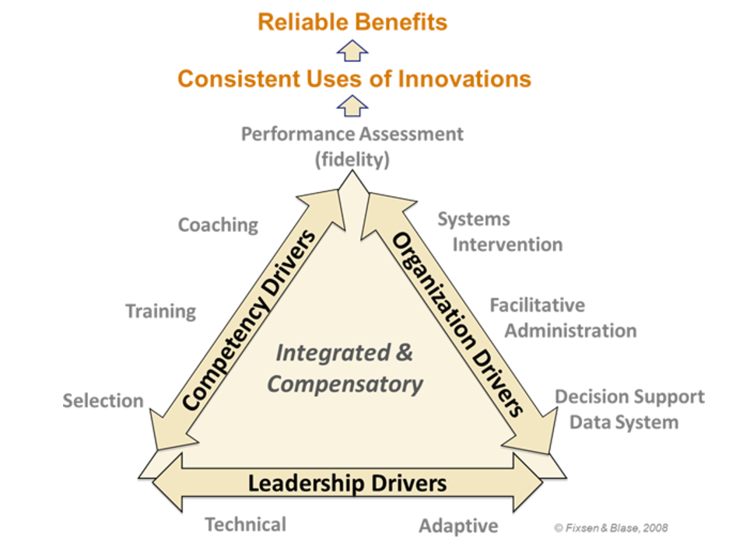
Implementation Practice

Slide 27
Dashboard Access
In the main folder of your MLT Google Folder (named Dashboard_LEANAME)
Only MLT Lead(s) and TA Providers have access at this point
Others can gain access – work with TA providers and email Andrew Schaper (schaper_a@cde.state.co.us)

Slide 28
Dashboard Navigation

Slide 29
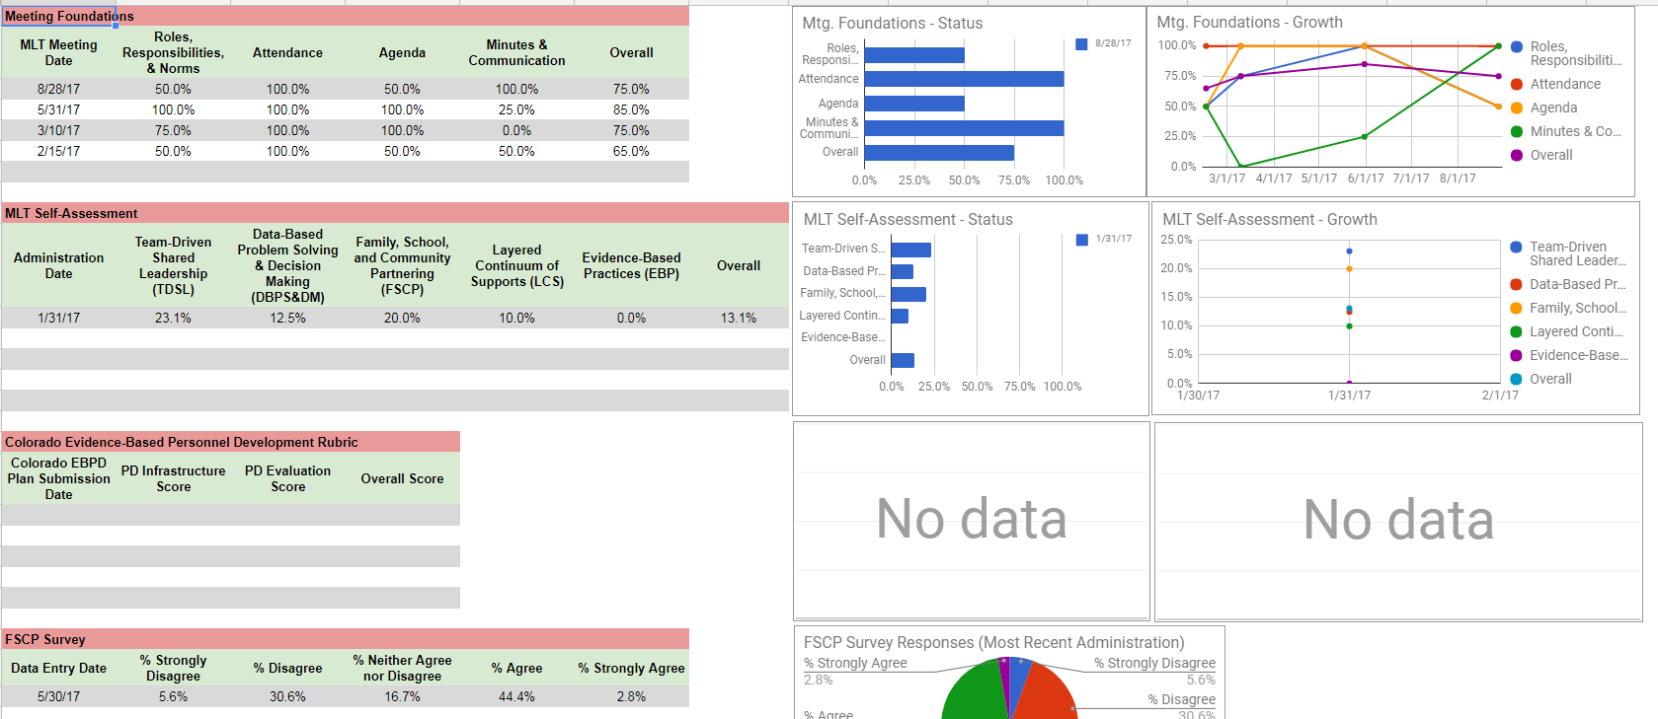
Basic Layout of the Dashboard Worksheet

Slide 30
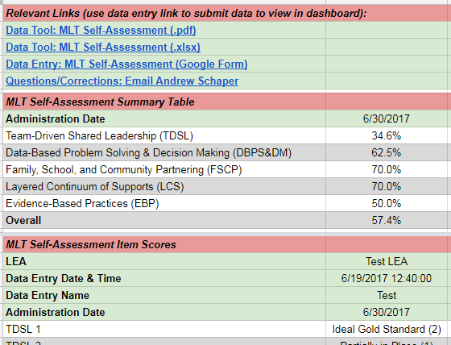
Measure Worksheet Layout

Slide 31
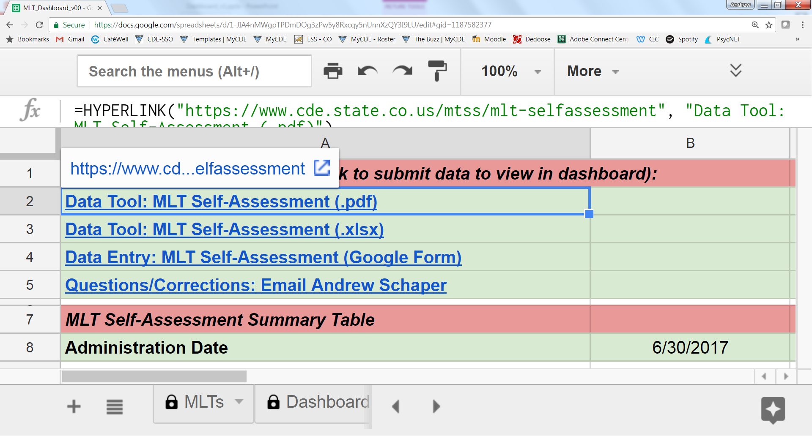
That annoying thing about hyperlinks…

Slide 32
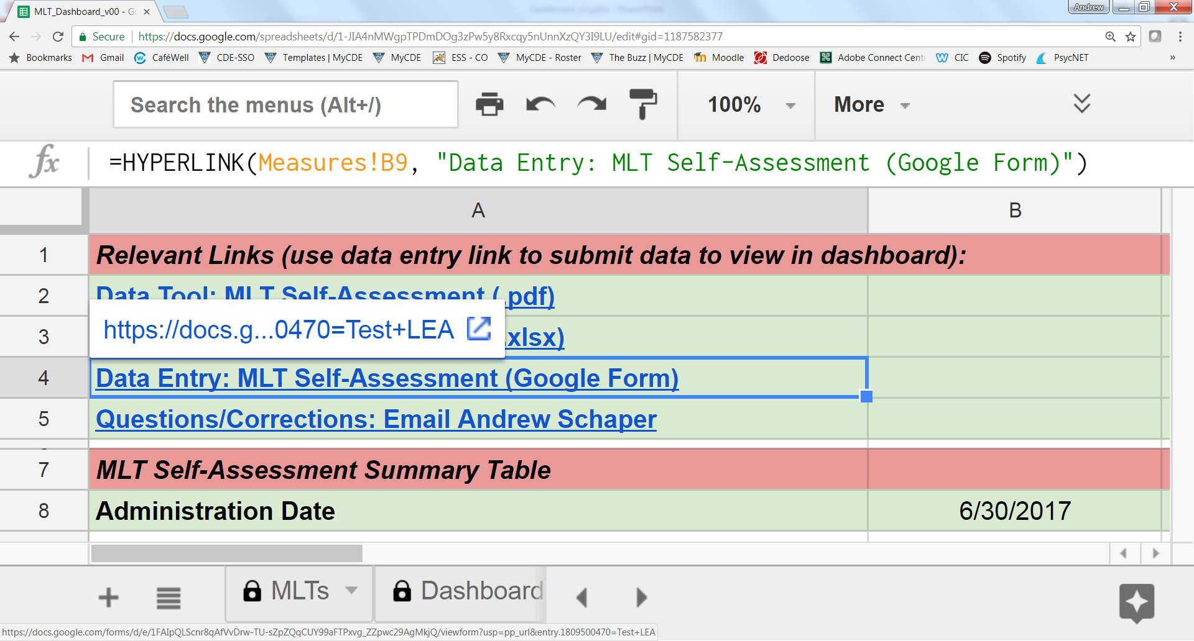
Where to enter MLT Self-Assessment Data

Slide 33
Team Completion of the Tool

Slide 34
MLT Self-Assessment Completion
Ensure roles are secured (e.g., Facilitator, Note-Taker) and Norms are clarified (e.g., set-aside rule if significant deliberation on a single item).
Consider your personal scores across all items.
As an MLT, proceed through 5 Components to come to Consensus as a team for each of the 35 items.
Use MLT-initiated decision rules; if dissension exists, discuss to resolve for score entry.
Capture evidence & supports (documentation) and comments or notes – as available and as needed.
Enter agreed upon scores within the Dashboard.
Time-Permitting: Compare/analyze against initial score (winter 2017). Consider possible priorities.

Slide 35
Integrated Learning and Networking (round tables)

Slide 36
Integrated Learning and Networking: Special Topics (round table conversations)
Handout 1: (small slip of paper, 1 per person)
Guiding questions and sentence starters are included below. If helpful, chart paper will be available. Also, a CDE staffer will be nearby, for support, and will give a 5-minute remaining time check, at which time, he/she will collect major takeaways and questions for CDE.
Why is this an area of interest for you? What do you hope to learn from others?
How could your MLT explore/investigate/ implement this area?
What are your primary celebrations/considerations/concerns related to this area?
What support(s) do you think you need?
What questions do you have?
Other inquiries?
Handout: 3-2-1 Personal Reflection (1 per person)
Write Down

Slide 37
Integrated Learning & Networking: Topics
Science & Tools
(main room)
Implementation science and practices
Action Planning
Initiative Inventory
Adult learning/PD planning
Communication Planning
Selection of demonstration sites
Components & Content
(next door)
Team-Driven Shared Leadership
Data-Based Problem-Solving & Decision-Making
Family, School, and Community Partnering
Layered Continuum of Supports
Evidence-Based Practices
Preschool – Third (P3)

Slide 38
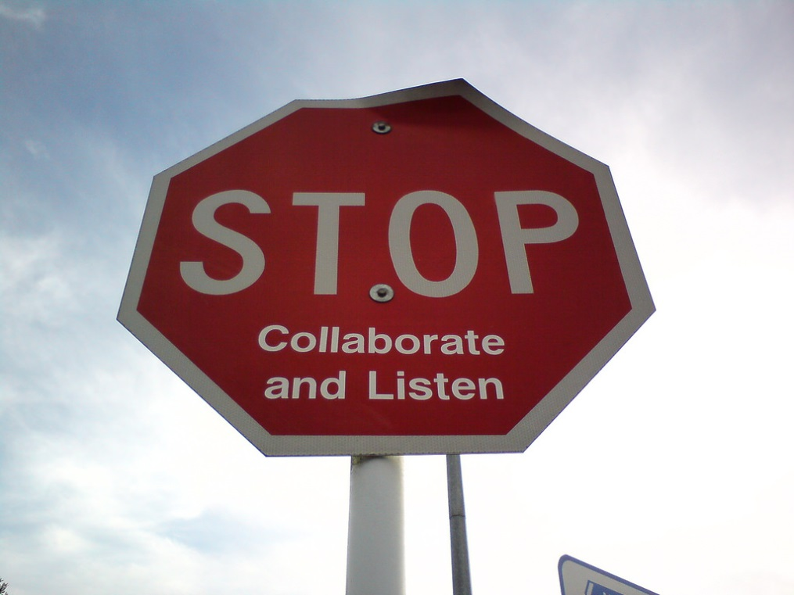
Lunch Break
Return for Breakouts
(see descriptions on table)

Slide 39
MLT > BLT

Slide 40
Teaming Structures Form a Natural Cascade
Leadership Teams
State
District
School
Classroom
Implementation Teams
Notes:
Have you ever wondered why this commonly used implementation science image is depicted as it is? Have you wondered why it’s not simply linear, but there is an implied hierarchy? On one hand, it has to do with the functionality. That is, it has to do with teams focusing on leadership tasks, and implementation tasks.
It is a great image because it focuses on one of the key components of CO-MTSS, team driven shared leadership. And it gains depth by highlighting the balance of leadership and implementation as part of team functioning. At the upper levels of the cascade teams focus more explicitly on the leadership drivers (adaptive and technical) to align initiatives, secure funding. But even at this level, state teams focus on implementation tasks.
In our case (i.e., in the case of the SPDG), the state implementation team focuses on developing and implementation of training and technical assistance that is delivered directly to district teams. In this sense, this is our team’s output.
Similarly, district teams focus on both leadership oriented tasks such as obtaining funding, including completing RFPs from the state. Further, they engage in the training and technical assistance delivered by the SIT. Finally, they plan their own initiatives based on strategic action planning, and guides the implementation of initiatives and evidence based programs.
This model also focuses on the underlying logic model of the implementation plan. At each level of the organization, teams have different responsibilities to facilitate effective implementation.

Slide 41
Leadership Team Coaching in Practice (Hawkins)
Six Criteria for Assessing “Real Teams” (Richardson, 2010)
Interdependence (collective tasks require working together)
Shared objectives (agreed collectively)
Autonomy (defined areas where they collectively decide)
Reflexivity (meets and reflects on performance and improvement)
Boundedness (clarity about boundaries)
Specified Roles (different roles contributing to collective performance)
Notes:
Possible prompts?
How would you describe effective teaming? What does it look like/sound like? What are the operations? What procedures reflect authentic collaboration?
Consider the collaboration within your system = are teams functioning as “real teams”? What teaming structures are in place?

Slide 42
Effective Teams
You need to do the team building in the context of doing the work itself.. both working on tasks and working on team-building… (Amy Richardson)
Brainstorm
What is a high-functioning team?
What does it mean to be a “real” team?
What are the attributes?

Slide 44
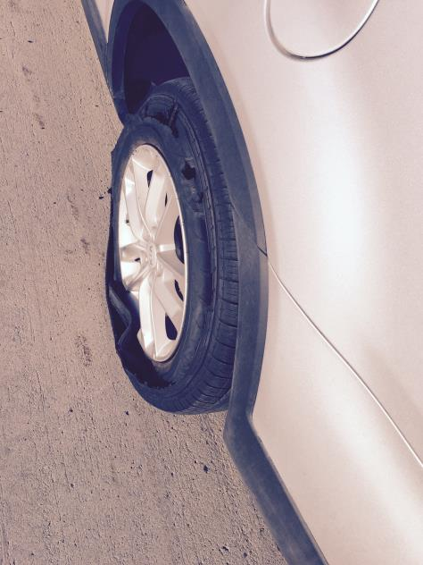
Team-Driven
Teaming Structures (alignment; high-functioning; efficient; integrated domains)
Collaboration is purposeful.
Communication plans (with feedback loops) exist.
Roles/responsibilities are defined.
Meeting protocols and norms are used consistently.
Implementation Team: Has knowledge, skill, and decision-making authority.
Notes:
Representative team- everyone in the learning community (all stakeholders, families & students considered, as well) has an equal and representative voice.
A representative team is formed to define the vision, clearly communicate it and carry it out.
Roles and responsibilities are clearly defined and understood by all.
Teams exist to serve various purposes (i.e. schoolwide MTSS, PLCs, SSTs, Individual student PS teams, etc.). They look at different data, meet at different intervals and include personnel from a variety of grades and groups.
School is a safe place and reflects the healthy, cultural characteristics of the students’ community.
Family and community members are valued as equal partners.
Protocols ensure efficiency and predictability.

Slide 45
Team Identity
Composition: Roles and responsibilities, whose voice do you need in the room?
Vision: Craft your vision/mission
Expectations: Logistics (when will you meet? where? how often?), who will wear what hat?
Norms and agreements: How will you make decisions? How will you evaluate your meetings?

Slide 46
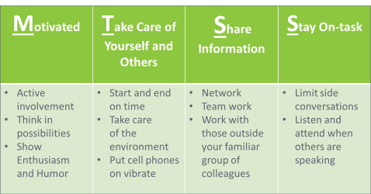
Practices for Teams
Schedules, Agendas, & Norms
Function/Purpose
Roles/Responsibilities
Membership: Invest in Shared Leadership
Meeting Protocols (e.g., Meeting Minutes; Consensus and Dissension; Evaluation)
Use a systematic, problem solving process
Identify gaps in system-wide processes in need of improvement
Use data-based decision making
Monitor progress toward system-wide goals
Implement evidence-based instruction and intervention
Notes:
Intentionally creating the stage to conduct problem solving can lead to effective decision making which in turn can facilitate positive student outcomes.
So, paying attention to team membership or ‘having the right people at the table’ to discuss the issue, people understanding their role and function in the specific setting for effective problem solving to occur, having formalized processes to conduct the work and framing the business of the work within acceptable norms (or how we treat each other when we work together are all critical to the success of effective problem solving.
Can you recognize these practices within your setting? If not, why not?
Remember that these effective practices, implemented well, lead to EFFICIENCY…and time is always a commodity to preserve.
Examples of decisions based on data:
Use data from universal screening to prevent problems from starting or getting worse
Use data from progress monitoring to guide daily instruction

Slide 47
Leadership Teams (Fixsen, Blase, 2012)
Important Initial Tasks
Develop the Capacity to Implement Well
Create alignment and Common language
Define initiative
Create process to support and problem-solve
Create common goal to implement effectively
Operationalize definitions
Notes:
This comes from Implementation Science literature. (but you’ll see it in other places; as MTSS is about “Educational Reform”, the literature on change in other educational areas, prioritizes these same things; this is “what works” for establishing strong collaborative leadership and sets the stage for transformation)
As you can see, these are the IMPORTANT INITIAL TASKS. This is where to start!!
Reminder that “operationalizing definitions” is so important. We often think that “we are all on the same page,” but we may need to be explicit to ensure that. (e.g., ‘what does rigor/robust mean to you’?)

Slide 48
Video (transition)
Teaming
https://www.youtube.com/watch?time_continue=13&v=4Rd9zQborxI

Slide 49
BLTs
What will you replicate from MLT > BLT?
Coherence Making: Alignment & Mindset (DuFour, Fullan, 2013)
Consider PD: Who needs to know what & when?
Enabling Context includes… Trust: How to establish and maintain…
Self-disclosure and inquiry
Vulnerability
Presume Positive Intent
Should feel “easy”…how can that be assured?

Slide 50
Video (transition)
20 Things you should Say More Often
https://www.youtube.com/watch?v=m5yCOSHeYn4

Slide 51
Action Planning

Slide 52
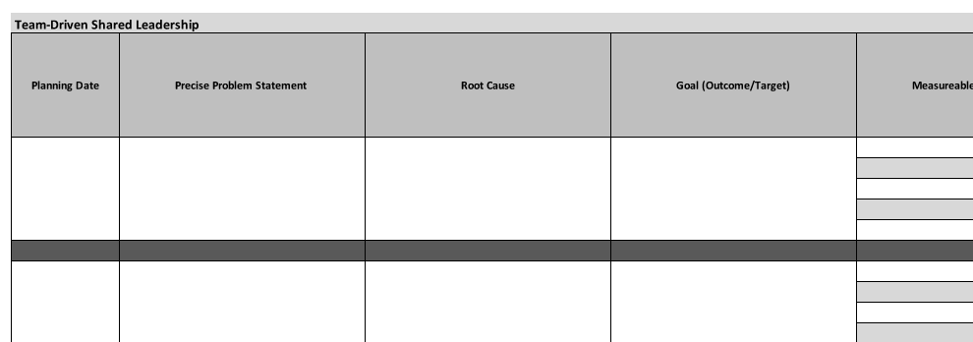
Action Planning Tool

Slide 53
Closure
Next Steps,
Evaluation, and
Final Thoughts

Slide 54
This CDE guidance document is meant for clarification, is not legally binding, and is not to be confused with legal advice. This guidance reflects CDE’s recommendations, but Local Education Agencies (LEAs) and Administrative Units (AUs) may have developed their own policies or procedures that differ from those described herein. Be sure to refer to your local AU’s policies and procedures through local leadership (e.g., Directors of Special Education, Title I Coordinators, superintendents). If you are seeking legal advice, please contact your legal counsel.
Note that the contents of this presentation and corresponding handouts were developed under a grant from the U.S. Department of Education. However, the content does not necessarily represent the policy of the U.S. Department of Education, and you should not assume endorsement by the federal government.
Notes:
Key Points:
This slide notes the funding source for this work.

