Slide 1
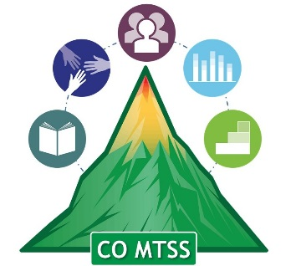
Bullying Prevention Training Series
Prevalence and Impact of Bullying
October, 2018
Adam Collins, Ph.D.
Bullying Prevention and Education Grant Coordinator
Collins_A@cde.state.co.us

Slide 2
Who Gets Bullied?
Notes:
Four roles in bullying

Slide 3
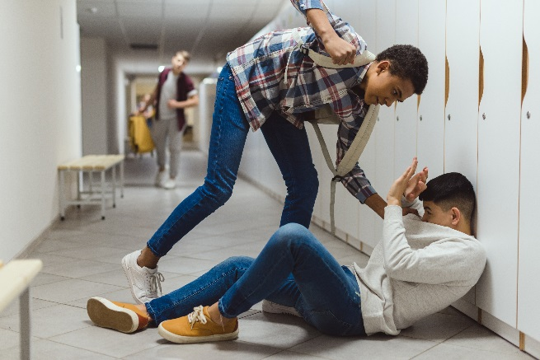
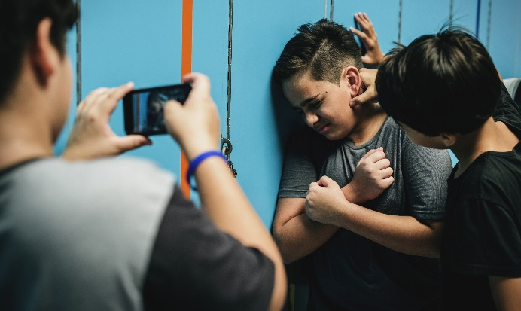
Who Gets Bullied?

Slide 4
Prevalence of Bullying
Bullying affects thousands of students each year. About 15% - 30% of students report being a part of bullying as either a target or perpetrator (see Rivara & Le Menestrel, 2016)
In Colorado (Healthy Kids Colorado Survey, 2017; YRBS, 2017)

Slide 5
Prevalence of Bullying
(National Crime Victimization Survey)

Slide 6
(National Crime Victimization Survey)

Slide 7
(National Crime Victimization Survey)

Slide 8
(National Crime Victimization Survey)

Slide 9
(National Crime Victimization Survey)

Slide 10
(National Crime Victimization Survey)

Slide 11
At Risk Populations
LGBTQ
Many studies have found LGBTQ youth to be more likely to experience bullying than cisgender youth (see Rivara & Le Menestrel, 2016)
Prevalence rates of bullying for LGB youth range between 25.6% - 43.6%
Disabilities
Students with disabilities are up to 1.5 times more likely to be bullied (Blake et al., 2012)
This is true from preschool through adolescence (Rose, 2015; Son et al., 2012)

Slide 12
Prevalence of Bullying Review
15-30% of students nationally are involved in bullying each year
Hallways and classrooms are the most common place for bullying
Bullying peaks in middle school, then declines
Bullying occurs at the same rate regardless of locale (e.g., urban, rural)
Students who are disabled or identify as LGBTQ are more likely to be involved in bullying

Slide 13
The Impact of Bullying

Slide 14
Impact of Bullying
Internalizing Symptoms
(Gini & Pozzoli, 2013; Hunter et al., 2014; Kidger et al., 2015; Klomek et al., 2009; 2015; Patchin, 2006; see Ttofi et al., 2011)
Self-Harm
Suicidal Ideation
Anxiety
Somatic Symptoms
Depression

Slide 15
Impact of Bullying
Externalizing Symptoms
(Espelage et al., 2013; Nakamoto & Schwartz, 2010; Radliff et al., 2012; Reijntjes et al., 2011)
Lower Grades
Truancy
Lower Test Scores
Delinquency
Substance Abuse
Aggression

Slide 16
Impact of Bullying
Somatic symptoms (Gini & Pozzoli, 2013; Hunter et al., 2014)
Symptoms of depression (see Ttofi et al., 2011)
Anxiety and self-harming behavior (Kidger et al., 2015; Klomek et al., 2009; 2015)
Suicidal ideation (Patchin, 2006; Ybarra et al., 2006)
Alcohol and drug abuse (Radliff et al., 2012)
Aggression (Reijntjes et al., 2011)
Truancy and delinquency (Reijntjes et al., 2011)
Lower grades and standardized test scores (Espelage et al., 2013; Nakamoto & Schwartz, 2010)
These Symptoms can Last for Years (Bowes et al., 2015)
Most Severe Consequences are for Students who are Bully-Victims (Arseneault et al., 2006)

Slide 17
Bullying Prevention Training Series
Prevalence and Impact of Bullying
October, 2018
Adam Collins, Ph.D.
Bullying Prevention and Education Grant Coordinator
Collins_A@cde.state.co.us

