Slide 1







Colorado Multi-Tiered System of Supports
Kickoff
January 31, 2017
As we get settled in, please make sure you have access to our resources for the day: http://www.cde.state.co.us/mtss/cde-ols-winter2017-mtss-kickoff

Slide 2

Housekeeping
PowerPoint & supplemental materials http://www.cde.state.co.us/mtss/cde-ols-winter2017-mtss-kickoff
Coffee/Tea/Water
Restrooms
Charge stations
Take care of your needs
Wifi: Signal

Slide 3


Slide 4

Goal of the Day
Kick off our MTSS work
  Lots of discussion
  Establish our starting point
Establish some specific action steps for moving forward

Slide 5
Agenda
9:30-10:15 Overview and Introductions
10:15-11:00 Team Driven Shared Leadership
11:00-11:15 Break
11:15-12:30 Data-based Problem Solving and Decision Making
12:30-1:00 Lunch
1:00-1:30 Family, School, and Community Partnering
1:30-2:00 Layered Continuum of Supports
2:00-2:15 Break
2:15-2:45 Evidence-Based Practices
2:45-3:30 Calendaring and Next Steps

Slide 6
MTSS Formula for Success
What
How
Where
Effective Interventions
Effective Implementation Methods
Effective Systems
Academic, Behavior,
Family,
Staff Supports, etc.
Implementation Science
Supportive Infrastructure
Why
Socially Significant Outcomes
Adapted from 2012 Dean Fixen and Karen Blasé, National Implementation Research Network
Notes:
So in summary, our goal in education is to improve student outcomes with efficiency and effectiveness. This graphic highlights explicitly the “how” to do this. If we utilize effective interventions (the what) and implement them using effective implementation methods (the how), in enabling contexts (the where), we will accomplish socially significant outcomes. (the why)
Education isn’t about exploration; We need to utilize an organized and intentional approach to plan and provide the learning for students.
Extra note if needed: An important note is Creating and sustaining an hospitable environment [the “where”] is necessary to “grow” whatever we hope will flourish; in this case, we’re talking about MTSS implementation. So, our culture, climate, and collaboration need to facilitate the process of implementation, not take away from it…and not be a barrier to progress.

Slide 7

CO-MTSS Scope and Sequence
Baseline Self Assessment
Action Planning around your MLT Self Assessment Scores
Initiative Inventory
Professional Learning Audit and Plan
Communication Planning

Slide 8

Funding Formula
$5000 for each participating district/BOCES/CSI
  For use through September 30,2017
  Money can be used for anything other than salary and food
As of October 1st, 2017, funding moves to a formula
  Your activities through September 30,2017 will determine eligibility for 2017-2018
First: You will get a baseline of $5000 for:
  Full attendance at the January Kickoff
  Completion of the Self Assessment
  Meeting with the CO-MTSS team at least 4 times
Second: you will be funded an additional percentage of the remaining incentive dollars based on 3 factors

Slide 9
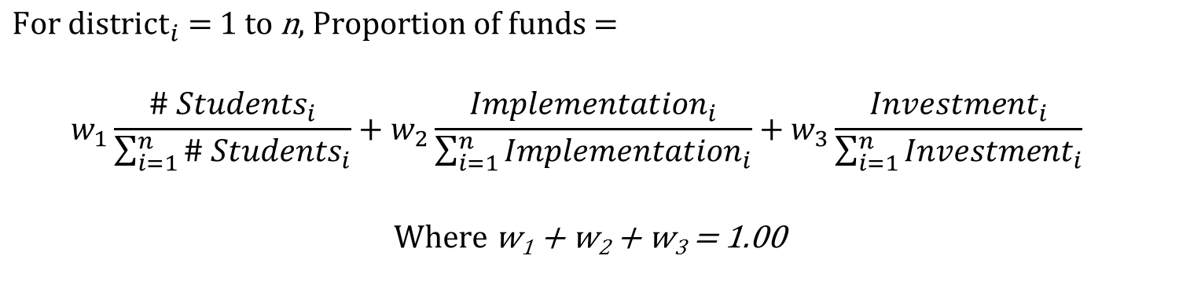
3 Factors for Incentive Dollars
Funding Formula
Number of Students Served
Implementation
Investment
Total # of students served in the BOCES/District
Scores on the MLT Self Assessment
Score on the PL Plan
Meeting Checklist
Completion of Pre-learning activities
Meeting Attendance
$$\text{For} {\text{district}}_{i}\text{ = 1} \text{to} \text{n}\text{, }\text{Proportion} \text{of} \text{funds}\text{ =}$$
  $$w_{1}\frac{{\# Students}_{i}}{\sum_{i=1}^{n}{{\# Students}_{i}}}+w_{2}\frac{{Implementation}_{i}}{\sum_{i=1}^{n}{{Implementation}_{i}}}+w_{3}\frac{{Investment}_{i}}{\sum_{i=1}^{n}{{Investment}_{i}}}$$
$$W\text{here} \text{w}\text{1}\text{ + }\text{w}\text{2}\text{ + }\text{w}\text{3}\text{ = 1.00}$$

Slide 10
Before we jump into our first activity…
Lets start by setting some roles and responsibilities for the day (you are welcome to rotate roles)
  Who is going to be the facilitator for discussions (make sure everyone gets a chance to talk, synthesize ideas, etc.)?
  Who is going to take notes and fill out the official forms that will be turned in?
  Who is going to be the task master and keep everyone on task?

Slide 11
First Activity
From what you have learned about CO-MTSS through
  Initial CO-MTSS meeting
  Kickoff Pre Learning Activities, and
  What Scott has described so far today
On your own, use sticky notes to indicate the following:
  How would your BOCES/District/CSI/Schools look different if MTSS was done really, really well.
Place all sticky notes on one piece of chart paper
As a team, move the sticky notes into categories
Based on the indicated categories, decide on one statement/vision of what you’d like MTSS to look like
Write the name of your district/BOCES/CSI at the top of the chart paper and just below it, write your MTSS statement. Post the chart paper for others to see.

Slide 12
Team Driven Shared Leadership

Slide 13

Team Driven Shared Leadership
Teaming structure and expectations distribute responsibility and shared decision making across school, district, and community members (e.g., students, families, generalists, specialists, district administrators, etc.) to organize coordinated systems of training, coaching, resources, implementation, and evaluation for adult services.
Notes:
PLAN FOR 45 MINUTES
I’m Andrew Schaper, and I am the Research and Evaluation Coordinator for this project. In this first segment we are going to learn a bit more about Team Driven Shared Leadership. Take a minute to read the definition for Team Driven Shared Leadership that you have seen before.
(Pause for 15 to 20 seconds)
As we embark on this work together, we’re beginning by discussing teaming because it really is up to you to implement MTSS within your LEAs. And it is important that we work to think about your identity as a team, and your work together will be the key ingredient for MAKING this work!

Slide 14
Objectives
Teams & Implementation Science
MLT Self-Assessment
Notes:
I’m going to spend about 15 minutes giving you some background on teams, and why we emphasize team infrastructure as much as we do in the MLT self-assessment. First we’ll being be discussing the research base for teaming, then move on to why we emphasize teaming from an implementation science perspective. Then we’ll have a quick activity on meeting foundations. Finally, we will spend the majority of our time working through the first section of the MLT Self-Assessment.
As I begin, I suggest you have the MLT-SA handy because I am going to refer to it repeatedly in the next 15 minutes so you can gain a better understanding of the items and why we think those items are important for building the infrastructure of your MLT.
OVERALL TIMING:
Team Functioning
Teaming & Implementation Science
Making Effective Teaming Visible – Efficient Meetings
Coming to Consensus
MLT Self-Assessment

Slide 15

Do you know this team?
Notes:
Before we get into what makes a good team, I thought it would be funny to take a look at a non-example…
[HIT PLAY]
Video is around 30 seconds

Slide 16
Teaming
“Teaming, by its nature, is a learning process.”
“… interdependent action is needed.”
Edmondson, A. (2012). Teaming: How organizations learn, innovate, and compete in the knowledge economy. San Francisco, CA: Jossey-Bass.
Notes:
1 minute
So getting back to business…
These are two quotes that I like because they summarize the heart of teaming. They really get a the core of what it means to be an effective team.
[PAUSE – 15 SECONDS BEFORE MOVING TO THE NEXT SLIDE]

Slide 17
Teaming
Manageable Number
1
Complimentary Skills
9, 10, 11
Engage w/ Stakeholders
4, 6, 8
Commitment
2, 3
Effective Teams
Effective Meetings
Purpose
Accountable
7
12, 13
Goals
Hawkins, P. (2014). Leadership team coaching: Developing collective transformational leadership (2nd ed.). London: Kogan Page.
Shared Approach
5
Notes:
There has been a lot of research on what it takes to make an effective team.
First, a team needs to have complimentary skills, which is why we’ve asked you to form teams with key people from across your organization.
Teams needs to be committed to their work. As you may remember from Scott’s initial meeting with you, implementation takes multiple years. Commitment is key.
Teams need to be focused on a purpose.
Teams need to be goal oriented to continue to MAKE the work happen.
You need to have a shared approach so work can be completed in a quick and efficient manner.
You need to be accountable for your work because follow-through will build momentum.
Effective meetings are where effective teaming becomes very visible.
Effective teams continuously engage with stakeholders at multiple levels such as school leaders, students, families, community partners, so and so forth.
Finally, effective teams need to be a manageable size to facilitate interdependent action.
As we begin the implementation journey with you, we want to acknowledge that a lot of our work is focused on establishing and maintaining effective teaming at the LEA level. This is the component we begin with because it establishes the foundation for our other work. In fact, the items on the MLT Self-Assessment tie directly to these effective teaming principles.
[CLICK] – These numbers represent the item numbers on the self-assessment. Take moment and look at an item or two to get a sense of how the tool relates to these effective teaming principles.
[Pause and allow audience to refer to MLT-SA] – 20 seconds

Slide 18
Teams & Implementation Science
‘Making it Happen’
‘Helping it Happen’
‘Letting it Happen’
http://implementation.fpg.unc.edu/module-3/topic-1
Notes:
Teams are the catalyst for MAKING effective implementation happen. Teams enable us to move from simply LETTING an innovation happen on it’s own, to MAKING it happen to ensure a program is implemented with fidelity to ensure actual benefits are realized.
“Letting it happen” – A policy or program has been mandated and stands alone. As you can see, this typically results in low-levels of implementation and little movement in outcomes.
“Helping it happen” – A policy or program has been mandated or adopted and you might put in place a few things -- materials, training resources, and websites. BUT, people are left to figure out how to solve problems. They are responsible for achieving positive outcomes.
“Making it happen”– A policy or program has been mandated or adopted and active and purposeful implementation best practices are provided to help practitioners and administrators. The Implementation Team is accountable for developing the implementation support systems, resolving organization and system issues that arise, and achieving positive results.
Making it happen is using implantation science in practice. You are using evidence based implementation purposefully to create the enabling context.

Slide 19
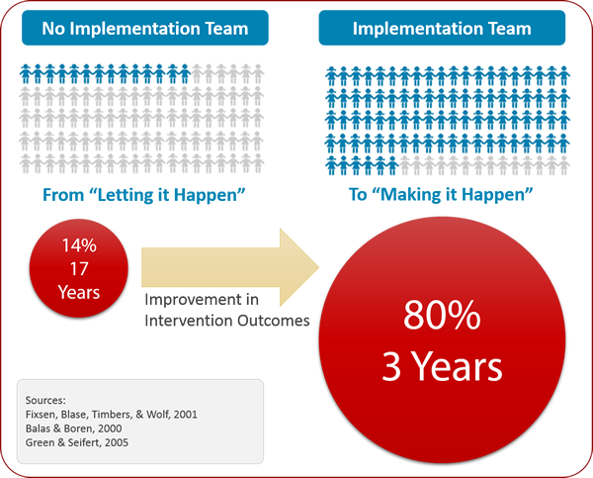
Teams & Implementation Science
http://implementation.fpg.unc.edu/module-3/topic-1
Notes:
And this is based in research. Without implementation teams, we can really only expect about 14% of you to reach adequate levels of fidelity in about 17 years. I DON’T THINK WE WANT TO WAIT THAT LONG. Research shows that implementation teams MAKE it happen with very excellent results; teams facilitate reaching fidelity milestones within 3 years rather than 17!
This is WHY we emphasize implementation teams, and why Implementation Teams have been called a new lever for organization change in education (Higgins, Weiner, & Young, 2012)..
HOW implementation MAKE it happen is another good questions. By utilizing implementation teams, we are working explicitly on the implementation drivers as levers to facilitate implementing programs with integrity to ensure valued outcomes.

Slide 20
CO-MTSS Implementation Teams
State
Region
District
School
Notes:
2 minutes
We take this implementation teaming seriously. For our MTSS work, we’ve formed teams at multiple levels to MAKE IT HAPPEN. We are going to support your in building school level teams….
We’re not just working with you at the district level. We’re also working from the school level to the state level to facilitate effective implementation of MTSS. We in the Office of Learning Supports are working as the state implementation team are working with you at the district and regional level. In turn, we’ll help you organize school-levels teams to effectively implement MTSS practices using evidence based and sustainable professional learning.
This is why we emphasize monitoring IMPLEMENTATION and OUTCOMES. We need to make sure we are doing our work well at multiple levels to facilitate the adult learning and activities required to enhance student outcomes.

Slide 21




Making Effective Teaming Visible – Efficient Meetings
Activity
Remember a recent meeting…
  … who was there
  … what was the purpose of the meeting
  … where was the meeting
  … what was the weather like outside
Using the Leadership Team Meeting Foundations Checklist, rate that meeting on your own (1.5 minutes)
With your neighbor – Discuss the biggest missing meeting components (2 minutes)
Notes:
Ok, so that’s a lot. And it can’t be done all at once. But one of our first goals is to make your effective teaming practices visible through effective and efficient meetings. The Meeting Foundations Checklist on your table is part of that goal.
So, I’ve been talking a lot in the last few minutes. We’re going to change gears and do a quick activity.
[CLICK]
Remember a recent meeting. Who was there? What was the purpose of the meeting? Where was the meeting? What was the weather like outside?
Take about a minute or two to rate the meeting using the Meeting Foundations Checklist. Once you are done, turn to someone sitting next to you and discuss the missing meeting foundation that would have helped that meeting be more productive.

Slide 22



Before we jump into the Self Assessment… How will you build consensus?
Primary Decision Rule
Secondary Decision Rule
If your vote is not 75% one way, what will you do to reach a consensus
‘Set Aside’ Rule
If you can’t come to consensus on an item in 2 minutes, put it aside, and return to it once you’ve finished the other items within the component
Simple Voting
Thumbs Up/Down/Sideways
Fist of Five
Notes:
Ok, now that we have some more background for Team Driven Shared Leadership, let’s begin to transition toward completing the MLT Self-Assessment.
Before we jump into the items of the self-assessment, we need to take a couple minutes to establish decision rules because your teams are going to have to move through the first 13 items fairly quickly.
We’ve already established roles in the first part of the meeting. We need to that we decide on decision making rules. You need to have a primary decision rule, a secondary rule, and we’ve provided you with a ‘set aside’ rule.
The primary rule is a simple way to attempt to reach consensus. It could be a fist of five, thumbs up, down or sideways, or simple voting. Or some other method you like.
The secondary decision rule is how you reach consensus when about 75% of your team doesn’t agree one way or another. This may involve a discussion.
Finally, the ‘set-aside’ rule is provided to help keep things moving. If you can’t come to a consensus on any of the items in 2 minutes, put it aside and return to it once you’ve finished the other items within the component.
Take 2 minutes and decide on rule for coming to consensus for today’s work

Slide 23
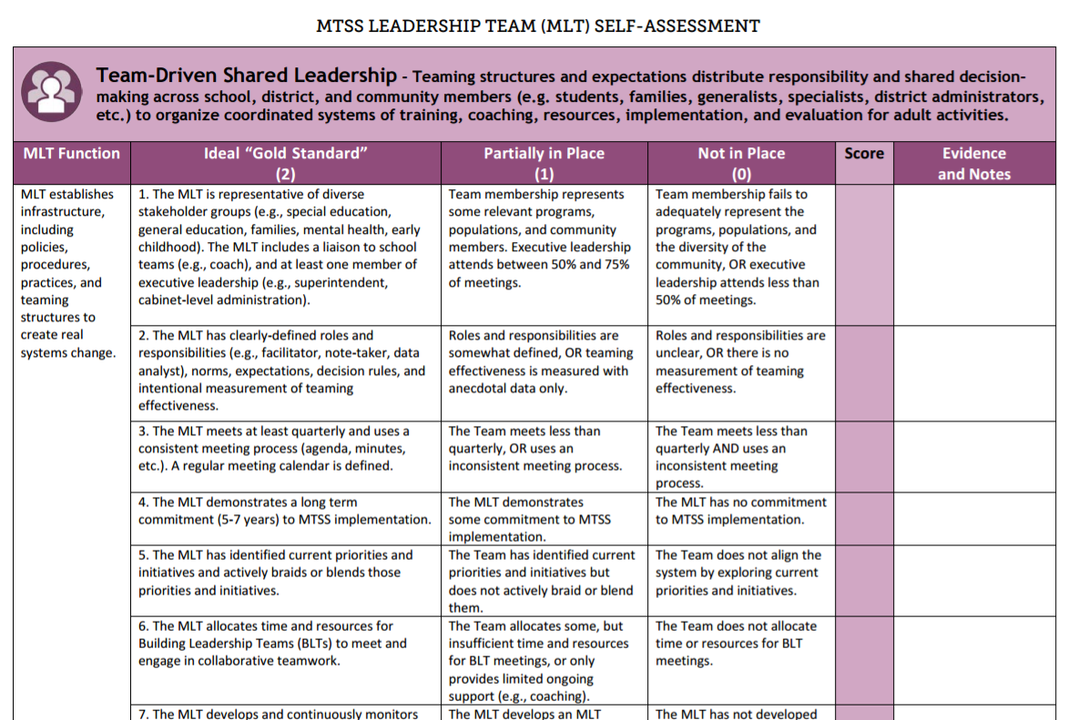
Notes:
In the next 5 minutes, silently and independently:
Read items 1 through 13 in TDSL
Rate your MLT (don’t share w/ others yet)
[PAUSE 5 MINUTES]
For the next 20 to 25 minutes:
Spend 1 to 2 minutes on each item, and come to a consensus as a team for the rating of that item using the rules you decided on.
Record your rating on the master version [we will need to decide whether this will be online, or offline]
Answers need to be 0, 1 or 2 (no fractions or decimals)
Pacing – we don’t want you to get to held up on any one item:
After 10 minutes – have items 1 to 5 complete
After 20 minutes – have items 1 to 10 complete
After 25 – have ALL items complete
Remember to use the ‘set aside’ rule if you haven’t come to a consensus on an item in 2 minutes.

Slide 24
Data-based Problem Solving and Decision Making

Slide 25
Objectives
Walk-through problem solving process with your score from Team-Based Shared Leadership component from the MLT Self-Assessment
Complete Data-Based Problem Solving and Decision Making component on MLT Self-Assessment

Slide 26

Data-Based Problem Solving and Decision-Making
A consistent process is used by stakeholder teams and applied at multiple levels to analyze and evaluate relevant information to plan and implement strategies that support sustainable improved student and system outcomes.

Slide 27
Improving Decision-Making
Problem
Data-Based
Problem Solving &
Decision Making
Solution
Out of Time
Adapted from TIPS/Rob Horner

Slide 28

Step 1: Problem Identification
What is the problem?
Step 4:
Plan
Evaluation
Step 2: Problem Analysis
Did it work?
Why is it occurring?
Step 3: Plan Implementation
What can we do about it?

Slide 29
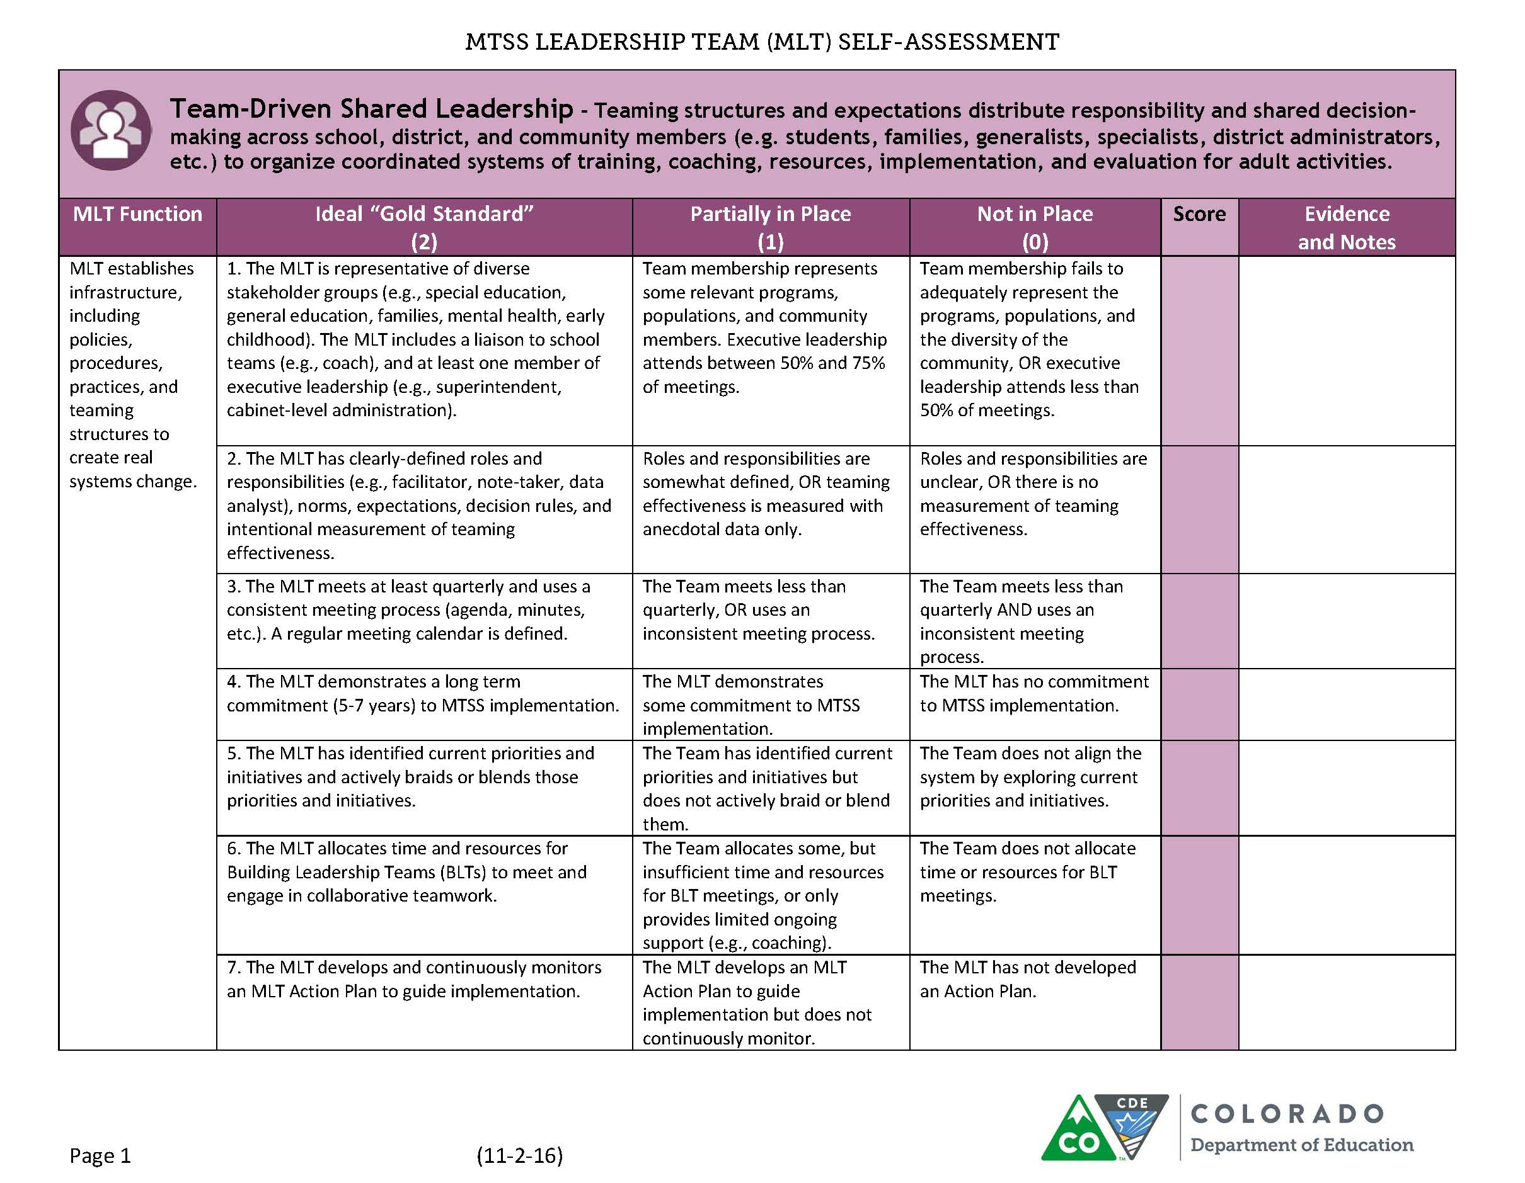
Step 1: Define
Use data to define the problem

Slide 30
Dedicated members from a diverse group (sign-in sheets)
2
We haven’t created an action plan to guide implementation.
1
Some confusion on roles, no back-up person identified
1
2
0
Haven’t reviewed priorities
Look at your TDSL scores. Circle a prioritized item.
What is a primary statement from that item?
1
Have early release district-wide
0
Notes:
Target low haning fruit or target a zero

Slide 31

Step 1: Define
We haven’t created an action plan to guide implementation.
  Precise statements include specification information on:
  -What is the problem?
  -How often is the problem happening?
  -Where is the problem happening?
  -Who is engaged in the problem?
  -When is the problem most likely to occur?

Slide 32
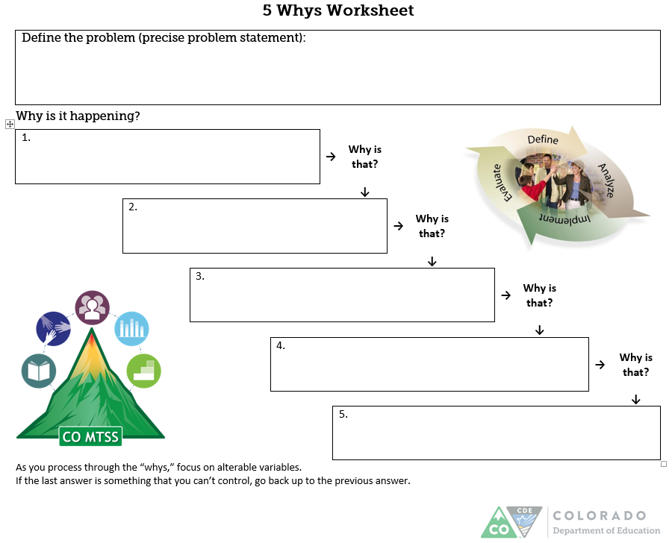
Primary vs. Precise Problem Statements
Primary
Precise
As of Jan 2017, our MTSS Leadership Team hasn’t created or reviewed an action plan to guide implementation of MTSS across ABC District.
We haven’t created an action plan to guide implementation.
As of Jan 2017, our MTSS Leadership Team hasn’t created or reviewed an action plan to guide implementation of MTSS across ABC District.
  By yourself, take your primary statement from before and make it precise.
What, How Often, Where, Who, When
Notes:
Share your primary statements. Select one. Then make it more precise.

Slide 33

Step 2: Analyze (Root Cause)
  Seeking a clear, agreed-upon picture: why is the problem occurring?
Considerations:
  Additional data (e.g., different
  sources, different stakeholders, qualitative and
  quantitative data)
Notes:
At step 2, we drill down and we want to think about why the problem is occurring. To do so, we can ask why is that repeatedly? Anyone have kids and they ask why over and over? Well we’ll do that here. (click animation).

Slide 34
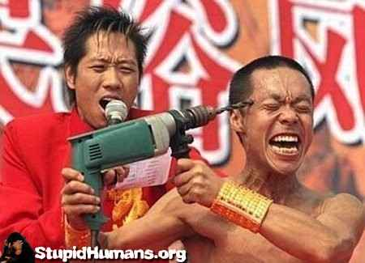
Drill Down

Slide 35

Root Cause Analysis
As of Jan 2017, our MTSS Leadership Team hasn’t created or reviewed an action plan to guide implementation of MTSS across ABC District.
We haven’t had an MTSS Leadership Team in the past
We’ve had many initiatives, and little understanding of the MTSS strategies for bringing them together
There has been no clear policy or vision for implementing MTSS in the District ABC
We (district leaders) have not created a clear vision of MTSS in District ABC
No Money!
We (district leaders) have varying knowledge about MTSS
Notes:
Have them complete a “why” after each one. Give them 30 seconds.

Slide 36


Step 3: Implement
Goal
Plan
Notes:
Need a goal so you know the problem is solved. Need to plan with actionable steps to reach goal/solve problem

Slide 37

Step 3: Implement
Precise Problem Statement:
As of Jan 2017, our MTSS Leadership Team hasn’t created or reviewed an action plan to guide implementation of MTSS across ABC District.
Because (Root Cause):
We (district leaders) have varying knowledge about MTSS
Goal:
  How will you know the problem is solved?
  By the end of the year, the MLT will have thorough understanding of MTSS as evidenced by a clear vision for moving MTSS work forward for District ABC.
Plan:
  Steps needed to reach the goal, including implementation and impact for each step
Notes:
How will you know the problem is solved?

Slide 38
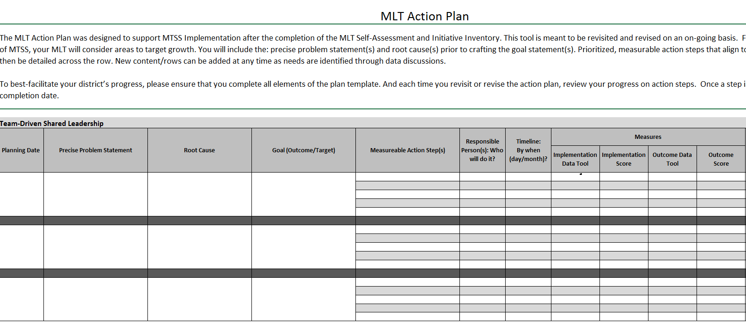
Action Planning Tool
Implementation Measure:
Did the team complete the action step?
Outcome Measure:
What was
the benefit?
Precise Statement
Root Cause
Overall Goal
Who?
By when?
Notes:
This is a screenshot of our action plan tool. Cropped edge out.

Slide 39
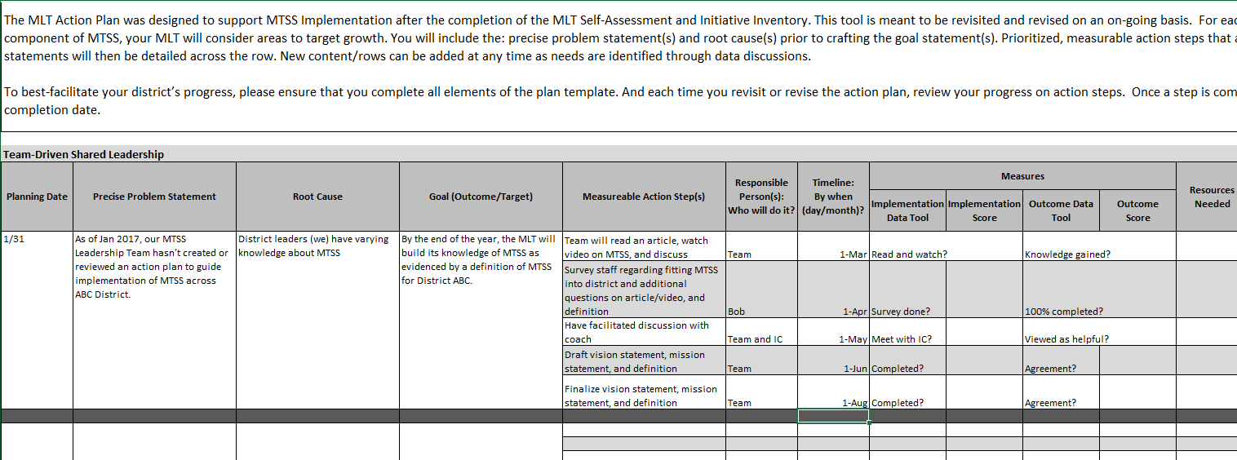
Action Planning Tool: Example
Implementation Data Tool:
Read and watch?
Survey done?
Meet with IC?
Completed?
Completed?
Your turn:
With a partner, take a few minutes to start completing the form for one precise problem statement and root cause you completed
Team will read an article, watch a video on MTSS, and discuss
Survey staff regarding fitting MTSS into district and additional questions on article/video, and statements/definitions
Draft vision statement, vision statement, and definition
Finalize vision statement, vision statement, and definition
Outcome Data Tool:
Knowledge gained?
100% of team completed survey?
Viewed as helpful?
Agreement?
Agreement?

Slide 40
Step 4: Evaluate
Set a review date
Check implementation and impact of our plan/action steps
  Adjust as needed
Notes:
During this stage, we want to examine if our plan is working. We ask if we followed the plan and what the impact is.

Slide 41
Summary
Step 1: Problem Identification (Precise Statement)
Step 2: Problem Analysis (Root Cause)
Step 3: Plan Implementation (Goal and Plan)
Step 4: Plan Evaluation (Review Date, Implementation and Impact of Plan/Action Steps)
Notes:
TO review

Slide 42
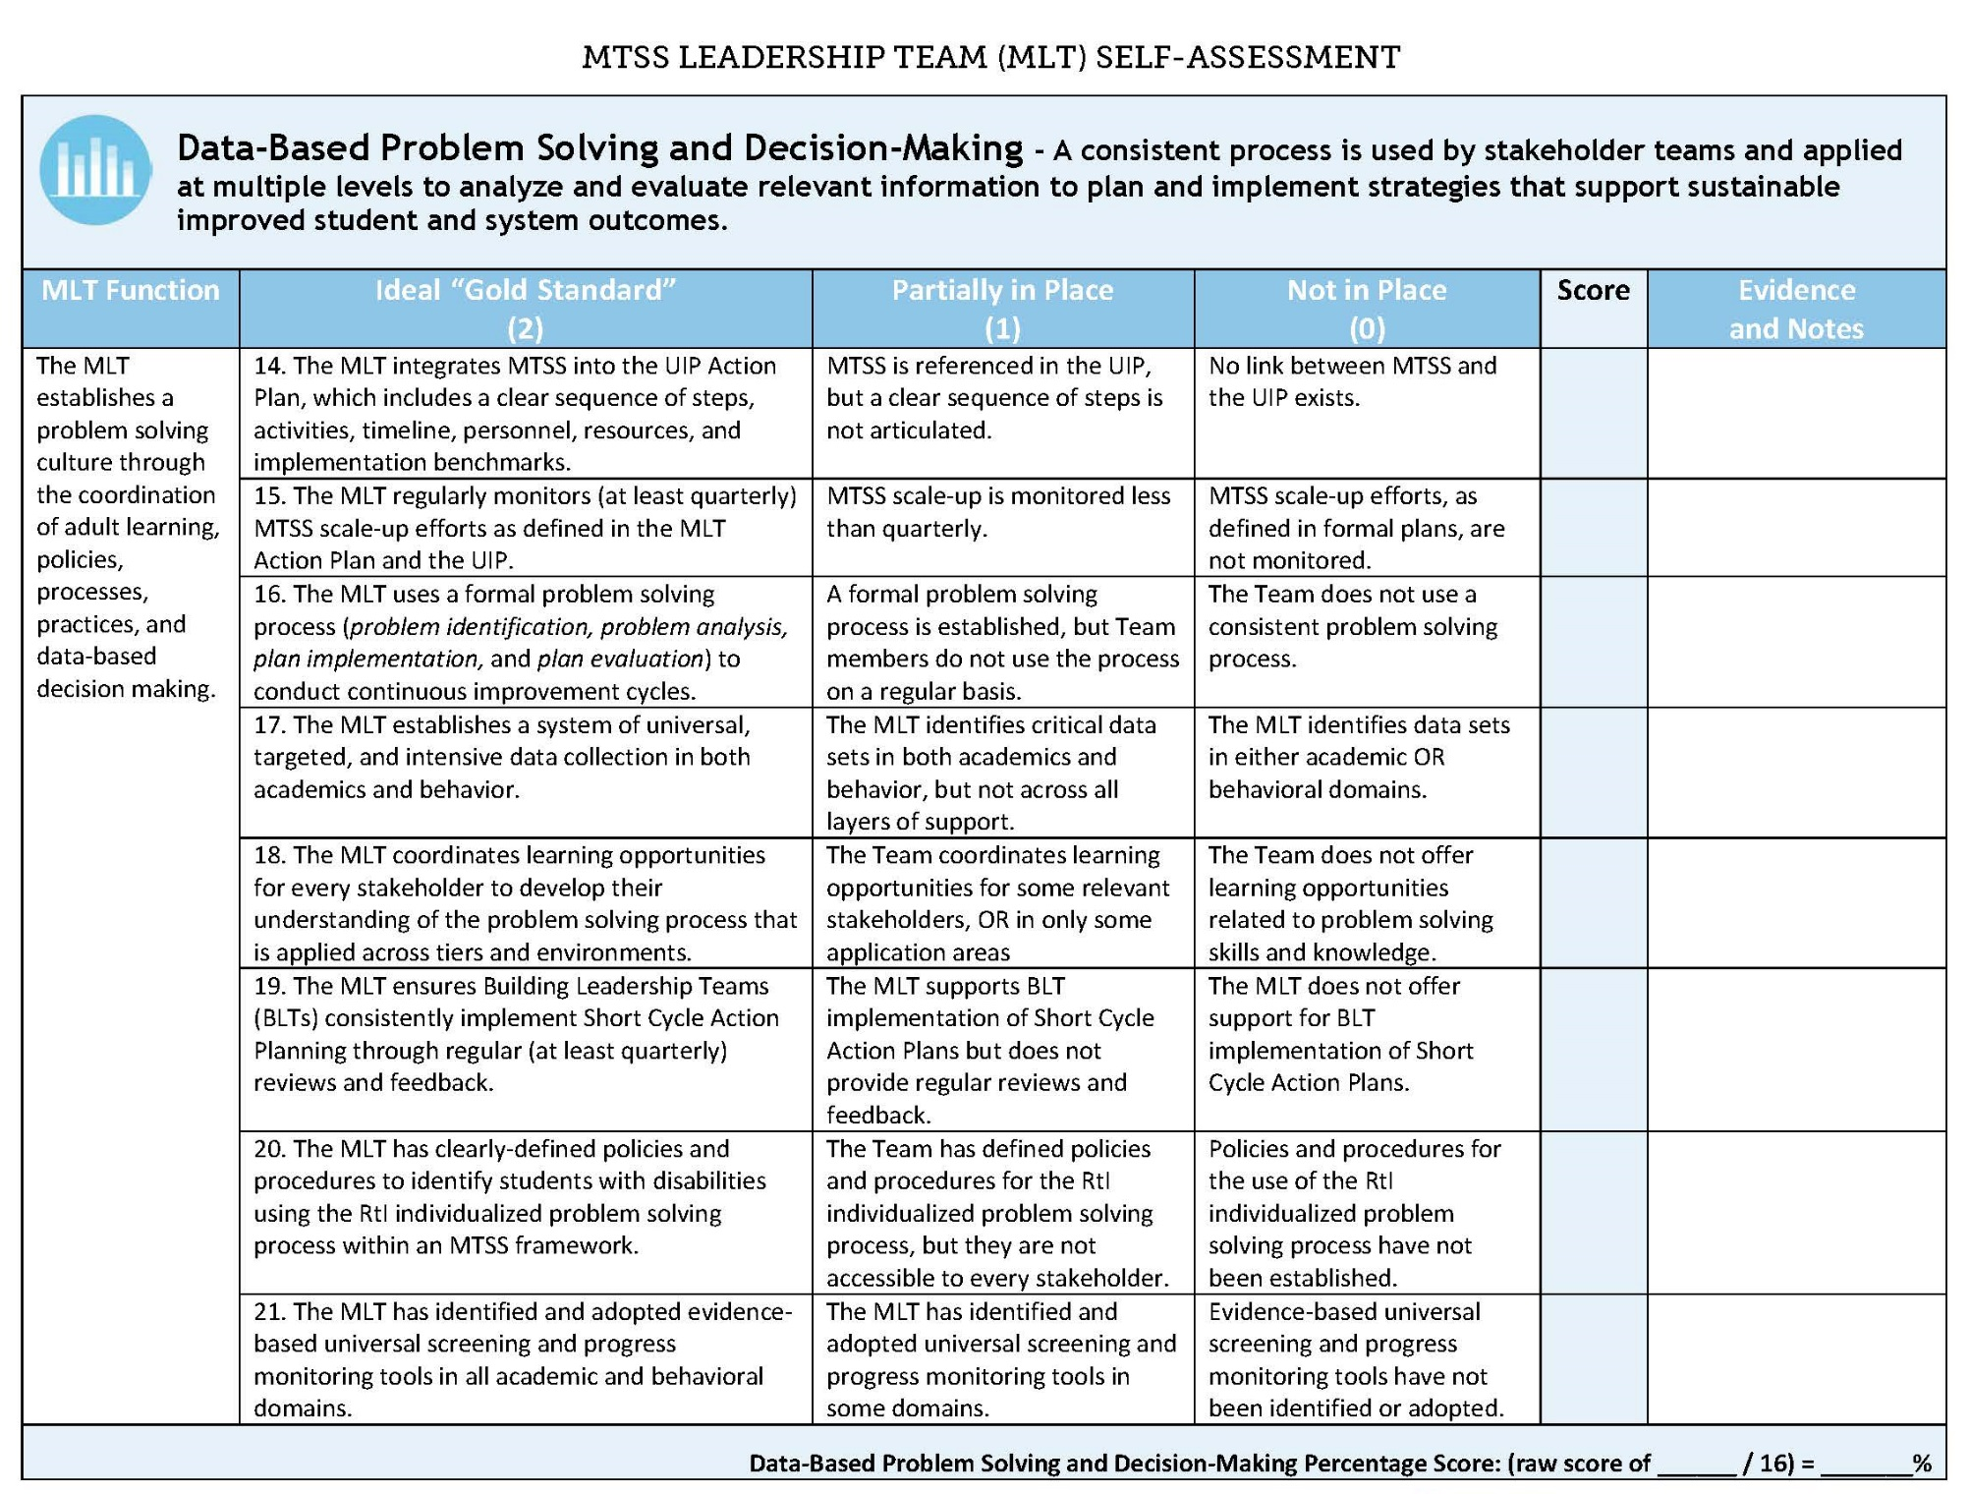
Notes:
Now look at your DBPS&DM page…

Slide 43
Family, School, and Community Partnering

Slide 44

Objectives
Define Family, School, and Community Partnering (FSCP) within MTSS,
Review some available tools and resources, and
Self-assess FSCP within systems.

Slide 45
Family, School, and Community Partnering
  Definition:
  The collaboration of families, schools, and communities as active partners in improving learner, classroom, school, district, and state outcomes.
Partnering is….
______________________________________
Notes:
On a piece of paper/notecatcher/index card/post-it note, Fill in the blank…
“Partnering is…” ___
Then, in looking at our definition, think: what gels/what differs?
Also…aloud for all:
Think of a partner in your life. What attributes (adjectives/descriptors) would you use to describe the relationship you have with that individual?

Slide 46
Four Core Beliefs
All parents have dreams for their children and want the best for them.
All parents have the capacity to support their children’s learning.
Parents and school staff should be equal partners.
The responsibility for building partnerships between school and home rests primarily with school staff and especially school leaders.
Henderson, A.T. et al. (2007) Beyond the bake sale: The essential guide to family-school partnerships.
Notes:
Reflection/discussion (brief)
Connections to READINESS!!! NOTE: “parents” here > within our language, “families”
Prompt idea(s):
What beliefs do you have/hold for FSCP? How are these aligned/challenging?
Consider the following four core beliefs to determine schools/districts are ready to partner with families.
Notes:
Dr. Joyce Epstein’s Theoretical Model, The Overlapping Spheres of Influence, states that stakeholders’ philosophies, experiences, and practices impact the extent to which families, schools, and communities collaborate.

Slide 47
Colorado Data
On the Colorado TELL Survey, the teaching condition with the strongest connection to high student achievement and growth is:
Community Support and Involvement
Parents/guardians in the community are engaged, influential, and supportive of teachers and schools
Across all school levels
In each year: 2009, 2011, 2013, and 2015
(New Teacher Center, 2015)
Notes:
COLO data (connect to UIP)

Slide 48
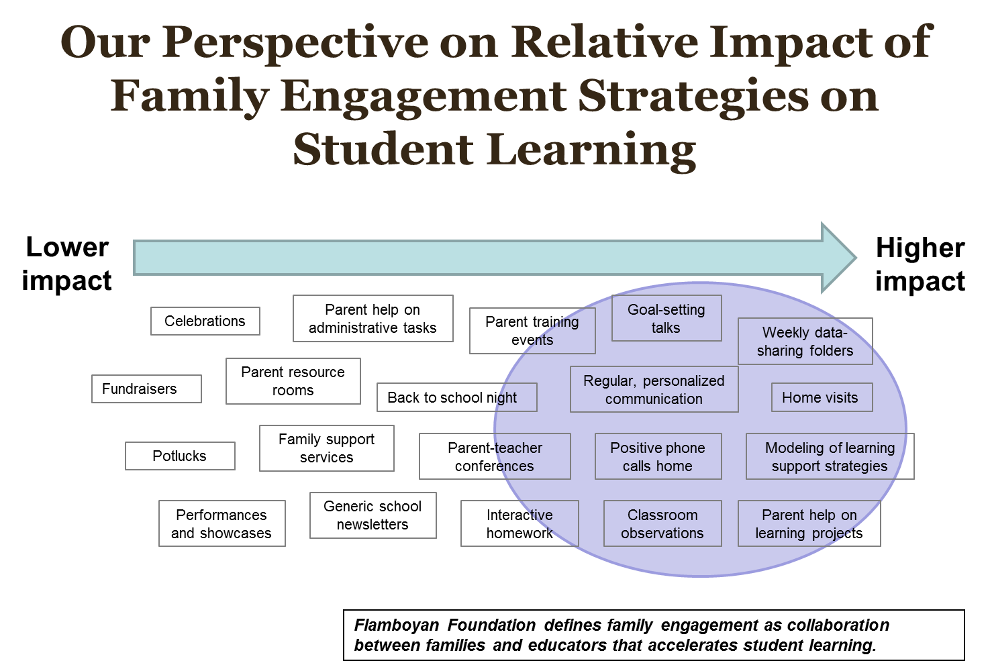
Notes:
Flamboyan Foundation, located in Washington DC, conducted a meta analysis linking FSCP to student learning. This slide shows which activities have a low vs. high impact on student achievement. It’s important to note that the low impact activities are not bad activities to implement. These activities—celebrations, potlucks, performances—are often great first steps to create a welcoming climate of partnership. However, schools and districts should work toward prioritizing the high impact strategies to have the highest impact on student learning.

Slide 49
Investigate Your Strategies (activity)
What do you have in place for FSCP?
Step 1:
  Individually:
  Using sticky notes, write one strategy per sticky.
  Write as many as you can think of…
  Consider “layers” (For Every Family? Some? A Few?)
Step 2:
  As a team:
  Place your sticky notes on the continuum where
  you think they “best fit”.
  Analyze your continuum: Consider these ideas…
  Is there evidence of Impact? What are strengths? Are there gaps? Opportunities?
http://www.cde.state.co.us/uip/promising

Slide 50
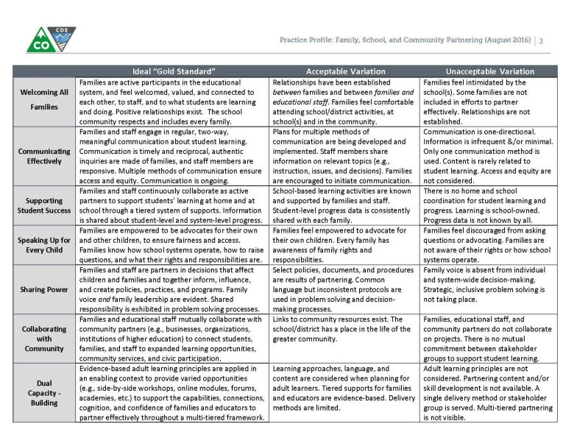

Application: Example Tools
http://www.cde.state.co.us/mtss/fscp
Notes:
Tools/resources on MTSS FSCP page.
[Animate slide.]
Including screenshot of Practice Profile (see full handout).

Slide 51

FSCP Representative
SPDG Opportunities and Responsibilities
  Online/Virtual Connections
  Face-to-Face Technical Assistance/
  Convening
  Annual completion of Survey (adapted version)
http://www.cde.state.co.us/uip/school_family_community_partnership_survey
Notes:
In addition to being an important voice and perspective on the MLT, the FSCP rep. on the MLT will have access to opportunities (per slide).

Slide 52
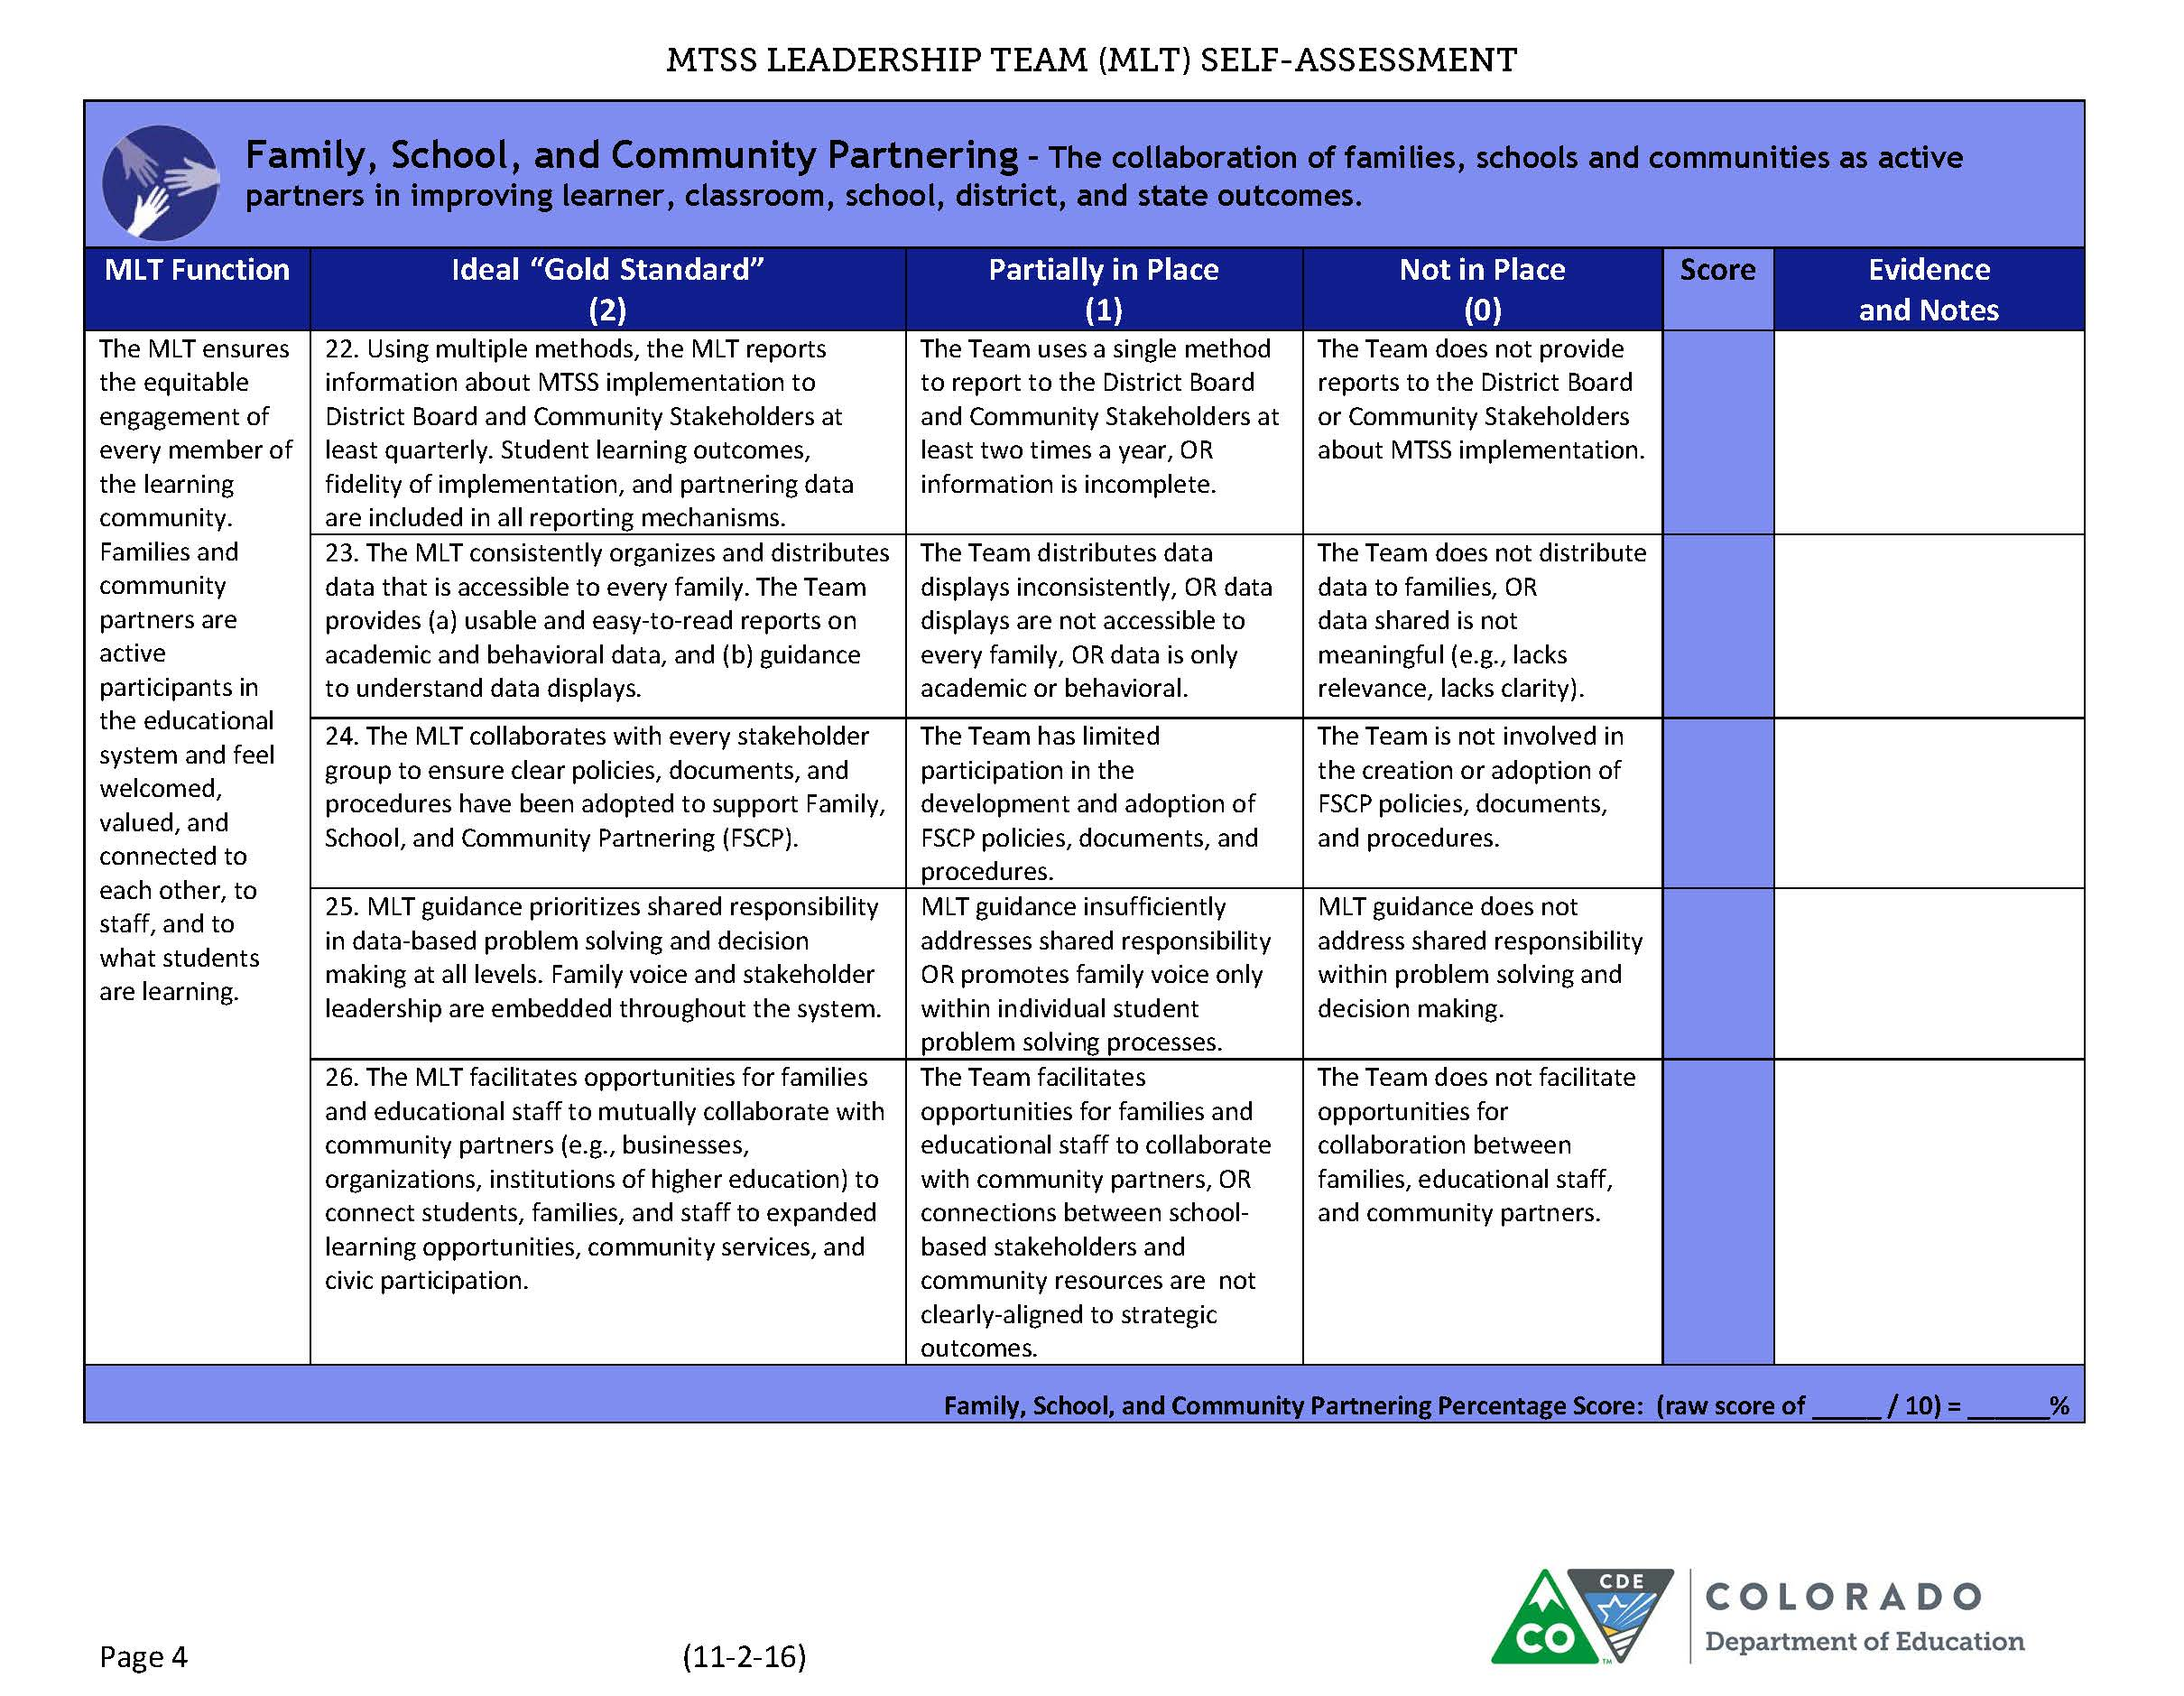
Notes:
Complete Component as a team.

Slide 53
Layered Continuum of Supports

Slide 54

Objectives
Layered Continuum to support every student
Data reflection: Implications for your schools.
Layered Continuum includes planning for all adult learning opportunities

Slide 55

Support Matched to Stakeholders’ Needs
Few = Universal + Targeted + Intensive
Some = Universal ALSO Targeted
Every = Universal
Intensive
Targeted
Universal
“The Layered Continuum of Supports”
(Note: Visual graphic
Representation
Adapted from practitioners)
Notes:
Tiered Logic-
“We layer supports on…(matching to need)…students do not ‘move through tiers’ (as if it were a “maze” for them to navigate).” (blanket analogy)
“layered continuum” = having a strong ‘core’ isn’t enough; having ‘quality interventions’ isn’t enough; all has to be equally supportive
Notes:
Universal—High quality instruction is provided to all students; best first instruction, for all kids, including SWD and Els. High quality instruction is aligned with CAS and CELP standards. Every student is a general education student first. Els spend 90-95% in General classroom, 74.2 % SWD spend <80% of their day in general classroom.
Some students benefit from additional instruction, progress monitoring and support to ensure educational gaps are eliminated.
Also, a few students benefit from more precise and explicit support to ensure their persistent academic or behavioral needs are met.
Targeted--Some students benefit from additional instruction, progress monitoring and support to ensure educational gaps are eliminated. Additional supports may be necessary for acceleration of Gifted or those with disabilities. or a pathway to SPED (i.e. English Language Development is tier 1)
Intensive--FEW students benefit from more precise and explicit support to ensure their persistent academic or behavioral needs are met (Supports are differentiated based on individual needs) We believe in a hybrid approach to decision making related to ways to support individual students. ( Occasionally, may require standard protocol but will always involve a PS team to make the determination for supports).

Slide 56
Shared Responsibility & Accountability
Notes:
Potential prompt:
What might this imply in relation to how we ensure layered supports for every student within our system?

Slide 57
2 mins
Shared Responsibility & Accountability
Discuss with an “elbow partner” one of these three prompts.
  What implications does this data have for first best instruction in your schools?
  What do you see as the biggest challenges for your schools?
  What systems are needed to support educators in your schools?
Activity:
“Turn-and- Talk” to a neighbor
Implications for your System
Notes:
What might this imply in relation to how we ensure layered supports for every student within our system?

Slide 58
Layered Continuum of Student Supports
Intensive
Math (Acceleration)
Targeted
Reading (Remediation)
Science
Universal
Communication
Label supports…not students
PE
Social Studies
Attendance

Slide 59
Layered Continuum of Adult Supports
Intensive
Data-based Problem Solving
and Decision Making
Targeted
Classroom Management
Instructional
Delivery
Universal
Other
Please don’t label adults either!
Differentiation
Assessment
Teaming

Slide 60
4 mins
Layered Continuum of Adult Supports
Activity
Step 1- Think of one group of adults in your district that you work with (e.g., gen ed teachers, SPED teachers, para-pros, parents, principals)
Step 2- Identify that customer’s biggest need.
Step 3- Identify supports you currently provide
Universal: What do you do for all adults in that area?
Targeted: What do you do for those that need some additional support in that area?
Intensive: What do you do for those adults that need the highest level of support in that area?
Step 4- What are the biggest gaps you see?
Activity:
“In small groups (Dyads/ Triads)
Implications for your System

Slide 61
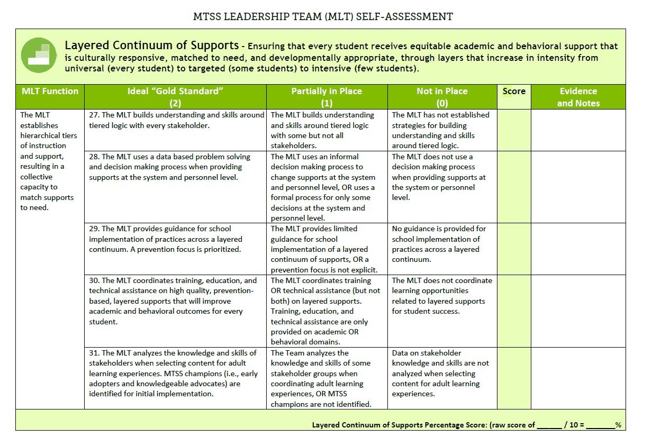
Notes:
As you complete this section consider your Selection Process for which adults (teachers, related service personnel, district/school administrators, support staff (e.g., bus drivers, cafeteria, parents, etc.)) are able to improve their competence. The MLT Function column, identifies areas that are important to attend to in order to build the capacity of your staff across your system.

Slide 62
Evidence Based Practices

Slide 63

Objectives
Understand the MLT function within Evidence-Based Practices(EBP)
Understand the difference between Evidence based and Research Based Practices
Evaluate an Evidence Based Practice used in your setting

Slide 64
Evidence-Based Practices Definition
Approaches to instruction, intervention, and assessment that have been proven effective through research indicating improved outcomes for students.
Notes:
When we are talking about practices we are talking about instruction, intervention, and assessments, we want to apply evidence based across all three domains for academic and behavioral practices.

Slide 65
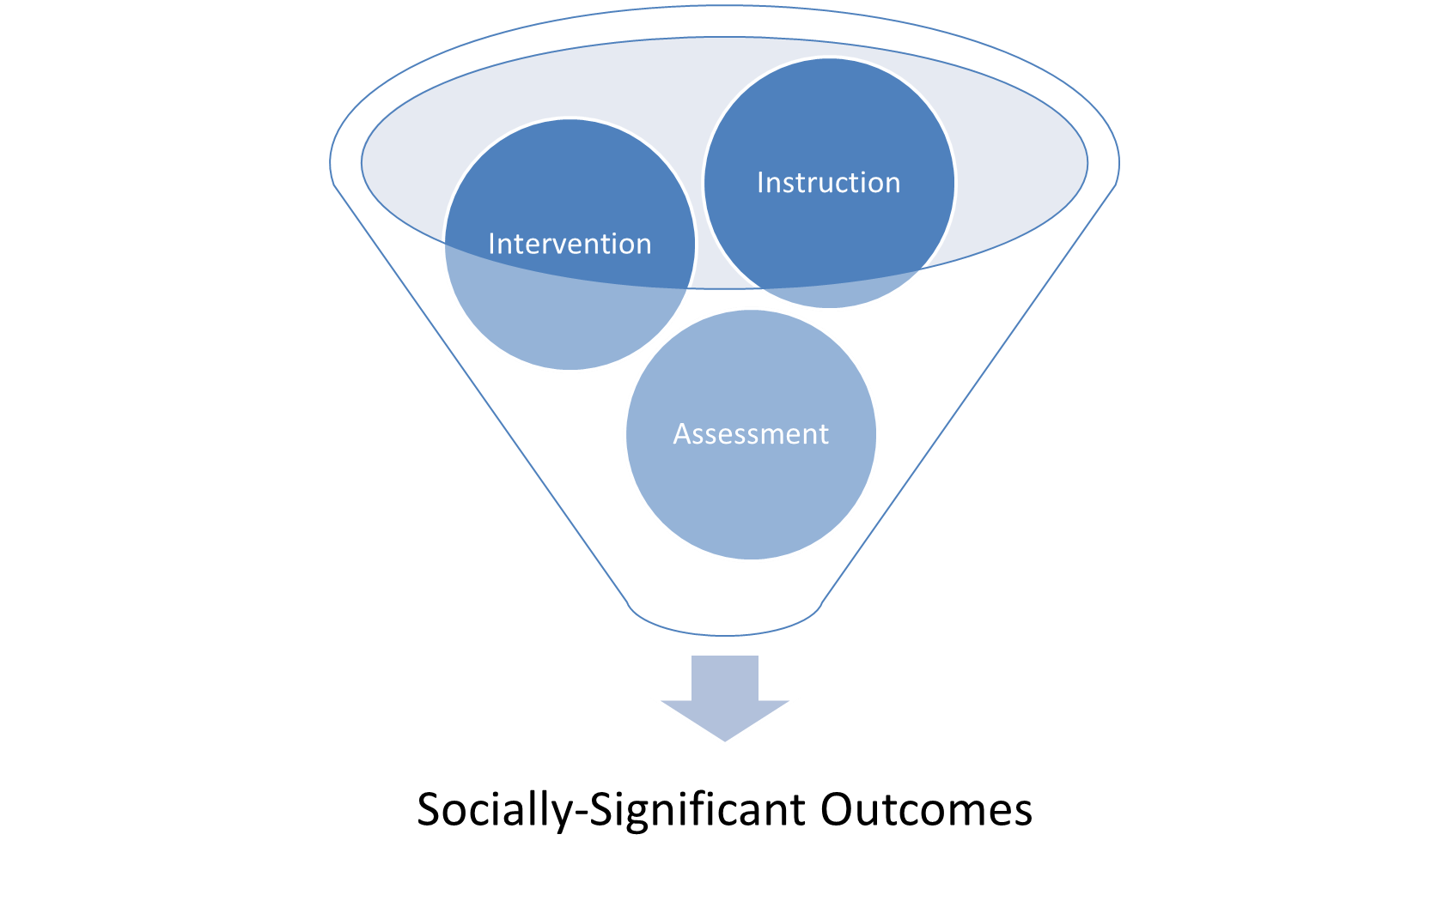
Evidence-Based Practices
Research using the actual practice with a specific population in a specific setting.
Developmentally appropriate? Culturally responsive?
Rigorous & relevant?
Notes:
Evidence based differs from Research based in that it has been through rigorous studies demonstrating success within a specific population. Intentionality applies across all three and you have to have a high level of rigor if you are going to have socially significant outcomes
(When yellow pops up) You’ve got to make sure the practice fits your environment

Slide 66

Contextual Fit
Need How well it might meet identified needs | Fit With current initiatives, priorities, supports, values | Resource availability Training, staffing, curricula, data systems, administration
Evidence Implementation and impact | Readiness for Replication Expert assistance, exemplars for observation, operationalized | Capacity to Implement Staff competencies. Skill and content knowledge related to the innovation
Formula for Success What x How x Where
Notes:
If you are looking to adopt an evidence based practice to fill a need, there are other things to consider as you engage in the selection process that go beyond the research showing it works. Often, we jump into implementing EBPs without considering these 6 components, which impacts the success of the practice.
Having a discussion around each of these 6 areas that make up contextual fit ensures that the decision to move forward or not is well matched to the need and the evidence of the program. Here is what we are talking about when we say contextual fit. (USE SLIDES AS TALKING POINTS)
You may have taken inventory of your initiative
Money and time is what we think about first but really consider human capital to do the work (ta and coaching support)
R for R: Do we have the capacity to scale up the practice.

Slide 67
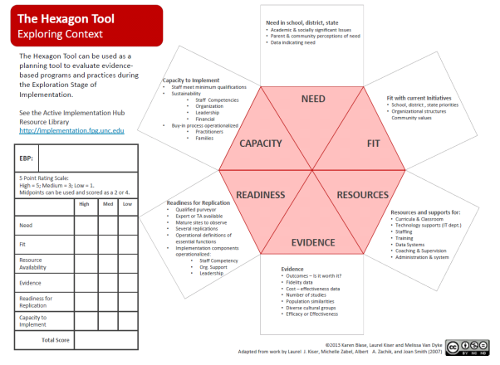
Contextual Fit: Hexagon Tool
Notes:
The Hexigon tool is not an evaluative tool. It is a decision making tool developed by NIRN to guide leadership teams in determining whether you should adopt an EBP. It provides a deeper and focused discussion so you can dissect the decision on whether to adopt or not.

Slide 68
10 mins
Hexagon Tool
Identify a practice used in your setting
Activity: With an elbow partner, use the Hexagon Tool to investigate the contextual fit of that practice
  Fill in the table on the left side of the handout
  Indicate the biggest contextual fit strengths
  Indicate the biggest contextual fit weaknesses
  Are there any areas that you could improve?
Activity:
“Turn-and- Talk” to a neighbor

Slide 69
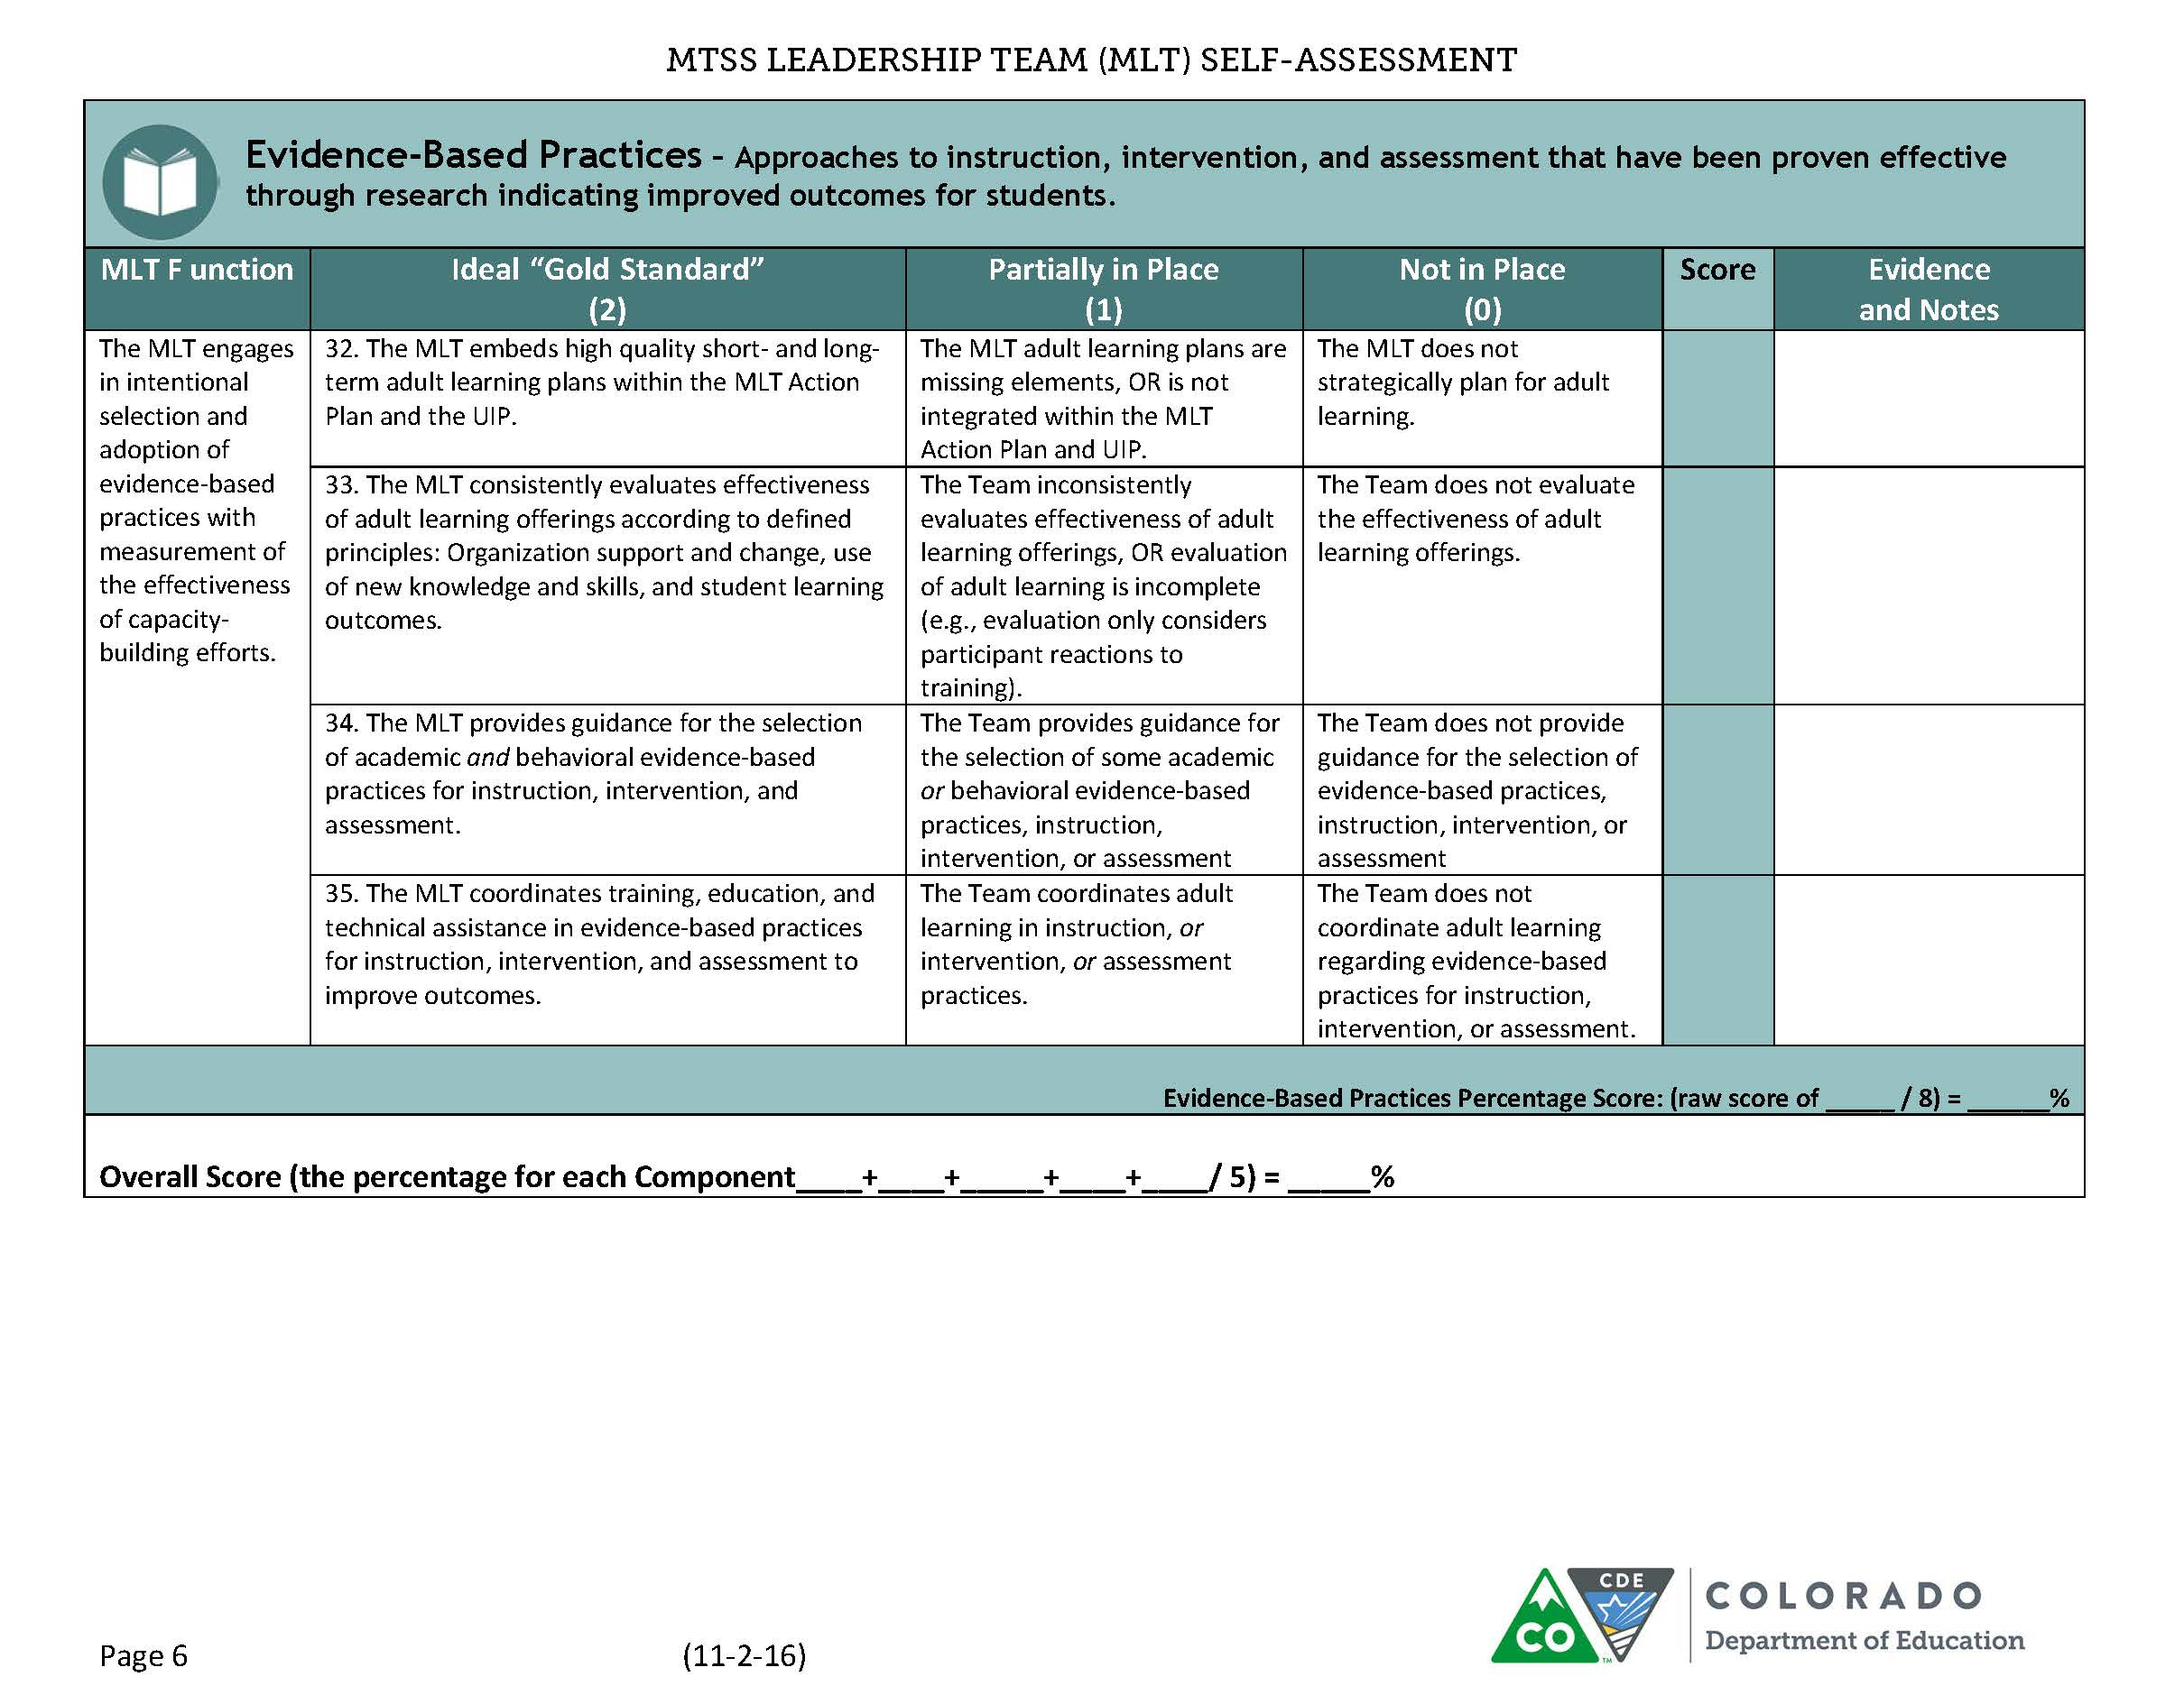
Notes:
Should be last slide, if there are additional slides move contact slide

Slide 70
Finishing Up and Next Steps

Slide 71
Objectives
Finalize our activities
Discuss what comes next
Schedule our next meeting(s)
Assess the day

Slide 72
First Activity
From what you have learned about CO-MTSS through
  Initial CO-MTSS meeting
  Kickoff Pre Learning Activities, and
  What Scott has described so far today
On your own, use sticky notes to indicate the following:
  How would your BOCES/District/CSI/Schools look different if MTSS was done really, really well.
Place all sticky notes on one piece of chart paper
As a team, move the sticky notes into categories
Based on the indicated categories, decide on one statement/vision of what you’d like MTSS to look like
Write the name of your district/BOCES/CSI at the top of the chart paper and just below it, write your MTSS statement. Post the chart paper for others to see.

Slide 73
CO-MTSS Scope and Sequence
Baseline Self Assessment (done!)
Action Planning around your MLT Self Assessment Scores
Initiative Inventory
Professional Learning Audit and Plan
Communication Planning
Considering the activities listed above as well as the needs of your district, plan your next meetings
  Please Ensure that someone from the CO-MTSS Team can be there with you in person or via distance for the discussions

Slide 74
Self Assessment Discussion
1. Discuss as a table your big take aways from the day
2. What are some immediate, low hanging fruit that the MLT can immediately move forward on regarding MTSS?
3. What is one action you would consider doing tomorrow that would improve the implementation of MTSS moving forward?
4. What is one action you would NOT consider doing tomorrow…for whatever reason ☺?
5. What is 1 enhancement you can make to your environment to increase the likelihood of doing #2 and #3 above?

Slide 75
Thank you for all your hard work today!
We are excited to partner with you in moving MTSS forward in Colorado!
For More Info:
Colorado Department of Education, Office of Learning Supports
https://www.cde.state.co.us/mtss

Slide 76

This CDE guidance document is meant for clarification, is not legally binding, and is not to be confused with legal advice. This guidance reflects CDE’s recommendations, but Administrative Units (AUs) may have developed their own policies or procedures that differ from those described herein. Be sure to refer to your local AU’s policies and procedures through the Director of Special Education. If you are seeking legal advice, please contact your legal counsel.
The contents of this handout were developed under a grant from the U.S. Department of Education. However, the content does not necessarily represent the policy of the U.S. Department of Education, and you should not assume endorsement by the federal government.

