Slide 1
Translation of Recent Policy for Health Champions
Amy Dyett, Director of Health and Wellness
October 2016 CCHS
Notes:
AMY

Slide 2

ESSA 101
Bi-partisan bill passed in December 2015
Replaces No Child Left Behind (NCLB)
Governs all aspects of the education system
Major changes:
      “Equity”
      Point of Control
Notes:
This is what you need to know…

Slide 3
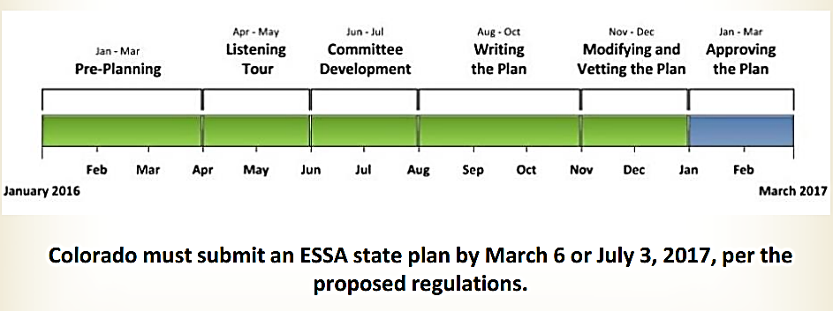
Colorado ESSA State Plan Timeline
Notes:
This is the timeline for

Slide 4
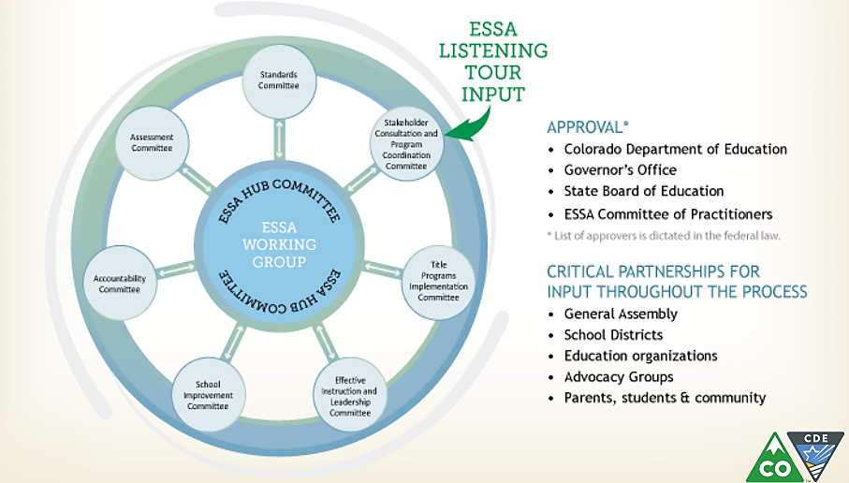
Colorado Hub and Spoke Committees
Notes:
Colorado chose a Hub and Spoke model to draft the ESSA State plan:
Standards
Assessment
Accountability
School Improvement
Quality Instruction and Leadership
Title Program
Stakeholder Consultation
Who sits on Hub and Spokes…

Slide 5
ESSA Opportunities for School Health
Title I/School Improvement
  Well-rounded education (replaces “core”)
      Definition of well-rounded includes health education and PE
  School-wide programs & targeted assistance schools (40%+ FRL)
  Schools can use this funding to develop school-wide health programs, such as hiring a school nurse/counselor, implementing nutrition and PA/PE programs, positive behavior and social-emotional support strategies
  Needs Assessments
Notes:
Health needs to be foundational to the education system. Integrate health into the systems, policies and environment of schools. Take time to learn the education landscape, collect relevant and local data and provide support/resources. “In the end, it’s simply doing what’s right for kids.” Quote from Superintendent of Lake County School District.

Slide 6
ESSA Opportunities for School Health
State Accountability Systems
  Current Colorado System:
    Academics
    Academic Growth
    Academic Growth Gaps
    Post-Secondary or Workforce Readiness
  MUST ADD A 5th INDICATOR
    Non-Academic (measure of school quality or success)
    Examples could include: School climate, absenteeism rates, discipline rates, mobility rates, etc.
Notes:
What we measure now
This is what’s on School Performance Framework
Therefore, data that is used on UIP/how we determine how those Title I funds are used
5th indicator must be same for school level, must be reliable and valid tool, must be able to disaggregate for sub groups – another change, homeless and military youth added to subgroups. ELL, Race/ethnicity, SPED, etc

Slide 7
ESSA Opportunities for School Health
Title II
Applies to ALL school staff
Broader definition for professional development
  For example, funds may support PD around behavioral and mental health needs of students

Slide 8
ESSA Opportunities for School Health
Title IV
Part A, Student Support and Academic Enhancement
  Well-rounded Education – 20%
  Safe and Healthy Students – 20%
  Effective Use of Technology – 15%
Needs assessment and school district plan for funds
Part B, 21st Century Community Learning Centers
  School-community Partnerships
  Funds afterschool programs – includes nutrition education and physical activity
Notes:
New Title IV: Block grants to states – distributed to school districts
Part A, Part B
Needs Assessment – Smart Source
Federal appropriations – SHAPE website if you are interested in doing more
Even if dollar amounts approved this year, but in the future, this allows for Title IV and therefore requires school health to be included in the UIP!

Slide 9

Why incorporate Health and Wellness?
ESSA State Plan will drive school- and district-level priorities and funding allocation.
What is included in this plan is what gets measured and accomplished on an ongoing basis.
Health is foundational to a students ability to learn and this lends the clout for integration.
Leveraging School Improvement Plans to Strengthen Health and Wellness Webinar
Notes:
THIS IS OUR OPPORTUNITY TO BE FORWARD THINKING AND GIVE RELEVANCE TO THE WORK YOU HAVE DONE OVER THE YEARS. LET’S GET IT IN NOW. Health needs to be foundational to the education system. Integrate health into the systems, policies and environment of schools. Take time to learn the education landscape, collect relevant and local data and provide support/resources. “In the end, it’s simply doing what’s right for kids.” Quote from Superintendent of Lake County School District.
..

Slide 10
What can YOU do!
Learn more about ESSA to be able to join the conversations
CDE’s newsletter on ESSA Updates
November 2016 - February 2017 Public Comment Period!
Continue to collect and use data and show the contribution you make to education
Notes:
Learn more about ESSA to be able to join the conversations
Is there anyone in your district on a committee?
What is your district planning/how are they involved or preparing for implementation?
CDE’s newsletter on ESSA Updates
November-February Public Comment Period!
November Joint-Coordinator Meeting
Continue to collect and use data and show the contribution you make to education
Systems change #1 – AWARENESS…continue to make the case between healthy students and better learners!

Slide 11
Thank you!
  Amy Dyett, MAT
  Director, Health and Wellness
  720-502-4716
  adyett@coloradoedinitiative.org

