Slide 1
Program Requirements
for LEAs with
Non-Public Schools
Notes:
Shannon

Slide 2
Training Overview
SE 9.11 Annual Consultation
FR 1.7 Proportionate Share
FR 9.4 Use of Funds for Non-Public Schools
Federal Statute
Demonstration of Compliance
Examples of Evidence
Notes:
Shannon

Slide 3
Does this Training apply to my LEA?
NO
YES
1
My district has not-for-profit non-public schools.
2
My district does not have any non-public schools.
3
My district only has for-profit non-public schools, stand alone pre-K facilities, and/or daycare facilities.
Notes:
Shannon

Slide 4
SE 9.11 Annual Consultation
Notes:
Start Michelle

Slide 5
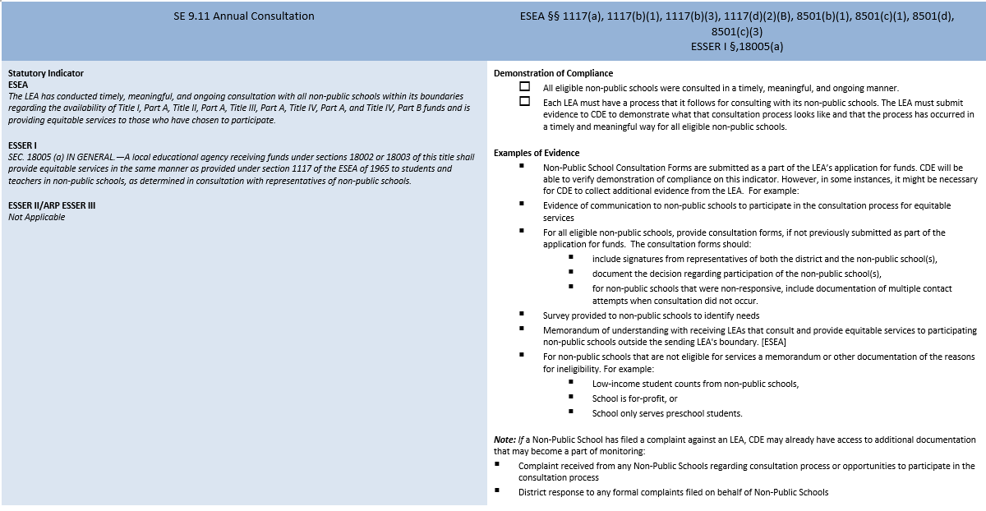
SE 9.11 Annual Consultation

Slide 6
SE 9.11 Annual Consultation: Overview
The goal of consultation is agreement between the LEA and appropriate non-public school officials on how to provide equitable and effective programs for eligible non-public school children. The “goal of reaching agreement” between an LEA and appropriate non-public school officials is grounded in timely, meaningful, and open communication between the LEA and the non-public school officials on key issues that are relevant to the equitable participation of eligible non-public school students, teachers and other education personnel, and families in ESEA programs.
LEAs are not required to consult with for-profit non-public schools, stand alone pre-K facilities, or daycare facilities.
Notes:
The goal of consultation is for a non-public school and the LEA to come to an agreement on how to provide equitable access to effective programs for children in non-public schools. The consultation needs to be meaningful, timely, and ongoing through the year as both parties agree upon the services needed through both ESEA and ESSER.

Slide 7
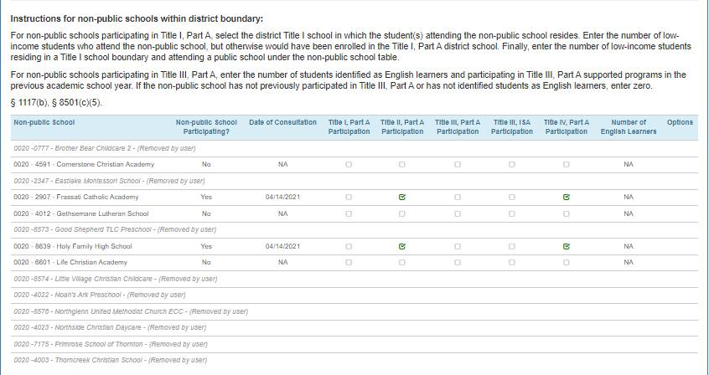
List of Non-public Schools
CDE will pre-populate the known non-public schools that are located in the district. If there are no schools listed, there is nothing for the LEA to do.
Note: LEAs should review this screen prior to completing the application as new schools are added each year.
http://www.cde.state.co.us/cdereval/pupilcurrentnonpublic

Slide 8
SE 9.11 Annual Consultation
The Annual Consultation indicator applies to ESEA and ESSER I Only
  ESSER II and ESSER III did not have an equitable services requirement
CDE will review submitted consultation forms from LEAs; forms will not need to be uploaded into Syncplicity
  ESEA Consultation - this form is submitted annually
  ESSER I Consultation - this form was submitted one time for ESSER I
Only non-profit schools are eligible for funds
All eligible schools must have a consultation on file regardless of whether or not they participate

Slide 9
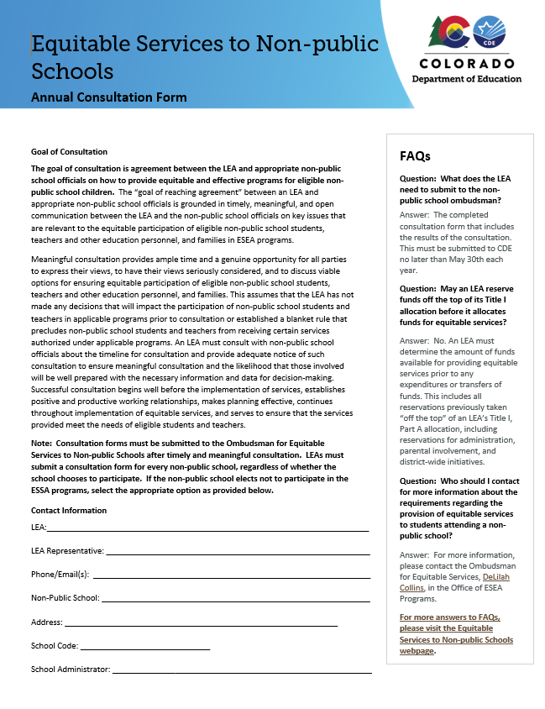
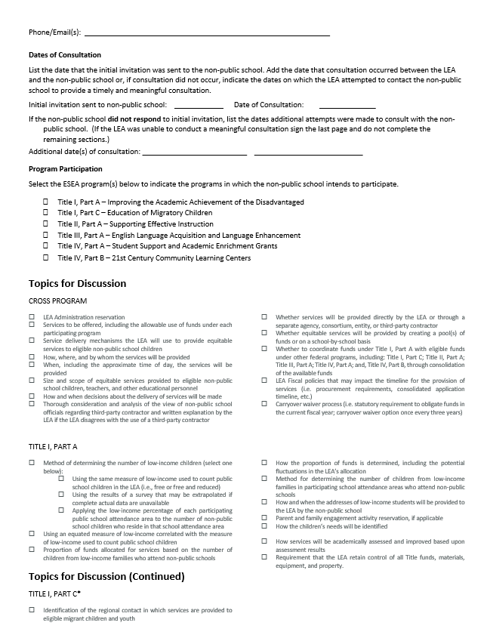
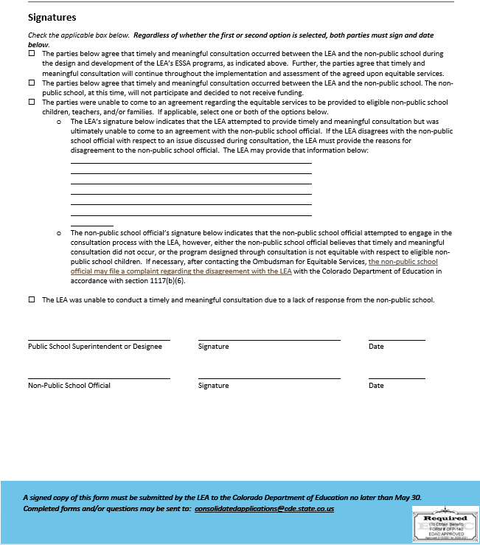
SE 9.11 Annual Consultation: ESEA Consultation Form

Slide 10
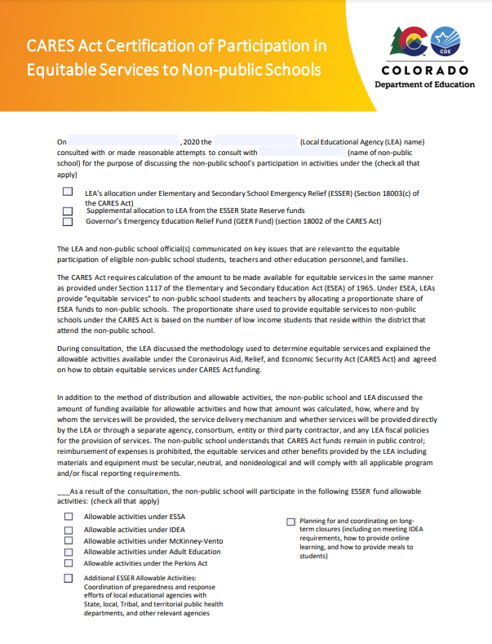
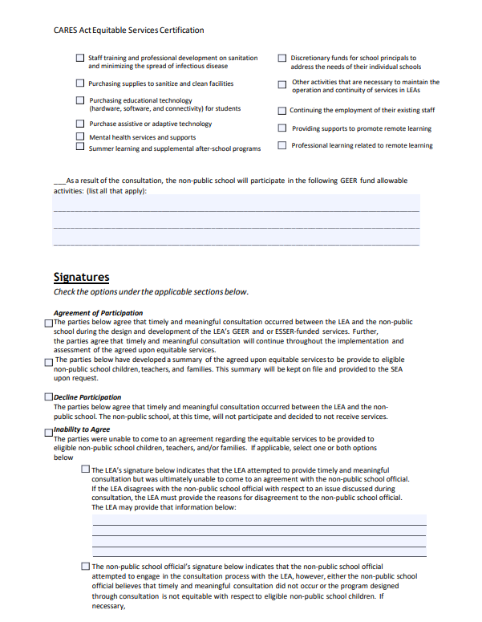
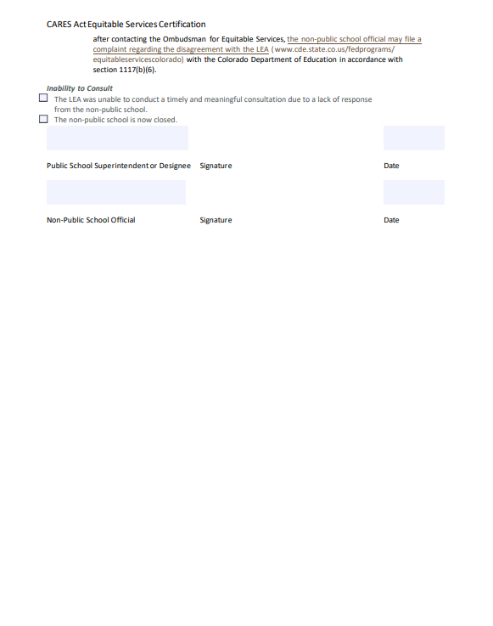
SE 9.11 Annual Consultation: ESSER I Consultation Form

Slide 11
SE 9.11 Annual Consultation: Demonstration of Compliance
All eligible non-public schools were consulted in a timely, meaningful, and ongoing manner.
Each LEA must have a process that it follows for consulting with its non-public schools. The LEA must submit evidence to CDE to demonstrate what that consultation process looks like and that the process has occurred in a timely and meaningful way for all eligible non-public schools.

Slide 12
SE 9.11 Annual Consultation: Examples of Evidence
Non-Public School Consultation Forms are submitted as a part of the LEA’s application for funds. CDE will be able to verify demonstration of compliance on this indicator. However, in some instances, it might be necessary for CDE to collect additional evidence from the LEA. For example:
Evidence of communication to non-public schools to participate in the consultation process for equitable services
For all eligible non-public schools, provide consultation forms, if not previously submitted as part of the application for funds. The consultation forms should:
  include signatures from representatives of both the district and the non-public school(s),
  document the decision regarding participation of the non-public school(s),
  for non-public schools that were non-responsive, include documentation of multiple contact attempts when consultation did not occur.
Survey provided to non-public schools to identify needs
Memorandum of understanding with receiving LEAs that consult and provide equitable services to participating non-public schools outside the sending LEA's boundary. [ESEA]
For non-public schools that are not eligible for services a memorandum or other documentation of the reasons for ineligibility. For example:
  low-income student counts from non-public schools,
  School is for-profit, or
  School only serves preschool students.
Note: If a Non-Public School has filed a complaint against an LEA, CDE may already have access to additional documentation that may become a part of monitoring:
Complaint received from any Non-Public Schools regarding consultation process or opportunities to participate in the consultation process
District response to any formal complaints filed on behalf of Non-Public Schools

Slide 13
SE 9.11 Annual Consultation: Evidence Needed
What CDE already has (LEA will not have to submit again):
CDE will check that the corresponding non-public consultation form is complete and aligns with the information included in the approved Consolidated Application and approved ESSER I Application for all eligible schools. This includes:
  A signature from the appropriate parties
  Documented decisions of how the non-public would like to participate
  A record of ongoing consultation
  If a school did not respond, the consultation form reflects multiple attempts
  The consultation form aligns with what is reported in the application for ESEA and ESSER I
Please note that the consultation forms are checked during the review of the application and during monitoring.
What LEAs need to submit:
A documented process of how the LEA consult with non-public schools
In the event that a consultation form is missing or does not demonstrate compliance, CDE will request additional evidence to ensure a timely, meaningful consultation occurred.
  This could include, but is not limited to, any of the examples listed on the indicator.

Slide 14
FR 1.7 Proportionate Share

Slide 15
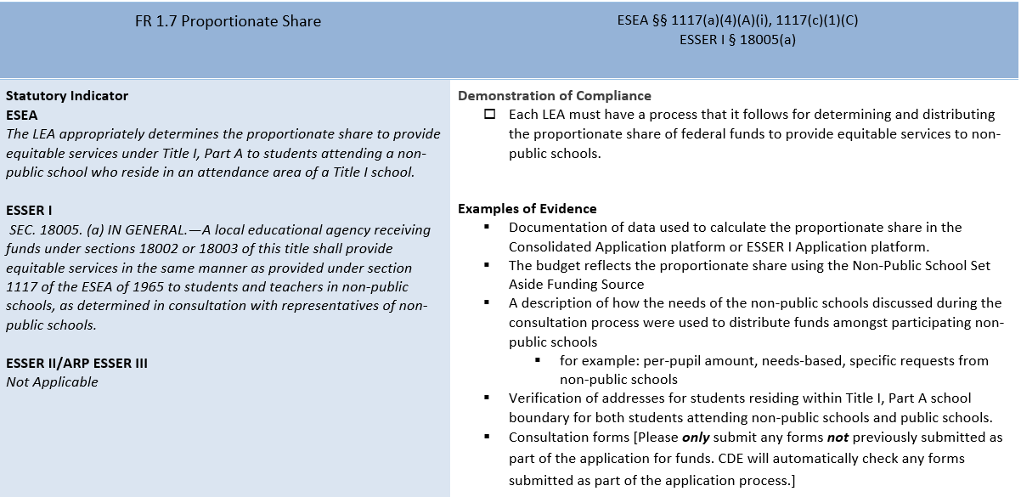
FR 1.7 Proportionate Share

Slide 16
FR 1.7 Proportionate Share: Overview
An LEA must apply the proportion used to calculate the proportional share to its entire Title I allocation (including any Title II, Part A or Title IV, Part A funds that an LEA transfers into Title I, Part A) before it reserves any funds for other purposes, including all reservations the ESEA requires or authorizes an LEA to take off the top of its Title I allocation, such as reservations for administration, parent and family engagement, children in institutions for neglected or delinquent children, homeless children and youth, and district-wide initiatives.
Notes:
It is required that the LEA dedicates the proportional share to the non-public schools prior to reserving funds for any other purpose.

Slide 17
FR 1.7 Proportionate Share
This indicator applies to ESEA funds and ESSER I funding only
Based on the information provided in both the Consolidated Application and the ESSER I Application, the proportionate share is automatically calculated.
  This indicator is ensuring the data entered into the applications is accurate and that there is a process that reflects how the funding is determined for each school

Slide 18
FR 1.7 Proportionate Share: Demonstration of Compliance
Each LEA must have a process that it follows for determining and distributing the proportionate share of federal funds to provide equitable services to non-public schools.

Slide 19
FR 1.7 Proportionate Share: Examples of Evidence
Documentation of data used to calculate the proportionate share in the Consolidated Application platform or ESSER I Application platform.
The budget reflects the proportionate share using the Non-Public School Set Aside Funding Source
A description of how the needs of the non-public schools discussed during the consultation process were used to distribute funds amongst participating non-public schools
  for example: per-pupil amount, needs-based, specific requests from non-public schools
Verification of addresses for students residing within Title I, Part A school boundary for both students attending non-public schools and public schools.
Consultation forms [Please only submit any forms not previously submitted as part of the application for funds. CDE will automatically check any forms submitted as part of the application process.]

Slide 20
Evidence Needed
What CDE already has (LEA will not have to submit again):
  Consultation form(s)
  Consolidated Application and the ESSER I application budget for non-public schools
    Consolidated Application Funding Source: Title I, Part A Non-Public School Set Aside - (9205)
    ESSER I Application Funding Source: ESSER Non-public School Set-Aside - (4425)
What LEAs need to submit:
  A process document of how the LEA calculates the amount of funding that goes to each school
  The documentation that verifies the data entered into both the Consolidated Application and the ESSER I Application, such as:
    Number of low income students residing within Title I school boundaries in the district attending a public school
    Number of low income students residing in a Title I school boundary and attending a private school

Slide 21
FR 9.4 Use of Funds for Non-Public Schools
Notes:
Shannon

Slide 22
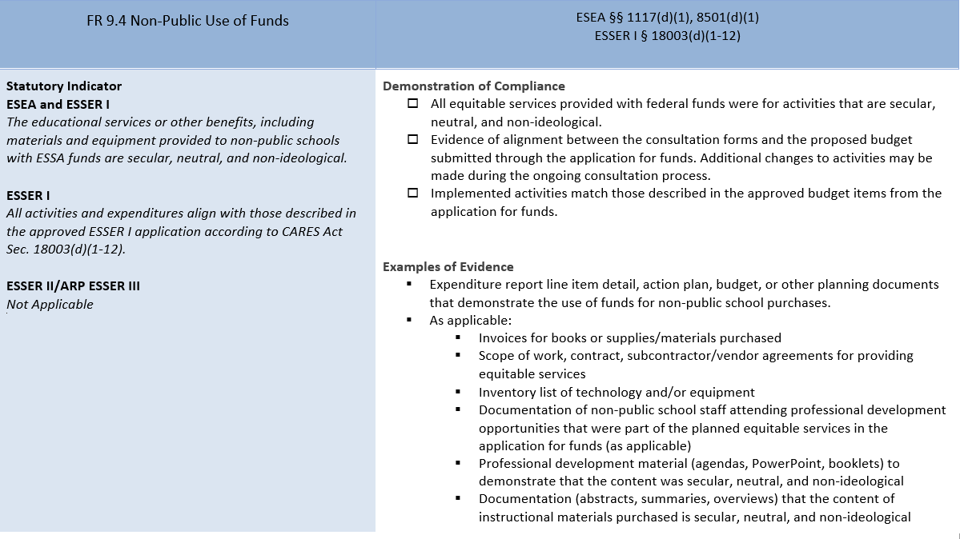
FR 9.4 Use of Funds for Non-Public Schools
Notes:
Shannon

Slide 23
FR 9.4 Use of Funds for Non-Public Schools: Overview
The purpose of this indicator is to ensure that the expended funds for non-public schools align with the proposed budget items and that funds for non-public schools were used for activities that are secular, neutral, and non-ideological.
This indicator applies to ESEA funds and ESSER I funding only
Notes:
Shannon

Slide 24
FR 9.4 Demonstration of Compliance
All equitable services provided with federal funds were for activities that are secular, neutral, and non-ideological.
Evidence of alignment between the consultation forms and the proposed budget submitted through the application for funds. Additional changes to activities may be made during the ongoing consultation process.
Implemented activities match those described in the approved budget items from the application for funds.
Notes:
Shannon

Slide 25
FR 9.4 Examples of Evidence
Expenditure report line item detail, action plan, budget, or other planning documents that demonstrate the use of funds for non-public school purchases.
As applicable:
  Invoices for books or supplies/materials purchased
  Scope of work, contract, subcontractor/vendor agreements for providing equitable services
  Inventory list of technology and/or equipment
  Documentation of non-public school staff attending professional development opportunities that were part of the planned equitable services in the application for funds (as applicable)
  Professional development material (agendas, PowerPoint, booklets) to demonstrate that the content was secular, neutral, and non-ideological
  Documentation (abstracts, summaries, overviews) that the content of instructional materials purchased is secular, neutral, and non-ideological
Notes:
Shannon

Slide 26
Evidence Needed
What CDE already has (LEA will not have to submit again):
Approved budget showing line items for non-public schools
Consultation Form(s)
What LEAs need to submit:
Expenditure report, action plan, budget, or other planning documents that match the submitted budget
Based upon review of the expenditure report, the LEA may be asked to submit additional information.
Notes:
Shannon

Slide 27
Monitoring Resources
Monitoring Resources
Federal Programs Monitoring Webpage
Trainings Page
Monitoring Schedule
Programs Requirement Document
Notes:
Shannon

Slide 28
Contacts
If you have any questions, contact:
Non-public School Ombudsman:
DeLilah Collins | Kathryn Wisner
Your regional contact
ESEA monitoring leads
ESSER monitoring leads
Notes:
Shannon

