Slide 1
ESEA Consolidated
Fund Request in GAINS System Training

Slide 2
Today's Agenda
Required roles
How to Access and Complete the Request for Funds
Demonstration in test site

Slide 3
Fund Requests in GAINS: Required Roles
There are two roles involved in submitting fund requests in GAINS
LEA Fiscal Update
LEA Fiscal Representative
The LEA Fiscal Update role is authorized to start and edit, but not approve and submit, fund requests on behalf of the organization.
The LEA Fiscal Representative role is authorized to approve and submit fund requests started by the LEA Fiscal Update. The person in this role will also certify compliance with the following:
U.S. Code Title 18, Section 1001 and Title 31, Sections 3729-3730 and 3801-3812
Cash Management Act (31 CFR part 205)
EDGAR Regulations (34 CFR part 80.20 and 80.21)
Cost Principals (2CFR Subpart E)
815 CMR 2.00 State Grants, Federal Awards, Federal Subgrants and Subsidies

Slide 4
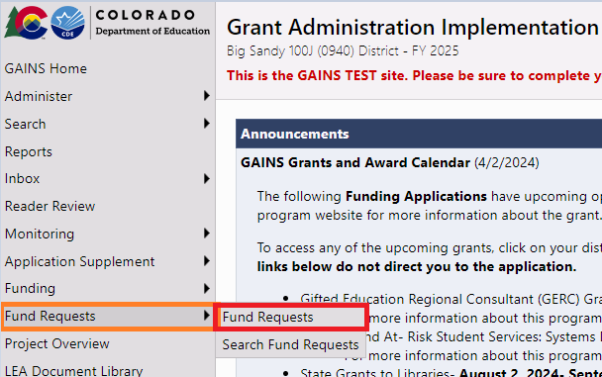
Locate the Fund Request
Hover over "Fund Requests" in the left navigation menu and select, "Fund Requests."

Slide 5
Identify the Program
All grant requests will appear on the Fund Request page. Applicants can use the FY and Application drop down to select the appropriate Funding Application.
Click on the link in the ‘Grant’ column to begin the request. This will take you to the Project Summary page.
Applicants will need to complete a request for each of the title programs that they receive and accept.

Slide 6
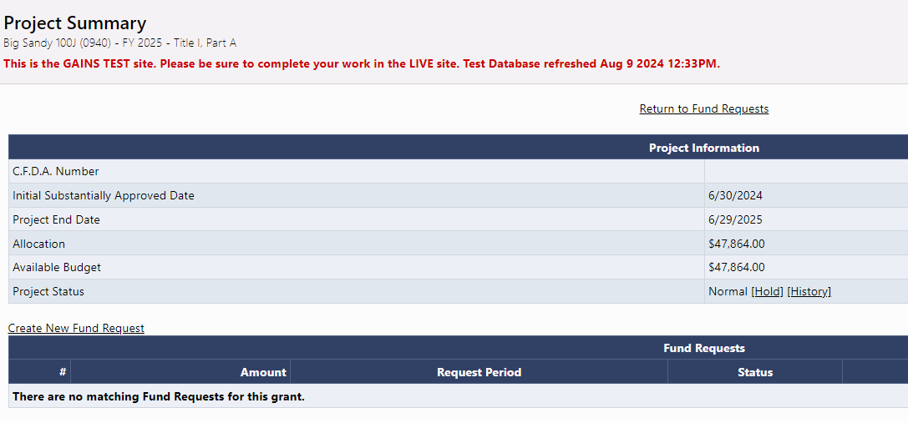
Project Summary Page
Click on "Create New Fund Request" to start.

Slide 7
Fund Request Sections
History Log: Tracks audit record of Fund Request status changes and any Comments associated with it.
Create Comment: Comment field for any internal notes (such as additional user approvals) and SEA comments if the request is returned for changes.
Expenditure Detail: Where the user will enter amount requested by Object Code and Function Code.
Request: User must enter “Fiscal Information As Of” date and may use the optional text box. All other fields are system-generated and require no action.
Related Documents: Document upload section for uploading supporting documentation such as general ledger.
Assurance: Text of Assurance statement that User will need to agree to upon moving request to Draft Completed.

Slide 8
Expenditure Details Page
You will enter the amount requested by Function and Object Code
If you hover over the open cells, it will show you the original budgeted amount, previous fund request amounts, total funds request and amount remaining for the function code/object code pair.

Slide 9
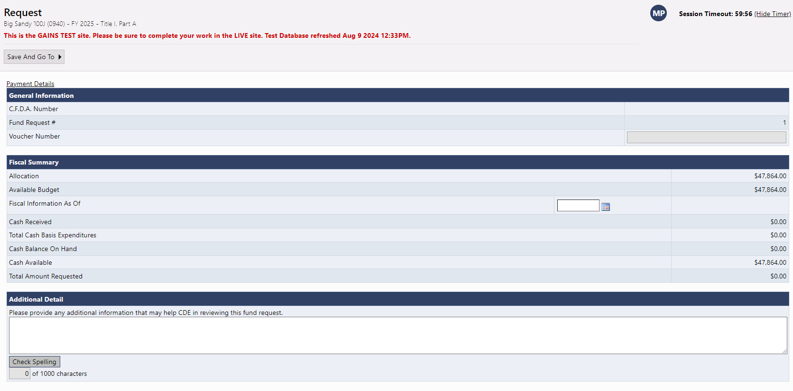
Request Page
General Information will be populated by the system.
Under Fiscal Summary, the only field that needs information is, "Fiscal Information As Of" date.
Everything else in Fiscal Summary is system-generated from other places.
Keep this Fiscal Information as of date field in mind! It is important in continuing a fund request.

Slide 10
Related Documents
Upload any required or optional document in the Related Documents section
Hover of the "i" bubble to see any instructions specific to this grant fund request.
For Title, the General Ledger is required for each program!
Please label the document in the provided Document Name field

Slide 11
Related Documents: Uploading Multiple Files
You can upload multiple files; simply click on "Upload New" again to bring the upload box up.
When uploading multiple files, please use the Document Name field to clearly indicate the file's content

Slide 12
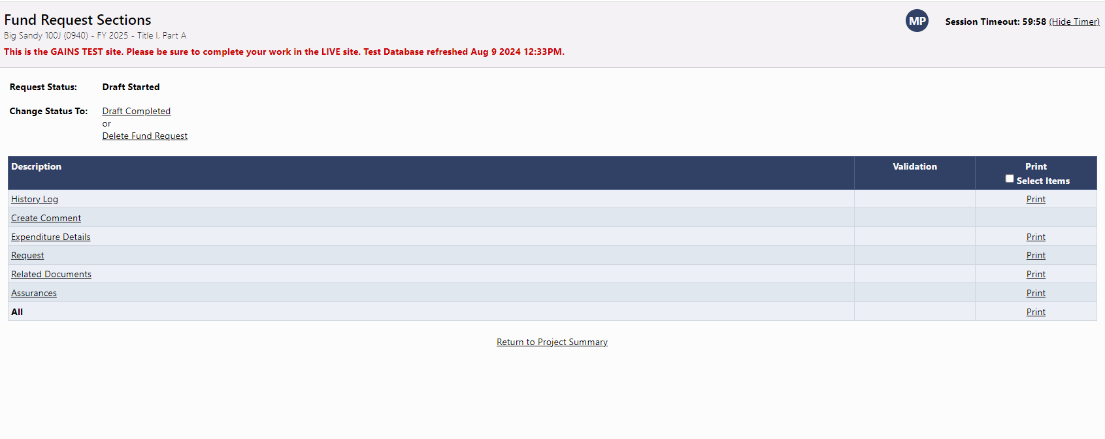
Submitting Fund Request: LEA Fiscal Update moves to Draft Completed
Similar to Funding Applications, the validation errors must be clear prior to submitting and the print option will appear for all applicable sections.
Once all errors are cleared, the LEA Fiscal Update will change the status to Draft Completed

Slide 13
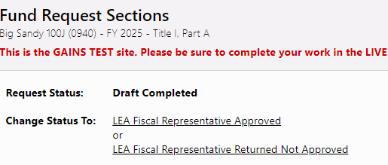
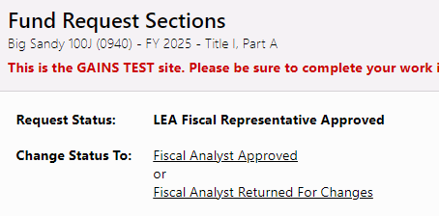
Submitting Fund Request: LEA Fiscal Representative moves to LEA Fiscal Representative Approved
Then, the LEA Fiscal Representative will receive a notification to review and either approve or return to LEA Fiscal Update to make changes
The Fund Request is considered submitted to CDE when in the status "LEA Fiscal Representative Approved"

Slide 14
Complete the Rest!
If you go back to the Fund Requests page, you will now see the amount pending for Title I, Part A!
Please also note that you will follow the same steps to complete the other title programs!

Slide 15
Incomplete Request for Funds

Slide 16
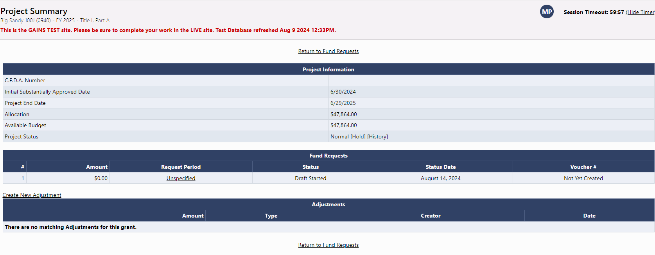
Continuing a Fund Request
In cases where you don't finish the fund request, you must come back to complete it! You will select the grant and go into the grant's Project Summary page. Then, they will select the RFF under the "Request Period." If you haven't entered a fiscal date, you will select "Unspecified."

Slide 17
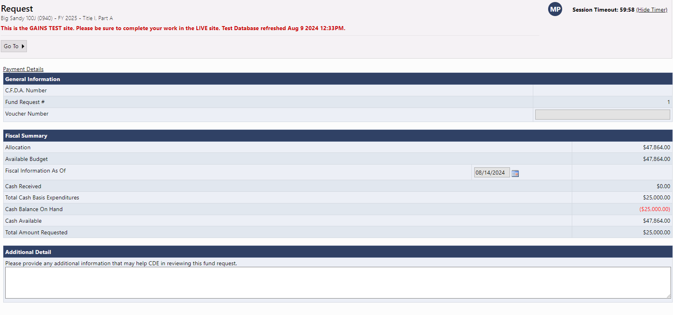
Reminder of the Fiscal Date Location
However, if you've entered a Fiscal Date on the Request page...

Slide 18
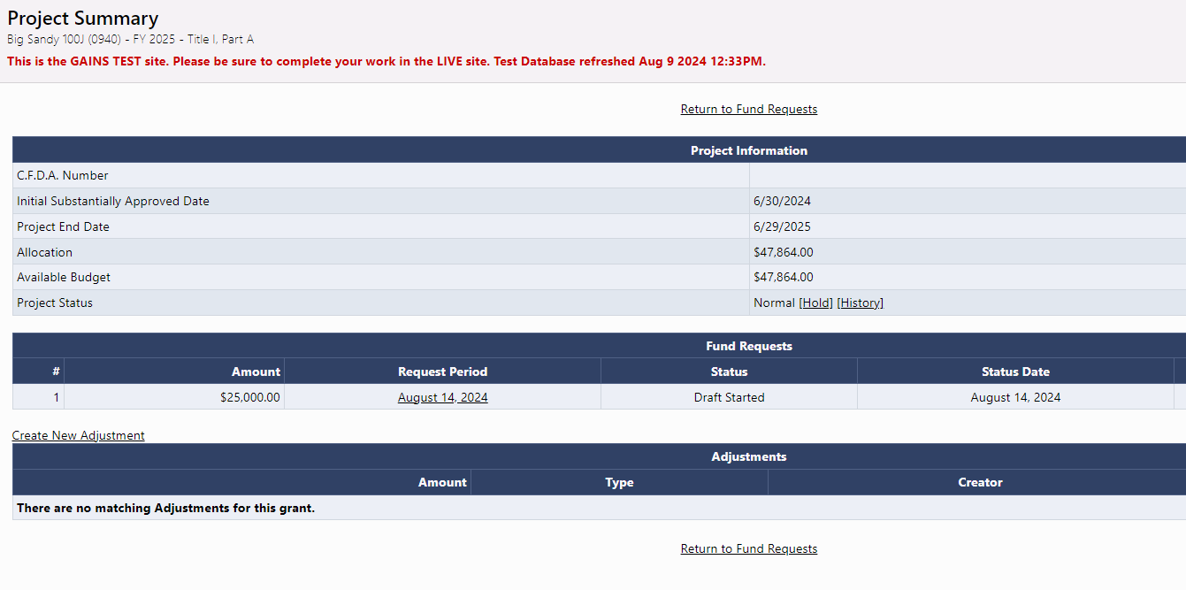
Continuing a Fund Request: Date
...that date will appear on the Project Summary page. So, instead of selecting "Unspecified," you will select the date!

Slide 19
What if the budget changes and those object code/function codes aren't appearing in your Request for Funds?

Slide 20
What if something changes?
You will only see the object code/function code combinations that have been approved by CDE. What if something changes and you started a request?

Slide 21
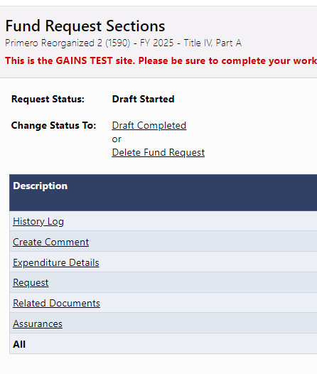
Delete Fund Request
If something changes, you will need to delete the fund request before submitting a revision. If you don't, the RFF won't appear with the correct information!
Then you will complete a revision request. This must be fully approved by CDE before starting a new request as it won't reflect the changes!

Slide 22
New Fund Request
Previous RFF without Change

Slide 23
New Fund Request: New Fields
Once approved by CDE, you will follow the same process to start a new fund request. But now, you will see the Object Code change:
NEW RFF with Change

Slide 24
Demonstration

Slide 25
Technical Assistance and GAINS Resources
GAINS Help Desk Ticket
GAINS CDE Resources
GAINS Training Webpage
Catch up on past trainings provided by CDE!
Ask for help and indicate a time that works best for you through this ticketing system!
Any additional resources will be posted in GAINS!
GAINS Office Hours
Every other Tuesday from 12:30 – 1:00pm for system questions!

