Slide 1
CDE Office Hours
March 3, 2022

Slide 2
CDE Team!
CDE Contacts!
Emails: LastName_FirstInital@cde.state.co.us
ESSER/ESEA Program Partners
Nazie Mohajeri-Nelson, Director of ESEA Office (mohajeri-nelson_n@cde.state.co.us)
DeLilah Collins, Assistant Director of ESEA Office (collins_d@cde.state.co.us)
ESEA Regional Contacts assigned by district
Title I: Laura Meushaw, Kathryn Wisner, Niko Kaloudis, Evita Byrd
Title II: Niko Kaloudis, Karen Bixler
Title III: Kathryn Wisner, Rachel Temple
Title IV: Tammy Giessinger, Michelle Prael
ESSER Team
Kristin Crumley, ESSER Monitoring Specialist (Crumley_k@cde.state.co.us)
Jonathan Schelke, ESSER Monitoring Specialist (schelke_j@cde.state.co.us)
Shannon Wilson, ESSER/ESEA Grants Administration Coordinator (Wilson_s@cde.state.co.us)
Mackenzie Owens, ESSER Reporting Specialist (owens_m@cde.state.co.us)
Data, Accountability, Reporting, and Evaluation
Tina Negley, Alan Shimmin, Mary Shen, and Mackenzie Owens
Fiscal Partners
Jennifer Okes, Chief Operating Officer (okes_j@cde.state.co.us)
Kate Bartlett, Executive Director of School District Operations (Bartlett_k@cde.state.co.us)
Jennifer Austin, Director of Grants Fiscal Management (Austin_j@cde.state.co.us)
Robert Hawkins, Grants Fiscal Analyst (Hawkins_s@cde.state.co.us)
Steven Kaleda, Grants Fiscal Analyst (Kaleda_s@cde.state.co.us)
ESSER Team
Bill Parsley, ESSER Fiscal Monitoring Supervisor (parsley_b@cde.state.co.us)
Hilery Morris, ESSER Fiscal Monitoring (morris_h@cde.state.co.us)
Sharon Mackey, ESSER Fiscal Monitoring (mackey_s@cde.state.co.us)

Slide 3
Welcome New Staff!
Evita Byrd, Title I Specialist
Karen Bixler, Title II Specialist
Rachel Temple, Title III Specialist

Slide 4
ESSER Office Hours
Topics
Updates and Reminders
Upcoming Grant Opportunities
New Directors Launchpad
Federally Funded Equipment
Notes:
Nazie

Slide 5
Updates, Reminders, and Clarifications

Slide 6
ESSER III March 24 Deadline
ESSER III applications need final approval by March 24
Please submit revisions as soon as possible!
You can include Placeholders in your budget
Should only be a small portion of your budget
Should not be for the current fiscal year
Must submit specific detail through PAR in order to draw down funds
Include placeholder language in the activity description
“Placeholder - The LEA is in the process of identifying needs for the remainder of the ESSER funds allocated to the LEA. The amount in this budget line is being set aside to use for future allowable activities that are unknown at this time. Once the allowable activities have been identified, the LEA will revise this budget line to propose the use of these funds. The LEA acknowledges that even if the remainder of the application has final approval, this placeholder line item is not approved and funding will not be distributed until the LEA submits revisions requesting approval for specific activities for these funds through the Post Award Revision (PAR) process. The LEA assures that these funds will not be obligated, used, or requested for reimbursement until proposed activities are approved by CDE through the PAR process.”

Slide 7
ESSER III Supplemental Funds Deadlines
For supplemental ESSER III Funds:
The deadline for the Safe In Person Plan has been extended to May 20, 2022
The Use of Funds Plan is also due May 20
If accepting the funds:
Read through and accept the application assurances;
Submit a hyperlink to your Safe In-Person Plan on the assurance that asks for the link
Submit a response to the Narrative Question. The narrative question response serves as CDE’s way of checking your Use of Funds Plan, which should also be posted to your organization’s website
Either submit a budget if you are ready to do so by May 20th or respond to the two additional narrative questions and complete the budget at a later date.
If declining funds:
Log into the online application system and decline funds as soon as possible so that those funds can be reallocated to other entities in the state.

Slide 8
Timelines Associated with ESSER I, II, and III
 | ESSER I (CARES Act) | ESSER II (CRSSA Act) | ARP ESSER III (ARP Act) | ARP ESSER III – State Reserve Funds (ARP Act)
Award Period | 03/13/20 – 09/30/21 | 03/13/20 – 09/30/22 | 03/13/20 – 09/30/23 | 03/13/20 – 09/30/23
Tydings Period - will end and funds must be spent by | 9/30/22 | 9/30/23 | 9/30/24 | 09/30/24
USDE Award to CDE | 05/07/20 | 01/06/21 | 3/24/21 | 11/4/21
CDE Must Make Subgrants to LEAs (90%) – LEAs must have final approval on ESSER I and II and substantial approval on ESSER III | 05/07/21 Final Approval | 01/06/22 Final Approval | 05/23/21 Substantial Approval | NA
All awards must be final | 05/07/21 | 01/06/22 | 03/24/22 | 11/2/22
CDE Application for LEAs Opened | 05/31/20 | 02/12/21 | 4/27/21 | Varies Across Grants Formula Awards ~ 1/12/22
Preliminary Application (T&A, assurances, GEPA) due | NA | NA | 5/23/21 | NA
Safe In-Person Plans | NA | NA | 5/23/21 | 2/25/22 5/20/22
LEA Use of Funds Plan (budget in ESSER I & II; budget/narrative questions in ESSER III) | 12/31/20 | 9/30/21 | 12/16/21 | 5/20/22
CDE Application Closed/Closes | 12/31/20 | 09/30/21 | 03/24/22 | 9/2/22
PAR Open – Rolling Basis | Date of Final Approval | Date of Final Approval | Date of Final Approval | Date of Final Approval
PAR Closes | 06/30/21 | 06/30/22 | 06/30/23 | 6/30/23
Carryover Application Will Open (Unexpended Funds Carried Over to Next Year) | 07/01/21 | 07/01/22 | 07/01/23 | 07/01/23
Carryover Application Will Close | 06/30/22 | 06/30/23 | 06/30/24 | 6/30/24
Monthly Deadline for Requesting Funds (LEA’s Request for Funds, RFF) | First Day of Each Month | First Day of Each Month | First Day of Each Month | First Day of Each Month
Deadline for Final Spending | 09/30/22 | 09/30/23 | 9/30/24 | 9/30/24
Deadline for Final Draw Down of Funds (RFF) | October/November 2022 | October/November 2023 | October/November 2024 | October/November 2024

Slide 9
Accountability Plan Survey
Due to the continuing challenges of the COVID-19 pandemic, the U.S. Department of Education is allowing 1-year changes to our methodologies for identification of schools for support and improvement (i.e., eligible for Title I School Improvement funds).
CDE’s proposed changes are open for public comment until Friday, March 4, 2022. Please submit feedback via surveys posted on our ESSA State Plan website.

Slide 10
HVAC Requirements/Bipolar Ionization
REMINDER:
In April 2021, Federal Programs along with our Capital Construction partners were advised by the Colorado Department of Public Health and Environment and the EPA about concerns with hydrogen peroxide systems.
If the LEA has purchased and installed hydrogen peroxide or bipolar ionized HVAC solutions:
Investigate and understand safety concerns
If the LEA has not purchased or installed hydrogen peroxide or bipolar ionized HVAC solutions but has requested to use ESSER funds for this activity
CDE will disallow the use of ESSER funds for these types of systems
CDE staff may question PAR requests related to hydrogen peroxide or bipolar ionized HVAC solutions
CDPHE/CDE guidance related to HVAC: http://www.cde.state.co.us/planning20-21/reopeningschools-faq

Slide 11
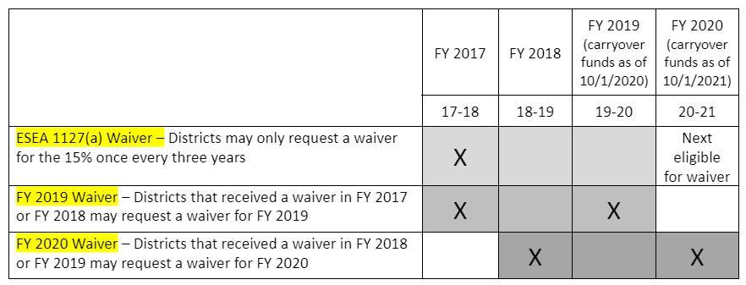
Update on Title I 15% Carryover Waiver
An LEA may not carryover more than 15% of its Title I allocation. (Section 1127(a))
CDE may waive this limitation once every three years if:
the LEA’s request is reasonable and necessary; or
a supplemental Title I appropriation becomes available.
USDE offered two waivers to States that waive the once-in-three-years requirement for FY 2019 and FY 2020 funds.
Enables CDE to allow an LEA to carryover more than 15% even if it granted the same LEA this waiver for either of the two previous fiscal years.
USDE has not released any information regarding a waiver for FY 2021 (carryover October 2022).
USDE Guidance
Notes:
As districts are allocating current budgets and planning for future budgets both ESEA and ESSER, we have had some questions and heard some concerns regarding spending in the allotted time frame and the allowance of carryover. We wanted to spend a couple of minutes discussing Title I carryover and its allowance.. According to ESEA districts may not carryover more than 15% of its Title I allocation each year. However, the law does account for things not going according to plan by allowing States the opportunity to waive this requirement for districts once every three years if it was deemed reasonable and necessary. As a result of COVID-19 and increasing of funds for at times similar purposes, supply chain issues and staffing limitations, USDE has allowed states to waive the one in three year requirement for FY 2019 so those funds that became carryover in October 2020 as well as FY 2020 - funds that became carryover in 2021. The graphic in the bottom right of the slide illustrates this allowance. The first line is the waiver process included in the law. The 2nd and 3rd line illustrates how a district may receive this waiver more than once in a three year period. In essence, the FY2019 and FY2020 would not count towards the once every three years limitation.
At this time, we have not received any information about a waiver for FY 2021. CDE recommends that district work to obligate at least 85 percent of their FY 2021 Title I funds by June 30, 2022. This would be especially true for LEAs that received a carryover waiver from CDE for FY 2019 or FY 2020 because they are not currently eligible to receive a waiver for their FY 2021 Title I-A funds. We will of course let you know if hear anything about a waiver for FY 2021 Title I funds.

Slide 12
Title I, Part A 15% Carryover Waiver Process
Budgeting
Grants Fiscal AFR Review
Grants Fiscal & LEA Review
Waiver Submission
Approval
LEAs budget 100% of their allocation in the Consolidated Application and actively try to spend the funds.
15-month Grant Award Period
CDE Office of Grants Fiscal reviews LEA Annual Financial Reports (AFR) and identifies LEAs over the 15% cap.
October
Grants Fiscal works with identified LEAs to determine if a waiver is necessary. Grants Fiscal may work with the LEA on spending down funds.
Grants Fiscal will instruct LEAs needing to carryover more than 15% of their Title I, Part A allocations to complete the Title I, Part A 15% Carryover Waiver with their Regional Contact then submit it to consolidatedapplications@cde.state.co.us.
CDE ESEA Team reviews the waiver and gives any feedback to the LEA. If approved, the LEA and CDE keep the waiver on file for monitoring purposes.
Key Point: While LEAs should always be tracking their spending internally, CDE will initiate the waiver process, not LEAs.
Notes:
This slide presents the process that Grants Fiscal and the ESEA Office follows regarding carryover. Although there are some carryover waivers needed each year, it tends to only be a handful. During Grant Fiscal’s review of AFRs in early October, they determine if a district needs a waiver. If a waiver is needed then the district will be contacted by their Regional Contact. The district does not need to take any action or request a waiver until they have received a notification from CDE.

Slide 13
Upcoming Grant Opportunities

Slide 14
Competitive Funding Opportunities
Current
Adult Education and Literacy
Computer Science Education
Curricula and Instructional Programming
Early Literacy - Professional Development
Education Workforce Fund
Educator Mentor Program
Gifted Education Universal Screening and Qualified Personnel
McKinney-Vento Education of Homeless Children and Youth
Rural CoAction
Rural Program Development
School Counselor Corps
In Development
McKinney-Vento Education of Homeless Children and Youth - Community-Based Organization Program
Concurrent Enrollment Expansion and Innovation
Educational Stability
Extended Learning Opportunities
Local Food Program

Slide 15
Competitive Funding Opportunities – ESSER State Reserve Fund
Current
Curricula and Instructional Programming
Supports districts in purchasing such K-8 mathematics curricula and K-3 READ Act-approved instructional programs.
Education Workforce Fund
Ensures LEAs have the capacity to meet the need for recruiting, retaining, and supporting the educator workforce.
Educator Mentor Program
Provides opportunities for districts to build, enhance, and strengthen mentoring programs to ensure beginning teachers have necessary support to build instructional capacity and effectiveness in the classroom by deepening mentoring programs at the local level.
Rural CoAction
Seeds the creation of new partnerships and furthers the development of existing partnerships and pathways for learning in our rural communities.
Rural Program Development
Provides funding to support the development of a wide range of programs to support re-engaging and strengthening student engagement–particularly for those students most impacted by the pandemic.
In Development
Extended Learning Opportunities – Details anticipated to be available in Spring 2022

Slide 16
Competitive Funding Opportunities – Other Current Programs
Current
Adult Education and Literacy
Supports programs that provide adult basic education, adult education leading to a high school equivalency credential, ESL instruction, or integrated basic education and skills training as part of a workforce development partnership or education attainment partnership.
Computer Science Education
Provides professional development for educators and support for increasing enrollment and participation of traditionally underrepresented students.
Early Literacy - Professional Development
Supports early literacy professional development for elementary educators.
Gifted Education Universal Screening and Qualified Personnel
Supports Administrative Units’ gifted education programs.
McKinney-Vento Education of Homeless Children and Youth
Supports initiatives to remove all educational barriers facing children and youth experiencing homelessness, with an emphasis on educational enrollment, attendance, and success.
School Counselor Corps
Program seeks to increase the availability of effective school-based counseling within schools to increase the graduation rate within the state and increase the percentage of students who appropriately prepare for, apply to, and continue into postsecondary education.

Slide 17
Competitive Funding Opportunities – Upcoming Programs
In Development
McKinney-Vento Education of Homeless Children and Youth - Community-Based Organization Program
Provides funding to Community-Based Organizations supporting the education of homeless children and youth.
Concurrent Enrollment Expansion and Innovation
Provides grants to partnering local education providers and institutions of higher education to expand and innovate concurrent enrollment opportunities to qualified students.
Educational Stability
Supports the educational stability of highly mobile students, including youth in foster care, those experiencing homelessness, and migrant students.
Local Food Program
Encourages school nutrition providers to procure local products, while in return fostering nutrition education, bolstering nutrition activities in the state, and supporting Colorado producers and farmers.

Slide 18
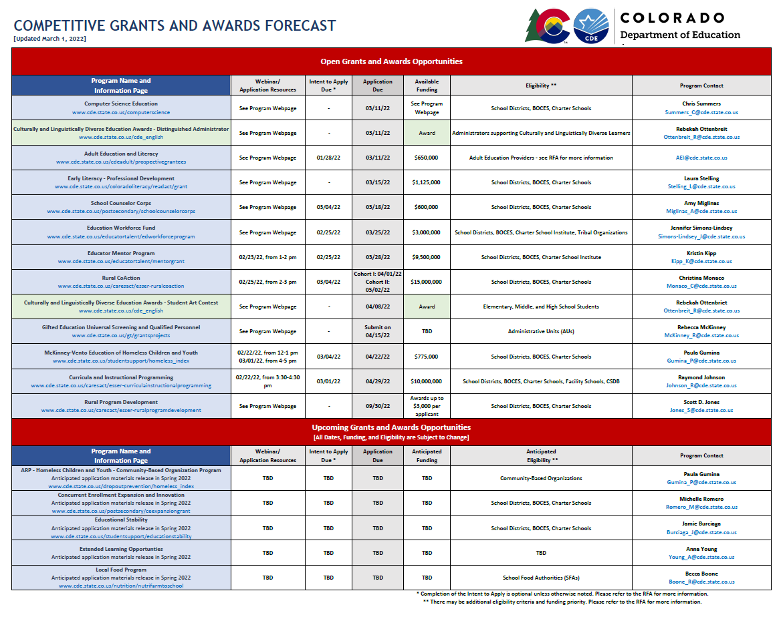
Competitive Grants and Awards Forecast

Slide 19
Where to find information on current and upcoming grant opportunities
The Scoop
Published every Wednesday by CDE’s Communications Office. Programs across the department utilize the Scoop to announce funding opportunities and provide deadline reminders. Additional content-specific newsletters can be found on the Communication Office’s webpage.
Competitive Grants and Awards Forecast
We host a calendar on our webpage to alert potential applicants to current and upcoming funding and award opportunities. This is updated as frequently as possible and usually every 1-2 months.
CDE Program Staff
Program managers for each grant are an excellent resource. Please don’t hesitate to contact them with questions as you complete an application, or even if you just want to explore whether a program would be a good fit. If there is a grant program you’re curious about that isn’t listed on the Grants Forecast, the program manager for that grant will be your best source of information on whether that opportunity has a new cycle coming up.

Slide 20
Competitive Grants and Awards Staff
Kim Burnham, Competitive Grants and Awards Supervisor 720-607-1495 (c) Burnham_K@cde.state.co.us
Brittany Jimenez, Program Support 303-518-7235 (c) Jimenez_B@cde.state.co.us
Patricia Gleason, Senior Consultant (Awards Programs) 303-866-6143 (o) | 303-910-5721 (c) Gleason_P@cde.state.co.us
Mandy Christensen, Senior Consultant (Competitive Grants) 303-866-6250 (o) | 303-957-6217 (c) Christensen_A@cde.state.co.us

Slide 21
New Directors Launchpad

Slide 22
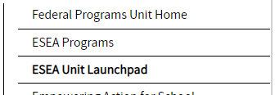
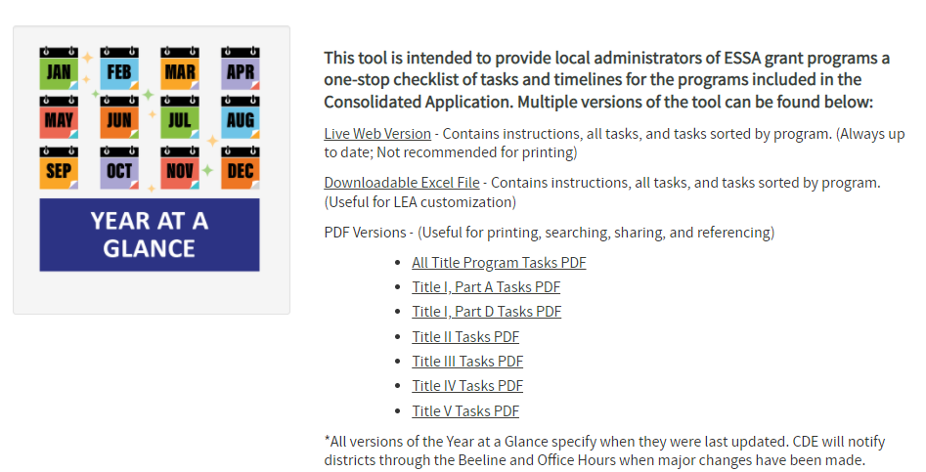
Year at a Glance Deep Dive
Phase I is complete and you can now access the Launchpad
Current uses:
Starting point to access ESEA Programs information
Year at a Glance
More to come with Phase II
Notes:
Niko Kaloudis, Title I & II Specialist in ESEA Programs Unit and 1 of the people working on building the ESEA Launchpad over the course of this year.
The Launchpad will be a “one stop shop” geared towards LEA staff that may be new to ESEA programs or just wanting to learn about programs/processes in our office.
We are hoping that it becomes an intuitive first step in learning about our programs.
[Niko walks through the YAG on live website and each of the versions]

Slide 23
Federally Funded Equipment

Slide 24
What is considered federally funded equipment
Per federal grant regulations, equipment is defined as tangible property with a useful life of more than one year and a purchase price of $5,000 and above (CFR 200.33). The equipment may be free standing or composed of several pieces working together. Generally, buildings and other structures don’t fall under this definition. However, a building that is easily movable or integral to other pieces of the equipment, may fall under these provisions.

Slide 25
Important implications for installation of equipment
Please note that if the installation of equipment is more than $2000 and requires an LEA to hire outside individuals to complete the installation, this will trigger the Davis-Bacon Act and other related Acts and the district must meet the requirements of that act . For more information please see the Department of Labor information sheet here.

Slide 26
Use of federally funded equipment
2 CFR 200.313(c) states equipment must be used by the LEA in the program or project for which it was acquired as long as it is needed, whether or not the project or program continues to be supported by the Federal award, and the LEA cannot encumber the property without prior approval of the Federal agency.
When no longer needed for the original program, the equipment may be used in other activities supported by the Federal agency, in the following order of priority:
Activities under another Federal award from the agency which funded the original program
Activities under Federal awards from other Federal agencies.
Non-federally-funded programs or projects

Slide 27
Use of federally funded equipment
During the time that equipment is for the project or program for which it was acquired, the LEA must also make equipment available for use on other projects or programs currently or previously supported by the Federal government. Only if such use will not interfere with the of the program for which it was originally acquired. In order of preference
Other programs supported by the awarding agency that financed the equipment
Programs or projects under Federal awards from other Federal agencies
Non-federally-funded programs or projects
User fees can be considered if appropriate. However, the LEA cannot use the equipment to provide services for a fee that is less than private companies charge for equivalent services unless specifically authorized by Federal statute as long as the Federal government has an interest in the equipment.
When acquiring replacement equipment, the LEA may use the equipment to be replaced as a trade-in or sell the property and use the proceeds to offset the cost of the replacement property.

Slide 28
Tracking of federally funded equipment
Under 2 CFR 200.313(d), an LEA is required to have documented procedures in place for managing equipment (including any replacements) until the final disposition of that equipment. This applies to all equipment both fully funded and only partially funded with federal funds.
The management procedures must:
Establish an adequate control system to prevent any loss, theft or damage
Ensure proper maintenance procedures to keep equipment in good working order
Compliant disposition procedures as described in more detail on subsequent slides
Include a documented physical inventory with results reconciled to property records at least every two years (unless LEA has a more frequent process). Process should include items such as:
Process performed when inventory is received;
Process describing what type of property is tagged and what position/office performs the tagging;
Process to adjust the inventory records in the event the property is sold, lost, or stolen, or cannot be repaired.

Slide 29
Tracking of federally funded equipment
The management procedures must also include maintenance of property records.
These property records must include at a minimum:
Description and serial number or other identification number
Source of funding for the property, including FAIN# (Federal Award Identification Number); and CFDA#
Title owner/holder
Acquisition date
Acquisition cost
Percentage of cost related to Federal participation for the program under which the property was acquired
Location, use and condition of property
Any ultimate disposition data including the date of disposal and sale price of the property, federal release of title/approval to dispose.

Slide 30
Tracking of federally funded equipment
While not required by federal guidance, CDE strongly recommends the best practice of accountability for highly walkable items (e.g. – Chromebooks, iPads, iPhones, calculators, etc.).
This accountability may include such items as:
Policy/procedures to define highly walkable items
Inventory, tagging and check out procedures to help track highly walkable items to ensure good stewardship of federal funds
Coding these items as 0735 Non-Cap Equipment rather than 0600 Supplies for ease of tracking
This helps ensure these items are also guarded against loss, theft or damage as well as mitigate fraud, waste and abuse.
The absence of these processes may be viewed as a lack of strong internal controls (required by 2 CFR 200.302(b)(4)) and has been the subject of Audit findings for similar entities as discussed during the BruMan training from the February 24th Office Hours.

Slide 31
Disposal and transfer of equipment
Under 2 CFR 200.313(e), when original or replacement equipment acquired under a Federal award is no longer needed for the original project or program or for other activities currently or previously supported by a Federal agency the LEA must request instructions from the Federal agency if required by the Federal award. Disposition of the equipment will be made as follows, in accordance with Federal agency’s instructions:
Items of equipment with a current per unit fair market value of $5,000 or less may be retained, sold, or otherwise disposed of with no further obligation to the Federal awarding agency.
If the Federal awarding agency fails to provide requested instructions within 120 days, items of equipment with a current per-unit fair-market value more than $5,000 may be retained by the LEA or sold.
The Federal agency is entitled to an amount calculated by multiplying the current market value or proceeds from sale by the Federal agency’s percentage in the cost of the original purchase. If the equipment is sold, the Federal agency may allow the LEA to deduct and retain from the Federal share $500 or ten percent of the proceeds, whichever is less, for its selling and handling expenses.

Slide 32
Disposal and transfer of equipment
LEAs may transfer title to the property to the Federal Government or to an eligible third party provided that, in such cases, the LEA is entitled to compensation for its percentage of the current fair market value of the property.
In cases where a LEA fails to take appropriate disposition actions, the Federal agency may direct the LEA to take such actions.

Slide 33
Upcoming Meetings

Slide 34
Any Requests for Upcoming Topics or Questions!
Upcoming Office Hours
March 17th
Other Trainings
March 8th @11am - 12:30pm - Schools of Choice Topic-Based Webinar: EDT for Charter Schools (register here)
March 29th - EDT Series Training #3: Implementing Changes Using EDT (time TBD)
Notes:
Niko can speak to the EDT trainings

Slide 35
CDE Team!
CDE Contacts!
Emails: LastName_FirstInital@cde.state.co.us
ESSER/ESEA Program Partners
Nazie Mohajeri-Nelson, Director of ESEA Office (mohajeri-nelson_n@cde.state.co.us)
DeLilah Collins, Assistant Director of ESEA Office (collins_d@cde.state.co.us)
ESEA Regional Contacts assigned by district
Title I: Laura Meushaw, Kathryn Wisner, Niko Kaloudis, Evita Byrd
Title II: Niko Kaloudis, Karen Bixler
Title III: Kathryn Wisner, Rachel Temple
Title IV: Tammy Giessinger, Michelle Prael
ESSER Team
Kristin Crumley, ESSER Monitoring Specialist (Crumley_k@cde.state.co.us)
Jonathan Schelke, ESSER Monitoring Specialist (schelke_j@cde.state.co.us)
Shannon Wilson, ESSER/ESEA Grants Administration Coordinator (Wilson_s@cde.state.co.us)
Mackenzie Owens, ESSER Reporting Specialist (owens_m@cde.state.co.us)
Data, Accountability, Reporting, and Evaluation
Tina Negley, Alan Shimmin, Mary Shen, and Mackenzie Owens
Fiscal Partners
Jennifer Okes, Chief Operating Officer (okes_j@cde.state.co.us)
Kate Bartlett, Executive Director of School District Operations (Bartlett_k@cde.state.co.us)
Jennifer Austin, Director of Grants Fiscal Management (Austin_j@cde.state.co.us)
Robert Hawkins, Grants Fiscal Analyst (Hawkins_s@cde.state.co.us)
Steven Kaleda, Grants Fiscal Analyst (Kaleda_s@cde.state.co.us)
ESSER Team
Bill Parsley, ESSER Fiscal Monitoring Supervisor (parsley_b@cde.state.co.us)
Hilery Morris, ESSER Fiscal Monitoring (morris_h@cde.state.co.us)
Sharon Mackey, ESSER Fiscal Monitoring (mackey_s@cde.state.co.us)

