Slide 1
CDE Office Hours
January 27, 2022

Slide 2
CDE Team!
CDE Contacts!
Emails: LastName_FirstInital@cde.state.co.us
ESSER/ESEA Program Partners
Nazie Mohajeri-Nelson, Director of ESEA Office (mohajeri-nelson_n@cde.state.co.us)
DeLilah Collins, Assistant Director of ESEA Office (collins_d@cde.state.co.us)
ESEA Regional Contacts assigned by district
Title I: Laura Meushaw, Kathryn Wisner, Niko Kaloudis
Title II: Niko Kaloudis
Title III: Kathryn Wisner
Title IV: Tammy Giessinger, Michelle Prael
Title V: Kristen Collins
ESSER Team
Kristin Crumley, ESSER Monitoring Specialist (Crumley_k@cde.state.co.us)
Jonathan Schelke, ESSER Monitoring Specialist (schelke_j@cde.state.co.us)
Shannon Wilson, ESSER/ESEA Grants Administration Coordinator (Wilson_s@cde.state.co.us)
Mackenzie Owens, ESSER Reporting Specialist (owens_m@cde.state.co.us)
Data, Accountability, Reporting, and Evaluation
Tina Negley, Alan Shimmin, Mary Shen, and Mackenzie Owens
Fiscal Partners
Jennifer Okes, Chief Operating Officer (okes_j@cde.state.co.us)
Kate Bartlett, Executive Director of School District Operations (Bartlett_k@cde.state.co.us)
Jennifer Austin, Director of Grants Fiscal Management (Austin_j@cde.state.co.us)
Robert Hawkins, Grants Fiscal Analyst (Hawkins_s@cde.state.co.us)
Steven Kaleda, Grants Fiscal Analyst (Kaleda_s@cde.state.co.us)
ESSER Team
Bill Parsley, ESSER Fiscal Monitoring Supervisor (parsley_b@cde.state.co.us)
Hilery Morris, ESSER Fiscal Monitoring (morris_h@cde.state.co.us)
Sharon Mackey, ESSER Fiscal Monitoring (mackey_s@cde.state.co.us)

Slide 3
ESSER Office Hours
Topics
Updates, Reminders, and Clarifications
Evaluation results
Q&A
Notes:
Nazie

Slide 4
Updates, Reminders, and Clarifications

Slide 5
Updates
Maintenance of Equity – Exception form due date!
All Colorado LEAs are excepted from FY22 (2021-2022) Maintenance of Equity (MoEq) requirements. Exception applies if an LEA
Has a total enrollment of less than 1,000 students (automatic exception);
Operates a single school (automatic exception);
Serves all students within each grade span with a single school (automatic exception); or
Demonstrates an exceptional or uncontrollable circumstance, such as unpredictable changes in student enrollment or a precipitous decline in the financial resources of the LEA as determined by the Secretary (eligible to request an exception). Additionally, an LEA that did not face an overall budget reduction in the combined state and local per pupil funding may also request an exception (Requires a form to be submitted to CDE).
Forms are due to CDE by March 18, 2022 via Smartsheet
If you have not yet done so, please submit the exception form as soon as possible if you are not on the list of automatic exceptions under 1-3 above (noted in Column G of the spreadsheet).
Information available on CDE’s Maintenance of Equity website

Slide 6
Reminders and Clarifications
USDE Guidance on Connection to COVID-19
“Emerge stronger from the pandemic”
Emphasizes the connection to the pandemic - allowable activities are flexible, however, allocability must be demonstrated/documented
Allowable activities must still be reasonable
Any placeholder items or discretionary items on budgets must be revised through Post Award Revision – prior to the end of the award period for that grant
ESSER II by June 30, 2022
ESSER III by June 30, 2023
PAR submission are reviewed for approval, just like a newly submitted item! Therefore, may receive comments or requests for additional information. Have to be approved before spending the funds!

Slide 7
Clarification: Construction Guidance
We have updated our construction guidance document to include regulations referenced in U.S. Department of Education FAQ document – as a reminder, USDE advises against using ESSER funds for new construction because of the regulations that must be met, shorter ESSER timelines may not be enough to finish the construction, and using funds for constructions may limit ability to use funds to meet essential needs in response to the pandemic.
There are no new regulations for changes!
Just a better alignment with USDE guidance.
Same regulations referenced in the Grant Award Letters that you receive when your application has final approval.
Regulations apply to any construction funded with federal funds
Construction is defined as new construction as well as remodeling, alterations, renovations, and repairs.
Reminders on construction:
Must follow local procurement policies and practices (e.g., capital expenditure thresholds and requirements)
All construction projects require prior written approval from CDE
Submit a budget line item that explains the need for the construction, describes the scope of work, and relationship to COVID-19
Include sufficient information in the description for reviewers to be able determine the reasonableness of the projected costs and why the construction is necessary to respond to, prepare for, or prevent the spread of COVID-19.
Please include the dates of construction, including projected completion dates.
If cost of construction is over $2,000, Davis-Bacon Act prevailing wages must be paid. Recommendation – contractors who are accustomed to working with federal funds.
Upcoming training on preparing for monitoring if have used ESSER funds for construction purposes!

Slide 8
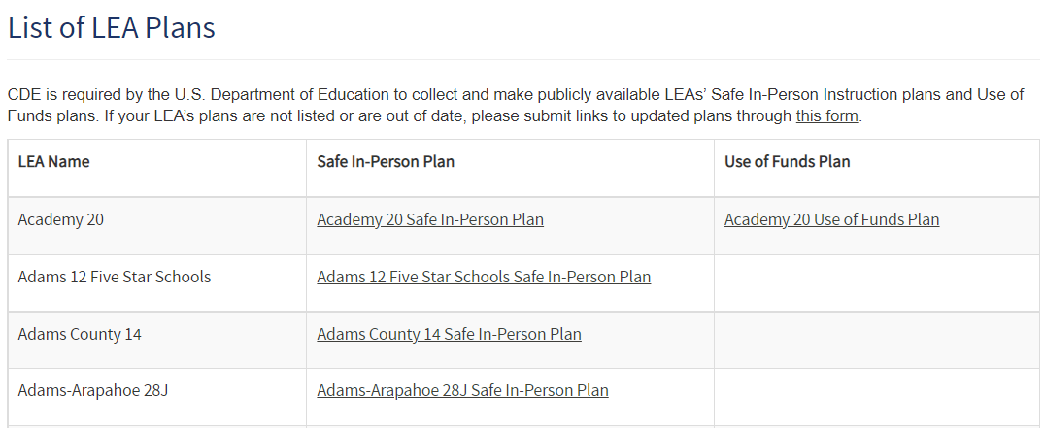
LEA Use of Funds Plans Website List
ESSER III requires that LEAs post two plans on their website:
Safe In-Person Instruction plan
Use of Funds plan.
CDE is required by the U.S. Department of Education to collect and make these plans publicly available.
The plans that we have received from LEAs are listed here.
If your LEA’s plans are not listed or are out of date, please submit the links through this form.
Resources to help you meet these requirements:
Office Hours recording and slides from Nov. 11 presentation on Use of Funds plan website requirements
ESSER III requirements page on the CDE website.
Use of Funds Plan Guidance
Safe Return to School Checklist

Slide 9
Upcoming Training
February Virtual Regional Networking Meeting
9:00-10:00- Consolidating Funds Schoolwide
This training will discuss how to consolidate ESEA funds schoolwide, how they can support LEA efforts, and how to meet requirements after selecting this flexibility. 10:00-10:45- Title III
This training will discuss the definitions and allowable activities under core instruction vs intervention vs supplemental instruction within Title III. 11:00-12:00- Monitoring
This training will provide an overview of current monitoring processes for both ESEA and ESSER monitoring.
Date: Februrary 15, 2022 Time: 9am- 12pm
Register Here
Register for all sessions with the same link. Attend by joining the Zoom room at the designated times for each session.
Contact Wilson_S@cde.state.co.us or your Regional Contact with any questions.

Slide 10
New COVID-19 Testing Resources
The White House announced new COVID-19 Testing resources on Jan. 12:
Providing additional Point-of-Care tests to schools to be distributed through CDPHE
Providing additional capacity for lab-based testing. Schools can register to participate in this free testing through the Midwest Coordination Center
New guidance to support testing in schools
School COVID 19 Testing Partners List
CDC COVID-19 Testing Toolkit
Rockefeller Foundation one-pager on starting school testing centers

Slide 11
Update: School-Based COVID-19 Testing Program

Slide 12
Office Hours Evaluation Results and Response and Changes

Slide 13
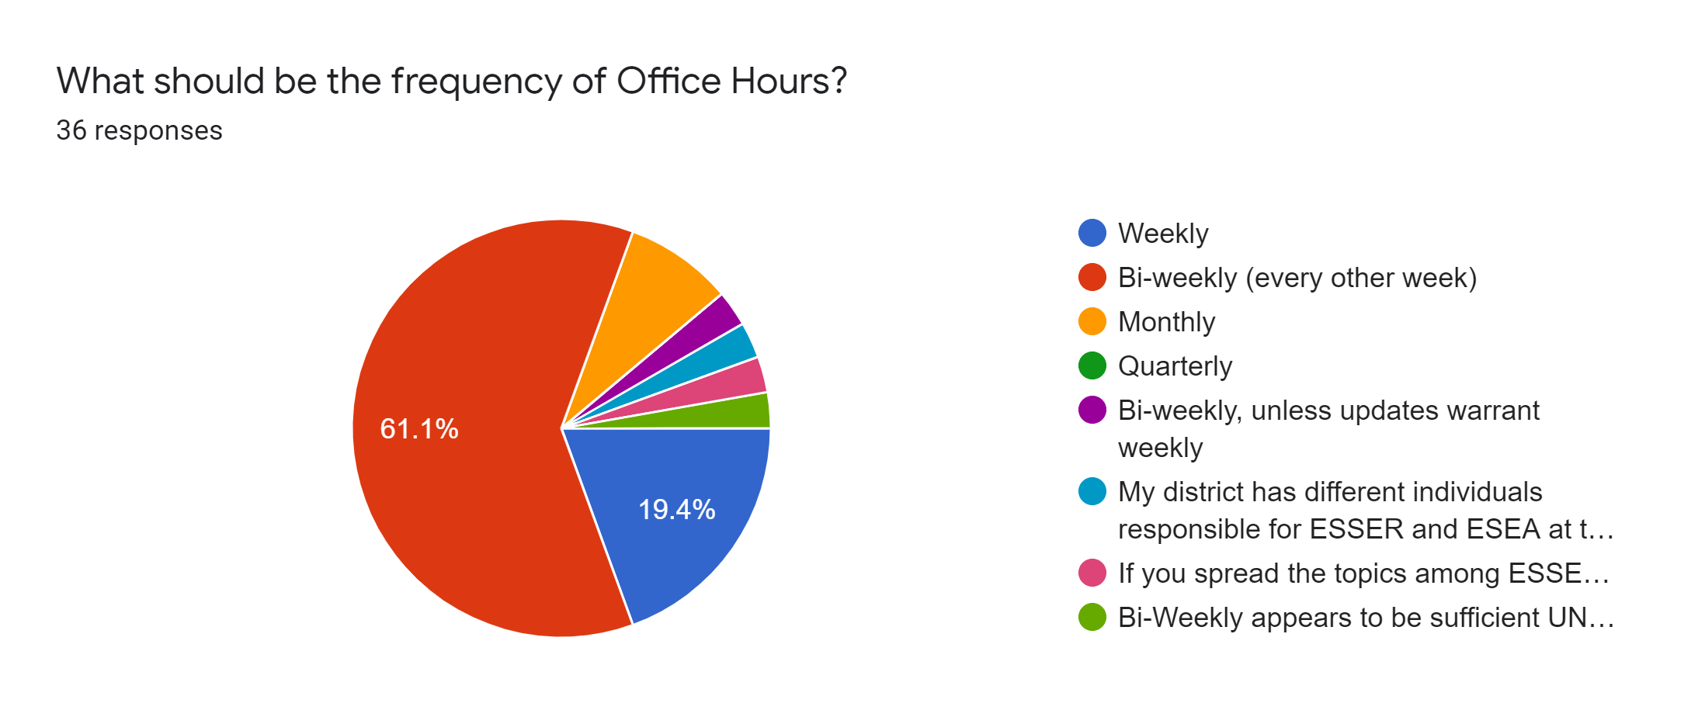
Feedback Received and Response/Changes - Frequency
We will change to bi-weekly office hours!

Slide 14
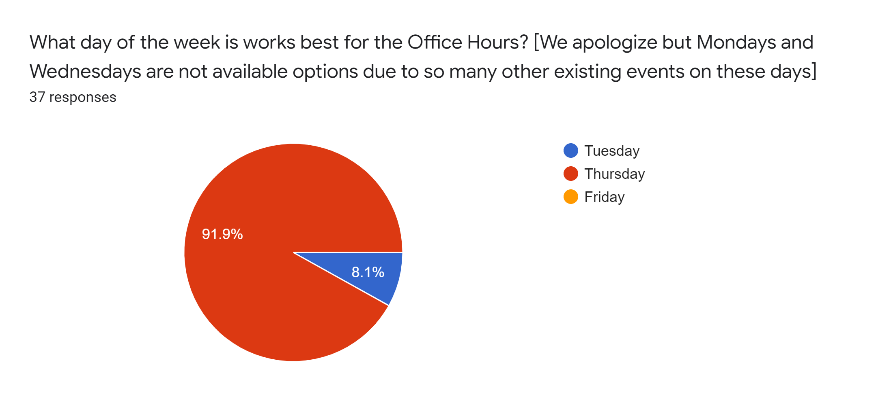
Feedback Received and Response/Changes – Day of the Week
We will keep Office Hours on Thursdays!

Slide 15
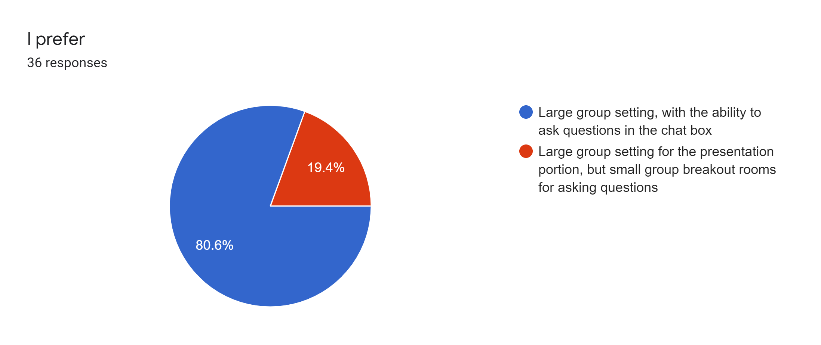
Feedback Received and Response/Changes – Structure
We will keep the large group setting, with occasional breakout as needed!

Slide 16
Feedback Received and Response/Changes – Topics and Suggestions
Upcoming grant opportunities - Competitive Grants and Awards will provide a training upcoming grant opportunities, with an option to do quarterly updates, if that would be helpful
Summary of previous office hours, including Q&As and/or ways to search previous presentations – a team will be working on how to structure the website to make it more user friendly and searchable for previously covered topics
Incorporate information about ESEA (e.g., ideas for uses of funds, deadlines, Cons App updates) – presentation and introduction to “New Directors” website, year-at-a-glance document, and more frequent topics on ESEA in upcoming office hours
There are other opportunities to keep up with ESEA information as well
Regional Networking Meetings, which are workshop trainings to provide deeper content pertaining to ESEA applications for funds, requirements, and monitoring – we will announce those in Office Hours
Beeline – if you do not currently receive our monthly newsletter and would like to be added to the listserv, please email Michelle Prael
CDE Update to Superintendents – we include overviews and upcoming events in the monthly newsletter to superintendents – if you are a superintendent but don’t receive those, please contact the CDE communications office
Federal regulations on equipment tracking, disposal, etc. – training scheduled for March 3
How to be monitoring-ready for both ESEA and ESSER – BruMan training on February 17, plus other upcoming office hours devoted to documenting and preparing for CDE/USDE monitoring
Data reporting under ESSER and ESEA – will incorporate into future office hours, but need more information about what would be helpful for you to hear
Submitting questions ahead of time – email Nazie or Emily Owen

Slide 17
Upcoming Meetings

Slide 18
Any Requests for Upcoming Topics or Questions!
Upcoming Office Hours:
February 3:
ARP-HCY
Website
Contacts: Dana Scott (scott_d@cde.state.co.us) or Paula Gumina (Gumina_p@cde.state.co.us)
Resources for Afghan Evacuees
February 10: No Office Hours
February 17: BruMan Training
Preparing for monitoring on allocability and salary documentation
March 3:
Tracking and Management of Federally-funded Equipment

Slide 19
CDE Team!
CDE Contacts!
Emails: LastName_FirstInital@cde.state.co.us
ESSER/ESEA Program Partners
Nazie Mohajeri-Nelson, Director of ESEA Office (mohajeri-nelson_n@cde.state.co.us)
DeLilah Collins, Assistant Director of ESEA Office (collins_d@cde.state.co.us)
ESEA Regional Contacts assigned by district
Title I: Laura Meushaw, Kathryn Wisner, Niko Kaloudis
Title II: Niko Kaloudis
Title III: Kathryn Wisner
Title IV: Tammy Giessinger, Michelle Prael
Title V: Kristen Collins
ESSER Team
Kristin Crumley, ESSER Monitoring Specialist (Crumley_k@cde.state.co.us)
Jonathan Schelke, ESSER Monitoring Specialist (schelke_j@cde.state.co.us)
Shannon Wilson, ESSER/ESEA Grants Administration Coordinator (Wilson_s@cde.state.co.us)
Mackenzie Owens, ESSER Reporting Specialist (owens_m@cde.state.co.us)
Data, Accountability, Reporting, and Evaluation
Tina Negley, Alan Shimmin, Mary Shen, and Mackenzie Owens
Fiscal Partners
Jennifer Okes, Chief Operating Officer (okes_j@cde.state.co.us)
Kate Bartlett, Executive Director of School District Operations (Bartlett_k@cde.state.co.us)
Jennifer Austin, Director of Grants Fiscal Management (Austin_j@cde.state.co.us)
Robert Hawkins, Grants Fiscal Analyst (Hawkins_s@cde.state.co.us)
Steven Kaleda, Grants Fiscal Analyst (Kaleda_s@cde.state.co.us)
ESSER Team
Bill Parsley, ESSER Fiscal Monitoring Supervisor (parsley_b@cde.state.co.us)
Hilery Morris, ESSER Fiscal Monitoring (morris_h@cde.state.co.us)
Sharon Mackey, ESSER Fiscal Monitoring (mackey_s@cde.state.co.us)

