Slide 1
CDE ESEA and ESSER Office Hours
October 24, 2024

Slide 2
ESEA/ESSER Office Hours
Topics:
Reminders
School District Review Program
Consolidated Application Feedback

Slide 3
ESEA & ESSER Reminders and Updates

Slide 4
Reminders
Submit Cons App Revisions as soon as possible!
November 15, 2024 ~ Final Request for Funds are due for
FY 2022 ESEA Funds
ESSER III Funds - all grants
ESSER III closeout forms ~ deadline extended to December 1!
Continue to check Countdown to Close-out website until you have:
Fully drawn down all ESSER funds AND
Submitted all data reports AND
Submitted Close-out Report AND
Finalized all monitoring activities and have received both a program and fiscal monitoring report AND
Have submitted a Real Property Report for any construction projects funded with ESSER funds (if applicable) - Coming Soon!

Slide 5
Updates
Numerous LEAs and grantees with large remaining ESSER III unrequested balances!
Next week, CDE representatives will be doing outreach to ensure that:
Funds are obligated!
No other accounting adjustments or PARs are needed!
Funds have been or will be requested by November 15, 2024!
Any other outstanding matters where CDE can support or answer questions!
Program and fiscal monitoring reports are being finalized and will be coming soon!

Slide 6
U.S. Census Bureau Annual
School District Review Program
Notes:
Tina

Slide 7
Purpose
The School District Review Program (SDRP) enables state officials to review the Census Bureau’s school district information and update Local Educational Agency (LEA) ID numbers, boundaries, names, levels, and grade ranges.
School district boundary data are used to estimate the number of school-aged children, ages 5 through 17, in families experiencing poverty for each financially responsible school district.
The SDRP considers a school district financially responsible when they pay for the education of the students that reside within their boundaries.
These poverty estimates serve as the basis of Title I eligibility and are used to determine the distribution of Title I funding.

Slide 8
SDRP Phases
Two phases of the SDRP:
Annotation Phase - State officials review and update the Census Bureau’s school district boundaries and information for their state. Available until December 2024.
Verification Phase - State officials review the Census Bureau’s latest school district information to verify the accuracy and completeness of their Annotation Phase submission. Officials have one week to complete the verification starting in April 2025.
Preliminary poverty estimates, based on these updates, are released in December 2025.

Slide 9
School District Boundaries
CDE is inviting districts to assist in the boundary review. Districts are encouraged to view their district boundaries online, using the TIGERweb application to determine if they accurately reflect school district boundaries.
TIGERweb (https://tigerweb.geo.census.gov/tigerweb/) is the Census Bureau’s online application for viewing school district and legal boundaries.
Applies to school district boundaries effective on or before January 1, 2025.

Slide 10
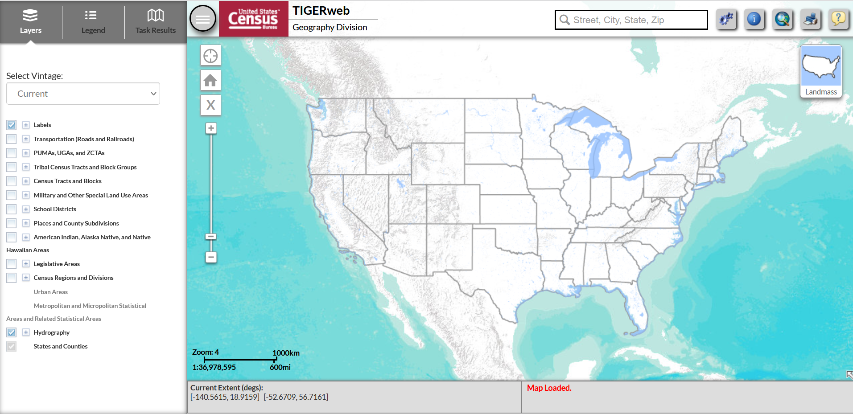
TIGERweb - Homescreen

Slide 11
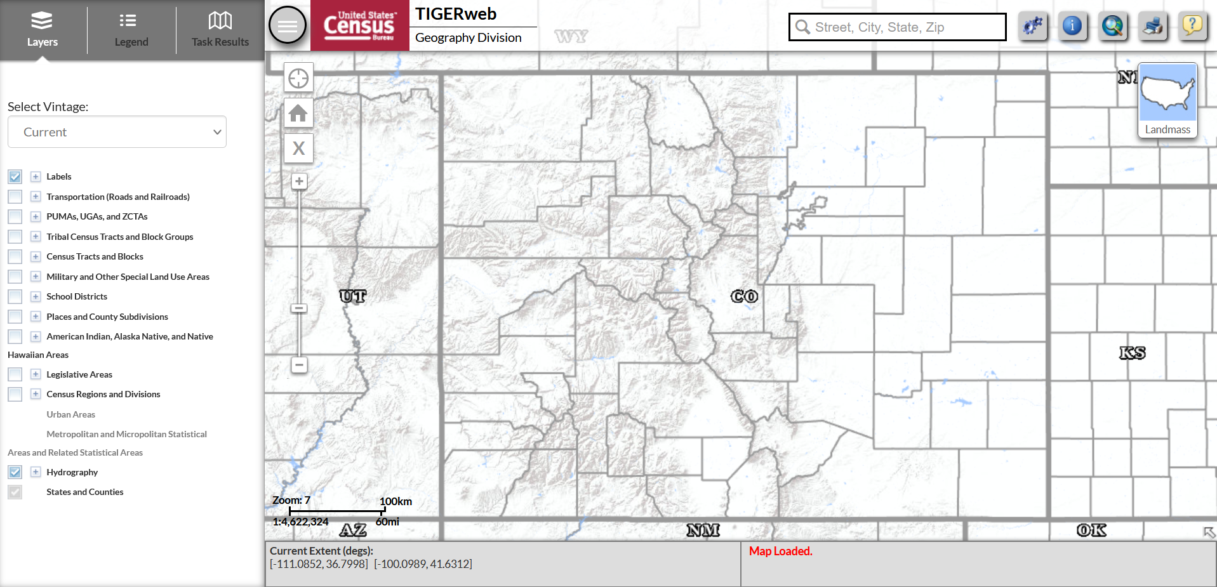
TIGERweb - Colorado

Slide 12
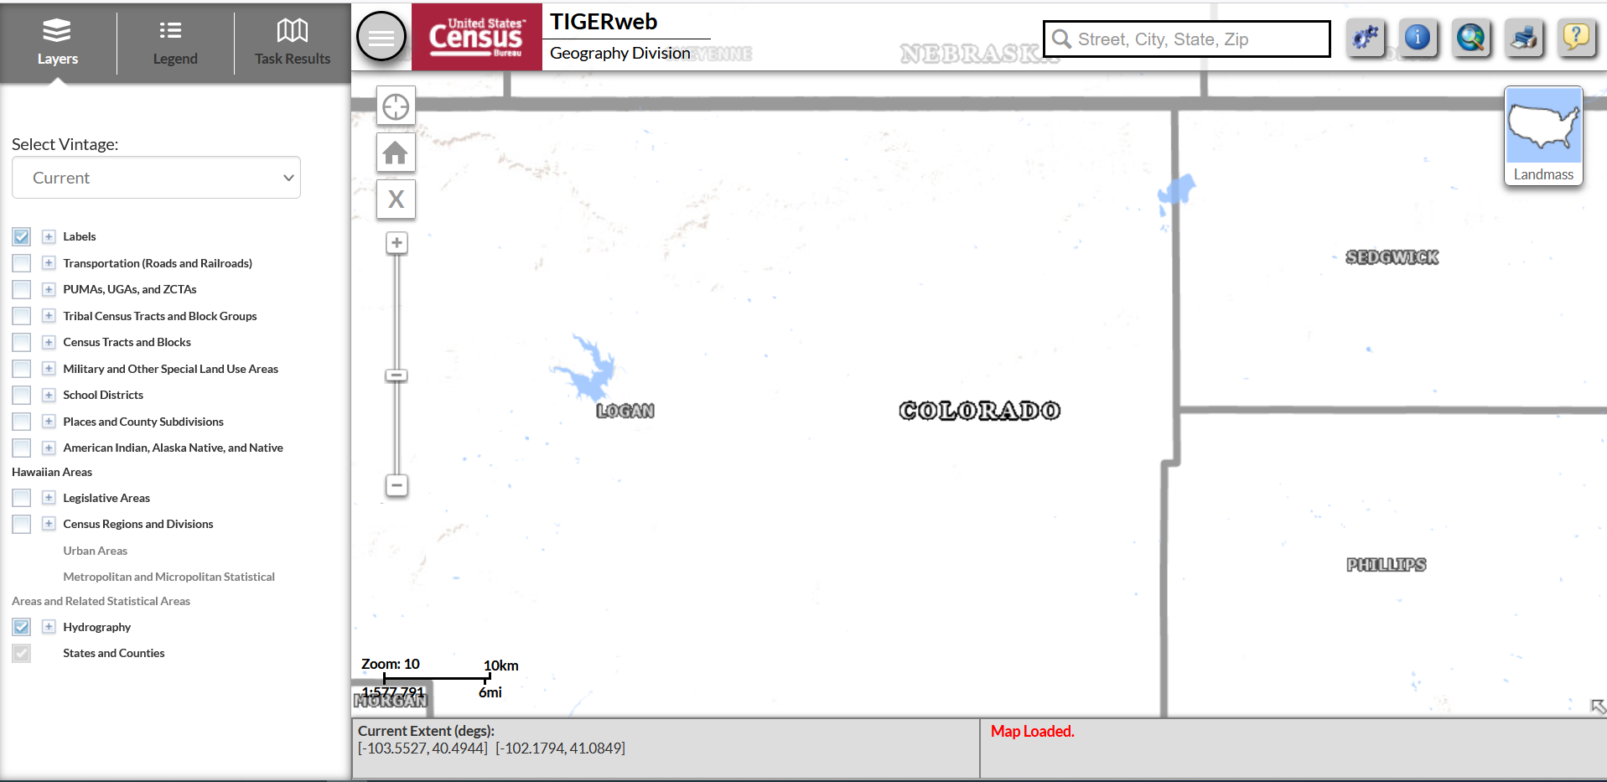
TIGERweb – Default Settings

Slide 13
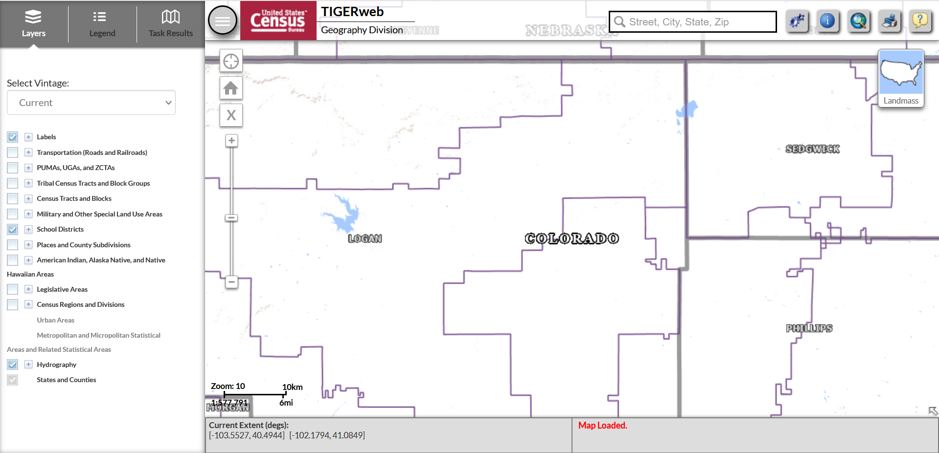
TIGERweb – District Boundaries

Slide 14
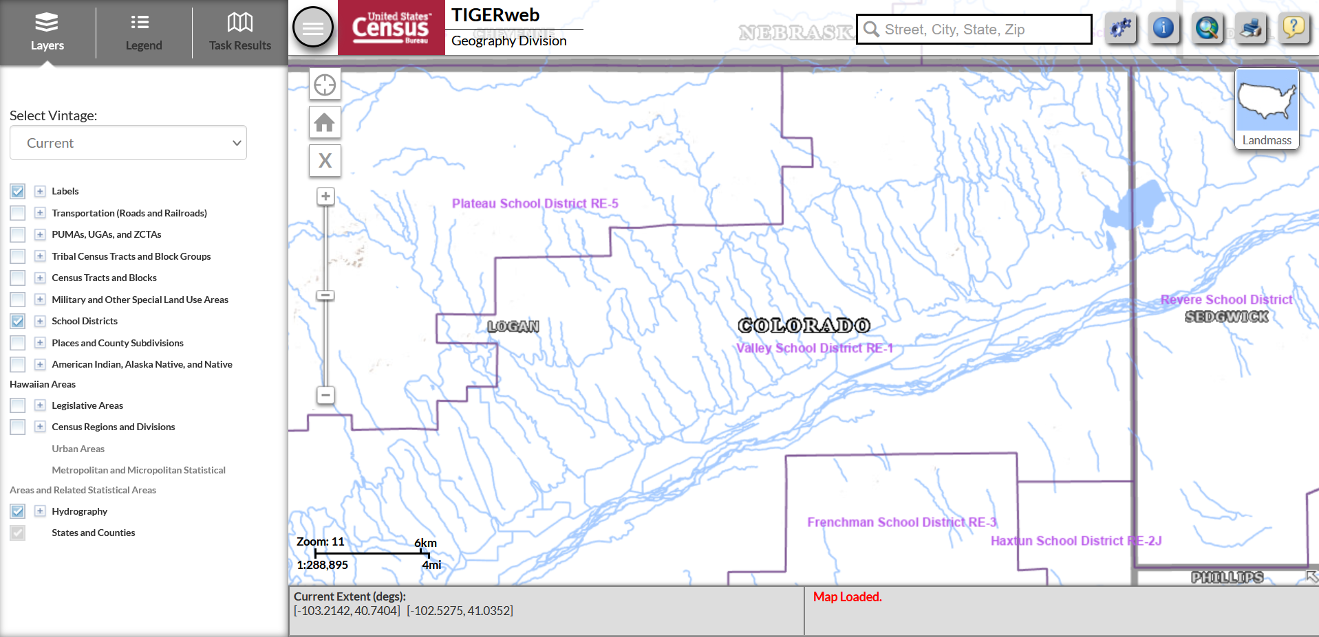
TIGERweb – Hydrography

Slide 15
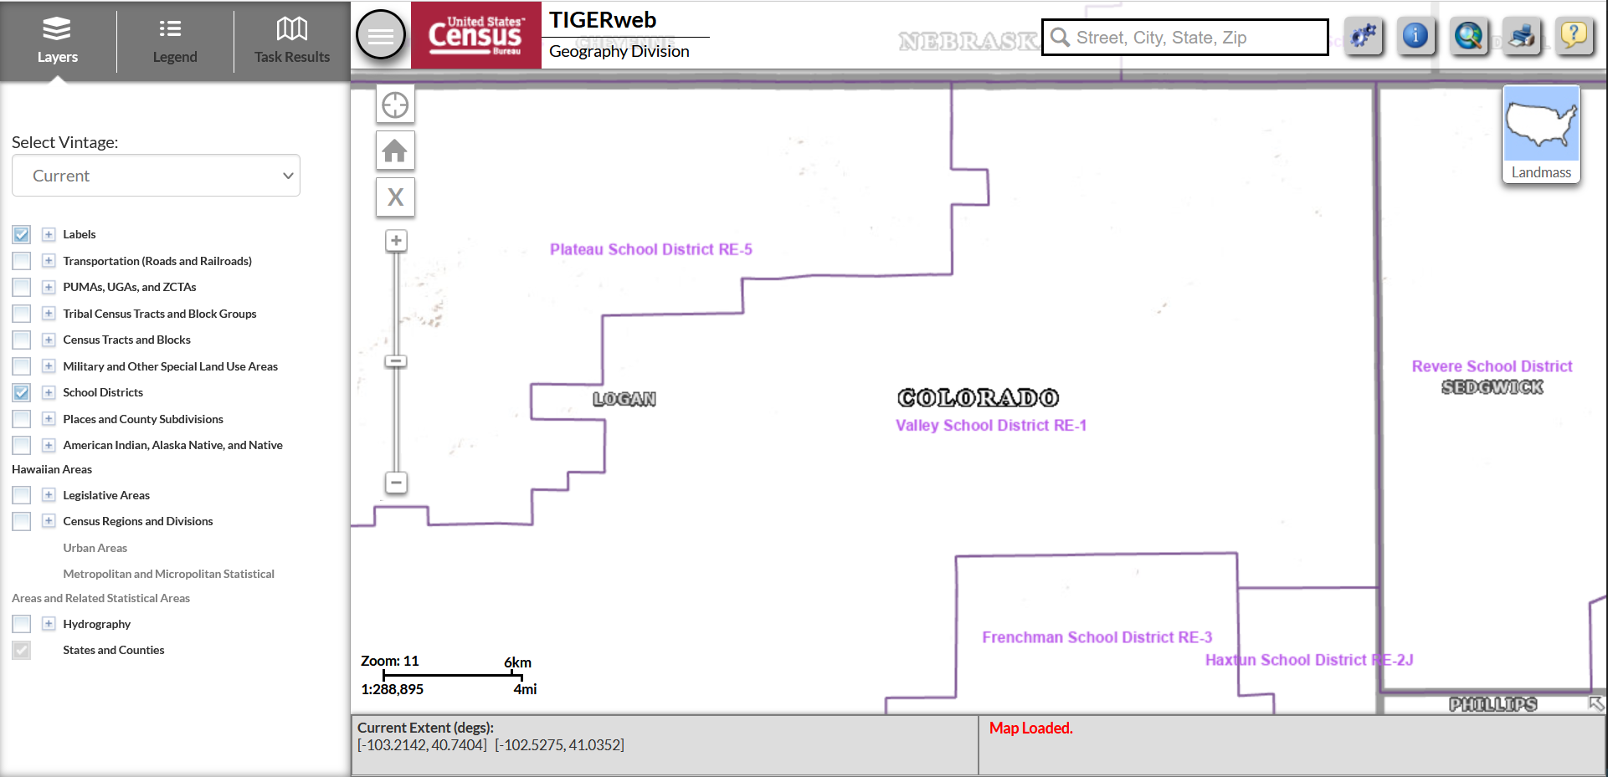
TIGERweb – Removing Features

Slide 16
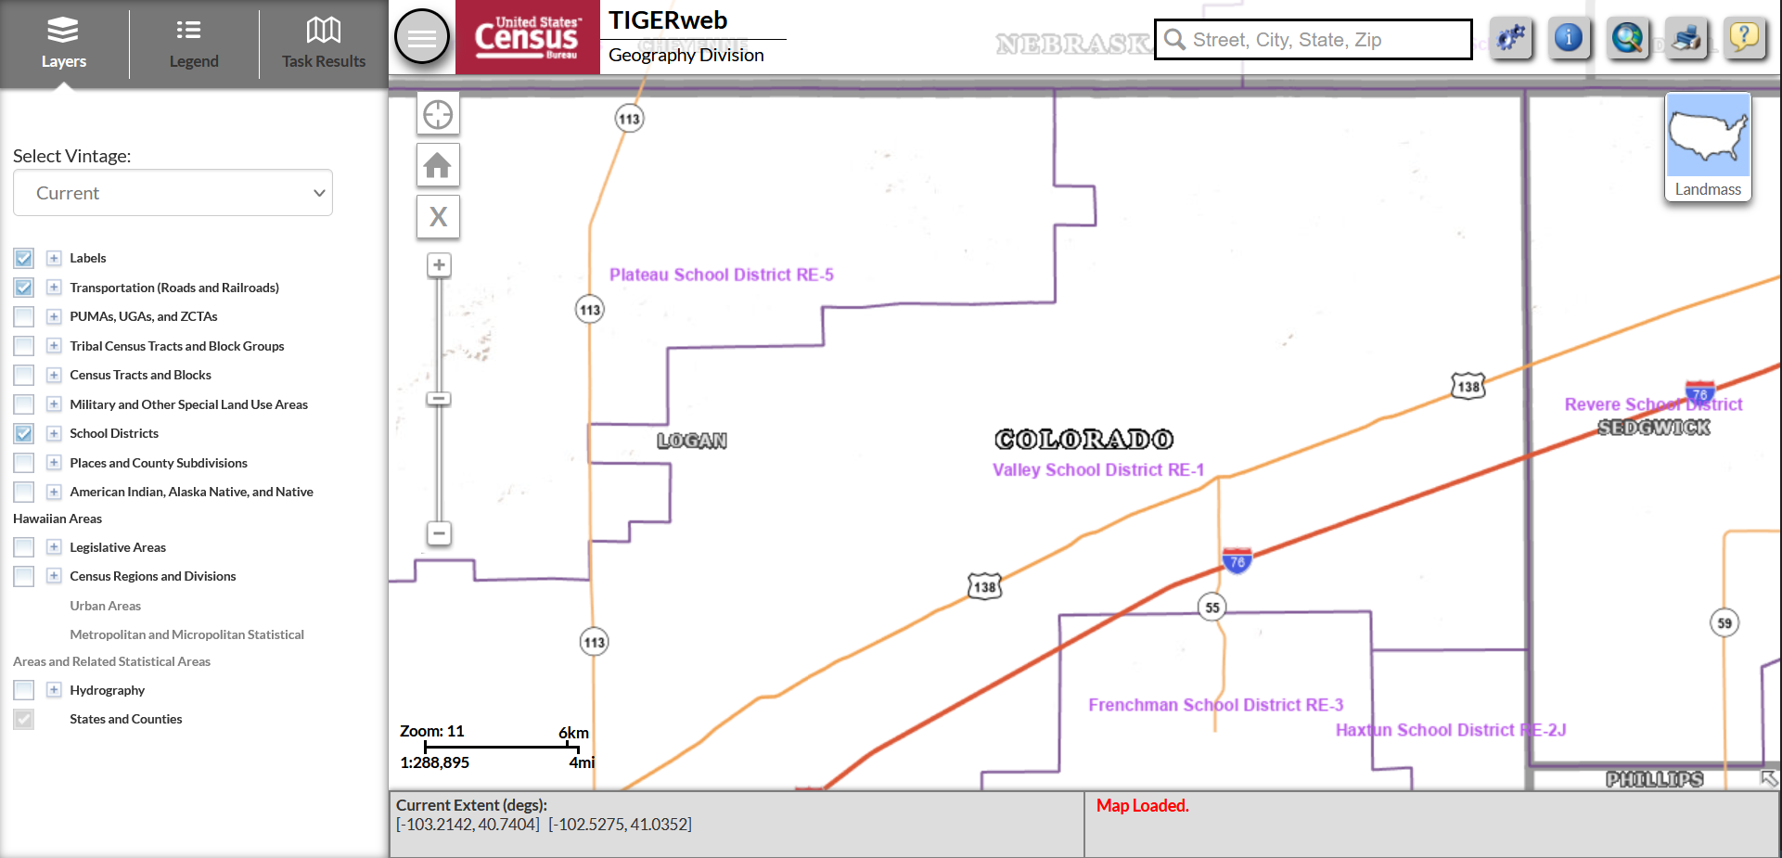
TIGERweb - Transportation

Slide 17
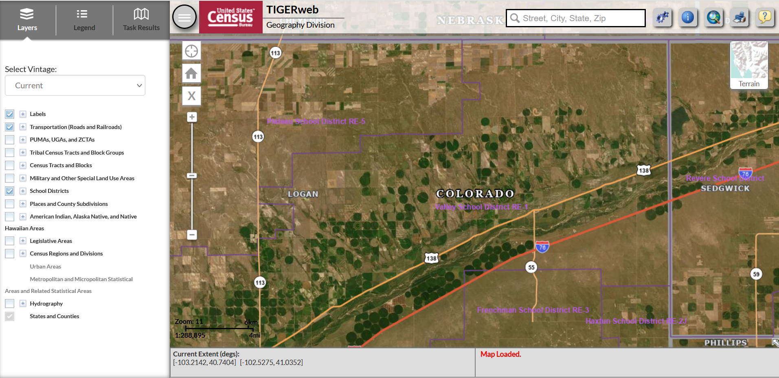
TIGERweb – Map Views

Slide 18
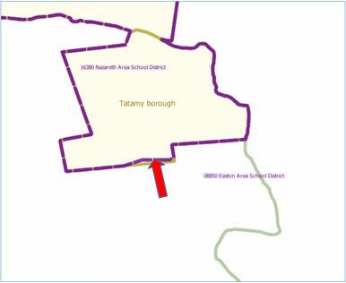
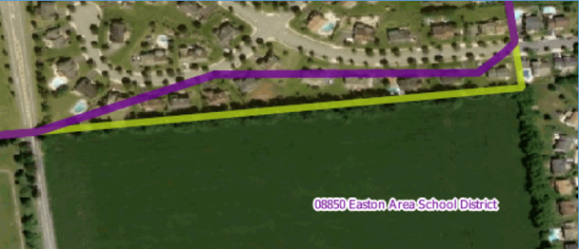
Correcting District Boundaries
To report an error in the district boundaries online, districts should take a screenshot of the current boundaries (using the TIGERweb system) and then annotate the updated boundary location on the same screenshot.
District should notify CDE as soon as possible to report any errors.

Slide 19
Submitting Boundary Changes
All requests to update school district boundaries should be submitted to Tina Negley (negley_t@cde.state.co.us).
Districts are encouraged to submit changes as soon as possible. All annotated screenshots must be submitted no later than December 1st to ensure the information is successfully uploaded in the Geographic Update Partnership Software (GUPS) by the December deadline.
Note that the Census Bureau generally does not accept boundary changes of less than 30 feet when the correction does not affect housing. In remote areas with sparse population, the Census Bureau considers a difference of 60-75 feet to not be significant if housing units are not present.

Slide 20
Contact Information
For all SDRP-related questions, please reach out to:
Tina Negley
negley_t@cde.state.co.us
720-766-2793

Slide 21
Cons App Feedback

Slide 22
Regional Networking: Cons App Feedback
Breakout rooms by region:
Room 1: North Central and Northeast Regions
Evita Byrd and Nathan Hickman
Room 2: Northwest and West Central Regions
Kim Boylan and Rachel Temple
Room 3: Pikes Peak Region
Nazie Mohajeri-Nelson and Sue Miller-Curley
Room 4: Southeast and Southwest Regions
Christina Adeboye Sullivan and Rachel Echsner
Room 5: Metro
Tammy Giessinger and other CDE Staff
Room 6: BOCES
Kristin Crumley and Laura Meushaw
Regional Contacts Webpage
Discussion: CDE would like your feedback on your experience with the 24-25 Cons App. In your experience, what should remain constant, change, or what considerations should be made pertaining to:
Application Process
Technical Assistance
GAINS System
Notes:
Rachel E

Slide 23
Cons App Feedback Note Catchers
North Central and Northeast Regions
Northwest and West Central Regions
Pikes Peak Region
Southeast and Southwest Regions
Metro
BOCES

Slide 24
Upcoming Meetings

Slide 25
Looking Ahead…
Any requests for topics or questions?
Upcoming Office Hours
November 14 ~ DATE CHANGE due to CoP Meeting
ESSER Reporting
November 21

Slide 26
CDE Contacts!
Emails: Lastname_Firstinitial@cde.state.co.us (e.g., Smith_a@cde.state.co.us)
Federal Programs & Supports (ESEA/ESSER Program Supports) | School Finance & Operations (Fiscal and Systems Supports)
Nazie Mohajeri-Nelson, Executive Director of Federal Programs & Supports Unit Program Specialists Program Implementation Supervisor: Laura Meushaw Program Implementation Coordinator: Christina Adeboye Sullivan Program Monitoring Supervisor: Tammy Giessinger ESEA/ESSER Monitoring Coordinator: Kristin Crumley Program Effectiveness Supervisor: Tina Negley Program Evaluation & Research Coordinator: Anna Rowan Strategic Recovery Office (ESSER State Reserve): Matt Koziol ESEA Programs Specialists and ESEA Regional Contacts (assigned by district) Title I: Laura Meushaw, Evita Byrd, Rachel Echsner, Kim Boylan Title II: Rachel Echsner, Sue Miller-Curley Title III: Rachel Temple, Kim Boylan Title IV & Stronger Connections Grant: Nathan Hickman, Evita Byrd Title V: Christina Adeboye-Sullivan, Rachel Echsner ESSER Program Specialists Kriselda Craven Nadine Penn ESEA and ESSER Data and Reporting Specialists Melissa Chaffin (ESEA) Jerry Ring (ESEA) Anna Rowan (ESEA) | Vacant, Executive Director of School District Operations Unit Fiscal Specialists Jennifer Austin, Director of Grants Fiscal Management ESEA Robert Hawkins, Grants Fiscal Analyst Steven Kaleda, Grants Fiscal Analyst ESSER Fiscal Specialist Steven Kaleda Grants Fiscal Analyst ESSER Monitoring Bill Parsley, ESSER Fiscal Monitoring Supervisor Hilery Morris, ESSER Fiscal Monitoring Kristina Jones, Federal Fiscal Monitoring and Reporting Specialist Werner Hagemann, ESSER Fiscal Monitoring Specialist Application Systems Specialists DeLilah Collins, Director of Grants Program Administration Online Applications Systems Technical Support Jessica Hollingshead Michelle Prael

