Slide 1
CDE Office Hours
September 28, 2023

Slide 2
ESSER Office Hours
Topics
Updates and Reminders
  Upcoming ESSER Deadlines
  Fall Regional Network Meetings
  Equity and Excellence Conference
Reporting Requirements
Stronger Connections Grant
Notes:
Nazie

Slide 3
Updates and Reminders

Slide 4
Deadlines Reminders
Important Dates
ESSA FY 2021-2022
  Performance Period: July 1, 2021 through September 30, 2023
  Funds must be spent by September 30th
  Reimbursement requests must be submitted as soon as possible (deadline 11/15/23)
ESSER II funds must be spent on or before September 30, 2023
  If obligated but cannot spend/draw down, can request a late liquidation
    See website for more information about late liquidations
  ESSER II Request for Funds are due by November 15, 2023
Resources
ESSER Launchpad page- includes deadlines and resources
Request for Funds webpage
ESSER Lead Reviewer list- CDE staff to contact with questions

Slide 5
Reminders on Federal Funds
ESEA FY22 and ESSER II funds are paid on a reimbursement basis.
  Obligate -> Spend -> Request Reimbursement
LEAs will need to complete and submit the Request for Funds Authorized Representative Designation form before requesting funds from CDE.
Program / Funding Stream | Obligation Due Date | Request for Funds Form
ESEA FY22 | September 30, 2023 | November 15, 2023
ESEA FY23 | September 30, 2024 | TBD
ESSER II | September 30, 2023 | November 15, 2023
ESSER III | September 30, 2024 | TBD

Slide 6
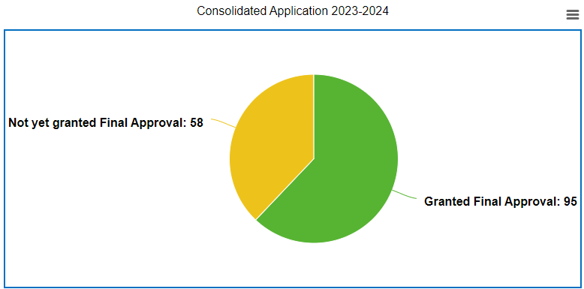
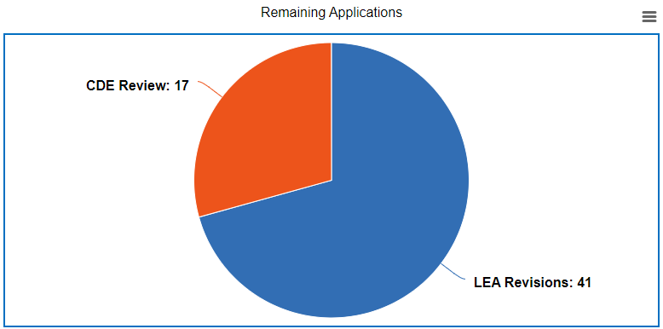
Consolidated Application Updates
Thank you for submitting your LEA’s 2023-24 Consolidated Application!
CDE’s goal for final approval for applications is 9/30/23. Please submit your revisions as soon as possible.
If you would like to check the status of your application or have any questions, please reach out to your Regional Contact(s).
Notes:
Rachel E/Laura
Megan Winicki confirmed data.

Slide 7

Fall Regional Network Meetings
FPSU will not be hosting our typical regional network meetings this fall. Instead we encourage you to connect with CDE through these opportunities:
GAINS Trainings with the Grants Program Administration Office
Equity and Excellence Conference
  Federal Programs Directors Panels
    Urban/large district panel
    Rural district and BOCES panel
Reach out to your Regional Contact to set up a call or meeting
Notes:
Rachel E.
There will be 2 panels of administrators that oversee federal grants at the E&E conference, one for smaller districts, and another for larger districts. They will share their insights and experience for not only completing the Consolidated Application, but for ensuring that stakeholder input is accessed and for funding the work needed to serve students, vs simply spending the money. For new and veteran Federal Program Administrators, it will be an important conversation.

Slide 8
Equity and Excellence Conference
Notes:
Evita

Slide 9




Basic Overview
The goal for this year’s Equity and Excellence Conference is for attendees from diverse professional backgrounds to learn and share ideas, strategies, and plans for how to improve best first instruction.
All Colorado educators and leaders are invited to attend, including but not limited to:
Core instructional and general education educators and leaders
Federal programs leaders
Special education leaders
English language development leaders
Leaders from BOCES, Administrative Units, and other local educational providers
November 1-2, 2023
NO REGISTRATION FEES
Hilton Denver Inverness
200 Inverness Drive West
Englewood, Colorado 80112
E&E Registration via Sched
E&E Webpage
Notes:
https://equityandexcellence.sched.com/
https://www.cde.state.co.us/equityandexcellence

Slide 10


Key Speakers and Breakout Session Presentations
Theme: Best First Instruction
Keynote Speakers
CONFERENCE TOPICS INCLUDE:
Using data-driven instruction and decision-making in Best First Instruction (BFI)
School culture/environments that enhance BFI
Aligned tiered supports/interventions with BFI
Family and community partnerships and engagement to support BFI
Mental, emotional, behavioral, and social health of students and educators to improve access to BFI
Talent management (educator recruitment, retention, support and development, etc.) to effectively implement BFI
DAY 1
DAY 2
Horacio Sanchez
President and CEO of Resiliency Inc.
Presenting: “Brain-Based Learning and Maximizing Student Achievement”
Robert Jackson
National/International Speaker
Presenting: “No More Excuses:
Engagement and Best First Instruction”
Breakout Information
(Explore and register for individual sessions online via Sched!)
56 total breakout sessions, 8 simultaneous sessions per breakout time
November 1 Breakout Times:
Session 1, 10:15-11:15
Session 2, 12:45-1:45
Session 3, 2:00-3:00
Session 4, 3:15-4:15
November 2 Breakout Times:
Session 1, 10:15-11:15
Session 2, 12:45-1:45
Session 3, 2:00-3:00

Slide 11
Reporting Requirements
Notes:
Tina/Mackenzie

Slide 12
ESSER Reporting
Notes:
Mackenzie

Slide 13
ESSER Funded Activities
The USDE has provided updated guidance for the following methods for the LEA Participation in ESSER Activities Survey:
• Evidence-based summer learning or summer enrichment programs
• Evidence-based afterschool programs
• Extended Instructional Time (including extended school day or school week or school year)
• Evidence-based high-dosage tutoring
You should report participation information for ESSER-funded activities, whether fully or partially funded with ESSER funds, that occurred within the reporting period, regardless of when ESSER expenditures associated with the activity took place.
If an activity spanned multiple reporting periods, you should report the participation for that activity in each reporting period during which the activity occurred. If the SEA or local educational agency administered multiple activities that qualify as the same type of Method/Intervention, students should be counted for each activity in which they were eligible and also counted in each applicable Student Group category (e.g., students with disabilities, migratory students). As a result, students may be counted more than once, in different categories.

Slide 14
ESSER Funded Activities Continued
For “Early childhood education program expansion or enhancement,” you should respond ‘Yes’ to the questions about expansion and enhancement only if the expansion or enhancement occurred within the reporting period.
For “Full-service community schools,” you should report the number of new or additional full-service community schools that were launched or received additional services and/or support in the reporting period. Enrollment in full-service community schools should be taken from the most recent school year.
For “Purchasing educational technology,” participation information should be reported for ESSER-funded educational technology that was utilized by students during the reporting period, including ESSER-funded educational technology purchased in previous reporting periods that continued to be utilized in the current reporting period.
Notes:
If you respond ‘Yes’ to the expansion or enhancement question, information on “additional students or slots” funded by ESSER must be reported.
For example, in the Fiscal Year 2023 (Year 4) APR, you would report enrollment from school year 2022-2023.

Slide 15
Example Scenarios and Updated Guidance
The updated guidance and example reporting scenarios will be available on our website by 9/29/23.
All three FY 22-23 ESSER surveys are due September 30th, 2023.
LEA Participation in ESSER Activities Survey (submitted via Syncplicity).
  All LEAs, including AUs, BOCES, etc., must submit.
  Please reach out if you need assistance or an extension.
Reengaging Students Survey (Google form)
  All LEAs who received an ESSER 90% allocation (districts) must submit.
School-Level Allocation Survey (Google form)
  All LEAs who received an ESSER 90% allocation (districts) and allocated funds to schools in their ESSER applications during FY 22-23 must submit.
Notes:
Note: As this activity continued into the FY24 reporting period, the LEA should prepare to report information about this activity in their FY24 (Year 5) APR and include student group membership counts for the 20 students who participated in the program in FY24. Enrollment counts for activities that occur during the summer should be taken from the previous school year.

Slide 16
ESSA State and Local Reports
Notes:
Tina

Slide 17
Public Reporting Under ESSA
The Every Student Succeeds Act (ESSA) requires states and districts to annually prepare and disseminate reports to inform policymakers, community, families/parents, and other stakeholders of the performance of all students and each disaggregated group at each level
State, as a whole (SEA responsibility)
District, as a whole and compared to the State (LEA responsibility)
School, as a whole and compared to the District and State (LEA responsibility)

Slide 18
State Report Card
Each State Educational Agency (SEA) that accepts funds under ESSA, shall prepare and disseminate to the public an annual State report card that is concise, widely accessible in a language and format that parents can understand, and developed in consultation with parents. §1111(h)(1)

Slide 19
Required Student Groups
All students
Racial/ethnic groups
Gender
Disability status
English proficiency status
Free/reduced meal eligibility
Migrant status
Homeless status
Status as a child in foster care
Military-connected status

Slide 20
Required Data Elements
Description and results of accountability system under ESSA, including:
  Minimum number of students for use in accountability system.
  Long-term goals and measures of interim progress.
  Indicators and methodology used to identify schools for, and exit from, support and improvement.
  Schools identified for Comprehensive or Targeted Support and Improvement.
Student achievement (by proficiency level)
  English language arts (ELA), math, and science
Student academic growth
  English language arts (ELA) and math
High school graduation rates
  4-year and 7-year adjusted cohorts
English language proficiency

Slide 21
Required Data Elements, Cont.
Other indicator(s) of school quality or student success
  Chronic absenteeism rates (elementary and middle)
  Dropout rates (high)
Progress toward meeting long-term goals and interim targets
Assessment participation rates
Percentages of students taking an alternate assessment
Select elements from the Civil Rights Data Collection (CRDC)
  Measures of school quality, climate, and safety
  Student enrollment
Professional qualifications of educators
  Inexperienced
  Teaching with emergency/provisional credentials
  Not teaching in the subject/field for which they are certified/licensed
Per-pupil expenditures of Federal, State, and local funds

Slide 22
Required Data Elements, Cont.
Results on the National Assessment of Educational Progress (NAEP)
  Reading and math
  Grades 4 and 8
Rate at which graduates enrolled, for the first academic year, in programs of postsecondary education
Any additional information the State or LEA believes will best provide parents, students, and other members of the public with information regarding the progress of each school

Slide 23
LEA Report Cards
Each Local Educational Agency (LEA) that accepts funds under ESSA, shall prepare and disseminate to the public a local report card that is concise and widely accessible, in a language parents can understand. §1111(h)(2)
Must include the same data elements as the SEA Report Card.
Must compare LEA to the State.
Must compare all schools in the LEA to the LEA and State.
Should include other LEA-determined information that will best provide parents, students, and other members of the public with information regarding the progress of each school.

Slide 24
Resources
ESSA State Report will be posted on CDE website
  https://www.cde.state.co.us/fedprograms/statereportcard
  Updated by December 31th
To assist districts in meeting their ESSA LEA Report requirements, CDE will post State, LEA, and school level data on its website
  https://www.cde.state.co.us/fedprograms/introduction
  Districts may link to CDE’s website or develop their own Local Report
    If a district chooses to develop their own report, please provide a link to Melissa Chaffin (chaffin_m@cde.state.co.us) or Tina Negley (negley_t@cde.state.co.us)

Slide 25
Stronger Connections Grant (SCG)
Notes:
Tammy

Slide 26

Today’s Topics
Overview and Status Update
Review of SCG Eligibility
Application Walkthrough
Reporting Requirements
Post-Award Revision (PAR) Process

Slide 27
Overview
The Bipartisan Safer Communities Act (BSCA), authorized $1 billion for states to pursue safer communities and healthier outcomes for students through activities that are allowable under Title IV, Part A of the Elementary and Secondary Education Act (ESEA).
The Colorado Department of Education (CDE) received a total allocation of $9,356,572 for a three-year performance period, ending on September 30, 2025.
95% of funds ($8,888,743) will be awarded to “high-need” local education agencies (LEAs) through the Stronger Connections Grant process.

Slide 28
SCG Implementation Status
Total Funds to be Awarded | $8,888,743
Applications with Final Approval | $6,592,173.21
Applications that Need Final Approval | $398,000
Remaining Funds to Award | $1,898,570
A second round of the competitive grant is being offered to award the remaining funds.
Up to $150,000 per applicant will be awarded.

Slide 29
Current Awardees (Final Approval)
Adams County School District 14 | Adams-Arapahoe 28J - AXL Academy | Adams-Arapahoe 28J - Vega Collegiate Academy | Agate School District 300
Burlington School District RE-6J | Centennial School District R-1 | Center Consolidated School District 26JT | Colorado River BOCES
Colorado Springs School District 11 | CSI - Early College of Arvada | CSI - Kwiyagat Community Academy | Deer Trail School District 26J
Elizabeth School District | Ellicott School District 22 | Garfield County School District 16 | Harrison School District 2
La Veta School District RE-2 | Lake County School District R-1 | Las Animas RE-1 - Academy of Las Animas Online | Las Animas School District RE-1
Mancos School District RE-6 | Manitou Springs School District 14 | Mapleton School District 1 | Mesa County Valley School District 51
Montezuma-Cortez RE-1 - 0609 Battle Rock Charter | Montezuma-Cortez School District RE-1 | Mountain Valley School District RE-1 | North Park School District R-1
Poudre School District R-1 | Pueblo School District 60 | School District 27J | Stratton School District R-4
Weld County School District RE-3J | Weld County School District RE-8 | Yuma School District 1

Slide 30
SCG Eligibility
Notes:
Nathan

Slide 31
“High-Need” LEA
The definition of a “high-need” LEA in Colorado, developed by the Colorado Department of Education (CDE), in consultation with stakeholders and with public input, is based on three criteria:
the percentage of students eligible for Free and Reduced Lunch (FRL),
the student-to-mental health professional ratio, and
the rate of chronic absenteeism, for public school districts within the state.
A summary of the public comment received is available through the Stronger Connections Grant website.
Notes:
Link to summary of public comment: https://www.cde.state.co.us/fedprograms/scg_public_comment_summary-0

Slide 32
Eligibility Determination
“High-need” LEAs were determined based on a total composite score utilizing three metrics:
Poverty rate - calculated based on the percentage of K-12 students eligible for free/reduced meals (FRL), utilizing 2021-22 Student October Snapshot data.
Student-to-mental health professional ratio - calculated based on the total number of K-12 students (utilizing 2021-22 Student October Snapshot data) divided by the total FTE (full-time equivalent) of staff with a job classification code of 211 (counselor), 236 (psychologist), or 237 (social worker), as reported by LEAs in the 2021-22 Human Resources Snapshot.
Chronic absenteeism rate - calculated based on the percentage of students considered chronically absent (students who are absent for any reason [excused or unexcused] for 10% or more of the days enrolled during the school year), utilizing 2021-22 Attendance Snapshot data.

Slide 33
Eligibility Determination, continued
Metric | Quartile 1 (1 point) | Quartile 2 (2 points) | Quartile 3 (3 points) | Quartile 4 (4 points)
Poverty Rate | Less than 27.5% | 27.5% - 40.7% | 40.8% - 53.0% | Greater than 53.0%
Student to Mental Health Professional Ratio | Less than 176 students per 1 (FTE) staff | 176 - 233.5 students per 1 (FTE) staff | 233.6 - 375 students per 1 (FTE) staff | More than 375 students per 1 (FTE) staff or no mental health professionals
Chronic Absenteeism Rate | Less than 22.2% | 22.2% - 30.7% | 30.8% - 39.7% | Greater than 39.7%
LEAs with at least 10 total points are considered “high-need” LEAs and
are eligible to apply for the Stronger Connections Grant.
Notes:
For each metric, LEAs were categorized into quartiles representing four approximately equal groups. LEAs with the lowest rates/ratios were assigned to Quartile 1, while LEAs with the highest rates/ratios were assigned to Quartile 4. The table shows the ranges associated with each quartile. Points were assigned to each criteria using the ranges in the table below, and a total composite score was calculated for each LEA, including the Charter School Institute, the Colorado School for the Deaf and the Blind, and any BOCES that serve their own schools.

Slide 34
“High-Need” LEAs
High-Need LEAs Awarded Funds
Adams County 14 | Las Animas RE-1
Agate 300 | Mancos Re-6
Burlington RE-6J | Montezuma-Cortez RE-1
0640 Centennial R-1 | North Park R-1
Colorado Springs 11 | Pueblo City 60
Ellicott 22 | Weld Re-8 Schools
Garfield 16 | Yuma 1
High-Need LEAs Eligible to Apply
Aguilar Reorganized 6 | Holly RE-3 | Rocky Ford R-2
Cotopaxi RE-3 | Huerfano Re-1 | Springfield RE-4
Dolores County RE No.2 | Lamar Re-2 | Trinidad 1
East Otero R-1 | North Conejos RE-1J | West End RE-2
Granada RE-1 | Norwood R-2J | Westminster Public Schools
Greeley 6 | Pritchett RE-3
Notes:
LEAs that meet CDE’s definition of a “high-need” LEA are automatically eligible to apply for this opportunity. The LEA must meaningfully engage all school leaders, including charter and non-public school leaders, in determining their plans for using SCG funding. A BOCES may submit an application on behalf of one or several automatically eligible LEAs.

Slide 35

Alternative Eligibility Option
LEAs that are not automatically eligible to apply based on CDE’s definition will have the option to submit an application using their own data to demonstrate an identified need.
All applications submitted under this category must include a data summary that clearly demonstrates an identified need aligned with the grant’s intent to address the health and safety of students and explains the urgency of the identified need.

Slide 36
Charter School Eligibility
U. S. Department of Education
A charter school that is an LEA, as defined in section 8101(30) of the ESEA, may receive a Stronger Connections subgrant like any other LEA. A charter school that is not an LEA may not receive a subgrant, but it may receive support under Stronger Connections through the LEA of which it is a part… LEAs should consult with charter schools that are part of their LEA when developing their application.
Colorado
LEAs may submit an application that includes their charter schools or may opt to submit a separate application jointly with their charter school(s) if the needs of the charter school(s) do not align with the identified needs of the LEA or the non-charter schools. Pursuant to C.R.S. 22-30.5-104 (11), a charter school may choose to apply apart from their authorizer for a competitive grant program created by a federal or state statute or program. However, the charter school’s authorizer must be the fiscal agent, if funded. If a charter school intends to apply for a grant that the school’s authorizing school district is also intending to apply for, the charter school shall seek to collaborate with the school district in the application and to submit the application jointly. An LEA may submit a separate application on behalf of the charter school only.

Slide 37
Application Walkthrough
Notes:
Tammy

Slide 38
Application Sections
Part I: Applicant Information
Part II: Eligibility
Part III: Equitable Services
Part IV: Program Assurances Form
Part V: Application Narrative [cannot exceed 10 pages]
  Section A: Demonstration of Need
  Section B: Stakeholder Engagement
  Section C: Program Goals, Evaluation, and Timeline
  Section D: Budget
  Section E: Evaluation and Sustainability Plan
Part VI: Budget Workbook (submit in Excel format in original CDE template)
Attachment B: Financial Management Risk Assessment
All applications materials are posted on the Stronger Connections Grant website.
Notes:
Insert the following links in the chat:
RFA:
Planning Template:

Slide 39

Allowable Uses of Funds
Funds shall be used for activities that are reasonable, necessary, and allowable under section 4108 of the ESEA to provide students with safer and healthier learning environments. Examples include, but are not limited to:
Drug and violence prevention activities that are evidence-based
School-based mental health services
Comprehensive health education programs
Integrating health and safety practices into school or athletic programs
Nutritional education and physical education activities
Implementation of schoolwide positive behavioral interventions and supports
Bullying and harassment prevention
Activities that improve instructional practices for developing relationship-building skills
Prevention of teen and dating violence, stalking, domestic abuse, and sexual violence and harassment
Mentoring and school counseling
Establishing or improving school dropout and reentry programs
Suicide prevention
Crisis management and conflict resolution techniques
School-based violence prevention strategies
Reducing exclusionary disciplinary practices
Establishing partnerships within the community to provide resources and support for schools
Strengthening relationships between schools and communities
High-quality training for school personnel in effective practices related to any of the above

Slide 40

Prohibited Uses of Funds
The Bipartisan Safer Communities Act (BSCA) and the Elementary and Secondary Education Act (ESEA) prohibit the use of these funds for:
Food
School construction
Providing any person with a dangerous weapon or training in the use of a dangerous weapon.*
*A “dangerous weapon” as defined in section 930(g)(2) of title 18 of the United States Code is a weapon, device, instrument, material, or substance, animate or inanimate, that is used for, or is readily capable of, causing death or serious bodily injury, except that such term does not include a pocket knife with a blade of less than 2 1/2 inches in length.

Slide 41
GEPA
Section 427 of the United States Department of Education's General Education Provisions Act (GEPA) requires each applicant for funds to include in its application a description of the steps the applicant proposes to take to ensure equitable access to, and participation in, its federally assisted program for students, teachers, and other program beneficiaries with special needs.
GEPA highlights six types of barriers that can impede equitable access or participation: gender, race, national origin, color, disability, or age.
Based on local circumstances, applicants should determine whether these or other barriers might prevent students, teachers, families etc., from such access or participation in the federally funded project or activity within the Stronger Connections Grant application.

Slide 42
Equitable Services
An LEA applying for the Stronger Connections Grant must consult with appropriate non-public school officials before making any decisions that affect the opportunities of eligible non-public school children and educators to participate (ESEA section 8501(c)(3)).
The LEA must ensure that timely and meaningful consultation has occurred and maintain a record of the process used. In addition, the LEA must submit written affirmation of the consultation, signed by a representative of the LEA and each non-public school, to CDE (Attachment A).
If an LEA is successful in receiving an SCG award, it must ensure that expenditures for equitable services for eligible non-public school students and educators are equal on a per-pupil basis to the expenditures for participating public school students and educators. The LEA could also choose to base the equitable services on a specific need or group of students in alignment with the services being provided to public schools.
The LEA must continue to consult with interested non-public school officials on the specific services the LEA will provide to students and educators, consistent with the LEA’s approved application.

Slide 43
Evidence-Based Interventions (EBIs)
LEAs are strongly encouraged to invest Stronger Connections Grant funds on evidence-based interventions (EBIs) that have been shown to significantly improve student safety and health, as well as academic outcomes. Specifically, “evidence-based” means an activity, strategy, or intervention that demonstrates a statistically significant effect on improving student outcomes or other relevant outcomes. ESEA section 8101(21) defines the term “evidence-based” and the definition includes four tiers of evidence.
Tier 1: Strong Evidence | Supported by one or more well-designed and well-implemented randomized control experimental studies.
Tier 2: Moderate Evidence | Supported by one or more well-designed and well-implemented quasi-experimental studies.
Tier 3: Promising Evidence | Supported by one or more well-designed and well implemented correlational studies (with statistical controls for selection bias).
Tier 4: Demonstrates a Rationale | Practices that have a well-defined logic model or theory of action, are supported by research, and have some effort underway by an SEA, LEA, or outside research organization to determine their effectiveness.

Slide 44
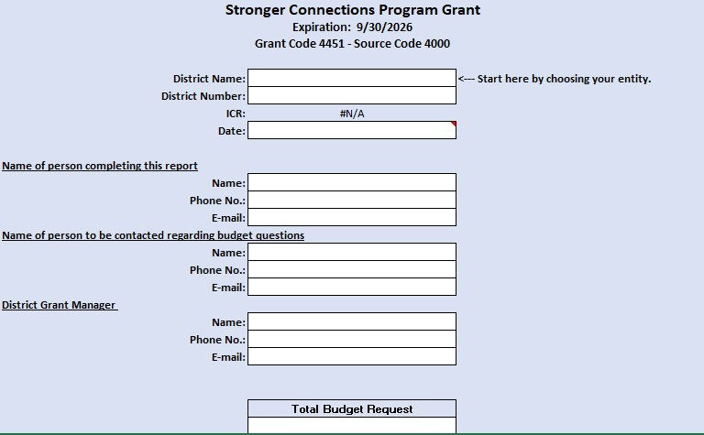
Budget Template, Cover Page

Slide 45
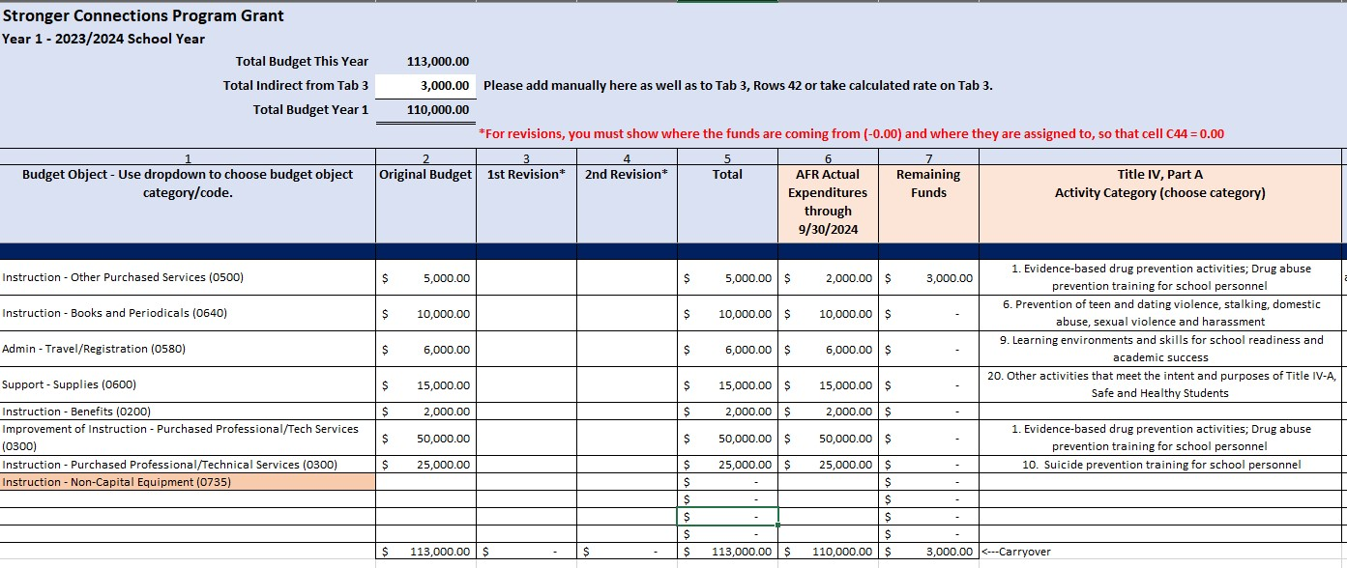
Budget Template, Year 1 & 2 Tab

Slide 46
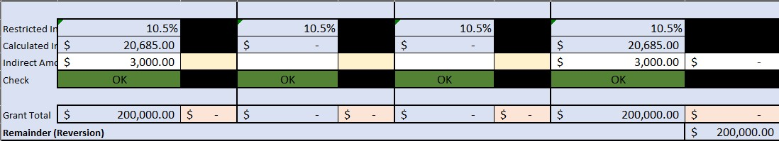
Budget Template, Summary Tab

Slide 47
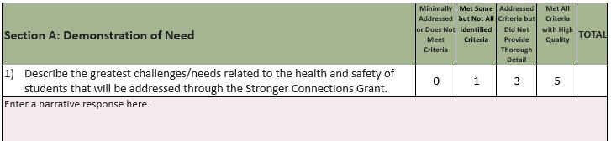
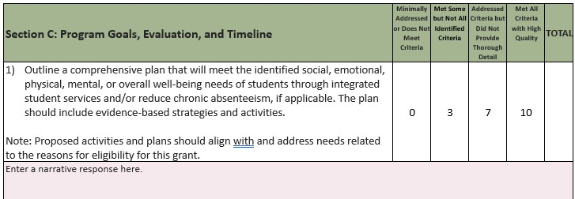
Scoring Criteria
Scoring Definitions
Minimally Addressed or Does Not Meet Criteria - information not provided
Met Some but Not All Identified Criteria - requires additional clarification
Addressed Criteria but Did Not Provide Thorough Detail - adequate response, but not thoroughly developed or high-quality response
Met All Criteria with High Quality - clear, concise, and well thought out response
Notes:
For the application to be recommended for funding, it must receive at least 70 points out of the 110 possible points and all required elements must be addressed. An application that scores below 70 points may be asked to submit revisions that would bring the application up to a fundable level. An application that receives a score of zero on any required elements will not be funded without revisions.
Consult with stakeholders
Incorporate elements of LEA’s Comprehensive Needs Assessment
Address all narrative questions

Slide 48

Application Submission and Review Timeline
All applications and supplemental materials will be submitted through the online application.
Application Opens | September 28, 2023 | LEAs can begin to collaborate with stakeholders, plan activities,and prepare the application.
Application Due | December 15, 2023 by 11:59 pm | Online applications must be submitted with all supplemental materials.
Grant Award Letters | March 2024 | Funds may be used for activities during the 2023-2024 (after final approval) and 2024-2025 school years.

Slide 49

Request for Reviewers
Commitment Timeline
Thursday, January 11, 2024: Readers receive review materials
Thursday, January 11, 2024 - Wednesday, January 31, 2024: Individual and Team Reviews
Thursday, February 1, 2024: Scores due to CDE by 9 am
*CDE staff will contact reviewers within the following week if any clarification is needed.

Slide 50
Reporting Requirements
Notes:
Nathan

Slide 51
Reporting Requirements
Reporting Requirements
Each grantee receiving funding through the Stronger Connections Grant Program is required to report, at a minimum, the following information on a timeline to be established by CDE to meet federal reporting requirements:
A description of and status of (e.g., completed, in progress) planned and implemented activities;
The number of students served or who benefited from funded activities in each year of the grant;
Professional development provided to support the program;
Any student outcomes (including, but not limited to, academic outcomes, student engagement outcomes, and school climate outcomes) identified through the implementation of funded activities;
Any teacher and/or school leader outcomes identified through the implementation of the funded activities; and
How program funds were used by the recipient and a summary of other resources used, if any, to implement SCG-funded activities.

Slide 52
Fiscal Requirements
Fiscal Requirements
The grantee shall expend funds in accordance with the approved application and budget.
Fiscal reporting requirements and deadlines will be forthcoming. CDE will contact LEAs via email/webinar as more details emerge.
Requests for Reimbursement must be submitted via the Formsite Application by the end of the first business day of the month. RFF/Formsite links can be found here: http://www.cde.state.co.us/cdefisgrant/requestforfundsforms.
The LEA must submit a reimbursement request at least quarterly.
Grants Fiscal can request additional backup documentation (i.e.: general ledgers/invoices/check stubs) to verify proof that expenditures were incurred throughout the life of the award.
Stronger Connections Grant funds must be tracked separately from other funds (including from ESEA Title IV, Part A).
All awards and expenditures are under regulation of: CFR Part 200, EDGAR as Applicable, and 2 CFR as Applicable.

Slide 53
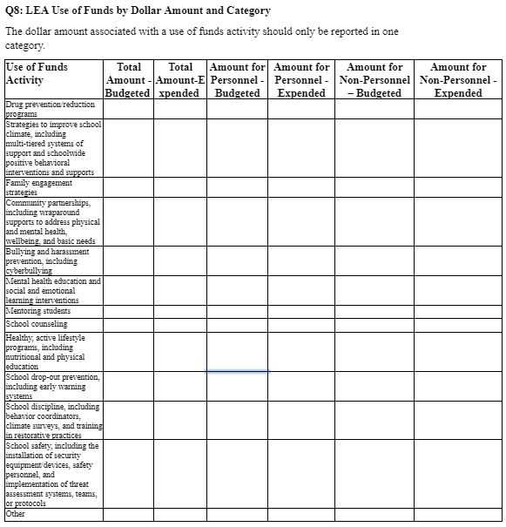
DRAFT Reporting to Department of Education
CDE is anticipating the need to report:
The number of LEAs using funds in each Activity Category.
The award amounts for each LEA.
The total amount budgeted and expended for each Activity Category.
The number of FTE budgeted and expended for each Activity Category.

Slide 54
Post-Award Revision Process
(PAR)
Notes:
Evita

Slide 55
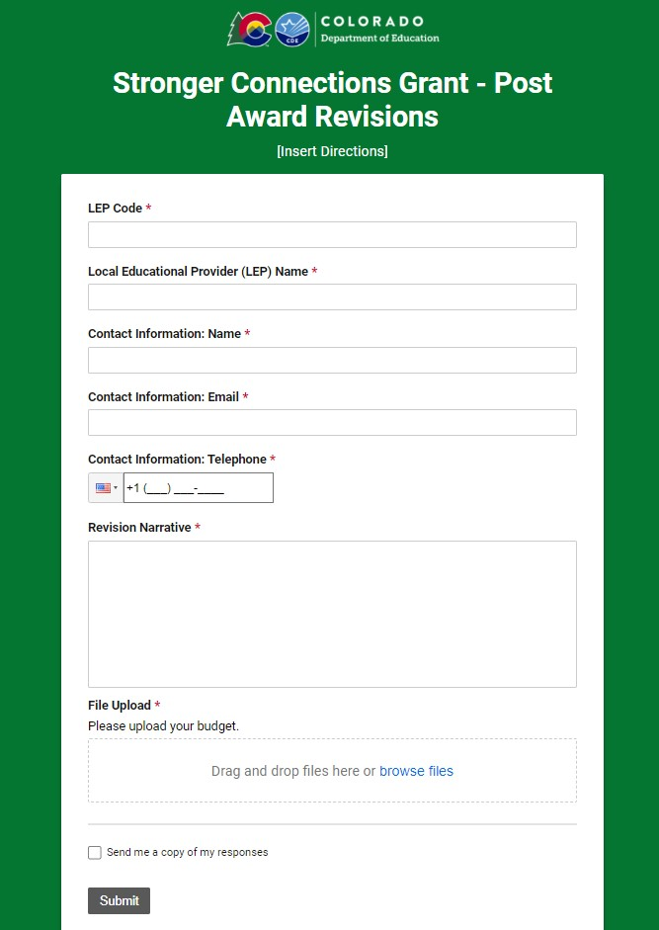
What to submit for a PAR
Submit PAR via Smartsheet
  Short narrative explanation of revisions
  Attach revised budget
Guidelines for the revised budget
  Make a copy of the approved budget template
  Indicate what has been changed by highlighting changes in yellow
  Update the name of the document to include the submission date (e.g., District Name Revised Budget 9.28.23)
  Remember: The revised budget cannot exceed the amount of the initial award.
LEA will be notified if the submission has been approved or if additional information is needed

Slide 56
When to submit a PAR
Follow general PAR guidelines, similar to the ESEA Consolidated Application
Change of scope
  Refer to initial submissions
  Example: PD activities to hiring an interventionist
Changes to direct cost programs that exceeds, or is expected to exceed, 10%
Changes to activity category
Changes to FTE

Slide 57


Contact Us
Please send questions regarding eligibility, uses of funds, or the application process to stronger_connections@cde.state.co.us.
If your LEA would like to apply for the funds but has concerns about your ability or capacity to submit the application, please reach out to Nathan Hickman at hickman_n@cde.state.co.us.

Slide 58
Upcoming Meetings

Slide 59

Looking Ahead…
Any requests for topics or questions?
Upcoming Office Hours:
  October 12
    PAR Submissions
  October 26

Slide 60
CDE Contacts!
Emails: Lastname_Firstinitial@cde.state.co.us (e.g., Smith_a@cde.state.co.us)
Federal Programs & Supports (ESEA/ESSER Program Supports) | School Finance & Operations (Fiscal and Systems Supports)
Nazie Mohajeri-Nelson, Executive Director of Federal Programs & Supports Unit Program Specialists Program Implementation Supervisor: Laura Meushaw Program Implementation Coordinator: Christina Adeboye Sullivan Program Monitoring Supervisor: Tammy Giessinger ESEA/ESSER Monitoring Coordinator: Kristin Crumley Program Effectiveness Supervisor: Tina Negley ESEA Programs Specialists and ESEA Regional Contacts (assigned by district) Title I: Laura Meushaw, Evita Byrd, Rachel Echsner Title II: Rachel Echsner Title III: Rachel Temple Title IV: Tammy Giessinger, Nathan Hickman, Evita Byrd Title V: Melissa Chaffin ESSER Program Specialists Jonathan Schelke Kim Boylan Kriselda Craven ESEA and ESSER Data and Reporting Specialists Tina Negley Mary Shen Mackenzie Owens Melissa Chaffin | Amy Carman, Executive Director of School District Operations Unit Fiscal Specialists Jennifer Austin, Director of Grants Fiscal Management ESEA Robert Hawkins, Grants Fiscal Analyst Steven Kaleda, Grants Fiscal Analyst ESSER Fiscal Specialist Steven Kaleda Grants Fiscal Analyst ESSER Monitoring Bill Parsley, ESSER Fiscal Monitoring Supervisor Hilery Morris, ESSER Fiscal Monitoring Kristina Jones, Federal Fiscal Monitoring and Reporting Specialist Werner Hagemann, ESSER Fiscal Monitoring Specialist Application Systems Specialists DeLilah Collins, Director of Grants Program Administration Online Applications Systems Technical Support Michelle Prael

