Slide 1
CDE ESEA and ESSER Office Hours
August 14, 2025

Slide 2
ESEA/ESSER Office Hours
Topics:
Updates and Reminders
  Elevating Excellence Conference
  Real Property Reporting
  Title IV Waivers
2025-26 Consolidated Application
  Due Dates and Timelines
  ESEA Launchpad Year at a Glance

Slide 3
Updates and Reminders

Slide 4
Updates
Elevating Excellence Conference
  Dates: September 17-18
  Location: Adams County Government Building
  Goal: Educational experts from diverse backgrounds to learn and share ideas, and plans for how to strengthen equitable systems
  Strands:
    Increasing student engagement
    Accelerating student outcomes
    Strengthening educator workforce
    Enhancing operational excellence
  Keynote speakers:
    Tara Brown - using positive connections - The Power of Your Leadership Footprint
    Dr. Joseph Johnson - lessons from high performing, high poverty schools across the nation
  Registration now open!
Notes:
Nazie

Slide 5
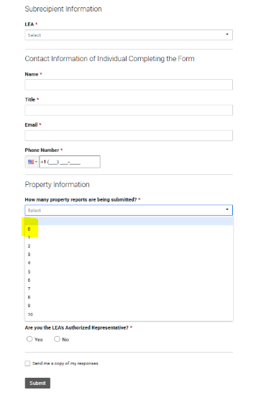
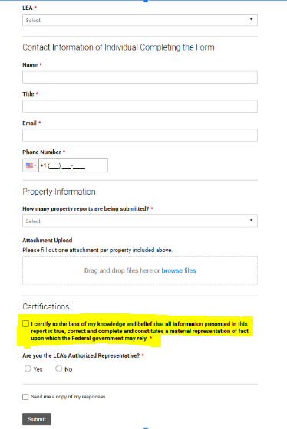
Real Property Reporting - Please complete the Smartsheet Submission Form - all ESSER recipients - Smartsheet Certification
Due Date
September 1, 2025
September 1 of each subsequent year if ESSER Real Property Reports are required for one or more parcel.
If reporting on 10 or more parcels, please complete and submit additional Smartsheets.
Notes:
Kim - If ESSER funds were used for real property improvements, regardless of dollar amount, please submit the ESSER Real Property Report/Certification Smartsheet, attaching the number of property reports per parcel. Please refer to the ESSER Grantee/Subgrantee reporting webpage for instructions and further information, including links to the April 10th Office Hours recording. if ESSER funds were not used for Real Property improvements, please submit the Smartsheet Certification, selecting “0” from the drop-down menu. Please remember to submit a separate certification for your Administrative Unit, if applicable.

Slide 6
ESSER Real Property Reporting and Certification Contacts
For questions about the Real Property Data Collection, please contact:
Kim Boylan
ESEA/ESSER Monitoring Specialist
boylan_k@cde.state.co.us
(720) 354-7031
Tammy Giessinger
Federal Programs Monitoring Supervisor
giessinger_t@cde.state.co.us
(720) 827-5291
For any ESSER-related questions or concerns, please contact:
Nazanin Mohajeri-Nelson, Ph.D.
Executive Director of Federal Programs and Support Unit
mohajeri-nelson_n@cde.state.co.us
(720) 626-3895

Slide 7
Title IV Waivers
Notes:
Rachel T

Slide 8
Types of Waivers
ESEA Waivers
Consolidated Application Waivers
Ed-Flex Waivers
Notes:
Rachel T

Slide 9
Ed-Flex and State Responsibilities
Educational Flexibility (Ed-Flex) allows States to waive certain requirements of Federal statute or regulations that may impede an LEA’s efforts to reform and improve education, without first having to submit those waivers to the U.S. Department of Education for review and approval.
Ed-Flex States are responsible for holding LEAs and schools, that are operating under a waiver, accountable for the performance of students affected by the waiver through annual monitoring and evaluation of performance toward educational goals outlined in the local waiver application (20 U.S.C. § 5891b(a)(4)(D)).
Notes:
Rachel T

Slide 10
Prohibited Ed-Flex Waivers
Requirements related to the following cannot be waived:
Parental participation and involvement
School improvement
Maintenance of effort
Comparability of services
Supplement, not supplant
State plans, standards, assessments, and accountability
Equitable services to non-public schools
Distribution of funds to States or LEAs
Health, safety, and civil rights
Individuals with Disabilities Education Act (IDEA)
Any requirements for Title III
Notes:
Rachel T

Slide 11
Current Waivers
Consolidated Application Waivers
Consolidated Application Extension Request (GAINS)
Title I, Part A District Level Activities Waiver
Title I, Part A Schoolwide Waiver
Ed-Flex Waivers
Title I, Part A 15% Carryover Waiver
NEW Title IV, Part A Apportionment Waiver
NEW Title IV, Part A Effective Use of Technology Infrastructure Maximum Waiver
CDE Waiver Website
Notes:
Rachel T

Slide 12
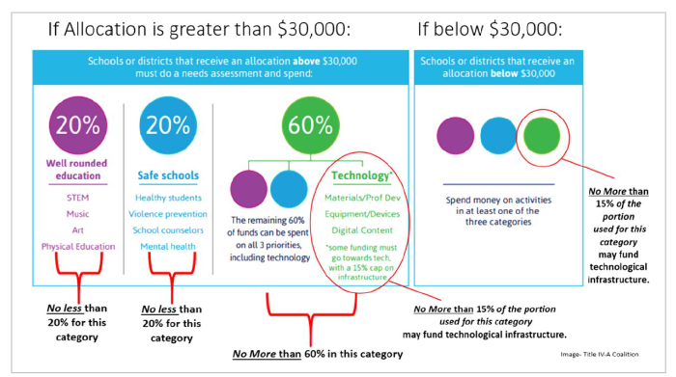
Title IV Apportionment Requirement

Slide 13
Ed-Flex Title IV, Part A Apportionment Waiver
Who: LEAs with a Title IV, Part A allocation of $30,000 or more
What: If an LEA’s budget does not meet the minimum apportionment requirements, then the LEA may apply to waive that requirement as long as the underlying purposes of the statutory requirements for Title IV, Part A are still met (i.e., purpose of Title IV and allowability of activities).
When:
Ideally, LEAs will consider waivers in the initial planning of the Title IV budget according to their needs assessment.
Waivers apply to one Federal fiscal year (July 1 to June 30) and are accepted on a rolling basis.
Where: Submit waivers via the online form.
Notes:
Example scenarios for when to use the waivers are in the March 13 Office Hours recording. https://www.cde.state.co.us/fedprograms/resourcesandtechnicalassistance

Slide 14
Title IV Effective Use of Technology 15% Infrastructure Maximum
LEAs shall use a portion of such funds to improve the use of technology to improve the academic achievement, academic growth, and digital literacy of all students, including by meeting the needs of such agency or consortium that are identified in the needs assessment. (ESEA section 4109(a)).
(b) SPECIAL RULE.—A local educational agency, or consortium of such agencies, shall not use more than 15 percent of funds for purchasing technology infrastructure as described in subsection (a)(2)(B), which shall include technology infrastructure purchased for the activities under subsection (a)(4)(A).
To clarify, LEAs or consortiums of LEAs may not spend more than 15 percent of funding in this content area on devices, equipment, software applications, platforms, digital instructional resources and/or other one-time IT purchases. (ESEA section 4109(b)).

Slide 15
Ed-Flex Title IV, Part A Effective Use of Technology
Infrastructure Maximum Waiver
Who: LEAs with any Title IV, Part A allocation amount
What: If an LEA budgets or submits a request for reimbursement that exceeds the 15% maximum on infrastructure, then the LEA may apply to waive that requirement as long as the underlying purposes of the statutory requirements for Title IV, Part A are still met (i.e., purpose of Title IV and allowability of activities).
When:
Ideally, LEAs will consider waivers in the initial planning of the Title IV budget according to their needs assessment.
Waivers apply to one Federal fiscal year (July 1 to June 30) and are accepted on a rolling basis.
Where: Submit waivers via the online form.

Slide 16

Questions?
Reach out to your ESEA Regional Contact as you plan if and when to use waivers.
Also, let us know if there are other Ed-Flex waivers that could assist the LEA with improving education.
Notes:
Evita

Slide 17
ESEA & ESSER Reminders and Updates
Notes:
Nazie

Slide 18
Overall Timeline
Date | Action Item
Friday, August 22 | ARAC Due
Tuesday, September 2 | Final opportunity to request 2023-2024 or 2024-2025 funds
Tuesday, September 30 | Final Expenditure Report (FER) due
Friday, October 3 | Submit a complete Consolidated Application within GAINS

Slide 19
2024-2025 Consolidated Application Updates
The 2024-2025 application will remain open for any LEAs with remaining funds in the current application so funds can be accessed (spent and draw down) until 9/30/25.
PARs must be submitted to be able to use funds in July-September.
PARs were due July 18, 2025. Contact Regional Contact if more time is needed.
2023-2024 and 2024-2025 funds must be drawn down by 9/2/2025 so that the Final Expenditure Report can be submitted by 9/30/2025.
Reminder that any 2023-2024 funds will expire 9/30/2025.

Slide 20
2025-2026 Consolidated Application Timeline - ARAC
Date | Action Item | Details
Available NOW! | ARACs are available to LEAs for remaining funds. ARACs are due on or before 8/22/2025. | ALL LEAs must accept the LEA’s Title II, III, IV and V allocations within the Acceptance, Relinquishment, Assignment, and Certification (ARAC) Application Supplement. Once the ARAC is submitted by the LEA’s Authorized Representative and approved, CDE will upload allocations every Tuesday and Thursday to the Consolidated Application. Some LEAs accepted Title IV funds prior to the funding freeze. For those LEAs, no additional action is required on the ARAC for Title IV. BOCES ARAC forms cannot be completed until all LEAs that plan to sign over funds have submitted an ARAC. The ARAC is located within the Grant Administration Implementation and Navigation System (GAINS) under Application Supplement. The following short recording on the ARAC will support you in the process.

Slide 21
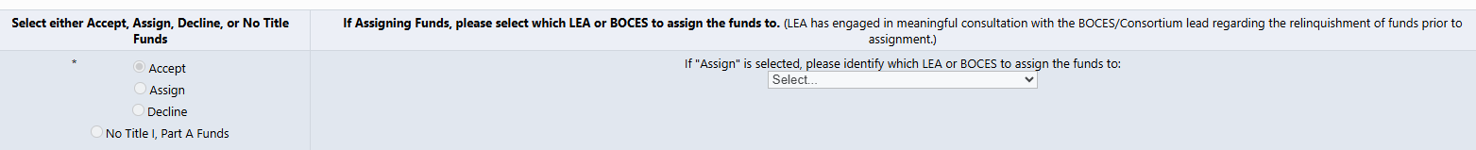
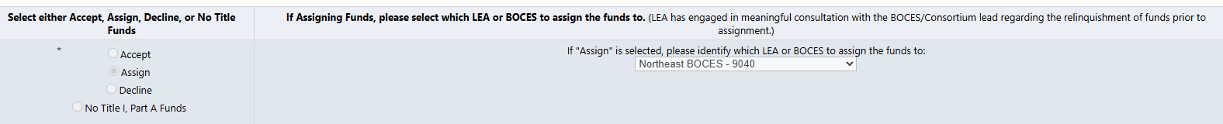
ARAC Reminder
For LEAs that will be accepting the funds, do not select a district.
For LEAs that will be assigning funds, select the LEA or BOCES that will be receiving the funds.

Slide 22
2025-2026 Consolidated Application Timeline -
Complete Application
Date | Action Item | Details
Friday, October 3 | Submit a complete Consolidated Application within GAINS on or before 10/3/2025. | CDE will review applications for final approval once a complete application is submitted by the LEA’s Authorized Representative. Budget needs to be balanced to submit. This may require removing any projected carryover amounts. Regional Contacts will be reviewing applications on a rolling basis once submitted. Highly Recommend referencing the Consolidated Application Planning Document when completing application. Current Bug Tracker: Districts with OVER $30,000 in Title IV; Title IV WR, SHS, EUT validations not calculating correctly what is budgeted. (Warning) Districts UNDER $30,000 in Title IV: Funds must be budgeted in a least one of the three following focus areas: 4421 Well-Rounded Education; 4422 Safe and Healthy Students; or 4423 Effective Use of Technology. Error is appearing even when funds are budgeted to one of the content areas.

Slide 23
Final 2024-2025 Fund Request
Date | Action Item | Details
Tuesday, September 2 | Final opportunity to request 2024-2025 funds. | Funds spent in 2024-2025 need to be requested by 9/2/2025. However, any funds spent in 2024-2025 and reflected in FER with associated documentation will be paid out to LEAs upon approval of the FER (due September 30). Any 2024-2025 funds not requested upon completion of the FER will be moved to carryover upon completion and approval of the FER. Any remaining 2023-2024 funds will expire on September 30, 2025.

Slide 24
Final Expenditure Report (FER)
Date | Action Item | Details
Tuesday, September 30 | Final Expenditure Report (FER) due on or before 9/30/2025. | In order for official carryover to be transferred into the 2025-2026 Consolidated Application, an LEA must submit and receive approval on the FER. FERs should be inclusive of all funds requested from the FY25 (2024-2025) application. Funds spent in 2024-2025 need to be requested by 9/2/2025. Note, any funds spent in 2024-2025 reflected in FER with associated documentation will be paid out to LEAs. The FER is available in GAINS under 2025. Instructions are available (FER Small Bite instructions and Recording.) Carryover can be included for final approval or may be approved in post award, depending on the status of the application when the FER is approved.

Slide 25
ESEA Launchpad Year at a Glance
2025 Update: ESEA Launchpad Year at a Glance
We have an updated, accessible document aligned with GAINS (by federal grant), and we have added helpful information for the Monitoring process!
Feel free to use this to:
Plan for the year ahead,
Train a colleague in the overarching application process, or
Just to remind yourself of upcoming steps in the process.
FPSU Consolidated Application
Notes:
Christina
https://www.cde.state.co.us/fedprograms/consapp/index

Slide 26
Upcoming Meetings

Slide 27

Looking Ahead…
Any requests for topics or questions?
Upcoming Office Hours
  August 28
  September 11*
    HR Coding for Title I Schools
    Title IA Comparability
*The time for the 9/11/25 Office Hours is pushed back one hour to 3:00-4:30 due to a meeting conflict

Slide 28
CDE Contacts!
Emails: Lastname_Firstinitial@cde.state.co.us (e.g., Smith_a@cde.state.co.us)
Federal Programs & Supports (ESEA/ESSER Program Supports) | School Finance & Operations (Fiscal and Systems Supports)
Nazie Mohajeri-Nelson, Executive Director of Federal Programs & Supports Unit Program Specialists Program Implementation Supervisor: Laura Meushaw Program Implementation Coordinator: Christina Adeboye Sullivan Program Monitoring Supervisor: Tammy Giessinger ESEA Monitoring Coordinator: Kristin Crumley Program Effectiveness Supervisor: Tina Negley Program Evaluation & Research Coordinator: Anna Rowan ESEA Programs Specialists and ESEA Regional Contacts (assigned by district) Title I: Laura Meushaw, Evita Byrd, Rachel Echsner, Kim Boylan Title II: Rachel Echsner Title III: Rachel Temple, Kim Boylan Title IV & Stronger Connections Grant: Nathan Hickman, Evita Byrd Title V: Christina Adeboye-Sullivan, Rachel Echsner ESSER Specialist: Kim Boylan ESEA Data and Reporting Specialists Melissa Chaffin (ESEA) Jerry Ring (ESEA) Anna Rowan (ESEA) | Vacant, Executive Director of School District Operations Unit Fiscal Specialists Jennifer Austin, Director of Grants Fiscal Management ESEA Robert Hawkins, Grants Fiscal Analyst Steven Kaleda, Grants Fiscal Analyst ESSER Fiscal Specialist Steven Kaleda Grants Fiscal Analyst ESSER Monitoring Bill Parsley, ESSER Fiscal Monitoring Supervisor Hilery Morris, ESSER Fiscal Monitoring Application Systems Specialists DeLilah Collins, Director of Grants Program Administration Online Applications Systems Technical Support Jessica Hollingshead Michelle Prael

