Slide 1
CDE ESEA and ESSER Office Hours
March 13, 2025

Slide 2
ESEA/ESSER Office Hours
Topics:
Updates and Reminders
Waiver Overview
EBI Training

Slide 3
ESEA & ESSER Reminders and Updates
Notes:
Nazie

Slide 4
U.S. Department of Education Initiates Reduction in Force (RIF)
March 11, 2025 - ED Press Release
4,133 ⇒ 2,183 (drop of 1,950) employees
  259 employees accepted the Deferred Resignation Program
  313 employees accepted the Voluntary Separation Incentive Payment
  1,378 administrative leave as of Friday, March 21, 2025
“The Department of Education will continue to deliver on all statutory programs that fall under the agency’s purview, including formula funding, student loans, Pell Grants, funding for special needs students, and competitive grantmaking.”
All departments are impacted; requiring significant re-organization of work

Slide 5
Updates and Reminders
Requesting Reimbursement - in GAINS
  Office Hours Materials
Grants Fiscal Training on Fund Requests PowerPoint
Grants Fiscal Training on Fund Requests Recording
  Submit requests monthly!
Current Funding
  School Year 2024-2025
Continuing Resolution

Slide 6
Waiver Overview
Notes:
Evita, Melissa, Nathan, Rachel

Slide 7
Types of Waivers
ESEA Waivers
Consolidated Application Waivers
Ed-Flex Waivers
Notes:
Evita

Slide 8
Ed-Flex and State Responsibilities
Educational Flexibility (Ed-Flex) allows States to waive certain requirements of Federal statute or regulations that may impede an LEA’s efforts to reform and improve education, without first having to submit those waivers to the U.S. Department of Education for review and approval.
Ed-Flex States are responsible for holding LEAs and schools, that are operating under a waiver, accountable for the performance of students affected by the waiver through annual monitoring and evaluation of performance toward educational goals outlined in the local waiver application (20 U.S.C. § 5891b(a)(4)(D)).
Notes:
Evita

Slide 9
Prohibited Ed-Flex Waivers
Requirements related to the following cannot be waived:
Equitable services to non-public schools
Distribution of funds to States or LEAs
Health, safety, and civil rights
Individuals with Disabilities Education Act (IDEA)
Any requirements for Title III
Parental participation and involvement
School improvement
Maintenance of effort
Comparability of services
Supplement, not supplant
State plans, standards, assessments, and accountability
Notes:
Evita

Slide 10
Current Waivers
Consolidated Application Waivers
Consolidated Application Extension Request (GAINS)
Title I, Part A District Level Activities Waiver
Title I, Part A Schoolwide Waiver
Ed-Flex Waivers
Title I, Part A 15% Carryover Waiver
NEW Title IV, Part A Apportionment Waiver
NEW Title IV, Part A Effective Use of Technology Infrastructure Maximum Waiver
CDE Waiver Website
Notes:
Rachel T

Slide 11
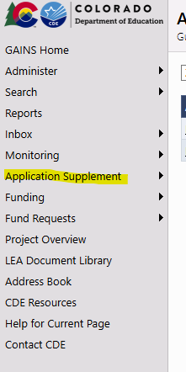
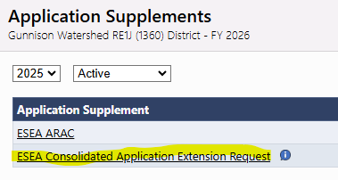
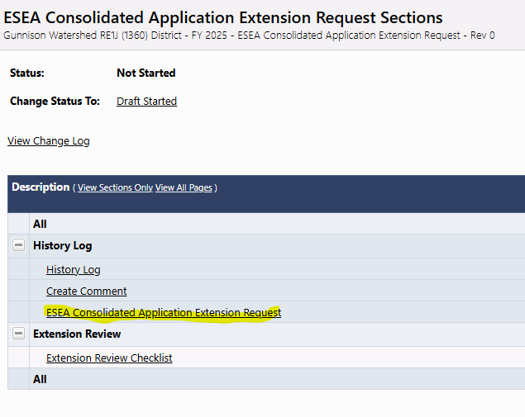
Consolidated Application Extension Request Waiver
ConsAppDue Date: June 30
All Consolidated Application Extension Requests will be submitted through GAINS.
Notes:
Rachel T

Slide 12
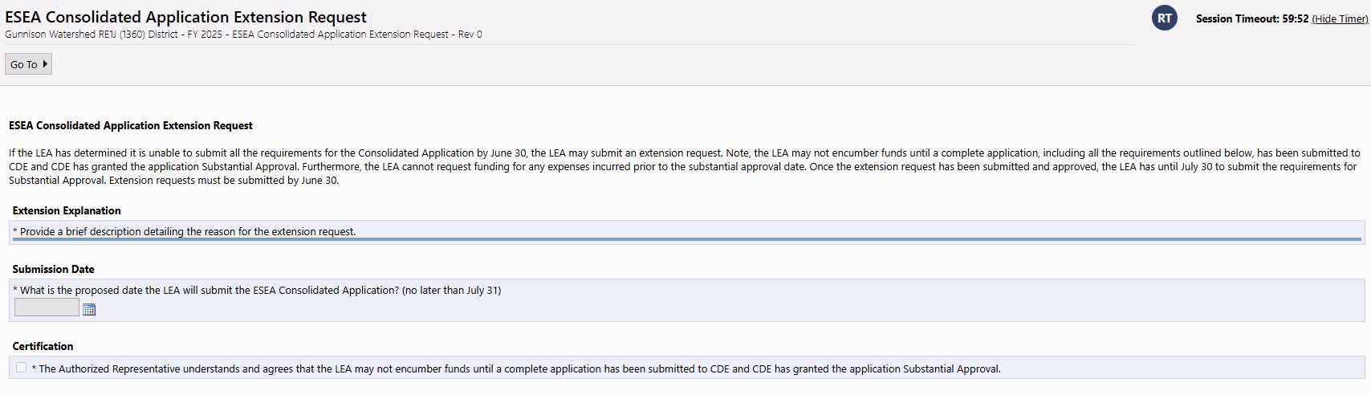
Extension Request Waiver, continued
Notes:
Rachel T

Slide 13
Title I, Part A District Level Set Asides Waiver
(formerly District Managed Activities)
Who: LEAs who receive Title I, Part A funds
What: LEAs that propose to exceed the 20% limitation for the use of District Level Activities (formerly District Managed Activities or DMA) are required to apply for a waiver.
When: Submit the waiver annually with the ESEA Consolidated Application by June 30.
Where: Submit the waiver via the online form.
Why: Based on data, the LEA has determined that additional district level activities would be more effective than school level activities. Please see the District Level Set-Asides website for examples.
Notes:
Evita

Slide 14
Title I, Part A Schoolwide Waiver
Who: LEAs who receive Title I, Part A funds
What: ESSA allows schools in which less than 40% of the students are from low-income families to apply for a waiver to be eligible to operate a schoolwide program. (ESSA §1008(1)(a)(1)(B))
When: Submit the waiver with the ESEA Consolidated Application by June 30, at the beginning of each three-year application cycle.
Where: Submit the waiver via the online form.
Why: Based on data, the LEA has determined that schoolwide programming would increase student achievement more than targeted assistance programming. Please see the Title I, Part A Schoolwide Programs website for examples.
Notes:
Melissa
A Title I, Part A schoolwide program is a comprehensive reform strategy designed to upgrade the entire educational program in a Title I school with a poverty percentage of 40% or more in order to improve the achievement of the lowest-achieving students.

Slide 15
ED Flex Title I, Part A 15% Carryover Waiver
Who: LEAs who receive Title I, Part A funds and CDE Office of Grants Fiscal has confirmed that the LEA has more than 15% carryover for one year’s Title I, Part A allocation
What: LEAs that receive $50,000 or more in Title I, Part A per fiscal year may not carry over more than 15% of funds into the next fiscal year. However, ESSA stipulates that the State (i.e., CDE) may waive this requirement once every three years. (ESEA §6339)
When: When notified by CDE Grants Fiscal or Federal Program and Supports; typically after annual financial reports (AFRs) have been reviewed by Grants Fiscal
Where: Submit waivers via the online form.
Notes:
Melissa
Please note that LEAs must communicate with the CDE Office of Grants Fiscal before submitting this waiver.

Slide 16
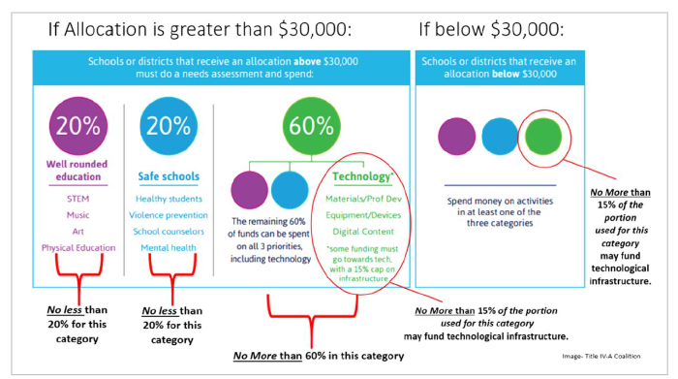
Title IV Apportionment Requirement
Notes:
Nathan

Slide 17
Ed-Flex Title IV, Part A Apportionment Waiver
Who: LEAs with a Title IV, Part A allocation of $30,000 or more
What: If an LEA’s budget does not meet the minimum apportionment requirements, then the LEA may apply to waive that requirement as long as the underlying purposes of the statutory requirements for Title IV, Part A are still met (i.e., purpose of Title IV and allowability of activities).
When:
Ideally, LEAs will consider waivers in the initial planning of the Title IV budget according to their needs assessment.
Waivers apply to one Federal fiscal year (July 1 to June 30) and are accepted on a rolling basis.
Where: Submit waivers via the online form.
Notes:
Nathan

Slide 18
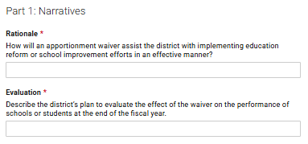
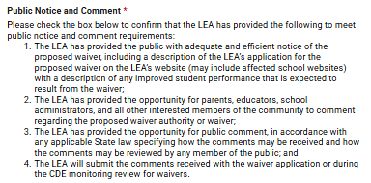
Waiver Narratives and Public Comment
Ed-Flex Title IV, Part A Apportionment Waiver
Notes:
Nathan

Slide 19
Apportionment Waiver Example #1
School District 0000
Title IV Allocation | $450,000
Needs Assessment | Through stakeholder engagement processes, school MTSS data review, and student feedback surveys, it was determined that additional mental health supports are needed districtwide. The LEA decided that all four Federally-identified schools and six additional middle and high schools with high levels of low-income students that also reported the highest need for mental health supports would receive an additional 0.5 FTE counselor as well as fund additional professional development at each site for staff in regards to mental health supports. Through feedback related to stakeholder engagement efforts and public posting of ESEA plans, it was determined that this need was more urgent and to be prioritized over all other potential Title IV funding uses.
Need for a waiver | All funds will be budgeted within the Safe and Healthy Students function code.
Notes:
Nathan

Slide 20
Apportionment Waiver Example #2
School District 0000
Title IV Allocation | $45,000
Needs Assessment | The LEA conducted a needs assessment using the UIP process. Through a review of the LEA’s curriculum, it was determined that the LEA was lacking in postsecondary education and career awareness and exploration activities. It was decided that purchasing an online concurrent enrollment license and career exploration tools as well as professional development for staff to implement these online tools would be most beneficial for students.
Need for a waiver | $35,000 (77%) will be budgeted in Well-Rounded Education for concurrent enrollment and career exploration tools and $10,000 (23%) will be budgeted in Effective Use of Technology for staff PD to implement these tools. 0% budgeted in Safe and Healthy Students necessitates a waiver.
Notes:
Nathan

Slide 21
Title IV Effective Use of Technology 15% Infrastructure Maximum
LEAs shall use a portion of such funds to improve the use of technology to improve the academic achievement, academic growth, and digital literacy of all students, including by meeting the needs of such agency or consortium that are identified in the needs assessment. (ESEA section 4109(a)).
(b) SPECIAL RULE.—A local educational agency, or consortium of such agencies, shall not use more than 15 percent of funds for purchasing technology infrastructure as described in subsection (a)(2)(B), which shall include technology infrastructure purchased for the activities under subsection (a)(4)(A).
To clarify, LEAs or consortiums of LEAs may not spend more than 15 percent of funding in this content area on devices, equipment, software applications, platforms, digital instructional resources and/or other one-time IT purchases. (ESEA section 4109(b)).
Notes:
Evita

Slide 22
Ed-Flex Title IV, Part A Effective Use of Technology
Infrastructure Maximum Waiver
Who: LEAs with any Title IV, Part A allocation amount
What: If an LEA budgets or submits a request for reimbursement that exceeds the 15% maximum on infrastructure, then the LEA may apply to waive that requirement as long as the underlying purposes of the statutory requirements for Title IV, Part A are still met (i.e., purpose of Title IV and allowability of activities).
When:
Ideally, LEAs will consider waivers in the initial planning of the Title IV budget according to their needs assessment.
Waivers apply to one Federal fiscal year (July 1 to June 30) and are accepted on a rolling basis.
Where: Submit waivers via the online form.
Notes:
Evita

Slide 23
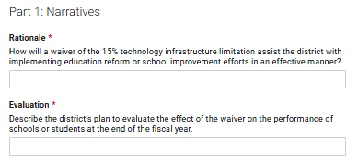
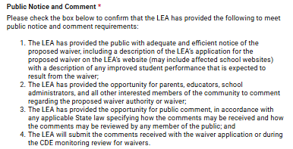
Waiver Narratives and Public Comment
Ed-Flex Title IV, Part A Effective Use of Technology Infrastructure Maximum Waiver
Notes:
Evita

Slide 24
Effective Use of Technology Infrastructure Maximum Waiver Example
School District 0000
Title IV Allocation | $10,000
Needs Assessment | The LEA conducted a needs assessment using the UIP process. It was determined that the LEA was lacking in teacher’s abilities to personalize learning to improve academic achievement. The LEA decided to budget funds for professional development for teachers to better understand and utilize their digital curriculum in order to personalize lessons for students. It was also determined that an additional software purchase would be necessary to enable teachers to access professional development and customization tools.
Need for a waiver | $7,000 (70%) budgeted in Effective Use of Technology for professional development and $3,000 (30%) to purchase additional software for access to PD and lesson customization. This $3,000 (30%) expenditure would count as infrastructure and be subject to the 15% infrastructure maximum rule.
Notes:
Evita

Slide 25
State Waiver Reporting
States with an approved Ed-Flex application must complete the Ed-Flex Annual Reporting Template each year (due in December). Reporting requirements include:
Number, specific type, and duration of waivers granted to each LEA
Effect of waivers on the implementation of State and local educational reforms
Relationship of waivers to school and student performance
CDE collects data through the local waiver application.
Notes:
Melissa

Slide 26

Questions
Reach out to your ESEA Regional Contact as you plan if and when to use waivers.
Notes:
Melissa

Slide 27
Elementary and Secondary Education Act (ESEA) Levels of Evidence Training
ESEA Office Hours
March 13, 2025
Notes:
Hello and welcome to the Elementary and Secondary Education Act, or ESEA, Levels of Evidence training. I am so glad you are joining me today as we walk through this important topic
My name is Jerry Ring and I am an ESEA Reporting and Evaluation Specialist at CDE and will be joined by my colleague Anna Rowan, an ESEA Evaluation and Research Analyst at CDE. This training is particularly relevant for local education agency federal programs grantees, as we will be discussing the levels of evidence that are recommended, and sometimes required, in federal program implementation. I appreciate you taking the time out of your busy schedule to learn more about this aspect of grant implementation, and my hope is that you will feel more confident in your understanding of evidence-based practices at the end of this hour.

Slide 28
Why are the ESEA levels of evidence important?
Consolidated Applications
  Winter 2025 RNM (2/27/25 and 3/4/25)
    PowerPoint Slides and Recording
Empowering Action for School Improvement (EASI) grants
Title Programs
Notes:
Why is this training important? As you are preparing to complete your Consolidated Application, understanding the levels of evidence and how to determine whether a strategy or program is evidenced-based will be helpful to you as you determine what to implement at your LEA.
This EBI presentation is a follow up to training to the Cons App training at the 2025 Winter RNM and a reminder that ESEA funds must (and in some cases should) be used for evidence-based intervention, how to select EBI, and what factors to consider. Links to the slide decks and recordings from those sessions are provided here.
Additionally, the EASI grants and Title Programs have specific requirements related to evidence-based interventions.

Slide 29
Agenda
Introduction & Warmup
ESEA Levels of Evidence Overview & Requirements
Unpacking the Levels of Evidence
Selecting Evidence-
Based Interventions
Additional Resources
Notes:
This is our agenda for today.
We will start with an introduction and warm-up, followed by an overview of the ESEA Levels of Evidence and requirements.
Next, Anna will unpack the levels of evidence. After that, we will take a look at practices for selecting evidence-based interventions, and we will wrap up with a review of a few additional relevant resources.
We will also drop the slides for today’s event in the chat now for you to follow along with, as we have lots of great content we will be covering!

Slide 30
Training Objectives
At the end of this training, participants will be able to:
Identify where in the ESEA the levels of evidence are defined;
Explain the four different levels of evidence and the criteria that define them; and
Introduce the What Works Clearinghouse (WWC) website that includes evidence-based practices and programs.
Notes:
I also want to start by laying out what you can expect to take away from this training. By the end of this training, participants will be able to:
Identify where in the ESEA the levels of evidence are defined;
Explain the four different levels of evidence and the criteria that define them; and
Introduce the What Works Clearinghouse website that includes evidence-based practices and programs.

Slide 31
Warmup/Pulse Check
I am confident in my general understanding of evidence-based practices.
I am confident in my specific understanding of the four levels of evidence (Strong Evidence, Moderate Evidence, Promising Evidence, and Demonstrates a Rationale).
I know where to find evidence-based interventions.
Notes:
Before we dive into the content, we’re going to start with a pulse check activity to see where you are with this topic.
Please respond to the three poll questions you will see pop up. You have the option of selecting that you strongly agree, somewhat agree, or disagree (for now) with the following statements:
I am confident in my general understanding of evidence-based practices.
I am confident in my specific understanding of the four levels of evidence (Strong Evidence, Moderate Evidence, Promising Evidence, and Demonstrates a Rationale).
I know where to find evidence-based interventions.
No matter how you answered, the goal of today’s training is to either build on or refresh your knowledge of what evidence-based programs/interventions are and why you should consider using them. I hope that when you leave this event, you will feel even better equipped to identify and select evidence-based practices.

Slide 32
ESEA Levels of Evidence Overview & Requirements
Notes:
In this section, we will begin by providing an overview of the ESEA Levels of Evidence, including the statutory requirements and definitions, and we will explore some of the different Title programs to which the levels of evidence apply.
As a reminder, the acronym ESEA refers to the Elementary and Secondary Education Act, which was signed into law in 1965 by President Lyndon Baines Johnson. The Every Student Succeeds Act, also referred to as ESSA, was signed by President Barack Obama in 2015 as a reauthorization of ESEA 50 years later. Outside of this presentation, you may see both the phrases “ESSA Levels of Evidence” and “ESEA Levels of Evidence” used interchangeably, as they refer to the same thing.

Slide 33
ESEA Levels of Evidence
Title Programs
The levels of evidence are defined in Title VIII—General Provisions. The General Provisions apply to “covered programs,” or the programs authorized by:
Title I-A: Improving Basic Programs Operated by Local Educational Agencies
Title I-C: Education of Migrant Children
Title I-D: Prevention and Intervention Programs for Children and Youths Who Are Neglected, Delinquent, or at-Risk
Title II-A: Supporting Effective Instruction
Title III-A: English Language Acquisition, Enhancement, and Academic Achievement Act
Title IV-A: Student Support and Academic Enrichment
Title IV-B: 21st Century Community Learning Centers
Title V-B, subpart 2: Rural and Low-Income School Program
Notes:
The ESEA levels of evidence are defined in the General Provisions, which contain important information and requirements applicable across the ESEA. As you may know, the General Provisions apply to “covered programs,” or the programs authorized by the titles you see listed.
Title I-A: Improving Basic Programs Operated by Local Educational Agencies
Title I-C: Education of Migrant Children
Title I-D: Prevention and Intervention Programs for Children and Youths Who Are Neglected, Delinquent, or At-Risk
Title II-A: Supporting Effective Instruction
Title III-A: English Language Acquisition, Enhancement, and Academic Achievement Act
Title IV-A: Student Support and Academic Enrichment
Title IV-B: 21st Century Community Learning Centers
Title V-B, subpart 2: Rural and Low-Income School Program
Right now, we are only focusing on the evidence-based definitions laid out in the General Provisions; you don’t need to know more about the entirety of the General Provisions for today’s topic.
So, while defined in the General Provisions, the degree to which an authorized activity needs to meet a specific level of evidence is outlined in the section of the statute that authorizes the program.

Slide 34
ESEA Levels of Evidence Statute
ESEA Section 8101
(21) EVIDENCE-BASED.–
  (A) IN GENERAL.–Except as provided in subparagraph (B), the term “evidence-based,” when used with respect to a state, local educational agency, or school activity, means an activity, strategy, or intervention that—
    (i) demonstrates a statistically significant effect on improving student outcomes or other relevant outcomes based on—
      (I) strong evidence from at least 1 well-designed and well-implemented experimental study
      (II) moderate evidence from at least 1 well-designed and well-implemented quasi-experimental study; or
      (III) promising evidence from at least 1 well-designed and well-implemented correlational study with statistical controls for selection bias; or
    (ii)(I) demonstrates a rationale based on high-quality research findings or positive evaluation that such activity, strategy, or intervention is likely to improve student outcomes or other relevant outcomes; and
      (II) includes ongoing efforts to examine the effects of such activity, strategy, or intervention.
Notes:
The definition for the ESEA Evidence-Based Levels is found in ESEA Section 8101 (21)(A).
(21) EVIDENCE-BASED.–
(A) IN GENERAL.–Except as provided in subparagraph (B), the term “evidence-based,” when used with respect to a State, local educational agency, or school activity, means an activity, strategy, or intervention that—
(i) demonstrates a statistically significant effect on improving student outcomes or other relevant outcomes based on either —
(I) strong evidence from at least 1 well-designed and well-implemented experimental study; or
(II) moderate evidence from at least 1 well-designed and well-implemented quasi-experimental study; or
(III) promising evidence from at least 1 well-designed and well-implemented correlational study with statistical controls for selection bias; or
(ii)(I) demonstrates a rationale based on high-quality research findings or positive evaluation that such activity, strategy, or intervention is likely to improve student outcomes or other relevant outcomes; and
(II) includes ongoing efforts to examine the effects of such activity, strategy, or intervention.
I am going to further define the specific terminology later in the presentation, like “statistically significant”; define the types of studies, such as “experimental” and “correlational” studies; and provide you with a glossary of terms, as well as the criteria that goes into these four evidence levels. But for now, I just want to provide you with the information regarding where these levels can be found in the statute.

Slide 35
ESEA Levels of Evidence
Tier 1
Strong Evidence
Tier 2
Moderate Evidence
Tier 3
Promising Evidence
Tier 4
Demonstrates a Rationale
Notes:
Here is a simplified look at each of the four levels, or tiers, for identifying the evidence base of interventions. Please note that these ‘Tiers’ are not the same as ‘Tiers ‘ as used when talking about Multi Tiered Systems of Support (MTSS).
The ESEA defines evidence-based interventions as being supported by certain criteria; some are similar within these categories, and some are distinct. The reason why it is important for federal program managers at the LEA level to understand these levels of evidence is so you can better understand the rigor of evidence associated with different types of interventions, and to explore whether they would work within your context, for your students.
The tiers are as follows:
Tier 1: Strong Evidence
Tier 2: Moderate Evidence
Tier 3: Promising Evidence
Tier 4: Demonstrates a Rationale

Slide 36
Requirements by Program
While the levels of evidence are defined in the General Provisions, the degree to which an authorized activity needs to meet a specific level of evidence is outlined in the section of the statute that authorizes the program.
Notes:
As I mentioned earlier, while the levels of evidence are defined in the General Provisions, the degree to which an authorized activity needs to meet a specific level of evidence is outlined in the section of the statute that authorizes the program.
Non-Regulatory Guidance is another source of information that is used to further clarify the degree to which activities must be evidence-based, as some Title programs encourage the use of evidence-based interventions while others, including several competitive grant programs and Title I, Section 1003 funds, require the use of evidence-based interventions that meet higher levels of evidence.

Slide 37
Selected Requirements by Programs
Program | Title | Examples of Requirements
Improving Basic Programs Operated by Local Education Agencies (LEAs) | Title I-A | Support and improvement plans for identified schools
Prevention and Intervention Programs for Children and Youth Who Are Neglected, Delinquent, or at Risk | Title I-D | Evidence-based services and interventions designed to keep such youth in school
Preparing, Training, and Recruiting High-Quality Teacher, Principals, or Other School Leaders | Title II-A | Providing high-quality, personalized professional development that is evidence-based
English Language Acquisition, Language Enhancement, and Academic Achievement Act | Title III-A | No statutory requirements
Student Support and Academic Enrichment Grants | Title IV-A | Drug and violence prevention activities and programs that are evidence-based
American Rescue Plan (ARP) | ARP Act of 2021 | Evidence-based activities to address learning loss
Notes:
You can see here some example requirements from Title I-A, Title I-D, Title II-A, Title III-A, Title IV-A, and the American Rescue Plan. Please note that these are not exhaustive but are shown to demonstrate some of the different examples of requirements within Titles.
Requirements also relate to other programs you are familiar with such as Title I, Part A Section 1003 or the Empowering Action for School Improvement (EASI) grants

Slide 38
Requirements by Programs
Some ESEA programs encourage the use of evidence-based interventions, while others require the use of evidence-based interventions that meet higher levels of evidence.
Programs have distinct requirements depending on the authorizing statute.
  Statutory language outlines required (must implement) and allowable (may implement) activities.
  Statutory language will indicate which activities (either required or allowable) have an evidence-based requirement.
Notes:
As discussed, Section 8101(21)(A) of the ESEA defines an evidence-based intervention as being supported by strong evidence, moderate evidence, promising evidence, or evidence that demonstrates a rationale. Some ESEA programs encourage the use of “evidence-based” interventions, while others require the use of “evidence-based” interventions that meet higher levels of evidence.
Programs have distinct requirements depending on their authorizing statute.
Statutory language outlines required (must implement) and allowable (may implement) activities.
Statutory language will indicate for which activities (either required or allowable) there is an evidence-based requirement.

Slide 39
Strengthening the Effectiveness of ESEA Investments
Identify Local Needs
Examine and Reflect
Select Relevant, Evidence-Based Interventions
Implement
Plan for Implementation
Non-Regulatory Guidance: Using Evidence to Strengthen Education Investments
Notes:
Whether a requirement for a Title program or not, the use of evidence-based practices and interventions is strongly recommended by the U.S. Department of Education (ED). But why?
Utilizing evidence-based practices provides high-quality interventions to students to improve their outcomes with these significant investments from Congress and ED.
ED released a helpful document for this process in September 2016, revised in 2023—the Non-Regulatory Guidance: Using Evidence to Strengthen Education Investments. We are dropping that link in the chat for you now.
This Non-Regulatory Guidance provides these five steps for you as decision-makers to use to help strengthen the effectiveness of these investments. Let’s review each of the five steps collectively.
Today we’re focusing mainly on this second step, Selecting Relevant, Evidence-Based Interventions. It’s important for you to understand that in addition to enhancing the use of evidence-based interventions, these five steps are really a continuous improvement process that can and should be used across any of the programs, activities, and interventions you offer.
Before you can select relevant interventions, you must first identify needs. To do this, you must examine data; understand the root causes of these needs; engage a variety of stakeholders such as students, families, educators, and other partners; and then prioritize needs. It’s also important to examine assets as well so that you do not duplicate efforts.
After identifying needs, the next step is determining the interventions that will best serve the needs AND that you have the capacity to implement. Local capacity cannot be understated when selecting interventions, because it is a significant predictor of the success of an intervention. What do we mean by local capacity? Capacity refers to available funding, staff resources, staff skills, and support for interventions. ALL of these factors should be considered when searching for and selecting evidence-based interventions.
Though we won’t spend a lot of time discussing how to plan for, implement, and then examine and reflect upon how the intervention is working, these steps promote the continuous improvement of evidence-based interventions that can help support better outcomes for students. And we’ll also see how this ties specifically into Tier 4: Demonstrates a Rationale level of evidence, since assessing and reassessing program implementation is a part of that process.
So again, understanding how the tiers of evidence-based interventions work, and where to find evidence-based interventions to use are important as you aim for the most effective interventions and hopefully the strongest improvements of student outcomes.

Slide 40

Knowledge Check #1
Where are the levels of evidence defined for ESEA?
  Title IV, Part A statute
  Each individual program’s statute
  Title VIII General Provisions
  Definitions are left up to the SEA to determine
True/False: Each title program must utilize evidence-based interventions for all activities.
True/False: Even when not required, evidence-based interventions are recommended.
Notes:
I’ll pause now for a brief knowledge check to ensure we’re all tracking. You should see three questions pop up on your screen —go ahead and answer them with what you believe are the correct responses, then we’ll review together.
Where are the levels of evidence defined for ESEA?
Title IV, Part A statute
Each individual program’s statute
Title VIII General Provisions
Definitions are left up to the SEA to determine
The answer is “Title VIII, General Provisions” as we learned about in the beginning of this section.
True/False: Each title program must utilize evidence-based interventions for all activities.
This is false. Evidence-based requirements are determined by the specific statute for each title program.
True/False: Even when not required, evidence-based interventions are recommended.
This is true! And a large reason why we’re discussing it today.

Slide 41
Unpacking the Levels of Evidence
Notes:
Now that we have seen where these levels of evidence come from (the General Provisions in Title VIII) and when they are required (dependent on the specific title and its statutory language), let’s spend some time unpacking what these levels of evidence are.

Slide 42
Criteria for ESEA’s Four Evidence Levels
Evidence Levels (Tiers 1-4)
Study Design
Sample
Outcomes
WWC Standards
Notes:
As we saw in Section 8101(21)(A), the ESEA statute defines an evidence-based intervention as being supported by four levels of evidence: strong evidence, moderate evidence, promising evidence, or evidence that demonstrates a rationale. These are referred to as the four levels, or tiers, of evidence.
It’s important to understand the criteria that are used to determine these four levels of evidence.
There are four criteria, or elements, used to explain and understand these four levels of evidence. Shown here, these criteria are the study design, the study sample (including the participants), the outcomes produced by the interventions, and how these evidence levels are rated based on the What Works Clearinghouse Standards. If you haven’t spent a lot of time navigating the What Works Clearinghouse, it can seem intimidating, but once you understand what it is and how to use it, it can be a game changer. That’s because, essentially, the What Works Clearinghouse has done all the hard work for you by using rigorous standards to review the evidence of effectiveness for a number of different education interventions and rate them, and it also provides a wealth of information from the studies, including the settings and populations! We’ll spend more time on the What Works Clearinghouse later.

Slide 43
Glossary of Terms
Type | Definition
 | Experimental Study: A rigorous study in which participants are randomly assigned to a treatment or control group.
Study Design | Quasi-Experimental Study: A rigorous study in which participants are not randomly selected. At baseline, intervention and control groups may not have similar characteristics. A study using a design that approximates an experimental design by identifying a comparison group similar to the treatment group in important respects.
 | Correlational Study: A nonexperimental study in which a relationship between the variables is examined without looking for causation
 | Sample: A set of individuals from a larger population selected to participate in a study.
Sample | Control Group: The group that does not receive the intervention, receives a different intervention, or conducts “business as usual.”
 | Intervention Group: The group that receives the intervention under study.
Notes:
Here is a glossary to introduce some key terms that will help you understand those first three criteria: study design, sample, and outcomes.
Beginning with the terms under the Study Design section, you will see the three different types of studies commonly talked about when determining the evidence-based intervention level or tier.
Experimental Study: A rigorous study in which participants are randomly assigned to a treatment or control group.
Quasi-experimental Study: A rigorous study in which participants are not randomly selected or randomly assigned to intervention or control groups. This means that the intervention and control groups may not have identical characteristics, but they may be similar in important respects (e.g., two different classes of students). These types of studies do not meet the standard of a true experimental randomized control trial, but they can still help researchers study the impacts of an intervention and try to infer causation.
Correlational Study: A nonexperimental study where a relationship between the variables is examined without looking for causation. Instead of causation, these look at the correlation or the strength of the relationship between an intervention and the outcomes.
Next, let’s review a few key terms related to Sample.
Sample: A set of individuals selected from a larger population to participate in a study.
Control Group: The group that does not receive the intervention, or receives a different intervention, or conducts “business as usual.”
Intervention Group: The group that receives the intervention that is being studied.

Slide 44
Glossary of Terms, con’t
Type | Definition
Sample | Random Assignment: Participants from the sample are randomized into different treatment groups. Each participant has an equal chance of being placed in the control or intervention group.
 | Random Selection/Sampling: Participants are randomly selected from the population, a process that ensures that the sample is unbiased and representative of the population.
 | Causation: The claim that an intervention, activity, or program is responsible for the reported outcome or outcomes (a cause-and-effect relationship). Only experimental studies demonstrate causation with confidence.
Outcomes | Correlation: A relationship between two or more variables or outcomes that is not known to be causal.
 | Statistical Significance: Statistically significant study results indicate that outcome findings are not random and may have resulted from the applied intervention.
Notes:
Continuing with a few more terms related to Sample, we have:
Random Assignment: Participants from the sample are randomized into different treatment groups. Each participant has an equal chance of being placed in the control or intervention group.
Random Selection/Sampling: Participants are randomly selected from the population, a process that ensures that the sample is unbiased and representative of the population.
And finally, we have three key terms related to Outcomes that it is helpful to know.
Causation: The claim that an intervention, activity, or program is responsible for the reported outcome or outcomes (a cause-and-effect relationship). Only experimental studies demonstrate causation with confidence.
Correlation: A relationship between two or more variables or outcomes that is not known to be causal.
Statistical Significance: A measure of the likelihood that the result is true and did not occur due to chance. Statistically significant study results indicate that outcome findings are not random and may have resulted from the applied intervention. We’ll take a closer look at this term on the next slide.
I know these were a lot of terms I read through quickly, but remember: these slides are available for you to save and reference!

Slide 45
Important Definition: Statistical Significance
Statistically significant study results indicate that outcome findings are not random and may have resulted from the applied intervention.
Common Misconception
Reality
Interventions that demonstrate statistical significance and strong levels of evidence are always the best and will produce the largest impacts in student outcomes.
Context is extremely important in determining whether an intervention will be successful in a new setting and with a new population.
Notes:
Before we get into the tiers of evidence, I want to spend another moment talking about statistical significance, which, again, is related to the outcomes of a study.
As I shared on the last slide, statistically significant study results indicate that outcome findings are not random and may have resulted from the applied intervention.
However, a common misconception is that interventions that demonstrate statistical significance and strong levels of evidence are always the best and will produce the largest impacts in student outcomes. In fact, saying something is statistically significant does not indicate the magnitude of the positive result. It just means the researchers are confident that differences noted before and after the intervention or between populations are likely not random and, therefore, most likely a result of the intervention.
This is a reminder that context is extremely important in determining if an intervention will be successful in a new setting and with a new population. In other words, just because it worked well in one place, does not guarantee it will work in another place.

Slide 46
Tier 1: Strong Evidence
Study Design
  Experimental
  Randomized control trial
Sample
  Large, multi-site sample, overlapping with populations and settings proposed to receive the intervention
  Random assignment
Outcomes
  Positive
  Statistically significant and favorable effect on a student outcome or other relevant outcome
WWC Standards
  Meets without reservations
  The equivalent quality for making causal inferences
Notes:
Let’s walk through these levels with these definitions now.
The first Level of Evidence is defined as Tier 1, which shows Strong Evidence that an intervention caused the improvement in an important outcome as shown by at least one well-designed, well-implemented experimental study (this terminology comes directly from the statute). Let’s break this down by going through each of the four criteria for Tier 1.
Study Design—The first criteria is the design of the study.
Studies in the Tier 1: Strong Evidence category are considered experimental and usually done by a randomized control trial, which is the gold standard in research. These types of studies ensure the researchers have control over many aspects of the study design so they can make causal inferences, which we’ll talk about when we get to the outcomes.
Sample—The second criteria relates to the sample, or the population, that is included in the study of an intervention.
Keep in mind that a defining factor not only for Tier 1, but for Tiers 1 through 3 are how participants are selected or assigned to the study.
For interventions to be considered as Tier 1: Strong Evidence, the Non-Regulatory Guidance indicates that the sample must include a large, multi-site sample, with overlapping populations AND settings. So, what exactly does that mean? Well, the Non-Regulatory Guidance cites another governing directive that you may be familiar with called EDGAR, which defines a large sample as more than 350 participants. Multisite means more than one site, and the sample must overlap with the population, meaning the types of students, AND the setting, such as rural or urban, being served by the intervention. So, for Tier 1, the sample must meet both the overlapping of populations AND settings.
Another key component about the population(s) being served is the way they are included in the study. For experimental/randomized control trials, the population of students receiving the intervention must be randomly assigned to either a control group that does not receive the intervention or a treatment group that does receive the intervention.
Outcomes—The third criteria for determining if intervention studies fall within Tier 1 is the outcomes produced for the population served.
Interventions in this tier must demonstrate a positive effect on student outcomes, and they must be statistically significant, which as we said earlier means that researchers can be confident that the results are not random and may have resulted from the applied intervention.
You may have heard the term “causal relationships,” which essentially means that the intervention caused the positive effect in outcomes, and Tier 1 is the only tier that can make these causal claims of strong evidence.
What Works Clearinghouse Standards—The last criteria involves the What Works Clearinghouse Evidence of Effectiveness Standards. We will learn more about these a bit later when we discuss interventions found in the Clearinghouse, but what you need to know is that Tier 1 status must meet What Works Clearinghouse standards without reservations, which means there were no issues with the study and that there was evidence of a causal link.

Slide 47
Tier 2: Moderate Evidence
Study Design
  Quasi-experimental
  Comparison group similar to treatment group
Sample
  Large, multi-site, overlapping with populations or settings proposed to receive the intervention
  Non-random assignment
Outcomes
  Positive
  Statistically significant and favorable effect on a student outcome or other relevant outcome
WWC Standards
  Meets with or without reservations
  The equivalent quality for making causal inferences
Notes:
The second Level of Evidence is labeled as Tier 2, which shows Moderate Evidence by at least one well-designed, well-implemented quasi-experimental study.
Study Design—A quasi-experimental study design does not meet the standard of a true experimental randomized control trial, but it can still help researchers study the impacts of an intervention and try to infer causation.
In this type of study, one of the main distinctions is that there is a comparison group that is similar to the treatment group.
The quasi-experimental design attempts to compare the outcomes for these two groups that are matched closely on the basis of some criteria.
Sample—The sample criteria here that are similar to Tier 1 are that it must include a large, multi-site sample. So, more than 350 participants, and more than one site.
However, one key distinction in Tier 2 sampling is with the overlapping requirement. In this case, the sample must overlap with either the populations OR the settings. One or the other, not both. Again, this speaks a little bit to the difference in rigor between these two types of studies.
Another one of the key differences in the sample criteria for Tier 2 is the assignment of participants. In quasi-experimental design, participants are NOT randomly assigned to treatment and control groups; they are split by some other means. Two groups are formed, but it is through various, non-random processes.
For example, student demographics and prior achievement levels are a good way to think about how groups might be formed or matched, in order for researchers to statistically control the differences between the two groups.
Outcomes—The third criteria for determining if intervention studies fall within Tier 2 is the outcomes produced for the population served. These are the same as they were for Tier 1.
The outcomes must have a positive and statistically significant effect on student outcomes.
What Works Clearinghouse Standards—There are slight differences in the What Works Clearinghouse Evidence of Effectiveness Standards for Tier 2.
They can either meet the What Works Clearinghouse standards WITH or WITHOUT reservations.
There are several factors that determine these ratings, but the main thing you need to know is that a well-implemented, quasi-experimental design study with positive, statistically significant findings that meet the sample criteria can meet Tier 2: Moderate Evidence of effectiveness WITHOUT any reservations, meaning there were no issues with the quasi-experimental design study.
However, in some cases, Tier 2 could include both randomized control trial studies or even quasi-experimental design studies that may have had some sort of issue that requires caution. These issues could be with the sampling, such as attrition, in other words when participants dropped out or left the study, so these interventions are given the Tier 2 status of Meets Standards but WITH reservations.
In Tier 2, you see some of that overlap among the four criteria that we talked about such as the outcomes, but you also see some of the differences in the study design, sample, and What Works Clearinghouse standards when comparing to Tier 1.

Slide 48
Tier 3: Promising Evidence
Study Design
  Correlational with statistical controls for selection bias
  Randomized selection
Sample
  N/A
Outcomes
  Positive
  Statistically significant and favorable effect on a student outcome or other relevant outcome
WWC Standards
  N/A
Notes:
The third Level of Evidence is Tier 3, which shows Promising Evidence by at least ONE well-designed, well-implemented correlational study. There are several key differences with this standard, as you can see.
Study Design—First, the study design is a correlational study design, which is not experimental like the others, and therefore cannot infer causation, rather correlation, or the relationship between an intervention and the outcomes.
In a correlational study with statistical controls for selection bias (such as socioeconomic status or gender), the strength of the relationship between two similar groups is examined.
The groups may look similar to one another, but there could also be differences in the classrooms that are not accounted for like they would be in the more rigorous studies. Nonetheless, these studies use some sort of random sampling or other analytic methods to help account for or reduce the differences between the two groups.
Sample—For Tier 3: Promising Evidence, you will see a primary difference here that the large, multi-site sample of a certain number of participants at more than one site is NOT required.
Outcomes—The Non-Regulatory Guidance says for studies be considered Tier 3, it is similar to the other Tiers 1 and 2 in that it must show a positive and statistically significant effect on student outcomes.
What Works Clearinghouse Standards—The other key difference for Tier 3 studies is that they are not rated within the What Works Clearinghouse Evidence of Effectiveness Standards.
However, using Tier 3 is still acceptable if there are no other Tier 1 or Tier 2 studies that meet your needs.
A correlational study with statistical controls for selection bias is designed to examine the strength of the relationship (not the causal relationship) between an intervention and a student outcome by comparing two similar groups.
In an example correlational study, researchers may look at how two classrooms with similar characteristics perform on a reading assessment after one of the classes (the treatment group) participates in a new reading program. While the researcher is looking at outcomes in classrooms that look similar, there may be other important differences between the classrooms (e.g., previous reading assessment scores) that are not accounted for but would be in more rigorous studies like experimental studies or quasi-experimental design. These types of studies cannot meet What Works Clearinghouse standards.

Slide 49
Knowledge Check #2
Which of the following are criteria for ESEA’s Tier 1-4 Evidence Levels? (Select all that apply)
  WWC standards
  Language
  Sample
  Timing
Tier 1 (Strong Evidence), Tier 2 (Moderate Evidence), and Tier 3 (Promising Evidence) have the same requirements for ______. (Select one)​
  Study Design​
  Sample​
  Outcomes​
  WWC Standards
Notes:
We just covered a lot of dense information in unpacking Tiers 1–3! Let’s pause for a moment to check in on how we are tracking.
You’re about to see two knowledge check questions pop up regarding some of the evidence requirements. Select what you believe is correct, and then we’ll discuss.
Let’s look at the first question—Which of the following are criteria for ESEA’s Tier 1–4: Evidence Levels? The answer here is both the What Works Clearinghouse standards and sample . Language and timing are not criteria.
The second question is asking you which criteria have the same requirement for Tiers 1–3. That would be outcomes. In all three tiers or levels of evidence, the interventions must show a positive and statistically significant effect on student outcomes.
​​

Slide 50
Tier 4: Demonstrates a Rationale
Study Design
  High-quality research findings or positive evaluation
  Well-specified logic model informed by research or an evaluation
Sample
  N/A
Outcomes
  Research-supported innovations designed to improve an important outcome
WWC Standards
  N/A
Notes:
The fourth Level of Evidence is defined as Tier 4: Demonstrates a Rationale. This tier has more differences than the other levels, as you can see. Before we dive into the differences, let’s discuss why you would use Tier 4.
Tier 4 gives education leaders the flexibility to design and test new interventions, with some caveats.
These interventions must be informed by research and seem reasonably likely to succeed, but they don’t yet have the kind of evidence that would place them in Tiers 1–3. Selected interventions may not meet the required evidence base, but when implemented, evaluated, and refined, they may prove to be effective. Simply put, Tier 4 allows you to identify interventions, study their implementation, measure their effects, and modify them to fit your local context.
In many cases, using Tier 4 evidence requires more work than selecting an evidence-based intervention in the higher tiers, because it often includes taking pieces from different models and creating your own intervention and then studying the intervention’s effectiveness. However, working within Tier 4 actually allows you to contribute to the evidence base by gathering evidence of the effectiveness of the intervention, so that it could eventually meet the requirements for the higher levels of evidence.
Study Design—First, the key difference in this study design is that there isn’t an actual experimental or correlational study.
Instead, this tier is based on high-quality research findings or a positive evaluation that is supported by a well-specified logic model or theory of action that is informed by research or an evaluation.
You see that there must still be a research base for Tier 4, but it does not have to be from a rigorous study design.
Sample—Because there is not a rigorous study design for Tier 4, there is no sample population or sampling requirement.
Outcomes—While a rigorous study design is not required for Tier 4, there must still be some effort underway to determine the effectiveness of the intervention’s outcomes to inform stakeholders about the success of that intervention. The Non-Regulatory Guidance specifies that interventions with little to no evidence should at least demonstrate a rationale for how they will achieve their intended goals and be examined to understand how they are working to improve outcomes within the specific context.
What Works Clearinghouse Standards—Tier 4 studies are not rated within the What Works Clearinghouse Evidence of Effectiveness Standards, because, again, there is not an evidence base for these interventions. You are building them as you implement and evaluate your interventions, which can then contribute to the evidence base.

Slide 51
Demonstrates a Rationale: Common Logic Model Elements
Problem Statement
Inputs​ | Activities​ | Outputs​ | Outcomes ​
Resources, contributions, investments into program | Describes what you will do | Observable products, services, or events that result from your activities | Can include short-, mid-, and/or long-term outcomes. Describes measurable changes in knowledge, behavior, or skills ​
Assumptions
Notes:
As I said, using Tier 4 evidence-based practices takes quite a bit of planning and information gathering up front and over time in order to evaluate the effectiveness of the intervention, because you are assessing both the quality of the intervention and the implementation process to ensure there is fidelity in the implementation.
Remember, there are two key requirements for Tier 4:
First, there must be a research-backed method that explains how the intervention could improve outcomes. This could be done through a logic model, theory of action, or some other literature review that describes this.
Second, there must be an effort to study and evaluate these anticipated outcomes.
Let’s take a look at a tool that helps meet the first requirement.
Logic models, as you may be familiar with, are very useful tools because they map out how the inputs and activities associated with selected evidence-based practices will lead to the intended outputs and outcomes over time. You can also use your logic model components to help inform the continuous improvement process when evaluating the intervention.
Let’s briefly review the common elements of logic models.
Inputs are the resources you will have for the intervention, so things like money/funding, instructional materials, and staff; basically, any investments that you are putting into the intervention.
Activities describe what you will do as a part of the intervention.
The outputs are the tangible results the intervention will put out. These are usually expressed in numbers, such as the number of students who pass an assessment, or the number of teachers trained.
Finally, the outcomes are the measurable changes that demonstrate the success of an intervention; so, the percentage of student who demonstrate a change in knowledge or behavior. These can be broken down into short-term, mid-term, and long-term outcomes.
I will be sharing more resources at the end of the presentation that provide information for further learning in some of these areas, including evaluation and logic models.

Slide 52
Demonstrates a Rationale: Evaluations
Assess
Process Evaluations focus on the implementation process and strive to uncover whether the program is going according to plan.
Outcome Evaluations determine the degree to which a program achieves its stated goals and objectives.
Evaluate
Target
Deliver & Monitor
Plan
Notes:
The second requirement of Tier 4: Demonstrates a Rationale is to study the effects and outcomes of the intervention. You must produce evidence to support claims that an intervention will achieve the intended outputs and produce the desired outcomes.
It is important to understand that studying the effects of an intervention is not a one-time thing. You have to continuously monitor the implementation, assess and reassess that implementation, and then refine as needed. You must conduct this process in a continuous feedback loop.
This process requires constant data collection, analyzing the data, and documenting your efforts along the way as changes are needed. As I said previously, developing a logic model can help you to determine the data you need to collect along the way to measure the outcomes.
Again, if you choose to innovate and help build the evidence base, there is much thought that has to go into the process of how you will do that. Evaluations are typically done either internally or externally with a qualified program evaluator, depending on LEA setup.
Evaluators should be involved early on in the planning so they can help you determine the outcomes and metrics to collect in order to inform the outcomes. There are different types of evaluations, and an evaluator can help you to determine the scope.
You may choose to evaluate the implementation aspects of an intervention via a process evaluation, or you may seek to determine outcomes via an outcome evaluation, which according to Tier 4, is what must be studied. You can always do both types of evaluation, which will provide a more complete picture of your program. But remember for Tier 4, determining the outcomes of an intervention is what is required.

Slide 53
Overview of Criteria for the different Levels of Evidence
Criteria | Tier 1: Strong Evidence | Tier 2: Moderate Evidence | Tier 3: Promising Evidence | Tier 4: Demonstrates a Rationale
Study Design | Experimental | Quasi-experimental | Correlational with statistical controls for selection bias | High-quality research findings or positive evaluation
Study Design | One well-designed and well-implemented study on the intervention | One well-designed and well-implemented study on the intervention | One well-designed and well implemented study on the intervention | Well-specified logic model informed by research or an evaluation that suggests how the intervention is likely to improve relevant outcomes
Sample | A large sample size of 350 or more participants Multi-site sample (i.e., more than one site) | A large sample size of 350 or more participants Multi-site sample (i.e., more than one site) | Uses sampling and/or analytic methods to reduce or account for differences between the intervention group and a comparison group | N/A
Sample | Overlapping populations and settings | Overlapping populations or settings | Uses sampling and/or analytic methods to reduce or account for differences between the intervention group and a comparison group | N/A
Sample | Random assignment to treatment/control group | Matching or statistically controlling differences between groups rather than random assignment | Uses sampling and/or analytic methods to reduce or account for differences between the intervention group and a comparison group | N/A
Outcomes | A statistically significant and positive (i.e., favorable) effect on a student outcome or other relevant outcome | A statistically significant and positive (i.e., favorable) effect on a student outcome or other relevant outcome | A statistically significant and positive (i.e., favorable) effect on a student outcome or other relevant outcome | Research-supported innovations designed to improve an important outcome
What Works Clearinghouse Standards | Meets without reservations | Meets with or without reservations | N/A | N/A
Notes:
Now we are going to pause briefly and look at the four tiers collectively so you can see the similarities and differences. Hopefully this table can help provide a quick, at-a-glance synopsis of criteria requirements these tiers have in common and what makes them unique.
Along the left side of the table, you can see the four criteria we discussed in the beginning of the section, and across the top are our four tiers of evidence.
This can be a helpful reference point, so remember these slides are available to you!

Slide 54
Knowledge Check #3
Which tier of evidence requires ongoing efforts to examine the intervention’s effects?
  Tier 1: Strong Evidence
  Tier 2: Moderate Evidence
  Tier 3: Promising Evidence
  Tier 4: Demonstrates a Rationale
Which tier of evidence involves a randomized control trial, the gold standard in research?
  Tier 1: Strong Evidence
  Tier 2: Moderate Evidence
  Tier 3: Promising Evidence
  Tier 4: Demonstrates a Rationale
Notes:
Let’s conduct another brief knowledge check to see how we are all doing. Read over the two questions that will pop up on your screen, make your selections, and then we will discuss together.
Let’s examine the correct answers together. Question 1 is asking which tier of evidence requires ongoing efforts to examine the intervention’s effects. That is, of course, what we just talked about—Tier 4: Demonstrates a Rationale, with the need to conduct ongoing evaluations to determine if the intervention is effective as you build the evidence base yourself. The second question is asking which tier requires a randomized control trial; that is Tier 1: Strong Evidence.

Slide 55

Caution: Consider the Context
Context is extremely important in determining whether an intervention will be successful in a new setting and with a new population.
Notes:
Now that we have a big-picture perspective of all four ESEA Levels of Evidence and the criteria for them to be designated in these tiers, and now that we have seen some of the similarities and the differences between them, I want to take a moment to remind you that even though an intervention may have either strong or moderate evidence, that intervention still MAY NOT be successful for your specific context.
It is important that you consider the context of these studies, the populations they have served, and/or the setting that these interventions were used in. To do that, you have to dig deeper. When you start diving into the What Works Clearinghouse you don’t just want to look at the Tier 1 and Tier 2 interventions and the What Works Clearinghouse ratings, you should also make note of both the setting and sample population to determine if they are similar to yours. Interventions that have demonstrated Tier 1: Strong Evidence, for example, may not be as effective if the contexts and sample populations are different from those in your local conditions or context.

Slide 56
Selecting Evidence-Based Interventions
Notes:
We have spent time discussing where the levels of evidence come from, why they are recommended or in some cases required, and what each of the four levels of evidence entails. We are going to take a few minutes now to learn a bit more about the selection process for evidence-based interventions, including a high-quality resource for sourcing them.

Slide 57
Pulse Check
Before today, had you heard of the What Works Clearinghouse?
Have you used the What Works Clearinghouse to search for interventions?
Notes:
We’ll start this section with a pulse check specifically related to the What Works Clearinghouse. Of course, I’ve already been talking about them quite a bit today, but I would love to know how familiar you are with using the What Works Clearinghouse.
These poll questions will pop up momentarily, and I will give you 1–2 minutes to select your answers.
The questions are as follows:
Before today, had you heard of the What Works Clearinghouse? You can respond by selecting “yes,” “no,” or “unsure.”
Have you used the What Works Clearinghouse to search for interventions? Again, you can respond by selecting “yes,” “no,” or “unsure.”
No matter what you answered to both of these questions, I hope you will learn a little bit more about the What Works Clearinghouse and how it can serve you and your work.

Slide 58

What Works Clearinghouse (WWC)
Notes:
While there are several different resources that you can use to search for evidence-based practices, we will focus now on one that is likely the most familiar, the What Works Clearinghouse.
The What Works Clearinghouse is an IES initiative within ED. Within the What Works Clearinghouse, panels of experts review education research using a set of rigorous design standards and protocols to identify well-designed, well-implemented research studies and then summarize the findings.
The What Works Clearinghouse has done the work to help educators identify and select evidence-based practices, which is why it is such a recommended resource for you!

Slide 59
WWC Product Types
Practice Guides | Intervention Reports | Individual Study Reviews
Present evidence-based recommendations for educators to improve student outcomes | Provide a summary of findings of the highest-quality research on an intervention or practice in education | Deliver summaries of studies that have been reviewed by the WWC
Include how-to guides, tips, examples, and solutions to potential roadblocks | Include findings, effectiveness ratings, information regarding context, and evidence tiers | Include a look at a single study and its ratings
Notes:
The What Works Clearinghouse has three different types of products that you can use to search for evidence-based practices: (1) practice guides, (2) intervention reports, and (3) individual study reviews. Each of these resource types contains evidence-based practices that educators can choose from.
Practice guides present evidence-based recommendations for educators to improve student outcomes. Practice guides can include things like how-to guides, tips, examples, and solutions to potential roadblocks.
Practice guides are based on reviews of research, combining research with the experiences of practitioners and the opinions of a panel of nationally recognized experts.
While practice guides may use evidence from “branded” or commercial products, they don’t focus on them; what’s important to note about practice guides is that they include specific recommendations and examples for educators to improve outcomes!
Intervention reports provide a summary of findings of the highest-quality research on an intervention or practice in education. These can include findings, effectiveness ratings, information regarding context, and evidence tiers.
Intervention reports focus on a specific intervention (remember, that can be a policy, program, or practice) and include a systematic review of the evidence for the specific intervention. These interventions are quite often branded products.
These show how and where the intervention was implemented.
These indicate whether the intervention was effective at improving important student outcomes.
Reviews of individual studies deliver summaries of studies that have been reviewed by the What Works Clearinghouse and include a look at a single study and its ratings.
These are reviews of individual studies about education practices, products, programs, and policies.
These reviews are compiled by reviewers who evaluate the studies based on rigorous statistical and methodological standards.
They provide an in-depth look at an individual study and its ratings as well as the context, setting, and population studied.
These reviews are often the building blocks for the other What Works Clearinghouse products, such as the practice guides and intervention reports just described.
Just a note on the difference between evidence-based strategies and evidence-based programs. The Practice Guides and Interventon Repoerts help identify evidence-based strategies, the Study reviews help identify evidence-based programs

Slide 60
WWC Ratings
Meets WWC Standards Without Reservations
Meets WWC Standards with Reservations
Does Not Meet WWC Standards
  Well-designed
  Randomized control trial, regression discontinuity design, or single-case design
  No problems with sample attrition
  Strong quasi-experimental or single-case
  Experimental study not as well implemented
  Control trial with attrition issues
  Baseline equivalence between groups not established
  Potential confounding variables
  Outcomes do not meet WWC requirements
Notes:
Finally, let’s revisit the What Works Clearinghouse ratings. We described these terms earlier when we discussed the criteria used for the ESEA levels of evidence. Knowing what we do now, let’s dive in just a little more. It is important to note here that these ratings involve the rigor of the study of an intervention; there are specific criteria related to the study design, sample population, and whether the study met the design standards based on the specific protocols used to rate eligible studies.
Again, an expert panel reviews and summarizes the quality of educational studies to determine whether they meet the What Works Clearinghouse Standards With or Without Reservations, or if they do not meet the What Works Clearinghouse Standards.
Meets What Works Clearinghouse Standards Without Reservations
To achieve this rating, the study must meet these criteria, which should look familiar to you:
The study must be a well-designed randomized controlled trial experimental design, which is the gold standard, that uses random sampling of a treatment and a control group.
It must be well implemented, meaning there were no issues with sample attrition where participants drop out of the study.
These studies have the highest degree of confidence that the intervention caused the outcome. There are very specific study design criteria the reviewers are looking for in studies to achieve this rating, which is the highest level a study can be rated.
Meets What Works Clearinghouse Standards With Reservations
To achieve this rating, the study design is either a strong quasi-experimental design or it could include a randomized controlled trials study. Because of the natural limitations of quasi-experimental design, including that it does not use random sampling, the study cannot rise to the level of meets without reservations. If it is a well implemented and designed quasi-experimental study, this is the highest rating it could achieve in the What Works Clearinghouse.
Additionally, a randomized control trial study that may have had design, implementation, or sample issues could be assigned this rating if it had the other key elements.
These studies have a lower degree of confidence that the intervention caused the outcome, as the outcome could have been attributed to something else, hence this rating.
Does Not Meet What Works Clearinghouse Standards
This is the lowest rating that is reserved for any type of study design that did not meet the rigorous criteria standards, including the sample and population requirements, and/or had multiple issues. These are studies that do not provide sufficient evidence that the intervention caused the outcome. Therefore, it cannot meet the standards.

Slide 61

Exploring the WWC Website
What Works Clearinghouse: https://ies.ed.gov/ncee/wwc/
Notes:
There are a few key features to be aware of on this home page:
The menu at the top is, of course, the easiest way to navigate the site.
The gray “Search the WWC” box shows the product types we discussed (including downloadable data from study reviews as well), and also has fields you can use to search.
As you see, the first field is “keyword,” helpful if you have something very specific you’re looking for.
You could choose to search by topic, which includes areas by subject (e.g., literacy, STEM) and student population (e.g., students with disabilities, English learners).
The third search option would be to narrow down the results based on grade level.
Additionally on the home page is the “What’s New” section, highlighting new resources and reports.

Slide 62
Additional Resources
Notes:
We are going to wrap up our time together today with some resources that you can access and review for further learning. We encourage you to bookmark these resources and return to them whenever you are working through evidence-based matters.

Slide 63
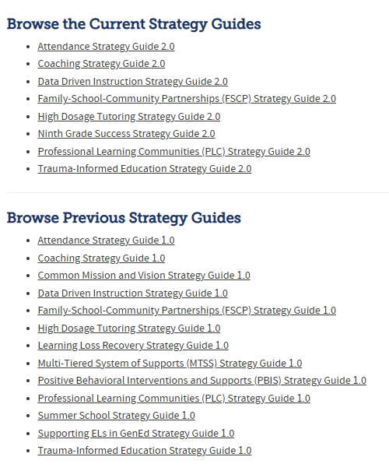
CDE
Strategy Guides
https://www.cde.state.co.us/uip/strategyguides
Notes:
CDE has created a number of strategy guides to help schools and districts better understand what research says about strategies that are commonly used in Unified Improvement Planning. We have organized these strategy guides based on the 4 Domains of Rapid School Improvement. These guides can be used for strategy selection or to determine areas of focus and action plans. More will be added as they are created.

Slide 64
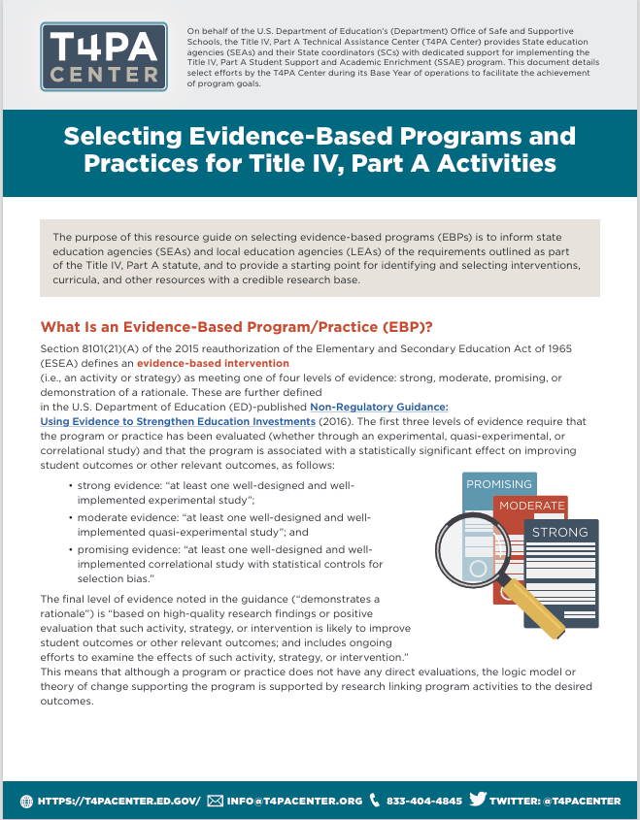

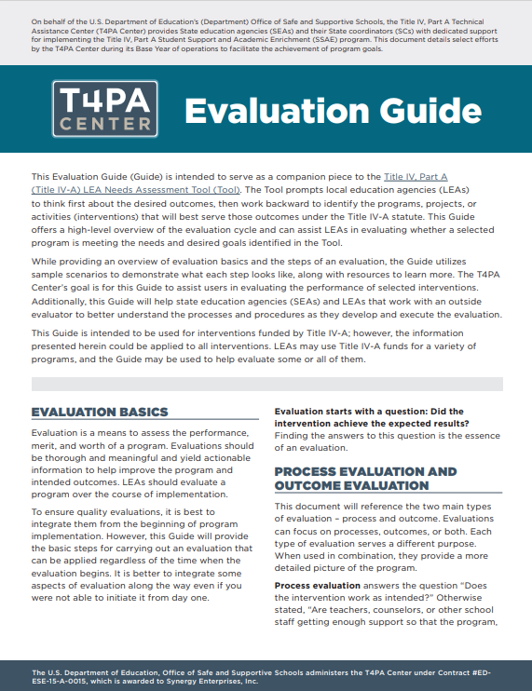
T4PA Center Resources
Notes:
First, we want to highlight three resources related to what we have been talking about today from the T4PA Center, which is the technical assistance center that operates on behalf of ED to provide support for implementing Title IV, Part A.
Selecting Evidence-Based Programs and Practices for Title IV, Part A: This resource guide provides information on evidence-based program requirements in the Title IV, Part A statute and provides a starting point for identifying and selecting interventions, curricula, and other resources with a credible research base.
Assisting LEAs With the Use of Evidence-Based Practices and Programs: This information sheet describes best practices for identifying, selecting, and implementing evidence-based practices and programs.
Evaluation Guide: This guide prompts you to think about desired outcomes, then work backward to identify the programs, projects, or interventions that will best serve those outcomes. This is particularly helpful for efforts in Tier 4: Demonstrates a Rationale.

Slide 65
Additional Resources
Helpful Links
  Understanding the ESSA Tiers of Evidence
  Non-Regulatory Guidance: Using Evidence to Strengthen Education Investments
  Continuous Improvement in Education: A Toolkit for Schools and Districts
ESEA Tiers of Evidence
  Using the WWC to Find ESSA Tiers of Evidence
  WWC Resources
  Aligning Evidence-Based Clearinghouses with the ESSA Tiers of Evidence
Identifying and Selecting EBPs
  Logic Models: A Tool for Effective Program Planning, Collaboration, and Monitoring
  Logic Models for Program Design, Implementation, and Evaluation: Workshop Toolkit
Building Evidence
Notes:
Here are some additional resources in the various areas of evidence-based practices and programs that are linked in the slides. I encourage you to explore some of or all of these resources as you and your teams continue using evidence-based practices.

Slide 66
Training Objectives
Reminder
At the end of this training, participants will be able to:
Identify where in the ESEA the levels of evidence are defined;
Explain the four different levels of evidence and the criteria that define them; and
Utilize the What Works Clearinghouse website to search for evidence-based practices and programs.
Notes:
Here are the training objectives we saw at the beginning of our time together. I hope that you agree that together we met these objectives, and you can reflect on just how much you learned in such a short time!

Slide 67
Questions?
Notes:
Does anyone have any questions, thoughts, or comments as we close out?

Slide 68
Anna Rowan
ESEA Program Evaluator and Research Analyst
Jerry Ring
ESEA Reporting and Program Evaluation Specialist
Notes:
Thank you again for coming to this training on the ESEA Levels of Evidence! We have provided our contact information for any follow-up questions or comments, and invite you to reach out.

Slide 69
Upcoming Meetings

Slide 70

Looking Ahead…
Any requests for topics or questions?
Upcoming Office Hours
  March 27
  April 10
    Rural District & BOCES Office Hours

Slide 71
CDE Contacts!
Emails: Lastname_Firstinitial@cde.state.co.us (e.g., Smith_a@cde.state.co.us)
Federal Programs & Supports (ESEA/ESSER Program Supports) | School Finance & Operations (Fiscal and Systems Supports)
Nazie Mohajeri-Nelson, Executive Director of Federal Programs & Supports Unit Program Specialists Program Implementation Supervisor: Laura Meushaw Program Implementation Coordinator: Christina Adeboye Sullivan Program Monitoring Supervisor: Tammy Giessinger ESEA/ESSER Monitoring Coordinator: Kristin Crumley Program Effectiveness Supervisor: Tina Negley Program Evaluation & Research Coordinator: Anna Rowan Strategic Recovery Office (ESSER State Reserve): Matt Koziol ESEA Programs Specialists and ESEA Regional Contacts (assigned by district) Title I: Laura Meushaw, Evita Byrd, Rachel Echsner, Kim Boylan Title II: Rachel Echsner, Sue Miller-Curley Title III: Rachel Temple, Kim Boylan Title IV & Stronger Connections Grant: Nathan Hickman, Evita Byrd Title V: Christina Adeboye-Sullivan, Rachel Echsner ESEA and ESSER Data and Reporting Specialists Melissa Chaffin (ESEA) Jerry Ring (ESEA) Anna Rowan (ESEA) | Vacant, Executive Director of School District Operations Unit Fiscal Specialists Jennifer Austin, Director of Grants Fiscal Management ESEA Robert Hawkins, Grants Fiscal Analyst Steven Kaleda, Grants Fiscal Analyst ESSER Fiscal Specialist Steven Kaleda Grants Fiscal Analyst ESSER Monitoring Bill Parsley, ESSER Fiscal Monitoring Supervisor Hilery Morris, ESSER Fiscal Monitoring Application Systems Specialists DeLilah Collins, Director of Grants Program Administration Online Applications Systems Technical Support Jessica Hollingshead Michelle Prael

