Slide 1

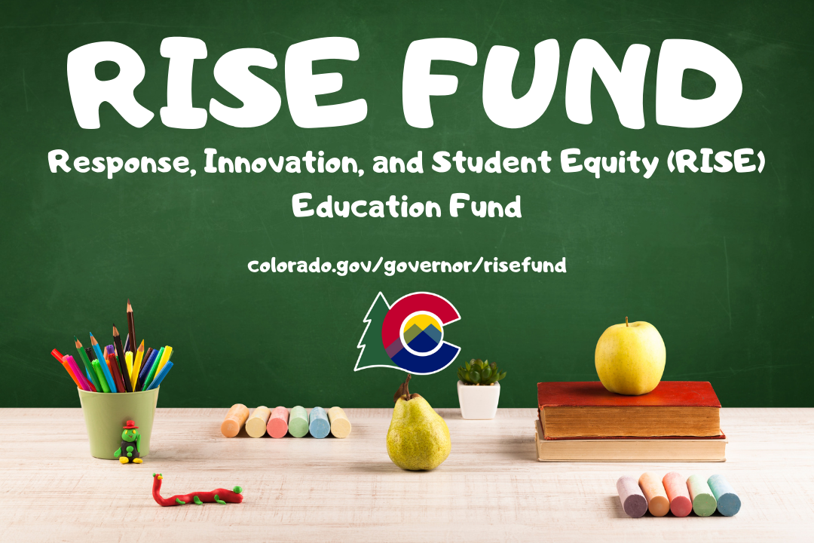

RISE Fund

Slide 2

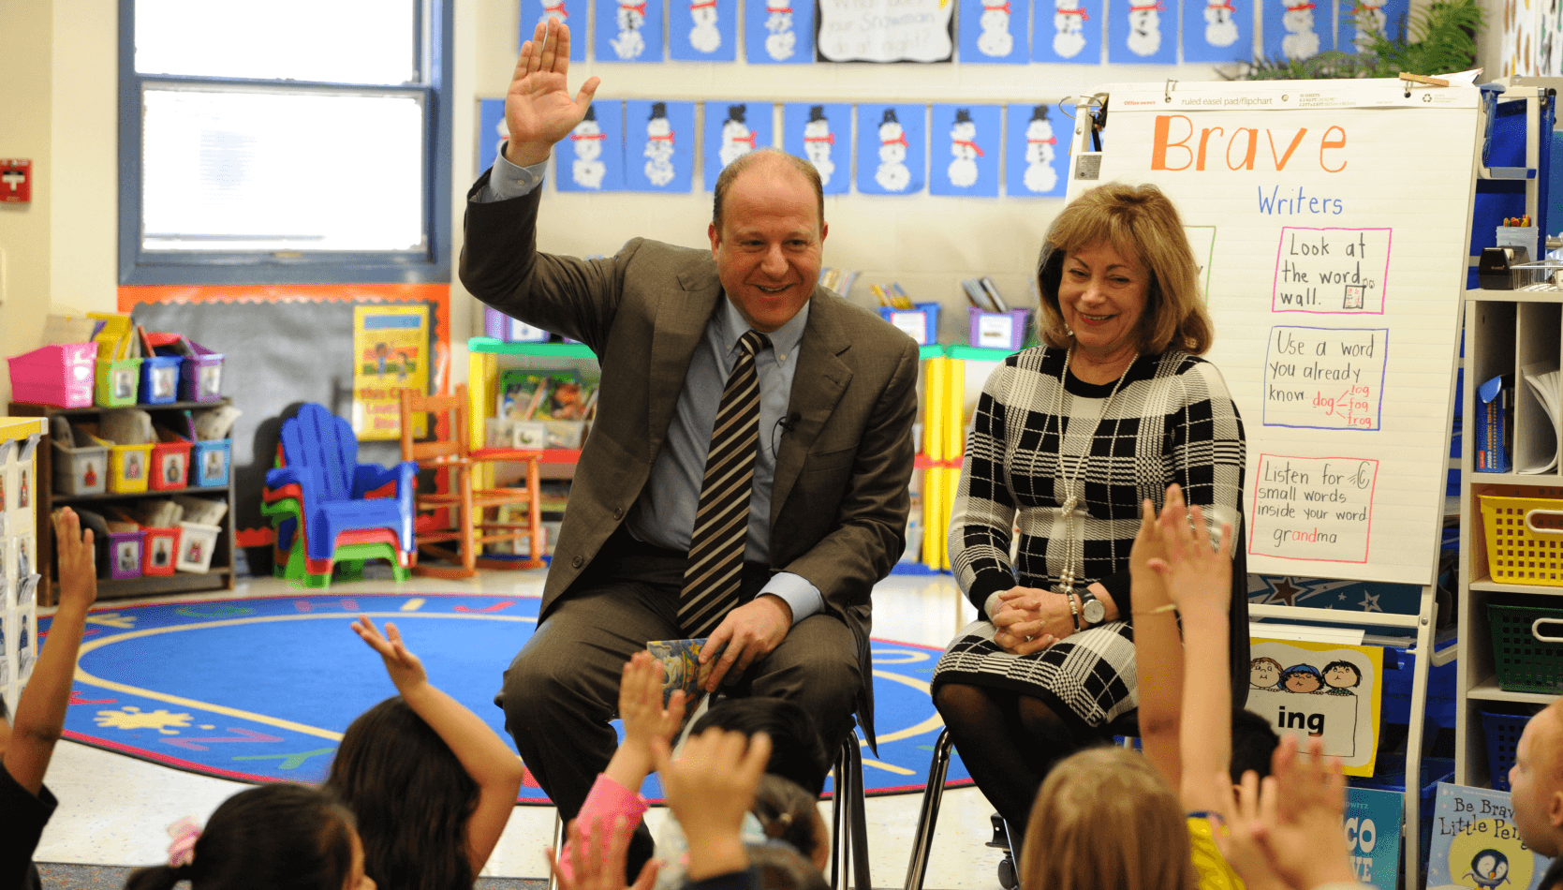
We also know that COVID-19 provides an opportunity to do something DIFFERENT.
Why RISE?
COVID-19 has not affected all children equally.
Students who already faced challenges… including
low-income students
minority students
English learners
Students with disabilities
Students experiencing food or housing insecurity
or system-involved students such as those in foster care
  risk falling further behind in the absence of targeted support.

Slide 3
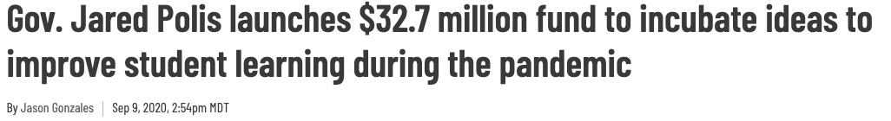
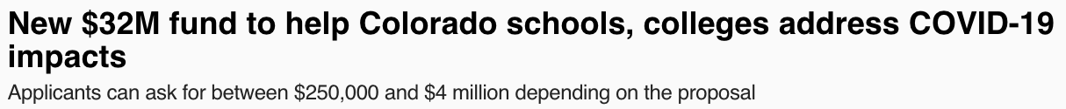
The Response, Innovation, and Student Equity Fund is a $32.7 million fund using Governor’s Emergency Education Relief Funds intended to:
address the social, economic, and health impacts of COVID-19
Promote innovation that improve student learning, closes equity gaps, and enhance operational efficiency for pre-K-12 through higher education
What is RISE?

Slide 4
Who is Eligible for RISE?
Eligible Lead Applicants:
School districts (on behalf of all schools or particular schools) or BOCES
Charter School Institute (CSI)
Charter schools
Public degree-granting institutions of higher education (or systems)
Federally-recognized Tribes
Consortia of such entities
Early childhood councils
Eligible Partners:
Non-profit or community-based organizations
Early childhood providers
Local government entities
Employers or workforce partners

Slide 5

RISE Areas of Focus
Providing new student-focused models of learning for students, which may include whole school turnarounds or reimagining higher education.
Dramatically rethinking the student experience for higher education institutions to improve student persistence, retention, and graduation rates, including shorter time to degree and dual and concurrent enrollment.
Strengthening and formalizing linkages between P-12, higher education, and industry, which may include work-based learning, improving transitions, apprenticeships, early colleges, and preparing students for in-demand careers and sectors in their community.
Catalyzing innovations for pre-K and higher education that can drive long-term impact after the life of the grant, which may include partnerships to address student and family needs, leveraging economies of scale through partnerships, and cost savings for institutions, school districts, and students.

Slide 6

RISE Application Windows
1st Grant Application Deadline: October 17, 2020 at 5 pm MT
Grant awards will be announced by November 6, 2020
2nd Grant Application Deadline: December 19, 2020 at 5 pm MT
Grant awards will be announced by January 22, 2021

Slide 7
Colorado Governor’s Office is partnering with Gates Family Foundation (GFF) and Gary Community Investments (GCI) to ensure the fund reaches a diversity of geographies across the state
$300,000 available for planning and design support grants. You can find more info about those grants at https://gatesfamilyfoundation.org/governors-ed-fund-planning-support/
Planning and Design Support

Slide 8
Apply for the RISE Fund at https://www.colorado.gov/governor/risefund
Please contact GEER.Reimbursements@state.co.us with any questions or contact the following staff listed below:
Kay Yang, GEER Grant Manager I kay.yang@state.co.us
Allie Kimmel, Senior Policy Advisor | allie.kimmel@state.co.us
Now Accepting Applications!

Slide 9
CRF Updates
September 10, 2020

Slide 10
CRF CDE Cross Unit Team
Jennifer Okes, Chief Operating Officer
Adam Williams, Financial Data Coordinator
Jennifer Austin, Director of Grants Fiscal Management
Kate Bartlett, Turnaround Program Manager
…in partnership with the Governor’s Office and Office of the State Controller

Slide 11
CRF Update
CRF Reporting Update
  Q1 – September 9, 2020 (THANK YOU ALL!)
  Q2 – October 2, 2020 – mark your calendars
  Q3 – January 5, 2021 – mark your calendars
CRF monitoring information forthcoming
US Treasury guidance – CDE is aware of new guidance published by the US Treasury – CDE researching
Indirect Cost Rates – CDE researching
We suspect that Office Hours on September 9-17-2020 will have far more detailed information to share

Slide 12
Questions

