Slide 1






ESEA Committee of Practitioners Meeting September 22, 2016
Unit of Federal Programs Administration

Slide 2

agenda
CoP Business
  Intros and Membership Update
  Approve minutes from last meeting
ESEA Consolidated Application
  Review Program Questions Draft
ESEA Monitoring
  Self-assessment tool preview
  Program Review preview
Lunch
ESSA School Improvement Spoke Update
Wrap up
2

Slide 3






Cons App questions
3

Slide 4
ESSA State Plan
Each SEA must describe:
  Its system of performance management for implementation of State and LEA plans regarding supporting all students, including homeless, migrant, economically disadvantaged, racial and ethnic groups, English learners, students with disabilities, etc.
    The description of an SEA’s performance management system must include information on the SEA’s review and approval of LEA plans, collection and use of data, monitoring, continuous improvement, and technical assistance. The description must include strategies, rational, and timelines.
4

Slide 5
Consolidated Application
LEA Application
The LEA Plan¹ describes the LEA’s overall plan for HOW supports and equitable access for all students will be provided by the LEA | The budget describes how funds will be used, specifically, through strategies and action steps, to provide the services described within the LEA plan
NOTE: Not all supports or programs within the LEA plan will be tied to a budget line item, but will still be required for approval of the LEA plan.
(d) NECESSARY MATERIALS.—The State educational agency shall require only descriptions, information, assurances, and other material that are absolutely necessary for the consideration of the local educational agency plan or application.
¹SEC. 1112(a)(1) - LOCAL EDUCATIONAL AGENCY PLANS. SUBGRANTS.—A local educational agency may receive a subgrant under this part for any fiscal year only if such agency has on file with the State educational agency a plan, approved by the State educational agency
5

Slide 6

LEA Plan
Document Overview and Note Catcher
General Guiding Questions:
  Do you understand what the question is asking (the intent of the question)?
  Do you know how you would answer this question?
  Do the considerations listed correspond to how you interpret the question?
  Do you have additional ideas for the considerations?
  Is there something we are missing or that you would like to see?
BOCES Guiding Questions:
  In addition to the questions above, how can CDE tailor the application to your BOCES considering your needs, time, and effort?
6

Slide 7


Monitoring Reviews

Slide 8
Tiered Program Reviews

Slide 9






















Universal, targeted, intensive activities
Universal monitoring activities
Targeted Activities
Intensive Activities
No issues identified
Issues resolved
District identified for Tier I: Universal Review
Universal Activities reviewed by CDE
Self-Assessment conducted by district
CDE reviews required follow- up activities.
Targeted Review Activities
Program Review Resolution
Follow-up
Issues resolved
District identified for Tier II: Targeted Review
Universal Activities reviewed by CDE
Self-Assessment conducted by district
CDE Develops
Targeted Review and solicits documentation
May include on- site program review
Program Review Resolution
Follow-up
Issues resolved
District identified for Tier III: Intensive Review
Universal Activities reviewed by CDE
Self-Assessment conducted by district
CDE solicits documents for review
Combined on- site program review
Program Review Resolution
Follow-up
Issues that may require follow-up:
Subgroup not meeting targets (SPF)
Excessive carryover
Use of alt. comparability calculators
Required changes in Cons App
Possible Follow-up Activities:
Virtual Academy or Cons App training
Submit comparability plan/formula
Monthly review of drawdowns
Cons App planning support
Customized review protocol components
Targeted list of indicators based on Tier II identifying factors and any issues identified through
Universal Activities and Self-Assessment processes.

Slide 10


Self-assessment
Purpose
  To be used by the LEA to:
    Self-assess program implementation
      Completed but not submitted
    Can be used to request support
    Prepare for onsite review (if applicable)
  Will be referred to throughout the year by CDE during webinars etc.
  Could be eventually be tied to a resource bank to support the requirement
Question:
How frequently do you think the LEA should complete this self- assessment?

Slide 11

Onsite Review
Introduction
  Purpose
    Emphasis on Support for Effective Programs
  Timeline
  Sample Schedule
Sample Standard
  Educator Effectiveness

Slide 12
Questions
Is it helpful to have separate compliance and effective
programs documents? Why or why not?
Will the self-assessment help you ensure your programs are compliant?
How can we ensure the field understands that the new performance management system (monitoring) is intended to identify and provide supports rather than impose punitive measures?

Slide 13

Bridging question:
Do you see a clear connection between the plan you will enter in the Consolidated Application (based on the questions) and what will be monitored under the new Performance Management System?

Slide 14

School Improvement
14

Slide 15
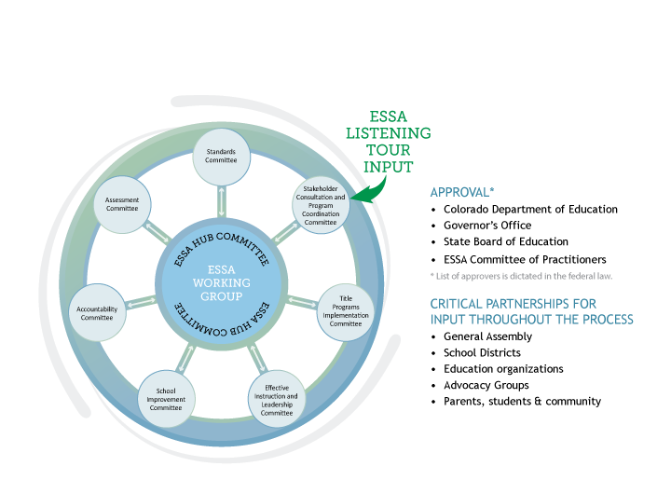
ESSA State plan Development
1
5

Slide 16



Decision Points
SEA supports for identified schools
  Definitions, timelines, interventions, and supports
    Comprehensive Support Schools
    Targeted Support Schools
    Additional interventions for schools not making progress
Identify and define “evidence-based” interventions
  Definition
  List of approved interventions?
Allocation of School Improvement resources
  CDE must reserve 7% of the state Title I allocation to support identified schools
    Formula v. Competitive
  Direct services to districts with identified schools
16

Slide 17

defintions
Comprehensive Schools:
  Includes at least the bottom 5% of lowest performing Title I schools
  Includes any high school failing to graduate at least 1/3 of students
  Identified at least every three years starting in 2017-18
Targeted Schools:
  Any schools that is consistently underperforming for one or more disaggregated groups of students
  Additional Targeted schools (schools with subgroups that would meet the lowest 5% definition)

Slide 18

Definitions continued
Evidence-based Strategy (based upon sec. 8002(21)(A)) is an
activity, strategy, or intervention that
  Has a research base (e.g., experimental design, promising evidence)
  Is likely to improve student outcomes or other relevant outcomes
  Includes ongoing efforts to examine the effects

Slide 19
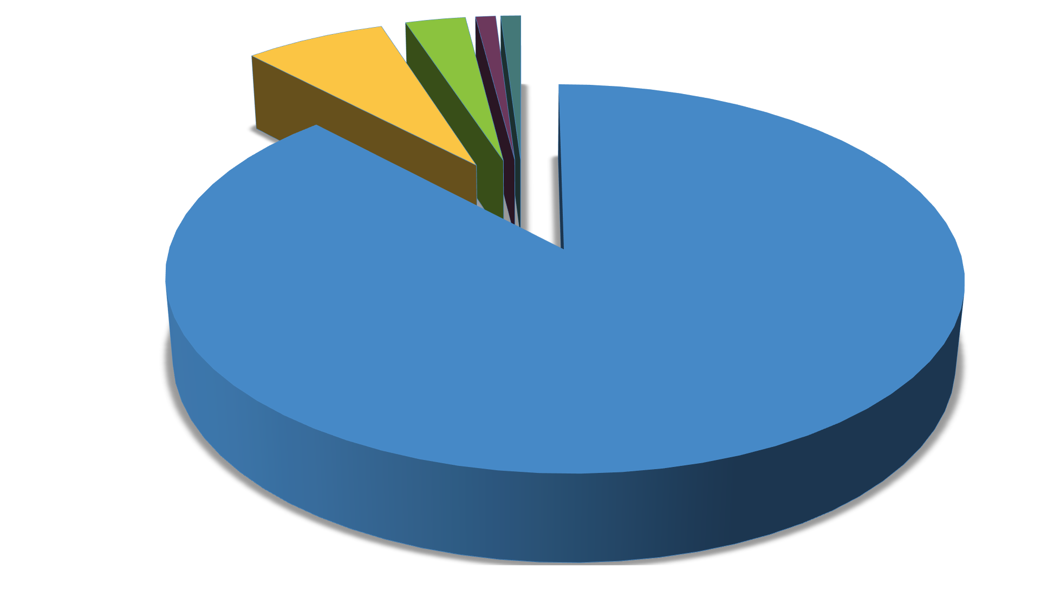
ESSA Title I Funds ~ $150M Annually (Estimates only)
Distibution to schools 132M 3% Dir Serv (Optional) 4.5M Delinquent Alloc. 1.5M
7% SI Funds (Required)10.5M State Admin 1.5M

Slide 20




7 % Must be set aside to support schools identified for ESEA School Improvement.
Eligibility for access to set aside
  Lowest 5% of Title I schools in the state
  High Schools with grad rate less than 67%
  Schools with underperforming Subgroups
Estimated ~ $10,500,000
95% of set-aside must go to LEAs with identified schools
SEA must
  Prioritize LEAs with large numbers of identified schools
  Take into account the geographic diversity of the LEAs in the state
Decision Points
  Award funds by formula?
  Award funds competitively (as under NCLB)?
  Hybrid (formula and competitive)?
  Should SEA retain funds to provide direct services?

Slide 21
Agenda – school improvement
Overview of expectations for School Improvement Spoke Committee
Work of School Improvement Spoke Committee to date
Discussion
21

Slide 22
Assumptions/definitions
The Accountability Spoke Committee is recommending how to identify comprehensive and targeted schools – and exit criteria. This will inform our committee work.
We plan to use the ESSA plan as an opportunity to re-vision supports for low performing systems.
State laws are still in effect – we will note and maintain a list of needed policy changes, if necessary.
We seek to clarify specific roles for state, districts and schools in supports and school improvement.
22

Slide 23

Current practices
Alignment of ESEA accountability requirements and state
accountability requirements
  School and district performance frameworks and identification of low performing districts/schools
  Unified Improvement Planning
  Title I Focus Schools and Priority Schools
  State and Title I requirements for parent notification
State and Federally Funded Supports
  Differentiated supports to districts and schools, including: Tiered Intervention Grant, Turnaround Network, Connect for Success grant, Turnaround Learning Academy, Diagnostic Review and Improvement Planning grant, School Turnaround Leaders
23
Development grant, Pathways for Early Action grant

Slide 24

structure
Groups | Roles
Committee Leads | Leadership for the committee
Working Group | Create draft plan based upon feedback
Internal Advisory Group | Advise, design thinking, draft specific sections, provide feedback
External Advisory Group | Advise, design thinking, provide feedback

Slide 25
membership
Variety of districts and organizations represented – superintendents, district administrators, advocacy organizations, community members
Urban and rural voices from across the state
Committee membership (see handout)

Slide 26

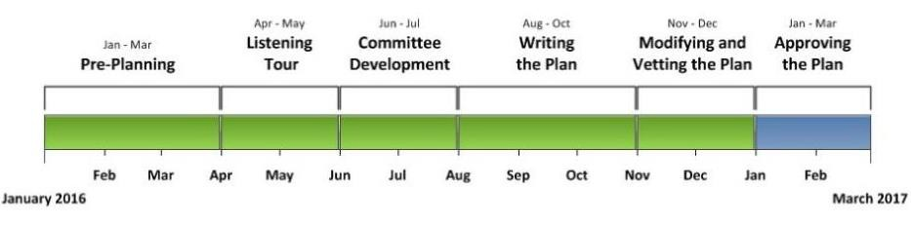
timeline
Colorado must submit an ESSA state plan by March 6 or July 3, 2017, per the
proposed regulations.
2
6

Slide 27

Timeline and focus
Timeline | Focus
Aug 17 Meeting | Orientation Design thinking on support structures
Sept 23 Meeting | Feedback on draft of support structures Design thinking on resource allocation
Oct (Meeting date TBD) | Feedback on draft of resource allocation Review of overall recommendations
End of Oct | Submit proposed plan for School Improvement and Supports to CDE and Hub Committee
Nov – Dec | Vet plan with your constituents and colleagues and provide general comments

Slide 28
Outcome
Creating a resource of the features to include in the design of the SEA supports.
Gathering input from advisory committee, State Board of Education, Hub Committee and feedback from Listening Tour.
Will use resource to review initial drafts.
CDE staff still sorting through responses.
Some examples of the categories include:
  Resource equity
  Menu of options
  Diagnostic tools and planning
  Performance management and progress monitoring
  Leadership development

Slide 29
Agenda discussion
Overview of expectations for School Improvement Spoke Committee
Work of School Improvement Spoke Committee to date
Discussion
29

Slide 30
Discussion questions
In designing systems of support, what are the features that
need to be in place?
  From CDE to districts with identified schools?
  From districts to identified schools?
  From other stakeholders?

Slide 31

contact
For more information, contact the School Improvement Spoke
Committee leads:
  Brad Bylsma, Federal Programs bylsma_b@cde.state.co.us
  Lisa Medler, Improvement Planning
medler_l@cde.state.co.us
  Peter Sherman, School and District Performance sherman_p@cde.state.co.us

Slide 32

Wrap up

Slide 33

Upcoming meetings
Thursday, October 6
  1560 Broadway (19th floor conference room)
Thursday, November 17
  Colorado Children’s Campaign (1580 Lincoln)
Thursday, February 16
  Colorado Children’s Campaign (1580 Lincoln)
Thursday, April 20
  Colorado Children’s Campaign (1580 Lincoln)
33

