Slide 1
ESEA Consolidated Application Questions 2024-2025
Federal Programs and Supports Unit

Slide 2
Purpose
To provide applicants with the narrative questions for the 2024-2025 Consolidated Application and the minimum requirements for responses
To highlight changes to the 2024-2025 Consolidated Application questions.
To inform applicants of upcoming support that will be provided.
Answer any questions that LEAs/BOCES may currently have regarding the Consolidated Application questions

Slide 3
Agenda
Summary of Available Support
  Trainings
  Tools
  Application Timeline
Highlight notable changes within the questions:
  Cross Program
  GEPA
  Title I, Part A
  Title I, Part D
  Equitable Distribution of Teachers (EDT)
  Title II
  Title III
  Title IV

Slide 4
Summary of Available Support

Slide 5
System of Support
Our goal in the Office of Federal Programs and Support is to develop system of support that will ensure LEA staff have what they need to successfully submit the Consolidated Application and continue the work of effectively meeting the needs of students.
Targeted Trainings
Narratives Training
April 9th
GAINS System Training April 25th
In Person
Work Sessions
Title I District Level Set-Asides
  Watch HERE
Non-Public Schools
  Watch HERE
Schoolwide vs. Targeted Assistance Programs
  Watch HERE
Title III & Immigrant Set-Aside
  Watch HERE
LEAs with
Less than 1,000 students
Regional In-person work sessions will provide the opportunity to work on your LEA’s Consolidated Application with the support of ESEA specialists and GAINS experts.
Register HERE.
Changes and rationale for updates to the 2024-2025 Consolidated Application questions.
Minimum requirements for responses for the updated Consolidated Application questions.
CDE’s Grants Program Administration (GPA) team will present
Register HERE.

Slide 6
Tools to Support Application Development
2024-2025 Paper Consolidated Application
Revised Response Guidance
Identifies the minimum required for approval and helpful resources.
Access to the LEA’s 2023-2024 Consolidated Application
Tools available at https://www.cde.state.co.us/fedprograms/consapp/index

Slide 7
Timeline: Substantial Approval
In order to receive Substantial Approval on the 2024-2025 Consolidated Application, the applicant will need to submit the following:
Activity​ | Due Date​ | Submission Location ​
School Improvement Retention of Funds Form​ | TBD​ | ESEA ARAC: School Improvement Retention of Funds page​
Approval and Transmittal Form​ | TBD​ | ESEA ARAC: FY 2024-2025 Consolidated Application for ESEA Program Funds Approval and Transmittal​
BOCES Member District ARAC Form​ | May 17​ | BOCES ESEA ARAC: FY 2024-2025 Consolidated Application for ESEA Program Funds Approval and Transmittal​
Non-Public School Consultation Forms​ | June 30​ | ESEA Consolidated: Non-Public Schools page​
Native American Education Tribal Consultation Form​ ​ ​ | June 30​ | Submit to Georgina Owen​
Online Application ​ | June 30​ | http://colorado.egrantsmanagement.com/default.aspx?ccipSessionKey=638463692306105471 ​

Slide 8
Consolidated Application Narratives

Slide 9
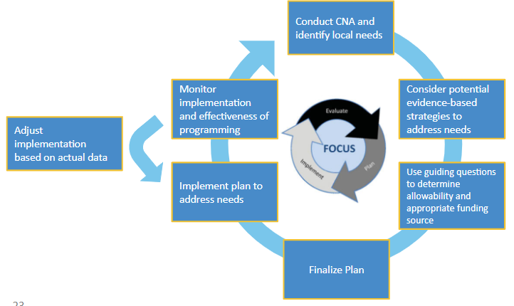
Rationale for Application Updates
Beginning of a new 3 year application cycle
Migration to a new platform
Applied lessons learned from the past 4 years of the application, new guidance, work of other states and/or initial monitoring work.
Considered flow and clarity of questions.
Revised questions and order to ensure that the needs of the LEA drive the use of ESEA funds.
Reviewed with ESSA State Committee of Practitioners (CoP)

Slide 10
Cross Program Highlights

Slide 11
Cross Program Narratives
Question Categories | 2023-2024 | 2024-2025 | Notable Differences
Stakeholders | 3.1, 3.2 | 1.1, 1.2 | List provided of common participants
Identified Needs for ESEA | 1.1, 1.2, 1.3, 2.1, 2.2 | 2.1
Program Evaluation | 5.1, 5.2 | 3.1, 3.2 | If the LEA makes effectiveness decisions, 3.2 is not applicable
Outreach | 4.1, 4.2 | 4.1, 4.2 | Bulleted list of evidence-based outreach strategies Specific outreach to EL/ML is its own question

Slide 12
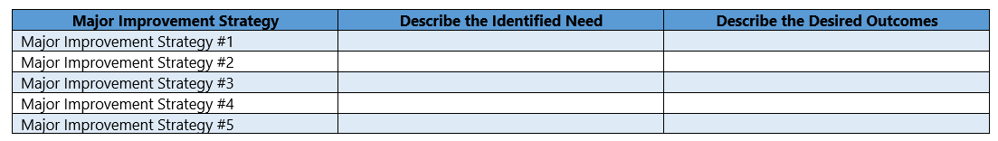
Cross Program - Identified Needs for ESEA Funds
Identified Needs for ESEA | Organized by the LEA’s Major Improvement Strategies in the LEA’s strategic plan (i.e., UIP, 90 day plan, SCAP) Consider needs related to students, staff, academic and behavioral needs, professional development or any other critical needs. Overarching strategy will be identified at the beginning of Need section Activities supporting needs will be tagged in budget
2.1 Based on the LEA’s comprehensive needs assessment, describe the identified needs that will be addressed with ESEA funds. Consider needs related to students, human capital, academic and behavioral needs, professional development, or any other critical needs. For each of the identified needs, describe the intended goals and desired outcomes. Note, the district will indicate in the budget the evidence-based strategies associated with each Major Improvement Strategy.

Slide 13
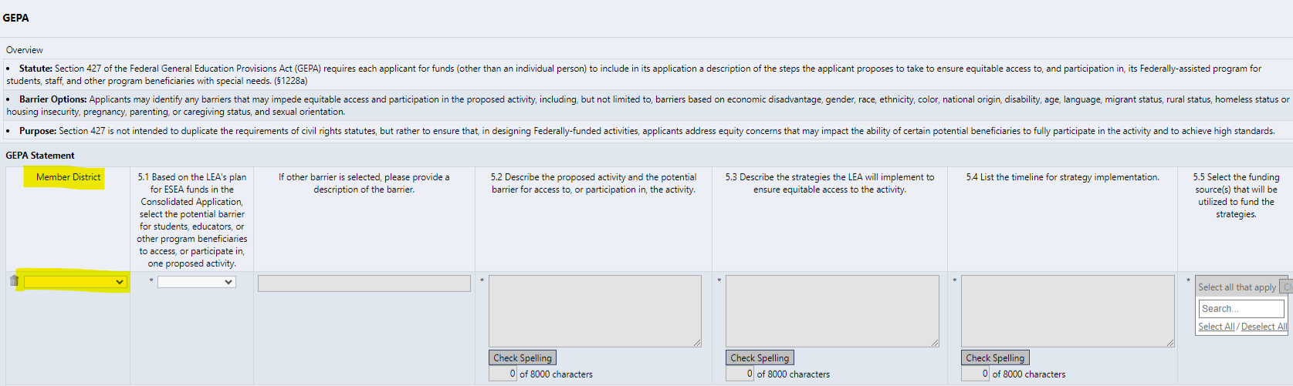
GAINS View- GEPA
Note: New USDE guidance has expanded the list of barriers to include language, migrant status, rural status, homeless status or housing insecurity, pregnancy, parenting, or caregiving status, and sexual orientation.

Slide 14
GEPA - District Example
Ensure your response addresses the system barriers, who is impacted, how you plan to overcome the barrier, and the timeline. See the following, simplified examples:
Example: The district will utilize Federal funds to provide literacy and math intervention. Multilingual learners have not made as much academic progress in the intervention programs as other students. The district has identified a lack of training for our staff to support multilingual learners, specifically in regard to the social, emotional, and academic success, as a root cause of low student achievement. To address this barrier, the district will provide quarterly professional development opportunities for teachers to employ culturally and linguistically responsive instructional practices throughout the school year.
Non-example: The district has many students who don’t speak English and these students are not meeting academic state standards. The district will use Federal funds to support these students in literacy and math.

Slide 15
GEPA - BOCES Example
BOCES Example: The BOCES will utilize Federal funds to provide professional development to teachers from several rural districts. One potential barrier is access to professional development due to the distance of member districts to the BOCES. To address this barrier, the BOCES will provide professional development in a hybrid format where teachers can stream the PD at their district’s schools in September and January.

Slide 16
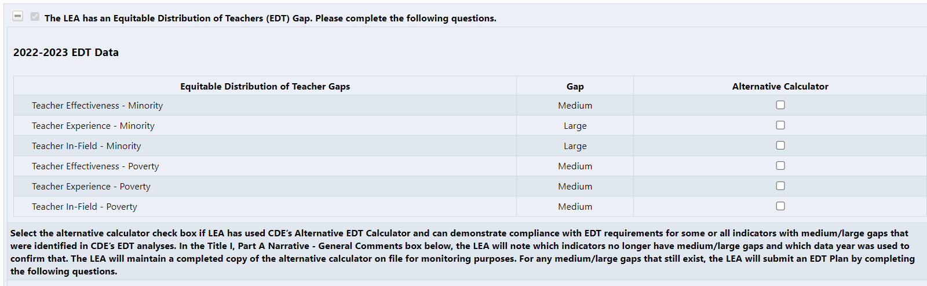
GAINS View- Equitable Distribution of Teachers (EDT)

Slide 17
EDT Cont.
Question 1: Stakeholders will be listed and selected, no longer a narrative.
Question 2: Description of stakeholder engagement.
Question 3: What root cause(s) was/were identified for each EDT disparity (gap)?
  Reworded to clarify the LEA should provide a root cause for each gap.
Question 4: Describe the key strategies the LEA implemented/will implement to address each root causes. Include the timeline for implementing these strategies
  Reworded to recognize that some strategies may already be implemented.

Slide 18
Title I Narratives

Slide 19
Title I, Part A
Question 1: Same as 2023-2024
Question 2: Shifted to describing the identification, support and services provided to homeless children and youth.
Question 3: Indicate if the LEA plans to use Title I, Part A funds to implement discipline practices that reduce student removal from the classroom.
  Select Yes or No
  If yes, reviewer will look for activities tagged in the budget to determine allowability and reasonableness.
Question 4: Indicate if the LEA plans to use Title I, Part A funds to effectively transition student through school and/or prepare them for college and career readiness.
  Select Yes or No
  If yes, reviewer will look for activities tagged in the budget to determine allowability and reasonableness.

Slide 20
Title I, Part D Overview
Purpose of Title I, Part D
To carry out high quality education programs to prepare children and youth for secondary school completion, training, employment, or further education
To provide activities to facilitate the transition of such children and youth from the correctional program to further education or employment
To operate programs in local schools including schools operated or funded by the Bureau of Indian Education,for children and youth returning from correctional facilities, and programs which may serve at-risk children and youth
The LEA is eligible when they have children who:
Live in locally operated institutions for neglected or delinquent youth that are not operated by the state.
Are 5-17, inclusive, years old.
Live in the residential program for at least one day during the 30-day count window.

Slide 21
Title I, Part D Subpart 2 Narrative
1. Describe the programs funded by Title I, Part D, the children and youth that these programs serve, and how educational needs are met by utilizing Title ID funding. Include the following:
How the LEA will assess the educational needs of the children
How the LEA will include parents/family to support educational achievement of students
A general description of the evidence-based strategies that will address the identified needs
2. Describe the formal agreements, regarding the program to be assisted, between -
a. the local educational agency; and
b. correctional facilities and alternative school programs serving children and youth involved with the juvenile justice system including such facilities operated by the Secretary of the Interior and Indian tribes;

Slide 22
Title I, Part D Subpart 2 Narrative cont’d
3. Describe the partnerships that the LEA has established with organizations to support children and youth (for example, correctional facilities, institutions of higher education, postsecondary and workforce readiness programs, probation officers). Ensure that any organizations supporting this work are included in the provided description.
4. Describe how the LEA will ensure that students are receiving the same opportunities as students in local public schools which they would otherwise attend.
5. Describe how the participating schools will facilitate a successful transition for children and youth from the correctional facilities to schools, including any social and health needs.
6. Describe the steps the LEA will take to find alternative placements for children and youth unable to participate in a traditional public school program.
7. Describe how, when, and how frequently the Title I, Part D funded programs will be evaluated and how evaluation results will be used to inform future plans.

Slide 23
Title I, Part D Subpart 2 Assurances
The LEA ensures that it has a process for determining if a child has an Individual Education Plan (IEP) and can implement the IEP.
The LEA ensures that the program will be coordinated with programs operated under the Juvenile Justice and Delinquency Prevention Act of 1974 and other comparable programs.

Slide 24
Title II Narratives

Slide 25
Title II, Part A
Question 1:
Describe how Title II, Part A funds will be used to supplement, not supplant, the professional growth and development efforts supported with state and local funds. Please note: evaluation and induction programs must be funded using state and local funds.
Changes:
No longer a table
No location required
Provide summary of professional growth system within narrative

Slide 26
Title II, Part A Cont.
Question 2:
If the LEA has schools identified for Comprehensive Support and Improvement (CS), Targeted Support and Improvement (TS) and Additional Targeted Support and Improvement (ATS). Please complete the following question:
How will schools identified as CS, TS, or ATS and those schools with the highest percentage of children identified as low-income be prioritized within the proposed Title II activities?
Changes:
No longer a table
Narrative should include how the LEA is addressing and prioritizing CS, TS, ATS and high needs schools.

Slide 27
Title III Narratives

Slide 28
Transition from EL to ML
We cannot fully transition from EL (English Learner) to ML (Multilingual Learner) until we get our ESSA State Plan approved in 2025-2026.
Throughout the application you will see: EL/ML

Slide 29
Previous Title III Narrative:
Title III Narrative, Question 1 - Professional Development
Complete the tables to describe how professional development is funded.
The LEA must provide high-quality professional development to classroom teachers (including teachers in classroom settings that are not designed for only language instruction educational programs), principals, administrators, and other school or community-based organizational personnel. The professional development must:
Improve the instruction of ELs;
Enhance the ability of teachers to understand and use curricula, assessment measures, and instructional strategies for ELs;
Be scientifically research-based and of sufficient duration and intensity. §3115(c)(2))

Slide 30
Changes to Title III Narrative Section
Identify Core ELD programs for elementary, middle, and high school
Narratives for the required Title III activities:
  Increase English proficiency
    Supplemental activities
  Professional development
  Family, community engagement
Immigrant Set Aside
  Discuss needs assessment, describe student population
  Allowable activities

Slide 31
GAINS Title III Narrative Question 1
Select the core English Language Development (ELD) programming methods/models of instruction provided within the LEA. Title III, Part A funds must be used for purposes that are supplemental to core ELD programming. This includes provision of direct instruction services, professional development, and the purchase of materials and supplies.

Slide 32
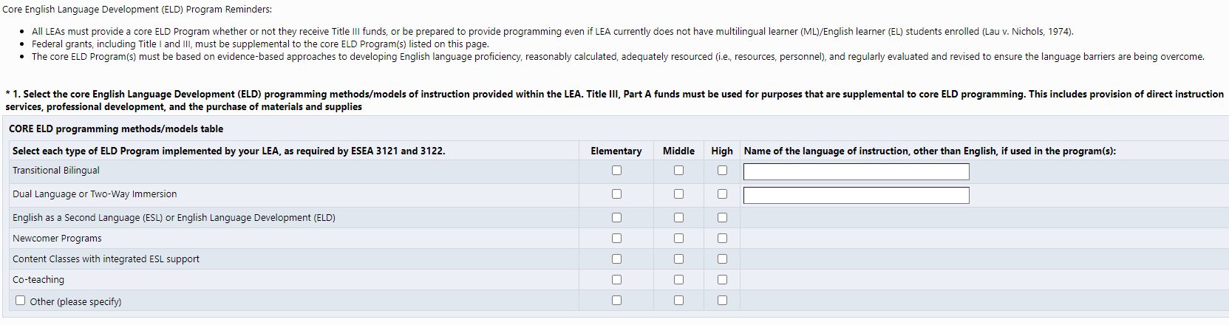
GAINS View- Narrative Question 1
Alignment with Consolidated State Performance Report (CSPR)
Co-teaching was added (not part of CSPR)
Supporting document will be linked (see next slide)

Slide 33
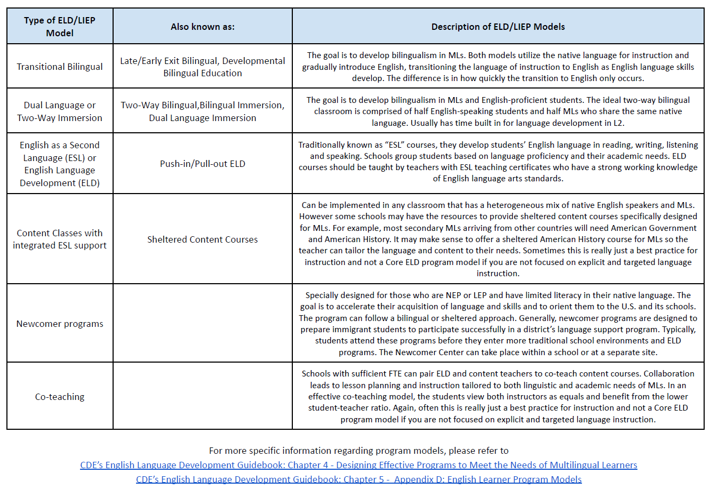
Supporting Document - linked in Narrative Question 1

Slide 34
GAINS Title III Narrative Question 2
Required Title III, Part A Activity: to increase the English language proficiency of multilingual learners (MLs) by providing effective language instruction educational programs that meet the needs of MLs and demonstrate success in increasing:
English language proficiency; and
Student academic achievement
Provide an overview of the supplemental activities (beyond required ELD Core Program/State and Federal Requirements) to be implemented this school year with Title III, Part A funds.

Slide 35
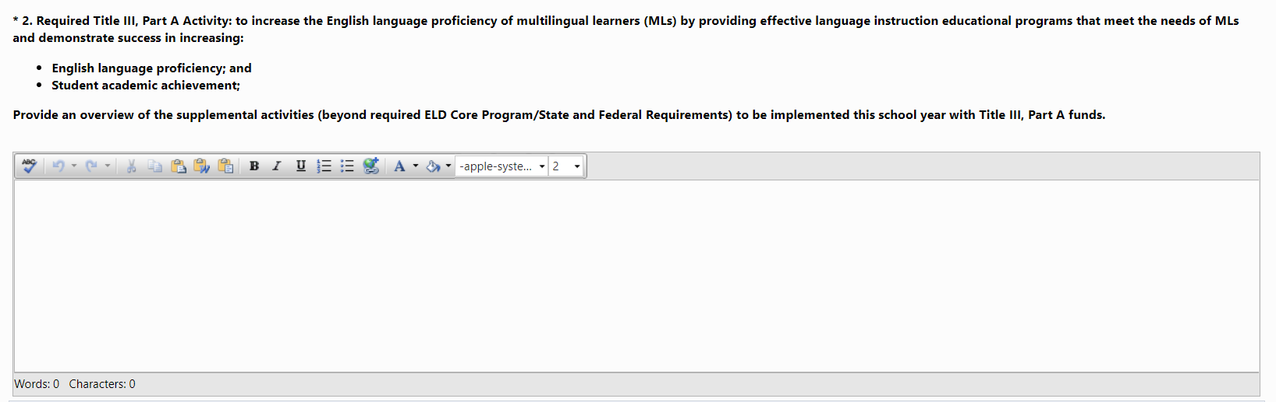
GAINS View- Narrative Question 2

Slide 36
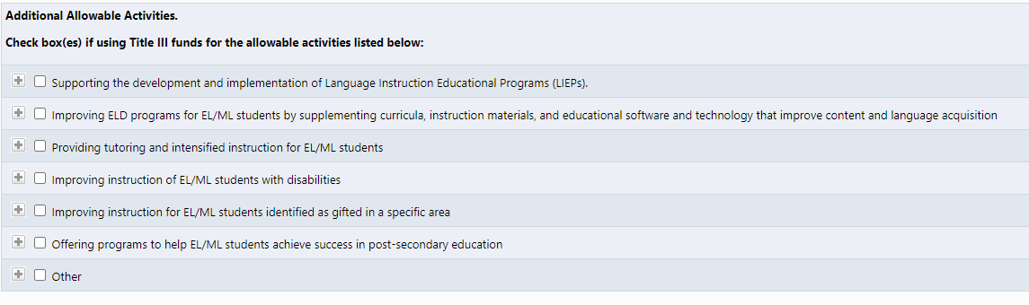
GAINS View- Narrative Question 2, Cont.

Slide 37
GAINS Title III Narrative Question 3
Required Title III, Part A Activity: to provide effective professional development to classroom teachers (including teachers in classroom settings that are not the settings of language instruction educational programs), principals and other school leaders, administrators, and other school or community-based organizational personnel, that is:
designed to improve the instruction and assessment of multilingual learners;
designed to enhance the ability of such teachers, principals, and other school leaders to understand and implement curricula, assessment practices and measures, and instructional strategies for multilingual learners;
effective in increasing children’s English language proficiency or substantially increasing the subject matter knowledge, teaching knowledge, and teaching skills of such teachers; and
of sufficient intensity and duration (which shall not include activities such as 1-day or short-term workshops and conferences) to have a positive and lasting impact on the teachers’ performance in the classroom, except that this subparagraph shall not apply to an activity that is one component of a long-term, comprehensive professional development plan established by a teacher and the teacher’s supervisor based on an assessment of the needs of the teacher, the supervisor, the students of the teacher, and any local educational agency employing the teacher, as appropriate
Complete the table below by indicating the name of the professional development activity and provide a detailed description.

Slide 38
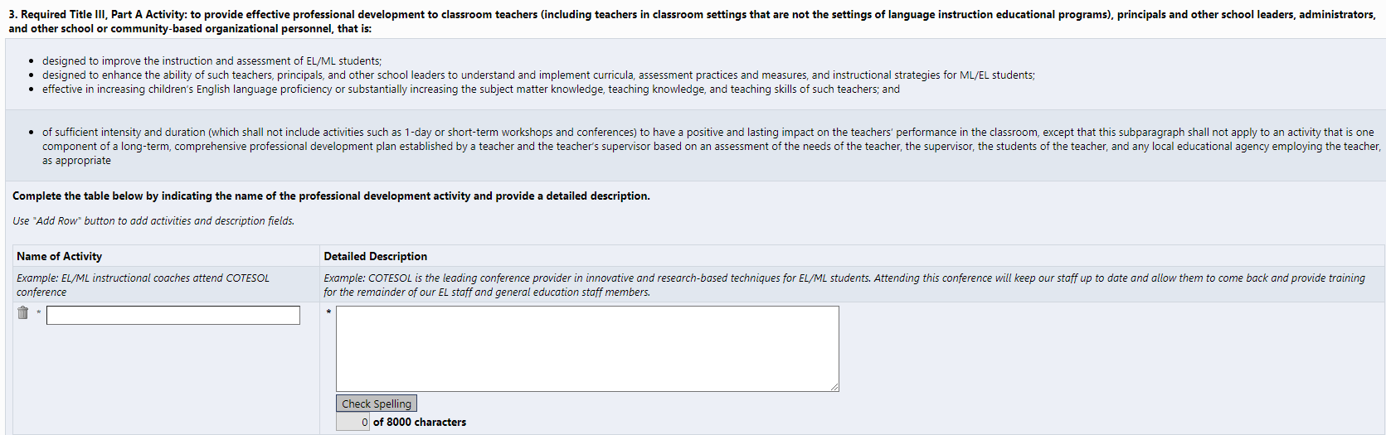
GAINS View- Narrative Question 3

Slide 39
GAINS Title III Narrative Question 4
Required Title III, Part A Activity: parent, family, and community engagement in language instruction educational programs using Title III funding.
Describe how the LEA uses Title III funds to implement ML-specific parent, family, and community engagement.

Slide 40
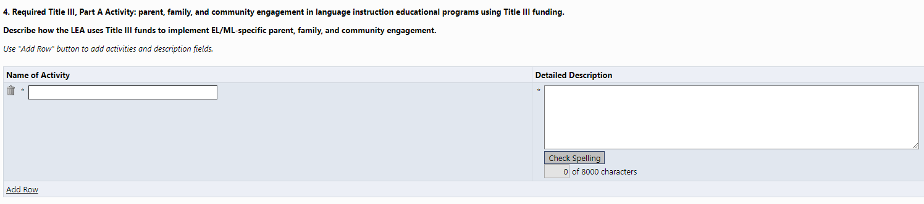
GAINS View- Narrative Question 4

Slide 41
Immigrant Set Aside Narratives

Slide 42
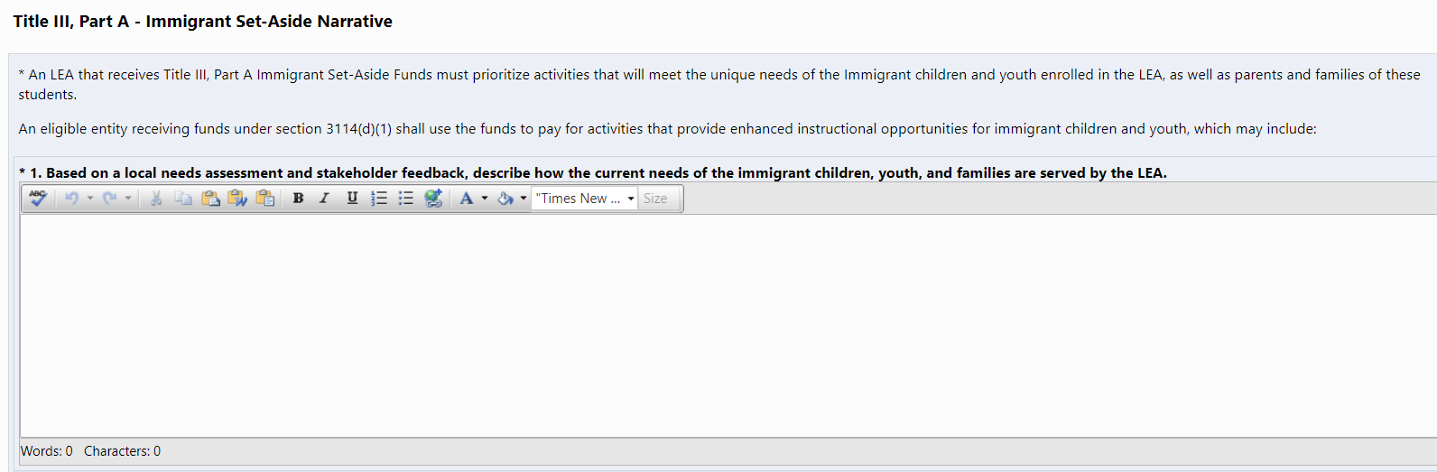
GAINS View- Immigrant Set Aside

Slide 43
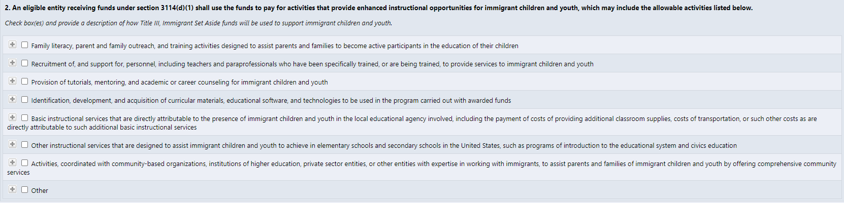
GAINS View- Immigrant Set Aside, Cont.

Slide 44
Title IV Narratives

Slide 45
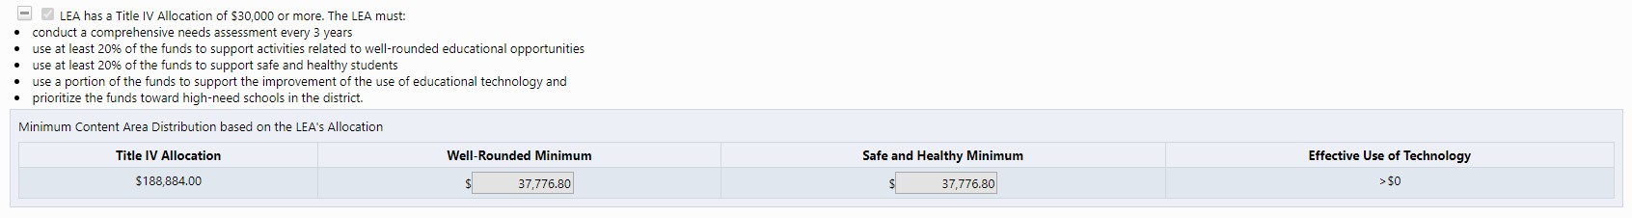
GAINS View- Title IV Narratives

Slide 46
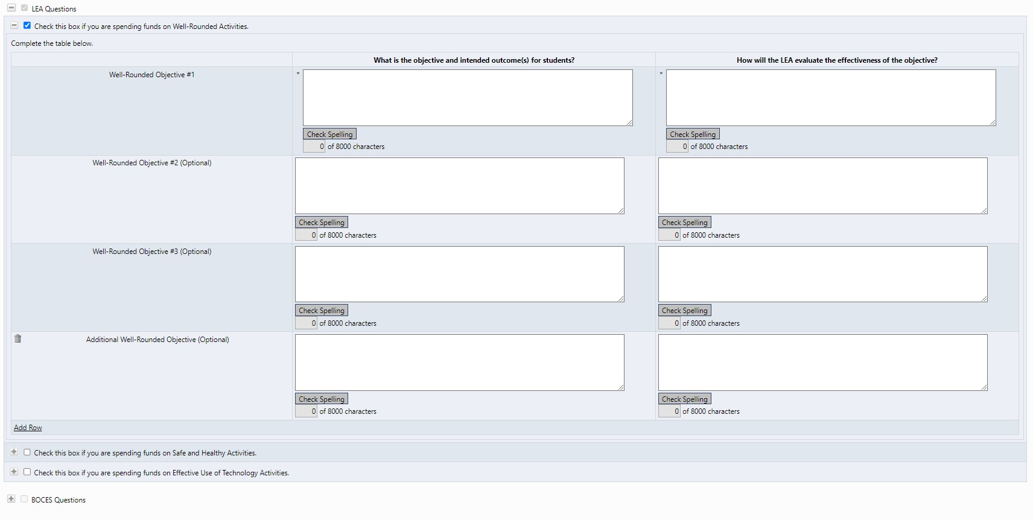
GAINS View- Title IV Narratives, Cont.

Slide 47
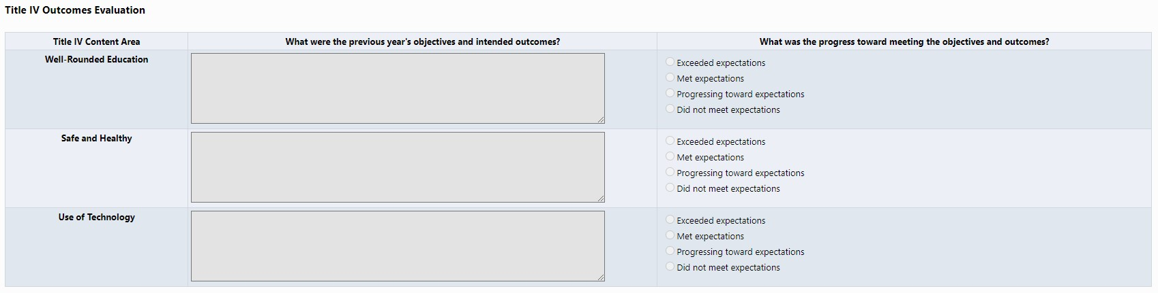
GAINS View- Title IV, Evaluations and Effectiveness
* For 24-25 Consolidated Application, LEAs will copy and paste Title IV objectives and outcomes from the 22-23 or 23-24 Consolidated Application and rate progress towards meeting expectations.

Slide 48
Resources

Slide 49
Additional Resources
The Launchpad for staff new to ESEA
Non-Public Resources
GEPA
Title I, Parts A and D
Title II
Title III
Title IV
Title V

Slide 50
Extension Requests
If the LEA/BOCES is unable to submit all the requirements for Substantial Approval by June 30 the LEA or BOCES may request an extension by submitting a completed extension request form. The extension request form is available online: www.cde.state.co.us/fedprograms/consapp/index
The LEA/BOCES may not encumber funds until a complete application has been submitted to CDE and granted Substantial Approval. Once the extension request has been submitted and approved, the LEA/BOCES has until the last business day in July to submit requirements for Substantial Approval.

Slide 51
System of Supports
Targeted Trainings
Narratives Training
April 9th
GAINS System Training April 25th
In Person
Work Sessions
Title I District Level Set-Asides
  Watch HERE
Non-Public Schools
  Watch HERE
Schoolwide vs. Targeted Assistance Programs
  Watch HERE
Title III & Immigrant Set-Aside
  Watch HERE
Less than 1,000
  Watch HERE
Changes and rationale for updates to the 2024-2025 Consolidated Application questions.
Minimum requirements for responses for the updated Consolidated Application questions.
Support Tools
  Paper Application
  Response Guidance/Review Checklist
CDE’s Grants Program Administration (GPA) team will present
Register HERE.
Regional In-person work sessions will provide the opportunity to work on your LEA’s Consolidated Application with the support of ESEA specialists and GAINS experts.
Register HERE.

Slide 52
Work Sessions
In person work sessions for support with the 2024-25 Consolidated Application
Metro
Highlands Ranch - May 2nd 12:00-3:00pm
Pikes Peak/Southeast
Pueblo - May 6th 1:00-4:00pm
North Central/Northeast
Greeley - May 15th 12:30-3:30pm
Northwest/West Central
Delta - May 14th 10:00am-1:00pm
Craig - May 15th 11:00am-2:00pm
Southwest
Alamosa - May 15th 12:30-3:30pm
Durango - May 16th 9:00am- 12:00pm
See more information and sign up for a session on the RNM webpage.

Slide 53
Questions?

Slide 54
CDE Contacts
Emails: Lastname_Firstinitial@cde.state.co.us (e.g., Smith_a@cde.state.co.us)
Federal Programs & Supports | School Finance & Operations (Fiscal and Systems Supports)
Nazie Mohajeri-Nelson, Executive Director of Federal Programs & Supports Unit Program Specialists Program Implementation Supervisor: Laura Meushaw Program Implementation Coordinator: Christina Adeboye Sullivan Program Monitoring Supervisor: Tammy Giessinger ESEA/ESSER Monitoring Coordinator: Kristin Crumley Program Effectiveness Supervisor: Tina Negley Program Evaluation & Research Coordinator: Mary Shen ESEA Programs Specialists and ESEA Regional Contacts (assigned by district) Title I: Laura Meushaw, Evita Byrd, Rachel Echsner, Kim Boylan Title II: Rachel Echsner, Sue Miller-Curley Title III: Rachel Temple, Kim Boylan Title IV & Stronger Connections Grant: Nathan Hickman, Evita Byrd Title V: Christina Adeboye-Sullivan, Rachel Echsner | Amy Carman, Executive Director of School District Operations Unit Fiscal Specialists Jennifer Austin, Director of Grants Fiscal Management ESEA Robert Hawkins, Grants Fiscal Analyst Steven Kaleda, Grants Fiscal Analyst Application Systems Specialists DeLilah Collins, Director of Grants Program Administration Online Applications Systems Technical Support Jessica Hollingshead

