Slide 1
CO Comprehensive Literacy State Development Grant
Stacey Smith, CLSD Program Grant Manager | smith_s@cde.state.co.us
Patrick Mueller, Grants Fiscal | mueller_p@cde.state.co.us
Mandy Christensen, Competitive Grants | christensen_m@cde.state.co.us
Notes:
Welcome
Introduction to staff on call
Housekeeping: All participants muted, hold questions until the end of each section, questions can be typed into the chat box (staff are moderating)
Recording and slides will be available on the CLSD webpage after today’s webinar

Slide 2
Webinar objectives
Quick overview of the CLSD Grant Program
Review of eligibility criteria and priority considerations
Review overlap and connection to the READ Act
Deeper dive into core components of the project
Open for questions

Slide 3
CLSD Overview
The Colorado Comprehensive Literacy State Development (CLSD) Grant is a federally supported grant (CFDA Number: 84.371C) intended to expand the use of evidence-based reading practices and interventions that advance literacy skills for children from birth through grade 12 with an emphasis on historically underserved students including children in poverty, English learners (ELs), and children with disabilities.
CLSD Website
CLSD FAQ Document
Age/Grade Ranges Supported
Grant funds are intended to support literacy efforts in the following ranges:
Birth-5 years including preschool
Kindergarten-5th grade
6th-12th grade

Slide 4
Funding overview
Approximately $6,160,625 is available for the 2021-2022 school year (Year 1) and $3,080,309 for each subsequent year (Years 2-4) for a total of $15,401,552 over 4 years.
The following percentages must apply to each age and grade range for all grant related activities and expenditures:
Birth-5 years (15%)
Kindergarten-5th grade (40%)
Grades 6-12 (40%)
Administrative + Indirect costs* (5%)
Suggestions for funding request amount?
Notes:
-Extra funds in year 1 of the grant will be allocated to support the development of a district-wide Comprehensive Local Literacy Plan (CLLP), and evaluation of existing structures, practices, and instructional materials.
-All administrative costs must be directly related to the CLSD project and pre-approved.
-Indirect costs cannot exceed 5%, including combined with admin costs. Indirect costs cannot exceed an applicant’s indirect cost rate agreement.
-Percentage breakdowns are a federal requirement. Applications that don’t meet this breakdown will be asked to modify their application or could be denied.

Slide 5
Eligibility and priority considerations
Charter schools
  Scope of project still has to be birth-12th grade
  Demonstrate the ability and plan for implementing all required grant components including systems-wide literacy planning
  If unable to serve birth-12th grade, consider reaching out to your authorizing district to let them know you are interested in being included in their application as a participating school
Priority considerations
  Can we still apply if not all of our included schools meet the priority criteria?

Slide 6
READ Act and CLSD
READ Act
  Mandated by statute
  Narrow and specific focus on K-3 reading
  Has very specific requirements for core instruction, assessments and professional development for educators
  Statewide initiative impacting all K-3 students
  State funded
Comprehensive Literacy State Development Grant (CLSD)
  Not mandated by statute or legislation
  Comprehensive focus on all components of literacy birth to graduation
  Focus is on expanding practitioner and administrator knowledge of the Science of Reading, evidence-based practices and transferring professional learning into classroom practice
  All K-3 activities still need to meet READ Act requirements
  Opportunity to expand literacy efforts beyond K-3 space with a focus on reading instruction only
  Initial project will support only CLSD grantees with a focus on historically underserved students
  Federally funded

Slide 7
Core components of CLSD project
Section B: Comprehensive Local Literacy Plan
Could include:
Needs assessment, evaluation of systems and structures, review of instructional materials (core, supplemental, intervention, assessments)
Review and update of an existing plan to increase effective use of scientifically and evidence-based practices
Expansion of a current plan to include comprehensive literacy plans for birth-5 years and 4th-12th grade
Planning to increase parent, family and community engagement
Improved assessment and support of English learners, students with disabilities, early reading risk identification, and historically marginalized students
Notes:
-Because this funding is more flexible, we are not looking for a cookie cutter, one size fits all approach. Each district will have unique needs and capacity for engaging in grant activities. Tell us what your district really needs to take comprehensive literacy efforts to the next level.

Slide 8
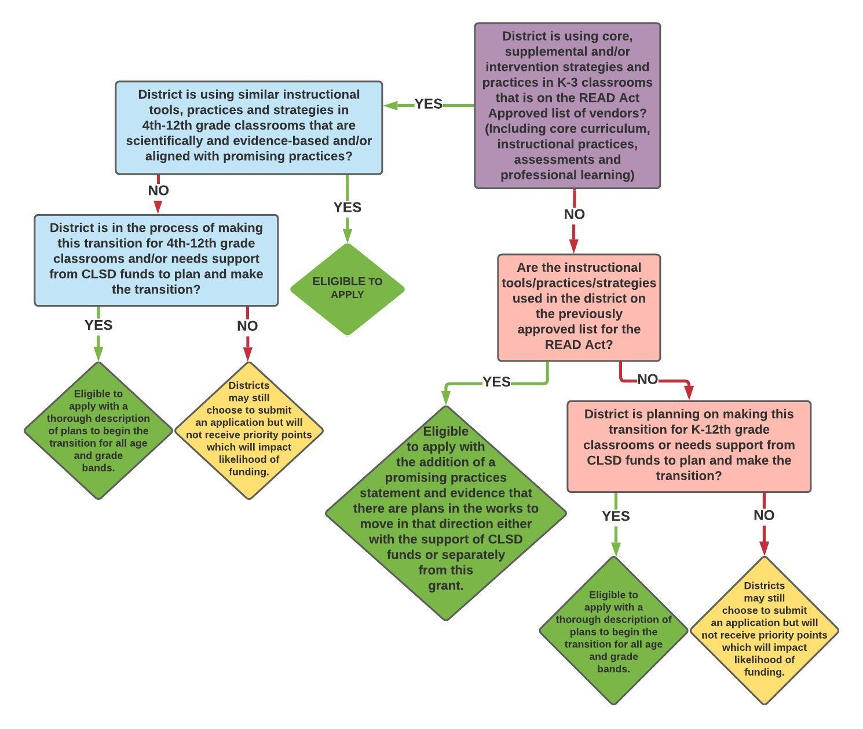
Core components of CLSD project
Section C: Use of scientifically and evidence-based practices
Link to guidance document:
http://www.cde.state.co.us/coloradoliteracy/clsdebpeligibilityguidancedocument

Slide 9
Core components of CLSD project
Section E: Professional development and literacy consulting
Professional development: Must be rooted in scientifically and evidence-based practices and support teacher and administrator knowledge on the Science of Reading and/or EBP.
Can be internal or external provider as long as it meets the required elements. Must submit desired professional development to CDE and receive approval before proceeding. Initial application can address specific PD need if specific trainings are not yet identified. Grantees can submit trainings for approval at a later date.
Literacy consultants
Can support grantees with needs assessments, comprehensive literacy planning, selecting appropriate and effective PD, coaching on transferring professional learning into classroom practice, evaluating and/or establishing systems and structures to support literacy efforts.
Are consultants required?
  No, but application must demonstrate internal capacity and expertise to carry out all grant related activities.
CLSD Literacy Consultant Advisory List application portal now open. Applications close Friday July 30, 2021.
  Link to RFA: http://www.cde.state.co.us/early/clsdliteracyconsultantadvisorylistrfa

Slide 10
Core components of CLSD project
Section F: Early childhood educator, parent, family and community engagement
Could include:
Establishing and/or expanding district-wide parent and family engagement efforts (CDE FSCP Framework)
Building partnerships with early childhood education providers not already connected with the district to improve school readiness and literacy outcomes
School-home partnership programs and materials
Home-based family literacy materials in other languages
Parent and caregiver language and literacy development programs
Building or expanding partnerships with local community-based agencies, libraries, and nonprofit agencies.
Get creative! Districts know their community needs best.

Slide 11

QUESTIONS?

