Slide 1
Teacher Student Data Link Cognos Reports

Slide 2
Accessing the Cognos Reports

Slide 3
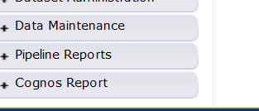
Accessing Cognos Reports
Opens new window

Slide 4
Accessing Reports
Click on the Folder Icon on the left to open the tables

Slide 5
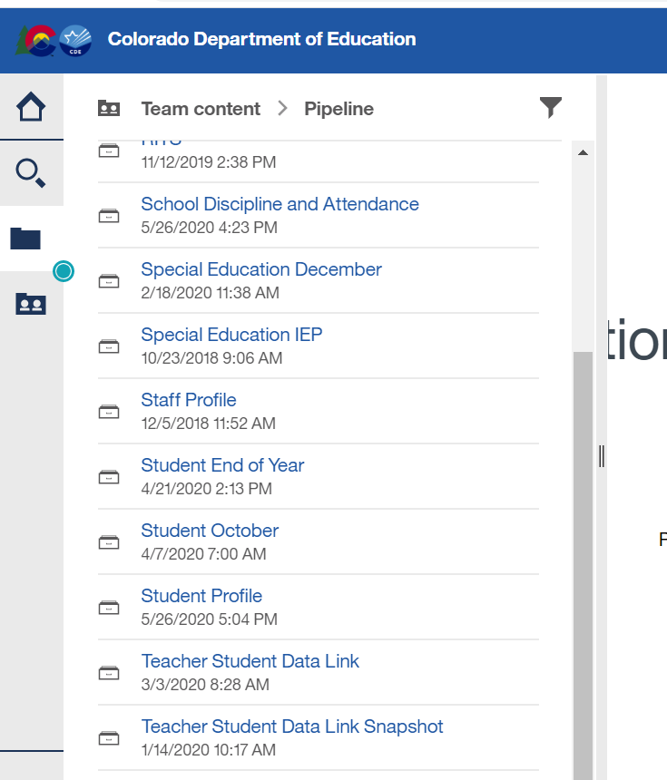
Finding the Teacher Student Data Link Reports
Use the scroll bar to scroll down if you have multiple folders
You can expand the window by dragging this bar with your mouse
Teacher Student Data Link – reports for the interchange
Teacher Student Data Link Snapshot – snapshot reports

Slide 6
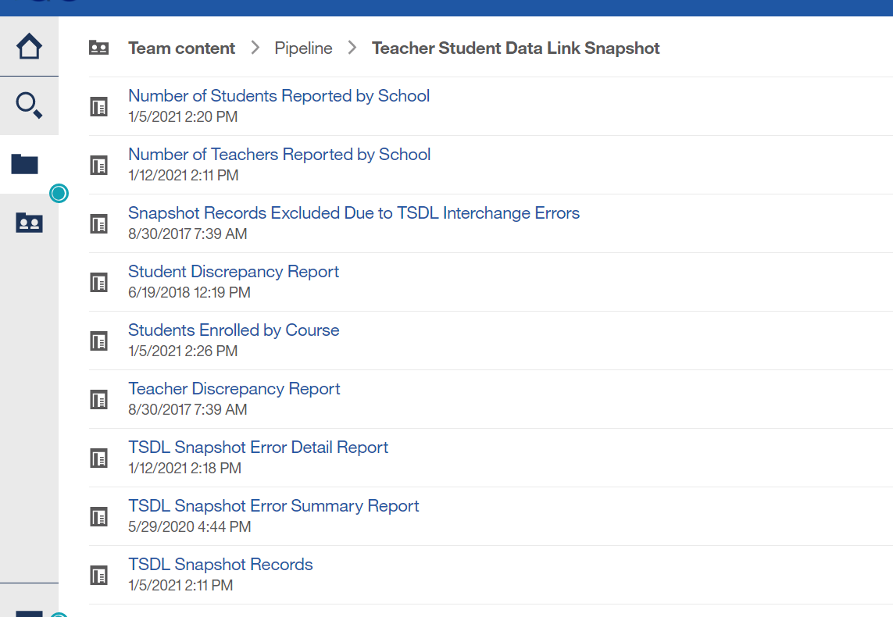
Teacher Student Data Link Snapshot Cognos Reports
Scroll bar to see all reports
Click on reports to open and view details

Slide 7
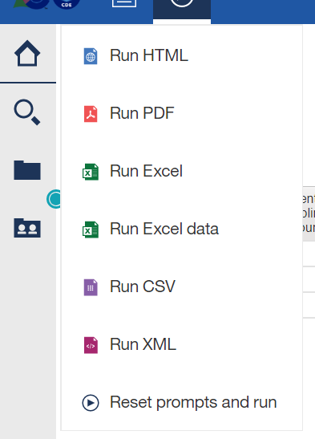
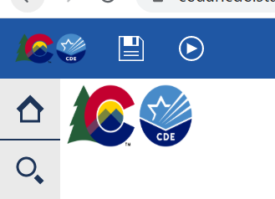
Exporting Reports into Excel
Click on ‘Play’ Button
(available when a report is showing)

Slide 8
Printing Reports
Can choose to print in excel or PDF
Document will open in selected format (pdf or excel)
Print from pdf or excel

Slide 9
TSDL Snapshot Reports

Slide 10
Available Reports
Number of Students Reported by School
Number of Teachers Reported by School
Snapshot Records Excluded Due to TSDL Interchange Errors
Student Discrepancy Report
Student Enrolled by Course
Teacher Discrepancy Report
TSDL Snapshot Error Detail Report
TSDL Snapshot Error Summary Report
TSDL Snapshot Records

Slide 11
Number of Students Reported by School
Provides headcount of students by school code/name
Headcount is counting the unique SASIDs reported for each school

Slide 12
Number of Teachers Reported by School
Provides headcount of teachers by school code/name
Headcount is counting the unique EDIDs reported for each school

Slide 13
Snapshot Records Excluded Due to TSDL Interchange Errors
Due to TSDL Interchange errors, the records are not being included in the Snapshot
Next Steps – review and correct TSDL interchange file and create a new TSDL Snapshot

Slide 14
Student Discrepancy Report
Displays ALL students reported in the Student Interchange that are NOT included in the TSDL Snapshot
Also calculates and displays ‘Weeks Enrolled’
Can be used to sort- those enrolled for a long period of time should be included
Can download report into excel to sort as necessary

Slide 15
Students Enrolled by Course
Provides count of students (headcount) by school, final grade/course completion status and local course code
Provides total by school and final grade/course completion status

Slide 16
Teacher Discrepancy Report
Provides list of staff reported in the Staff Assignment file with job class codes 201, 202 and 206 (teachers) that are not included in the TSDL snapshot
Provides the Teaching Subject Area reported in the Staff Assignment file
All 6th- 12th grade mathematics, English language arts, and Sciences teacher should be included in the snapshot file

Slide 17
Error Reports
TSDL Snapshot Error Detail Report
Displays each error and record in detail
TSDL Snapshot Error Summary Report
Displays a count of records with each error code

Slide 18
TSDL Snapshot Records
Provides the full snapshot records included in your snapshot
Can only provide current year due to size of TSDL snapshot files

Slide 19
TSDL Snapshot Resources
TSDL Snapshot Documentation found at: http://www.cde.state.co.us/datapipeline/tsdl
Contact:
Peter Hoffman hoffman_p@cde.state.co.us

