Slide 1
Staff Evaluation Snapshot
Collection Training
Dawna Gudka-Collection lead
April 22nd, 2025

Slide 2
Today’s Agenda
Identity management Roles Needed for this collection
Why is this data collected
Timeline for collection
Collection resources
Data collected
Data Pipeline Process
Validating Data
Submit Staff Evaluation Snapshot Data
In the chat, please add your first name and 4-digit LEA or 5-digit AU code

Slide 3
Identity Management System
(IdM) Roles

Slide 4
Identity Management System (idM) Roles needed for this collection
Staff Interchange Roles (both 4-digit LEAs and 5 digit AUs):
  STF~ LEAUSER – upload and modify staff interchange files OR
  STF~LEAVIEWER – view (only) staff interchange data
Staff Evaluation Snapshot Roles (only 4-digit LEA codes):
  EVS~LEAAPPROVER – Approves, creates, views Snapshot OR
  EVS~LEAUSER - creates, views Snapshot OR
  EVS~LEAVIEWER- views snapshot
A user can only have one role under each main category, or they could get locked out of Data Pipeline
Staff Evaluation Snapshot Collection
staffevaluation@cde.state.co.us

Slide 5
Why did the Staff Evaluation data get moved to this collection in 2022-2023 school year?

Slide 6

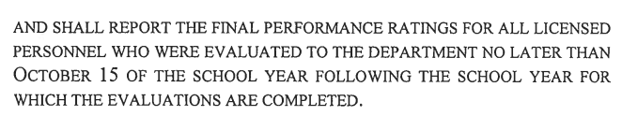
Why is the data collected?
SB22-070
Staff Evaluation Snapshot Collection
staffevaluation@cde.state.co.us

Slide 7
Published Data

Slide 8
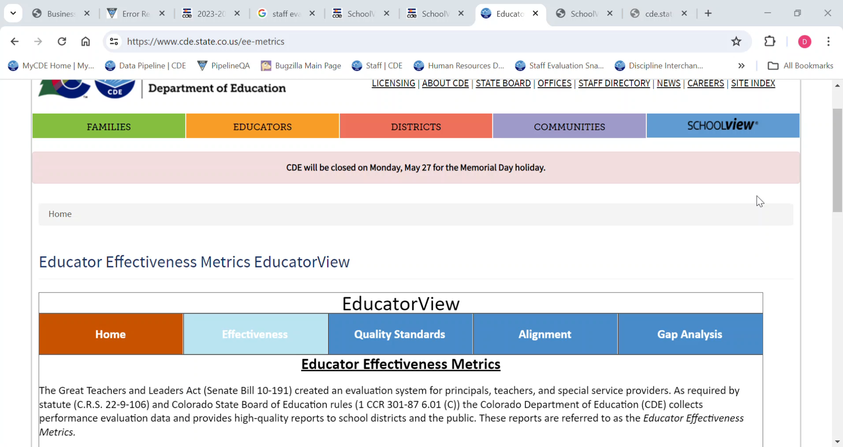
Published Data
Educator View
Staff Evaluation Snapshot Collection
staffevaluation@cde.state.co.us

Slide 9
CDE Website, Data Pipeline Collections overview & Staff Evaluation Snapshot Collection Resources

Slide 10
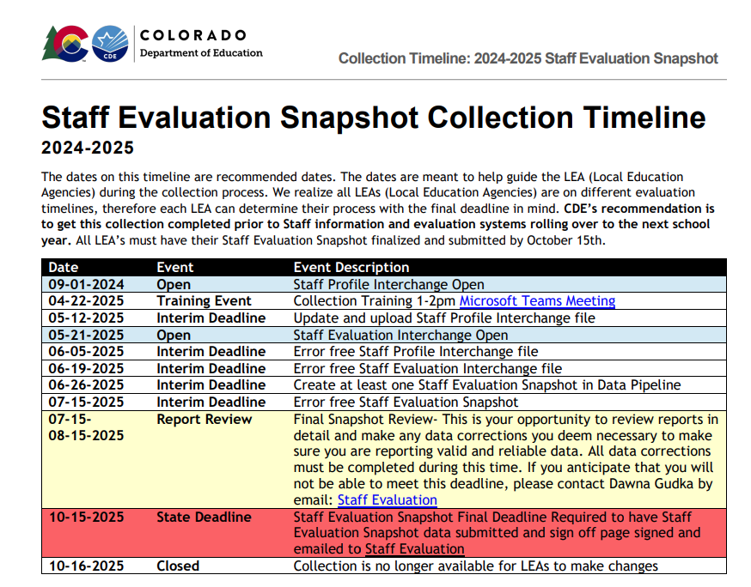
Staff Evaluation Timeline
Staff Evaluation Snapshot Collection
staffevaluation@cde.state.co.us

Slide 11
Data Pipeline
Bookmark suggestions
Identity Management/Single Sign-On: Data Pipeline
Data Pipeline
Log into Data Pipeline
Staff Evaluation Snapshot Collection
staffevaluation@cde.state.co.us

Slide 12
Staff Evaluation Snapshot Collection Resources
  Staff Evaluation Snapshot Collection Resources
    Data Pipeline Interchange Website-Staff
      Staff Interchange-Staff Profile file layout
      Staff Interchange-Staff Evaluation file layout
    Staff Evaluation Snapshot website
      Staff Evaluation Snapshot file layout
Staff Evaluation Snapshot Collection
staffevaluation@cde.state.co.us

Slide 13
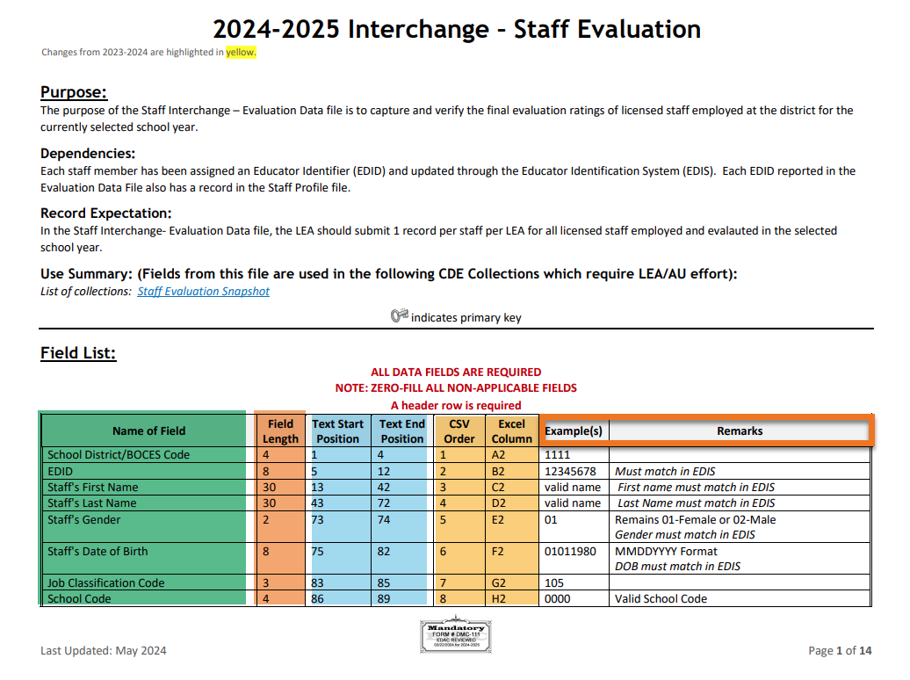
File Layout
Staff Evaluation Snapshot Collection
staffevaluation@cde.state.co.us

Slide 14
Collection Recommendations

Slide 15
Collection Recommendations-Get it completed early
Reasons we suggest to get the collection completed early!
  COPMS (RANDA) rolls over to the new school year
  Evaluators leave for summer break
  Some Evaluators will not be returning for the next school year
Staff Evaluation Snapshot Collection
staffevaluation@cde.state.co.us

Slide 16
Evaluation Data Collected

Slide 17
Evaluations for Teachers
Job Codes
201 Teacher, Regular
202 Teacher, Special Education
206 Teacher, Title 1
216 Librarian/Media Consultant
222 Reading Interventionist
223 Math Interventionist
Evaluation Ratings
Teacher Overall Performance Evaluation Rating
Teacher Quality Standard 1: Know Content
Teacher Quality Standard 2: Establish Environment
Teacher Quality Standard 3: Facilitate Learning
Teacher Quality Standard 4: Professionalism
Teacher Measures of Student Learning
Staff Evaluation Snapshot Collection
staffevaluation@cde.state.co.us

Slide 18
Evaluations for Special Service Providers
Job Codes
211 Counselors
231 Audiologist
233 School Nurse, Registered Nurse
234 Occupational Therapist
235 Physical Therapist
236 Psychologist
237 Social Worker
238 Speech Language Pathologist
242 School Orientation and Mobility Specialist
Evaluation Ratings
Special Services Provider (SSP) Overall Performance Evaluation Rating
Special Services Provider (SSP) Quality Standard 1: Professional Expertise
Special Services Provider (SSP) Quality Standard 2: Learning Environment
Special Services Provider (SSP) Quality Standard 3: High Quality Delivery
Special Services Provider (SSP) Quality Standard 4: Professionalism
Special Services Provider (SSP) Measures of Student Outcomes
Staff Evaluation Snapshot Collection
staffevaluation@cde.state.co.us

Slide 19
Evaluations for Principals
Job Codes
Principals
Assistant/Deputy/Associate Principal
Evaluation Ratings
Principal Overall Performance Evaluation Rating
Principal Quality Standard 1: Strategy
Principal Quality Standard 2: Culture
Principal Quality Standard 3: Instruction
Principal Quality Standard 4: Professionalism
Principal Measures of Student Learning
Staff Evaluation Snapshot Collection
staffevaluation@cde.state.co.us

Slide 20
Data Pipeline Process

Slide 21
What makes up the Staff Evaluation Snapshot
Staff Evaluation Snapshot Data
(This is the actual data that gets reported in the Staff Evaluation Snapshot collection)
2024-2025 Staff Profile Interchange file
2024-2025 Staff Evaluation Interchange file
Staff Evaluation Snapshot Collection
staffevaluation@cde.state.co.us

Slide 22
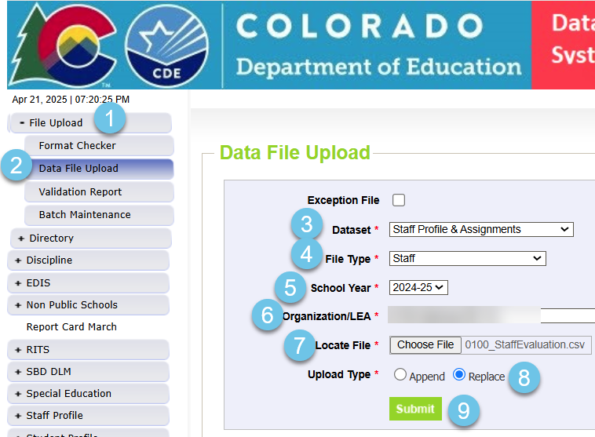
Staff Profile Interchange file upload
Staff Profile must contain all staff 2024-2025 school year
Staff Evaluation Snapshot Collection
staffevaluation@cde.state.co.us

Slide 23
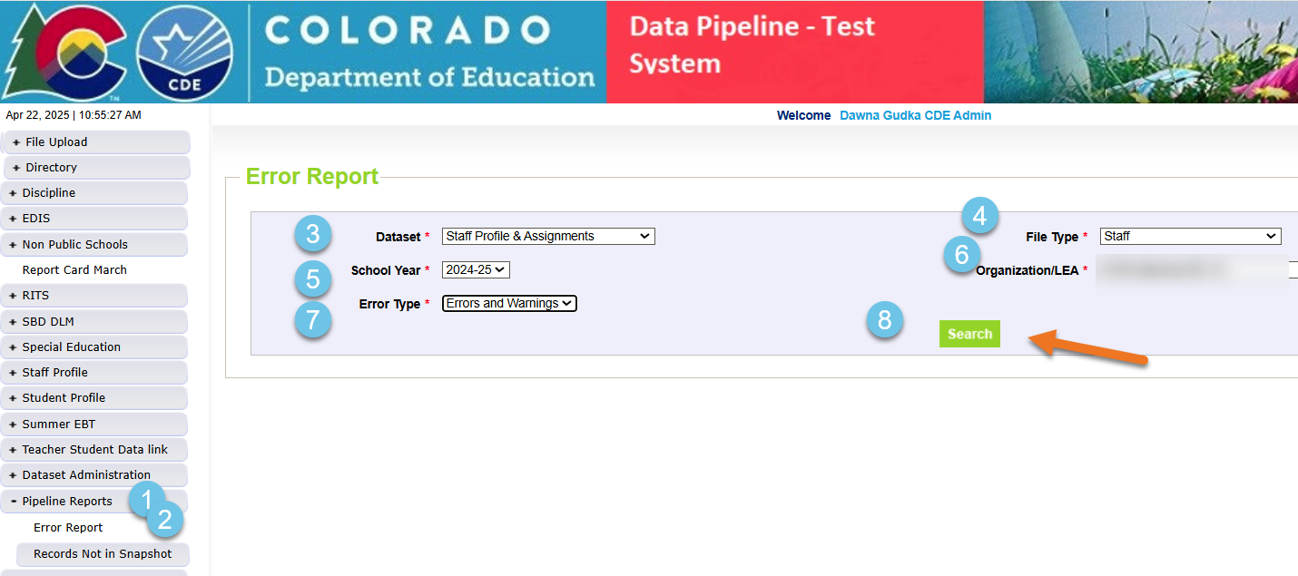
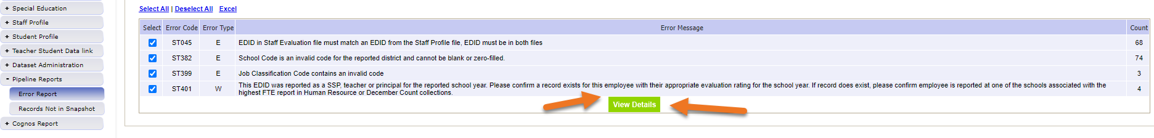
Staff Profile Interchange file-checking for errors
Staff Evaluation Snapshot Collection
staffevaluation@cde.state.co.us

Slide 24
Staff Evaluation
Pull your staff evaluation interchange file from your staff system
If your LEA does not use COPMS, pull your staff evaluation file from your staff system
Staff Evaluation Snapshot Collection
staffevaluation@cde.state.co.us

Slide 25
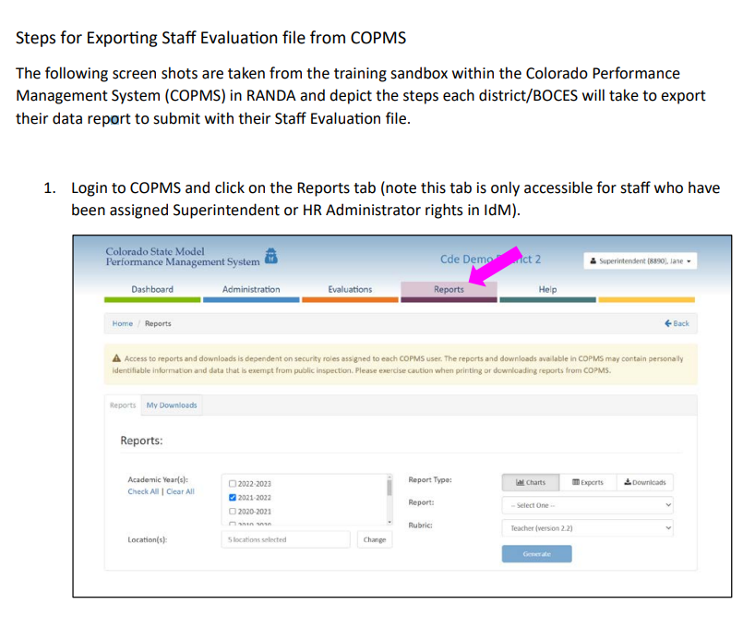
Staff Evaluation-Steps for Exporting Staff Evaluation file from COPMS-RANDA
Extract file from Vendor
Steps for Exporting Staff Evaluation file from COPMS (RANDA)
Staff Evaluation Snapshot Collection
staffevaluation@cde.state.co.us

Slide 26
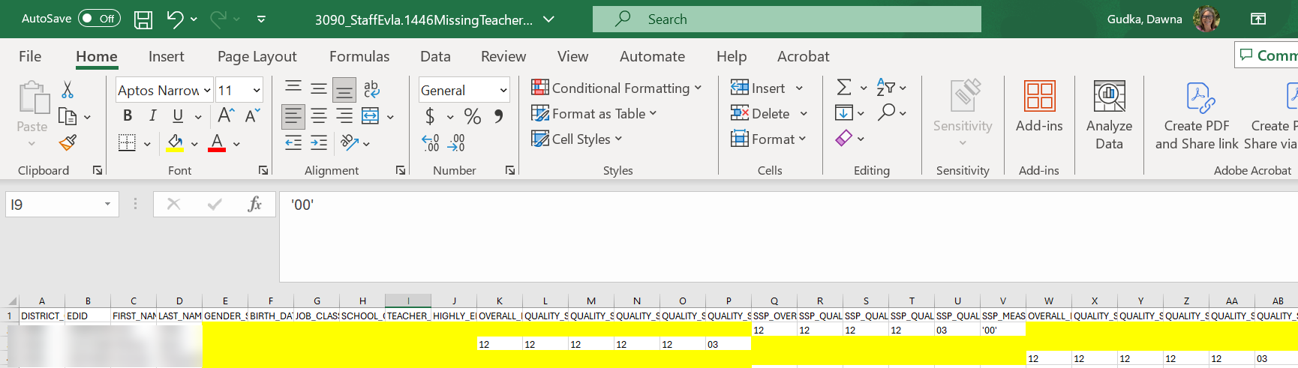
Staff Evaluation COPMS (Randa) Extract
Staff Evaluation Snapshot Collection
staffevaluation@cde.state.co.us

Slide 27
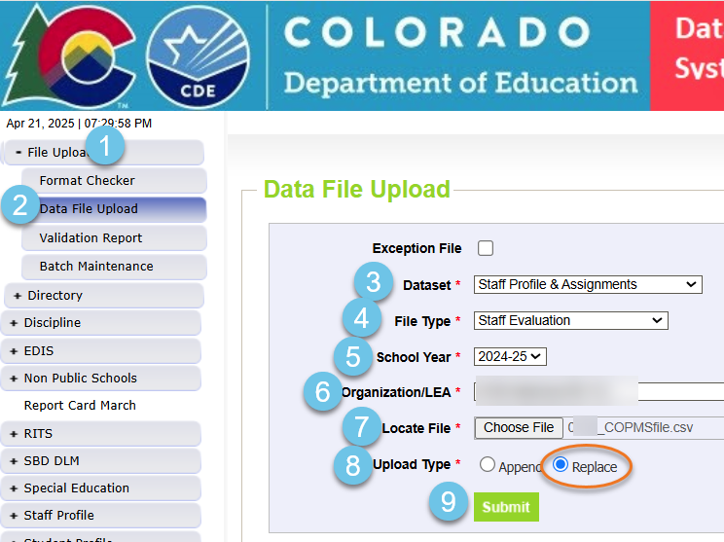
Staff Evaluation interchange file upload
Staff Evaluation Snapshot Collection
staffevaluation@cde.state.co.us

Slide 28
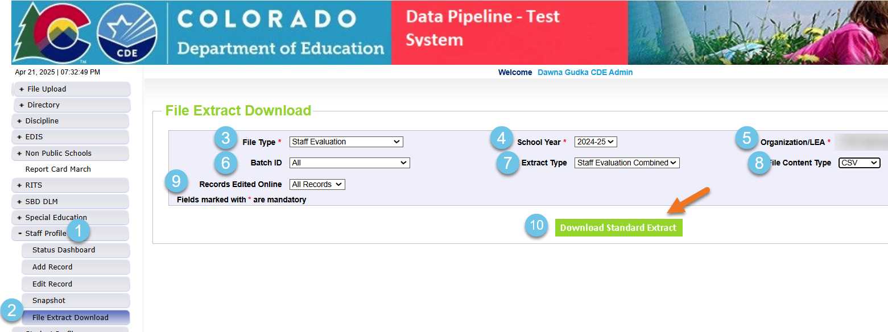
Optional Extract Process
Strongly suggest this process if your LEA uses COPMS (RANDA)
Once you upload your incomplete staff evaluation interchange file from COPMS (RANDA) into Data Pipeline DO NOT VIEW YOUR STAFF EVALUATION ITNERCHANGE ERRORS. This is totally different from any other collection.
You can now extract a staff evaluation file that will produce all staff that CDE is looking for evaluation data for: Staff Evaluation Combined
Staff Evaluation Snapshot Collection
staffevaluation@cde.state.co.us

Slide 29
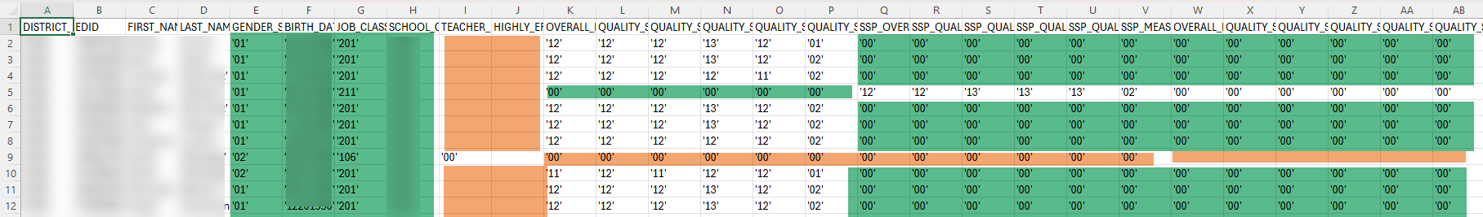
Staff Evaluation completed file
Our developers created the combined extract to help districts that use COPMS. After uploading your staff evaluation file that you extracted from COPMS (RANDA) that was incomplete with data, Data Pipeline went out and looked at your Human Resources or Special Education December count data and populated the incomplete data from COPMS.
Staff Evaluation Snapshot Collection
staffevaluation@cde.state.co.us

Slide 30
What needs to be added to the combined file before I upload the file?
What other data must you add to the combined extract?
Add all evaluated staff members including their information that started with your district after December 1st
Add evaluation ratings if applicable or 00 for fields that are not applicable
2. Add all Teachers and Special Service Providers Probationary status
3. Add 00 to all Principals Probationary status (since this does not apply to Principals)
Add valid code for highly effective process data field for all staff members
Save your combined extract
Staff Evaluation Snapshot Collection
staffevaluation@cde.state.co.us

Slide 31
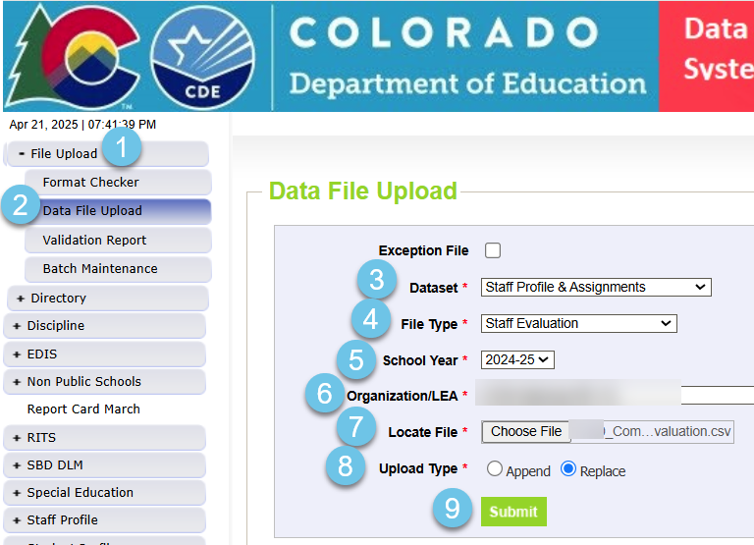
Using the Staff Evaluation Combined Extract complete
Staff Evaluation Snapshot Collection
staffevaluation@cde.state.co.us

Slide 32
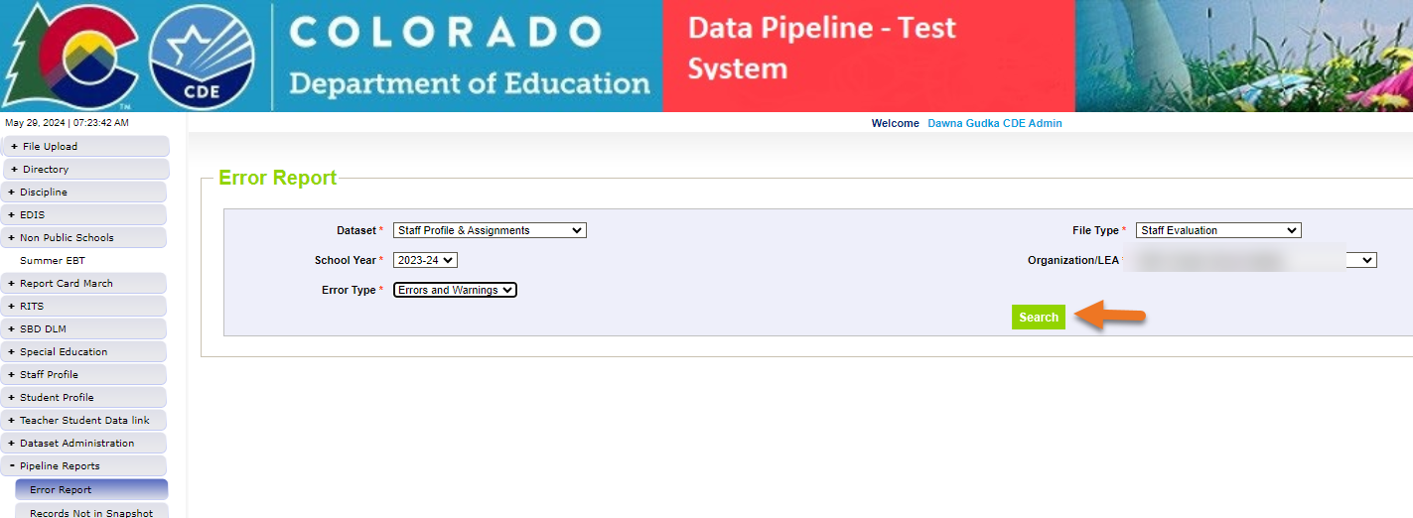
Checking for errors-Interchange level
Staff Evaluation Snapshot Collection
staffevaluation@cde.state.co.us

Slide 33
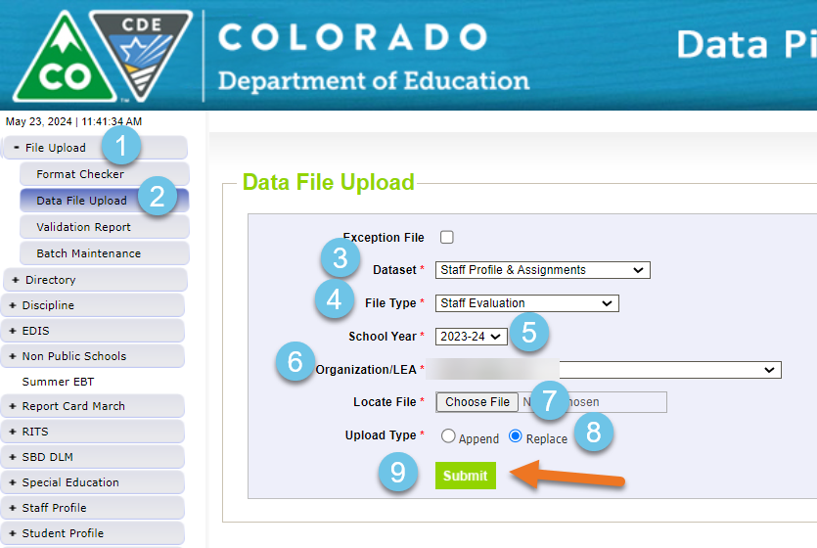
Correct your errors and upload corrected interchange file
Staff Evaluation Snapshot Collection
staffevaluation@cde.state.co.us

Slide 34
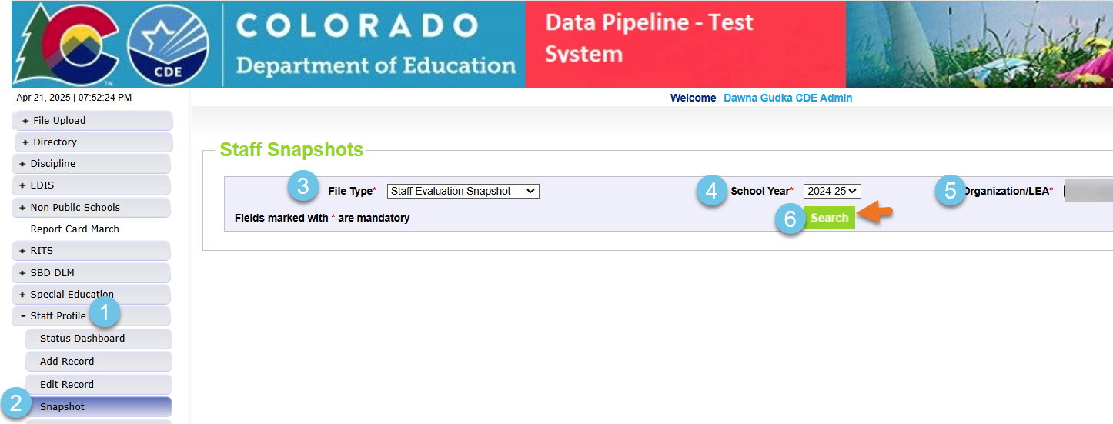
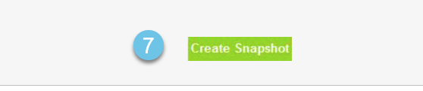
Creating Staff Evaluation Snapshot
Staff Evaluation Snapshot Collection
staffevaluation@cde.state.co.us

Slide 35
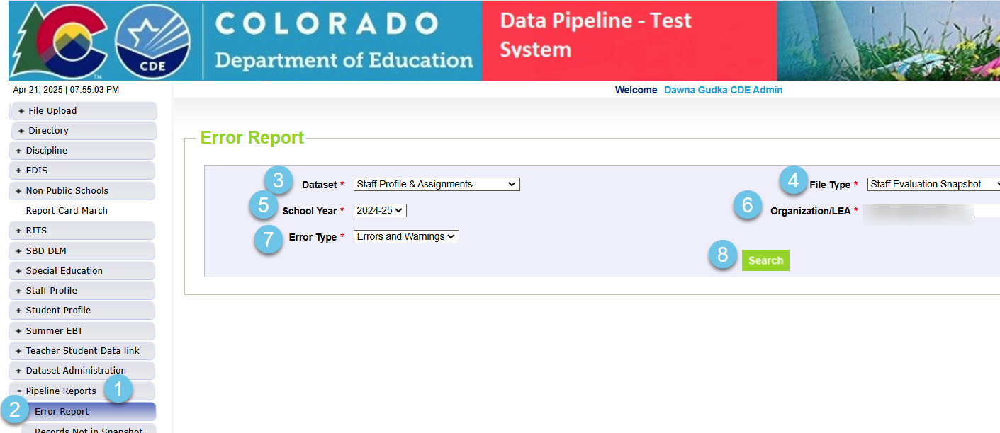
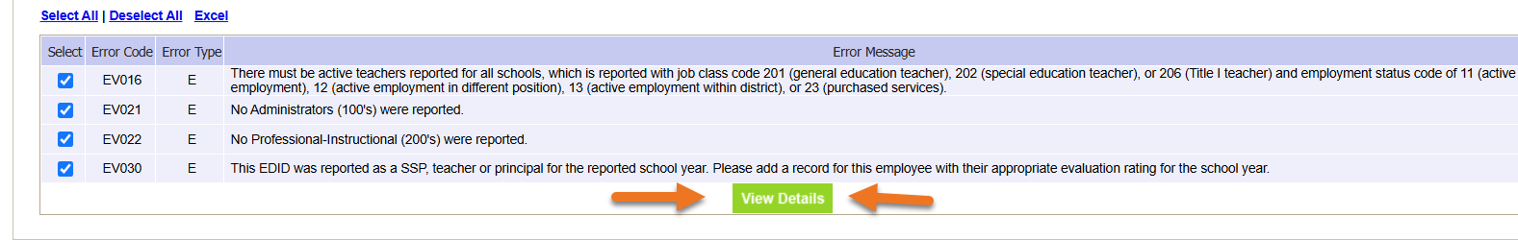
Checking for errors-snapshot level
Staff Evaluation Snapshot Collection
staffevaluation@cde.state.co.us

Slide 36
Reminder to create a new snapshot each time to correct your interchange file or files
When creating a snapshot, Data Pipeline takes a snapshot of your data at the time that you clicked on the create snapshot button.
Staff Evaluation Snapshot Collection
staffevaluation@cde.state.co.us

Slide 37
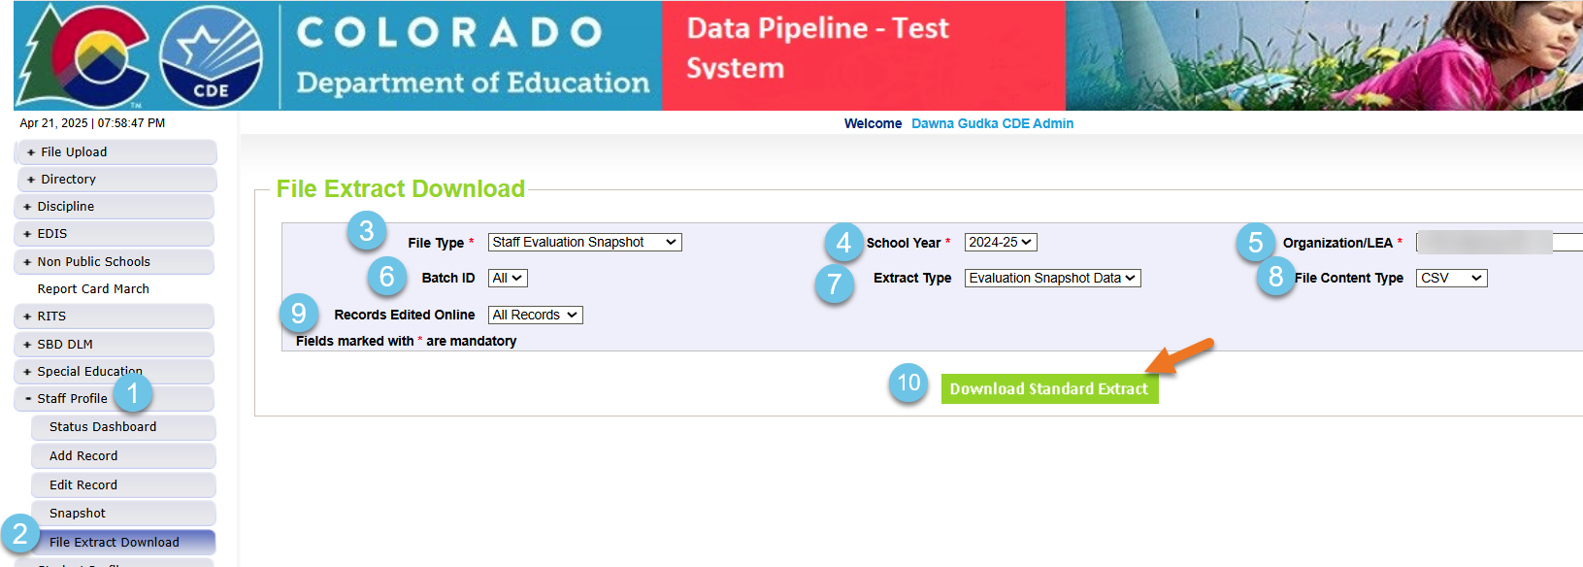
Once Snapshot is error free-Validate data
Review your snapshot records using Data Pipeline snapshot extract
Staff Evaluation Snapshot Collection
staffevaluation@cde.state.co.us

Slide 38
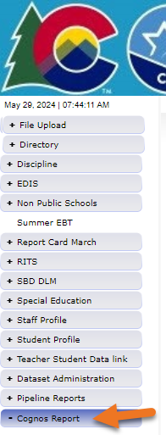
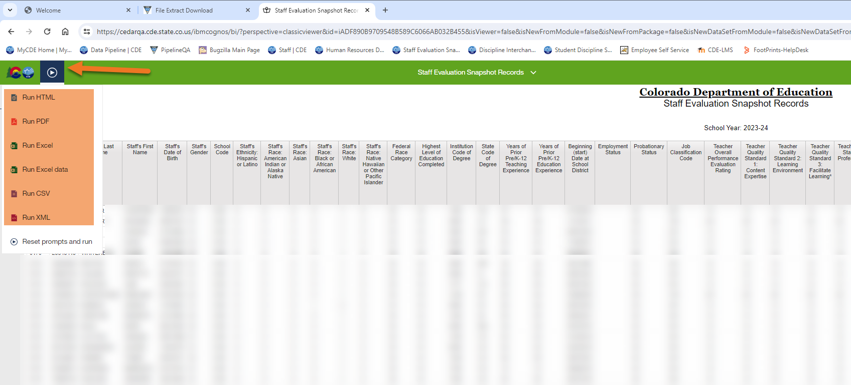
View and or download Staff Evaluation Snapshot records using Cognos (CEDAR)
Staff Evaluation Snapshot Collection
staffevaluation@cde.state.co.us

Slide 39
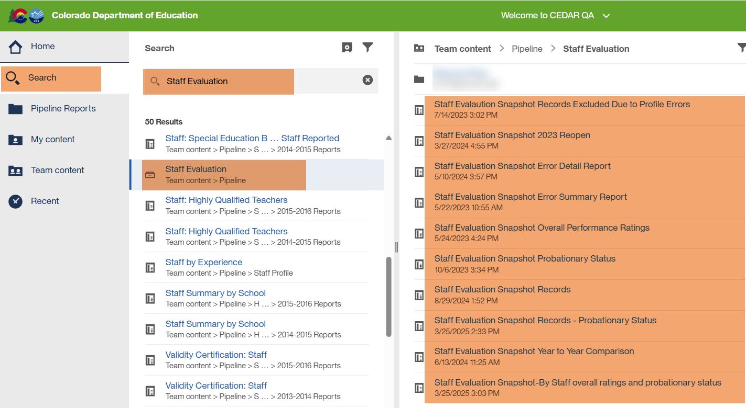
Staff Evaluation Cognos (CEDAR) Reports Available
Staff Evaluation Snapshot Collection
staffevaluation@cde.state.co.us

Slide 40
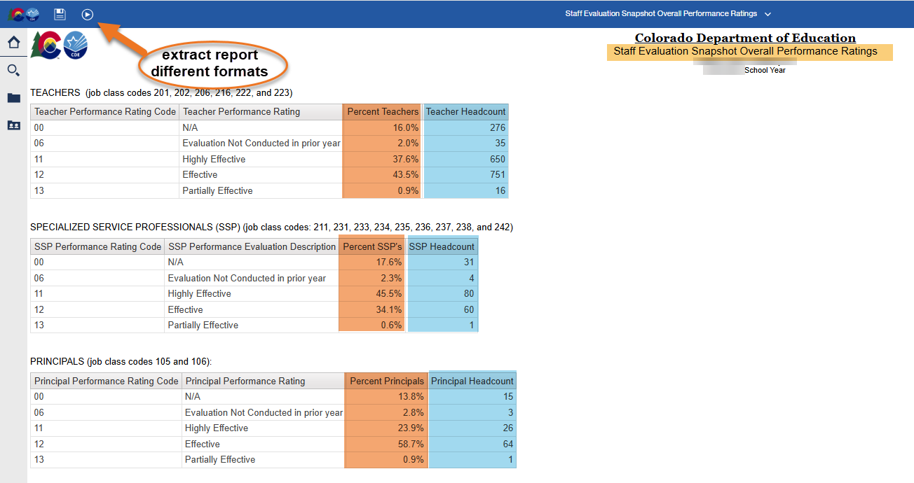
Using Other Cognos Reports to Validate your Data
Staff Evaluation Snapshot Collection
staffevaluation@cde.state.co.us

Slide 41
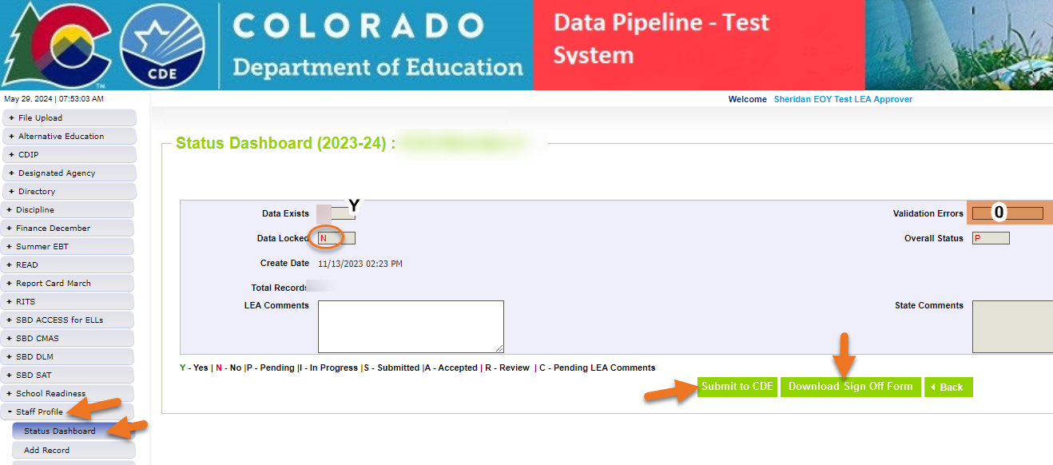
Submit data and download signature page
Staff Evaluation Snapshot Collection
staffevaluation@cde.state.co.us

Slide 42
Reminders and Questions

Slide 43

Thank you for joining today!
When emailing CDE, please include your 4-digit LEA number or your 5-digit AU number this helps us answer your questions quickly.
Please do not send PII (Personally Identifiable Information) via email. This includes exception requests!

Slide 44

Questions
Staff Evaluation Snapshot Collection
staffevaluation@cde.state.co.us

Slide 45
Questions & Resources:
Staff Evaluation Snapshot Collection
Staff Evaluation Snapshot Collection
StaffEvaluation@cde.state.co.us
Dawna Gudka
(303) 598-7901

