Slide 1
SEY Office Hours
May 2025

Slide 2
Agenda
Regular Phase Timeline
Collaborating with Program Staff
CEDAR/COGNOS Report highlight
“SASID Lookup: SEY and OCT (prior, current, subsequent year)”
School Level Errors and Exceptions
  SE181, SE182, SE183 FRL threshold check
Anticipated Year of Graduation
  Assignment Logic
  Post Cross Warnings—AYG Reconciliation
  Coding Implications
Federal vs State Graduation/Completion Data
Contract Students and PAI Codes

Slide 3
Regular Phase Timeline
Date | Event | Event Description | Notes
5/29/2025 | Interim Deadline | Create initial SEY snapshot | Begin working through the errors that require the most collaboration between data staff and program staff in the district. Collaborate with SPED staff regarding students who have or will participate in SPED Transition Services. Collaborate with High School staff regarding students who will participate in a Postsecondary Program (ASCENT, P-Tech 5 or 6, TREP) next year.
6/11/2025 | Interim Deadline | Error free interchange files. Student Demographic (DEM) Student School Association (SSA) Graduation Guidelines (GG) Title 1 (TA schools only) | Errors on the SSA or DEM file prevent the student’s record from pulling into the SEY snapshot. These may cause ‘missing record’ errors.
7/31/2025 | Interim Deadline | Submit any necessary reporting exceptions for review. | Especially critical for English Learner exceptions as these are a time-intensive review and may required additional documentation.
8/14/2025 | Interim Deadline | Error free SEY Snapshot | Critical date as the SEY collection is time intensive.
8/14/2025 to 9/4/2025 | Report Review | • Validate Student End of Year data using CEDAR/COGNOS reports. • Submit snapshot as soon as review is complete | Collaborate with schools to review student lists. Student List: Dropouts Student List: AYG Cohort Student List: District and School Mobility
9/4/2025 | State Deadline | Submit SEY snapshot | Only users with the LEA Approver role for the SEY collection can submit the snapshot.

Slide 4
Collaborating with Program Staff
District Accountability Staff
  Dropouts
    Student List: Dropout
  Graduate/Completer
    Graduation Guidelines
    Potential Summer Grad/Completers
      August 31, 2025, cut-off for students to be considered grad/completer of 2024-2025 school year
    Student List: AYG Cohort
  Mobility
    Student List: District and School Mobility
Postsecondary Programs
  Students who participated in ASCENT/P-Tech/ TREP in 2024-2025
  Students returning in 2025-2026
SPED Transition
  Students who participated in Transition in 2024-2025
  Students returning in 2025-2026 for Transition
Homeless Status
  SE284 & SE308 errors
Migrant Status
Free Reduced Lunch
  Homeless, Migrant, or Foster + FRL errors
  SE181/SE182/SE183 errors
  SE282 & SE283 warnings
English Learners
  SE170 & SE209 errors
    Mid-Year Change form required if 2+ years of EL History
  SE309 – new error checks students who took ACCESS must be NEP/LEP in the current year
Resource from Accountability Unit: Use of Data Pipeline & Assessment Collections…

Slide 5
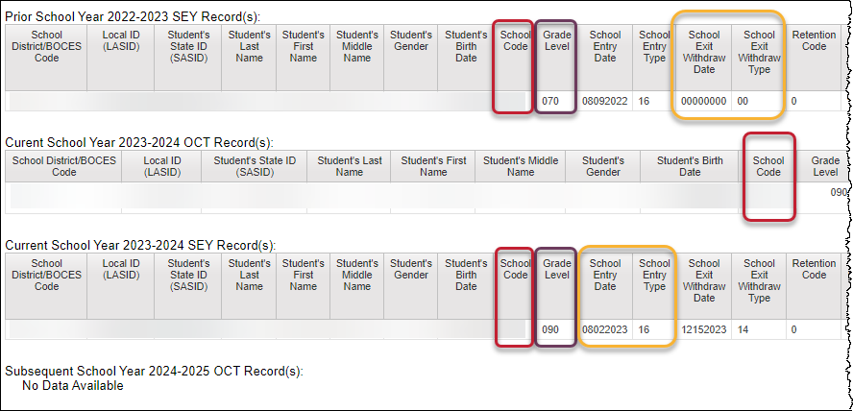
Investigating Errors
SASID Lookup: SEY and OCT record (prior, current, subsequent year)
Code | Issue
SE049/ SE057 | Missing SEY record for student with OCT rec in current year
SE102/ SE105/ SE109/ SE115 | Exit type prior year + entry type/school code current year
SE113/ SE117/ SE242/ SE243 | Grade level & retention code prior year + current year grade level
SE064/ SE404/ SE292/ SE293 | Missing Record: Student included in prior year with exit type 00 (or retention 2 or 3) should have record in current year
SE060 | Missing OCT record when SEY shows enrollment on OCT 1st
SE050 | Current year exit type expects another record with matching entry type
… | SPED Transition Coding
… | Postsecondary Program Coding
… | OCT compared to SEY demographic
Best report to research cross collection errors related to prior SEY or OCT data.
During post-cross phase, use to research errors related to next year OCT.

Slide 6
School Level Exceptions

Slide 7
School Level Errors that allow exceptions
Important: These exceptions will be loaded into pipeline beginning 8/1/25
  Any reviewed and approved prior to 8/1 will be held pending a final review on 8/1 before uploading into pipeline
  Once loaded, this rule won’t trigger even if interchange files are incorrect
Rules:
  SE052: All schools with grades PK-12 must have at least one record
    Same as OC101 in Student October
  SE054: No graduates or completers (school exit types 90-96) reported at a school whose grade range includes grade 12.
    Most common if school serves homebased education only (home option school)
    Schools with small populations with few or no grade 12 students in current year
Rules cont.
  SE181/SE182/SE183:
  FRL threshold changes from OCT to SEY (15% or more)
    When a school experiences a significant population increase for all students
    When school is impacted by large number of students reported in OCT based on carry-over status that was removed after OCT due to lack of current year documentation
  SE282/SE283 warnings highlight specific SASIDs with a FRL change between OCT and SEY.
    Helpful when researching SE181, SE182, or SE183 errors

Slide 8
Anticipated Year of Graduation (AYG)

Slide 9
AYG Assignment Logic
Assigned in the school year a student is first reported as entering high school in Colorado through the Student End of Year collection (grades 9-12)
  AYG is automatically assigned during the SEY collection process
  Once assigned, AYG does not change
  Based upon the student’s highest grade level as of October 1st
If reported in multiple districts, will base AYG on the highest grade level as of 10/1
  EXAMPLE:
    District A reports 10th grade with an exit date on/after October 1st
    District B reports 9th grade with an exit date on/after October 1st
    Student’s AYG will be calculated based on the 10th grade record in District A
  Post-Cross Phase includes mechanics to reconcile AYG across districts
The following data fields are all set in the year that a student’s AYG is assigned
  Starting Year for Graduation Cohort
  Starting Grade for Graduation Cohort
  Starting District for Graduation Cohort
  Anticipated Year of Graduation
Grade Level | AYG Calculation | Example (Current Year 2024-2025)
9th | Current Year + 3 | AYG 2028
10th | Current Year + 2 | AYG 2027
11th | Current Year + 1 | AYG 2026
12th | Current Year | AYG 2025
Notes:
Verified Transfer Out: School Exit Types 02, 05, 13, 14, 15, 16
Exit Types that Comprise the AYG Cohort: 00, 01, 40, 12, 26, 18, 19, 21, 30, 50, 70, 90, 92, 93, 94, 95, 96

Slide 10
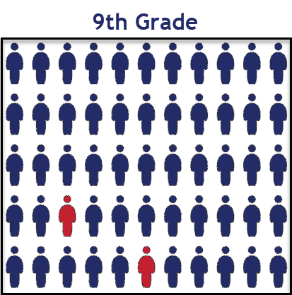
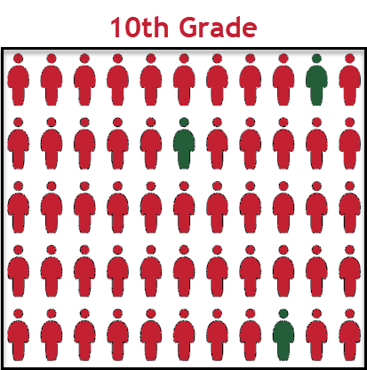
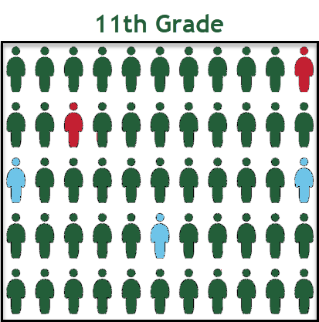
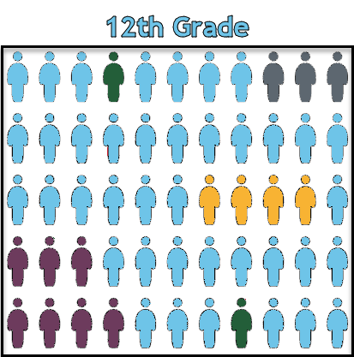
AYG represented in a High School Population
9th grade example:
Mostly AYG 2028
Few AYG 2027 who experienced a retention
10th grade example:
Mostly AYG 2027
Few AYG 2026 who experienced a retention
11th grade example:
Mostly AYG 2026
AYG 2025 if experienced a retention
AYG 2027 if experienced grade acceleration
12th grade example:
Mostly AYG 2025,
AYG 2024, 2023, 2022 if experienced a retention, are participating in SPED Transition, or a Postsecondary Program
AYG 2026 or AYG 2027 if experienced grade acceleration
Notes:
Once a student is assigned an AYG, that AYG remains constant.
Students who experience grade reassignments (acceleration or retention) remain in their original AYG cohort.

Slide 11
AYG Q&A
Q: A student is transferring into the LEA from out of state or out of country whose age does not align with their number of transferrable high school credits. What grade level should they be placed in?
A: LEAs determine appropriate grade level based upon their local policies. LEAs are encouraged to consider the following:
  Student’s current transfer credits and instructional needs
  If placed in (blank) grade, can they reach 12th grade before they reach the maximum age for educational services?
  AYG is based upon the first record for a student in a CO high school.
    The grade level of that record will determine the AYG.
    Once set, AYG does not change.
  Some postsecondary programs have restrictions related to AYG (ASCENT, PTECH, TREP)
Q: What is the AYG Reconciliation Process?
A: In the reporting year a student first enters a CO high school, a process is run during the Post-Cross phase to reconcile the student’s AYG if they have multiple enrollment records (in an LEA or across CO) at different grade levels. Student’s AYG is set based upon the highest grade level as of Oct. 1st.

Slide 12
Post-Cross Warnings: AYG Reconciliation
Post-Cross AYG Warnings
SE909—AYG Reconciliation Notice: Student's Anticipated Year of Graduation was reconciled across two or more school districts in CO. Their AYG was set based upon the highest grade level reported as of 10/1 this year per AYG assignment logic when a student enters a Colorado public high school for the first time.
SE910—AYG Reconciliation follow up: Student in grade K-8 has been reported as receiving an Anticipated Year of Graduation (AYG). Review student's grade level in your district and using the CEDAR report ‘SASID Lookup: Cross LEA'. Contact the SEY collection lead if you believe the student should NOT be assigned an AYG during the current year SEY collection.
SE911—AYG Reminder: Student in grade 100, 110, or 120 with entry type 05 or 14 whose AYG is being set based upon their grade level in the current year SEY collection. Ensure student's grade level is accurate.
Actions based on these warnings
Reported grade level accurately reflect student’s educational history for the year
  No action needed
  Record AYG for student knowing it will not change since this may be relevant later in student’s educational career.
Grade level does not accurately reflect student’s educational history.
  Contact SEY collection lead. A post-cross data change request may be needed to correct the situation.
  Most common issue is a grade reassignment after October 1st where student entered at a higher grade for a single day and was immediately grade reassigned down to a lower grade

Slide 13
AYG Coding Implications
Homebased Education = 1 (yes)
International/Foreign Exchange Students
Student must have a school exit type that removes them from the AYG cohort if AYG 2025, 2024, 2023, or 2022 so they don’t impact the 4-, 5-, 6-, or 7- year rates this year
Typically, school exit type 16 on last day of school
May return in 2025-2026 with school entry type 16
Refer to your LEA’s policy to determine which scenarios are options within your LEA
Scenario 1: Student cannot earn a diploma or completion certificate
  Grade 12, use school exit type 05 on the last day of school to remove student from AYG cohort.
  Grade 11 or below, use school exit type 00 then a one-day record in the next school year with school exit type 05
Scenario 2: Student earns a completion certificate from the LEA
  Use school exit type 92
Scenario 3: Student earns a high school diploma from the LEA
  Use school exit type 90
  Graduation Guidelines required

Slide 14
Transfer Out with Exit Type Remaining in AYG Cohort
Exit Types Remaining in AYG Cohort
Last District of Attendance
Transfer Out but Attributed to Last District of Attendance
  12—Transfer to a detention center within LEA
  18—Transfer to a Career and Technical (Vocational) Education Program
  19—Transfer to a Facility School/State Operated Program
  21—Transfer to a facility operated by the CO Department of Corrections or Division of Youth corrections
  26—Transfer to a detention center out of LEA
  30—Illness/Injury
Other Exit Types in Cohort:
  40, 01 (dropped out)
  50 (expelled)
  70 (transfer to HSED program)
  00 (still enrolled)
  90, 92, 93, 94, 95, 96 (graduate or completer)
Follow up annually to determine if updated status is needed
Status updates
  Transfer out—Request for Transcripts Received:
    Prior Year—enter adjustment record with adjustment justification code 41
    Current Year—one-day record with applicable school exit type
  HSED Completer:
    Prior year – enter adjustment record with adjustment justification code 42
    Current year – one day record at the end of the year with exit type 94 as applicable
  Graduate:
    Prior or Current Year—One-day record at the end of the current year with school exit type 90 or 95 as applicable; must have reported GG measures
  Other Completer:
    Prior or Current Year—One-day record at the end of the current year with school exit type 92

Slide 15
State and Federal Reporting Differences
Graduation/Completion

Slide 16
State and Federal Graduation/Completion Reporting
State
Federal
Graduate:
  School exit type 90
    Alternate assessment participant = 0 (no)
    Alternate assessment participant = 1 (yes)
  School exit type 95
  School exit type 96
Other Completer:
  School exit type 92; locally defined certificate of completion
  School exit types 93 and 94; HSED Recipient
Rates Generated:
  4-, 5-, 6-, and 7-year Graduation and Completion
Graduate:
  School exit type 90 with alternate assessment participant = 0 (no)
  School exit type 95
  School exit type 96
Other Completer:
  School exit type 92; locally defined certificate of completion
  School exit type 90 with alternate assessment participant = 1
Not Recognized as Completer or Graduate:
  School exit types 93 and 94; HSED Recipient
Reported Data:
  4- and 7- year graduation rates
  Annual graduate and completer counts

Slide 17
Contract Students

Slide 18





BOCES Schools/Programs
Contract with a BOCES or another School District?
School: BOCES/other district has their own school code
Program: BOCES/other district does NOT have a school code
Home District:
no SEY record,
Group B PAI = 31 or 33
Contract District: SEY record,
Group A PAI = 02 or 04
Home District: SEY Record with Group A PAI 01-08 and Non-School Program Code 03
BOCES Program: no state reporting, including SEY
Home District:
OCT record,
Group B PAI = 31 or 33,
Funding Code = Applicable
Contract District: OCT record,
Group A PAI = 02 or 04,
Funding Code = not funded
Home District: OCT Record with Group A PAI 01-08 and Non-School Program Code 03
BOCES Program: no state reporting, including OCT
Notes:
PAI Codes (on the SSA file):
Group A = Pupils attending an educational program operated by the reporting district
Group B = Resident Pupils attending an educational program not operated by the reporting district
Special Education PAI Codes:
See the Special Education IEP Interchange – Child Participation file layout for information
Based upon students within the Administrative Unit (AU) – which means codes may vary from the PAI codes used on the SSA file since those are based upon district level information
District providing educational services is the district accountable to the student for graduation/completion & dropout rates
OCT coding ensures district of residence is funded because they are paying the Contract BOCES/District school for the services. Contract/BOCES district is not receiving funding.

Slide 19
Exiting to BOCES School Example
Home District
Current Year SSA | School Code | PAI | Entry Type | Entry Date | Exit Type | Exit Date
Attending district school (SEY/Attendance) | 1234 | 01-08 | 02 | 08/15/2024 | 13 | 09/01/2024
Attending BOCES School (OCT/DEC) | 1234 | 31 or 33 | 11* | 09/02/2024 | 00 | 00/00/0000
Subsequent Year SSA | School Code | PAI | Entry Type | Entry Date | Exit Type | Exit Date
Attending BOCES School (OCT/DEC) | 1234 | 31 or 33 | 02* | 08/16/2024 | 00 | 00/00/0000
*Any entry type is permissible since entry type for SSA records with group B PAI codes does not pull into any collection.
BOCES District
Current Year SSA | School Code | PAI | Entry Type | Entry Date | Exit Type | Exit Date
BOCES School Record | 5678 | 01-08 | 13 | 09/02/2024 | 00 | 00/00/0000
Subsequent Year SSA | School Code | PAI | Entry Type | Entry Date | Exit Type | Exit Date
BOCES School Record | 5678 | 01-08 | 02 | 08/15/2025 | 00 | 00/00/0000

Slide 20
Enrollment Status Change: Non-School Program Example
Current Year SSA | School Code | PAI | Entry Type | Entry Date | Exit Type | Exit Date | Non-School Program
Attending district school | 1234 | 01-08 | 02 | 08/15/2024 | 11 | 09/01/2024 | 00
Attending BOCES/LEA program | 1234 | 01-08 | 11 | 09/02/2024 | 00 | 00/00/0000 | 03

Slide 21
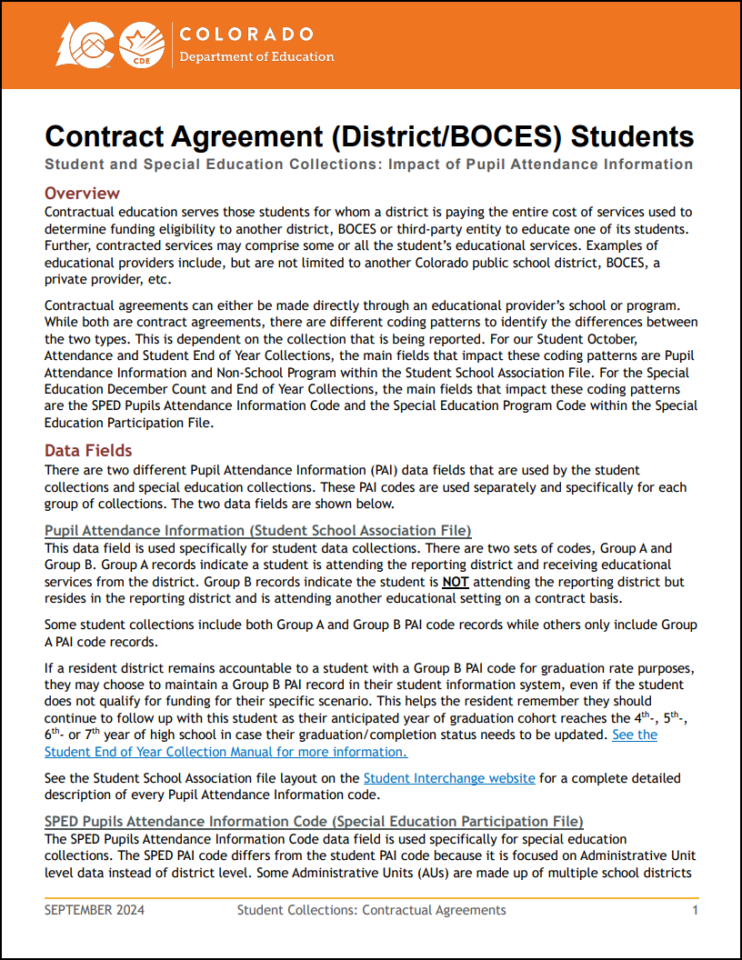
Student Interchange Resource Highlight:
Contract Students—Impact of PAI Codes
Available on Student Interchange Website
Student Pupil Attendance Information (PAI) codes determine if a record is included at the district/LEA level in a student collection
  Student October
    All Student PAI codes (Group A and B)
  Student End of Year
    Group A Student PAI Codes 01-08 only
    School Entry/Exit types tracked across PAI 01-08 records only
    Point student leaves a LEA (Group A) to a contract scenario (Group B) will require an applicable school exit type
Special Education PAI Codes determine inclusion of a record at the AU level for SpED collections and may not align with Student PAI codes

Slide 22
Questions?

