Slide 1
Student End of Year
Office Hours
June 2024

Slide 2
Agenda
Timeline Review
Monitoring Potential Summer Graduates/Completers
Retention Code
Grade Reassignment
  SE113, SE117, SE242, SE243, etc.
School Level Errors
  SE052, SE054, SE181, SE182, SE183
Mid-Year EL Changes
Questions & Answers

Slide 3
Timeline
Date | Event | Event Description | Notes
06/12/2024 | Interim Deadline | Error free interchange files. Student Demographic (DEM) Student School Association (SSA) Graduation Guidelines (GG) Title 1 (TA schools only) | Errors on the SSA or DEM file prevent the student’s record from pulling into the SEY snapshot. These may cause ‘missing record’ errors.
7/25/2024 | Interim Deadline | Submit any necessary reporting exceptions for review. | Especially critical for English Learner exceptions as these are a time-intensive review and may required additional documentation.
8/8/2024 | Interim Deadline | Error free SEY Snapshot | Critical date as the SEY collection is time intensive.
8/9/2024 to 9/5/2024 | Report Review | • Validate Student End of Year data using CEDAR/COGNOS reports. • Submit snapshot as soon as review is complete | Collaborate with schools to review student lists. Student List: Dropouts Student List: AYG Cohort Student List: District and School Mobility Review initial rates. Graduation: 3-,4-,5-,6-,7-year rates by School Year Graduation Rates: District and School by AYG Dropout: District and School Rates Mobility: District and School Rates
9/5/2024 | State Deadline | Submit SEY snapshot | Only users with the LEA Approver role for the SEY collection can submit the snapshot.

Slide 4
Monitoring Potential Summer Graduates/Completers
8/31/2024 is the last date a student may be counted as a graduate or completer of the 2023-2024 school year (school exit types 90-96)
  This is why the SEY initial deadline takes place in early September
Option 1: Wait to update potential summer grad/completer’s student’s school exit type/retention code until August
  Triggers SE171 error until student’s school exit type or retention code are updated
  Preferred method because the error serves as a reminder
Option 2: Code student as retained and update their coding if they meeting requirements over the summer
  School Exit Type 00 with Retention Code 1
  Does not trigger SE171 error
  LEAs must have internal methods to check summer graduates aren’t overlooked
Post-Cross Business Rules (SE906)
  12th grade student marked retained in SEY without a record in next year’s OCT
  Opportunity to catch summer graduate/completers that slipped through with school exit type 00 and retention 1 instead of being updated in August.

Slide 5
Retention Codes
Retention Code always indicates the expected grade level for the student in the following school year.
  A retention code in 2023-2024 SEY indicates the student will be in the same grade level again in 2024-2025.
Retention Code = 1 may be used for any student K-12
  Must have school exit type 00 with school exit date 00000000
Retention Codes 2 and 3 are reserved for 12th grade students with special circumstances only
Code | Definition
0 | No/Not Applicable
1 | Yes – student will repeat this grade the next school year
2 | Yes – 12th grader who will return to participate in an approved postsecondary program in the next year (i.e. ASCENT, P-TECH, and TREP).
3 | Yes – 12th grader with an IEP who will return to participate in 18-21 transition services in the next year.

Slide 6
Retention Codes: 12th graders
1
2
3
Also known as an Academic Retention
Postsecondary Program
  ASCENT
  PTECH years 5-6
  TREP
SPED 18-21 Transition Services
School Exit Type 00
See coding guides in section 5 of the SEY collection manual
See coding guides in section 5 of the SEY collection manual
Record required in following year
Record expected in following year
Record required in following year

Slide 7
Grade Reassignment
Reflects student who began the year in one grade level and was later changed to another grade level
May occur at the beginning of the year to adjust a student’s grade level when the prior year retention code was inaccurate OR based on the student’s academic needs
May occur mid-year based on student’s academic needs
Requires two consecutive enrollment records
  School Exit Type 10 on the first record
  School Entry Type 10 on the second record
Business rules resolved by grade reassignment
  SE113/SE242 prior year did not have retention code, grade level should be +1
  SE117/SE243 prior year had retention code, grade level should be same

Slide 8
Grade Reassignment Pattern
Beginning of Year Example:
Correcting SE242, student should have been marked retained in prior year but was not
School Entry Date | School Entry Type | Grade Level | School Exit Date | School Exit Type
07012023 | 02 | 050 | 07012023 | 10
08152023 | 10 | 040 | 00000000 | 00
Mid-Year Example:
Student experienced a grade promotion mid-year
School Entry Date | School Entry Type | Grade Level | School Exit Date | School Exit Type
08152023 | 02 | 100 | 01092024 | 10
01102024 | 10 | 110 | 00000000 | 00

Slide 9
School Level Errors
SE052: All schools with grades PK-12 must have at least one record
  Same as OC101 in Student October
SE054: No graduates or completers (school exit types 90-96) reported at a school whose grade range includes grade 12.
  Most common if school serves homebased education students only.
  May occur in schools with small populations that have few or no 12th grade students in the current year.
SE181/SE182/SE183:
FRL threshold changes from OCT to SEY (10% or more)
  When reduced or free lunch shows 0 students in OCT and 0 students in SEY, will trigger
  When a school experiences a significant population increase for all students, may trigger
  SE282/SE283 warnings highlight other changes for specific SASIDs. Two known reasons for a change:
    Carry-over status in OCT removed for SEY
    November verification process found student to not be eligible for free or reduced lunch

Slide 10
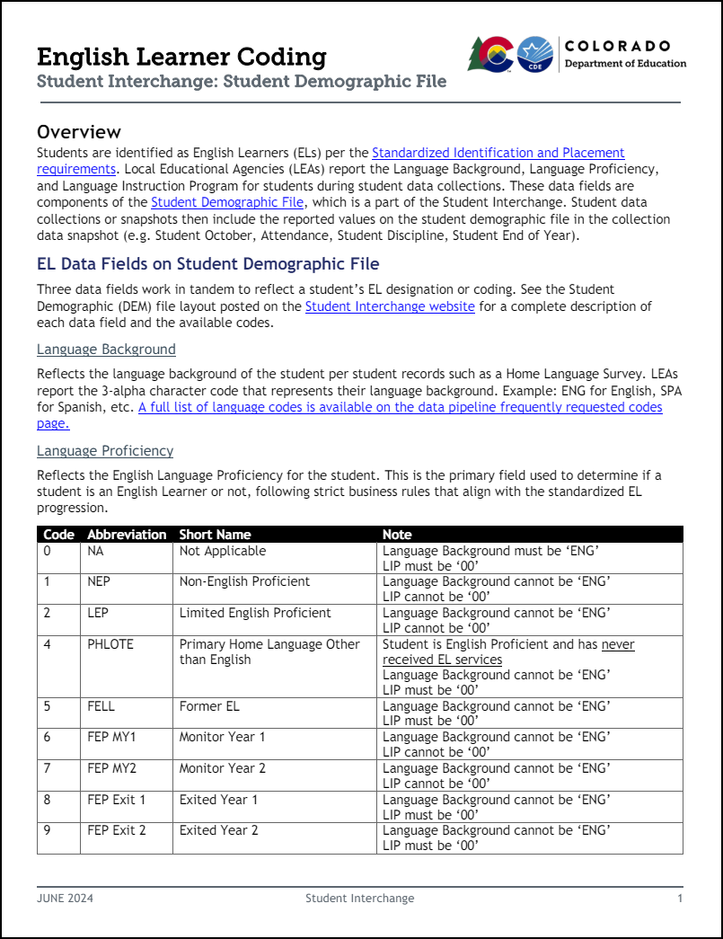
*New* Resource Highlight:
EL Coding Guide
Available on Student Interchange & SEY websites in the additional resources section
Includes annual EL data cycle and Standardized EL Progression
Supports coding when students transfer between districts
General information regarding business rules and exceptions

Slide 11
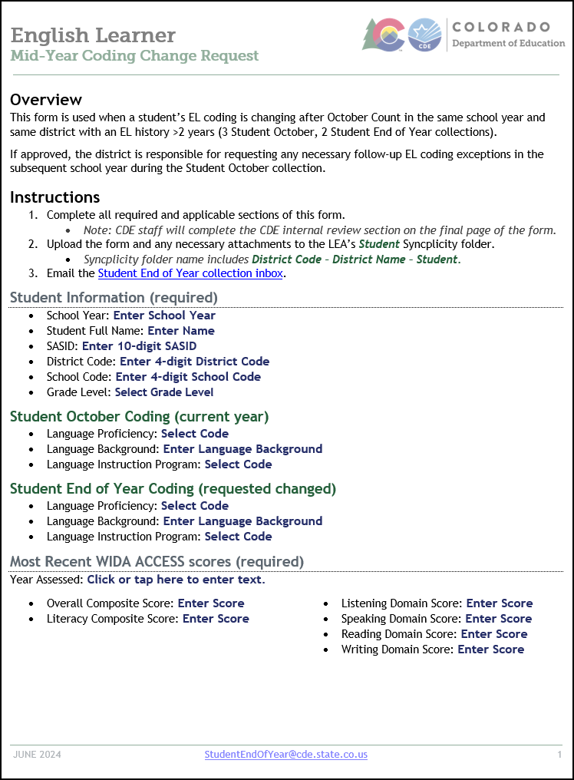
Mid-Year EL Changes
Scenarios
Receiving LEA of mid-year transfer student
  Regular exception request template.
  Include note regarding screening in reason for request.
  Students with prior EL history should follow standardized EL progression.
Miscoded in OCT: Less than 2 years of EL History
  Regular exception request template.
Miscoded in OCT: More than 2 years of EL History
  Requires mid-year change form AND regular exception request template.

Slide 12
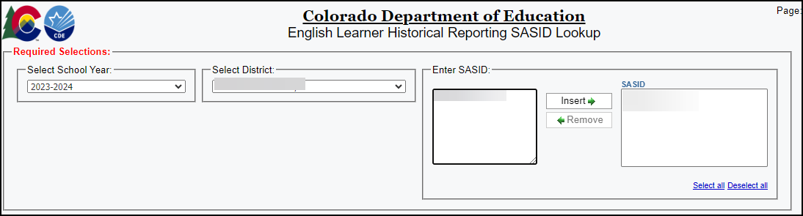
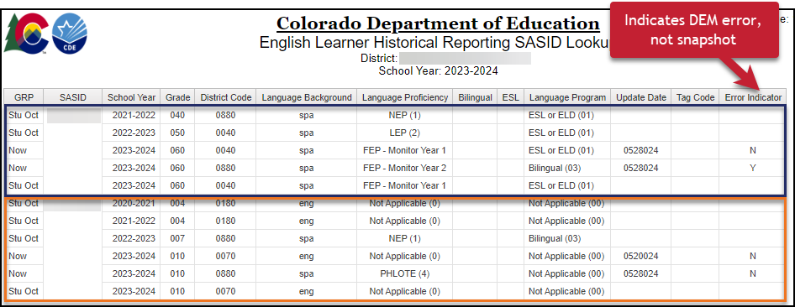
CEDAR Report Highlight:
English Learner Historical Reporting SASID Lookup
Student Profile Report
Recently Consolidated single SASID lookup & multi-SASID lookup versions into one report
  If enter a SASID with spaces before or after the 10-digit number, report may not run.
DEM errors based on prior year Stu OCT compared to ‘Now’ record.
  Expected to follow the EL Progression when in the same district or student screened in receiving district and found to be English Proficient.
SEY errors based on current year (2023-2024) Stu OCT compared to ‘Now’ record.
  Expected to match Stu OCT within the same district.

Slide 13
Q & A

