Slide 1
SEY Office Hours
July 2025

Slide 2
Agenda
Monthly Tasks
Status Dashboard Screen
Expelled Students
Adequate Documentation of Transfer
Exception Request Reminders
COGNOS/CEDAR Reports
  SASID Lookup Reports
  Student List Reports

Slide 3
Regular Phase Timeline
Date | Event | Event Description | Notes
7/31/2025 | Interim Deadline | Submit any necessary reporting exceptions for review. | Especially critical for English Learner exceptions as these are a time-intensive review and may required additional documentation.
8/1/2025 | Other Date | School Level Exceptions begin to be processed (SE181, SE182, SE183, SE052, SE054) | Any approved school-level exceptions prior to this date are ‘saved’ for a final check on 8/1 before loading into pipeline
8/14/2025 | Interim Deadline | Error free SEY Snapshot | Critical date as the SEY collection is time intensive.
8/14/2025 to 9/4/2025 | Report Review | • Validate Student End of Year data using CEDAR/COGNOS reports. • Submit snapshot as soon as review is complete | Collaborate with schools to review student lists. Student List: Dropouts Student List: AYG Cohort Student List: District and School Mobility
9/4/2025 | State Deadline | Submit SEY snapshot | Only users with the LEA Approver role for the SEY collection can submit the snapshot.
Reminder: This collection has multiple phases requiring action by SEY Data Respondents.
Cross LEA Phase: 9/18/2025 to 10/16/2025
Post-Cross LEA Phase: 10/23/2025 to 11/18/2025
Final Deadline (Superintendent Verification Form): 12/2/2025
Data Release: January 2026

Slide 4
Suggested Monthly Checklist: June/July
July
August
7/15 Training: July SEY Office Hours
7/31 Interim Deadline: Submit all exception requests for review
SEY snapshot should almost be error free
  Types of remaining errors:
    Pending exception requests
    Exit type/retention for potential summer graduates/completers being monitored through summer school
    Pending input from additional colleagues
Review and address SEY warnings
8/12 Training: Aug SEY office hours
8/14 Interim Deadline: Error free snapshot
8/14 to 9/4 Report Review
  Student List: Dropouts
  Student List: AYG Cohort
  Other COGNOS/CEDAR reports
Ensure accurate retention codes
  Check SEY 2025 grade and retention code compared to 2026 grade level for students at beginning of year
Verify coding for SPED Transition and Postsecondary Program students
9/4 State Deadline: Submit error-free SEY Snapshot

Slide 5
Data Pipeline: Status Dashboard Screen

Slide 6
Status Dashboard Components
Interchange
SEY Snapshot
Components
  Data Exists (Yes/No)
  Validation Errors (#)
  RITS Errors (#)
  Last Updated Date (date and time)
Important Reminders
  If the last updated date on an interchange file is more recent than the snapshot, then the snapshot isn’t reflecting any changes made to the interchange
  SSA file should have a last updated date after the DEM file when fixing SSA errors for ‘no corresponding record on DEM file’
Components
  Data Exists (Yes/No)
  Validation Errors (#)
  Total Records (#)
  Data Locked ‘Y’ means snapshot creation is not available
    Post-Cross LEA updates can be completed in this status
  Overall Status
    ‘P’ Pending
    ‘S’ Submitted
  Last Updated Date (date and time)
LEA Approver Buttons
  Submit to CDE
  Download Sign-Off Form
    Not available until Post-Cross Phase

Slide 7
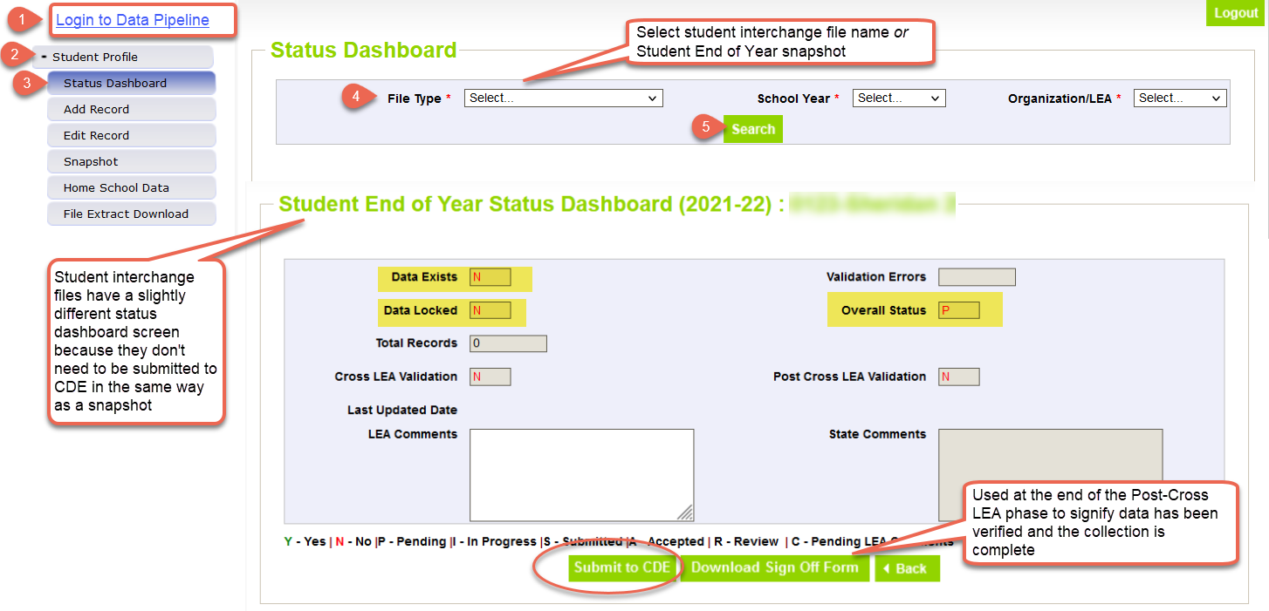
Status Dashboard Screen

Slide 8
Expelled Students

Slide 9
Expelled Students: General Information
The enrollment records for students who are expelled (per Local Board Policy) are impacted by the following components
  Term of expulsion
  Educational services received during the time of expulsion (no/yes/type)
School Exit/Entry types along with the corresponding School Exit/Entry dates reflect the term of expulsion and indicate if educational services are received or not
Additional data fields are utilized when a student is receiving educational services.
  Expelled Education (SSA file)
  Non-School Program (SSA file)
    01 – Single District Online Program
    02 – District-Run Program
    04 – Third Party Program

Slide 10
Expelled Coding Scenarios
Without services: term ends within current year
School Code | School Entry Date | School Entry Type | School Exit Date | School Exit Type
5678 | 08152024 | 02 | 09252024 | 55
5678* | 05012025 | 55 | 00000000 | 00
Without services: term ends next year
School Year | School Code | School Entry Date | School Entry Type | School Exit Date | School Exit Type
Current | 5678 | 08152024 | 02 | 04012025 | 50
Subsequent | 5678* | 01092026 | 50 | 00000000 | 00
With Services: term ends within current year
District Code | School Code | School Entry Date | School Entry Type | School Exit Date | School Exit Type | Expelled Student | Non-School Program
1234 | 5678 | 08152023 | 02 | 09252023 | 56 | 0 | 00
1234 | 5678* | 09262023 | 56 | 04012024 | 11 | 1 | 01, 02, 04
1234 | 5678 | 04022024 | 11 | 00000000 | 00 | 0 | 00
With Services: term ends within next year
School Year | District Code | School Code | School Entry Date | School Entry Type | School Exit Date | School Exit Type | Expelled Student | Non-School Program
Current | 1234 | 5678 | 08152023 | 02 | 09252023 | 56 | 0 | 00
Current | 1234 | 5678* | 09262023 | 56 | 00000000 | 00 | 1 | 01, 02, 04
Subsequent | 1234 | 5678* | 08102024 | 02 | 09252024 | 11 | 1 | 01, 02, 04
Subsequent | 1234 | 5678 | 09262024 | 11 | 00000000 | 00 | 0 | 00

Slide 11
Adequate Documentation of Transfer

Slide 12
Adequate Documentation of Transfer
Adequate documentation is maintained year-round for every student who transfers out of the district (K-12)
Required documentation varies based on school exit type
  Most common type of documentation: Confirmation of Enrollment and Attendance (COE/A)
SEY Adequate Documentation Site
  Sample forms and templates
  List of documentation required for each school exit type
Documentation should be readily available upon request—reviewed by SEY Collection Lead on a case-by-case basis
  SE722 Warnings
    Regular Phase: These students might need documentation later, start watching this list.
    Cross LEA Phase: Pull this list and start compiling documentation.
      Request documentation if it is not already on file.
      Check your reported SASID compared to SASID reported by the other LEA, requesting merges as needed from RITS Coordinator
  SE903 Errors (Post-Cross Phase)
    Must submit a COE/A via Syncplicity as additional documentation when requesting exception, allowing use of school exit type 13

Slide 13
Adequate Documentation by School Exit Types
School Exit Type(s) | Documentation
02 | Obituary, Notification from parent/guardian Written confirmation from school administrator
05 | Written records request Confirmation of enrollment and attendance Written confirmation from school administrator Parent/guardian written notification
13 | Confirmation of enrollment and attendance
14, 15, 18, 19, 21, 26, 70 | Written records request Confirmation of enrollment and attendance
16 | Written intent to homeschool notification signed by parent/guardian
30 | Doctor’s note
All documentation should include:
Student’s full name
SASID
Student’s date of birth

Slide 14
Confirmation of Enrollment and Attendance (COE/A)
COE/A Document
  Provided by receiving district when student has begun attending the receiving school
  Must include date of enrollment and date of attendance
  Must include student’s SASID and full name
  If a SASID merge has taken place or student is found to have two different SASIDs, include both SASIDs on the form
Sending LEA
  Request COE/A after student transfers out of district
Receiving LEA
  Respond within 14 business days
  Acceptable Responses
    Not Enrolled or Attending
    Enrolled, but has not yet attended
    Enrolled (date) and attended (start date)
School Exit Type 13:
  Must have COE/A
    RITS system is not sufficient evidence
  COE/A must indicate student began attending the receiving LEA within the current school year (before 6/30)

Slide 15
Exception Request Reminders

Slide 16
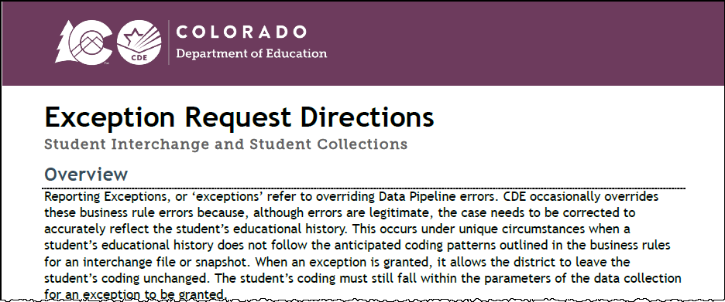
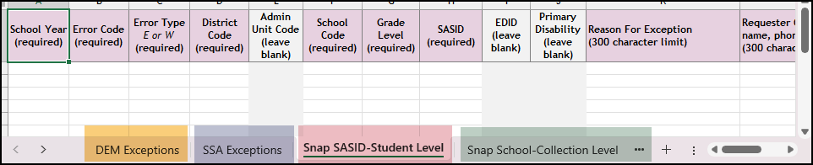
New (June 2025) Exception Request Templates and Directions
Updated Directions (PDF)
Provides information regarding all student collections using the same template and process (Student Interchange, OCT, SEY, ATS)
Shows required information for different exception types
DEM, SSA, Snapshot SASID-Student Level, Snapshot School-Collection Level
Syncplicity instructions
Details regarding situations that require ‘additional information’ forms
Collection/File Specific Notes
Updated Request Template (XLS)
Include multiple tabs to accommodate different types of exceptions
Not all exception requests require the same data fields
Each error code requires a separate row
Leading zeros are required
Multilingual Learner Request Template (XLS)
Separate request form with an extra tab with sample ‘reasons for request’ by request of the field due to the complex nature of these requests.
Multilingual Learner: Sequence Change Request Form (DOC) and fillable PDF

Slide 17
Exception Request Process
Interim Deadline:
7/31/2025
Download exception request template
  Detailed directions also available
Select and complete the applicable tab of the request document
  Form was updated to include tabs for DEM, SSA, Snapshot Student Level, and Snapshot School/Collection level requests
Save the exception to your computer with a unique name
Upload the complete request to your LEA’s student Syncplicity folder using the applicable subfolder for the collection/time of year
  Folder Name: District Code – DISTRICT NAME – Student
    Subfolder: SEY 2024-25
Email StudentEndOfYear@cde.state.co.us to notify SEY a request is ready for review

Slide 18
CEDAR/COGNOS Reports:
SASID Lookup

Slide 19
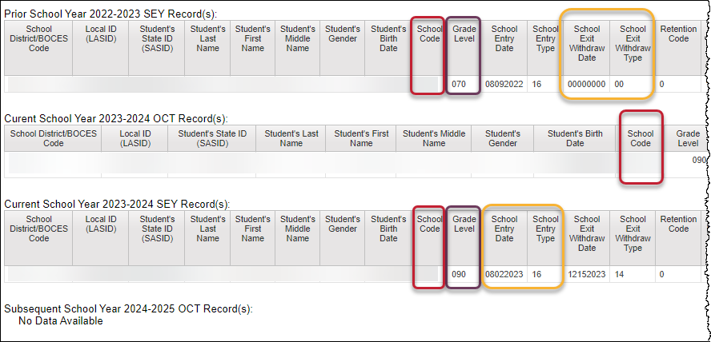
SASID Lookup: SEY and OCT record (prior, current, subsequent year)
One SASID at a time
Shows your LEA’s reported records only
  Prior SEY, Current OCT, Current SEY, Subsequent OCT
Best report to research cross collection errors related to prior SEY or OCT data
During post-cross phase, use to research errors related to next year OCT

Slide 20
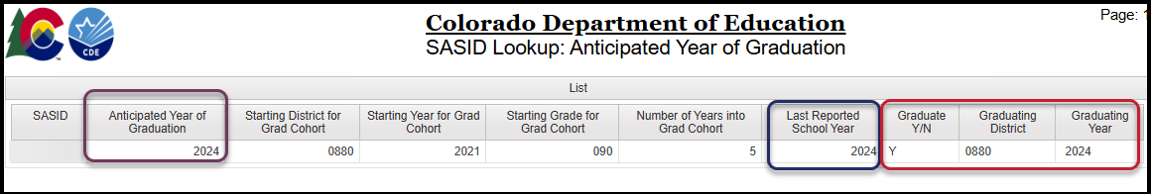
SASID Lookup: Anticipated Year of Graduation
Available to SEY Approvers, Users, and Viewers
Single or multiple SASID lookup
Last reported year updates as snapshots are created
  If SASID is not included in the current SEY collection, will remain a prior year
Shows AYG, if assigned
  Once set during SEY collection the year the student enters a CO public high school for the first time, this value does not change
Shows if student has been counted as a graduate, graduating district and year (if applicable)
  Once counted as a graduate for a specific LEA, student does not move between cohorts

Slide 21
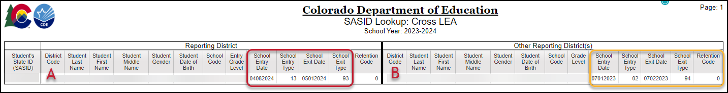
SASID Lookup: Cross LEA
Available throughout the entire collection
Designed to help research SE700 business rules, SE900 business rules, and some regular phase business rules (SE137, SE138, etc.)
In the example above, District A is the last district of attendance. We’d expect District B to update their exit type to show exit type 13.

Slide 22
CEDAR/COGNOS Reports:
Student List

Slide 23
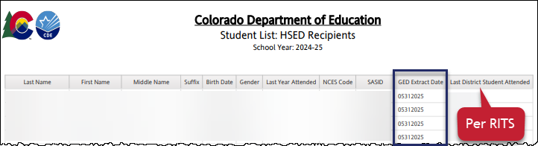
Student List: HSED Recipients
Lists students reported to CDE as having received their HSED (GED) during the current school year
The ‘GED Extract Date’ is the date CDE received this information
  Updated monthly on last day of month
The last district the student attended may indicate the student as an HSED recipient with school exit type 93/94 (current year) or an adjustment record (prior year)
Reach out to SEY Collection lead if you believe there is a record in error
  The data CDE receives is run through a matching system to find the student’s SASID

Slide 24
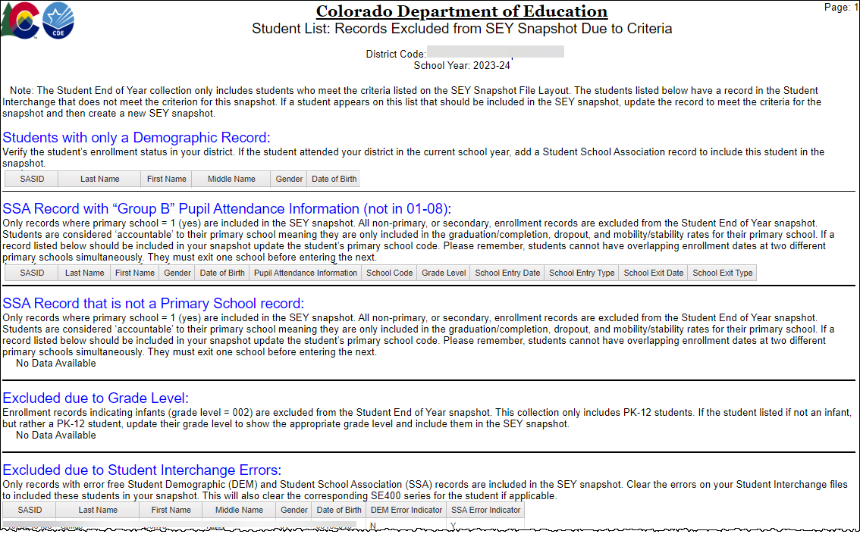
Student List: Records Excluded from SEY Snapshot Due to Criteria
Lists student records that are not part of the snapshot due to one of the following reasons
DEM record only
Group B PAI Code
Primary School = 0 (no)
Grade Level = 002 (infant)
Errors on DEM and/or SSA file

Slide 25
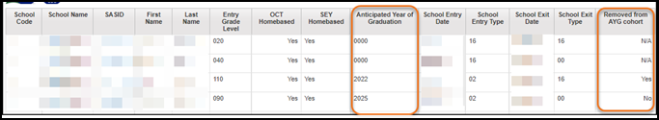
Student List: SEY Homebased Education Status
Lists students reported as homebased education = 1 (yes)
Fields:
  AYG
  School entry date
  School entry type
  School exit date
  School exit type
Reminder:
  Homebased education students trigger errors if they have school exit types 90-96, 40, or 01
  If AYG is 2025 or earlier (2024, 2023, 2022), must have an exit type that removes them from the AYG cohort

Slide 26
Additional Student Lists…
Student List: AYG Cohort
  Includes all students in a specific AYG cohort (denominator of graduation rates) and their final reported outcome
  Applicable lists for SEY 2025
    AYG 2026, 3 years in cohort
    AYG 2025, 4 years in cohort
    AYG 2024, 5 years in cohort
    AYG 2023, 6 years in cohort
    AYG 2022, 7 years in cohort
Student List: AYG Cohort Adjustments
  List students with an adjustment record for in the selected school year
    Only LEAs who have uploaded an Adjustment file will have data in this report
Student List: District and School Mobility
  Lists all students with their mobility status at the district and school level
Student List: Dropouts
  List of students counted as dropouts for the given school year
These reports will be covered in more detail in the August SEY Office Hours

Slide 27
Questions?

