Slide 1
Cognos Reports and Finalizing the School Discipline files

Slide 2
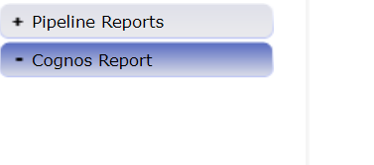
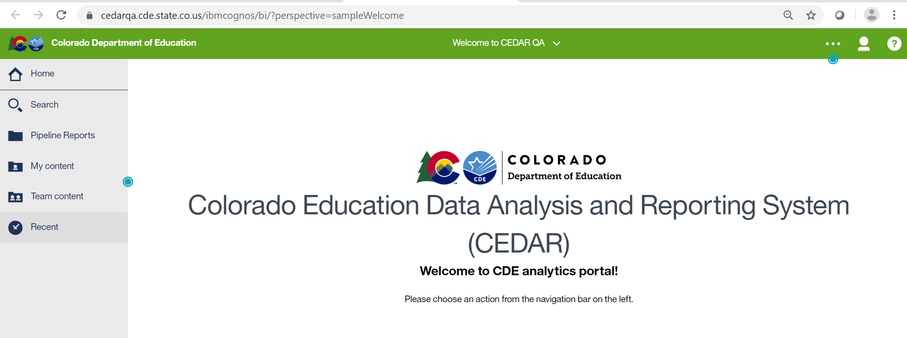
Accessing Cognos:
NEW LOOK!

Slide 3
Cognos Reports – Select Pipeline Reports on the left

Slide 4
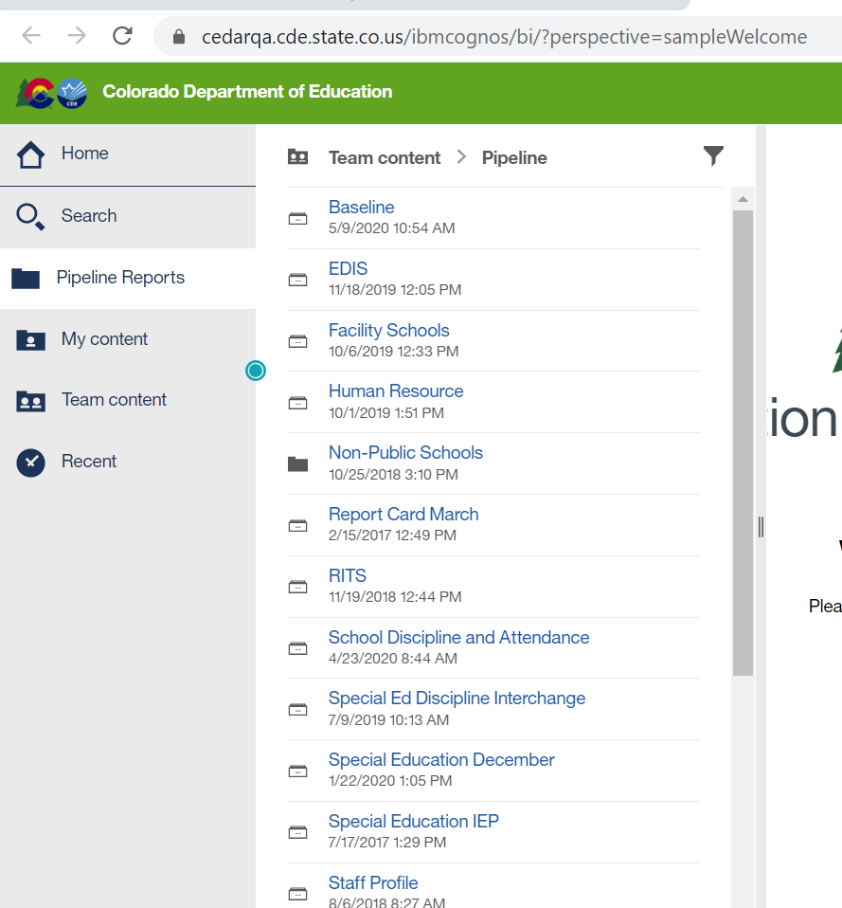
Viewing Attendance Reports
School Discipline reports
are in the
School Discipline and Attendance Folder
Date and Time listed does NOT reflect snapshot or file upload date

Slide 5
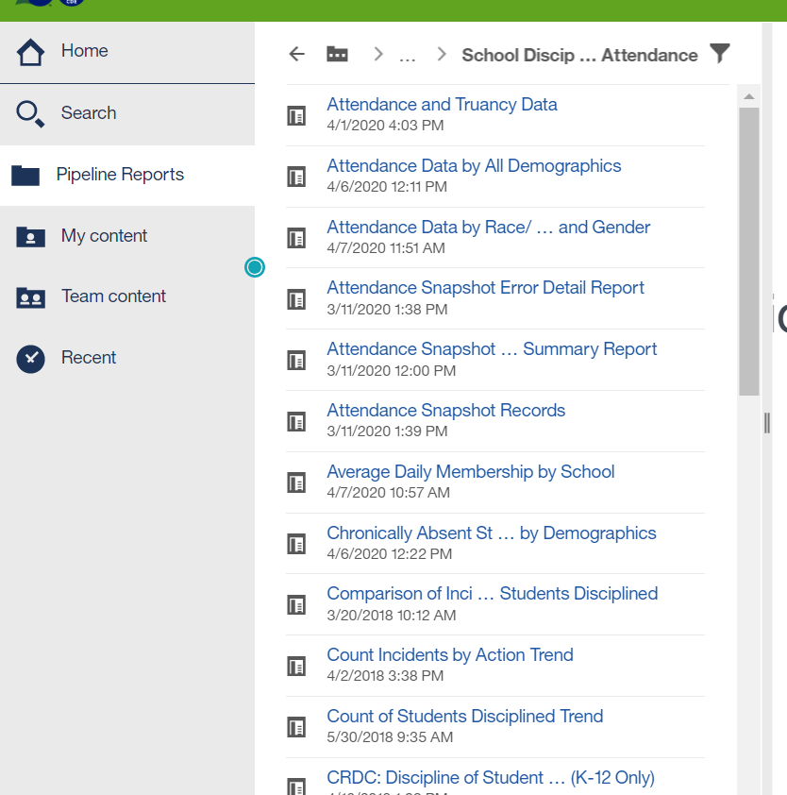
Attendance Reports
Can scroll down to view more report options with scrollbar
Can expand further to the right to see full report names

Slide 6
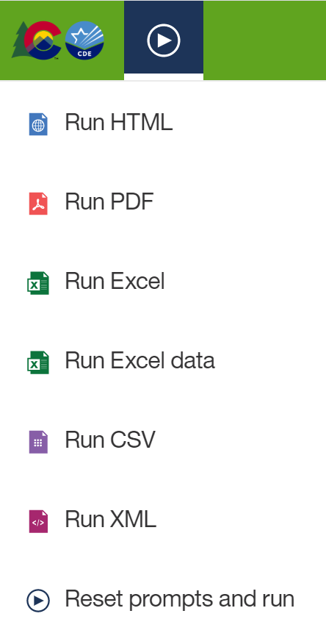
Exporting Reports into Excel
Click on ‘Play’ Button
(available when a report is showing)

Slide 7
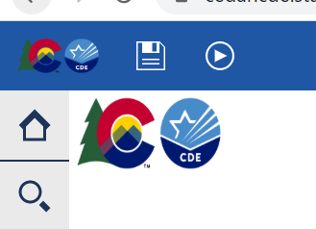
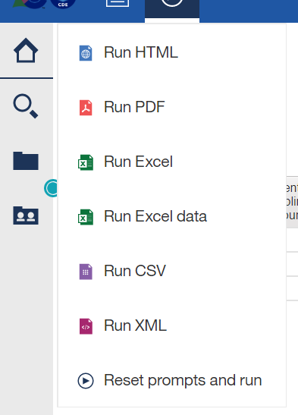
Printing Reports
Can choose to print in excel or PDF
Document will open in selected format (pdf or excel)
Print from pdf or excel

Slide 8
Discipline by Action Taken Reports
Discipline Action Error Detail Report
Discipline Action Error Summary Report
Summary of Behavior by Action
Count Incidents by Action Trend
Comparison of Incidents Reported and Students Disciplined

Slide 9
Discipline by Student Demographic Reports
Comparison of Incidents Reported and Students Disciplined
Count of Students Disciplined Trend
Summary of Disciplinary Actions by Federal Race/Ethnicity
Summary of Disciplinary Actions by Gender
Summary of Disciplinary Actions by Grade
Summary of Disciplinary by Demographic File
Demographics Error Detail Report
Demographics Error Summary Report

Slide 10
Firearm (GFSA) Data Reports
Firearm Error Detail Report
Firearm Error Summary Report
Summary of Firearm Data

Slide 11
Key Words used in Report Titles
Error Detail Report
Includes record with each error
Error Summary Report
Provides count of records with each error
Trend
Data provided for current year, prior year and 2 years prior
Summary
Grouping the data reported into categories

Slide 12
Summary of Behavior by Action
Provides the Type of Behavior (code and description) AND totals as reported for each by School:
Number of Incidents
Classroom Removals
In-School Suspensions
Out-of-School Suspensions
Expulsions
Law Enforcement Referrals
Other Action Taken
Behavior Codes 01-16 are included. Codes 17-22 are for CRDC purposes only and not included in state reporting online or in this cognos report
Discipline by Action

Slide 13
Count Incidents by Action Trend
Provides data reported in the Discipline by Action Taken File for the current year, prior year and 2 years previously
Total Number of Incidents
Classroom Removal Incidents
In School Suspension Incidents
Out of School Suspension Incidents
Expulsion Incidents
Law Referral Incidents
Other Action Taken Incidents
Behavior Codes 01-16 are included. Codes 17-22 are for CRDC purposes only and not included in state reporting online or in this cognos report
Discipline by Action

Slide 14
Comparison of Incidents Reported and Students Disciplined
Provides the total counts of incidents reported per school
Behavior Codes 01-16 are included. Codes 17-22 are for CRDC purposes only and not included in state reporting online or in this cognos report
Provides the total count of students disciplined reported by school
These numbers will assist with any comparison error(s) in your data file and to verify accuracy of both reports
Recall, the count of students disciplined should be either more than or equal to the count of incidents reported
Discipline by Action
Discipline by Student Demographics

Slide 15
Count of Students Disciplined Trend
Provides data reported in the Discipline by Student Demographic File for the current year, prior year and 2 years previously
Number of Students Reported as Disciplined (unduplicated count)
Number of Students Reported with Classroom Removals
Number of Students Reported with In School Suspension
Number of Students Reported with Out of School Suspension
Number of Students Reported with Expulsions (with or without services)
Number of Students Reported with a Law Enforcement Referral
Number of Students Reported with an Other Action Taken
Total Number of Students Disciplined (duplicated count)
Discipline by Student Demographics

Slide 16
Summary Reports for Discipline by Student Demographic
Summary of Disciplinary Actions by Federal Race/Ethnicity
Total of each disciplinary action reported by Federal Race/Ethnicity for each School
Summary of Disciplinary Actions by Gender
Total of each disciplinary action reported by Gender for each School
Summary of Disciplinary Actions by Grade
Total of each disciplinary action reported by Grade for each School
Summary of Discipline by Demographic File
Total of each disciplinary action reported by Federal Race/Ethnicity, Gender, Grade, Special Education, 504, and ELL status for each School
Discipline by Student Demographics

Slide 17
Summary of Firearm Data
Provides data only if Firearm file was uploaded
Provides Firearm data by School, Grade Level and Firearm Weapon Code/Description
Firearm (GFSA) Discipline

Slide 18
CRDC Reports
All will have title “CRDC: %%%%”
These reports will have data included for review

Slide 19
Finalize Data
New dummy file is available to finalize all 3 files at once; this file is titled “All Discipline”
All files must be uploaded and error free OR indicated as “No” for all schools in No Reportable Incidents tab prior to finalizing
By finalizing the “All Discipline” file ALL 3 files are finalized
Download sign off form will indicate which schools have data reported

Slide 20
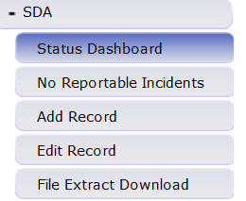
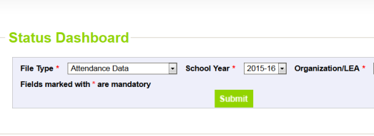
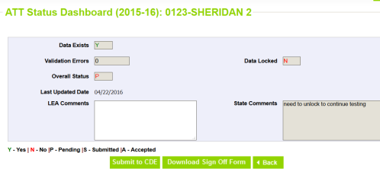
Finalize Data Steps
Only the SDA~LEAAPPROVER role can perform this step
ALL DISCIPLINE

