Slide 1
May 9th, 2024
Student Discipline- How to complete the Safe Schools Accreditation Report in Data Pipeline
Dawna Gudka-Student Discipline Collection Lead

Slide 2
Data Pipeline Roles in the Identity Management (idM) Roles
Data Respondents that have the STU Approver role can complete this report
Discipline Snapshot Roles
STU-LEAVIEWER
STU-LEAUSER
STU-LEAAPPROVER
*Note: can only have 1 role under each role category
or you will get locked out of Data Pipeline

Slide 3
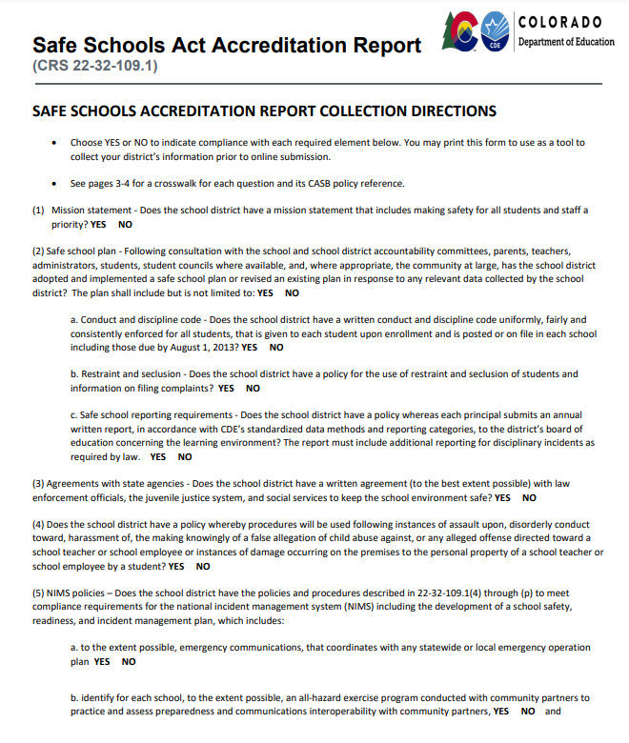
Safe Schools Act Accreditation Report Resource

Slide 4
Safe Schools Act Accreditation

Slide 5
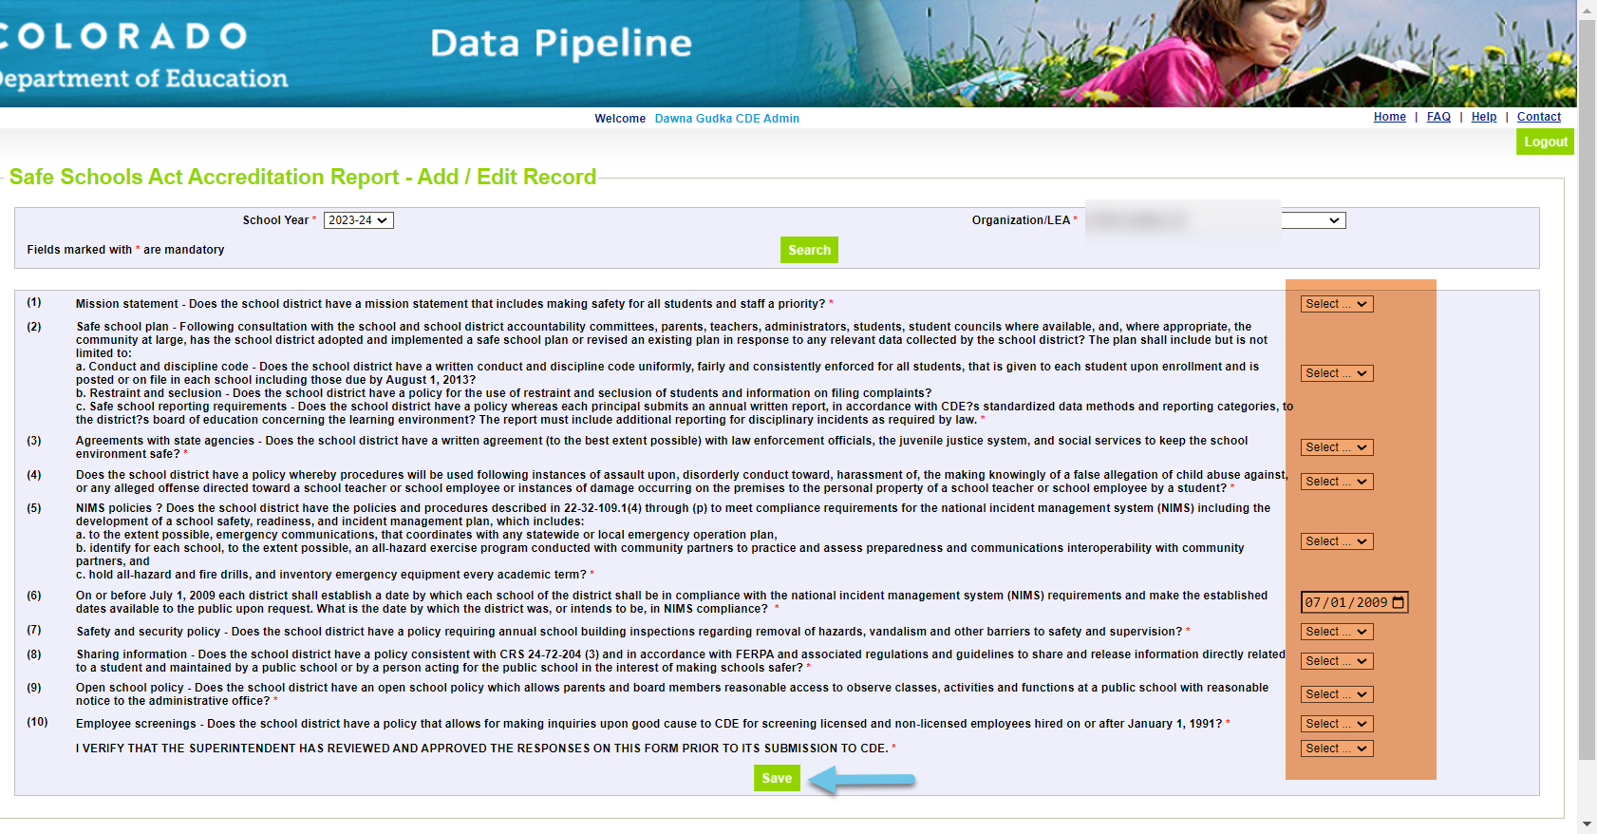
Complete the form, and click on SAVE

Slide 6
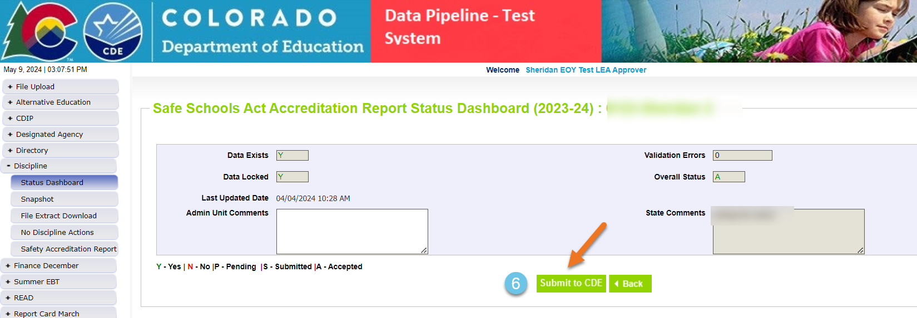
Submit your Safe Schools Act Accreditation Report to CDE

