Slide 1
Prevent Harassment or Discrimination Collection Training
May 12th, 2025
Carrie Martin
Prevent Harassment or Discrimination Collection Lead
Notes:
Hello, I’m Carrie Martin and I am the Prevent Harassment or Discrimination Lead. Thank you so much for joining us today.

Slide 2

Agenda
Collection Background
Collection Timeline
Collection Data & Errors
Data Pipeline Process
Frequently Asked Questions
Additional Information & Collection Resources
Questions
Notes:
Today's agenda

Slide 3
Collection Background

Slide 4
Background - Concerning Protections for Students Against Discriminatory Practices at School
In April 2023, the Colorado General Assembly passed Senate Bill 23-296. The act defines "harassment or discrimination" as any unwelcome physical or verbal conduct or any written, pictorial, or visual communication by a student or employee that is directed at a student or group of students because of that student's or group's membership in, or perceived membership in, a protected class. The act seeks to provide equitable standards for harassment to ensure that students who are subject to harassment or discrimination are provided a prompt and fair process, information about their rights and status of the complaint, and supportive measures or accommodations to remedy the impact of the harassment or discrimination.
On or before July 1, 2025, and on or before July 1 of each year thereafter, each public school of a school district shall report to the school district, and each institute charter school shall report to the Charter School Institute, the following information, aggregated and without personally identifiable information about the parties, from the prior twelve months:
  The number of formal harassment or discrimination reports received by the school and the type of bias reported when discrimination or harassment was found.
  The time to complete each investigation and to make findings related to each report.
On or before August 1, 2025, and on or before August 1 of each year thereafter, the Charter School Institute and each school district shall report to the Colorado Department of Education the information it received from each school.
Notes:
In April 2023, the Colorado General Assembly passed Senate Bill 23-296. This act defines harassment or discrimination and outlines the reporting requirements and deadlines.

Slide 5
Collection Timeline

Slide 6
Timeline
Date | Event | Event Description
5/1/2025 | Official Open | PHD Collection Open
5/12/2025 | Training | Prevent Harassment or Discrimination Training, Register
6/5/2025 | Interim Deadline | Upload Prevent Harassment or Discrimination File at least once
7/3/2025 | Interim Deadline | Error free Prevent Harassment or Discrimination File
7/7-7/25/2025 | Report Review | LEAs should use this time to review reports prior to the deadline. Typically, one week prior to the deadline.
8/1/2025 | State Deadline | PHD Collection Closes- All LEAs must have Prevent Harassment or Discrimination submitted in Data Pipeline.
8/8/2025 | State Deadline | Signature page emailed to Prevent Harassment or Discrimination

Slide 7
Collection Data

Slide 8
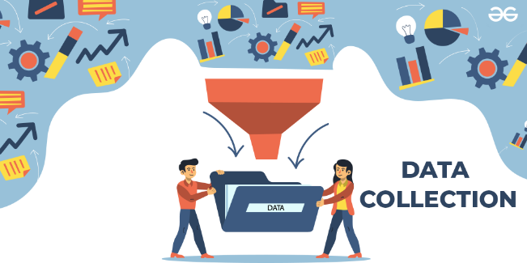
Prevent Harassment or Discrimination Data
The Prevent Harassment or Discrimination (PHD) collection is a periodic collection.
In the file, the number of harassment or discrimination reports received by the school during the reporting school year.
What is included in the file?
All reports of student harassment or discrimination at each school
Duration of the investigation
Type(s) of bias found
Includes reports where no bias was found

Slide 9
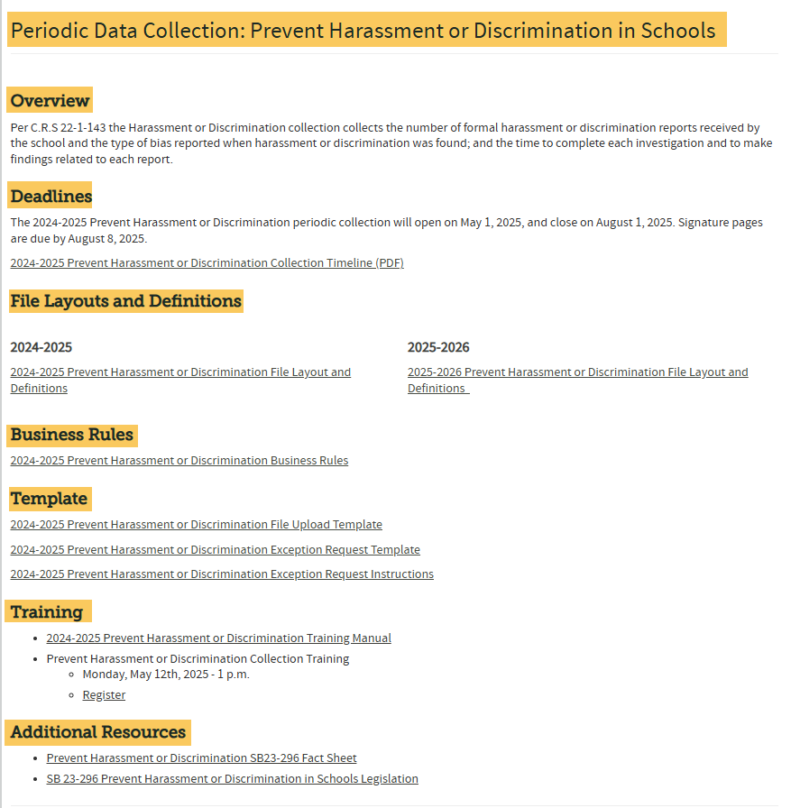
Resources
Prevent Harassment or Discrimination in Schools website

Slide 10
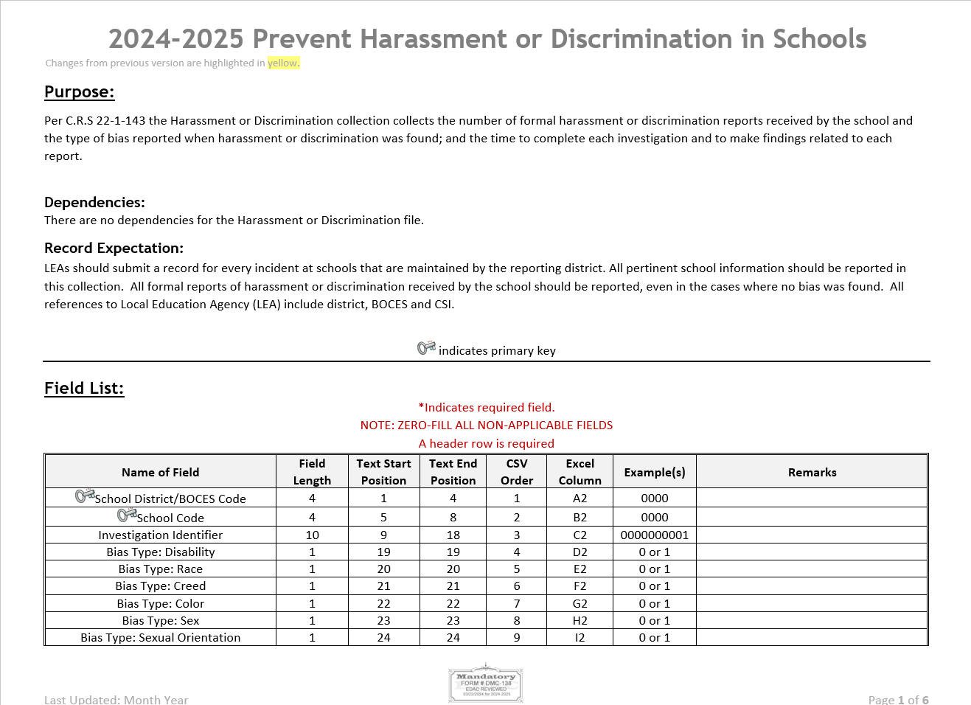
Prevent Harassment or Discrimination File Layout
NEW Collection
PHD File Layout

Slide 11
Prevent Harassment or Discrimination
Business Rules Highlights
  Error PH024-No incidents have been reported for this school. If this is accurate, please refer to the Exception Request Instructions.
    Exception Request Template and Exception Request Instructions
  Error PH028-Bias type no bias cannot be zero when all other biases are zero. Must select a bias for the record.
    In other words, if the investigation determined a bias was found, at least one bias type must be selected
  Error PH020-Report Investigation Time is required and must be a valid code.
Code | Description
01 | Within 60 school days
02 | Within 61-90 school days
03 | Exceeded 90 school days

Slide 12
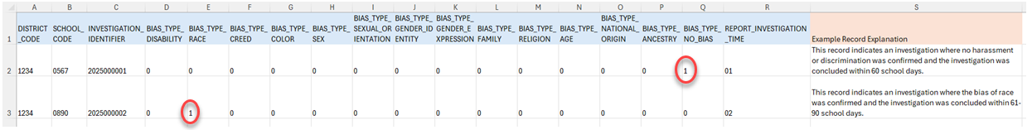
Example Records
If a report of harassment or discrimination was investigated and no bias was found then none of the individual Bias Type fields would be indicated (all zeros), the Bias Type: No Bias would be one (1) indicating yes, there was no bias found. This is an example of both record types:

Slide 13
Data Pipeline Process

Slide 14
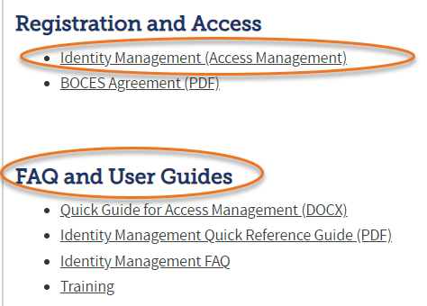
Data Pipeline
Roles in the Identity Management (IdM)
Identity Management (IdM)
Prevent Harassment or Discrimination Roles
PHD ~ LEAVIEWER
PHD ~ LEAUSER (recommended)
PHD ~ LEAAPPROVER (recommended)
*Note: Each user is assigned only one role, or they will encounter errors when trying to login to Data Pipeline.

Slide 15
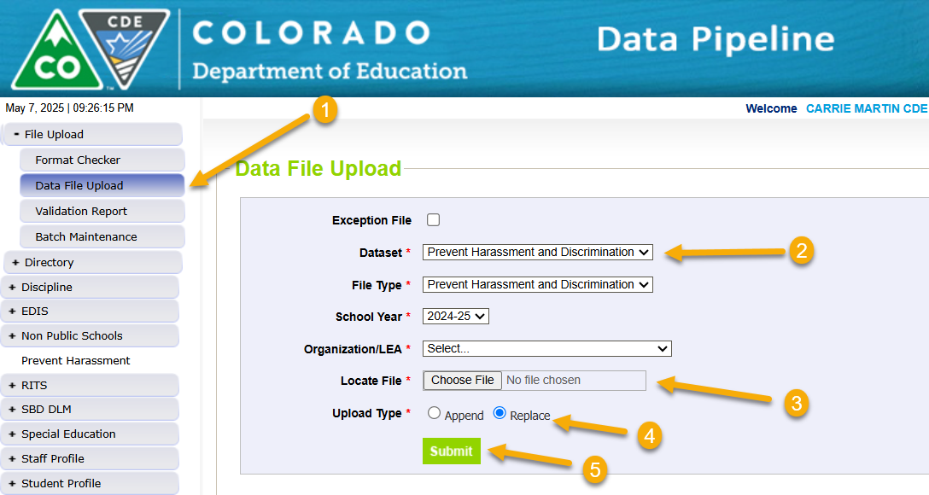
Upload Prevent Harassment or Discrimination File
Steps
1. Login to Data Pipeline
2. Select File Upload
3. Select Data File Upload
4. Complete the Dropdown menus, indicating the specific file you are uploading.
  Dataset: Prevent Harassment and Discrimination
  File Type: Prevent Harassment and Discrimination
  School Year: Current School Year
  Organization/LEA: Your district
  File Name: Choose File → Select file from your computer
    .csv, .xls, .xlsx (.xlsx is preferred)
    Spaces are not allowed in the file name
  Upload Type = Append or Replace
    Relace is recommended
5. Select Submit

Slide 16
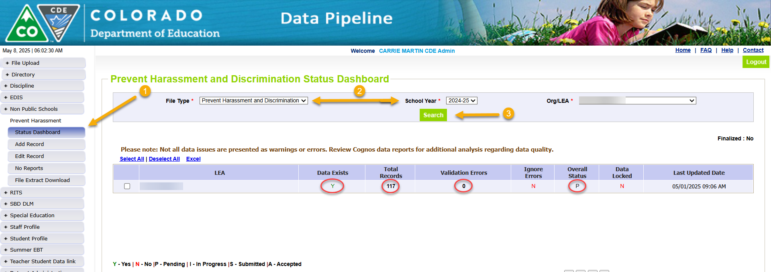
Status of the Prevent Harassment or Discrimination Upload
Steps
1. Select Prevent Harassment
2. Select Status Dashboard
3. Complete the Dropdown menus, indicating the specific file you are uploading.
  File Type: Prevent Harassment and Discrimination
  School Year: Current School Year
  Organization/LEA: Your district
4. Select Search

Slide 17
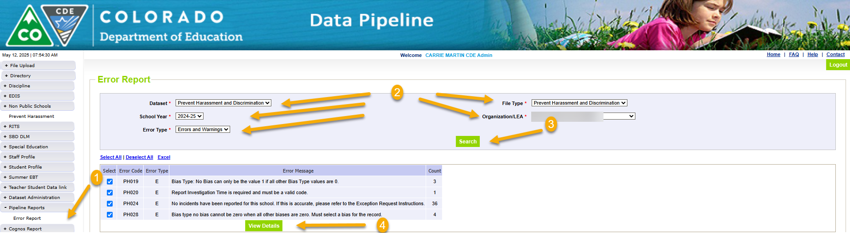
Review File Errors for Prevent Harassment or Discrimination
Steps
1. Select Pipeline Reports
2. Select Error Report
3. Complete the Dropdown menus
  Dataset: Prevent Harassment and Discrimination
  File Type: Prevent Harassment and Discrimination
  School Year: Current School Year
  Organization/LEA: Your district
  Error Type = Errors and Warnings(recommended)
4. Select Search (Any Errors or Warnings will display)
5. Select View Details

Slide 18
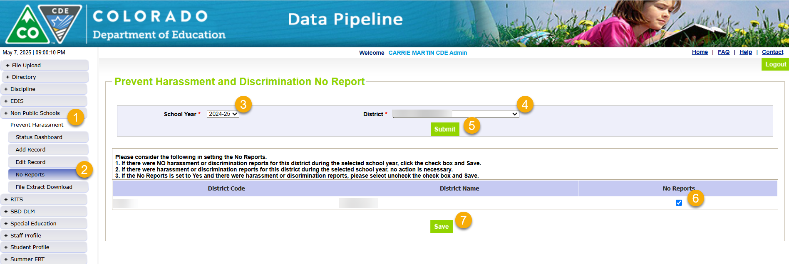
Data Pipeline Process-
NO formal harassment or discrimination reports
THIS IS ONLY IF YOUR DISTRICT HAS NO HARASSMENT OR DISCRIMINATION DATA TO REPORT
Notes:
Reminder: This collection includes all reports for the current school year. Please be mindful of where we are in the school year when completing this section.

Slide 19
Frequently Asked Questions

Slide 20

What if more than one bias is found?
Record all biases found during the investigation.

Slide 21

Where do I find this data?
Refer to your LEA’s policy that protects students experiencing harassment or discrimination.
Student Information System (SIS)
Review your student discipline data, including the Civil Rights Data Collection (CRDC) behaviors
  Many of the behaviors overlap
May also be captured manually

Slide 22
Additional Information
&
Collection Resources

Slide 23
What is PII?
Personally Identifiable Information (PII)
Student Personally Identifiable Information (PII) is defined by state and federal laws as information that, alone or in combination, personally identifies an individual
  This includes direct identifiers
  (i.e. student and staff names, SASID, EDID, etc.)
  Includes information that when combined is identifiable
Colorado’s Student Data Transparency and Security Act outlines requirements for how Student PII is collected, used and shared
CDE has prepared guidance on how to comply with this and other privacy laws which can be found here.

Slide 24

Sharing Data
Use secure methods to transfer any PII to CDE
  Contact Data Collection leads with questions about how to transmit PII securely
    Each Data Collection leads maintains their own Syncplicity folders for specific collections, reach out to the collection lead for access
  Use Syncplicity to encrypt emails to CDE
Avoid sending PII via unencrypted email or to unsecured faxes when sharing data between or within districts
  Use Syncplicity to encrypt emails to CDE
Check local policies for restrictions, requirements, etc. regarding PII
  Do not use PII in trainings, presentations, etc.
  Do not share PII with unauthorized individuals
  Do not share passwords
  Follow local policies when transmitting PII to any third party

Slide 25

Collection Resources
Prevent Harassment or Discrimination website
  PHD File Layout
  PHD Business Rules
  PHD Training Manual
  PHD Fact Sheet
Data Pipeline Home Page
Town Hall Presentations
CDE Website
Additional Resources and CDE contacts for Harassment, Discrimination, Title IX, and Bullying
Prevention of Harassment, Discrimination, and Bullying in Colorado Schools Site

Slide 26

Q

Slide 27

PreventHD@cde.state.co.us
Carrie Martin
720.665.4456

