Slide 1
October 16, 2025
Data Pipeline Town Hall
The goal of the webinar is to provide updates on the Data Pipeline, current, and upcoming data collections. These webinars also provide a forum for districts, BOCES, and Administrative Units to have questions answered about Data Pipeline.

Slide 2
Colorado Department of Education
Identity Management (IdM)
Identity Management Site
Frequently Asked Questions
How do I add myself or others to the email listserv for town hall emails and/or a specific collection?
  Email lists are dependent on a person’s access rights in IdM. Contact your LAM to get an account or be assigned to a specific collection.
Where can I find the IdM role mappings for Data Pipeline and other applications?
  Role Mapping (XLS)
I am a LAM. How do I update the user permissions for someone in my district?
  Follow the steps outlined in the IdM Quick Guide for Access Management (DOCX)
Important: Users are not automatically removed from IdM when their email address is no longer active in your district. The LAM must deactivate their IdM account to ensure only designated staff can access CDE’s data reporting system.
Support:
  Michael Threlkeld
  Forgot Password
  Request LAM Assistance
Notes:
LAMs, please check the IdM roles for your district. Remove permissions for users who have retired, left your district, or are no longer assigned to a collection. Add roles for new hires and newly assigned respondents for specific collections.

Slide 3

What is PII?
Student and Staff Personally Identifiable Information (PII) is defined by state and federal laws as information that, alone or in combination, personally identifies an individual
  This includes direct identifiers
  (i.e. student and staff names, SASID, EDID, etc.)
  Includes information that when combined is identifiable
Colorado’s Student Data Transparency and Security Act outlines requirements for how Student PII is collected, used and shared
See the Data Privacy and Security website for prepared guidance on how to comply with this and other privacy laws.

Slide 4

Sharing Data
Use secure methods to transfer any PII to CDE
  Contact Data Collection leads with questions about how to transmit PII securely
    Each Data Collection leads maintains their own Syncplicity folders for specific collections, reach out to the collection lead for access
  Use Syncplicity to encrypt emails to CDE
Avoid sending PII via unencrypted email or to unsecured faxes when sharing data between or within districts
  Use Syncplicity to encrypt emails to CDE
Check local policies for restrictions, requirements, etc. regarding PII
  Do not use PII in trainings, presentations, etc.
  Do not share PII with unauthorized individuals
  Do not share passwords
  Follow local policies when transmitting PII to any third party

Slide 5
Today’s Agenda
Agenda Topic | Presenter
Open Data Collections and Upcoming Deadlines in Data Pipeline | Host: Peter Hoffman
Student Interchange: Gifted and Talented Fields | Reagan Ward
Student End of Year | Reagan Ward
Student October | Collin Slutzky
Kindergarten School Readiness | Justin Chrisco

Slide 6
Open Collections and
Upcoming Deadlines in
Data Pipeline

Slide 7
Open Collections and Upcoming Dates:
Year-Round & Interchanges
Name | Category | Status | Key Dates
RITS | Year Round | Open | N/A
EDIS | Year Round | Open | N/A
Directory | Year Round | Open | N/A
Student | Interchange | 2025 & 2026 Open | 2024-2025: Maintain error free files 2025-2026: Maintain error free DEM & SSA files
At-Risk | Interchange | Open | Maintain error free file
Title I | Interchange | 2025 & 2026 Open | 2024-2025: Maintain error free file, Closes 10/17/2025 2025-2026: Maintain error free file
Special Education IEP | Interchange | Open | Maintain error free files
Staff | Interchange | 2025 & 2026 Open | 2024-2025: Closing soon 2025-2026: Interim Deadlines for initial uploads 10/24 staff profile initial file upload 10/31 staff assignment initial file upload
Data Pipeline Resources: Data Pipeline Collection Dates (XLS)

Slide 8
Open Collections and Upcoming Dates:
Snapshots
Name | Category | Status | Final Deadline Date | Next Milestone | Looking Ahead
Student End of Year: Cross LEA Phase | Snapshot | Closes Today | Oct. 16, 2025 | Deadline: 10/16/25
Student End of Year: Post-Cross LEA Phase |  | Coming Soon | Nov. 18, 2025 | October SEY Office Hours 10/21/2025 (registration link) | Opens 10/23/2025
Student October | Snapshot | Open | Nov. 10, 2025 | Interim Deadline: 10/27/25 Error-free Student October Snapshot | Report Review: 11/3/25 to 11/10/25 noon
Data Pipeline Resources: Data Pipeline Collection Dates (XLS)

Slide 9
Open Collections and Upcoming Dates:
Periodic
Name | Category | Status | Final Deadline Date | Next Milestone | Looking Ahead
Instructional Days and Hours | Periodic | Open | Dec. 19, 2025 | Collection Opens: 9/17/25 | Collection Closes: 12/19/25
Kindergarten School Readiness | Periodic | Open | Dec. 12, 2025 | Interim Deadline: 11/14/25 | Deadline: 12/12/25
Non-Public Schools Fall Enrollment Count | Periodic | Open | Jan. 12, 2025 | Opens 10/13/2025
Data Pipeline Resources: Data Pipeline Collection Dates (XLS)

Slide 10
Student Interchange:
Gifted and Talented Fields
Reagan Ward

Slide 11
Gifted and Talented Data Fields
SSA Data Field
Resource:
Gifted and Talented—SSA Data Fields (PDF)
Indicate a student who has been formally identified as gifted using AU-wide procedures aligned to CDE guidelines in one or more of the 14 domains
  General intellect ability, creative or productive thinking, leadership abilities, reading, writing, math, science, social studies, world language, visual arts, performing arts, musical, dance, psychomotor
  1—yes
  0—no
Once a student is identified in a category, they remain identified in that category throughout their educational career
  Except Gifted in General Intellect Ability, this may be removed when more specific identifications are added if in alignment with CDE guidelines
  Students may add categories of identification throughout their educational career
  Identification is portable across CO schools
Student Interchange
StudentOctober@cde.state.co.us or StudentEndOfYear@cde.state.co.us

Slide 12
Gifted and Talented Data Fields
Snapshot Internal Flag
Resource:
Gifted and Talented—SSA Data Fields (PDF)
Many student data snapshots include an internal flag calculated based upon at the 14 SSA fields
9 (or 1)—Yes, gifted in at least one of the SSA fields
0—No, not gifted in any of the SSA fields
Collections with GT Internal Flag based upon SSA data
  Student October
  Student End of Year
  Student Attendance
  Assessment Pre-ID files (based on October G/T status)
  Assessment SBDs
Student Interchange
StudentOctober@cde.state.co.us or StudentEndOfYear@cde.state.co.us

Slide 13
Business Rules
Resource:
Gifted and Talented—SSA Data Fields (PDF)
Student October
Student End of Year
OC212 error: If GT flag = yes in the prior year SEY in your district, must be yes in the current year OCT
OC213 warning: If GT flag = yes in the prior year SEY in another LEA, but your LEA shows GT = no in the current year OCT
  This is a warning for 2025-2026, but could turn into an error in a future year
OC121 warning: Your districts count of GT K-12 students is significantly different than the prior year (+/- 25%)
SE163 error: Grade 1-12 student GT = yes in prior year SEY must have GT = yes in current year SEY
SE312 error: GT = yes in current year OCT must also be GT = yes in current year SEY
SE233 warning: Collection Level—your LEA reported no Gifted pupils
Student Interchange
StudentOctober@cde.state.co.us or StudentEndOfYear@cde.state.co.us

Slide 14
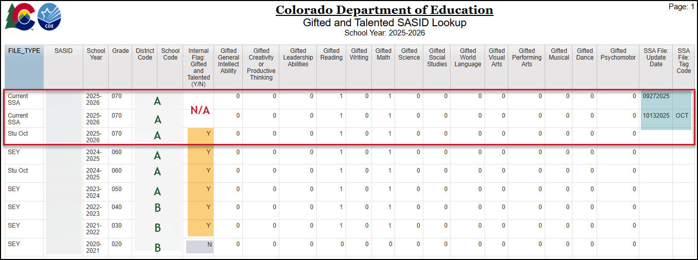
Student Interchange COGNOS/CEDAR Report:
Gifted and Talented SASID Lookup
Report Category: Student Interchange
Report Updated: Aug 2025 (expanded years)
Reflects:
  Current SSA file (all tags)
  SEY Snapshot History (all years)
  Current year and Prior year OCT
Research prior CO GT reporting for incoming transfer student when family indicates student received GT services in the past
Research OCT and SEY errors
Student Interchange
StudentEndOfYear@cde.state.co.us

Slide 15
Questions & Resources:
Student Interchange
Student Interchange Website
Data Pipeline Collections Support Page:
Request a meeting for Student Interchange support
with Collin or Reagan
2024-2025 Student Interchange StudentEndOfYear@cde.state.co.us
2025-2026 Student Interchange
July 2025-Dec 2025: StudentOctober@cde.state.co.us
Jan 2026-Dec 2026: StudentEndOfYear@cde.state.co.us

Slide 16
Student End of Year
Reagan Ward

Slide 17
SEY Collection Timeline:
Cross LEA Phase
Date | Event | Event Description
10/16/2025 | Cross LEA Deadline | Resubmit error-free SEY Snapshot
10/17/2025 to 10/22/2025 | Closed | Snapshot closed in preparation for the Post-Cross LEA Phase
10/21/2025, 10:30-11:30am | Training Event | October SEY Office Hours
10/23/2025 to 11/18/2025 | Post-Cross LEA Phase | See the SEY Website for the detailed timeline
11/21/2025 to 11/25/2025 | Final Report Review | Final review of rates Reconcile any issues found in CDE’s final review (notified by SEY lead) Any changes require a new sign-off form
12/2/2025 | Deadline | Superintendent Verification (Sign-Off) form due. Collection Closes.
October SEY Office Hours Agenda:
Timeline Review
Post-Cross LEA Phase
  Overview
  Steps
  Phase Mechanics
  Exceptions
  Post-Cross Change Requests
  SASID Merges in Post-Cross
  Business Rules
Final Dates
  CDE Final Report Review
  Superintendent Verification Form
  January Data Release
Q&A
Student End of Year
StudentEndOfYear@cde.state.co.us

Slide 18
SEY Status as of 8:30am on 10/16
Submission Checklist:
*LEA Approvers*
Error free interchange files
Validate Data
  Review SE700 series warnings
  Review CEDAR/COGNOS reports
  (rates and lists)
Error free SEY Snapshot
Reminder: The Cross LEA Phase allows LEAs to update any data field.
The Post-Cross Phase is very restricted in possible updates, requiring extra steps to make changes to records that aren’t triggering SE900 series errors.
Student End of Year
StudentEndOfYear@cde.state.co.us

Slide 19
Looking ahead to the Post-Cross LEA Phase
Minimum Required Action
Unique Components
Review errors and warnings
  SE900 series errors and warnings
  SE001-SE700 series errors
Update SEY snapshot at least once
Review SEY Data using CEDAR/COGNOS Reports
Submit Superintendent Verification Form
  Forms accepted 11/12 through 12/2
During this phase, snapshots are not unlocked, only ‘updated’
Limited Data Updates
  Independent: School exit types for students with SE900 series errors
  Supported:
    Updates to correct SE001-SE700 series errors
    Correcting SEY retention codes in response to 2025-2026 October errors
    Correcting SEY data fields in response to SE900 warnings
Student End of Year
StudentEndOfYear@cde.state.co.us

Slide 20
Questions & Resources:
Student End of Year
StudentEndOfYear@cde.state.co.us
720-484-9057
Data Pipeline Collection Support Page: Request a SEY meeting
  Student End of Year Collection Website
  Student Interchange Website
  Graduation Guidelines (Program) Website

Slide 21
Student October
Collin Slutzky

Slide 22
October Count Timeline
Date​ | Event​ | Event Description​
10/14/2025 | Interim Deadline​ | Create an initial Student October Snapshot​
10/27/2025 | Interim Deadline​ | Submit any necessary reporting exceptions for review.
10/27/2025 | Interim Deadline​ | Error free Student October Snapshot​
10/28/2025 | Training Event​ | Data Validation, Transfer Enrollment Exceptions and Cognos Reports 1-2 p.m.​ Registration Link
10/30/2025 | Training Event​ | Data Pipeline Duplicate Process and Submission 11-12 pm Registration Link
11/03/2025 | Report Review​ | Review Student October Cognos Reports for data validation. Submit Student October Snapshot data as soon as review is complete.​
11/10/2025, 12:00 p.m.​ | State Deadline​ | Submit Student October Snapshot data​
Student October
StudentOctober@cde.state.co.us

Slide 23
October Count Timeline:
Duplicate Phase
Date​ | Event​ | Event Description​
11/13/2025 | Deadline | Duplicate count funding documentation due to School Auditing Office​
11/19/2025 | Other Date | School Auditing makes decisions on funding duplicates
11/26/2025 | Deadline​ | Resubmit Student October Snapshot data to CDE based on decisions from School Auditing
12/05/2025 | Deadline​ | Collection Closes Secretary of the Board of Education Verification (sign-off) form due Data remains embargoed until the official release in January
01/21/2026 | Data Release​ | Official data release
Student October
StudentOctober@cde.state.co.us

Slide 24
Student October Training Schedule
Data Validation and Cognos Reports Training
  Date/Time: 10/24/2025 1-2 p.m.
  Click here to register for the Data Validation and Cognos Training
Data Pipeline Duplicate Process and Submission Training
  Date/Time: 10/28/2025 9-10 a.m.
  Click here to register for the Duplicate Process and Submission Training
StudentOctober@cde.state.co.us
Student October

Slide 25
Student October:
Changes and Updates
High-risk students who are 21 years old and attending an AEC may be eligible for funding if they have sufficient credits to graduate by the end of the current school year
  These students will be pulled into your snapshot, but will flag an error (OC210) and require an exception
  This is separate from IEP/Transition eligibility for students turning 21 during the semester
Student October
StudentOctober@cde.state.co.us

Slide 26
Student October:
New Business Rules
OC210: Students over age 21 as of 10/1 may receive funding if they attend an AEC program and have enough credits to graduate within the current school year.
  Must be cleared with an exception request
OC212: K-12 student who was indicated as gifted and talented yes (9) in the prior Student End of Year whose current October status indicates gifted and talented no (0) within the same LEA. Student must be indicated gifted and talented in at least one of the 14 gifted and talented domains in the current year.
  During the SEY Cross-LEA Phase: Update prior year SEY snapshot and recreate OCT snapshot to clear this error. Request an exception if prior year SEY snapshot can no longer be updated (SEY Post-Cross LEA Phase).
OC213 (Warning): K-12 student who was indicated as gifted and talented yes (9) in the prior Student End of Year in another LEA whose current October status indicates gifted and talented no (0) in your LEA. Student must be indicated gifted and talented in at least one of the 14 gifted and talented domains in the current year.
Student October
StudentOctober@cde.state.co.us

Slide 27
Student October:
SSA File Layout Issues
Some districts have had the following issues with their SIS extracts:
  Innovative Learning Opportunity Pilot (ILOP) field still present
  Abbreviated School Day Schedule Status and Total Days on an Abbreviated School Day Schedule fields not included
If ILOP field is still present but Abbreviated School Day fields are included, you can delete the ILOP field
If Abbreviated School Day fields are missing, you must contact your SIS vendor and notify them of changes in the 2025-26 SSA file layout
When editing your file, please follow these steps to ensure Excel doesn’t break your file’s formatting
Student October
StudentOctober@cde.state.co.us

Slide 28
Questions & Resources:
October Count
Collin Slutzky
studentoctober@cde.state.co.us
(720) 760-3569
Student October Website
Student Interchange Website
School Auditing Office Website

Slide 29
Kindergarten School Readiness
Justin Chrisco

Slide 30
Timeline
Date​ | Event​ | Event Description​
9/29/2025 | Training Event | Training Webinar
10/6/2025 | Opens | Collection opens
11/14/2025 | Interim Deadline | Upload Kindergarten School Readiness file
12/12/2025 | Closes | Collection closes
Kindergarten School Readiness
KSRData@cde.state.co.us

Slide 31
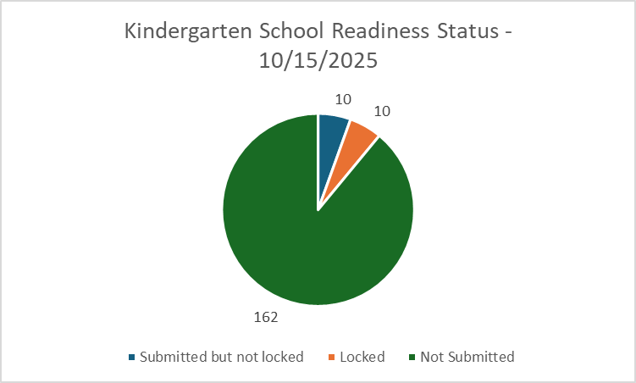
Kindergarten School Readiness:
Status as of 10/15/2025
10 Submitted but not locked
10 Have locked
162 Districts have not submitted
Kindergarten School Readiness
KSRData@cde.state.co.us

Slide 32
Questions & Resources:
Kindergarten School Readiness
Justin Chrisco
KSRData@cde.state.co.us
Kindergarten School Readiness - Data Collection
Kindergarten School Readiness - Implementation

Slide 33

Thank you for Joining Today!
Next Town Hall will be Oct. 23rd
Reminder:
LAMs, please review your IdM users to ensure accurate permissions for data respondents in your district.
Deactivate users who no longer oversee a data collection in your district.

