Slide 1
Short Bytes
English Learners: Exceptions
July through Student October
Notes:
Hello and welcome to this short byte. Today we will review English Learners: exceptions that may occur from July through our Student October data collection. Let’s get started.

Slide 2
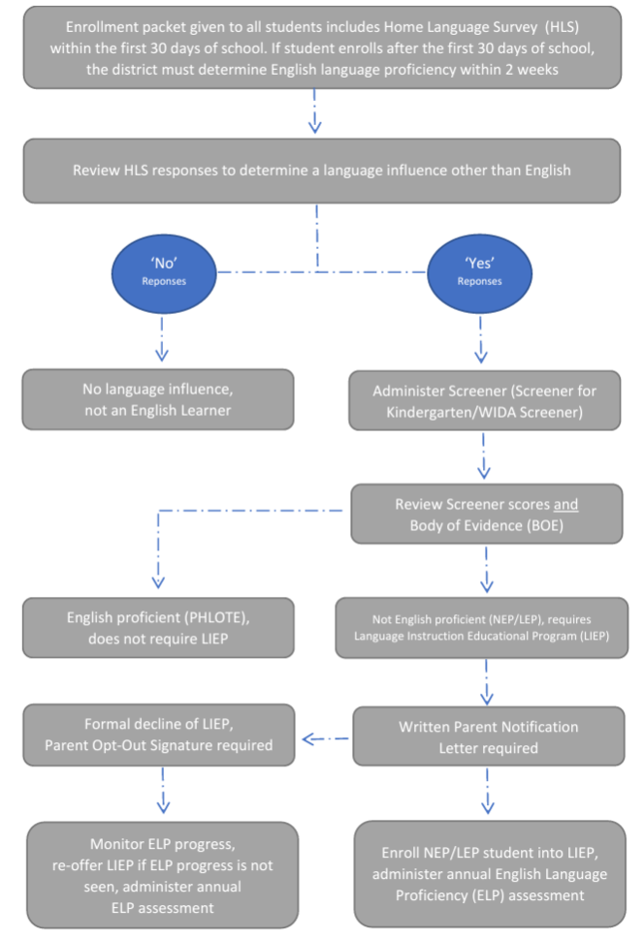
Colorado Standardized Identification English Learners (ELs) are those students who are linguistically diverse and identified as having a level of English Language Proficiency (ELP) that requires language support to achieve standards in grade-level content in English (Colorado Revised Statutes under the English Language Proficiency Act 22-24-103).
Reminder: Districts should maintain copies of Screener & WIDA ACCESS scores
Site: CDE ELL Funding Factor Count &
Audit Resource Guide
Site: CDE Standardized Procedures for English Learner Identification
Site: CDE Standardized Procedures for English Learner Redesignation
Site: Student Interchange File Layout and Definitions-Student Demographic
Investigate
Identification
Notes:
So how does a student become identified as an English learner? On this slide you will see a visual to describe the standardized identification procedures.
Based on state and federal laws, and with input from stakeholders, Colorado has outlined the following standardized procedure for districts to follow to identify English learners. To ensure an equitable identification process for all students, all students must follow the same process.
During new student registration, the enrollment packet that is distributed to ALL students should also include the home language survey.
The HLS should be collected and reviewed by a trained staff member
If the HLS indicates and school determines a language influence other than English, administer the screener assessment
Screener for Kindergarten in Kinder through first semester first grade students
WIDA Screener is given to students in second semester first grade through grade 12
Use screener score and other BOE to determine language proficiency and appropriate ELD services
Notify parents in writing and document the informed consent for placement into ELD services and programs
All identified English learners which include ELs who are identified but not enrolled in ELD services because of parent opt-out, will take the annual English Language Proficiency assessment, ACCESS
PHLOTE – talk about these students may have an influence other than English, but now impacting access to grade level content… so they don’t receive services and coding looks different (Language Proficiency Codes=00) not on the Language Proficiency Progression.
I am going to pause for a minute and talk about situations when parents answer ‘no’ to any of the HLS questions. Sometimes parents respond ‘no’ due to lack of understanding to the questions like when questions are presented in a language parents cannot read, or they are choosing to not disclose information due to perceived actions that might negatively impact their child. When you notice responses don’t match how the student is accessing grade level content… you have the authority to screen student’s English proficiency in order to ensure you are not missing students who could benefit from LIEPs. Remind yourselves the HLS is a tool to help you investigate your student’s proficiency, but it is not what is used to determine EL designation or edibility for LIEPs. The Screener scores, the student BOE and your professional judgement as an educator are used to determine EL programs and how to code students.

Slide 3
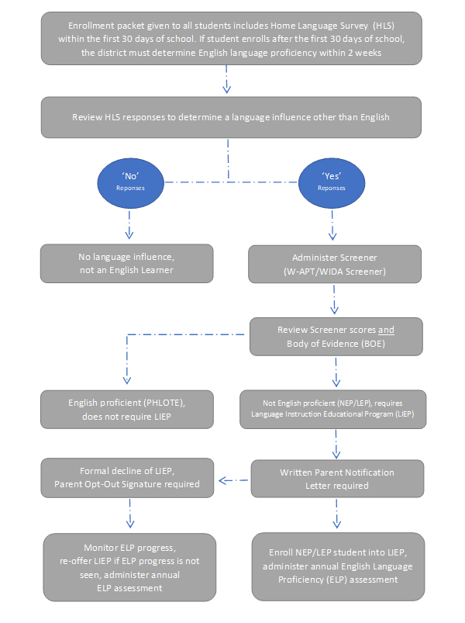
Senate Bill 109, CRS 22-24-106 requires one common assessment to identify students.
Screener for Kindergarten and WIDA Screener, is the state mandated placement assessment that must be used as one indicator to determine English Language Proficiency (ELP).
Screener scores are only one element to consider…
always use a district determined standardized
Body of Evidence (BOE) to determine English Language Proficiency
(ELP) level
Screener scores and BOE determine ELP level and enrollment into a Language Instruction Educational Program (LIEP).
BOE may include:
family interviews
local school/district assessments
informal assessments
student academic records
Notes:
http://www.cde.state.co.us/cde_english/elstandardizedidentificationandfaqs

Slide 4
English Learner State Proficiency Progression
Redesignation: Annual ELP Assessment Scores & BOE
Identification: Screener & BOE
NEP/LEP
FEP Monitor Year 1
FEP Monitor Year 2
FEP Exited Year 1
FEP Exited Year 2
FELL
All identified NEPs & LEPs must take the annual ELP assessment, ACCESS/Alternate ACCESS
Language Proficiency Code = ‘1’ or ‘2’
Language Instruction Program Code = 98
Parents may decline for their child to be enrolled in a Language Instruction Program (LIP) but cannot decline the EL designation or the requirement for students to participate in the annual assessments (WIDA ACCESS).
When parents refuse LIP, this must be documented but does not release the district from its responsibility for providing access to a meaningful education. The district must support the academic learning of all identified English Learners (ELs). The Civil Rights Obligations remains the foundation of the legal rights of ELs.
Notes:
Let's take a closer look at the state proficiency progression. This is the visual that represents how English learners are identified through screening and a collection of evidence as well as how they are coded after meeting the state's redesignation criteria.
The progression starts identification seen in gray box on the left, after screening, students are identified as non-english proficient NEP or limited English proficient LEP and would start to receive. English language development instruction students can be coded as NEP or LEP for multiple years until the district ELL coordinator or team makes a redesignation decision.
Redesignation includes a review of WIDA access scores and a collection of body of evidence that demonstrates the student is FEP or fluent English proficient students who transition successfully to classrooms with minimal language support or redesignated and will be coded as FEP monitor year one. And each year, the student will continue along the progression indicated in the green boxes before being coded as former English language learner or fell FL after two years of monitoring and two years as exited.
Very important here to note all identified NEPs and LEPs take annual tests to measure how language instruction and supports or helping them attain English.
The every Student Succeeds Act, or ESSA, ESSA states, parents and families can formally opt out of services instructions programming by not giving their consent for their child to participate in an LIP indicated as language instruction program code 98. But parents and families cannot formally opt out of the district's decision to designate or identify their child as an English learner. As such, if the district has identified students as an English learner through the following the state standardized identification procedures, students will retain their EL designation and be coded with the language proficiency code of one or two. Opt-out students are expected to take access or alternate access each year until a review of scores and a collection of evidence indicate that the student should be redesignated and coded as fluent English, proficient or FEP.
When parents opt out enrollment of their child into an LIP, districts must collect and store signed opt out documentation. Keep in mind, the district still has a responsibility for providing access to meaningful education. Civil rights obligation remains the foundation of legal rights for English learners, which means the district must support the academic and linguistic learning for all identified English learners, whether they are enrolled in language instruction programs or not.
And finally, as a friendly reminder, please make sure your district has clearly outlined how reports will be retained should an NEP or LEP student be audited for the ELL factor funding count, it's highly likely you will be asked to provide Screener score reports. Links to the ELL funding factor audit resource guide and standardized identification procedures are on this slide for your reference.

Slide 5
Student Demographic Data Fields (3 Data Elements)
Language Background
Identified on the Home Language Survey (HLS)
Students who are NEP, LEP, FEP, FELL, or PHLOTE must have a language background other than English (ENG)
Language Proficiency
Indicates student’s English language proficiency (ability to speak, listen, read, and write in English)
Language Instruction Program
Indicates the type of English language instructional program used to education a student who is an English learner
Not an English Learner | English Learner
0 – Not Applicable 4 – PHLOTE, English Proficient (Primary Home Language Other Than English) | 1 – NEP, Non-English Proficient 2 – LEP, Limited English Proficient 5 – FELL, Former EL 6 – FEP, Monitor Year 1 7 – FEP, Monitor Year 2 8 – FEP, Exited Year 1 9 – FEP, Exited Year 2
Notes:
There are three fields that pertain to EL coding and how you communicate this type of information to us here at CDE. The first is language background. Language background is determined via a language survey or also called a home language questionnaire. Students who are NEP, LEP, FEP, FELL or PHLOTE must have a language background of something other than English (indicated by eng). The second field is the language proficiency field. This field indicates the student’s English language proficiency or in other words the student’s ability to speak, listen, read and write in English. There are really two sections of proficiency codes, not English learners and English learners. If the student is an English learner or has been in the past, then we have codes listed on the right hand of the screen 1-NEP (Non-English Proficient), 2-LEP (Limited English Proficient), 5-FELL (Former EL), 6-FEP Monitor Year 1, 7-FEP Monitor Year 2, 8-FEP Exited Year 1, and 9-FEP Exited Year 2. If the student is not an English learner, we use proficiency codes 0 – Not Applicable or 4 – PHLOTE (Primary Home Language Other Than English). The third field is the language instruction program. This is the type of program in which an EL student receives their services. All three data fields are used when reporting English learner data to CDE and have error checks related to specific coding patterns.

Slide 6
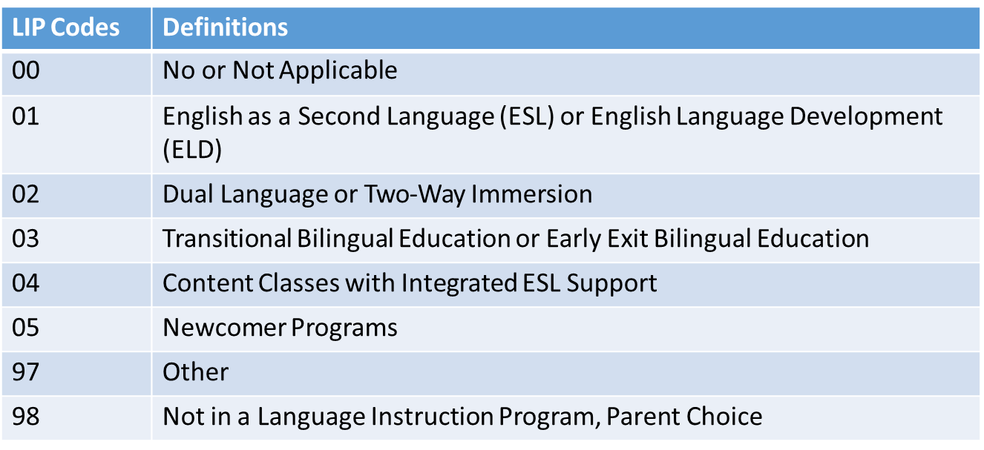
Coding Tips
Language Background = ‘eng’
Language Proficiency Code = ‘0’
Language Instruction Program = ’00’
Language Background ≠ ‘eng’
Language Proficiency Code ≠ ‘0’
Language Instruction Program Dependent on Proficiency Code
Language Proficiency Codes
NEP, LEP, FEP Monitor 1, FEP Monitor 2 ≠ ’00’
PHLOTE or FELL = ’00’
FEP Exited Year 1 or Year 2 can have any codes
Notes:
When thinking through the coding pattern for a student, it is best to first ask yourself, “what is the student’s language background?” If the student’s language background is English, they must have a language proficiency code of zero (or not applicable) and a language instruction program 00 (not applicable). This essentially means that students who speak English should not be enrolled in an English Learning program. On the flip side, if the student’s language background is something other than English, the student must have a valid language proficiency code of something other than 0. The language instruction program is dependent on the language proficiency code described below.
As mentioned before, if a student has a Language Background of English, their LIP must be ‘00’. Otherwise, there are specific instructions for Language Proficiency Codes other than ‘00’. NEP, LEP, FEP Monitor Year 1 and Monitor year 2 Language Proficiency Codes must have a LIP of anything other than ‘00’. PHLOTE or FELL students must have an LIP of ‘00’ since they have demonstrated proficiency in English. FEP exited Year 1 and year 2 can have any of the below codes. If you are concerned that your program is not included in any of the defined programs, please call the Office of CLDE for help in selecting the most appropriate program type.

Slide 7
Following the State Language Proficiency Progression
Student October Count and Student End of Year (EOY) data remains the same within the current school year.
Student EOY lags by one year: summation of the previous school year, is not the status of the student for next year.
Avoid coding errors: make language proficiency code changes next school year. EL instruction/programming changes occurs anytime during the current school year.
When students are not following the EL State Proficiency Progression Sequence, there are some situations that may require an Exception Request.
Notes:
Let’s jump into Language Proficiency for a second. Again, Language proficiency is related to the typical progression flow chart that we saw at the beginning of this presentation. EL fields reported for Student October Count are the same as for Student End of Year. Student End of Year codes represent the instructional programming that a student received during the school year. All changes to student coding should happen during Student October Count. This means even if you have discussions about redesignation after you received ACCESS scores in May, the student should not be redesignated on the End of Year count. They would be redesignated during the Student October Count in the following school year. Please provide program/instructional adjustments any time during the school year, however coding changes should generally only happen during Student October. Students who do not follow the EL State proficiency progression sequence may flag many errors so keep in mind coding changes may require exception requests through CDE’s data services office.

Slide 8
Common SP Errors for EL Exception Requests – Language Proficiency
SP183 - Student does not follow logical sequence for EL. Student is coded FEP Monitor Year 2 (Language Proficiency = 7). Last October the student was coded as NEP (1) or LEP (2). Students who are redesignated to FEP must have a full year as Monitor Year 1 (6) prior to being Monitor Year 2.
SP180 - Student does not follow logical sequence for EL. Student is coded as FEP (Language Proficiency = 6, 7, 8, or 9). Prior year Student October the student was coded as Not Applicable (0). Students should be reported in an EL program prior to being redesignated as FEP.
SP166 - Student does not follow logical sequence for ELL. Student is currently coded as Language Proficiency = 0 (N/A). Prior year Student October your district reported this student as an EL student with a Language Proficiency code that was NOT zero (Previous October Language Proficiency = 1, 2, 3, 4, 5, 6, 7, 8, or 9).
Student was coded as ‘Not EL’ last year. If student is identified as EL this year, code as NEP/LEP. Or if student is not identified as an EL this year, code as NA or PHLOTE.
Student was identified as EL last year, review district identification for current EL determination.
SP164 - Student does not follow logical sequence for EL. Student is currently coded as PHLOTE (Language Proficiency = 4). Last October student was coded as in or previously in an EL program (Language Proficiency = 1, 2, 5, 6, 7, 8, or 9). Students who have been in an EL program should not be coded PHLOTE.
Follow EL Logical Sequence: NEP>LEP>FEP M1>FEP M2>FEP Exit1> FEP Exit 2>FELL. Code student as FEP M1 this year.
Student was identified as PHLOTE last year, review district identification for current EL determination.
Notes:
Now let’s talk through some common errors that you may encounter when reporting EL information within our Student October Collection. These errors will flag at the Student Interchange level, specifically our Student Demographic File when a student does not follow the typical language proficiency progression. I will just review a few. SP183 states Student does not follow logical sequence for EL. Student is coded FEP Monitor Year 2 (Language Proficiency = 7). Last October the student was coded as NEP (1) or LEP (2). Students who are redesignated to FEP must have a full year as Monitor Year 1 (6) prior to being Monitor Year 2. This error will flag when a student falls out of sequence. Again, our sequence is NEP>LEP> FEP M1>FEP M2>FEP Exit1> FEP Exit 2>FELL. The system is expecting to code the student as FEP M1 this year. Jumping down to SP166, Student does not follow logical sequence for ELL. Student is currently coded as Language Proficiency = 0 (N/A). Prior year Student October your district reported this student as an EL student with a Language Proficiency code that was NOT zero (Previous October Language Proficiency = 1, 2, 3, 4, 5, 6, 7, 8, or 9). This error is flagging because the student was identified as EL last year. Please review district identification for current EL determination and reach out to our CLDE office for further instruction.

Slide 9
CEDAR/COGNOS: English Learner Historical Reporting
Reminder: This report is a tool to review EL coding, it does not determine a student’s current Language Proficiency. Follow the State’s standardized identification procedures and redesignation procedures.
Site: CDE Standardized Procedures for English Learner Identification
Site: CDE Standardized Procedures for English Learner Redesignation
Operational report to help districts check the English Learner history for a student by SASID
Reflects data from prior Student October Collections and Current Student Demographic (DEM) file
Available to data pipeline users with STD~LEAViewer or STD~LEAUser access
Notes:
The Colorado Education Data and Reporting Portal, CEDAR also known as COGNOS, contains many helpful reports to support district data respondents. One such report is called English Learner Historical Reporting which allows a data respondent to review the EL coding for a student in both their district and prior districts when researching EL errors. EL Program staff may wish to partner with data staff to review this report if they have questions about the past coding for an EL student or an incoming student who they believe may have EL history. It is important to note that this report is a tool to support districts when researching EL errors. It DOES NOT determine the appropriate Language Proficiency identification for a student. Follow the state’s standardized identification and redesignation procedures. You’ll notice the report shows the Student October coding for a student and the current coding to allow monitoring not only during the Student October Collection but to verify if the current status matches what was reported in Student October. Please note that this report will only allow data pipeline users with STD~LEAViewer or STD~LEAUser roles within Identity Management access to this report. Again, this report is only used as a tool to support LEAs when researching errors or warnings on EL Progression of a student not for identification or redesignation procedures.

Slide 10
Personally Identifiable Information (PII)
Personally Identifiable Information (PII) is defined by state and federal laws as information that alone, or in combination, personally identifies an individual
Includes direct identifiers (i.e. SASID, student names)
Includes information when combined is identifiable
Colorado’s Student Data Transparency and Security Act outlines requirements for how Student PII is collected, used and shared
See CDE’s data security and privacy site for more information
Syncplicity
Secure file transfer site used to communicate PII with CDE collection leads
Each collection lead maintains their own Syncplicity folder and can assign rights to that folder
Student End of Year, Student October, and Attendance all utilize the same primary folder with subfolders to organize the collections
Primary Syncplicity Folder: District Code – DISTRICT NAME – Student
Notes:
Before we look at our exception request form, we need to talk about Personally Identifiable information. Personally identifiable information is defined by state and federal laws as information that alone or in combination personally identifies an individual. So, in this instance we're talking about students. It would be direct identifiers such as SASID, student names, date of births or other information that when you combine it together would identify a student. Because of Colorado's student data transparency and Security Act we really need to think about the requirements for how we communicate student PII and how it is used and shared. So, this is data that we do need to keep secure and we do need to keep private. That means that when communicating with CDE staff or communicating amongst one another, it's important to know that e-mail is not considered secure. If personal identifiable information must be sent to CDE staff, we use a system called Syncplicity. This is a secure file transfer site used to communicate student information with collection leads. For Student End of Year, Student October or the Attendance collections, please use the primary Syncplicity folder indicated by District Code – District Name – Student to send student information securely to data collection leads. All exception requests will go through this safe process.

Slide 11
Regular Exception Template
Required for all reporting exceptions, even when additional documentation is also being provided
Uploaded to Syncplicity for Review (Student Folder)
Create a new exception request form when additional exceptions are needed, not a running list
Available on Student Interchange Website
Notes:
Once you have done your research on various errors that flag for EL students, it may be time to request an exception. Exceptions are used when a student is accurately coded but is still flagging an error within Data Pipeline. Let's look at the regular exception collection template. The regular exception template is the template used for the majority of exceptions in the student data collections, not just English learner exceptions. It's imperative that the information on this form is accurate. The error code, error type, District code, and SASID must be accurate. Otherwise, the exception does not process correctly. Data respondents are encouraged to copy this information directly from the corresponding error detail report. Once you have completed it exception template, it is now time to save it and upload to Syncplicity. After uploading the document to Syncplicity (again we use this because the exception request will contain PII), you will email the Student October data collection lead. The Student October Collection lead will guide you to the next steps in the exception process. The exception request form can be found on the Student Interchange website. Exceptions are only used, again, for students who are coded accurately and continue to flag errors within the Data Pipeline System. Please reach out to the Student October Collection lead if you have any questions on errors flagging, whether or not an exception is needed and coding patterns.

Slide 12
Reason for Exception Examples
Student does not speak a language other than English or student is not EL.
Consider providing: District has mis-identified the student. District's robust documentation and body of evidence demonstrates this recently identified EL student (2 reporting years or less) is not eligible for language instruction.
Student incorrectly identified as EL student, code student as PHLOTE
Consider providing: Student was screened in the district on ‘date’. Documented screener scores and body of evidence indicated student is fully proficient in English. Student should have been coded as PHLOTE to begin with and was never provided EL services.
Student's Language Proficiency is FEPM2 (7) (skipped FEP M1 in progression in records - coding)
Consider providing: Student took ACCESS/ALT ACCESS during ‘school year’. Conference with ELD Team/Dept, documented scores and body of evidence indicated should have been redesignated to FEP M1 last school year. Code as FEP M2 now. Student had mid-year exception approved in Student End of Year Collection.
Student was LEP last year but after October Count so was not reported in October Count with a language. This year, they moved to FEP Monitor 1 (6).
Student was LEP last year but after October Count so was not reported in October Count as a LEP student. Student was screened upon enrollment after report deadline (Student October). Screener and body of evidence indicated student is fully proficient in English. This year, they moved to Monitor 1 (6). Student had mid-year exception approved in Student End of Year Collection.
Notes:
Student does not speak a language other than English or student is not EL.
Consider providing: District has mis-identified the student. District's robust documentation and body of evidence demonstrates this recently identified EL student (2 reporting years or less) is not eligible for language instruction.
Student incorrectly identified as EL student, code student as PHLOTE
Consider providing: Student was screened in the district on ‘date’. Documented screener scores and body of evidence indicated student is fully proficient in English. Student should have been coded as PHLOTE to begin with and was never provided EL services.
Student's Language Proficiency is FEPM2 (7) (skipped FEP M1 in progression in records - coding)
Consider providing: Student took ACCESS/ALT ACCESS during ‘school year’. Conference with ELD Team/Dept, documented scores and body of evidence indicated should have been redesignated to FEP M1 last school year. Code as FEP M2 now. Student had mid-year exception approved in Student End of Year Collection.
Student was LEP last year but after October Count so was not reported in October Count with a language. This year, they moved to FEP Monitor 1 (6).
Student was LEP last year but after October Count so was not reported in October Count as a LEP student. Student was screened upon enrollment after report deadline (Student October). Screener and body of evidence indicated student is fully proficient in English. This year, they moved to Monitor 1 (6). Student had mid-year exception approved in Student End of Year Collection.

Slide 13
Additional Support: CLDE Office Student October Collection Lead
Notes:
If you would like additional support or would need more information, please contact the CLDE office or the student October collection lead here at CDE and we would be happy to talk to you about our English learner students and the identification process. Thank you so much for joining us for this short byte.

