Slide 1
November 21, 2024 Data Pipeline Town Hall
The goal of the webinar is to provide updates on the Data Pipeline, current, and upcoming data collections. These webinars also provide a forum for districts, BOCES, and Administrative Units to have questions answered about Data Pipeline.

Slide 2
Colorado Department of Education Identity Management (IdM)
Identity Management Site
Frequently Asked Questions
How do I add myself or others to the email listserv for town hall emails and/or a specific collection?
Email lists are dependent on a person’s access rights in IdM. Contact your LAM to get an account or be assigned to a specific collection.
Where can I find the IdM role mappings for Data Pipeline and other applications?
Role Mapping (XLS)
I am a LAM. How do I update the user permissions for someone in my district?
Follow the steps outlined in the IdM Quick Guide for Access Management (DOCX)
Important: Users are not automatically removed from IdM when their email address is no longer active in your district. The LAM must deactivate their IdM account to ensure only designated staff can access CDE’s data reporting system.
Notes:
LAMs, please check the IdM roles for your district. Remove permissions for users who have retired, left your district, or are no longer assigned to a collection. Add roles for new hires and newly assigned respondents for specific collections.

Slide 3
What is PII?
Student and Staff Personally Identifiable Information (PII) is defined by state and federal laws as information that, alone or in combination, personally identifies an individual
This includes direct identifiers (i.e. student and staff names, SASID, EDID, etc.)
Includes information that when combined is identifiable
Colorado’s Student Data Transparency and Security Act outlines requirements for how Student PII is collected, used and shared
See the Data Privacy and Security website for prepared guidance on how to comply with this and other privacy laws.

Slide 4
Sharing Data
Use secure methods to transfer any PII to CDE
Contact Data Collection leads with questions about how to transmit PII securely
Each Data Collection leads maintains their own Syncplicity folders for specific collections, reach out to the collection lead for access
Use Syncplicity to encrypt emails to CDE
Avoid sending PII via unencrypted email or to unsecured faxes when sharing data between or within districts
Use Syncplicity to encrypt emails to CDE
Check local policies for restrictions, requirements, etc. regarding PII
Do not use PII in trainings, presentations, etc.
Do not share PII with unauthorized individuals
Do not share passwords
Follow local policies when transmitting PII to any third party

Slide 5
Today’s Agenda
Agenda Topic | Presenter
Open Data Collections and Upcoming Deadlines in Data Pipeline
Civil Rights Data Collection (CRDC) | Annette Severson
Kindergarten School Readiness | Tara Rhodes
Human Resources | Dawna Gudka
Special Education December Count | Lindsey Heitman
School Auditing Updates | Rebecca McRee
Student October | Annette Severson (Brooke Wenzel)
Student End of Year | Reagan Ward

Slide 6
Open Collections and Upcoming Deadlines in Data Pipeline

Slide 7
Open Collections and Upcoming Dates: Year-Round & Interchanges
Name | Category | Status | Key Dates
RITS | Year Round | Open | N/A
EDIS | Year Round | Open | N/A
Directory | Year Round | Open | N/A
Student | Interchange | Open | 2023-2024 and 2024-2025 are open
At-Risk | Interchange | Open | 2024-2025 open
Title I | Interchange | Open | 2024-2025 open
Special Education IEP | Interchange | Open | 2024-2025 open
Staff | Interchange | Open | 2024-2025 open
Data Pipeline Resources: Data Pipeline Collection Dates (XLS)

Slide 8
Open Collections and Upcoming Dates: Snapshots
Name | Category | Status | Final Deadline Date | Next Milestone | Looking Ahead
Student October | Snapshot | Open | Nov. 27, 2024 | Deadline: 11/27/2024 Resubmit Student October Snapshot data to CDE based on decisions from School Auditing | Deadline: 12/6/2024 Submit Verification Form
Student End of Year | Snapshot | Closed | Nov. 19, 2024 | Deadline: 12/3/2024 Superintendent Verification Due | Data Release: 1/14/2025
Special Education December Count | Snapshot | Soft Open | Feb. 21, 2025 | Interim Deadline: 12/18/2024 Interchange Files error-free | Interim Deadline: 12/18/2024 Interchange files error free
Human Resources | Snapshot | Open | Feb. 21, 2025 | Interchange files should be uploaded into Data Pipeline at least once | Interim Deadline: Count Day 12/1/24
Data Pipeline Resources: Data Pipeline Collection Dates (XLS)

Slide 9
Open Collections and Upcoming Dates: Periodic
Name | Category | Status | Final Deadline Date | Next Milestone | Looking Ahead
Non-Public Schools Fall Enrollment Count | Periodic | Open | Dec. 2, 2024 | N/A | N/A
Kindergarten School Readiness | Periodic | Open | Dec. 11, 2024 | Collection Opens: 10/23/2024 | N/A
Data Pipeline Resources: Data Pipeline Collection Dates (XLS)

Slide 10
Civil Rights Data Collection (CRDC)

Slide 11
Overview
The U.S. Department of Education [ED] conducts the Civil Rights Data Collection (CRDC)
CDE pre-populates data if available. Information on data fields, calculations and collections utilized are posted online

Slide 12
2023-24 CRDC Timeline
Opt-Out of CDE Pre-population of data: November 22nd
If your LEA does not want CDE to pre-populate data for CRDC, please complete the form and email Annette Severson
Opening December 9, 2024
Deadline March 7, 2025
CRDC Resources available online

Slide 13
Questions & Resources: Civil Rights Data Collection
CRDC Resource Center
CRDC Partner Support Center - crdc@aemcorp.com
CDE Contact: Annette Severson – Severson_a@cde.state.co.us

Slide 14
Kindergarten School Readiness
Tara Rhodes

Slide 15
Kindergarten School Readiness (KSR) Important Dates and Changes for 24-25 Collection
Important Dates:
11/19/2024: Target upload date. You should have received an email from me yesterday if you have not yet uploaded.
12/11/2024: KSR Data Collection Due Date (~3 weeks to go!)
Please note that this information is part of the CAP4K Legislative Report that is due in February to the legislature. Consequently, I will need all submissions in by the deadline so that analysis can be completed in January, along with executive leadership review prior to publication.
Changes for the 24-25 Collection:
One additional column was added to the file layout to denote the assessment used. This replaced the front-end screen in Data Pipeline.
This change was made to accommodate the State Board's approval of single-domain assessment tools.
A short tutorial (~6min) of how to add and populate this column has been posted here.
Kindergarten School Readiness (KSR)
KSRData@cde.state.co.us

Slide 16
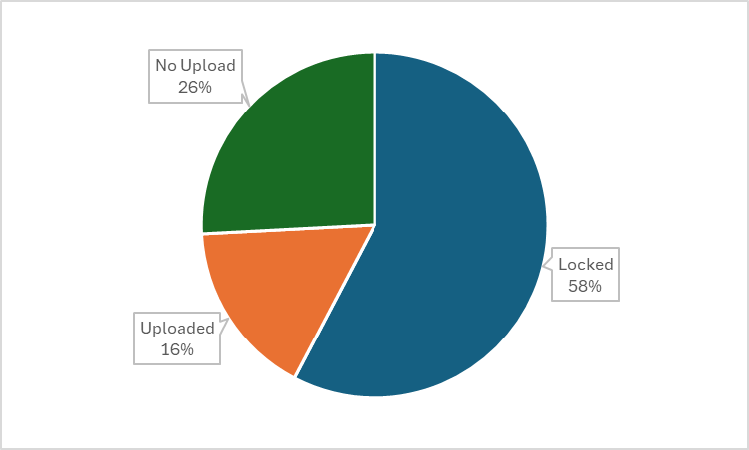
Kindergarten School Readiness (KSR) Collection Status
Kindergarten School Readiness (KSR)
KSRData@cde.state.co.us

Slide 17
Reminders and Current To-Do's Kindergarten School Readiness (KSR)
Current Reminders and To-Do's:
Please upload, if you have not yet done so.
Please make sure you are saving your file as an .xlsx before uploading
Please make sure that you are sending in your sign-off form to KSRData@cde.state.co.us.
Resources:
Recordings of trainings
Tutorial on how to add the additional column
Website with file layout, business rules, and additional resources
Please reach out with any questions!
Kindergarten School Readiness (KSR)
KSRData@cde.state.co.us

Slide 18
Questions & Resources Kindergarten School Readiness (KSR)
Contact: Tara Rhodes
Email: KSRData@cde.state.co.us
Phone: 720.601.4125
Kindergarten School Readiness Website
PTO: 11/25-11/29

Slide 19
Human Resources Snapshot
Dawna Gudka

Slide 20
Identity Management System IdM Roles for Human Resources Snapshot Collection
Staff Interchange Roles
STF~LEAUSER-upload and modify staff interchange files
OR
STF~LEAVIEWER-View only staff interchange data
Human Resources Snapshot Roles
HRD~LEAAPPROVER-approves, creates, views Snapshot
OR
HRD~LEAUSER-creates, views Snapshot
OR
HRD~LEAVIEWER-views Snapshot
A user can only have one role under each collection category!
Human Resources Snapshot Collection
HumanResourcesData@cde.state.co.us

Slide 21
Human Resources Timeline
Date | Event | Event Description
10/31/24 | Interim Deadline | Upload at least one Staff Profile file
11/1/24 | Open | Human Resources Snapshot Opens
11/7/24 | Interim Deadline | Upload at least one Staff Assignment file
12/1/24 | Count Day | Official Annual Staff Count Day
12/18/24 | Interim Deadline | Interchange files error free
1/10/25 | Interim Deadline | Create at least one Human Resources Snapshot
1/24/25 | Interim Deadline | Human Resources Snapshot Error Free
1/24-1/31/25 | Report Review | Review Special Education Staff Report via Cognos in the Human Resources folder) for accuracy to ensure all special education staff reported within your district is appropriate. Collaborate with your LEA’s Administrative Unite during this process. Verify that all staff are accurately reported
2/14/25 | Interim Deadline | Staff Profile and Staff Assignment interchange files, and Human Resources Snapshot Error Free
2/21/25 | Deadline | Human Resources Snapshot must be submitted to CDE and verification emailed to Human Resources Snapshot
Human Resources Snapshot HumanResourcesData@cde.state.co.us

Slide 22
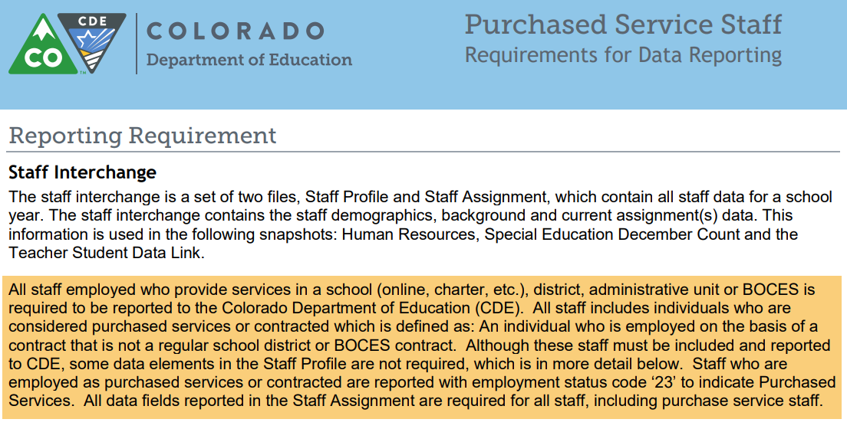
Staff Profile-Who gets reported? ALL STAFF employed and or providing services to your students
All staff employed and or servicing LEA (district students) as of December 1st are included in the Human Resources Collection
ALL Employed STAFF
Full & Part time staff
General Education staff
Special Education staff
Districts report their Special Ed Staff as part of their staff interchange files OR
Administrative Unit reports special education staff for all member districts and the districts exclude them
Charter School staff
Active assignment on December 1st
District (LEA) staff
District level staff are reported with School Code 9980 for ‘District Wide’
Purchased Staff servicing LEA students
Purchased staff resource documentation
Human Resources Snapshot Collection
HumanResourcesData@cde.state.co.us

Slide 23
Data Pipeline Process-checking for errors
Checking for errors in Data Pipeline Error Report
Click on View Details to see the error in detail
Human Resources Snapshot Collection
HumanResourcesData@cde.state.co.us

Slide 24
Human Resources Snapshot Collection
Staff Interchange website
Human Resources Snapshot website
Questions contact: Dawna Gudka-collection lead
Email HumanResourcesData@cde.state.co.us
(303) 598-7901
Reminder to include your 4-digit LEA code in all CDE emails

Slide 25
Special Education December Count Snapshot
Lindsey Heitman

Slide 26
Special Education December Count: Staff and Student Snapshot Timeline
November Due Dates
December Due Dates
January Due Dates
30th - Thursday - All errors resolved – complete snapshot
February Due Dates
10th – 18th - Monday – Tuesday - Resolving Duplicates
1st - Sunday - Official count date (or last date prior your school was in session)
30th - Feb 7th Thursday – Friday - Report Review
18th – 21st - Tuesday - Friday - Final Report Review
21st - Friday - Final Submission Due
1st - Friday – Sped December Count Snapshot available in Data Pipeline
13th – Wednesday - Interchange files uploaded - Sped Child, Sped Participation, Staff Profile, Staff Assign
18th - Wednesday: Interchange files error free and at least one snapshot created
These files must be uploaded AND records error-free before they will pull into your December Count Snapshot.
The “missing” staff records will triggers errors DC114-DC115, DC225 – DC229 until they are included
Please download the full 24-25 Timeline from the Special Education December Count Snapshot webpage.
Special Education December Count – Lindsey Heitman
SpedDecCount@cde.state.co.us

Slide 27
Special Education December Count: Trainings
Posted on the Special Education December Snapshot webpage
2024 – 2025 Special Education December Count Snapshot Annual Collection Training
Special Education December Count Office Hours
Wednesday, November 20th from 10:30 – 11:30
Private school student report, Data Pipeline snapshot process and error reports, reminders
Slides posted, recording should be posted by Friday
Upcoming
Special Education December Count Office Hours
Wednesday, December 4th from 1:00 – 2:00
Staff Approval Matrix
Microsoft Teams Meeting Join the meeting now
Special Education December Count – Lindsey Heitman
SpedDecCount@cde.state.co.us

Slide 28
Transfer Students – going through evaluation by current AU as of 12/01 and still receiving services
Student transferred to AU with an IEP
IEP lapsed in another AU or soon after student started attending your AU and is still going through the evaluation process as of 12/01
If an interim plan is in place and the student is receiving services, they may be reported with Funding Status =50 and are eligible for funding
Date of Entry to Special Education - use date student began attending in your AU/receiving services
Special Education December Count – Lindsey Heitman
SpedDecCount@cde.state.co.us

Slide 29
Questions & Resources: Special Education December Count
Lindsey Heitman
SpedDecCount@cde.state.co.us
(720) 456-2033
Special Education IEP Interchange Webpage Special Education December Snapshot Webpage

Slide 30
School Auditing Office
Rebecca McRee

Slide 31
Annual Audit Review
Starting with the 2024-2025 fiscal year, the School Auditing Office will be shifting its audit approach.
All districts and BOCES (that operate their own schools and/or submit data during the Student October data collection) will participate in the Annual Audit Review.
No later than December 11, 2024, all districts and BOCES must:
Complete all funded count audit questionnaires (pupil, at-risk, and ELL), and
Upload initial audit documentation (as described in the corresponding questionnaires) to Syncplicity.
School Auditing Office
audit@cde.state.co.us

Slide 32
Annual Audit Review (continued)
Between December 2024 and March 2025 the School Auditing Office will be reviewing each district/BOCES (1) submitted Student October Count data, (2) responses provided on the audit questionnaires, and (3) the initial audit documentation provided as outlined on the questionnaires to determine which districts/BOCES/schools will be engaged for one of the following expanded audits:
Focused Audit Review
Comprehensive Audit Review
"Next steps" communication regarding expanded audits is expected to be sent via email no later than April 1, 2025.
School Auditing Office
audit@cde.state.co.us

Slide 33
Annual Audit Review- Trainings
The School Auditing Office will be hosting a training on this new process (Preparing for the New Annual Audit Review)
When: Tuesday, December 3, 2024 at 1:30pm
To access this training, click on the link located in the green box located on the Training and Office Hours website.
The link will go live approximately 15 minutes prior to the start of the training
Additional Information :
Previously recorded (7/23/24): Preparing for the New Annual Audit Review
(PDF) (Recording)
2024 Student October Count Audit Resource Guide- see page 6 ("Annual Audit Review 2024-2025)
School Auditing Office
audit@cde.state.co.us

Slide 34
Questions & Resources: Duplicate Count/ Annual Audit Review
audit@cde.state.co.us
Pupil Count website
2024 Student October Audit Resource Guide

Slide 35
Student October
Brooke Wenzel

Slide 36
Student October Timeline
Duplicate Phase
Date | Event | Event Description
11/27/2024 | Deadline | Resubmit Student October Snapshot data to CDE based on decisions from School Auditing
12/06/2024 | Deadline | Collection closes Sign-off form due. Data remains embargoed until the official release in January.
01/15/2025 | Data Release | Official data release
Student October – Brooke Wenzel
StudentOctober@cde.state.co.us

Slide 37
Goal of Duplicate Phase
Emails were sent out regarding funding duplicate decisions.
Districts that are required to make updates (based on the School Auditing Office’s decisions) will be automatically unlocked.
Those that need to make other updates, i.e. update FRL, must request to have their data unlocked and provide me with a summary of the updates that you will be making. – Some updates need approval!
Please update your data (at the Interchange level) before requesting your data to be unlocked. It will quicken the process.
Those that make changes must make those updates at the Interchange level, take a new snapshot, validate your data, and resubmit to CDE immediately. (all by November 27th)
Student October – Brooke Wenzel
StudentOctober@cde.state.co.us

Slide 38
Ready to Submit (again)
Student Profile -> Status Dashboard and click ‘Submit to CDE’
Must have LEAAPPROVER role in IDM to complete this step
Once data is submitted it will be locked
Signoff Form Due December 6th Signed by Secretary of Board of Education and Chief Financial Officer
Student October – Brooke Wenzel
StudentOctober@cde.state.co.us

Slide 39
2024-2025 Student October Data Release
Final Student October data will be publicly released on Wednesday, January 15th, 2025
Data is embargoed until the public release date!
Pupil Membership Website
Student October – Brooke Wenzel
StudentOctober@cde.state.co.us

Slide 40
Questions & Resources:
Questions & Resources: Student October
Brooke Wenzel StudentOctober@cde.state.co.us 720-441-7963
Student October Webpage
Student Interchange Webpage

Slide 41
Student End of Year
Reagan Ward

Slide 42
SEY Collection Timeline: Upcoming Events
Date | Event | Event Description
11/19/2024 (noon) | Deadline | Post-Cross phase ends. Districts must have error free SEY snapshot and have addressed any necessary post-cross changes.
12/3/2024 | Deadline | Collection closes. • Superintendent Verification (sign-off) form due. • Data remains embargoed until the official release in January
1/14/2024 | Data Release | Planned official data release. Data is embargoed until notified by SEY lead that data has been released and is posted on the Education Statistics Website.
Visit the SEY Website to download the complete SEY Collection Timeline with Training Dates
Student End of Year – Reagan Ward
StudentEndOfYear@cde.state.co.us

Slide 43
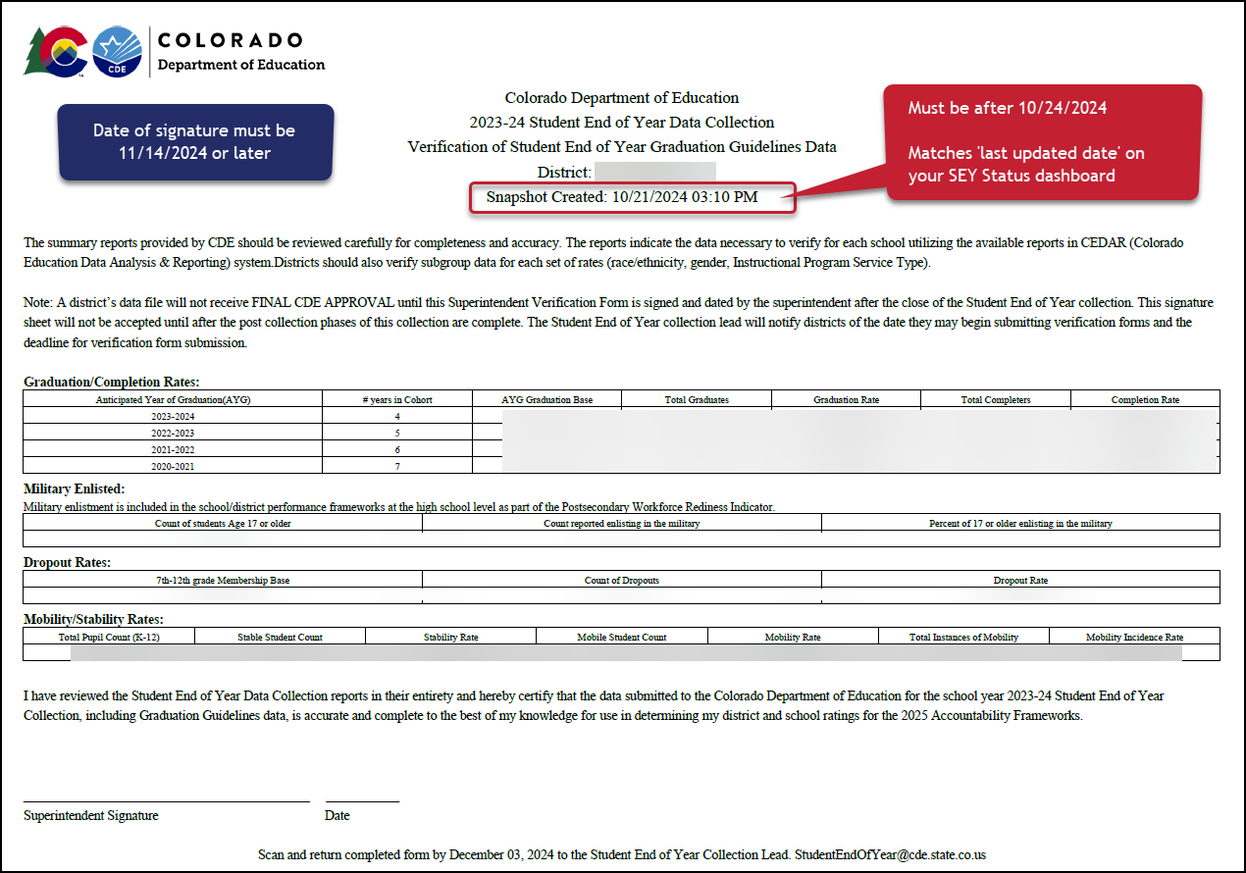
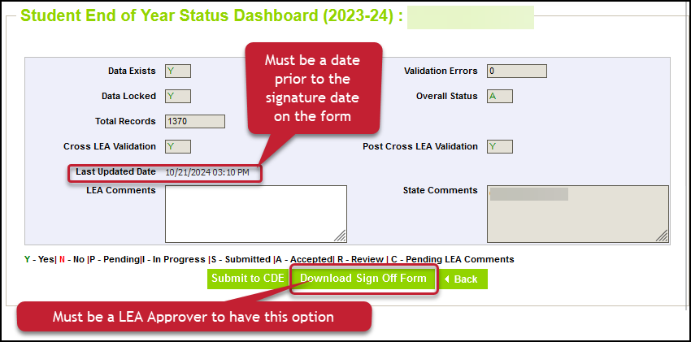
Superintendent Verification (Sign-Off)
Checklist before submitting form:
Snapshot Updated at least once (10/24/24 date or later)
Error Free
All additional changes addressed
Data Validated
Form contains rates for all categories
Signature date after the ‘last updated date’ on your status dashboard
Snapshot created date on top of form matches last updated date on status dashboard
Signature Date 11/14/2024 or later
Email completed forms to StudentEndOfYear@cde.state.co.us
Or upload to Syncplicity and notify StudentEndOfYear@cde.state.co.us
Student End of Year – Reagan Ward
StudentEndOfYear@cde.state.co.us

Slide 44
SEY Public Data Release Scheduled Date – January 14, 2025
Education statistics based upon the 2023-2024 SEY data are embargoed until the public data release in January 2025
District data available through COGNOS/CEDAR reports
Districts receive a preview of the state-wide data a few days prior to the public data release
Sent to SEY Data Respondents from the SEY Collection Lead
SEY Data Respondents should share with applicable administrative staff within their district (i.e. superintendent, accountability contact, etc.)
CDE sends out a press release and notifications through their communication department when this data is publicly released
SEY Data Collection lead will send an email to data respondents when the embargo has lifted and data has been publicly released as well
Mobility/Stability Rates & Statistics
Annual calculation
Reflect students in grades K-12
Dropout Rates & Statistics
Annual calculation
Reflect students in grades 7-12
Annual Instructional Program Service Type (IPST) status
Graduation/Completion Rates & Statistics
Cohort based calculation
Reflect students in given Anticipated Year of Graduation (AYG) cohort
IPST cohort based upon qualifying IPST status at some point during 9-12th grade
SEY Privacy Guidelines Site
New guidelines implemented 2022-2023 that remain in place
Mixed methods (blurring small populations, top and bottom masking, limited suppression) designed to protect student privacy while providing transparent information regarding rates
Student End of Year – Reagan Ward
StudentEndOfYear@cde.state.co.us

Slide 45
Questions & Resources: Student End of Year
StudentEndOfYear@cde.state.co.us
720-484-9057
Student End of Year Website
Student Interchange Website
Graduation Guidelines Website

Slide 46
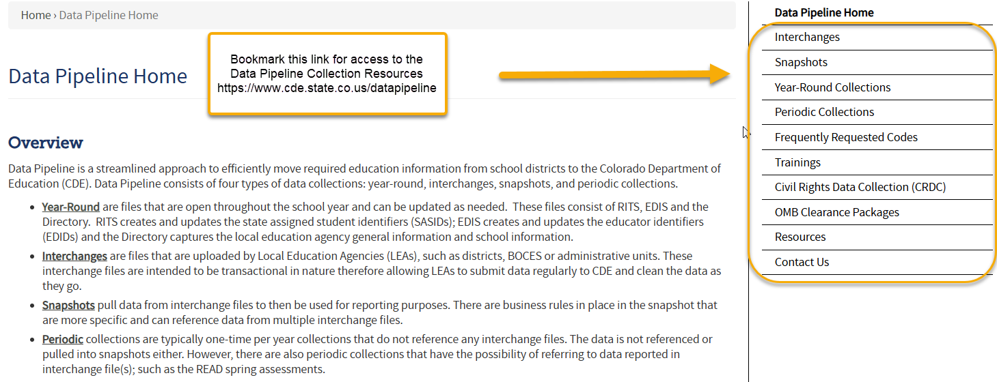
Thank you for joining today!
Next Town Hall will be December 5th
Helpful Link to Bookmark:
Data Pipeline Homepage
No Town Hall November 28th!

