Slide 1
January 11th, 2024 Data Pipeline Town Hall
The goal of the webinar is to provide updates on the Data Pipeline, and current or upcoming data collections. These webinars also provide a forum for districts, BOCES, and Administrative Units to have questions answered about Data Pipeline.

Slide 2
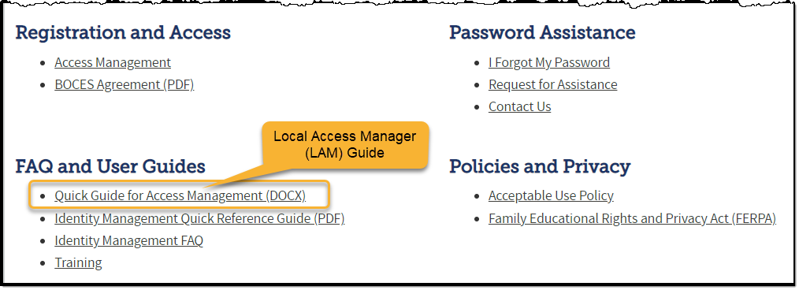
Colorado Department of Education Identity Management (IdM)
Identity Management Site
Frequently Asked Questions
How do I add myself or others to the email listserv for town hall emails and/or a specific collection?
Email lists are dependent on a person’s access rights in IdM. Contact your LAM to get an account or be assigned to a specific collection.
Where can I find the IdM role mappings for Data Pipeline and other applications?
Role Mapping (XLS)

Slide 3
What is PII?
Personally Identifiable Information (PII) is defined by state and federal laws as information that, alone or in combination, personally identifies an individual
This includes direct identifiers (i.e. student and staff names, SASID, EDID, etc.)
Includes information that when combined is identifiable
Colorado’s Student Data Transparency and Security Act outlines requirements for how Student PII is collected, used and shared
CDE has prepared guidance on how to comply with this and other privacy laws which can be found here.

Slide 4
Sharing Data
Use secure methods to transfer any PII to CDE
Contact Data Collection leads with questions about how to transmit PII securely
Each Data Collection leads maintains their own Syncplicity folders for specific collections, reach out to the collection lead for access
Use Syncplicity to encrypt emails to CDE
Avoid sending PII via unencrypted email or to unsecured faxes when sharing data between or within districts
Use Syncplicity to encrypt emails to CDE
Check local policies for restrictions, requirements, etc. regarding PII
Do not use PII in trainings, presentations, etc.
Do not share PII with unauthorized individuals
Do not share passwords
Follow local policies when transmitting PII to any third party

Slide 5
Collection Email Addresses
Additional support has been added to help manage emails for the CDE Team
Some emails may be signed as "Technical Help Support"
The data collection leads you know, and trust are:
Still responding and signing their names as needed
Training & assisting the Technical Help Support staff
Data Collection | Email Addresses
Attendance | Attendance@cde.state.co.us
Directory | DirectoryData@cde.state.co.us
EDIS | EDIS@cde.state.co.us
Human Resources | HumanResourcesData@cde.state.co.us
READ Collections | ReadActData@cde.state.co.us
Report Card March | ReportCard@cde.state.co.us
RITS | RITS@cde.state.co.us
Special Ed December Count | SpedDecCount@cde.state.co.us
Special Ed Discipline | SpedDiscipline@cde.state.co.us
Special Ed End of Year | SpedEndOfYear@cde.state.co.us
Staff Evaluation | StaffEvaluation@cde.state.co.us
Student Discipline Snapshot | StudentDiscipline@cde.state.co.us
Student End of Year | StudentEndOfYear@cde.state.co.us
Student October Count | StudentOctober@cde.state.co.us
Teacher Student Data Link | TeacherStudentDataLink@cde.state.co.us
These email addresses are also posted on the Data Pipeline website and Contact list for reference

Slide 6
Today’s Agenda
Agenda Topic | Presenter
Open Data Collections and Upcoming Deadlines in Data Pipeline
Civil Rights Data Collection (CRDC) | Annette Severson
Human Resources | Dawna Gudka
Special Education December Count | Lindsey Heitman
2023-2024 Student October Data Release | Brooke Wenzel

Slide 7
Open Collections and Upcoming Deadlines in Data Pipeline

Slide 8
Open Collections and Upcoming Dates – 1 of 2
Name | Category | Status | Key Dates
RITS | Year Round | Open
EDIS | Year Round | Open
Directory | Year Round | Open
Student | Interchange | Open
Title I | Interchange | Open
Special Education IEP | Interchange | Open
Staff | Interchange | Open
TSDL | Interchange | Open
Data Pipeline Resources: Data Pipeline Collection Dates (XLS)

Slide 9
Open Collections and Upcoming Dates – 2 of 2
Name | Category | Status | Final Deadline Date | Deadline Milestone | Looking Ahead
Student October | Snapshot | Closed |  |  | Public Data Release: 01/17/2024
SPED December | Snapshot | Open | Feb. 23, 2024 | Deadline: 1/25/2024 complete error-free snapshot | 1/25/24 – 02/02/24 December Count Staff and Student Reports Review
Human Resources | Snapshot | Open | Feb. 23, 2024 | Collection goal: 1/12/24 Create at least one HR Snapshot | 2/15/24 must have a complete Human Resources Snapshot
Data Pipeline Resources: Data Pipeline Collection Dates (XLS)

Slide 10
Civil Rights Data Collection 2021-2022 School Year Data
Annette Severson

Slide 11
Overview
The U.S. Department of Education [ED] conducts the Civil Rights Data Collection (CRDC)
Collects data on key education and civil rights issues in our nation's public schools. The CRDC collects a variety of information including, student enrollment and educational programs and services, disaggregated by race/ethnicity, sex, limited English proficiency and disability.
Information collected by the CRDC is also used by other ED offices as well as policymakers and researchers outside of ED.
CRDC 2021-22
Severson_a@cde.state.co.us

Slide 12
CRDC Phases
MAY 15 – JUNE30 2023
SUMMER/FALL 2023
DEC 11 – FEB 26 2023 - 2024
DEC 11 – FEB 26 2024
SPRING/SUMMER 2024
REGISTRATION
Update and verify contact information and list of schools Update and verify contact information and list of schools
Use tools to review list of data elements and to prepare for the collection School/LEA forms Flat file submission Survey tool guides Excel templates Data elements
REVIEW & SUBMIT DATA
Review and submit data via file upload or manual entry
CERTIFY DATA
COLLECTION TOOLS
Review submitted data and resolve errors and warnings Action plans Reviewing data
DATA QUALITY
Review the data for quality Data quality manuals
PRE-COLLECTION
PRE-COLLECTION
COLLECTION
COLLECTION
POST-COLLECTION
CRDC 2021-22
Severson_a@cde.state.co.us

Slide 13
CDE Status
Enrollment file and been updated and re-uploaded to CRDC; it should be done processing sometime today
Once file is fully processed, CDE will notify districts to review and proceed with the CRDC process
List of Data Elements pre-populated by CDE is posted online
https://www.cde.state.co.us/datapipeline/crdc-cde-data-provision
CRDC 2021-22
Severson_a@cde.state.co.us

Slide 14
Contact Information
Additional resources: please visit the CRDC Resource Center at https://crdc.communities.ed.gov.
Questions? Contact the CRDC Partner Support Center (PSC):
CRDC Partner Support Center
Telephone: 855-255-6901
E - mail: crdc@aemcorp.com
CRDC Resource Center: https://crdc.grads360.org
CRDC 2021-22
Severson_a@cde.state.co.us

Slide 15
Human Resources
Dawna Gudka

Slide 16
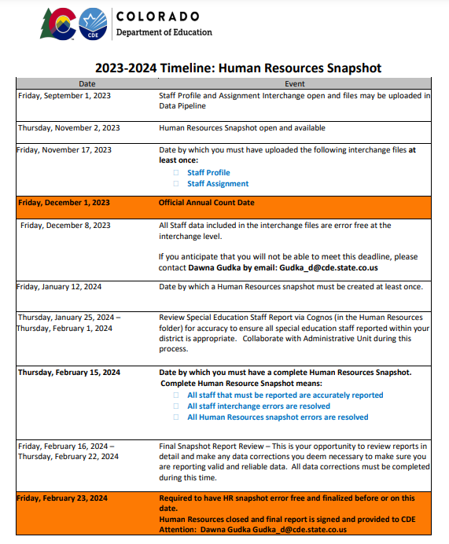
Human Resources Collection Timeline
Date by which a Human Resources Snapshot must be created at least once
Human Resources Snapshot Collection
Gudka_d@cde.state.co.us

Slide 17
Human Resources Collection Common Errors
HR200 A matching endorsement for the teaching subject area code and grade level reported was not found for this teacher in the license database. Please update the field 'Demonstrates In-Field Status 1' to another code (02= Degree; 03=36 Semester Hours; 04=Passed Exam; or 05=Out of Field)
Human Resources Snapshot Collection
Gudka_d@cde.state.co.us

Slide 18
Human Resources Collection Common Errors cont.
HR033 If Subject Area of Degree 1, 2 or 3 is valid then Highest Level of Education must be 16 or higher.
Subject Area of Degree 1 - A broad description of each degree(s) a middle, junior, or high school teacher has received (bachelors, masters or doctorate). For teachers without a bachelor’s degree or higher (highest level of education code 16 or higher), the code ‘2100’ would be reported for ‘No Degree’.
HR230 The Educator Shortage Survey has not yet been indicated as completed. This will be updated every Thursday evening. To complete the Educator Shortage Survey
Human Resources Snapshot Collection
Gudka_d@cde.state.co.us

Slide 19
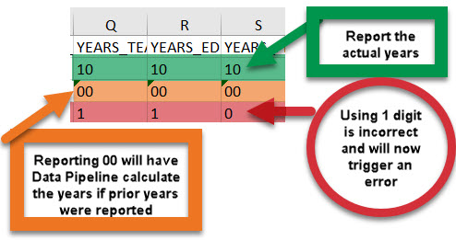
Human Resources Collection Staff Profile Interchange file
MUST CONTAIN TWO DIGIT NUMBER
Human Resources Snapshot Collection
Gudka_d@cde.state.co.us

Slide 20
Questions & Resources for Human Resources Collection
Collection Resources
Staff Interchange
Staff Profile File Layout
Staff Assignment File Layout
Human Resources Snapshot
Questions
Email: Human Resources
Dawna Gudka (303) 598-7901

Slide 21
Special Education December Count
Lindsey Heitman

Slide 22
Special Education December Count: 2023 -2024 Timeline
November Due Dates
December Due Dates
January Due Dates
25th - Thursday - All errors resolved – complete snapshot
February Due Dates
7th – 15th - Wednesday – Thursday - Resolving Duplicates
1st - Friday - Official count date
25th - Feb 2nd Thursday – Friday - Report Review
15th – 22nd - Thursday - Thursday - Final Report Review
23rd - Friday - Final Submission Due
1st -Wednesday – Sped December Count Snapshot available in Data Pipeline
17^{th -} Friday- Interchange files uploaded - Sped Child, Sped Participation, Staff Profile, Staff Assign
8th - Friday: Interchange files error free and at least one snapshot created
Special Education December Count- Lindsey Heitman
SpedDecCount@cde.state.co.us

Slide 23
Special Education December Count
Next deadline is Thursday, January 25th 10 working days!
Date to have a complete Special Education December Count Snapshot:
All Child file and Participation file errors (interchange errors) resolved
All Dec Staff snapshot errors resolved (this requires all Sped staff Interchange errors to be resolved)
All Dec Student snapshot errors resolved
What to work on now?
Create December Count snapshots and work with your staff data respondent until all errors are resolved
AU respondent should check both staff and Student snapshot error reports:
Pipeline Reports/Error Report
Sp. Ed December Count Staff
Sp. Ed December Count Student
OR Cognos Reports/Special Education December folder
Errors: staff detail report of errors to correct
Errors: student detail report of errors to correct
Special Education December Count- Lindsey Heitman SpedDecCount@cde.state.co.us

Slide 24
*The Included Snapshot Records reports help to troubleshoot errors DC114, DC115, DC019, DC020, DC225, DC226, DC227, DC191-204
Special Education December Count Cognos Reports
-->Cognos Reports/Special Education December Count
Error Reports: Staff and Student have separate reports
Excluded Report: Includes excluded records – those w/ interchange errors
Included Report: Includes records that are included in the snapshot
Special Education December Count- Lindsey Heitman SpedDecCount@cde.state.co.us

Slide 25
Special Education December Count: Troubleshooting Grade Case Load Match- Dec Student Errors
DC114 – The Primary Provider reported on a student record must have a JCC of 202 or 238.
Every Special Education student record must contain the EDID of a staff member with a job class code of 202 or 238 in the Primary Provider field.
What to check:
Did the Primary Provider EDID appearing on this student’s record pull into the Staff Snapshot? Verify in the Included Snapshot Records: Staff Interchange report.
Did all staff assignment records for this EDID pull into Snapshot? If not, please correct the staff file interchange errors and resubmit interchange files and create a new snapshot.
Is the Primary of the providers on this student’s record a JCC 202 or 238? If not please add one.
DC115 – Student records must have an edid with Job Class Code 202 or 238 reported and the grade levels reported on the Staff record must include the grade level of this student. Please verify that the associated Staff records made it to Snapshot and have the correct grades marked yes.
What to check:
Did all the EDIDs appearing on this student’s record pull into Staff Snapshot?
Did all staff assignment records for these EDIDs pull into Snapshot? If not, please correct the staff file interchange errors and resubmit interchange files, once processed run a new snapshot.
Please ensure the grade level of this student is checked yes on the staff assignment record for the EDIDs associated with this student.
Special Education December Count- Lindsey Heitman
SpedDecCount@cde.state.co.us

Slide 26
Special Education December Count: Troubleshooting Grade Case Load Match Errors
If you receive grade caseload match errors such as:
Student errors: DC114, DC115, DC225, DC226, DC227, DC228, DC229
Staff errors: DC019 and DC020
Fixing DC225 first may result in resolving DC114 and DC115 errors
Consider fixing them in this order: DC225, DC114, and then any remaining DC115
DC225– The following students have a Primary Service Provider EDID reported that is not included in the Staff Snapshot. Please verify if the staff has an error free record at the Interchange.
To determine why records are missing from the December Snapshot, check:
Pipeline Reports/Records Not in Snapshot report
Cognos Excluded Records Reports (only lists records with errors at Interchange)
often-times caseload errors are caused because not all records have made it to snapshot
Special Education December Count- Lindsey Heitman
SpedDecCount@cde.state.co.us

Slide 27
Pipeline Reports/Records Not in Snapshot
Special Education December Count:
Records Not in Snapshot Report
Records that are not in the Included Snapshot Records report may be located in the Records Not in Snapshot report for December Staff or December Student
Missing records are broken out by Student or Staff and file types for each
Special Education December Count- Lindsey Heitman
SpedDecCount@cde.state.co.us

Slide 28
Special Education December Count: Troubleshooting Errors DC191 – DC205 (Grades of staff and students served must match)
DC191 thru DC205 – these errors look at each individual grade level and compare student grades to grades marked on the staff assignment records.
What to check:
Use Cognos Reports/Special Education December report “Included Snapshot Records: Staff Interchange” to compare grades for your student and staff snapshot records
Cognos Reports/Special Education December à Included Snapshot Records: IEP Interchange
Cognos Reports/Special Education December à Included Snapshot Records: Staff Interchange
In the IEP snapshot records report, filter/search all 5 EDID fields for each EDID triggering one of the DC191-DC205 error codes and then highlight all student records this staff member is attached to. Then check/highlight the the Entry Grade Level fields to reference all student grades being served by that EDID. Similarly, you can pull up the Staff snapshot records to reference all grade levels marked with 1 on the staffs record(s).
Special Education December Count- Lindsey Heitman
SpedDecCount@cde.state.co.us

Slide 29
Questions & Resources: Special Education December Count
Lindsey Heitman
SpedDecCount@cde.state.co.us
(303) 866 - 5759
Special Education IEP Interchange Webpage
Special Education December Count Snapshot Webpage

Slide 30
2023-2024 Student October Data Release
Brooke Wenzel

Slide 31
Data Release
Embargoed: Sent via email to OCT LEA Approvers (January 10, 2024)
May share this data internally with appropriate staff (e.g. Superintendent, other administrative staff).
Public Release: Wednesday, January 17, 2024
CDE Communication office will issue a press release
OCT Respondents receive follow-up email from me
Data will be posted on the following website:
Pupil Membership Statistics Website
Student October – Brooke Wenzel
StudentOctober@cde.state.co.us

Slide 32
Thank you
Thank you all for your hard work on this collection!
Closed survey last week
Email me if you have any other questions/comments to improve next year’s Student October Data Collection
How can we make the Student October collection easier for you?
Update error/warning messages?
Automated emails misleading?
Training topics?
COGNOS report upgrades?
Student October – Brooke Wenzel
StudentOctober@cde.state.co.us

Slide 33
Questions & Resources: Student October
Brooke Wenzel
StudentOctober@cde.state.co.us
720-441-7963
Student October Webpage Student Interchange Webpage

Slide 34
Thank you for joining today!
Next Town Hall will be January 18th, 2024
Reminder: When emailing or calling CDE, please include your 4-digit LEA or your 5-digit AU code. This will help us answer your questions.

