Slide 1
May 8, 2025 Data Pipeline Town Hall
The goal of the webinar is to provide updates on the Data Pipeline, current, and upcoming data collections. These webinars also provide a forum for districts, BOCES, and Administrative Units to have questions answered about Data Pipeline.

Slide 2
Colorado Department of Education Identity Management (IdM)
Identity Management Site
Frequently Asked Questions
How do I add myself or others to the email listserv for town hall emails and/or a specific collection?
Email lists are dependent on a person’s access rights in IdM. Contact your LAM to get an account or be assigned to a specific collection.
Where can I find the IdM role mappings for Data Pipeline and other applications?
Role Mapping (XLS)
I am a LAM. How do I update the user permissions for someone in my district?
Follow the steps outlined in the IdM Quick Guide for Access Management (DOCX)
Important: Users are not automatically removed from IdM when their email address is no longer active in your district. The LAM must deactivate their IdM account to ensure only designated staff can access CDE’s data reporting system.
Notes:
LAMs, please check the IdM roles for your district. Remove permissions for users who have retired, left your district, or are no longer assigned to a collection. Add roles for new hires and newly assigned respondents for specific collections.

Slide 3
What is PII?
Student and Staff Personally Identifiable Information (PII) is defined by state and federal laws as information that, alone or in combination, personally identifies an individual
This includes direct identifiers (i.e. student and staff names, SASID, EDID, etc.)
Includes information that when combined is identifiable
Colorado’s Student Data Transparency and Security Act outlines requirements for how Student PII is collected, used and shared
See the Data Privacy and Security website for prepared guidance on how to comply with this and other privacy laws.

Slide 4
Sharing Data
Use secure methods to transfer any PII to CDE
Contact Data Collection leads with questions about how to transmit PII securely
Each Data Collection leads maintains their own Syncplicity folders for specific collections, reach out to the collection lead for access
Use Syncplicity to encrypt emails to CDE
Avoid sending PII via unencrypted email or to unsecured faxes when sharing data between or within districts
Use Syncplicity to encrypt emails to CDE
Check local policies for restrictions, requirements, etc. regarding PII
Do not use PII in trainings, presentations, etc.
Do not share PII with unauthorized individuals
Do not share passwords
Follow local policies when transmitting PII to any third party

Slide 5
Today’s Agenda
Agenda Topic | Presenter
Open Data Collections and Upcoming Deadlines in Data Pipeline | Host: Dawna Gudka
SBD Collections | Leon Merker
Student Discipline | Carrie Martin
Staff Evaluation | Dawna Gudka
READ Collections | Tara Rhodes
Special Education Discipline | Lindsey Heitman
Special Education End of Year | Lindsey Heitman

Slide 6
Open Collections and Upcoming Deadlines in Data Pipeline

Slide 7
Open Collections and Upcoming Dates: Year-Round & Interchanges
Name | Category | Status | Key Dates
RITS | Year Round | Open | N/A
EDIS | Year Round | Open | N/A
Directory | Year Round | Open | Reduced Academic Calendar: 2/5/2025 to 5/9/2025 School Code Change Requests: 2/5/2025 to 6/30/2025
Student | Interchange | Open | 5/9/2025 Interim Deadline: Upload initial end of year DEM, SSA, GG file in preparation for Spring student collections
At-Risk | Interchange | Closed | N/A
Title I | Interchange | Open | 5/9/2025 Interim Deadline: Upload initial end of year file in preparation for Attendance and SEY collections
Special Education IEP | Interchange | Open | Special Education EOY Snapshot open now
Staff | Interchange | Open | Staff Evaluation Interchange opens 5/21/25
Discipline Action | Interchange | Open | This interchange file is needed for Student Discipline Snapshot and Special Education Discipline Snapshot Collections
Teacher Student Data Link | Interchange | Open | Upload an interchange file at least once by 5/16/2025
Data Pipeline Resources: Data Pipeline Collection Dates (XLS)

Slide 8
Open Collections and Upcoming Dates: Snapshots
Name | Category | Status | Final Deadline Date | Next Milestone | Looking Ahead
Teacher Student Data Link | Snapshot | Open | Aug. 29, 2025 | Interim Deadline: 5/16/2025, upload TSDL interchange at least once | Interim Deadline: 6/13/2025, error free TSDL interchange
Staff Evaluation | Snapshot | Coming Soon | Oct. 15, 2025 | Update and upload Staff Profile now in preparation of Staff Evaluation Interchange opening | Staff Evaluation Interchange opens 5/21/25
Student End of Year | Snapshot | Open | Dec. 2, 2025 | Interim Deadline: Upload SSA/DEM/GG/TT1 files by 5/9 | Training: May SEY Office Hours 5/13/2025, 10:30-11:30am
Student Attendance | Snapshot | Open | July 25, 2025 | Interim Deadline: Upload SSA/DEM files by 5/09 | Collection Training 5/7/2025
Special Education Discipline | Snapshot | Open | Aug. 1, 2025 | Interim Deadline: upload or update Disc Action and Sped Participation files at least once by 5/9/25 | Snapshot Opens: 5/1/2025
Student Discipline | Snapshot | Open | July 31, 2025 | Interim Deadline (5/09/25): Update and upload Student Demographics and Student School Association files Upload Student Discipline Interchange file at least once | Training: May Office Hours 5/12/25, 10:00-11:00am
Special Education EOY | Snapshot | Open | Oct. 3, 2025 | Interim Deadline: 6/26/25 IEP Interchange files error free | Snapshot Opens: 5/1/2025
Data Pipeline Resources: Data Pipeline Collection Dates (XLS)

Slide 9
Open Collections and Upcoming Dates: Periodic
Name | Category | Status | Final Deadline Date | Next Milestone | Looking Ahead
Summer EBT | Periodic | Corrections Period Coming Soon | Feb. 28, 2025 | Corrections Period: 5/19/2025 to 9/3/2025
Alternative Education Campus | Periodic | Open | Jun. 27, 2025 | Planned Measures File: 3/19/2025 to 6/27/2025 | Actual Measures File: 5/19/25 to 6/27/25
Prevent Harassment or Discrimination | Periodic | Open | August 1, 2025 | Interim Deadline: Upload Prevent Harassment or Discrimination File at least once by 6/5/25 | Training: PHD Collection Training 5/12/25, 1:00-2:00 pm
READ Spring Assessments | Periodic | Open | June 13, 2025 | Other Date: 5/15/2025 target initial upload date | Other Date: 6/6/25 error free submission target
READ Literacy Programs & Assessments | Periodic | Open | June 13, 2025 | Other Date: 5/15/2025 target initial upload date | Other Date: 6/6/25 error free submission target
Data Pipeline Resources: Data Pipeline Collection Dates (XLS)

Slide 10
Assessment SBD Reviews Leon Merker

Slide 11
Introductions
Leon Merker
SBD Collection Lead, Primary SBD support
Merker_l@cde.state.co.us
Jasmine Carey
Back up SBD Collection Lead, SBD support
Carey_j@cde.state.co.us
Assessment SBDs
sbdsupport@cde.state.co.us

Slide 12
Student Biographical Data (SBD) Timeline
SBD Collections
There are three collections coming up starting next week
Details are in the Periodic Collections on the Data Pipeline page
Please make sure you have users in each collection group to receive emails about the specific collection
An email will be sent to all active users when the collection opens
Assessment and Collection Page Link | Data Pipeline Group | SBD Review Window
Colorado PSAT/SAT | SAT | May 13 – 21, 2025
Colorado Measures of Academic Success (CMAS): Mathematics, ELA, CSLA, Science and Social Studies Colorado Alternate (CoAlt): Science and Social Studies | CMS | May 15 – 28, 2025
Colorado Alternate (CoAlt): English Language Arts and Mathematics (Dynamic Learning Maps) | DLM | May 28 – June 4, 2025
Assessment SBDs
sbdsupport@cde.state.co.us

Slide 13
SBD Training Webinar
The SBD Training Webinar recording for SAT, CMAS, and DLM collections will be posted as soon as possible on the collection page for all three collections
Slides for the SBD Training Webinar are posted on the SBD collection pages
Assessment SBDs
sbdsupport@cde.state.co.us

Slide 14
Preparing for SBD
Download and review the documentation on the Data Pipeline Collection Pages
File Layout – describes the data collected and gives directions on how they should be filled out
SBD Manual – if you have never done an SBD review, please review the step by step section of the manual before you start working on the collection
Business Rules
Failsafe Template (if needed to move a student to another district)
Attend the training webinar, review the training powerpoint, or watch the training webinar once posted
Make sure you have the appropriate groups in IDM and have at least one district data respondent with the LEA Approver role for each collection
Remove users who are no longer with your district
Assessment SBDs
sbdsupport@cde.state.co.us

Slide 15
Changes to the collections for 2025
Change details are in the layouts
CMAS and DLM changes are only in valid values
SAT layout has been changed
No Pre-ID District and School
Responsible District and School reflect the student’s registration during testing and cannot be changed in SBD
It will never be blank going forward and any student moves will need to be done using a failsafe process like CMAS
Assessment SBDs
sbdsupport@cde.state.co.us

Slide 16
Questions & Resources: Assessment SBDs
Contact SBD Support with any questions:
Email: sbdsupport@cde.state.co.us
Phone: 720.696.0185
Please do not use the general CDE Help Desk!
Remember not to send PII by email or on voicemail because an email will be autogenerated.

Slide 17
Student Discipline
Carrie Martin

Slide 18
Student Discipline Collection Timeline
Date | Event | Event Description
5/06/2025 | Open | Student Discipline Snapshot Open
5/09/2025 | Interim Deadline | Update and upload Student Interchange files: Student Demographics and Student School Association Districts are expected to have an upload date of 4/1/25 or later to meet this interim deadline
5/09/2025 | Interim Deadline | Upload Student Discipline Interchange file at least once
6/11/2025 | Interim Deadline | Error free Student Demographics and Student School Association Interchange files
6/21/2025 | Interim Deadline | Create at least one student discipline snapshot
7/08/2025 | Interim Deadline | Student Discipline Snapshot records error free
7/08-7/26/2025 | Report Review | LEAs should use this time to review reports prior to the deadline. Typically, one week prior to the deadline.
7/31/2025 | State Deadline | All LEAs must have a Student Discipline Snapshot submitted in Data Pipeline
8/9/2025 | State Deadline | Signature page emailed to Student Discipline Snapshot
8/31/2025 | Data Release | Data published
StudentDiscipline@cde.state.co.us

Slide 19
Exceptions
LEAs will need to submit an Exception Request in the proper format for schools with no reportable discipline
Example: 2 of 12 schools in LEA had no reportable behaviors during the 2024-2025 school year
Exception Request Template and Exception Request Instructions available soon on the Student Discipline Snapshot website.
Include Student Discipline Records for the duration of the school year
2024-2025 School Year is defined as July 1, 2024 through June 20, 2025
Student Discipline Snapshot Collection
StudentDiscipline@cde.state.co.us

Slide 20
Office Hours
Student Discipline Office Hours
Monday May 12th 10:00 – 10:45
Monday June 9th 10:00 – 10:45
Student Discipline reporting questions
Student Discipline Snapshot Collection
StudentDiscipline@cde.state.co.us

Slide 21
Questions & Resources: Student Discipline
Student Discipline Snapshot Site
Student Discipline Snapshot Timeline
Discipline Interchange Website
Discipline Action File Layout
StudentDiscipline@cde.state.co.us
Carrie Martin-Collection lead
(720) 665-4456

Slide 22
Staff Evaluation
Dawna Gudka

Slide 23
Collection Timeline
Date | Event | Event Description
04-22-2025 | Training Event | Collection Training Recording PowerPoint Posted on the website under Trainings
05-12-2025 | Interim Deadline | Update and upload Staff Profile Interchange file
05-21-2025 | Open | Staff Evaluation Interchange Open
06-05-2025 | Interim Deadline | Error free Staff Profile Interchange file
06-19-2025 | Interim Deadline | Error free Staff Evaluation Interchange file
06-26-2025 | Interim Deadline | Create at least one Staff Evaluation Snapshot in Data Pipeline
07-15-2025 | Interim Deadline | Error free Staff Evaluation Snapshot
07-15- 08-15-2025 | Report Review | Final Snapshot Review- This is your opportunity to review reports in detail and make any data corrections you deem necessary to make sure you are reporting valid and reliable data. All data corrections must be completed during this time. If you anticipate that you will not be able to meet this deadline, please contact Dawna Gudka by email: Staff Evaluation
10-15-2025 | State Deadline | Staff Evaluation Snapshot Final Deadline Required to have Staff Evaluation Snapshot data submitted and sign off page signed and emailed to Staff Evaluation
Dawna Gudka
Staff Evaluation Snapshot

Slide 24
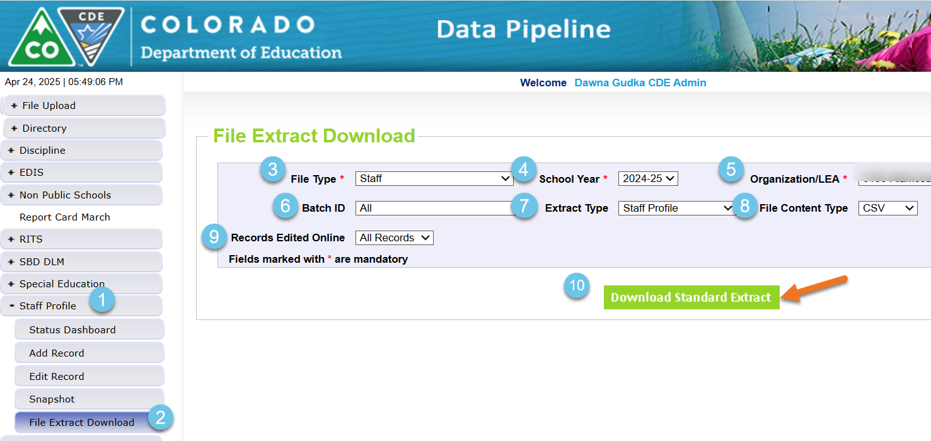
Extracting Staff Profile file from Data Pipeline
If you are unsure if your staff profile in Data Pipeline is complete and up to date, extract a staff profile file. To extract a staff profile,
Staff Evaluation Snapshot Collection
StaffEvaluation@cde.state.co.us

Slide 25
Task that you can start completing now
Staff Profile needs to be updated with any staff that came in after December 1st
Staff Profile should contain all staff that provided services to your students throughout the entire 2024-2025 School Year
What Staff are included in this collection
Teachers job codes 201, 202, 206, 216, 222, 223
Special Service Providers 211, 231, 233, 234,235, 236, 237, 238, 242
Principals 105, 106
Get your staff profile uploaded and error free
As soon as your LEA finishes evaluations, pull your extract from COPMS (RANDA) or the staff evaluation system that your LEA uses
Staff Evaluation Snapshot Collection
StaffEvaluation@cde.state.co.us

Slide 26
Questions & Resources: Staff Evaluation Snapshot Collection
Staff Interchange website
Staff Profile file layout
Staff Evaluation file layout
Staff Evaluation Snapshot website
Staff Evaluation Timeline
Dawna Gudka-Collection lead
(303) 598-7901
StaffEvaluation@cde.state.co.us

Slide 27
READ Collections
Tara Rhodes

Slide 28
Spring READ Assessment

Slide 29
Spring READ Assessment District Required Reporting
Districts must annually report the information necessary to determine the prevalence of SRDs among students in grades K-3.
This data determines the per-pupil funding for districts by dividing the amount of money available by the total number of K-3 students identified as having an SRD in the preceding budget year. Districts must also report whether students in grades 4-12 remain on a READ plan.
The data provided in this report will be publicly reported and will enable the department to calculate district funding.
Spring READ Assessment
READActData@cde.state.co.us

Slide 30
Spring READ Assessment Changes for 24-25
No structural changes to the file layout (no addition/deletion of fields).
Drop-down menus in Pipeline have been updated to "READ Assessment" for clarity.
Some assessments were removed. These are ones that are no longer approved.
Cleaned up language and standardized field names.
For example, the SRD Status field is now labeled as such.
Added a warning that checks to see if the district's READ Literacy Programs and Assessment data collection has been submitted.
Added a warning around ELAT schools and assessment choice.
Altered the sign-off form to include the count of SRD as well as the SRD percentage for the district.
Please have the appropriate staff review this at your district before submitting your data!
Spring READ Assessment
READActData@cde.state.co.us

Slide 31
Spring READ Assessment Reminders
As you are approaching your assessment window, please make sure that all kindergarten through 3rd grade students are assessed.
Please also make sure that: 1. all enrolled kindergarten through 3rd grade students are included in your file submission; and 2. the students noted on your cohort report in 4th-12th grade.
Please make sure that you have confirmed and coded the correct assessment for each student in your file submission. This affects the identification of students with significant reading deficiencies in your submission.
Spring READ Assessment
READActData@cde.state.co.us

Slide 32
READ Literacy Programs and Assessment

Slide 33
READ Literacy Programs and Assessment Status Update
Status Update:
Number of Uploads: 31/182 (17.0%)
Number of Submissions: 19/182 (10.4%)
Please note that this collection runs in the same window as the Spring READ Assessment collection but is a separate upload.
Reminders:
Please do not zero-fill your file. This will create errors.
Please only use the code 00 for any non-published programs (ie., district developed).
READ Literacy Programs and Assessment
READActData@cde.state.co.us

Slide 34
Timeline
Date | Event | Event Description
4/1/2025 | Training Event | Spring READ Assessment Training Event; recording here
4/8/2025 | Training Event | READ Literacy Programs and Assessment Training Event; recording here
4/15/2025 | Collection Open | The Spring READ Assessment and READ Literacy Programs and Assessment data collections open
5/15/2025 | Other Date | Please complete a preliminary upload by this date; this does not have to be error-free
6/6/2025 | Other Date | Please complete an error-free submission by this date
6/6/2025 | Report Review | Assuming an error-free submission has been completed, use this time to review any reports
6/13/2025 | Collection Close | Spring READ Assessment and READ Literacy Programs and Assessment data collections close
Tara Rhodes
READActData@cde.state.co.us

Slide 35
READ Training

Slide 36
READ Training General Information
READ Training Collection:
Dates: 8/1/2025 - 8/31/2025
The READ Training Export Report is now in production with the updated file layout.
Training Opportunities:
May 20 from 3-4pm; more oriented for READ leads
More information at this link
July 15 from 1-2pm; more oriented for district data respondents
More information at this link
READ Training Collection
READActData@cde.state.co.us

Slide 37
Questions & Resources: READ Act Data Collections
Tara Rhodes
READActData@cde.state.co.us
Phone: 720.601.4125
Websites:
Spring READ Assessment Collection
READ Literacy Programs and Assessment Collection
READ Training Collection

Slide 38
Special Education Discipline
Lindsey Heitman

Slide 39
Special Education Discipline Snapshot Timeline and Annual Training
March 15th – Discipline Interchange opened
May 1, 2025 - SPED Discipline Snapshot opens
May 9, 2025 - All Interchange files that feed into snapshot uploaded or updated at least once
June 26, 2025 - Interchange errors resolved – Discipline Action File, Child File, Participation File and at least one snapshot taken
July 24, 2025 - All Exception requests submitted to CDE processing
July 25, 2025 - Snapshot error-free
July 25 – Aug. 1, 2025 - Report Review and final submission
Friday Aug. 1, 2025 - Final Submission due to CDE
Training
Special Education Discipline Annual Snapshot Training
Tuesday May 6th 10:00 – 11:30
Overview of the snapshot data required and process in Data Pipeline
*Slides and recording should be posted soon
Student Discipline Office Hours
Monday May 12th 10:00 – 10:45
Monday June 9th 10:00 – 10:45
Student or Sped Discipline reporting questions
Join the meeting now
Special Education Discipline – Lindsey Heitman
SpedDiscipline@cde.state.co.us

Slide 40
Questions & Resources: Special Education Discipline
Lindsey Heitman
SpedDiscipline@cde.state.co.us
Discipline Interchange Webpage Special Education Discipline Snapshot Webpage

Slide 41
Special Education End of Year
Lindsey Heitman

Slide 42
Special Education End of Year: Timeline and Training
2024-2025 Special Education EOY Snapshot Timeline
Upcoming Training
Sped EOY Annual Training Webinar
Tuesday May 13th - 1:00 – 2:30
Join the meeting now
Office Hours TBD
May 1, 2025 - SPED EOY Snapshot official open
June 26, 2025 – IEP Interchange files error-free
September 4, 2025 - Exception requests submitted to CDE
September 11, 2025 – All errors resolved at snapshot/interchange
September 12 -19, 2025 -Initial Report Review
September 22 - 26, 2025 – Resolving duplicates
September 29 – October 1, 2025 – Final Report Review
October 3, 2025 - Final submission due to CDE
Special Education EOY – Lindsey Heitman
SpedEndofYear@cde.state.co.us

Slide 43
Special Education End of Year: Initial Evaluations and Which Path to Report them in
Part C evaluations (early intervention) are no longer reported, but you will need to know which children were receiving Part C services to determine if they should be reported in Path 2.
Report Path 2 and 3 (Sped Referral Types 02 or 03) records in the school year the IEP was implemented – meaning services have physically begun
Path 1
Includes ages 0-3 evaluated for Part C
Path 2
Includes ages 2.5-3.9 referred from Part C to Part B services
Path 3
Includes ages 2.5-21 referred to Part B services and not receiving Part C at time of referral
NOTE:
Path 2 field – Date Child Found Eligible for Path 1 is still required to be reported
Only initial evaluations are required to be reported to CDE and in only one collection year!
Special Education EOY – Lindsey Heitman
SpedEndofYear@cde.state.co.us

Slide 44
Special Education End of Year - Initial referral record -parents decide to wait and start preschool and services in the fall
Path 2 or 3 referral records should be reported in the school year in which the IEP was implemented.
Implemented means the services have begun and child is attending school.
That date should match the Start Date of Services/Date of Entry to Sped.
If you are reporting a ‘Date IEP Implemented’ on an initial referral record, that would indicate services are already being received by the student
How to report an initial evaluation that wrapped up in the spring or summer, child was found eligible, and parents request to wait and start services in the fall when child begins preschool?
If you expect services to start in the fall (per parent), please hold and report an initial referral record next year, school year – 25-26
Nothing should be reported for this student in the 24-25 Sped EOY – they should not have a record in your Child/Participation files this year
The 25-26 record will contain the Special Education Referral Type code of 02 or 03 and all the evaluation dates that occurred in the spring of 2025, as well as any applicable delay codes for the initial evaluation timeframe.
If Initial evaluation process is completed prior to 6/30/2025 and parent decides to NOT enroll their child or start services in your AU
please go ahead and report that initial referral record in 24-25 with the delay code ’01’, which indicates child never enrolled
Special Education EOY – Lindsey Heitman
SpedEndofYear@cde.state.co.us

Slide 45
Special Education EOY Enrich Process for Initials that Start in the Fall
In Enrich under student’s Program History tab:
Do an Admin Edit and populate ‘Actual Start Date of Services’ with the expected first day of school for the 25-26 school year. Ex: 08/16/2025
If record is a C to B, you will be prompted for a delay code if the student will have turned 3 by then
45, 41, or 49 are all codes that might fit= all valid delay reasons
Next you must recollect the data
After recollecting, the system should automatically withhold the record from the 24-25 EOY files and hold it for the 25-26 EOY files instead.
In 25-26 collection year, someone will need to revisit these records and adjust them according to the final outcome.
Reason for Delay in IEP Implementation field-
Did they really enroll and start services? If so, the 45, 41, or 49 can stay
Did they end up not enrolling after all? If so, adjust to delay code 01
Special Education EOY – Lindsey Heitman
SpedEndofYear@cde.state.co.us

Slide 46
Questions & Resources: SPED End of Year
Lindsey Heitman
SpedEndofYear@cde.state.co.us
Special Education IEP Interchange Webpage Special Education End of Year Snapshot Webpage

Slide 47
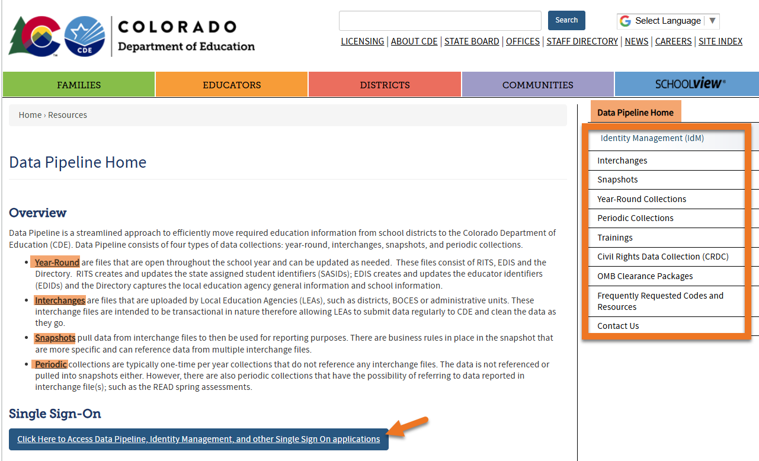
Thank you for Joining Today!
Next Town Hall will be May 15th
Reminder for the week
Data Pipeline Home Webpage

