Slide 1
April 18, 2024 Data Pipeline Town Hall
The goal of the webinar is to provide updates on the Data Pipeline, current, and upcoming data collections. These webinars also provide a forum for districts, BOCES, and Administrative Units to have questions answered about Data Pipeline.

Slide 2
Colorado Department of Education Identity Management (IdM)
Identity Management Site
Frequently Asked Questions
How do I add myself or others to the email listserv for town hall emails and/or a specific collection?
Email lists are dependent on a person’s access rights in IdM. Contact your LAM to get an account or be assigned to a specific collection.
Where can I find the IdM role mappings for Data Pipeline and other applications?
Role Mapping (XLS)
I am a LAM. How do I update the user permissions for someone in my district?
Follow the steps outlined in the IdM Quick Guide for Access Management (DOCX)
Important: Users are not automatically removed from IdM when their email address is no longer active in your district. The LAM must deactivate their IdM account to ensure only designated staff can access CDE’s data reporting system.

Slide 3
What is PII?
Student Personally Identifiable Information (PII) is defined by state and federal laws as information that, alone or in combination, personally identifies an individual
This includes direct identifiers (i.e. student and staff names, SASID, EDID, etc.)
Includes information that when combined is identifiable
Colorado’s Student Data Transparency and Security Act outlines requirements for how Student PII is collected, used and shared
See the Data Privacy and Security website for prepared guidance on how to comply with this and other privacy laws.

Slide 4
Sharing Data
Use secure methods to transfer any PII to CDE
Contact Data Collection leads with questions about how to transmit PII securely
Each Data Collection leads maintains their own Syncplicity folders for specific collections, reach out to the collection lead for access
Use Syncplicity to encrypt emails to CDE
Avoid sending PII via unencrypted email or to unsecured faxes when sharing data between or within districts
Use Syncplicity to encrypt emails to CDE
Check local policies for restrictions, requirements, etc. regarding PII
Do not use PII in trainings, presentations, etc.
Do not share PII with unauthorized individuals
Do not share passwords
Follow local policies when transmitting PII to any third party

Slide 5
Today’s Agenda
Agenda Topic | Presenter
Open Data Collections and Upcoming Deadlines in Data Pipeline
Newcomer Count DocuSign (HB 24-1389) | Reagan Ward
READ Spring Assessment Reporting | Tara Rhodes
K-3 Literacy Programs & Assessment Reporting | Tara Rhodes
Summer EBT | Madeleine Breza
Student Discipline | Dawna Gudka
Student End of Year | Reagan Ward
2024-2025 Student Interchange | Brooke Wenzel
Attendance | Brooke Wenzel

Slide 6
Open Collections and Upcoming Deadlines in Data Pipeline

Slide 7
Open Collections and Upcoming Dates
Name | Category | Status | Key Dates
RITS | Year Round | Open
EDIS | Year Round | Open
Directory | Year Round | Open | Reduced Academic Calendar Applications 3/6/2024 to 5/10/2024 School Code Change Requests 2/5/2024 to 6/28/2024
Student | Interchange | Open | Interim Deadline: 5/9/2024 Initial upload DEM & SSA files for Spring reporting (Attendance, Discipline, Student End of Year)
Title I | Interchange | Open
Special Education IEP | Interchange | Open
Staff | Interchange | Open
TSDL | Interchange | Open
Discipline | Interchange | Open
Data Pipeline Resources: Data Pipeline Collection Dates (XLS)

Slide 8
Open Collections and Upcoming Dates cont.
Name | Category | Status | Final Deadline Date | Deadline Milestone | Looking Ahead
TSDL | Snapshot | Open | Aug. 30, 2024
Attendance | Snapshot | Open | July 12, 2024 |  | Training Event 5/8/24
Student Discipline | Snapshot | Coming Soon | July 31, 2024 |  | Interchange open
Student End of Year | Snapshot | Soft Open | Nov. 19, 2024 | Training Event: 4/22/24 Collaborative Webinar - SPED Transition Services | Training Event: 4/29/24 SEY Collection Overview (Session 2 of 2)
S-EBT | Periodic | Open | Apr. 30, 2024
Special Education Discipline | Snapshot | Coming Soon | August 29, 2024 |  | Snapshot officially opens 5/1/2024
Special Education End of Year | Snapshot | Soft Open | September 27, 2024 |  | Snapshot soft open – NOW - officially opens 5/1/2024
Data Pipeline Resources: Data Pipeline Collection Dates (XLS)

Slide 9
Newcomer Student Counts HB 24-1389
Reagan Ward

Slide 10
Timeline
Date | Event | Event Description
4/15/2024 | Deadline | Submit ‘Intent to Participate’ form indicating District plans to participate in this count with a point of contact (Superintendent or Designee).
4/16/2024 | CDE Generates DocuSign | Sent to Superintendent/Designee indicated on intent to participate form
4/23/2024 | Deadline | Submit completed DocuSign with district provided data
5/1/2024 | CDE Notification to Districts | CDE provides notification to districts of funding allocation
5/30/2024 | CDE Funds Distribution | Latest date by which CDE distributes funding to districts
Reminders:
To receive House Bill 24-1389 funding, districts must submit an attestation form, signed by the local Superintendent or their designee, which certifies counts provided by both CDE (based on prior submitted district data) and the district.
DocuSign (attestation form) sent to the Superintendent or Designee indicated on a district’s intent to participate form on Tuesday, April 16th.
Funding is a two-part distribution for the 2023-2024 budget year
Part 1: “Fixed Cost” based upon number of newcomer students 10/03/2023 through 2/29/2024
Part 2: “Net Enrollment” prorated per-pupil funding based on net enrollment of students between October count and 2/29/2024 district count of students.
HB 24-1389
Funding for Newcomer Students

Slide 11
DocuSign (Attestation) form
CDE Data
District Provided Data
2023-2024 Student October Enrollment Count of K-12 Students
Number of Newcomers after Student October through 2/9/2024
District option to ‘request to resubmit 2024 ACCESS counts’ provided on DocuSign. If selected, district must enter their resubmitted number of newcomers 10/3/2023 to 2/9/2024. District may be subject to provide a SASID list of students to support this option if requested.
K-12 Student Enrollment as of 2/29
Count of Newcomers from 2/10 to 2/29
Newcomers determined by Language Proficiency (NEP/LEP) and Date First Enrolled in US data fields
Note: Instructions for submitting the district provided data are included in the DocuSign. SEY and OCT data respondents were sent a copy of the directions via email 4/11/24 with a town hall recap.
HB 24-1389
Funding for Newcomer Students

Slide 12
Count of Newcomers from 2/10 – 2/29
District Provided
District Provide counts based on following logic:
Primary School = ‘1’ (school of accountability/primary enrollment record)
Grade Levels K-12 (006-120)
Pupil Attendance Information Codes 01-08 (student must be attending an educational program operated by the reporting district)
All Funding Codes, including non-eligible students
Students with Language Proficiency Codes = ‘1’ (NEP) or ‘2’ (LEP)
Students with Date First Enrolled in U.S. between February 10th, 2024, and February 29th, 2024.
Students with School Exit Date that does not equal (<>) February 29th, 2024, or earlier.
HB 24-1389
Funding for Newcomer Students

Slide 13
Student Enrollment as of 2/29
District Provided
District Provide counts based on following logic:
Primary School = ‘1’ (school of accountability/primary enrollment record)
Grade Levels K-12 (006-120)
Pupil Attendance Information Codes 01-08 (student must be attending an educational program operated by the reporting district)
All Funding Codes, including non-eligible students.
Students with School Exit Date that does not equal (<>) February 29th, 2024, or earlier.
Funding for Newcomer Students
HB 24-1389

Slide 14
Questions & Resources: HB 24-1389 Newcomer Counts
ACCESS Counts: Brooke Wenzel
Wenzel_b@cde.state.co.us
District Provided Data: Reagan Ward
Ward_r@cde.state.co.us
Funding: Tim Kahle
Kahle_t@cde.state.co.us

Slide 15
READ Spring Assessment Reporting
Tara Rhodes

Slide 16
READ Data Collections Overview
The READ Act provides per-pupil intervention funds to assist LEPs in providing intervention support to students identified as having significant reading deficiencies (SRDs).
For the 2023-24 reporting window, there are three file uploads required in Data Pipeline in order for a district to successfully complete the READ data collection:
2023-24 Spring READ Assessment Data (DUE 6/14/24)
2024-25 Literacy Programs & Assessment Data (DUE 6/28/24)
2024-25 Teacher Training Completion Data (DUE 8/30/24)
READ Act Data Collections – Spring Assessment Data
Readactdata@cde.state.co.us

Slide 17
READ Data Collections Purpose and Criteria
Purpose: Districts must annually report the data necessary to determine the prevalence of SRDs among K-3 students. This data determines the per-pupil funding for districts by dividing the amount of money available by the total number of K-3 students identified as having an SRD in the preceding budget year. Districts must also report whether students in grades 4-12th grade remain on a READ plan or not.
Criteria: Districts are required to report student level READ Act administered interim assessments along with the student’s score, READ plan status, intervention supports, and demographic data. All K-3 students enrolled in the district at the time of data submission are required to be reported. In addition, all 4-12th grade students who exited 3rd grade on a READ plan.
Link to view the READ data collections website
READ Act Data Collections – Spring Assessment Data
Readactdata@cde.state.co.us

Slide 18
READ Data Collections Purpose and Criteria Cont.
Spring READ Assessment reporting window is scheduled to open April 10, 2024 and is scheduled to close June 14, 2024.
Timeline:
• April 10, 2024: Data collection opens, and files may be uploaded in Data Pipeline
• June 14, 2024: Date by which district must have error free and locked file in the Status Dashboard
• June 21, 2024: CDE conducts cross LEA validation process and districts will work with each other to remove duplicate SASIDS
• June 28, 2024: Date by which district must have file resubmitted with duplicate SASIDs removed
• July 25, 2024: CDE sends emails to data respondents with final SRD numbers through Data Pipeline for district confirmation
• July 29, 2024: CDE sends emails to superintendents with final SRD numbers
READ Act Data Collections – Spring Assessment Data
Readactdata@cde.state.co.us

Slide 19
READ Data Collections Changes for 23-24 Collection
There were no changes to the file layout for the Spring READ assessment data reporting for the 23-24 collection.
However, there have been updates to cut scores as well as approved programs.
Please review the updates on the READ Act Approved Assessments webpage.
READ Act Data Collections – Spring Assessment Data
Readactdata@cde.state.co.us

Slide 20
Questions & Resources: READ Spring Assessments
Email: ReadActData@cde.state.co.us
READ Collections Website

Slide 21
K-3 Literacy Programs & Assessment Reporting
Tara Rhodes

Slide 22
Literacy Programs & Assessment Reporting Purpose and Criteria
Purpose: The 2019 updates to the READ Act (SB19-199) require that districts report their K-3 instructional literacy programs and READ Act interim and diagnostic assessments by school and grade level (K-3). In addition, districts that use READ Act money and/or Early Literacy Grant funding for teacher professional development must provide information on how their professional development plan aligns to scientific and evidence-based literacy instruction. This requirement is annual, regardless of whether districts are eligible for biennial UIP flexibility.
Criteria: For the 24-25 school year, districts are required to report the READ Act administered interim and diagnostic assessments along with their core, supplemental, and intervention instructional literacy programs for grades K-3 for each school in their district (including charter schools)
Link to view the READ data collections website
READ Act Data Collections – Literacy Programs
ReadActData@cde.state.co.us

Slide 23
Literacy Programs & Assessment Reporting Timeline
Literacy Programs & Assessment reporting window is scheduled to open on April 24, 2024 and close June 28, 2024.
Timeline:
• April 24, 2024: Data collection opens, and files may be uploaded in Data Pipeline
• June 28, 2024: Date by which district must have error free and locked file in the Status Dashboard
READ Act Data Collections – Literacy Programs
ReadActData@cde.state.co.us

Slide 24
Literacy Programs & Assessment Reporting Changes for 24-25 Collection
There were no changes to the ordering or inclusion of fields in the file layout for the literacy programs and assessment data reporting for the 24-25 collection.
However, a few field lengths were adjusted for the core, supplemental, and intervention programming code fields.
Additionally, updates have been made to the advisory list for the instructional programming.
Please review the updates on the Advisory List of Instructional Programming Webpage.
READ Act Data Collections – Literacy Programs
ReadActData@cde.state.co.us

Slide 25
READ Data Collections Preparation for Collection Openings
Steps to Take to Prepare for the Collection Opening:
For Spring READ Assessment Data Reporting:
• Begin having conversations with the READ leads in your district to see if any programming changes are planned for next year.
• The interim and diagnostic lists have been updated for the 2024-25 school year. Please reference this link to see which assessments will no longer be available for the 24-25 school year and which ones are new.
For Literacy Programs and Assessment:
• Extract your data file from the last reporting cycle to see what has been reported historically.
READ Act Data Collections – Spring Assessment Data
Readactdata@cde.state.co.us

Slide 26
Questions & Resources: K-3 Literacy Programs & Assessments
Email: ReadActData@cde.state.co.us
READ Collections Website

Slide 27
SAT, CMAS, and DLM SBDs
Tara Rhodes

Slide 28
Upcoming Trainings
This year, the Assessment Division will be hosting two trainings for the SBD collections:
SAT SBD Training Webinar
4/23 at 11:30am – 12:30pm
Microsoft Teams Link
CMAS and DLM SBD Training Webinar
4/30 at 11:30am – 12:30pm
Microsoft Teams Link
Both webinars will be recorded and posted to the SBD websites as soon as possible after the training has concluded.
Assessment SBDs
Sbdsupport@cde.state.co.us

Slide 29
Questions and Resources: SBD Collections
Email: SBDSupport@cde.state.co.us
SAT SBD Webpage
CMAS SBD Webpage
DLM SBD Webpage

Slide 30
Summer-EBT Program

Slide 31
Summer EBT Data Collection
Collection will open April 1 through April 30
All districts required to submit student level data by due date
USDA updated guidance providing more flexibility in requirements:
Submit data for National School Lunch program sites only
Submit data for NSLP sites PLUS any Free and Reduced eligible transfer students to a non-NSLP sites during the school year (any students that was enrolled at a NSLP site, even for a short period of time, would be eligible for S-EBT benefits)
Submit data for all enrolled students at both NSLP sites and non NSLP sites*
Summer EBT
s-ebt@cde.state.co.us
Notes:
This next update, is a major update, and I want to remind everyone that this is a new program and with that comes updated USDA guidance
Giving districts and charter institutions more flexibility
USDA has come out with this new guidance help alleviate some issues that have been coming up
However, I want to emphasize that our preference, is that you upload all your data as the goal is to capture all eligible students
I also want to point out that for districts or charters that have already uploaded and want to make changes based on this new guidance, you still have that opportunity, if your preference is to change the data you uploaded please let us know and we can unlock your file
You will find all of these updates in the FAQ which is linked in the slides, and we will also include it in the chat

Slide 32
S-EBT File Layout
 | Name of Field | Field Length | Text Start Position | Text End Position | CSV Order | Excel Column | Examples | Remarks
1 | School District Code* | 4 | 1 | 4 | 1 | A2 | 0000
2 | School Code* | 4 | 5 | 8 | 2 | B2 | 0000
3 | Entry Date* | 8 | 9 | 16 | 3 | C2 | 08152021 | Format is MMDDYYYY
4 | Exit Withdraw Date* | 8 | 17 | 24 | 4 | D2 | 10152021 | Format is MMDDYYYY; 0 fill if N/A
5 | Student’s State ID (SASID)* | 10 | 25 | 34 | 5 | E2 | 0000000000
6 | Local ID (LASID)* | 10 | 35 | 44 | 6 | F2 | 0000000000
7 | Student’s First Name* | 30 | 45 | 74 | 7 | G2 | Valid Name
8 | Student’s Middle Name* | 30 | 75 | 104 | 8 | H2 | Valid Name | NMN if none
9 | Student’s Last Name* | 30 | 105 | 134 | 9 | I2 | Valid Name
10 | Student’s Gender* | 2 | 135 | 136 | 10 | J2 | 01, 02
11 | Student’s Date of Birth* | 8 | 137 | 144 | 11 | K2 | 08152008 | Format is MMDDYYYY
12 | Student’s Grade Level* | 3 | 145 | 147 | 12 | L2 | 060
13 | Student’s Language Background | 3 | 148 | 150 | 13 | M2 | ENG
14 | Primary Parent/Guardian First Name* | 30 | 151 | 180 | 14 | N2 | Valid Name
15 | Primary Parent/Guardian Last Name* | 30 | 181 | 210 | 15 | O2 | Valid Name
16 | Primary Parent/Guardian Telephone Number | 10 | 211 | 220 | 16 | P2 | 5551231234; None
17 | Student’s Primary Mailing Address 1* | 44 | 221 | 264 | 17 | Q2 | 123 Star Quarry Road
18 | Student’s Primary Mailing Address 2 | 42 | 265 | 306 | 18 | R2 | Apt. 2 | Try to avoid special characters, i.e., #, &, @, etc.
19 | Student’s Primary Mailing City* | 50 | 307 | 356 | 19 | S2 | Nowhere
20 | Student’s Primary Mailing State* | 2 | 357 | 358 | 20 | T2 | CO
21 | Student’s Primary Mailing Postal Code* | 10 | 359 | 368 | 21 | U2 | 99999-0000, 99999
22 | Free/Reduced Lunch Price Eligible* | 2 | 369 | 370 | 22 | V2 | 00, 01, 02
23 | FRPL Eligibility Date | 8 | 371 | 378 | 23 | W2 | 10152021 | Format is MMDDYYYY
Summer EBT
s-ebt@cde.state.co.us

Slide 33
Submissions
*76/184 districts have submitted their final data

Slide 34
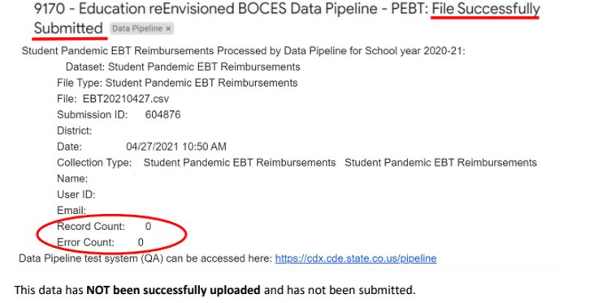
Common Errors
Common Error – Converting to excel losing leading zeros
Follow the formatting instructions: https://www.cde.state.co.us/datapipeline/convertcsvtoexcel
Common Error – No records uploaded
Summer EBT
s-ebt@cde.state.co.us

Slide 35
Questions & Resources: Summer EBT
S-EBT General Email
Data Collection FAQ
School Nutrition Summer-EBT webpage
Data Pipeline S-EBT webpage
Office Hours Sign-up

Slide 36
Student Discipline
Dawna Gudka/Lindsey Heitman

Slide 37
Student Discipline Interchange-Discipline Action Length
Student Discipline Snapshot
Student Discipline Snapshot email
Notes:
We’ve also reached out to Infinite Campus

Slide 38
Student Discipline Training PowerPoints and Recording available
Student Discipline Snapshot Training
March 20th
PowerPoint Presentation posted on website, under trainings
Recorded Presentation
November 8th
PowerPoint Presentation posted on website, under trainings
Recorded Presentation
SPED Discipline Snapshot Training
April 15th
PowerPoint Presentation posted on website, under trainings
Recorded Presentation
Student Discipline Office Hours
June 5th
Click here to join the meeting
Student Discipline Snapshot
Student Discipline Snapshot email
Notes:
We’ve also reached out to Infinite Campus

Slide 39
Questions & Resources: Student Discipline
Student Interchange website
Student Demographics file layout
Student School Association file layout
Discipline Interchange website
Discipline file layout
Student Discipline Snapshot website
Student Discipline Snapshot file layout
Special Education Discipline Snapshot website
Special Education Discipline Snapshot file layout
Dawna Gudka-Student Discipline Snapshot collection lead
(303) 598-7901
Email Student Discipline Snapshot
Lindsey Heitman-SPED Discipline collection lead
(303) 866-5759
Email SPED Discipline Snapshot

Slide 40
Student End of Year
Reagan Ward

Slide 41
SEY Collection Timeline: Upcoming Events
Date | Event | Event Description
04/22/2024 1:00-2:00pm | Training Event | Collaborative Webinar – Special Education 18-21 Transition Services This webinar is designed for data respondents and district special education staff who support 18-21 transition services. Click here to register for this training event.
04/26/2024 | Closed | Soft open phase ends and snapshots are closed until the next phase.
04/29/2024 9:00-10:30am | Training Event | Collection Overview Training 2 of 2 This training covers all elements of the Student End of Year collection. It is being offered in two identical sessions to provide the opportunity for all SEY data respondents to attend a live session. Click here to register for this training event.
05/02/2024 | Open | Collection officially opens. Districts may create snapshots. Adjustment (ADJ) interchange file opens.
05/09/2024 | Interim Deadline | Upload the remaining initial end of year interchange files. Student Demographic (DEM) Student School Association (SSA) Title 1 (Targeted Assistance schools only) Graduation Guidelines (if district missed April 11th interim deadline) Districts are expected to have an upload date 04/01/2024 or later to meet this interim deadline.
05/15/2024 | Training Event | May SEY Office Hours
05/30/2024 | Interim Deadline | Create initial SEY snapshot
Visit the SEY Website to download the complete SEY Collection Timeline with Training Dates
Student End of Year – Reagan Ward
StudentEndOfYear@cde.state.co.us

Slide 42
Training
Collection Overview
Offered in two identical sessions
4/3/2024, 1:00-2:30pm
4/29/2024, 9:00-10:30am
Primary training for SEY collection
Strongly suggest that all SEY respondents attend one of the two sessions
Collaborative Webinars
Designed for program staff and data staff to attend together
Postsecondary Programs
3/6/2024, 1:00-2:00pm
Special Education 18-21 Transition
4/22/2024, 1:00-2:00pm
Monthly Office Hours
Ongoing support throughout collection
Select Wednesdays 2:30-3:30pm
5/15, 6/12, 7/17, 8/14, 9/18, 10/23, 11/13
Agenda varies based upon questions from respondents and information pertinent to the specific point in the collection
Short Byte Videos
Pre-recorded topic-based videos
5-15 minutes long
Registration Links & Detailed Schedule available on SEY Website
Student End of Year – Reagan Ward
StudentEndOfYear@cde.state.co.us

Slide 43
CEDAR/COGNOS Report Highlight SASID Lookup: SEY and OCT record (prior, current, subsequent year)
Best report to research cross collection errors related to prior SEY or OCT data
Common issues:
Prior school code + current entry type
School code OCT + school code SEY
Exit type prior + entry type current
Grade level prior + grade level current
OCT demographic info + SEY demographic info
Missing Records
Entry/exit type agreement for students with multiple enrollment records in the current year
Student End of Year – Reagan Ward
StudentEndOfYear@cde.state.co.us

Slide 44
Documentation Highlight: SEY Collection Manual
Section 1: Overview and Phases
Includes detailed information regarding each source interchange data file, addressing errors and warnings, and reporting exceptions.
Section 2: Data Pipeline
Includes step-by-step directions for using each portion of data pipeline needed to complete the SEY collection.
Section 3: CEDAR/COGNOS Basics
Includes general information about using CEDAR/COGNOS.
See the SEY CEDAR report guide for details regarding specific reports.
Update coming soon
Section 4: Syncplicity and Personally Identifiable Information
Includes directions for using Syncplicity.
Section 5: Common Coding Patterns
Postsecondary Programs
Special Education Transition
Facility School Students
Expelled Students
BOCES Schools and BOCES Programs
Non-School Programs
Part-Time Home-Based Education
Grade Reassignment
Summer Dropout
Section 6: Frequently Asked Questions
One-Day Records
Retention Codes
English Learners
Dual Enrolled Students
Mid-Year Graduates
Internal Flags (AYG, IPST, etc.)
SEY Data Uses
Student End of Year – Reagan Ward
StudentEndOfYear@cde.state.co.us

Slide 45
Questions & Resources: Student End of Year
Reagan Ward
StudentEndOfYear@cde.state.co.us
720-484-9057
Student End of Year Webpage Student Interchange Webpage Graduation Guidelines Webpage

Slide 46
2024-2025 Student Interchange
Brooke Wenzel

Slide 47
2024-2025 Student Interchange Information
Opens on July 15, 2024!
Be mindful when uploading Student Interchange Files as we will have two years (2023-2024 and 2024-2025) open at the same time over the summer
Should have received an email (same email was sent to our SIS vendors) on April 4th
Please read over all File Layouts on the Student Interchange Website
Student Demographic
Student School Association
Graduation Guidelines
Adjustment (only for Student End of Year – will open when SEY opens)
Few Updates – Definitions, New Data Elements, etc. (yellow highlighting and redlines)
Met with stakeholders at CDE (Special Education Team, Postsecondary Unit, etc.)
All files had a format update (accessibility purposes)
“District/BOCES” replaced with “Local Education Agency (LEA)” where we saw fit
2024-2025 Student Interchange – Brooke Wenzel
StudentOctober@cde.state.co.us

Slide 48
2024-2025 Student Demographic
Definition Updates
2024-2025 Student Interchange – Brooke Wenzel
StudentOctober@cde.state.co.us

Slide 49
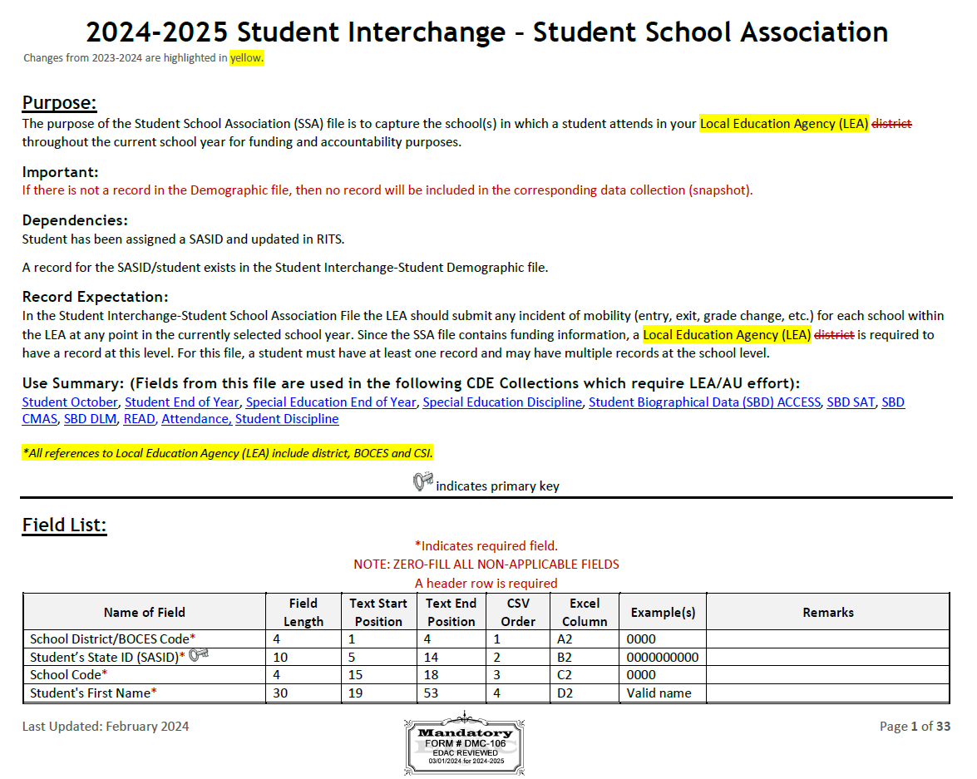
2024-2025 Student School Association
Definition Updates
Added 4 new yes/no fields for Alternative Instruction Courses (in response to PSF Act 1 CCR 301-39)
Independent Study Course
Work-Based Learning Opportunity Course
Blended Learning Course
Supplemental Online Course
2024-2025 Student Interchange – Brooke Wenzel
StudentOctober@cde.state.co.us

Slide 50
2024-2025 Graduation Guidelines and 2024-2025 Adjustment
Graduation Guidelines
Used during Student End of Year
Adjustment
Only used in specific circumstances during the Student End of Year Collection
Opens in May with the start of the Student End of Year Collection
2024-2025 Student Interchange – Brooke Wenzel
StudentOctober@cde.state.co.us

Slide 51
Student Interchange Timeline Document
Recommended Timeline under “Deadlines” on Student Interchange Website
Broad overview of the Student Interchange and how it is utilized throughout the year for data collections.
Has each month listed with prior year collection information (2023-2024) and current year collection information (2024-2025)
July shown as example:
2024-2025 Student Interchange – Brooke Wenzel
StudentOctober@cde.state.co.us

Slide 52
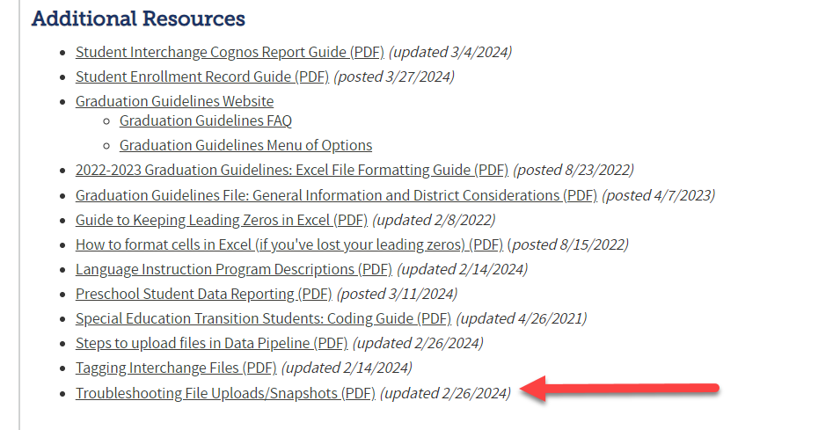
Troubleshooting File Uploads/Snapshots Document
Document posted under “Additional Resources” on Student Interchange Website
Goes through how to troubleshoot a file that fails to upload or a snapshot that fails to process
This process is close to what Collection Leads do when troubleshooting failed uploads!
Tons of screenshots of Data Pipeline emails and what to look for
2024-2025 Student Interchange – Brooke Wenzel
StudentOctober@cde.state.co.us

Slide 53
Student Interchange Summer Office Hours
Two identical Office Hours
July 24th, 10:00 – 11:30 a.m.
August 15th, 1:00 – 2:30 p.m.
Registration Links can be found on the Student Interchange Website under “Training”
Target Audience: New Respondents/Those who want a better understanding
Student Interchange Overview/Introduction
Resources
Fields
Errors at Interchange level
Year-round Uploads
What collections pull from Interchange
Data Pipeline
SIS Extraction
Uploading
Error Checking
Re-Uploading Interchange Files
2024-2025 Student Interchange – Brooke Wenzel
StudentOctober@cde.state.co.us

Slide 54
Questions & Resources: 2024-2025 Student Interchange
Brooke Wenzel
StudentOctober@cde.state.co.us
720-441-7963
Student Interchange Webpage

Slide 55
Attendance
Brooke Wenzel

Slide 56
Attendance Timeline
Date | Event | Event Description
04/17/2024 | Open | Districts may begin creating snapshots. Attendance Snapshot dependencies are the Student Demographic File and Student School Association File.
05/08/2024 10:30-12:00 p.m. | Training Event | Collection Overview Training
05/09/2024 | Interim Deadline | Upload Student Demographic and Student School Association Files
05/28/2024 | Interim Deadline | Create an initial Attendance Snapshot
06/12/2024 | Interim Deadline | Error free Student Interchange file uploads
06/26/2024 | Interim Deadline | Error free Attendance Snapshot
07/05/2024 | Report Review | Review Attendance Cognos Reports for data validation. Submit Attendance Snapshot data as soon as review is complete.
07/12/2024 | Deadline | Submit Attendance Snapshot data.
07/26/2024 | Deadline | Collection closes Superintendent Verification (sign-off) form due. Data remains embargoed until the official release in August.
08/16/2024 | Data Release | Official data release
See the Attendance website for collection timeline
Attendance – Brooke Wenzel
Attendance@cde.state.co.us

Slide 57
Quick Guide for Attendance Reporting
All attendance student-level data will be reported in the Student Interchange: Student School Association File
You need the STD~LEA User role to make any updates to the Student files OR
You will need to work with the Student Interchange respondent to make updates during the Attendance snapshot process
IDM Roles – Can be assigned by your LAM (Local Access Manager)
ATS roles have automatically been assigned to those that had SDA roles
You will need at least 1 person in your district assigned to LEAPPROVER
Application | Collection | Role | Internal Name
Pipeline | Student Interchange | LEA USER | -STD~LEAUSER
Pipeline | Attendance | LEA USER or APPROVER | -ATS~LEAUSER -ATS~LEAAPPROVER
Attendance – Brooke Wenzel
Attendance@cde.state.co.us

Slide 58
Creating Attendance Snapshot
Attendance Snapshot is now located under Student Profile!
Select Student Profile then Snapshot
Fill out prompts for Attendance (File Type: Attendance, School Year: 2023-24, Organization/LEA should auto-fill)
Attendance – Brooke Wenzel
Attendance@cde.state.co.us

Slide 59
AS020 – Known Issue
Error AS020 is not displaying in Cognos Error Report, please use Pipeline Error Report if you are receiving this error.
Please reach out to me if you run into any other issues – big move from SDA to STD and we could have missed something!
Attendance – Brooke Wenzel
Attendance@cde.state.co.us

Slide 60
Attendance Training
2023-2024 Collection Overview
May 8th, 2024
10:30-12:00 p.m.
Login information is posted on the Attendance Website under Training
Attendance – Brooke Wenzel
Attendance@cde.state.co.us

Slide 61
Questions & Resources: Attendance
Brooke Wenzel
Attendance@cde.state.co.us
720-441-7963
Attendance Webpage
Student Interchange Webpage

Slide 62
Thank you for joining today!
Next Town Hall will be April 25th
Missed a town hall?
Check out the Archived Town Hall Presentation site.
Archived agendas, presentations, and recordings posted for the last three months.

Slide 63
Collection Email Addresses
Additional support has been added to help manage emails for the CDE Team
Some emails may be signed as "Technical Help Support"
The data collection leads you know, and trust are:
Still responding and signing their names as needed
Training & assisting the Technical Help Support staff
Note: These email addresses are also posted on the Data Pipeline website and Contact list for reference
Data Collection | Email Addresses
Attendance | Attendance@cde.state.co.us
Directory | DirectoryData@cde.state.co.us
EDIS | EDIS@cde.state.co.us
Human Resources | HumanResourcesData@cde.state.co.us
READ Collections | ReadActData@cde.state.co.us
Report Card March | ReportCard@cde.state.co.us
RITS | RITS@cde.state.co.us
Special Ed December Count | SpedDecCount@cde.state.co.us
Special Ed Discipline | SpedDiscipline@cde.state.co.us
Special Ed End of Year | SpedEndOfYear@cde.state.co.us
Staff Evaluation | StaffEvaluation@cde.state.co.us
Student Discipline Snapshot | StudentDiscipline@cde.state.co.us
Student End of Year | StudentEndOfYear@cde.state.co.us
Student October Count | StudentOctober@cde.state.co.us
Teacher Student Data Link | TeacherStudentDataLink@cde.state.co.us

