Slide 1
April 11, 2024 Data Pipeline Town Hall
The goal of the webinar is to provide updates on the Data Pipeline, current, and upcoming data collections. These webinars also provide a forum for districts, BOCES, and Administrative Units to have questions answered about Data Pipeline.

Slide 2
Colorado Department of Education Identity Management (IdM)
Identity Management Site
Frequently Asked Questions
How do I add myself or others to the email listserv for town hall emails and/or a specific collection?
Email lists are dependent on a person’s access rights in IdM. Contact your LAM to get an account or be assigned to a specific collection.
Where can I find the IdM role mappings for Data Pipeline and other applications?
Role Mapping (XLS)
I am a LAM. How do I update the user permissions for someone in my district?
Follow the steps outlined in the IdM Quick Guide for Access Management (DOCX)
Important: Users are not automatically removed from IdM when their email address is no longer active in your district. The LAM must deactivate their IdM account to ensure only designated staff can access CDE’s data reporting system.

Slide 3
What is PII?
Student Personally Identifiable Information (PII) is defined by state and federal laws as information that, alone or in combination, personally identifies an individual
This includes direct identifiers (i.e. student and staff names, SASID, EDID, etc.)
Includes information that when combined is identifiable
Colorado’s Student Data Transparency and Security Act outlines requirements for how Student PII is collected, used and shared
See the Data Privacy and Security website for prepared guidance on how to comply with this and other privacy laws.

Slide 4
Sharing Data
Use secure methods to transfer any PII to CDE
Contact Data Collection leads with questions about how to transmit PII securely
Each Data Collection leads maintains their own Syncplicity folders for specific collections, reach out to the collection lead for access
Use Syncplicity to encrypt emails to CDE
Avoid sending PII via unencrypted email or to unsecured faxes when sharing data between or within districts
Use Syncplicity to encrypt emails to CDE
Check local policies for restrictions, requirements, etc. regarding PII
Do not use PII in trainings, presentations, etc.
Do not share PII with unauthorized individuals
Do not share passwords
Follow local policies when transmitting PII to any third party

Slide 5
Today’s Agenda
Agenda Topic | Presenter
Open Data Collections and Upcoming Deadlines in Data Pipeline
HB 24-1389 Newcomer Student Counts | Tim Kahle, Brooke Wenzel, Reagan Ward
READ Spring Assessment Reporting | Tara Rhodes
K-3 Literacy Programs & Assessment Reporting | Tara Rhodes
Summer EBT | Madeleine Breza
Student Discipline | Dawna Gudka
Special Education Discipline | Lindsey Heitman

Slide 6
Open Collections and Upcoming Deadlines in Data Pipeline

Slide 7
Open Collections and Upcoming Dates
Name | Category | Status | Key Dates
RITS | Year Round | Open
EDIS | Year Round | Open
Directory | Year Round | Open | Reduced Academic Calendar Applications 3/6/2024 to 5/10/2024 School Code Change Requests 2/5/2024 to 6/28/2024
Student | Interchange | Open | Interim Deadline: 4/11/24 upload initial GG file
Title I | Interchange | Open
Special Education IEP | Interchange | Open
Staff | Interchange | Open
TSDL | Interchange | Open
Discipline | Interchange | Coming Soon | Opens 4/15/2024
Data Pipeline Resources: Data Pipeline Collection Dates (XLS)

Slide 8
Open Collections and Upcoming Dates cont.
Name | Category | Status | Final Deadline Date | Deadline Milestone | Looking Ahead
TSDL | Snapshot | Open | Aug. 30, 2024
Attendance | Snapshot | Coming Soon | July 12, 2024 |  | Opens 4/17/2024
Student Discipline | Snapshot | Coming Soon | July 31, 2024 |  | Interchange file opens 4/15/2024
Student End of Year | Snapshot | Soft Open | Nov. 19, 2024 | Interim Deadline: Upload initial GG file by 4/11/2024 | Training Event: 04/22/24 Collaborative Webinar - SPED Transition Services
Report Card March | Periodic | Open | Apr. 12, 2024
S-EBT | Periodic | Open | Apr. 30, 2024
Special Education Discipline | Snapshot | Coming Soon | August 29, 2024 |  | Snapshot officially opens 5/1/2024
Special Education End of Year | Snapshot | Coming Soon | September 27, 2024 |  | Snapshot officially opens 5/1/2024
Data Pipeline Resources: Data Pipeline Collection Dates (XLS)

Slide 9
Newcomer Student Counts HB 24-1389
Tim Kahle, Brooke Wenzel, Reagan Ward

Slide 10
HB 24-1389 Introduction
On Friday, April 5, 2024, the legislature passed HB24-1389, which provides up to $24 million in one-time funding to help offset the cost for districts that have had an increase in the number of newly arrived English learners since the 2023-2024 Student October Count.
To receive House Bill 24-1389 funding, districts must submit an attestation form, signed by the local Superintendent or their designee, which certifies counts provided by both CDE (based on prior submitted district data) and the district.
Attestation must be completed and submitted by 4/23/24.
Prior to attesting to these counts, district superintendents (or their designee) will be required to complete the "Intent to Participate" form.
Intent to Participate must be complete and submitted by 4/15/24.
HB 24-1389
Funding for Newcomer Students

Slide 11
HB 24-1389: One-Time Additional Funding for Newcomer Students entering after the Student October count date for 2023-2024 school year
Two-part distribution of additional funds for the 2023-2024 budget year
Requires districts to provide additional data to CDE
Total Number of Newcomers
⁺
Net Enrollment
⁼
Total $ District Distribution
Part 1: “Fixed-Cost” Funding
Funding is guaranteed to any district that enrolled newcomer students after Student October Count
Fixed “tiered” amount
Part 2: “Net-Enrollment” Funding
Funding is provided for extraordinary enrollment increases (over and above October Count enrollment)
This funding is provided on a $4,500 per pupil basis, which could be prorated up or down based on available funding.
The total number for this funding cannot exceed the Total # of Newcomers from Part I
HB 24-1389
Funding for Newcomer Students

Slide 12
Funding Components
Part 1: Fixed Cost
Part 2: Net Enrollment
4,500* per pupil
Prorated up or down based on available funds
Tier # | Newcomer Enrollment | Total Funding
0 | 0 | 0
1 | 1 – 5 | $15,000
2 | 6 – 10 | $30,000
3 | 11 – 30 | $75,000
4 | 31 – 50 | $125,000
5 | 51 – 100 | $200,000
6 | 101 – 200 | $400,000
7 | 201 – 500 | $550,000
8 | 501 + | $750,000
HB 24-1389
Funding for Newcomer Students

Slide 13
Funding Examples
District A
District B
CDE Data: Newcomers on ACCESS = 9
District Data: Newcomers 2/10 to 2/29 = 4
CDE Data: K-12 October Count 2023-2024 = 200
District Data: 2/29 Count of Students = 205
CDE Data: Newcomers on ACCESS = 1,000
District Data: Newcomers 2/10 to 2/29 = 150
CDE Data: K-12 October Count 2023-2024 = 38,000
District Data: 2/29 Enrollment Count = 38,700
HB 24-1389
Funding for Newcomer Students

Slide 14
District A Example
Tier # | Newcomer Enrollment | Total Funding
0 | 0 | 0
1 | 1 – 5 | $15,000
2 | 6 – 10 | $30,000
3 | 11 – 30 | $75,000
4 | 31 – 50 | $125,000
5 | 51 – 100 | $200,000
6 | 101 – 200 | $400,000
7 | 201 – 500 | $550,000
8 | 501 + | $750,000
9
CDE Data: Access Newcomer Count
⁺
4
District: Newcomers 2/10-2/29
⁼
13
Total Number of Newcomers
205
District: 2/29 Count of Enrolled Students
200
CDE Data:
Student October Count of K-12 Students
⁻
⁼
5
Net Enrollment
5 x $4,500 per pupil* = $22,500
*prorated based on funds
Total District Distribution:
$97,500
HB 24-1389
Funding for Newcomer Students

Slide 15
District B Example
Tier # | Newcomer Enrollment | Total Funding
0 | 0 | 0
1 | 1 – 5 | $15,000
2 | 6 – 10 | $30,000
3 | 11 – 30 | $75,000
4 | 31 – 50 | $125,000
5 | 51 – 100 | $200,000
6 | 101 – 200 | $400,000
7 | 201 – 500 | $550,000
8 | 501 + | $750,000
1,000
CDE Data: Access Newcomer Count
⁺
150
District: Newcomers 2/10-2/29
⁼
1,150
Total Number of Newcomers
38,700
District: 2/29 Count of Enrolled Students
38,000
CDE Data:
Student October Count of K-12 Students
⁻
⁼
700
Net Enrollment
700 x $4,500 per pupil* = $3,150,000
*prorated based on funds
Total District Distribution:
$3,900,000
HB 24-1389
Funding for Newcomer Students

Slide 16
Data used for Calculations
In lieu of a formal count CDE will use data the department already has coupled with data from districts to generate two numbers.
(Total # of newcomers & net enrollment change)
CDE Data:
ACCESS for ELLs Number of Newcomers after Student October through 2/9/2024
District Provided: Count of Newcomers from 2/10 – 2/29
⁺
⁼
Total Number of Newcomers
District Provided: Student Enrollment as of 2/29
CDE Data:
2023-2024 Student October Enrollment Count of K-12 Students
Net Enrollment
⁻
⁼
HB 24-1389
Funding for Newcomer Students

Slide 17
2023-2024 Student October Count
CDE Data
K-12 students counted in pupil membership for Student October 2023-2024
Data is publicly posted to the website can be found on the Pupil Membership Statistics page
Notes:
Make sure you are viewing K-12 counts and are including Detention Center students
HB 24-1389
Funding for Newcomer Students

Slide 18
ACCESS for ELLs: Number of Newcomers after October Count through 2/9/2024
CDE Data
ACCESS reported SASID was not funded in October 2023-2024
If SASID was reported in OCT with a funding code of 86/87/96 they remain eligible if they meet the next criteria
AND
SASID has a ‘date first enrolled in the US’ 10/03/2023 to 02/09/2024 as reported on ACCESS
If date first enrolled in US reported on ACCESS is 10/2/2023 or before excluded because outside the definitions in the legislation
If date first enrolled in US reported on ACCESS is 02/10/24 or after excluded because they are part of the District provided data (per legislative definition)
2024 Total ACCESS Count | 2024 Students in ACCESS AND reported in Student October as funded | 2024 Students in ACCESS, not in or funded in Student October, with a Date First Enrolled in the US before Oct 3 | 2024 Students in ACCESS, not in or funded in Student October, with a Date First Enrolled in the US after Feb 9 | 2024 Students in ACCESS, not in or funded in Student October, with a Date First Enrolled in the US missing in ACCESS File | 2024 Students in ACCESS, not in Student October, with a Date First Enrolled in the US between Oct 3 and Feb 9
# | # | # | # | # | #
HB 24-1389
Funding for Newcomer Students

Slide 19
Count of Newcomers from 2/10 – 2/29
District Provided
District Provide counts based on following logic:
Primary School = ‘1’ (school of accountability/primary enrollment record)
Grade Levels K-12 (006-120)
Pupil Attendance Information Codes 01-08 (student must be attending an educational program operated by the reporting district)
All Funding Codes, including non-eligible students
Students with Language Proficiency Codes = ‘1’ (NEP) or ‘2’ (LEP)
Students with Date First Enrolled in U.S. between February 10th, 2024, and February 29th, 2024.
Students with School Exit Date that does not equal (<>) February 29th, 2024, or earlier.
HB 24-1389
Funding for Newcomer Students

Slide 20
Student Enrollment as of 2/29
District Provided
District Provide counts based on following logic:
Primary School = ‘1’ (school of accountability/primary enrollment record)
Grade Levels K-12 (006-120)
Pupil Attendance Information Codes 01-08 (student must be attending an educational program operated by the reporting district)
All Funding Codes, including non-eligible students.
Students with School Exit Date that does not equal (<>) February 29th, 2024, or earlier.
Funding for Newcomer Students
HB 24-1389

Slide 21
Timeline
Date | Event | Event Description
4/15/2024 | Deadline | Submit ‘Intent to Participate’ form indicating District plans to participate in this count with a point of contact (Superintendent or Designee).
4/16/2024 | CDE Generates DocuSign | Sent to Superintendent/Designee indicated on intent to participate form
4/23/2024 | Deadline | Submit completed DocuSign with district provided data
5/1/2024 | CDE Notification to Districts | CDE provides notification to districts of funding allocation
5/30/2024 | CDE Funds Distribution | Latest date by which CDE distributes funding to districts
HB 24-1389
Funding for Newcomer Students

Slide 22
Questions & Resources: HB 24-1389 Newcomer Counts
ACCESS Counts: Brooke Wenzel
Wenzel_b@cde.state.co.us
District Provided Data: Reagan Ward
Ward_r@cde.state.co.us
Funding: Tim Kahle
Kahle_t@cde.state.co.us

Slide 23
READ Spring Assessment Reporting
Tara Rhodes

Slide 24
READ Data Collections Overview
The READ Act provides per-pupil intervention funds to assist LEPs in providing intervention support to students identified as having significant reading deficiencies (SRDs).
For the 2023-24 reporting window, there are three file uploads required in Data Pipeline in order for a district to successfully complete the READ data collection:
2023-24 Spring READ Assessment Data (DUE 6/14/24)
2024-25 Literacy Programs & Assessment Data (DUE 6/28/24)
2024-25 Teacher Training Completion Data (DUE 8/30/24)
READ Act Data Collections – Spring Assessment Data
Readactdata@cde.state.co.us

Slide 25
READ Data Collections Purpose and Criteria
Purpose: Districts must annually report the data necessary to determine the prevalence of SRDs among K-3 students. This data determines the per-pupil funding for districts by dividing the amount of money available by the total number of K-3 students identified as having an SRD in the preceding budget year. Districts must also report whether students in grades 4-12th grade remain on a READ plan or not.
Criteria: Districts are required to report student level READ Act administered interim assessments along with the student’s score, READ plan status, intervention supports, and demographic data. All K-3 students enrolled in the district at the time of data submission are required to be reported. In addition, all 4-12th grade students who exited 3rd grade on a READ plan.
Link to view the READ data collections website:
https://www.cde.state.co.us/coloradoliteracy/readdatapipeline
READ Act Data Collections – Spring Assessment Data
Readactdata@cde.state.co.us

Slide 26
READ Data Collections Purpose and Criteria Cont.
Spring READ Assessment reporting window is scheduled to open April 10, 2024 and is scheduled to close June 14, 2024.
Timeline:
• April 10, 2024: Data collection opens, and files may be uploaded in Data Pipeline
• June 14, 2024: Date by which district must have error free and locked file in the Status Dashboard
• June 21, 2024: CDE conducts cross LEA validation process and districts will work with each other to remove duplicate SASIDS
• June 28, 2024: Date by which district must have file resubmitted with duplicate SASIDs removed
• July 25, 2024: CDE sends emails to data respondents with final SRD numbers through Data Pipeline for district confirmation
• July 29, 2024: CDE sends emails to superintendents with final SRD numbers
READ Act Data Collections – Spring Assessment Data
Readactdata@cde.state.co.us

Slide 27
READ Data Collections Changes for 23-24 Collection
There were no changes to the file layout for the Spring READ assessment data reporting for the 23-24 collection.
However, there have been updates to cut scores as well as approved programs. Please review the updates here: https://www.cde.state.co.us/coloradoliteracy/readactassessments
READ Act Data Collections – Spring Assessment Data
Readactdata@cde.state.co.us

Slide 28
Questions & Resources: READ Spring Assessments
Email: ReadActData@cde.state.co.us
Website: https://www.cde.state.co.us/coloradoliteracy/readdatapipeline

Slide 29
K-3 Literacy Programs & Assessment Reporting
Tara Rhodes

Slide 30
Literacy Programs & Assessment Reporting Purpose and Criteria
Purpose: The 2019 updates to the READ Act (SB19-199) require that districts report their K-3 instructional literacy programs and READ Act interim and diagnostic assessments by school and grade level (K-3). In addition, districts that use READ Act money and/or Early Literacy Grant funding for teacher professional development must provide information on how their professional development plan aligns to scientific and evidence-based literacy instruction. This requirement is annual, regardless of whether districts are eligible for biennial UIP flexibility.
Criteria: For the 24-25 school year, districts are required to report the READ Act administered interim and diagnostic assessments along with their core, supplemental, and intervention instructional literacy programs for grades K-3 for each school in their district (including charter schools)
Link to view the READ data collections website:
https://www.cde.state.co.us/coloradoliteracy/readdatapipeline
READ Act Data Collections – Literacy Programs
ReadActData@cde.state.co.us

Slide 31
Literacy Programs & Assessment Reporting Timeline
Literacy Programs & Assessment reporting window is scheduled to open on April 17, 2024 and close June 28, 2024.
Timeline:
• April 17, 2024: Data collection opens, and files may be uploaded in Data Pipeline
• June 28, 2024: Date by which district must have error free and locked file in the Status Dashboard
READ Act Data Collections – Literacy Programs
ReadActData@cde.state.co.us

Slide 32
Literacy Programs & Assessment Reporting Changes for 24-25 Collection
There were no changes to the ordering or inclusion of fields in the file layout for the literacy programs and assessment data reporting for the 24-25 collection.
However, a few field lengths were adjusted for the core, supplemental, and intervention programming code fields.
Additionally, updates have been made to the advisory list for the instructional programming. Please review the updates here: https://www.cde.state.co.us/coloradoliteracy/advisorylistofinstructionalprogramming2020
READ Act Data Collections – Literacy Programs
ReadActData@cde.state.co.us

Slide 33
READ Data Collections Preparation for Collection Openings
Steps to Take to Prepare for the Collection Opening:
For Spring READ Assessment Data Reporting:
• Begin having conversations with the READ leads in your district to see if any programming changes are planned for next year.
• The interim and diagnostic lists have been updated for the 2024-25 school year. Please reference this link to see which assessments will no longer be available for the 24-25 school year and which ones are new.
For Literacy Programs and Assessment:
• Extract your data file from the last reporting cycle to see what has been reported historically.
READ Act Data Collections – Spring Assessment Data
Readactdata@cde.state.co.us

Slide 34
Questions & Resources: K-3 Literacy Programs & Assessments
Email: ReadActData@cde.state.co.us
Website: https://www.cde.state.co.us/coloradoliteracy/readdatapipeline

Slide 35
Summer EBT
Madeleine Breza

Slide 36
Summer EBT Data Collection
Collection will open April 1 through April 30
All districts required to submit student level data by due date
USDA updated guidance providing more flexibility in requirements:
Submit data for National School Lunch program sites only
Submit data for NSLP sites PLUS any Free and Reduced eligible transfer students to non-NSLP sites during the school year(any students that was enrolled at a NSLP site, even for a short period of time, would be eligible for S-EBT benefits)
Submit data for all enrolled students at both NSLP sites and non NSLP sites*
Summer EBT
s-ebt@cde.state.co.us

Slide 37
S-EBT File Layout
 | Name of Field | Field Length | Text Start Position | Text End Position | CSV Order | Excel Column | Examples | Remarks
1 | School District Code* | 4 | 1 | 4 | 1 | A2 | 0000
2 | School Code* | 4 | 5 | 8 | 2 | B2 | 0000
3 | Entry Date* | 8 | 9 | 16 | 3 | C2 | 08152021 | Format is MMDDYYYY
4 | Exit Withdraw Date* | 8 | 17 | 24 | 4 | D2 | 10152021 | Format is MMDDYYYY; 0 fill if N/A
5 | Student’s State ID (SASID)* | 10 | 25 | 34 | 5 | E2 | 0000000000
6 | Local ID (LASID)* | 10 | 35 | 44 | 6 | F2 | 0000000000
7 | Student’s First Name* | 30 | 45 | 74 | 7 | G2 | Valid Name
8 | Student’s Middle Name* | 30 | 75 | 104 | 8 | H2 | Valid Name | NMN if none
9 | Student’s Last Name* | 30 | 105 | 134 | 9 | I2 | Valid Name
10 | Student’s Gender* | 2 | 135 | 136 | 10 | J2 | 01, 02
11 | Student’s Date of Birth* | 8 | 137 | 144 | 11 | K2 | 08152008 | Format is MMDDYYYY
12 | Student’s Grade Level* | 3 | 145 | 147 | 12 | L2 | 060
13 | Student’s Language Background | 3 | 148 | 150 | 13 | M2 | ENG
14 | Primary Parent/Guardian First Name* | 30 | 151 | 180 | 14 | N2 | Valid Name
15 | Primary Parent/Guardian Last Name* | 30 | 181 | 210 | 15 | O2 | Valid Name
16 | Primary Parent/Guardian Telephone Number | 10 | 211 | 220 | 16 | P2 | 5551231234; None
17 | Student’s Primary Mailing Address 1* | 44 | 221 | 264 | 17 | Q2 | 123 Star Quarry Road
18 | Student’s Primary Mailing Address 2 | 42 | 265 | 306 | 18 | R2 | Apt. 2 | Try to avoid special characters, i.e., #, &, @, etc.
19 | Student’s Primary Mailing City* | 50 | 307 | 356 | 19 | S2 | Nowhere
20 | Student’s Primary Mailing State* | 2 | 357 | 358 | 20 | T2 | CO
21 | Student’s Primary Mailing Postal Code* | 10 | 359 | 368 | 21 | U2 | 99999-0000, 99999
22 | Free/Reduced Lunch Price Eligible* | 2 | 369 | 370 | 22 | V2 | 00, 01, 02
23 | FRPL Eligibility Date | 8 | 371 | 378 | 23 | W2 | 10152021 | Format is MMDDYYYY
Summer EBT
s-ebt@cde.state.co.us

Slide 38
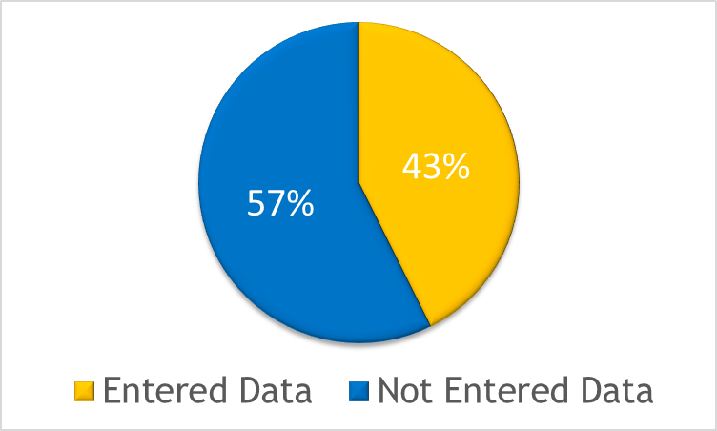
Submissions
*32/182 districts have submitted their final data
Summer EBT
s-ebt@cde.state.co.us

Slide 39
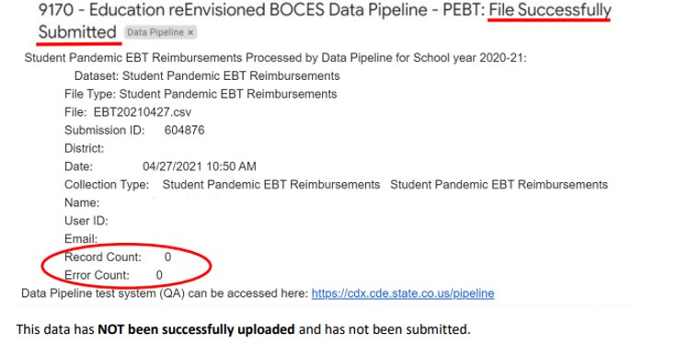
Common Errors
Common Error – Converting to excel losing leading zeros
Follow the formatting instructions posted on the data pipeline website
Common Error – No records uploaded
Summer EBT
s-ebt@cde.state.co.us

Slide 40
SIS Vendors
Infinite Campus Update
Infinite Campus has not updated their S-EBT export. The changes from the P-EBT to the S-EBT don't include any new columns. Districts can run the extraction and remove the columns highlighted in yellow before submitting. The columns to delete are V (Non-School Program Code) and everything after X (FRPL Eligibility Date). It may also be necessary to convert the csv file to excel.
If your report is only generating at a semester level versus the entire school year data, you will want to combine S1 & S2 data, and filter to remove duplicative students and run a cross reference of benefits. If a student was eligible at any point of the school year, submit the eligible status in the report.
*Please let us know if you are having issues with your SIS Vendor
Summer EBT
s-ebt@cde.state.co.us
Notes:
We’ve also reached out to Infinite Campus

Slide 41
Questions & Resources: Summer EBT
S-EBT General Email
Data Collection FAQ
School Nutrition Summer-EBT webpage
Data Pipeline S-EBT webpage
Office Hours Sign-up

Slide 42
Student Discipline
Dawna Gudka

Slide 43
Student Discipline: Collection Timeline
Date | Event | Event Description
March 20th | Webinar Training | 9-10AM Recording
April 15th | Interchange | Student Demographics, and Student School Association files need to be updated
April 15th | Discipline Interchange Opens | LEA’s can begin uploading the discipline by action interchange file
May 6th | Discipline Snapshot Opens | LEA’s can create a Student Discipline Snapshot
May 8th | Target deadline | LEA’s must upload at least one discipline interchange file
May 24th | Interchange files updated | LEA’s must update and upload the student demographics and student school association files into Data Pipeline
June 5th | Office Hours | 9-10AM Click here to join the meeting
June 14th | Target deadline | Interchange files error free
June 21st | Target deadline | Create at least one student discipline snapshot
July 8th | Target deadline | Discipline snapshot is error free
July 31st | DEADLINE | All LEA’s must have Student Discipline Snapshot approved and submitted to CDE
Student Discipline Snapshot
Student Discipline Snapshot email

Slide 44
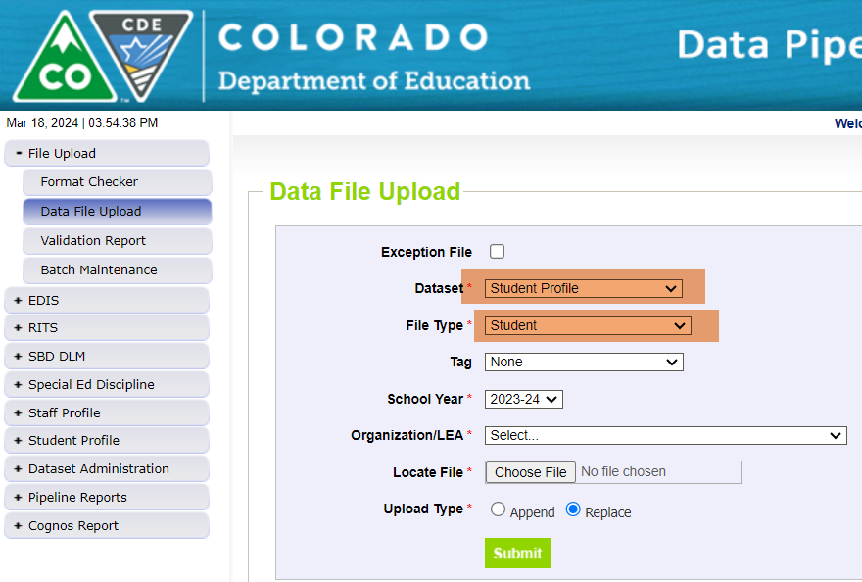
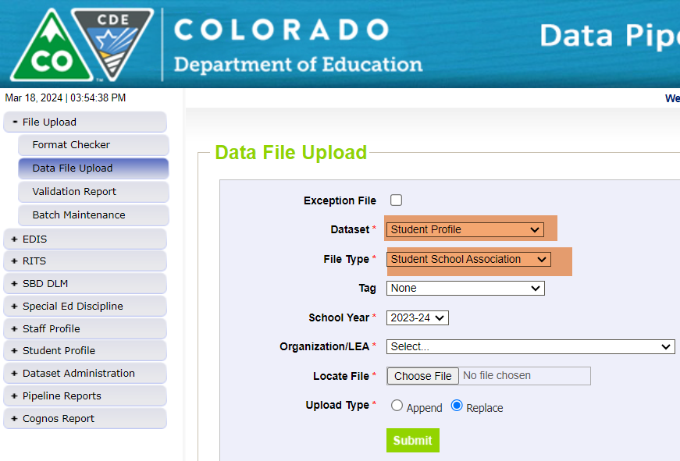
Student Discipline Snapshot Collection Preparing for the Student Discipline Interchange to OPEN-Upload Student Interchange files Student Demographics and Student School Association
What can I do to prepare for the Student Discipline Interchange to open?
Upload your current Student Profile (demographics) file
Upload your current Student School Association file
Discipline by Action interchange will open April 15th
Student Discipline Snapshot Collection
Student Discipline Snapshot Email

Slide 45
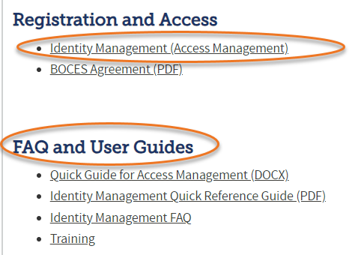
Student Discipline Snapshot Collection Roles in Identity Management System (IdM)
Identity Management (IdM)
Student Interchange Roles
STD-VIEWER
STD-LEAUSER
Discipline Interchange Roles
DIS-LEAVIEWER
DIS-LEAUSER
Discipline Snapshot Roles
STU-LEAVIEWER
STU-LEAUSER
STU-LEAAPPROVER
*Note: can only have 1 role under each role category
or you will get locked out of Data Pipeline
Student Discipline Snapshot Collection
Student Discipline Snapshot Email

Slide 46
Questions & Resources: Student Discipline
Student Interchange website
Student Demographics file layout
Student School Association file layout
Discipline Interchange website
Discipline file layout
Student Discipline Snapshot website
Student Discipline Snapshot file layout
Dawna Gudka-collection lead
(303) 598-7901
Email Student Discipline Snapshot

Slide 47
Special Education Discipline
Lindsey Heitman

Slide 48
Special Education Discipline Snapshot Opening Soon
Special Education Discipline Interchange 23-24 will open 4/15
NOTE: File layout has changed
District respondents upload one Discipline Action file that includes ALL students
Must have DIS User Role to upload the file
File is at the student level and should include all disciplinary incidents and resulting actions that occurred between 7/1/2023 – 6/30/2024 (a record for each action and the associated incident)
Special Education Discipline Snapshot 23-24 will open 5/1
AUs will need the SPI Approver or User role and may start creating snapshots once the district has begun uploading the Discipline Action file
No change in the data fields that are pulled into this snapshot from the Discipline Action File
Data Pipeline Webpage Resources:
Data Pipeline Home - bookmark for quick access to all the Data Pipeline Resources: Interchanges, Snapshots, Year-Round, Periodic, Trainings (Town Halls), Frequently Requested Codes, and more.
Discipline Interchange – Discipline Action File Layout, Timeline, Excel Template
Special Education Discipline Snapshot - Snapshot File Layout, Timeline (same as the one posted on the Discipline Interchange page)
Special Education Discipline
SpedDiscipline@cde.state.co.us

Slide 49
Special Education Discipline Snapshot First Snapshot Training
Webinar Training Date:
Monday April 15th 1:00 – 2:30
Who should attend? District data respondents with DIS role and AU data respondents with SPI role
Microsoft Teams meeting
Click here to join the meeting
Meeting ID: 285 117 173 53 Passcode: WvKNkh
Or call in (audio only)
+1 929-341-4269 280130110#
Phone Conference ID: 280 130 110#
Special Education Discipline
SpedDiscipline@cde.state.co.us

Slide 50
Questions & Resources: SPED Discipline
Discipline Interchange
Special Education Discipline Snapshot
SpedDiscipline@cde.state.co.us
Collection Lead:
Lindsey Heitman Heitman_l@cde.state.co.us

Slide 51
Thank you for joining today!
Next Town Hall will be April 18th
Tip: Bookmark the Data Pipeline home page and the IdM landing page.
These two sites help respondents navigate to the collection websites and tools needed as a data respondent.

Slide 52
Collection Email Addresses
Additional support has been added to help manage emails for the CDE Team
Some emails may be signed as "Technical Help Support"
The data collection leads you know, and trust are:
Still responding and signing their names as needed
Training & assisting the Technical Help Support staff
Note: These email addresses are also posted on the Data Pipeline website and Contact list for reference
Data Collection | Email Addresses
Attendance | Attendance@cde.state.co.us
Directory | DirectoryData@cde.state.co.us
EDIS | EDIS@cde.state.co.us
Human Resources | HumanResourcesData@cde.state.co.us
READ Collections | ReadActData@cde.state.co.us
Report Card March | ReportCard@cde.state.co.us
RITS | RITS@cde.state.co.us
Special Ed December Count | SpedDecCount@cde.state.co.us
Special Ed Discipline | SpedDiscipline@cde.state.co.us
Special Ed End of Year | SpedEndOfYear@cde.state.co.us
Staff Evaluation | StaffEvaluation@cde.state.co.us
Student Discipline Snapshot | StudentDiscipline@cde.state.co.us
Student End of Year | StudentEndOfYear@cde.state.co.us
Student October Count | StudentOctober@cde.state.co.us
Teacher Student Data Link | TeacherStudentDataLink@cde.state.co.us

