Slide 1
April 3, 2025
Data Pipeline Town Hall
The goal of the webinar is to provide updates on the Data Pipeline, current, and upcoming data collections. These webinars also provide a forum for districts, BOCES, and Administrative Units to have questions answered about Data Pipeline.

Slide 2
Colorado Department of Education
Identity Management (IdM)
Identity Management Site
Frequently Asked Questions
How do I add myself or others to the email listserv for town hall emails and/or a specific collection?
  Email lists are dependent on a person’s access rights in IdM. Contact your LAM to get an account or be assigned to a specific collection.
Where can I find the IdM role mappings for Data Pipeline and other applications?
  Role Mapping (XLS)
I am a LAM. How do I update the user permissions for someone in my district?
  Follow the steps outlined in the IdM Quick Guide for Access Management (DOCX)
Important: Users are not automatically removed from IdM when their email address is no longer active in your district. The LAM must deactivate their IdM account to ensure only designated staff can access CDE’s data reporting system.
Notes:
LAMs, please check the IdM roles for your district. Remove permissions for users who have retired, left your district, or are no longer assigned to a collection. Add roles for new hires and newly assigned respondents for specific collections.

Slide 3

What is PII?
Student and Staff Personally Identifiable Information (PII) is defined by state and federal laws as information that, alone or in combination, personally identifies an individual
  This includes direct identifiers
  (i.e. student and staff names, SASID, EDID, etc.)
  Includes information that when combined is identifiable
Colorado’s Student Data Transparency and Security Act outlines requirements for how Student PII is collected, used and shared
See the Data Privacy and Security website for prepared guidance on how to comply with this and other privacy laws.

Slide 4

Sharing Data
Use secure methods to transfer any PII to CDE
  Contact Data Collection leads with questions about how to transmit PII securely
    Each Data Collection leads maintains their own Syncplicity folders for specific collections, reach out to the collection lead for access
  Use Syncplicity to encrypt emails to CDE
Avoid sending PII via unencrypted email or to unsecured faxes when sharing data between or within districts
  Use Syncplicity to encrypt emails to CDE
Check local policies for restrictions, requirements, etc. regarding PII
  Do not use PII in trainings, presentations, etc.
  Do not share PII with unauthorized individuals
  Do not share passwords
  Follow local policies when transmitting PII to any third party

Slide 5
Today’s Agenda
Agenda Topic | Presenter
Open Data Collections and Upcoming Deadlines in Data Pipeline | Host: Lindsey Heitman
READ Collections | Tara Rhodes
Student Attendance | Peter Hoffman
Student End of Year | Reagan Ward
Student Discipline | Dawna Gudka
RITS Merge Updates | Jessica Tribbett
New! Instructional Days and Hours Collection | Jessica Tribbett
Special Education Discipline | Lindsey Heitman
Special Education End of Year | Lindsey Heitman

Slide 6
Open Collections and
Upcoming Deadlines in
Data Pipeline

Slide 7
Open Collections and Upcoming Dates:
Year-Round & Interchanges
Name | Category | Status | Key Dates
RITS | Year Round | Open | N/A
EDIS | Year Round | Open | N/A
Directory | Year Round | Open | Reduced Academic Calendar: 2/5/2025 to 5/9/2025 School Code Change Requests: 2/5/2025 to 6/30/2025
Student | Interchange | Open | April Recommendation: Upload GG by 4/10
At-Risk | Interchange | Closed | N/A
Title I | Interchange | Open | May 2025: Update file in preparation for SEY and ATS reporting
Special Education IEP | Interchange | Open | Special Education EOY Snapshot soft open now
Staff | Interchange | Open | Staff Evaluation Interchange opens 5/21/25
Discipline Action | Interchange | Open | This interchange file is needed for Student Discipline Snapshot and Special Education Discipline Snapshot Collections
Teacher Student Data Link | Interchange | Open | Upload an interchange file at least once by 5/16/2025
Data Pipeline Resources: Data Pipeline Collection Dates (XLS)

Slide 8
Open Collections and Upcoming Dates:
Snapshots
Name | Category | Status | Final Deadline Date | Next Milestone | Looking Ahead
Teacher Student Data Link | Snapshot | Open | Aug. 29, 2025 | Upload an interchange file at least once: 5/16/2025
Student End of Year | Snapshot | Soft Open | Dec. 2, 2025 | Other Date: 4/10/2025—Upload GG file and review COGNOS reports to monitor GG | Training Event: Special Education 18-21 Transition Services Collaborative Webinar—4/22/2025, 1:00-2:00pm
Student Attendance | Snapshot | Coming Soon | July 25, 2025 | Interim Deadline: Upload SSA/DEM files by 5/09 | Snapshot Opens: 4/16/2025 Collection Training 5/7/2025
Special Education Discipline | Snapshot | Coming Soon | Aug. 1, 2025 |  | Snapshot Opens: 5/1/2025
Student Discipline | Snapshot | Coming Soon | July 31, 2025 |  | Snapshot Opens: 5/1/2025
Special Education EOY | Snapshot | Coming Soon | Oct. 3, 2025 |  | Snapshot Opens: 5/1/2025
Data Pipeline Resources: Data Pipeline Collection Dates (XLS)

Slide 9
Open Collections and Upcoming Dates:
Periodic
Name | Category | Status | Final Deadline Date | Next Milestone | Looking Ahead
Summer EBT | Periodic | Closed | Feb. 28, 2025 | Collection Closes: 2/28/2025 LEAs must submit an error-free file | Corrections Period: 5/19/2025 to 9/3/2025
Report Card March | Periodic | Open | Apr. 11, 2025
Alternative Education Campus | Periodic | Open | Jun. 27, 2025 | Application/Renewal File: 3/19/25 to 4/25/25 Planned Measures File: 3/19/2025 to 6/27/2025 | Actual Measures File: 5/19/25 to 6/27/25
READ Spring Assessments | Periodic | Coming Soon | June 13, 2025 | Collection Opens 4/15/25 | Other Date: 5/15/2025 target initial upload date
READ Literacy Programs & Assessments | Periodic | Coming Soon | June 13, 2025 | Training Event: 4/8/25, 1-2pm | Collection Opens 4/15/25
Data Pipeline Resources: Data Pipeline Collection Dates (XLS)

Slide 10
READ Collections
Tara Rhodes

Slide 11
Spring READ Assessment

Slide 12
READ Act District Reporting Requirements
Districts must annually report the information necessary to determine the prevalence of SRDs among students in grades K-3.
This data determines the per-pupil funding for districts by dividing the amount of money available by the total number of K-3 students identified as having an SRD in the preceding budget year. Districts must also report whether students in grades 4-12 remain on a READ plan.
The data provided in this report will be publicly reported and will enable the department to calculate district funding.
The 2024-25 collection will run from 4/15/2025 through 6/13/2025.
READ Act Data Collections – Spring READ Assessment
READActData@cde.state.co.us

Slide 13
Spring READ Assessment:
Changes for 24-25
No structural changes to the file layout (no addition/deletion of fields).
Drop-down menus in Pipeline have been updated to "READ Assessment" for clarity.
Some assessments were removed. These are ones that are no longer approved.
Cleaned up language and standardized field names.
For example, the SRD Status field is now labeled as such.
Altered the sign-off form to include the count of SRD as well as the SRD percentage for the district.
Please have the appropriate staff review this at your district before submitting your data!
READ Act Data Collections: Spring READ Assessment
READActData@cde.state.co.us

Slide 14
Spring READ Assessment:
Reminders
As you are approaching your assessment window, please make sure that all kindergarten through 3rd grade students are assessed.
Please also make sure that: 1. all enrolled kindergarten through 3rd grade students are included in your file submission; and 2. the students noted on your cohort report in 4th-12th grade.
Please make sure that you have confirmed and coded the correct assessment for each student in your file submission. This affects the identification of students with significant reading deficiencies in your submission.
READ Act Data Collections: Spring READ Assessment
READActData@cde.state.co.us

Slide 15
READ Literacy Programs and Assessment

Slide 16
READ Literacy Programs and Assessment:
Changes for 25-26
Changes:
No structural changes to the file layout (no addition/deletion of fields).
Drop-down menus in Pipeline have been updated to "READ Literacy" for clarity.
Three codes were added to the file layout for three programs that came up during last year's collection.
Reminders:
As a reminder, this collection looks ahead to next school year (25-26). Please either submit or work with district leaders to submit any school code changes before the 6/30 deadline so that your school list is accurate for this collection.
Please also work with any other district personnel to ensure that any changes for programming for next year are reflected in this collection.
READ Act Data Collections – READ Literacy
READActData@cde.state.co.us

Slide 17
Collection Timeline
Date | Event | Event Description
4/1/2025 | Training Event | Training Webinar for Spring READ Assessment Data Collection (Recorded)
4/8/2025 | Training Event | Training Webinar for READ Literacy Programs and Assessment, 1-2pm
4/15/2025 | Collection Open | Spring READ Assessment and READ Literacy Programs and Assessment data collections open.
5/15/2025 | Other Date | Target date for preliminary uploads
6/6/2025 | Other Date | Target date for error-free submission
6/6/2025 | Report Review | Assuming an error-free upload, this week can be used to verify the accuracy of the data submitted through the available reports in Cognos.
6/13/2025 | Collection Close | Spring READ Assessment and READ Literacy Programs and Assessment data collections close
READ Act Data Collections
READActData@cde.state.co.us

Slide 18
READ Training

Slide 19
READ Training:
General Information and Action Steps
General Information
Data Collection Dates: 8/1/2025 - 8/30/2025
READ Training Data Collection Webinar: 7/15/2025 from 1-2pm
Our training team is hosting a series of office hours as well, which are focused more on the training requirements but I will be presenting some information around the data components. Those are being held:
April 22, 2025 from 3-4pm
May 20, 2025 from 3-4pm
Please make sure that anyone who is required to take the training does so before August 1, 2025.
READ Act Data Collections – READ Training
READActData@cde.state.co.us

Slide 20
READ Act Data Collections:
Resources
Resources:
Updated webpages
  Spring READ Assessment
  READ Literacy Programs and Assessment
  READ Training
Working to get the recording from Tuesday and slide deck up on the website as well.
READ Act Data Collections
READActData@cde.state.co.us

Slide 21
Questions & Resources:
READ Collections
Tara Rhodes
READActData@cde.state.co.us
Phone: 720.601.4125

Slide 22
Student Attendance
Peter Hoffman

Slide 23
Student Attendance Collection Timeline
Date | Event | Event Description
04/16/2025 | Open | Districts may begin creating snapshots. Attendance Snapshot dependencies are the Student Demographic File and Student School Association File.
05/07/2025 10:30-12:00 p.m. | Training Event | Collection Overview Training. Registration link here. Can also be found on the Attendance Website.
05/09/2025 | Interim Deadline | Upload Student Demographic and Student School Association Files
05/23/2025 | Interim Deadline | Create an initial Attendance Snapshot
06/11/2025 | Interim Deadline | Error free Student Interchange file uploads
06/20/2025 | Interim Deadline | Submit any necessary reporting exceptions for review.
06/27/2025 | Interim Deadline | Error free Attendance Snapshot
07/03/2025 | Report Review | Review Attendance Cognos Reports for data validation. Submit Attendance Snapshot data as soon as review is complete.
07/11/2025 | Deadline | Submit Attendance Snapshot data.
07/25/2025 | Deadline | Collection closes Superintendent Verification (sign-off) form due. Data remains embargoed until the official release in August.
08/21/2025 | Data Release | Official data release
Student Attendance – Peter Hoffman
Attendance@cde.state.co.us

Slide 24
Quick Guide for Attendance Reporting
All attendance student-level data will be reported in the Student Interchange: Student School Association File
  You need the STD~LEA User role to make any updates to the Student files OR
  You will need to work with the Student Interchange respondent to make updates during the Attendance snapshot process
IDM Roles – Can be assigned by your LAM (Local Access Manager)*
You will need at least 1 person in your district assigned to LEAPPROVER
Application | Collection | Role | Internal Name
Pipeline | Student Interchange | LEA USER | -STD~LEAUSER
Pipeline | Attendance | LEA USER or APPROVER | -ATS~LEAUSER -ATS~LEAAPPROVER
Student Attendance – Peter Hoffman
Attendance@cde.state.co.us

Slide 25
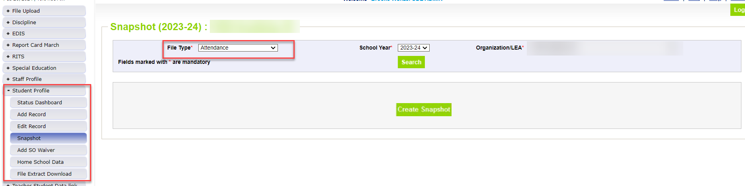
Creating Attendance Snapshot
Attendance Snapshot is now located under Student Profile!
  Select Student Profile then Snapshot
  Fill out prompts for Attendance (File Type: Attendance, School Year: 2024-25, Organization/LEA should auto-fill)
Student Attendance – Peter Hoffman
Attendance@cde.state.co.us

Slide 26
Attendance Training
2024-2025 Collection Overview
May 7th, 2025
10:30a.m.-12:00p.m.
Registration can be found on the Attendance Website or click here to register.
Student Attendance – Peter Hoffman
Attendance@cde.state.co.us

Slide 27
Questions & Resources:
Student Attendance
Peter Hoffman
Attendance@cde.state.co.us
720-925-8611
Attendance Webpage
Student Interchange Webpage

Slide 28
Student End of Year
Reagan Ward

Slide 29
SEY Soft Open Phase
Collection Timeline
Date | Event | Event Description
4/10/2025 | Other Date | Suggestion: Upload Graduation Guidelines (GG) interchange file and review CEDAR/COGNOS reports. Students expected to graduate in 2024-2025 must have met both English and Math minimum requirements.
4/22/2025 | Training Event | Special Education 18-21 Transition Services This webinar is designed for data respondents and district special education staff who support 18-21 transition services. Secondary Transition Collaborative Webinar Registration
4/24/2025 to 4/30/2025 | Closed | Soft open phase ends and snapshots are closed until the next phase.
4/29/2025 | Training Event | Collection Overview Training 2 of 2: This training covers all elements of the Student End of Year collection. This training is being offered in two identical sessions to provide the opportunity for all SEY data respondents to attend a live session. Collection Overview 2 of 2 Registration
5/1/2025 | Open | Regular Phase Begins: Collection officially opens. Adjustment (ADJ) interchange file opens. Exception Requests will begin to be processed This includes pre-approved mid-year EL changes for SE209/SE180
Student End of Year – Reagan Ward
StudentEndOfYear@cde.state.co.us

Slide 30
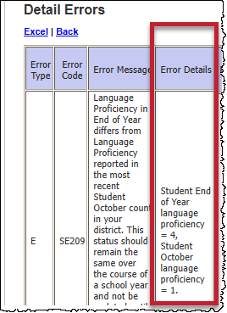
Updates/Fixes in Progress
Snapshot Failure for a few LEAs
  Impacted LEAs/Reason: LEAs with one-day records reconciling students with exit 00 in 2023-2024 who transferred over the summer from a school code that is no longer valid in 2024-2025 (entry type 03 for a closed school)
  Issue: A couple of the OCT to SEY business rules are causing this issue because the school code wasn’t part of OCT (due to being closed)
  Fix expected within the next couple of days
SE301 misfiring
  Issue: Work done to update SEY Digital Math benchmark caused a glitch
  Fix expected within the next couple of days
Ongoing work to add the customized ‘error details’ to more rules that cross reference multiple collections
Student End of Year – Reagan Ward
StudentEndOfYear@cde.state.co.us

Slide 31
Questions & Resources:
Student End of Year
StudentEndOfYear@cde.state.co.us
720-484-9057
  Student End of Year Collection Website
  Student Interchange Website
  Graduation Guidelines (Program) Website

Slide 32
Student Discipline
Dawna Gudka

Slide 33
Student Discipline
Collection Timeline
Date | Event | Event Description
3/01/2025 | Open | Discipline Action Interchange Open
5/06/2025 | Open | Student Discipline Snapshot Open
5/06/2025 | Interim Deadline | Upload Student Discipline Interchange file at least once
5/09/2025 | Interim Deadline | Update and upload Student Interchange files: Student Demographics and Student School Association Districts are expected to have an upload date of 4/1/25 or later to meet this interim deadline
5/09/2025 | Interim Deadline | Upload Student Discipline Interchange file at least once
6/11/2025 | Interim Deadline | Error free Student Demographics and Student School Association Interchange files
6/21/2025 | Interim Deadline | Create at least one student discipline snapshot
7/08-07/26/2025 | Report Review | Student Discipline Snapshot records error free
7/31/2025 | State Deadline | LEAs should use this time to review reports prior to the deadline. Typically, one week prior to the deadline.
8/9/2025 | State Deadline | Signature page emailed to Student Discipline Snapshot
8/31/2025 | Data Release | Data published
StudentDiscipline@cde.state.co.us

Slide 34
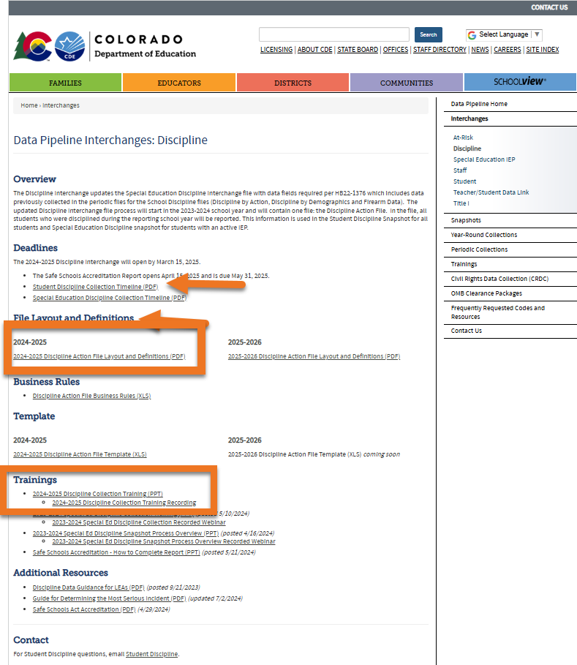
Discipline Interchange website
Discipline Interchange website
2024-2025 Discipline Action File Layout
Training recording
Student Discipline Snapshot Collection
StudentDiscipline@cde.state.co.us

Slide 35

Office Hours
  Student Discipline Office Hours
    Monday April 14th 10:00 – 10:45
    Monday May 12th 10:00 – 10:45
    Monday June 9th 10:00 – 10:45
      Student Discipline reporting questions
      Join the meeting now
Student Discipline Snapshot Collection
StudentDiscipline@cde.state.co.us

Slide 36
Questions & Resources:
Student Discipline
Student Discipline Snapshot Site
 Student Discipline Snapshot Timeline
Discipline Interchange Website
 Discipline Action File Layout
StudentDiscipline@cde.state.co.us
Dawna Gudka-Collection lead
(303) 598-7901

Slide 37
RITS Merge Updates
Jessica Tribbett

Slide 38
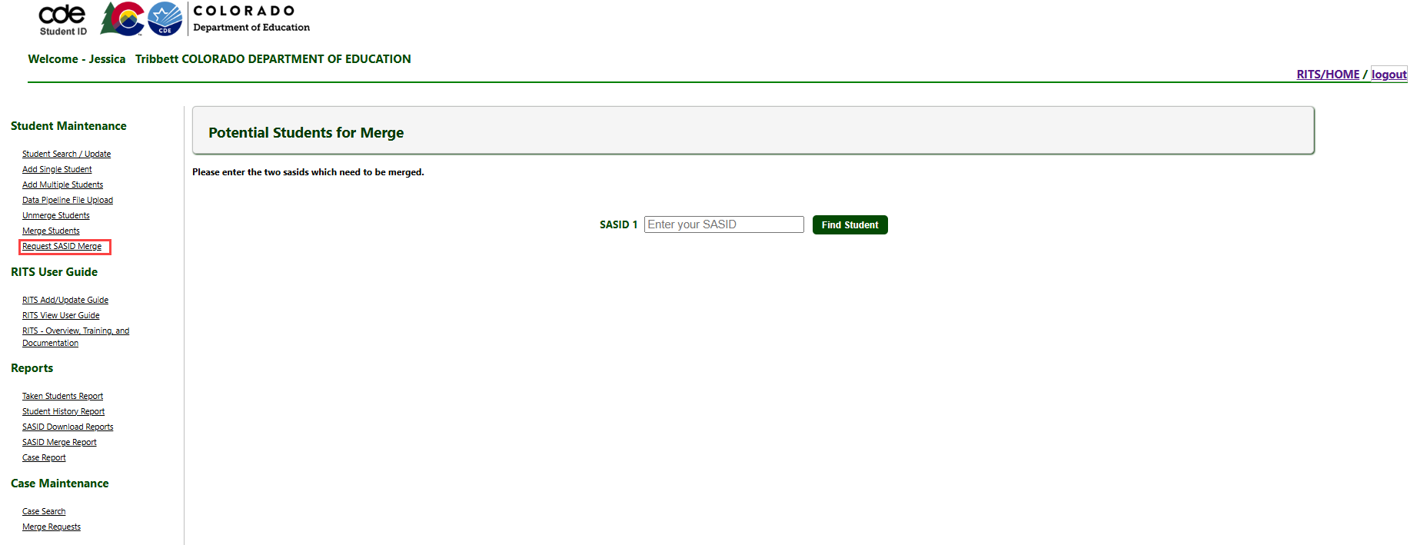
RITS Web – Request a SASID Merge
RITS Web
RITS@cde.state.co.us

Slide 39
Questions & Resources:
RITS
RITS@cde.state.co.us

Slide 40
New! Instructional Days and Hours Collection
Jessica Tribbett

Slide 41
Instructional Days & Hours - Overview
HB24-1063 – Addressing Abbreviated School Days
Bill Summary Full Legislation
Instructional hours;
School calendars;
The number of hours students spend on instructional time during the school year.
Days of instruction for elementary and secondary schools;
Instructional hours for elementary and secondary schools;
Estimated non-instructional hours, school closures, snow days, and time spent on lunch and passing between classes.
Instructional Days and Hours
Tribbett_Jessica@cde.state.co.us

Slide 42
Instructional Days & Hours - Date Fields
Instructional Days and Hours File Layout (pdf)
Field Name | Field Name
Min Grade for Calendar | Reduced Academic Calendar Request
Max Grade for Calendar | Reason for RAC Request
Total Teacher Workdays | Day Not in Session
Total Days of Instruction/Student Contact Days | Total Planned Recess Hours
Total Hours for School Year | Recess Indicator
Total Hours of Instruction | Total Planned Lunch Hours
Total Planned Passing Period Hours | Total Planned Hours for Snow Days/Emergency Closures
Passing Period Indicator | Date Calendar Adopted by School Board
Instructional Days and Hours
Tribbett_Jessica@cde.state.co.us

Slide 43
Questions & Resources:
Instructional Hours and Days
Instructional Days and Hours website
Tribbett_Jessica@cde.state.co.us

Slide 44
Special Education Discipline
Lindsey Heitman

Slide 45

Special Education Discipline Snapshot
Timeline and Annual Training
March 15th – Discipline Interchange opened
May 1, 2025 - SPED Discipline Snapshot opens
May 9, 2025 - All Interchange files that feed into snapshot updated at least once
June 26, 2025 - Interchange errors resolved – Discipline Action File, Child File, Participation File and at least one snapshot taken
July 24, 2025 - All Exception requests submitted to CDE processing
July 25, 2025 - Snapshot error-free
July 25 – Aug. 1, 2025 - Report Review and final submission
Friday Aug. 1, 2025 - Final Submission due to CDE
  *Please note the final due date has been moved up (end of July versus end of August)
  Upcoming Training
  Special Education Discipline Annual Snapshot Training
    Tuesday May 6th 10:00 – 11:30
      Overview of the snapshot data required and process in Data Pipeline
      Join the meeting now
  Student Discipline Office Hours
    Monday April 14th 10:00 – 10:45
    Monday May 12th 10:00 – 10:45
    Monday June 9th 10:00 – 10:45
      Student Discipline reporting questions
      Join the meeting now
SpedDiscipline@cde.state.co.us
Special Education Discipline – Lindsey Heitman

Slide 46
Questions & Resources:
Special Education Discipline
Lindsey Heitman
SpedDiscipline@cde.state.co.us
Discipline Interchange Webpage
Special Education Discipline Snapshot Webpage

Slide 47
Special Education EOY
Lindsey Heitman

Slide 48

Special Education End of Year:
Timeline and Training
  Upcoming Training
  Special Education Discipline Annual Snapshot Training
    Tuesday May 6th 10:00 – 11:30
      Overview of the snapshot data required and process in Data Pipeline
  Upcoming Training
  Special Education Discipline Annual Snapshot Training
    Tuesday May 6th 10:00 – 11:30
      Overview of the snapshot data required and process in Data Pipeline
2024-2025 Special Education EOY Snapshot Timeline
  Upcoming Training
  Sped EOY Annual Training Webinar
  Thursday May 8th - 1:00 – 2:30
  Join the meeting now
  Office Hours TBD
May 1, 2025 - SPED EOY Snapshot official open
June 26, 2025 – IEP Interchange files error-free
September 4, 2025 - All Exception requests submitted to CDE
September 11, 2025 – All errors resolved at snapshot/interchange
September 12 -19, 2025 -Initial Report Review
September 22 - 26, 2025 – Resolving duplicates
September 29 – October 1, 2025 – Final Report Review
October 3, 2025 - Final submission due to CDE
Special Education EOY – Lindsey Heitman
SpedEndofYear@cde.state.co.us

Slide 49
Questions & Resources:
Special Education End of Year
Lindsey Heitman
SpedEndofYear@cde.state.co.us
Special Education IEP Interchange Webpage
Special Education End of Year Snapshot Webpage

Slide 50

Thank you for Joining Today!
Next Town Hall will be
April 10th
Vendor Training coming to town hall soon!
CDE will be hosting a vendor training during the April 24th town hall to go over the 2025-2026 collection updates.

