Slide 1
March 21, 2024 Data Pipeline Town Hall
The goal of the webinar is to provide updates on the Data Pipeline, current, and upcoming data collections. These webinars also provide a forum for districts, BOCES, and Administrative Units to have questions answered about Data Pipeline.

Slide 2
Colorado Department of Education Identity Management (IdM)
Identity Management Site
Frequently Asked Questions
How do I add myself or others to the email listserv for town hall emails and/or a specific collection?
Email lists are dependent on a person’s access rights in IdM. Contact your LAM to get an account or be assigned to a specific collection.
Where can I find the IdM role mappings for Data Pipeline and other applications?
Role Mapping (XLS)
I am a LAM. How do I update the user permissions for someone in my district?
Follow the steps outlined in the IdM Quick Guide for Access Management (DOCX)
Important: Users are not automatically removed from IdM when their email address is no longer active in your district. The LAM must deactivate their IdM account to ensure only designated staff can access CDE’s data reporting system.

Slide 3
What is PII?
Student Personally Identifiable Information (PII) is defined by state and federal laws as information that, alone or in combination, personally identifies an individual
This includes direct identifiers (i.e. student and staff names, SASID, EDID, etc.)
Includes information that when combined is identifiable
Colorado’s Student Data Transparency and Security Act outlines requirements for how Student PII is collected, used and shared
See the Data Privacy and Security website for prepared guidance on how to comply with this and other privacy laws.

Slide 4
Sharing Data
Use secure methods to transfer any PII to CDE
Contact Data Collection leads with questions about how to transmit PII securely
Each Data Collection leads maintains their own Syncplicity folders for specific collections, reach out to the collection lead for access
Use Syncplicity to encrypt emails to CDE
Avoid sending PII via unencrypted email or to unsecured faxes when sharing data between or within districts
Use Syncplicity to encrypt emails to CDE
Check local policies for restrictions, requirements, etc. regarding PII
Do not use PII in trainings, presentations, etc.
Do not share PII with unauthorized individuals
Do not share passwords
Follow local policies when transmitting PII to any third party

Slide 5
Today’s Agenda
Agenda Topic | Presenter
Open Data Collections and Upcoming Deadlines in Data Pipeline
Civil Rights Data Collection (CRDC) | Annette Severson
Report Card March | Peter Hoffman
School Finance Act Update | Rebecca McRee
Summer EBT | Michelle Monge

Slide 6
Open Collections and Upcoming Deadlines in Data Pipeline

Slide 7
Open Collections and Upcoming Dates
Name | Category | Status | Key Dates
RITS | Year Round | Open
EDIS | Year Round | Open
Directory | Year Round | Open | Reduced Academic Calendar Applications 3/6/2024 to 5/10/2024 School Code Change Requests 2/5/2024 to 6/28/2024
Student | Interchange | Open | Interim Deadline: 4/11/24 upload initial GG file
Title I | Interchange | Open
Special Education IEP | Interchange | Open
Staff | Interchange | Open
TSDL | Interchange | Open
Data Pipeline Resources: Data Pipeline Collection Dates (XLS)

Slide 8
Open Collections and Upcoming Dates cont.
Name | Category | Status | Final Deadline Date | Deadline Milestone | Looking Ahead
Human Resources | Snapshot | Open | Feb. 23, 2024
TSDL | Snapshot | Open | Aug. 30, 2024
Attendance | Snapshot | Coming Soon | July 12, 2024 |  | Opens 4/17/2024
Student End of Year | Snapshot | Coming Soon | Nov. 19, 2024 | Interim Deadline: Upload initial GG file by 4/11/2024 | Soft Open 4/1/2024
Report Card March | Periodic | Open | Apr. 12, 2024
ACCESS for ELLs | Periodic | Coming Soon | Mar. 20, 2024 |  | Opens 3/11/2024
S-EBT | Periodic | Coming Soon | Apr. 30, 2024 |  | Opens 4/1/2024
Data Pipeline Resources: Data Pipeline Collection Dates (XLS)

Slide 9
Civil Rights Data Collection (CRDC)
Annette Severson

Slide 10
Current Status
Final Extension set for April 1st
Letter was sent yesterday (3/20) explaining the extension and that no additional extensions will be granted
For questions or assistance with the collection process, please contact the CRDC Partner Support:
CRDC Partner Support Center
Email: CRDC@aemcorp.com
Phone: (855) 255-6901
Civil Rights Data Collection
CRDC@aemcorp.com

Slide 11
Overall District Status – Almost there! (as of March 20th)
Civil Rights Data Collection
CRDC@aemcorp.com

Slide 12
Questions & Resources: CRDC
CRDC Partner Support Center
Email: CRDC@aemcorp.com
Phone: (855) 255-6901

Slide 13
Report Card March
Peter Hoffman

Slide 14
Report Card March: Collection Timeline
Date | Event | Event Description
March 6, 2024 | Report Card March Opens | Report Card March available to upload
April 12, 2024 | Report Card March Closes | Date that Report Card March must be submitted to CDE and sign off form returned to ReportCard@cde.state.co.us
Report Card March
ReportCard@cde.state.co.us

Slide 15
Changes to 2023-2023 Report Card March
HB 21-1221 Jack & Caits Law
6 Fields Added
Updates to this house bill caused a few fields in RCM to be updated.
Link to HB 21-1221
Bullying Policy: Prohibit Bullying Flag
Bullying Policy: Define Bullying Flag
Bullying Policy: Prevention and Intervention Flag
Bullying Policy: Reporting Flag
Bullying Policy: Investigating and Responding Flag
Bullying Policy: Supports and Referrals Flag
3 Fields Removed
Bullying policy: Biennial Survey Flag
Bullying Policy: Bullying Prevention Team Flag
Bullying Policy: Consequences Flag
Report Card March
ReportCard@cde.state.co.us

Slide 16
Changes to 2023-2023 Report Card March – New Fields
New fields are all yes or no responses
0 for no
1 for yes
6 Fields Added
Bullying Policy: Prohibit Bullying Flag - yes or no flag which indicates whether or not your school publicly (e.g., in school handbook, on school website) prohibits bullying, retaliation against those reporting bullying, and making knowingly false accusations of bullying behavior.
Bullying Policy: Define Bullying Flag - A yes or no flag which indicates whether or not your school publicly defines bullying and how it is different from other forms of aggression.
Bullying Policy: Prevention and Intervention Flag - yes or no flag which indicates whether or not your school publicly describes its bullying prevention and intervention efforts (e.g., training staff, a team that leads bullying prevention efforts, surveying students on the severity and frequency of bullying).
Bullying Policy: Reporting Flag - A yes or no flag which indicates whether or not your school publicly describes the ways bullying can be reported to school staff.
Bullying Policy: Investigating and Responding Flag - A yes or no flag which indicates whether or not your school publicly describes the investigative procedures that the school follows when a report of bullying is made and how the school responds to bullying behavior.
Bullying Policy: Supports and Referrals Flag - A yes or no flag which indicates whether or not your school publicly describes the supports and referrals provided to students involved in bullying. This includes efforts to:
change the behavior of students engaged in bullying,
support targets of bullying in ways that avoid increasing their likelihood of discipline, and
support witnesses of bullying.
Report Card March
ReportCard@cde.state.co.us

Slide 17
2023-2023 Report Card March
Edit Record – Status Dashboard
Ways to Submit
Reminder: If Edit Record method is used, the status dashboard will show 0 records. That is OK! If satisfied with the data – it is ok to proceed to submit the data.
Edit Record
File Upload
Only choose one method, if you use file upload you cannot edit your data later via edit record and vice versa. Doing so can lead to errors.
CEDAR / COGNOS Reports
CEDAR / COGNOS Reports for RCM have been updated with the new fields.
Please re-check them if you have been waiting for this update.
Pipeline Reports -> Report Card March -> Data Summary Report
Report Card March
ReportCard@cde.state.co.us

Slide 18
Questions & Resources: Report Card March
Peter Hoffman
720-965-8611
ReportCard@cde.state.co.us
Report Card March Website

Slide 19
Update: Rules for the Administration of the Public School Finance Act of 1994
Rebecca McRee

Slide 20
Rulemaking Timeline: 1 CCR 301-39
2021-2023
During these years, the Department worked with Stakeholders to learn about evolving, relevant, and engaging learning opportunities to be considered in the determination for student funding that fell outside the traditional “seat-time” funding model
December 2023- State Board Meeting
Notice of Rulemaking
February 2024- State Board Meeting
Rulemaking Hearing
March 2024- State Board Meeting
State Board of Education adopts proposed changes to the Rules that include alternative instructional time in the determination for student funding
July 2024
Updated Rules will be implemented starting in the 2024/2025 school year
State Board Rules: 1 CCR 301-39
audit@cde.state.co.us

Slide 21
Rules Implementation
Informational Office Hours Session will be held on Thurs., March 21, 2024 at 10:30am.
The focus of this Informational Session will be to highlight changes in the updated Rules that will impact funding and audit documentation requirements for the 2024/2025 school year.
To access the informational session, click on the link found in the green box located on the School Auditing Office’s Training and Office Hours website.
Link will be activated 15 minutes prior to the start of the session.
DRAFT version of the 2024 Student October Count Audit Resource Guide will be posted to the Pupil Count webpage on Fri., May 3, 2024.
Districts are encouraged to send questions or requests for clarification to the School Audit Office (audit@cde.state.co.us) by June 1, 2024.
State Board Rules: 1 CCR 301-39
audit@cde.state.co.us

Slide 22
Rules Implementation (continued)
School Auditing Office will host an open Office Hours on Thurs., May 16, 2024 at 1:00pm to answer questions.
To access Office Hours, click on the link found in the green box located on the School Auditing Office’s Training and Office Hours website.
Link will be activated 15 minutes prior to the start of the session.
FINAL version of the 2024 Student October Count Audit Resource Guide will be posted to the Pupil Count webpage on July 1, 2024.
State Board Rules: 1 CCR 301-39
audit@cde.state.co.us

Slide 23
Questions & Resources:
School Auditing Office
Email: audit@cde.state.co.us
Rebecca McRee, Audit Supervisor
Mcree_r@cde.state.co.us

Slide 24
Summer-EBT Program

Slide 25
Permanent Summer-EBT
New, permanent federal program that helps ensure Colorado children can access adequate, healthy foods during summer break
$120/eligible student, EBT card to purchase groceries
Administrative funding for SFAs
State Legislation passed in November 2023 (SB23B-002)
CDHS lead agency, CDE partner agency
Similar to P-EBT: data collection, CDHS disbursement
Major Differences: mandatory data collection, ability to use family contact info, community-based organizations support
Notes:
The Summer Electronic Benefit Transfer (S-EBT) Program is a new, permanent federal program that helps ensure Colorado children can access adequate, healthy foods during summer break when school is out of session.
The program will go in to effect this summer, 2024, and families with school aged children that are eligible for free or reduced-priced school meals may receive $40/month ($120 total) per child during the summer months to purchase groceries. Funds will be placed on EBT cards and received via mail. This program will operate alongside the summer meals program.

Slide 26
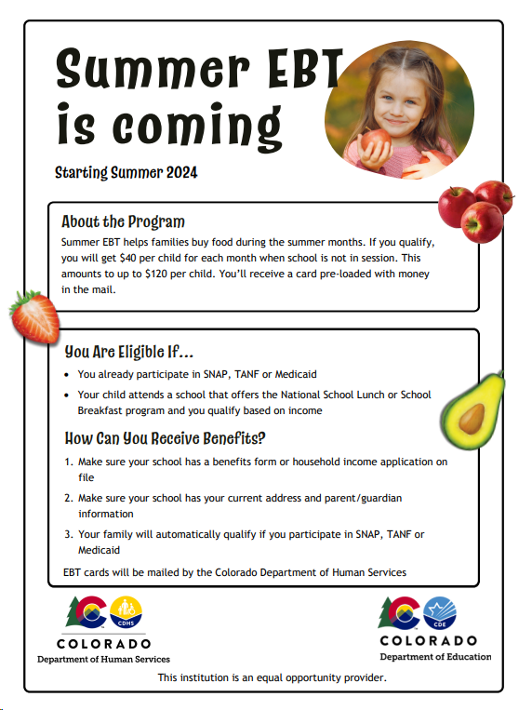
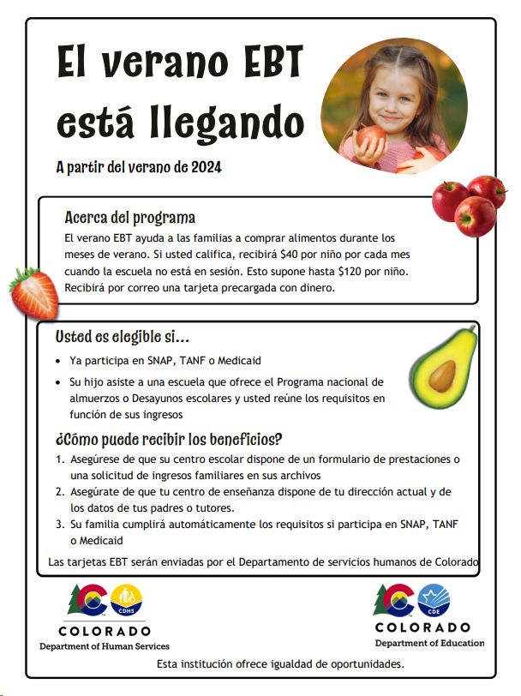
Currently…
CDHS & CDE submitted state plan and waiting for USDA approval
Encourage families to submit household income information through nutrition income applications
Connect with your district’s nutrition team to start conversations around submission
Ensure all student eligibility is received and up to date
Additional outreach materials, FAQs and training resources coming soon!
Notes:
To ensure families receive these benefits, continue to encourage families to submit household income information and update their mailing address using your district’s communication channels this school year. Household income information may be collected through free and reduced lunch applications, a combo form or the Family Economic Data Survey (FEDS) form.
Make sure that

Slide 27
Data Collection
Collection will open April 1 through April 30
All districts required to submit student level data by due date
All enrolled students must be included in collection
Provisional sites are required to use current year eligibility determinations
Office hours will be available once collection is open
Utilize file layout to start building collection
Verify current student enrollment for missing information and up to date eligibility
Submit student data in data pipeline
Notes:
ensuring data is accurate and parent/guardian information is updated. Let districts know why this information is important: parent/guardian info where and to whom the card will be sent, ensuring accurate da
A main burden that districts dealt with was families reaching out for assistance. One of the best ways to address families not having to reach out is through an accurate data collection. Ensuring accurate data may reduce inquiries from families, the call center cannot handle these types of questions.

Slide 28
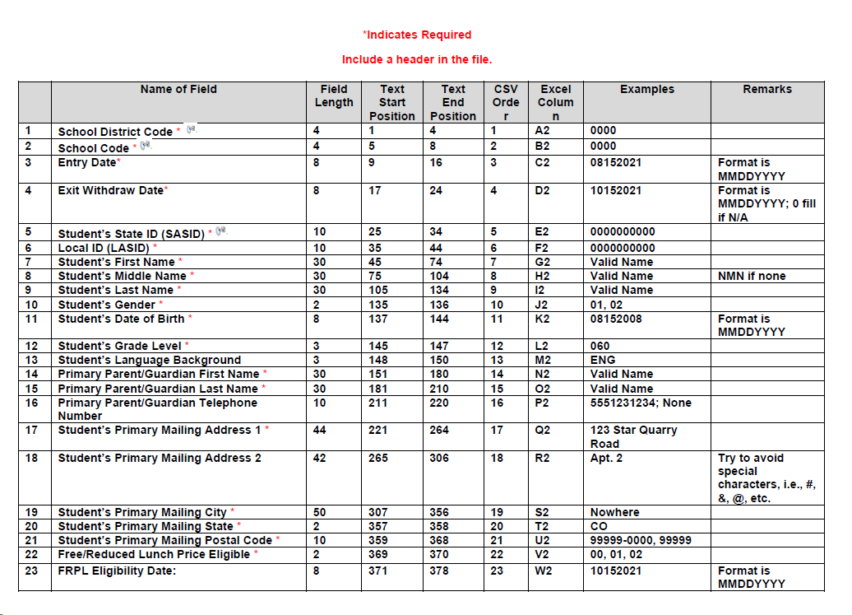
File Layout

Slide 29
Resources
School Nutrition Summer-EBT webpage
Data Pipeline
S-EBT webpage
For Questions email s-ebt@cde.state.co.us
Notes:
Office hours will be held during the data collection.
FAQ has been added to the data pipeline webpage and we have also included trouble shooting common errors.

Slide 30
Thank you for joining today!
Next Town Hall will be March 28th
LAMs, please review your district’s list of data pipeline users.
Remove staff who have left your district.
Ensure appropriate staff are assigned to Spring data collections.

Slide 31
Collection Email Addresses
Additional support has been added to help manage emails for the CDE Team
Some emails may be signed as "Technical Help Support"
The data collection leads you know, and trust are:
Still responding and signing their names as needed
Training & assisting the Technical Help Support staff
Note: These email addresses are also posted on the Data Pipeline website and Contact list for reference
Data Collection | Email Addresses
Attendance | Attendance@cde.state.co.us
Directory | DirectoryData@cde.state.co.us
EDIS | EDIS@cde.state.co.us
Human Resources | HumanResourcesData@cde.state.co.us
READ Collections | ReadActData@cde.state.co.us
Report Card March | ReportCard@cde.state.co.us
RITS | RITS@cde.state.co.us
Special Ed December Count | SpedDecCount@cde.state.co.us
Special Ed Discipline | SpedDiscipline@cde.state.co.us
Special Ed End of Year | SpedEndOfYear@cde.state.co.us
Staff Evaluation | StaffEvaluation@cde.state.co.us
Student Discipline Snapshot | StudentDiscipline@cde.state.co.us
Student End of Year | StudentEndOfYear@cde.state.co.us
Student October Count | StudentOctober@cde.state.co.us
Teacher Student Data Link | TeacherStudentDataLink@cde.state.co.us

